Slide 1
Scheduler: Working Hard So You Don’t Have To!
Sarah Frieldsmith and Bee Bornheimer
Notes:
Hi everyone! Welcome to Scheduler – Working hard so you don’t have to!
I am Sarah and I am doing the recorded presentation. My esteemed colleague, Bee, will be joining us for the live Q&A session. Bee is also the model in the photos you’ll see later in the presentation.

Slide 2
About the University of San Diego
Approximately 8,900 students (undergraduate, graduate, law) and 900 full- and part-time faculty
Eight academic divisions
Two libraries:
Copley Library
Legal Research Center
And a little about me
Systems Librarian for university
15 years of experience in public library consortium
Notes:
Public library people that are watching, bear with me through the intro. This is a general Sierra audience presentation!
Both Bee and I are librarians at the University of San Diego. (Not to be confused with UCSD or SDSU, both also fine institutions.)
The University of San Diego is a private Catholic university committed to the liberal arts tradition. We serve approximately 8,900 students – undergraduate, graduate, and law students – and 900 full and part time faculty. The university has 8 academic divisions and two libraries: the Copley library and the Legal Research Center.
As of summer 2021, I am the Systems Librarian for the University of San Diego and take care of the library specific software stuff, of which Sierra is the most important, naturally. Bee has been invaluable in helping me get settled in, as she more or less did my job before she transitioned to a faculty position as the Digital Resources and Cataloging Librarian for the Legal Research Center.
While my first several library jobs were in academic institutions, I managed Sierra for a public library consortium for 15 years before returning to the academic sphere. Back in the day, Scheduler was an add-on product, and the price tag wasn’t tiny. My public library didn’t acquire Scheduler until they went with a third-party discovery layer and needed to regularly export the entire set of MARC records, a process best done in the middle of the night. I am a bit chagrined to say that I never leveraged Scheduler for anything other than outputting MARC records to the third-party discovery layer.
When it was announced that Scheduler would be part of everyone’s bundle, but would require an activation fee, there was a flurry of discussion on the Sierra list asking what people used Scheduler for.

Slide 3
“Scheduler has been an enormous help. It’s like the staff member who never left their post during our current isolation.”
- George Leggiero, Kent State University
Notes:
George Leggiero from Kent State University wrote: “Scheduler has been an enormous help. It’s like the staff member who never left their post during our current isolation.”
My takeaway from that was that Scheduler is like a staff member. Who doesn’t need an extra staff member? I can supervise the heck out of staff member Scheduler. Sure, Scheduler can’t bring me back a cup of Joe from their coffee run, but I can go get my own coffee now!

Slide 4
Notes:
And peruse a magazine, take a nap, go for a stroll and smell the flowers…
Seriously, though. Maybe you’ll finally be able to dip your toe in the SQL pool after reviewing one of the fantastic SQL presentations.

Slide 5
So, what can Scheduler do?
Create a Review File
Load MARC Records
Load Patron Records
Output MARC Records
Output Delimited Records
Harvest XML Records
Notes:
On to the meat of the presentation. What can Scheduler do?
Scheduler can create a review file. Scheduler uses a saved search and a designated review file number to create a review file at a designated time. It will overwrite any file that might be in the designated review file number spot when it runs.
Scheduler can load MARC records. Scheduler can connect to an FTP server and pick up a batch of MARC records and load them using a chosen load table. It can also create a system review file (one of the ones you have to “copy” to access) of all the records from the load.
Scheduler can load patron records. Traditionally, this was done mostly by academic and school libraries, but public libraries are often asked to load patron records for entire school districts.
Scheduler can output MARC records. It does require tying up a review file large enough to hold the number of records you are exporting for the time the export is run, and require a place for the export to go, like an FTP server. The review file is available between exports for use, but it will be overwritten every time the export runs.
Scheduler can output delimited records. This is very similar to exporting MARC records, in that it uses a review file and FTP server. You might use this to export certain fields for ingestion into a non-MARC system.
Finally, Scheduler can harvest XML records. This does require having harvesting profiles set up and may not be as immediately useful when you are just getting started.

Slide 6
And what can’t Scheduler do?
Update records in a review file
Web Management Reports
Statistics
Anything requiring more than one step
Example: Scheduler cannot load records and immediately create a review file with criteria based on that load (it can create a list of all the loaded records)
Anything requiring a trigger – it cannot take an action based on a condition
Example: Scheduler cannot check if new records were created since a previous export, and then export those records
…but wait!
Notes:
All this is awesome! But what can’t Scheduler do?
Scheduler can’t update records in a review file. While I, and you, can think of a billion uses for Scheduler to update a set of records that are in a review file, it doesn’t do that.
Scheduler can’t run Web Management Reports.
Scheduler can’t run a Statistics report.
Scheduler can’t do anything requiring more than one step. Scheduler cannot load records and then immediately create a review file based on that load.
Scheduler can’t to anything requiring a trigger. You only want a job to run if staff collected fines that day? Or only if new records were created? The job runs no matter what.
Ugh! You say. I NEED for my virtual assistant to be able to do things in sequence.

Slide 7
Scheduling in sequence
Schedule a Load Records
Schedule a Create Review File
Records with certain criteria
Notes:
Your new best friend CAN do things in sequence, if you schedule them that way. Go ahead and schedule that record load and then schedule the create list for a time interval after which the load should have completed. The review file will be sitting around waiting for your updates when you are ready to do them.

Slide 8
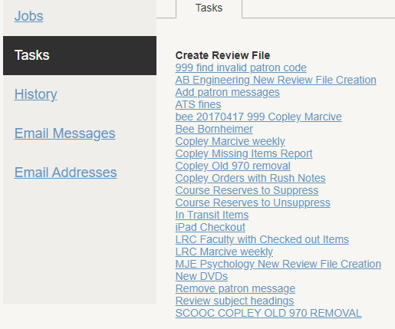
Examples – Create Review File
Notes:
On to some examples. Create Lists Review Files. I know everyone here has some review files that they create on a regular basis. When I was a baby system administrator, I used to go in to work on the first workday of the month before anyone else using Sierra started working to create lists and export statistical data for the previous month. Who could have done that for me? Scheduler could have. Quarterly, I created lists for libraries to look for an assortment of missing, claims returned, and lost in transit items. Scheduler can get that started. We used Unique Management Services as a Collection Agency. They would occasionally ask for a data sync. Scheduler can make sure that file is always ready to go. There are ongoing cleanup projects where lists are created looking for bad or missing data. Scheduler can maintain those lists and make sure they are always nice and full.
At the University of San Diego, we load patron records daily, using Scheduler. Then there are lists that are scheduled to clean up that data. One list finds patron records that have invalid codes. For us, this indicates a new major or department code that has not been mapped yet. Another list finds patron records that are missing data points. This list is used later by staff to insert a message asking staff to update the missing information. Another list is created to find records that have the message but the data is no longer missing. This list is used later by staff to remove the message.
Another list looks for orders with rush notes. No more digging through a stack of papers on your desk, or a bunch of emails in a folder. Just check the list Scheduler has thoughtfully prepared.

Slide 9
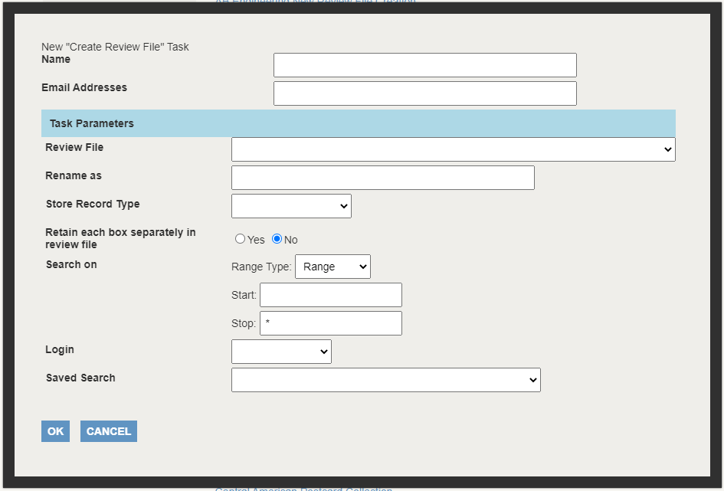
Notes:
This is the screen where you set up the review file. The name is the name of the Task. The email address will receive alerts for when the review file starts, when it ends, and whether or not it was successful, so choose wisely. You may not want the notifications taking over your inbox. You select the review file that is going to be its home. It will overwrite anything in there. It’s a good idea to “own” these types of files, to make it less likely that another staff person will use or move them.
Rename as will be the name of the review file in create lists. The rest are similar to setting up a review file in Create Lists. The Login is the Sierra Login you want to have associated with the file. The Saved Search is a search you have already saved that you want to automatically run.

Slide 10
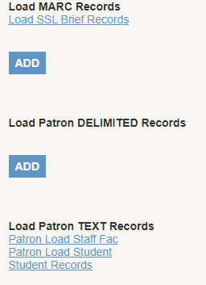
Examples – Load Records
Patron load TEXT Records, format 3: https://csdirect.iii.com/manual/Default.htm#i_addlsysfunc_load_patron_rec.html
Notes:
Loading records. It might look like we are not using this section very much, but Scheduler saves a HUGE amount of time by loading student and faculty and staff records for us.
I want to note here that patron records can be loaded as MARC, delimited, and text records. From my stint in public libraries, I was already familiar with loading patrons in MARC and delimited format. I know, I know. Why in the world would you load patron records using MARC? Well, one, because creating a delimited file was tough and pretty much none of the records prepares ever got the right number of delimiters in the right place, and two, if the fields changed, the previously configured delimiter format had to be updated, and working with outside organizations can be tough. So translating the school district data to MARC seemed easier. But that is only because I did not know about TEXT records. Be smarter than I was. Use TEXT records. Your outside organizations might even be able to successfully supply the data in that format. I couldn’t find documentation on TEXT records in the Sierra manual, but it is in the Millennium manual, linked to in the slide.

Slide 11
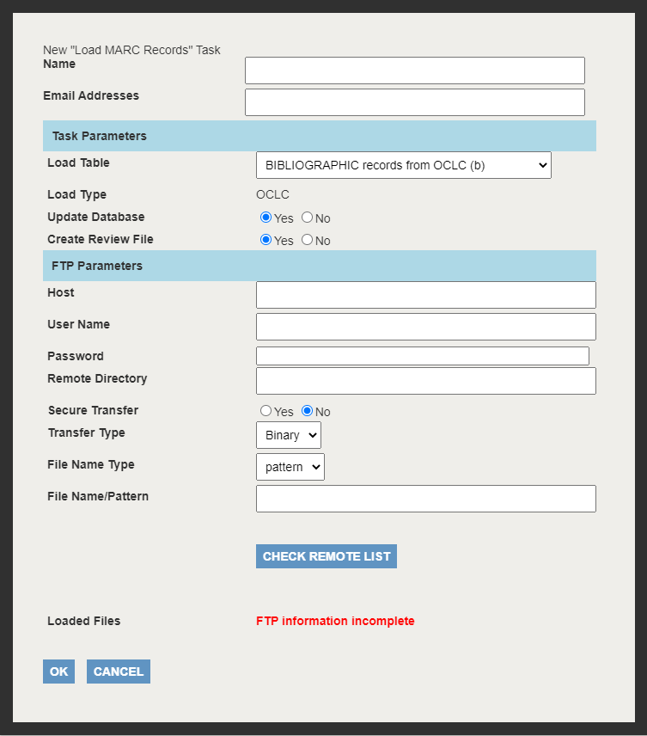
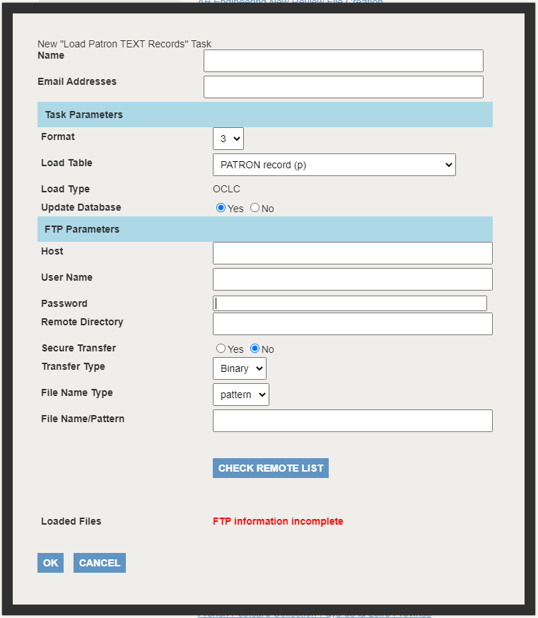
Notes:
For loading records, you have to know which load table you want to use. If you are unsure, and do not have anyone to ask that would know, I would do several small test runs of this job to figure out which one would be best.
FTP parameters is where Sierra is going to get the file from. Once you have the FTP info set, you can click “Check remote list” to see the files.
Loading patron TEXT files is similar, except you don’t get to pick a load table. I would start with the manual page from the previous slide and then open a ticket with Innovative if you have questions. Or ask your fellow Sierra users.

Slide 12
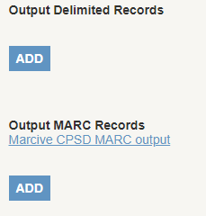
Examples – Output Records
Notes:
Output records. I have seen this used most often to output MARC records to a discovery layer. You could also use it based on a saved search in Create Lists to export data, like specific fields for last month’s order data. Unfortunately, it can’t leverage Web Management Reports or Statistics.

Slide 13
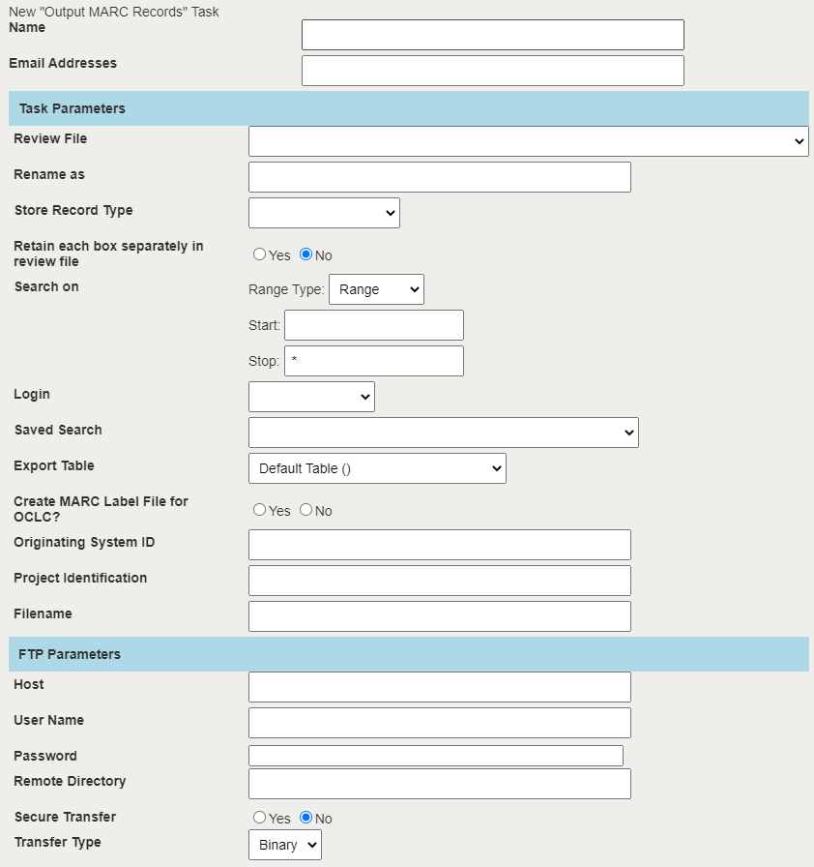
Notes:
Setting up output records is like setting up a create list, with the addition of WHERE you want the records to go.

Slide 14
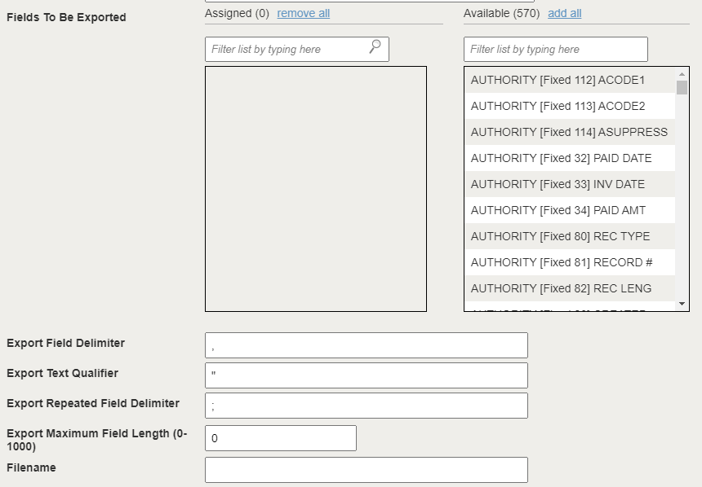
Notes:
Outputting delimited records is the longest form to set up. This is a snippet from the middle of the form, where you can see that you select which fields to export and the delimiters, very similar to exporting a review file from Create Lists.

Slide 15
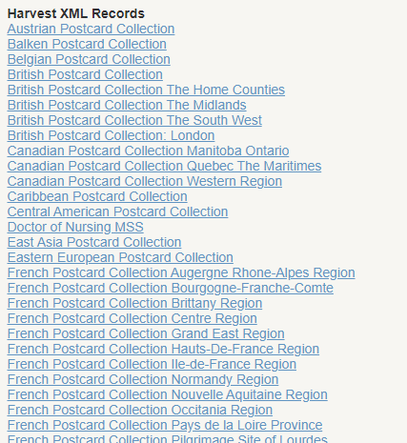
Examples – Harvest XML Records
Notes:
Harvest XML records. The University of San Diego uses this a lot. In theory. Most of these collections are not getting added to regularly, so the jobs don’t necessarily need to be run, but they are, just in case, and we never have to think about it. How nice is that?

Slide 16
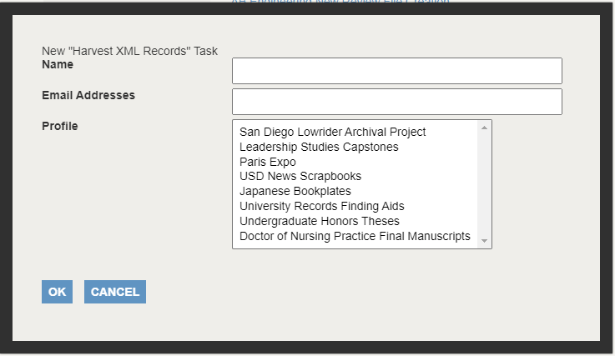
Notes:
Harvest XML records configuration is all done in the Profile. The only options here are to add Name and Email Address.

Slide 17
Jobs – Scheduling Tasks
Run on demand – schedule it to run one time 15 minutes in the future
Schedule a one-time task/job
Schedule recurring task/job
Daily
Weekly
Biweekly
Monthly
Yearly
Schedule start time HH:MM AM/PM
Schedule repeat indefinitely or specific end date
Notes:
Some other notes about Scheduler. It can be run on demand – you can schedule a job to run one time at a designated time, say, 15 minutes into the future.
Scheduler can be used for one-time or recurring jobs. For recurring jobs, those can be run daily, weekly, biweekly, monthly, and yearly. If you need a job to be run multiple times a day, you would schedule one recurring daily job for each time slot.
You schedule the start time for the job in hours hours minutes minutes format and then select AM or PM.
The job can be scheduled to repeat indefinitely or to end the repeat on a specific date.

Slide 18
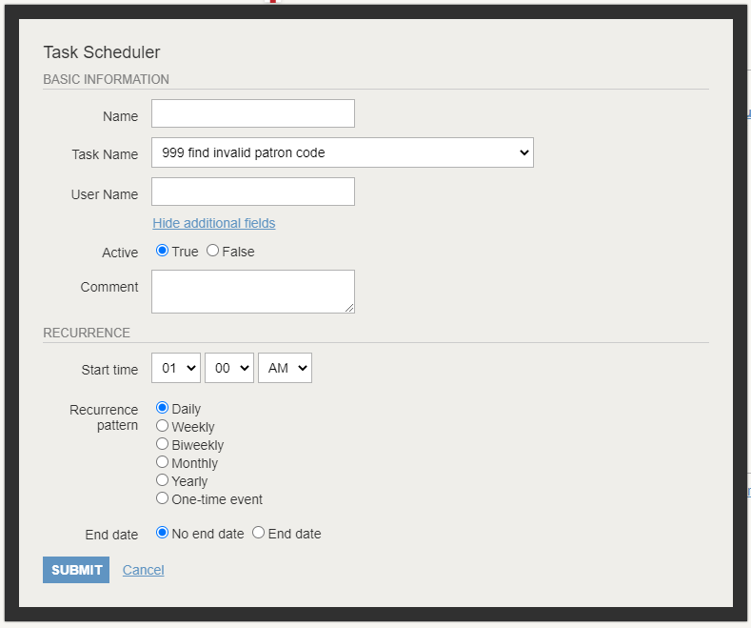
Notes:
This is how you schedule a task to run. It’s under “Jobs” in the navigation menu. Personally, I’d prefer “Scheduled Tasks” as each job only has one task, but that’s neither here nor there.

Slide 19
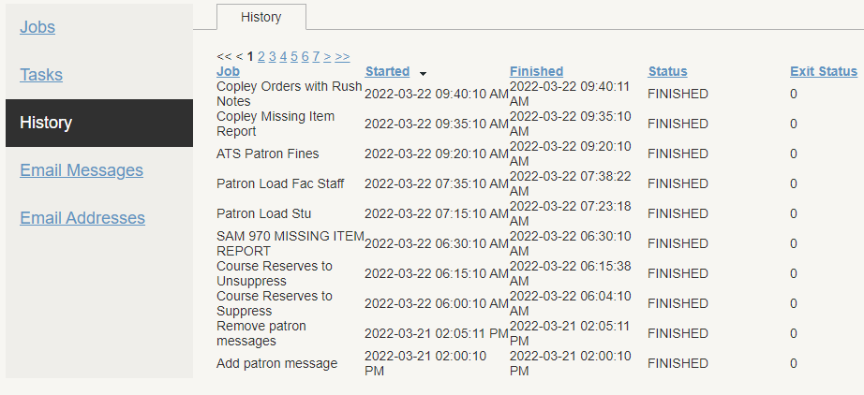
History
Notes:
Scheduler includes History of when each Job was run, when it started and finished, and whether it was successful or not.

Slide 20
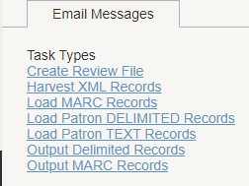
Email Messages
Notes:
Email Messages allows you to customize the Subject and body text of the different email alerts for each Task Type. You can choose not to set that information. The information will apply to every job that is run of that type, so make sure the text will make sense to recipients.

Slide 21
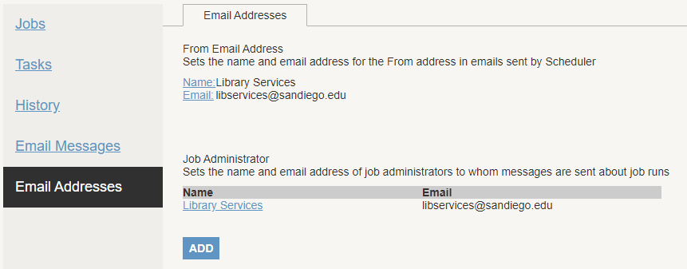
Email Addresses
Notes:
Email Addresses is where you set who the emails are coming from. The Job Administrator gets an email notification when a job fails.

Slide 22
THANK YOU
Questions?
Sarah Frieldsmith sfrieldsmith@sandiego.edu
Notes:
I had originally conceived of this presentation as a live panel discussion, and still think that might have been the best format. I hope you join Bee and I in the Q&A session! Come share your ideas or what you’re doing already or what you want to do, so we can all get Scheduler working even harder for us! Please don’t hesitate to reach out to me, your colleagues on the Sierra listserv, or chat on Discord. There’s a ton of helpful people out there. Thank you

