Slide 2
Fund report for Selectors
Jason Fleming
University of North Carolina Wilmington
Notes:
Hello and thank you all for coming to this late session on the last day.
I wanted to report on this project that we undertook at my library last Fall
I know that there are different practices across libraries, but I hope that some of this still might be helpful to exxplain
I work at a medium sized academic library. W have a number of librarians who serve as liaisons to different academic departments across campus. Part of their job is to order books in different disciplines using funds that we have set up.
This process is mostly straightforward so it probably won't take the entire hour to go over this, but I will take questions and we can have a conversation at the end.
We are still in our early stages of this kind of development with sierra so I am eager to hear your ideas to take back home!

Slide 3
The problem
Titles disappear from Activity screen in Fund Module as Fund Activity Report is run by business manager
Selectors (Academic Liaisons) don’t use Sierra
Notes:
We first met with the business manager to try and figure out how she uses the fund module. When she runs the Fund activity report it clears the activity from showing up. It was determined by the Collections manager that the Liaisons for the different funds need to know what is going on with the fund

Slide 4
1. Missing Information in Sierra
Titles, and limited order information appear in Activity section of individual Funds. However, this information disappears whenever a fund activity report is run.
Notes:
So it's not just that the items ordered/being ordered against aren't showing up. The reason they can't just keep a tally off this theirselves is that they aren't the only ones ordering against these funds. Any faculty member in the department who requests something or get something through PDA then the orders are placed against these funds. Also this information even when it is present in the activity report it doesn't display who requested the item

Slide 5
2. Selectors rarely use Sierra desktop
Notes:
This might not be true of all selectors but Sierra is definitely not the easiest interface for them to go to and occasionally retrieve this kind of information. So part of our effort is to reduce barriers for librarians

Slide 6
The conversation
Notes:
The collection coordinator approached me with this problem, and asked if we could develop a solution.
Create a web application that will allow selectors to easily see what titles have been purchased for the fiscal year by their fund. Currently in Sierra this informaiton is wiped out on a monthly basis by Sherry doing Monthly Fund activity reports. Jeanne would like a breakdown of the Title, Date ordered, estimated price, date received, amount paid, selector initials, and requestor name for each entry

Slide 7
Project Request Form
Notes:
all staff at our library have access to this sharepoint form where they can ask it to start a new project of any variety. so for a project such as this they would come to this form and start the process

Slide 8
Project Request Form
Notes:
there are a number of required and optional fields they can fill out to submit a project to us. It really helps when staff are specific about what they would like so that we can prioritize it successfully

Slide 9
Project Request Form
Notes:
once the form is filled out and submitted the head of IT does a review and in this case I would go to the requestor and set up a meeting to talk about the issue.

Slide 10
Project Idea
Need to know how much is available in each fund at any given time
Need to know items that have been ordered against a specific fund
Notes:
Here is the information they are looking for the web application to provide. There was also a discussion of how the information would be provided. Such as, they would first see an overview of all funds, and then click a specific fund to get more detailed information

Slide 11
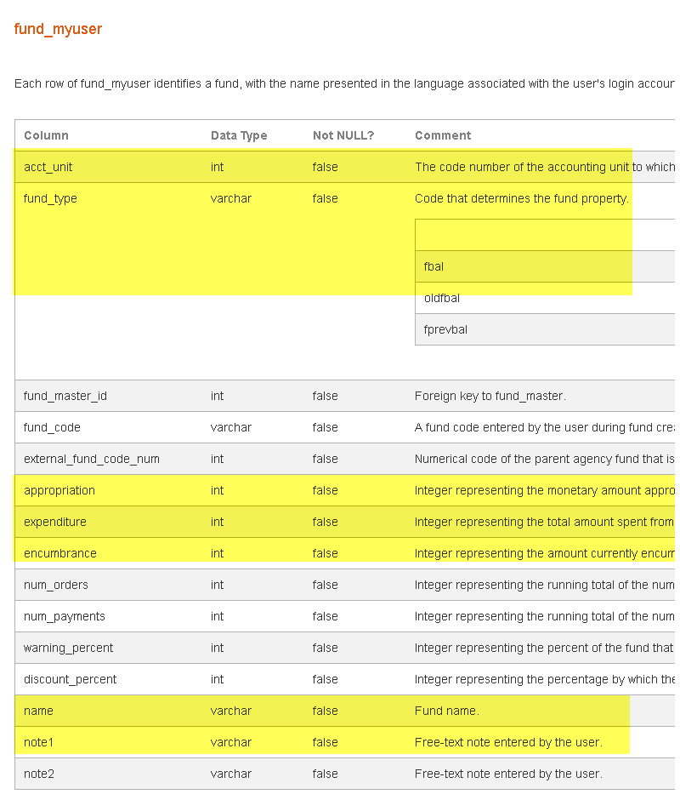
Finding the Data
http://techdocs.iii.com/sierradna/Home.html?viewGroupName=Fund
Notes:
I went to the Sierra DNA at techdocs.iii.com to start collecting where the different elements that were needed and determine the best way to join the information. I also started putting together notes for the web developer so they would know how different queries should work together. This is just one of the tables we needed to get all of the information for this request.

Slide 12
Constructing the queries
Display General Financials for all Funds
SELECT
name, to_char((appropriation::decimal)/100::float8, '999999.99') as appropriation,
to_char((expenditure::decimal)/100::float8, '999999.99') as expenditure,
to_char((encumbrance::decimal)/100::float8, '999999.99') as encumbrance,
to_char(((appropriation::decimal)/100::float8 -((expenditure::decimal)/100::float8 + (encumbrance::decimal)/100::float8)), '999999.99') as free_balance,
to_char(((appropriation::decimal)/100::float8 -(expenditure::decimal)/100::float8), '999999.99') as cash_balance
FROM sierra_view.fund_myuser
WHERE fund_type='fbal'
and acct_unit='3'
and note1='Departmental Funds'
Notes:
This is the first query that gets the general fund information. This information is completely viewable within sierra, we are just duplicating that view using queries. We wrren't totally sure how some of these numbers were generated when the project started because it was the beginning of the seemester so nothing was really encumbered yet. So as you can see this selected section changed because we found out that we weren't correctly calculating the free balance correctly

Slide 13
Constructing the Queries
Order information for selected fund
Select best_title,sierra_view.material_property_myuser.name AS material_type,'o'||order_view.record_num||'a' AS order_record,user_defined_ocode3_myuser.name AS request_source,invoice_record_line.paid_amt,estimated_price AS Encumbrance, sierra_view.order_status_property_myuser.name AS order_status,to_char(order_view.record_creation_date_gmt, 'MM/DD/YYYY') AS order_creation_date
From sierra_view.order_record_cmf
LEFT JOIN sierra_view.fund_master ON sierra_view.fund_master.code_num::text=ltrim(sierra_view.order_record_cmf.fund_code, '0')
Left Join sierra_view.order_view ON sierra_view.order_view.record_id=sierra_view.order_record_cmf.order_record_id
Left Join sierra_view.order_status_property_myuser ON sierra_view.order_status_property_myuser.code=sierra_view.order_view.order_status_code
LEFT JOIN sierra_view.invoice_record_line ON sierra_view.invoice_record_line.order_record_metadata_id=sierra_view.order_view.record_id
LEFT JOIN sierra_view.user_defined_ocode3_myuser ON sierra_view.user_defined_ocode3_myuser.code=sierra_view.order_view.ocode3
LEFT JOIN sierra_view.bib_record_order_record_link ON sierra_view.bib_record_order_record_link.order_record_id=sierra_view.order_view.record_id
LEFT JOIN sierra_view.bib_record_property ON sierra_view.bib_record_property.bib_record_id=sierra_view.bib_record_order_record_link.bib_record_id
LEFT JOIN sierra_view.material_property_myuser ON sierra_view.material_property_myuser.code=sierra_view.bib_record_property.material_code
where
accounting_unit_id='4' and fund_master.id='264' /*this is an example drill down to the fund using the id coming from Step 1 in the fund_myuser table */ and order_status_code !='z'
and order_view.record_creation_date_gmt>='2015-07-01' /*current fiscal year start */
Notes:
This query gets most of the order and invoice information. When there are a lot of orders it does take a little bit too generate. So far we haven't seen it time out though

Slide 14
Constructing the Queries
Retrieve Requestor’s name
Select field_content
FROM sierra_view.varfield_view
LEFT JOIN sierra_view.order_view
ON sierra_view.varfield_view.record_num=sierra_view.order_view.record_num
/*Here is where you look for the Selector by code s */
where (varfield_view.varfield_type_code='r' or varfield_view.varfield_type_code='s')
/*Here is where you access this information via the record num found in Step 2A*/
and order_view.record_num='514035'
Notes:
There was one additional piece of information we couldn't get from the previous query and that was the name of the person who requested the item.

Slide 15
Web Application
Notes:
The authentication screen uses ldap and is restricted to library staff.

Slide 16
Web application development: Expenditures
Notes:
Here is where all the funds are displayed with their overview of information

Slide 17
Web Application: Orders
Notes:
Here is where the order information is displayed. Some of this is not available view view funds even if the specific title was still in there, but it was requested in the project request for the selectors to use

Slide 18
Web Application: Code
Notes:
Here is a snippet of what the PHP code looks like in the backend.
Our developer uses Yii PHP to put the application developer using the Model View Controller framework.
Currently he has the code on GitLabs marked as private but when I get back I can talk to him about making this availailable to the community

Slide 19
Questions
Jason Fleming
flemingj@uncw.edu

