Slide 1
Duplicate Checking With Tableau
Brandon Cole and Lloyd Chittenden

Slide 2
What is Marmot?
We are a consortium of 29 libraries sharing a single Sierra server
19 Public Libraries
Six Academics
Four School Districts

Slide 3
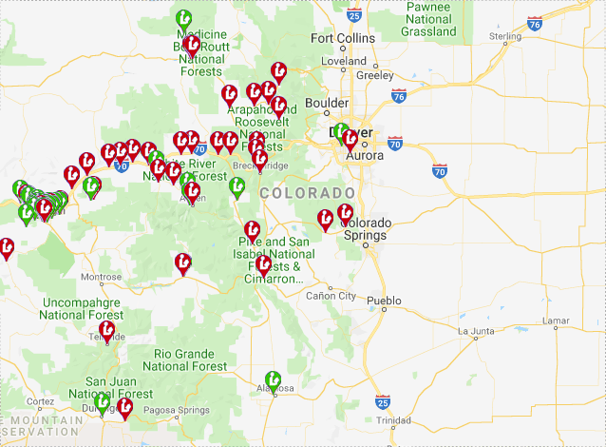
We are all over Colorado

Slide 4
What is the problem?
We have a big problem with duplicates
We were not happy with Sierra’s Headings Reports for finding duplicates
We realized that SQL allowed us to use Tableau to create our own utility to find duplicates

Slide 5
Why are duplicates a problem?
We have to pay for authority work on each record
They make holds and requests inefficient

Slide 6
Marmot’s solution
When we started using Tableau and SQL to create statistics reports we realized that it could be used to create a duplicate searching utility
We created three tools to find duplicates
BIB UTIL# (001 and 019)
ISN (020, 022, 024, 028)
020a

Slide 7
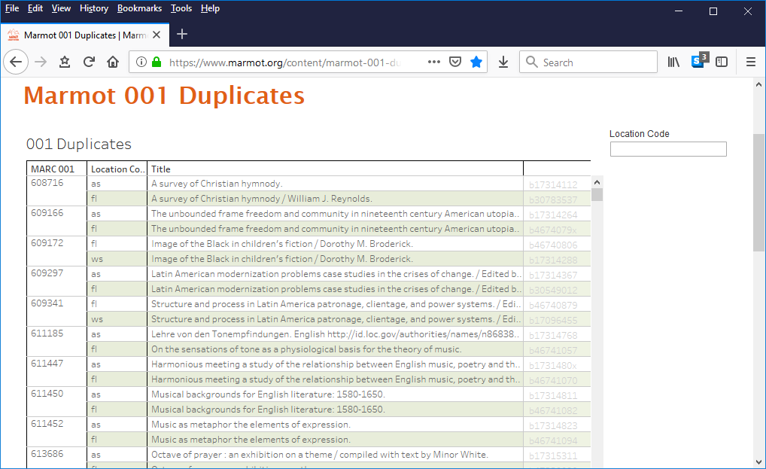
The duplicate Bib Util # tool

Slide 8
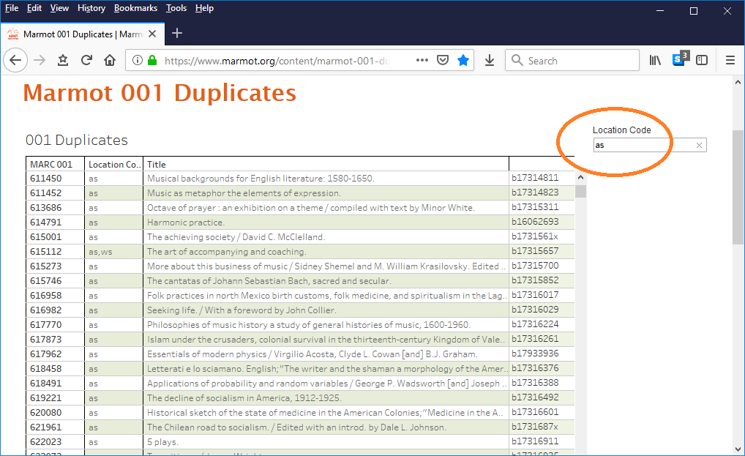
Each library can limit to their location

Slide 9
Now we only see dups that include that one library

Slide 10
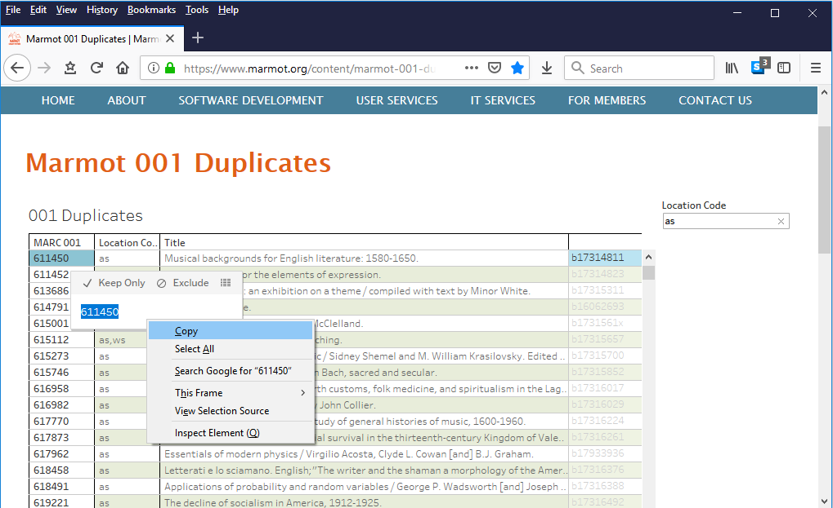
Copy the 001

Slide 11
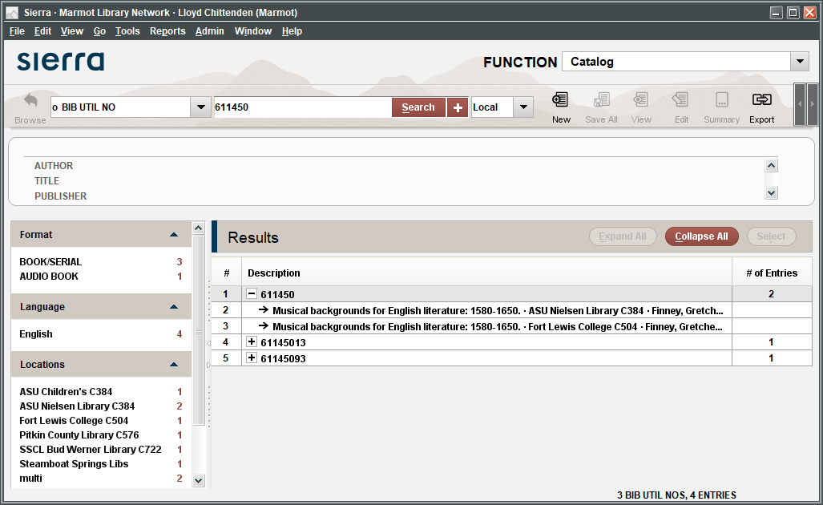
Paste into Sierra and fix the duplicate

Slide 12
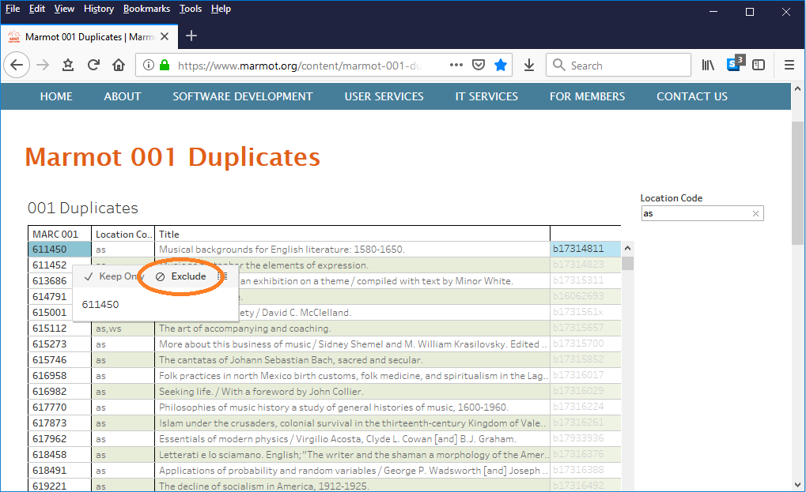
Exclude this pair

Slide 13
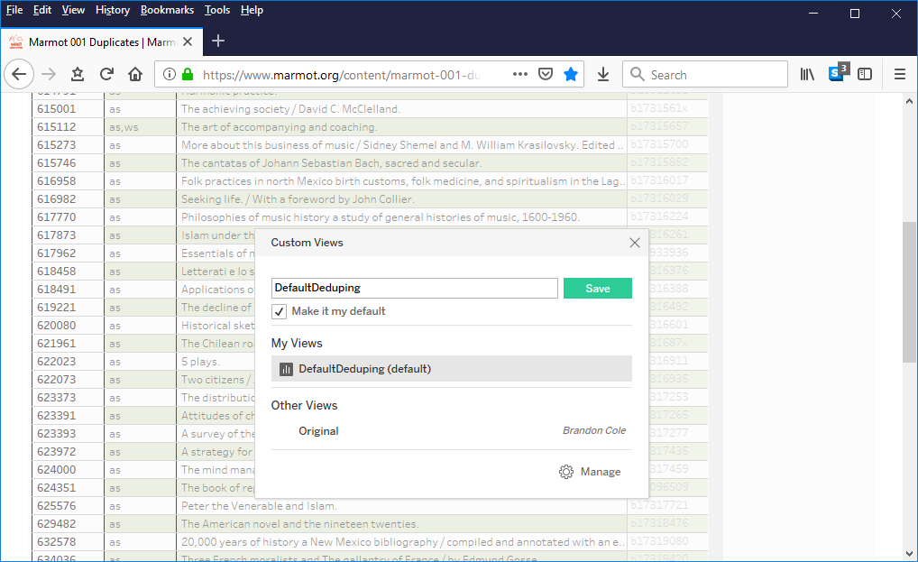
Save this view to save your excluded dup

Slide 14
One Tableau login for all dedupers
Everyone uses the same login, so they all see the same view
A duplicate pair that one library excludes disappears for everyone
Each user can still limit to their location within the view
Tableau allows multiple users at the same time

Slide 15
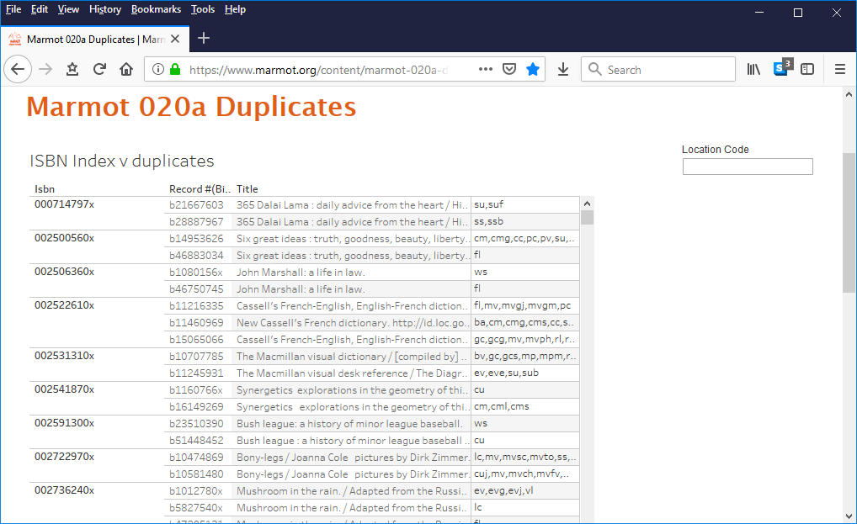
We also have one that looks at ISBNs

Slide 16
How we built the tool
Standard SQL Queries pull the initial list of bib record numbers
We upload the bib numbers into a Sierra review file so we can export locations
SQL queries will pull multiple locations in a way that will appear to be duplicate records, so we have to pull the locations out of Create Lists
This step may not be needed for single site institutions
Copy the locations export into Google sheet
Configure and Display in Tableau
Display based on a Google sheet also improves performance

Slide 17
001 duplicates SQL query
select dups.record_type_code || dups.record_num
from sierra_view.varfield_view dups
join (select count(*), field_content, record_type_code
from sierra_view.varfield_view
where marc_tag = '001' and record_type_code = 'b'
group by record_type_code, field_content
having count(*) > 1
) seed on seed.field_content = dups.field_content and seed.record_type_code = dups.record_type_code
order by dups.field_content

Slide 18
020 duplicates query
SELECT
id2reckey (p.record_id) || 'a' AS rid,
p.index_entry
FROM
sierra_view.phrase_entry AS p
JOIN sierra_view.bib_record AS b ON p.record_id = b.record_id
WHERE
--presently limited to e-books
p.index_tag = 'i'
AND p.index_entry IN (
SELECT
p.index_entry
FROM
sierra_view.phrase_entry AS p
WHERE
p.index_tag = 'i'
GROUP BY
p.index_entry
HAVING
count(p.id) > 1)
ORDER BY
index_entry,
rid
Just need to change these two index tags to get a different Sierra index

Slide 19
Import into Sierra
Since we have bib record numbers we can use “Import Records” in Create Lists
If your files of duplicates are very large you may need to split them up

Slide 20
Export from Sierra
Fields to Export for the Google sheet
Record Number
001 or 020 tag
Bib Locations Field
Bib Location Field
Title
Use something uncommon for the field delimiter like a ~

Slide 21
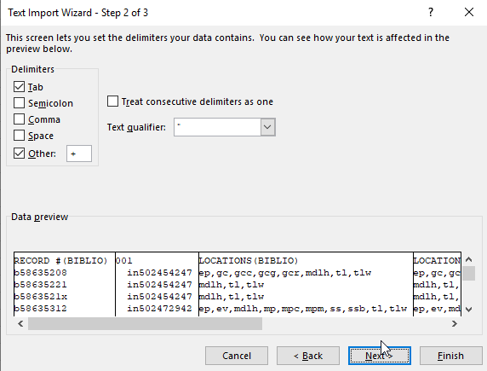
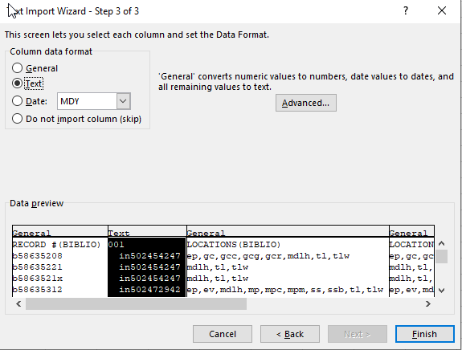
Transfer CSV to Google Sheets
Best to open in Excel first using Data>From Text
Opens a Text import wizard
Choose Delimited
Choose Other for Delimiter and put in the character you used
For the Column data format make sure your 001 or 020 column is formatted as text

Slide 22
Building the Tableau Worksheet
Connect to the Data Source (Google sheet or Excel)
For Google sheets this will open a browser window to choose the google account
Next choose the document you want to link to

Slide 23
Building the Tableau Worksheet
Pull the data into the rows
Depending on the amount of date, the worksheet can take a long time to update upon adding each row
Add record number as a mark so that last column isn’t empty
Add desired filters (location)

Slide 24
Building the Tableau Worksheet
A calculated field in Tableau combines the locations and location field if the locations field is empty

Slide 25
Building the Tableau Worksheet
From here you can either export to a Tableau server or share the workbook locally
Tableau server is a separate subscription.
Allows password protection web access
Can share locally as a workbook to others who also have Tableau Desktop

Slide 26
Live Demo

