Slide 1
Optimizing your OPAC
Letting Library Users Drive Development
Presented by Joel Tonyan
University of Colorado Colorado Springs

Slide 2
Objectives
What Skills Do You Need?
Soliciting User Feedback
An Overview of Innovative’s WebPAC Architecture
Updating your WebPAC’s Look and Feel and Adding New Features
Using Google Analytics to Assess Your WebPAC

Slide 3
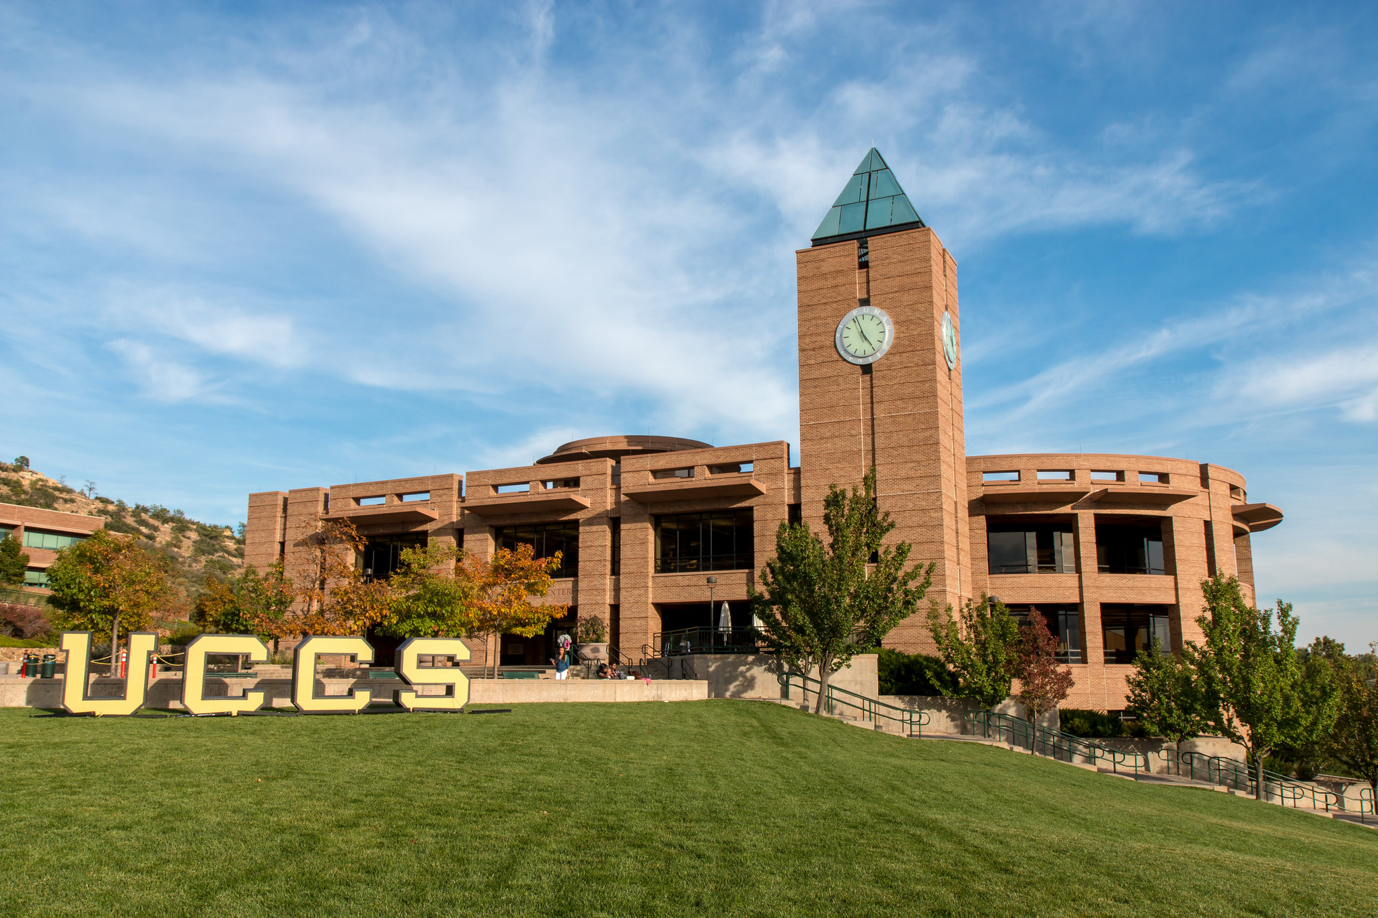
About My Library
Kraemer Family Library—midsize academic library serving a community of approximately 20,000 users
Longtime Innovative user—migrated from Millennium to Sierra in 2012
Web Services and Emerging Technologies Department—Team of three. I’m the lead developer of our WebPAC, with support from my two colleagues

Slide 4
What Skills Do You Need?

Slide 5
What Skills Do I Need?
Required Skills
HTML
CSS
Beneficial Skills (but not absolutely necessary)
JavaScript
PHP
Google Analytics
Bootstrap

Slide 6
How Can You Learn New Skills?
How-to Books
Free Online Courses
Khan Academy (www.khanacademy.org)
Code Academy (www.codeacademy.com)
Examine other people’s code

Slide 7
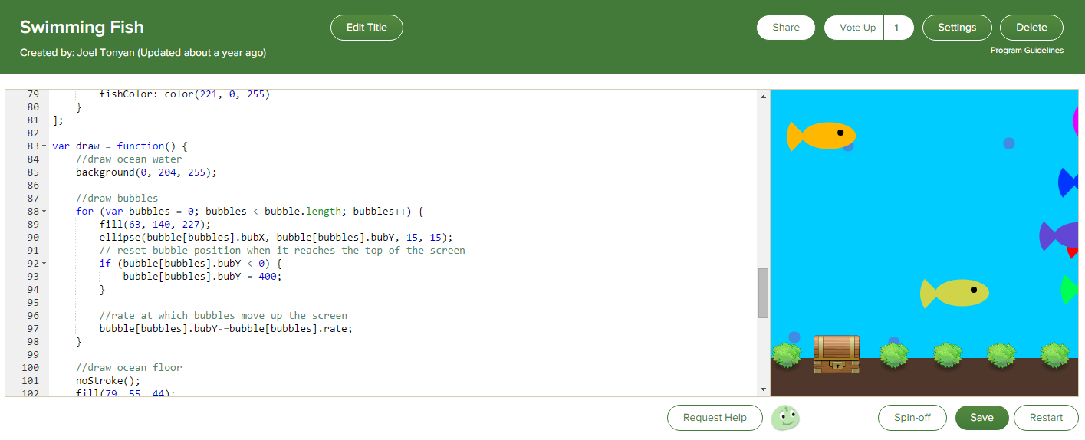
Khan Academy

Slide 8
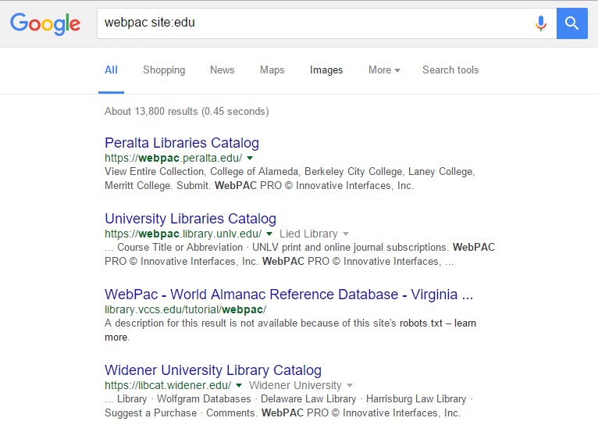
Examine Other People’s Code
A Google search for WebPAC will help you locate other Innovative libraries

Slide 9
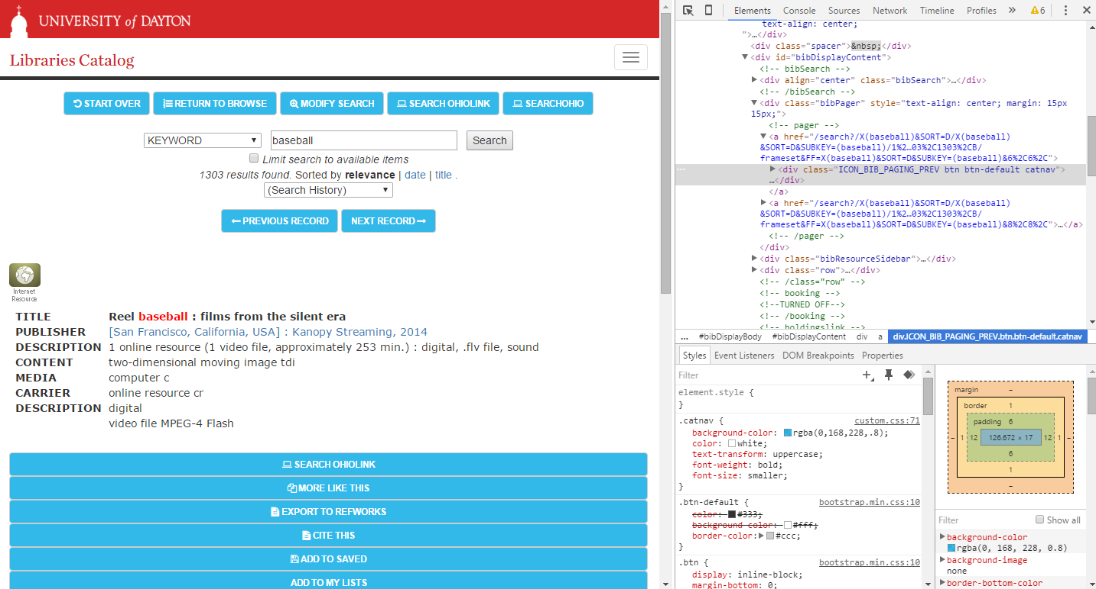
Examine Other People’s Code, cont.

Slide 10
Soliciting User Feedback

Slide 11
Soliciting User Feedback
Methods for soliciting feedback
Set up a usability table with a computer displaying your WebPAC and gather feedback from patrons
A/B test new features side by side, using your Staging and Live Servers
Observations, for instance, asking a group of users to locate a specific book and then observing them as they complete the task
In-person or online surveys
Feedback offered during patron interactions or when teaching
Google Analytics

Slide 12
An Overview of Innovative’s WebPAC Architecture

Slide 13
Staging and Live Web Servers
The Staging Server
Used for development
Accessible via port 2082 (for instance, library.uccs.edu:2082)
The Live Server
Your production server
What your patrons use to browse your collection
* Both servers have real-time access to your database server

Slide 14
Webmaster and Web Options
Webmaster Function
Used to edit the HTML and CSS files that control the appearance and layout of your WebPAC as well as upload image files
Includes a basic text editor
Web Options Function
Used to enable and disable functionality in your WebPAC, configure server parameters such as the SSL port number, and so on

Slide 15
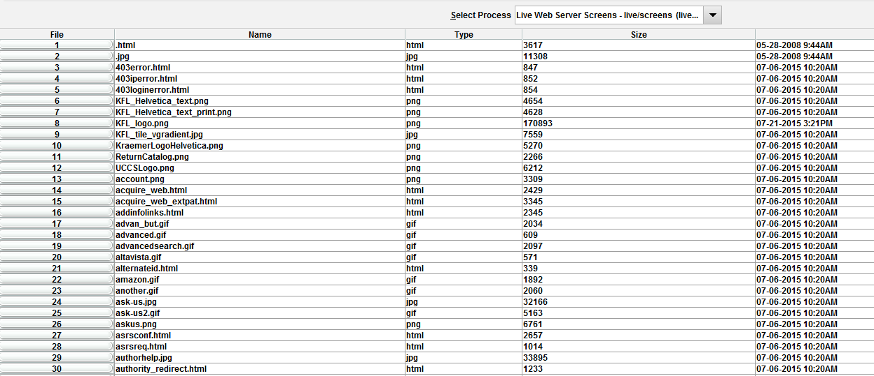
Webmaster
Uses a flat directory structure. All files are stored in /screens/
Includes a built-in text editor for editing HTML and CSS Files

Slide 16
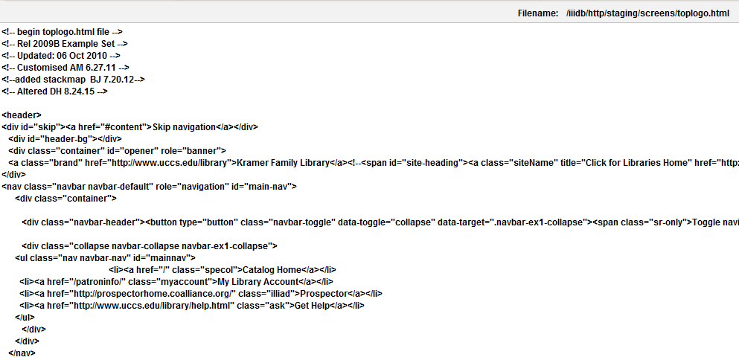
Webmaster, cont.
The built-in text editor is useful for making quick changes
Not robust enough for serious development

Slide 17
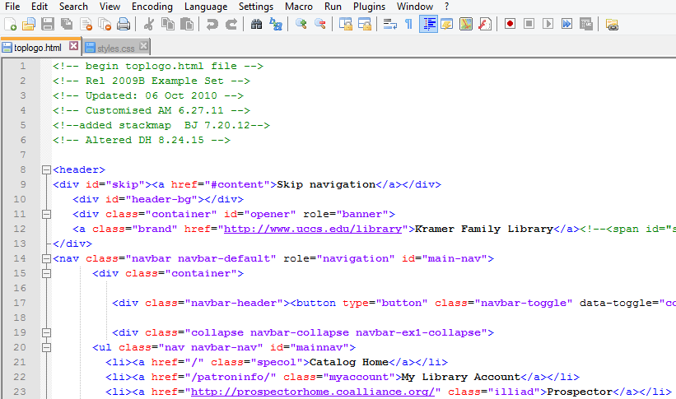
Webmaster, cont.
You’re MUCH better off using a free text editor such as Notepad++
Simply download a file directly from Webmaster or via FTP, edit it, and then reupload it

Slide 18
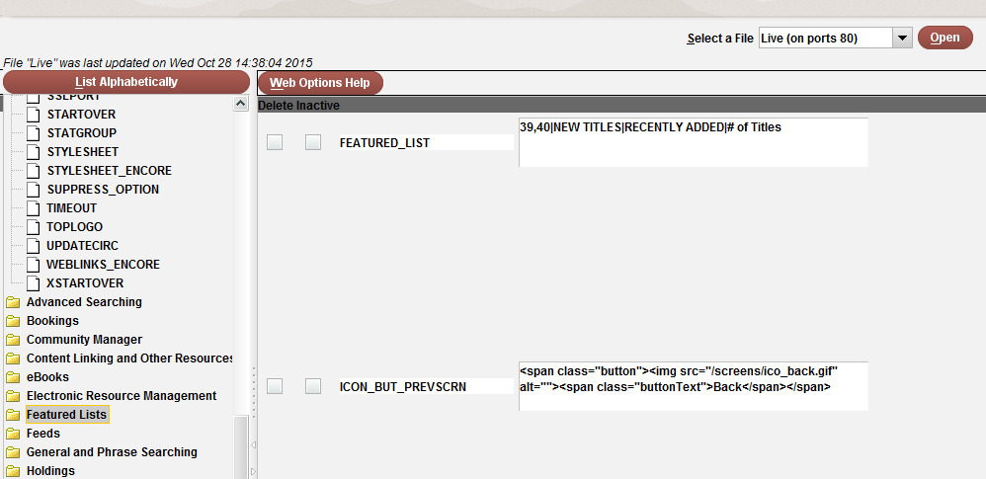
Web Options
Live and Staging Server Web Options can be individually configured
Changes don’t go into effect until you restart the respective web server

Slide 19
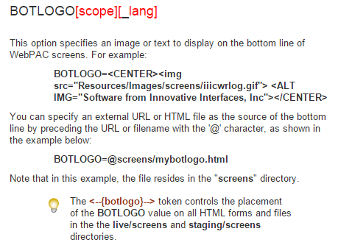
Web Options, cont.
Innovative’s documentation defines each option and provides examples of acceptable parameters

Slide 20
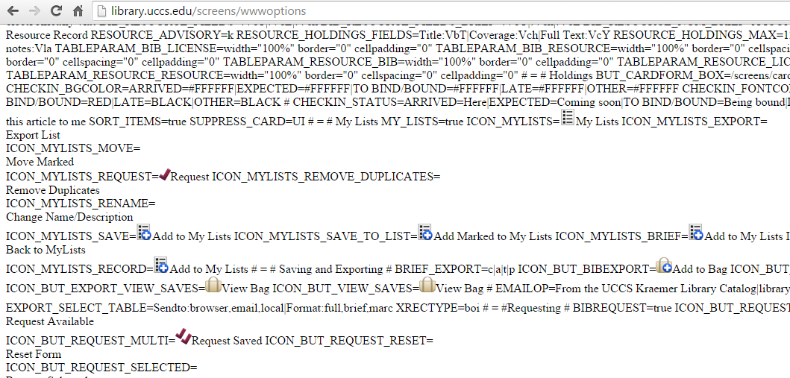
Web Options, cont.
View all your Web Options in an single page by navigating to http://catalog.domain.com/screens/wwwoptions

Slide 21
Updating your WebPAC’s Look and Feel and Adding New Features

Slide 22
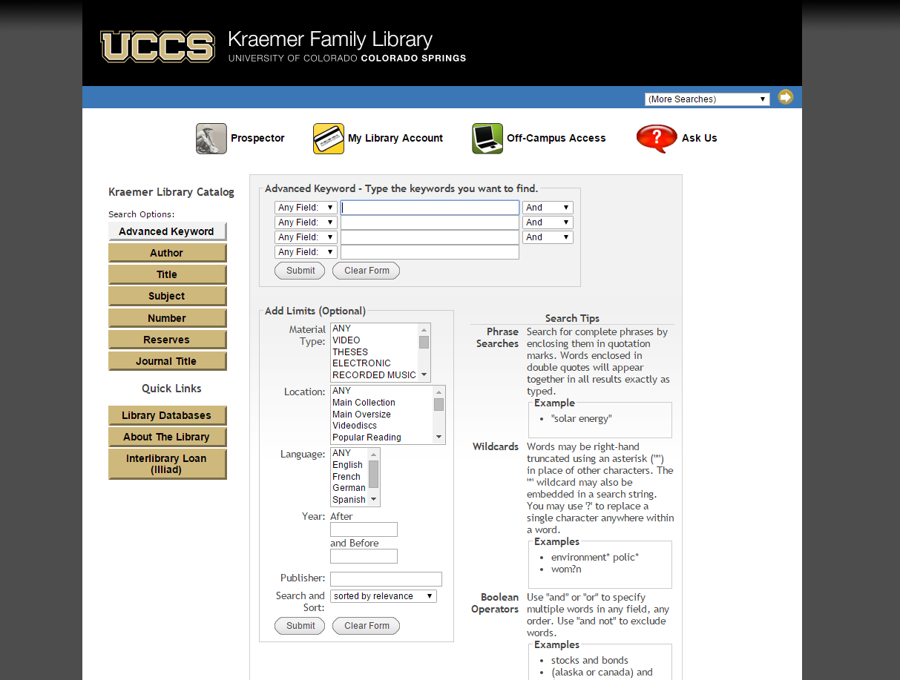
Advanced Search: Before

Slide 23
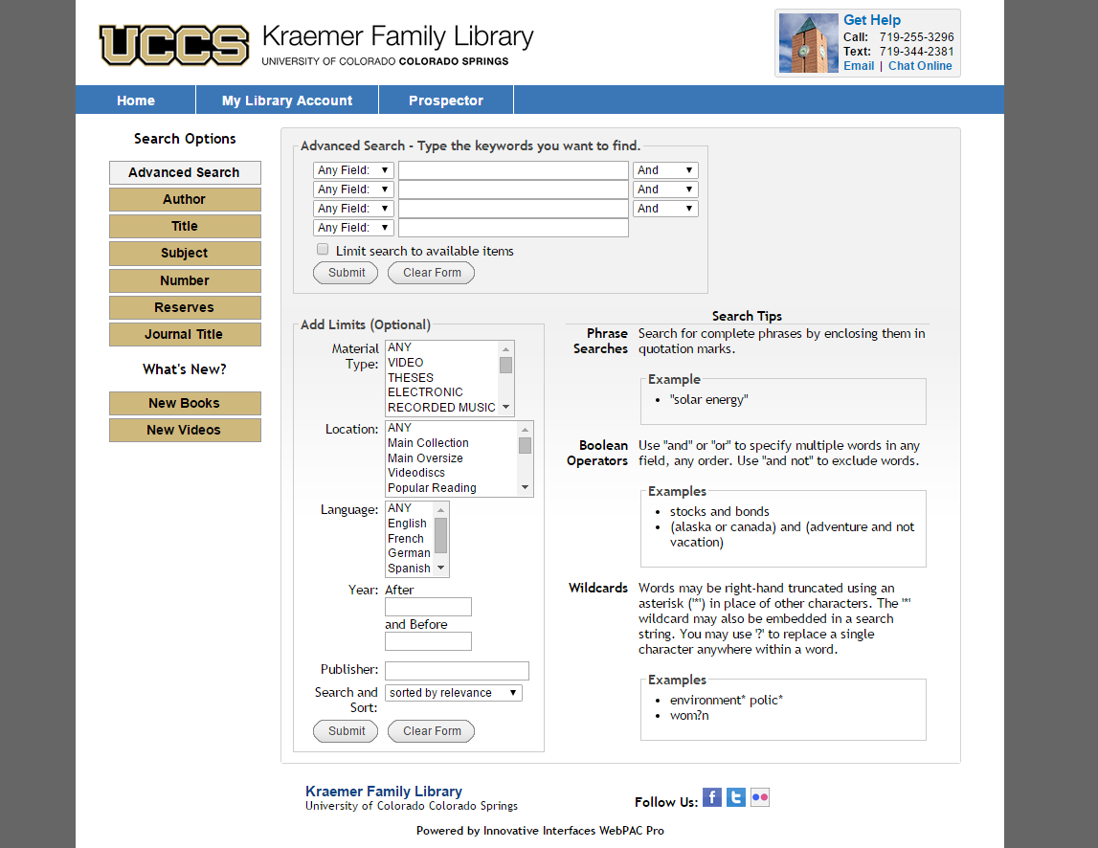
Advanced Search: After

Slide 24
Advanced Search: After

Slide 25
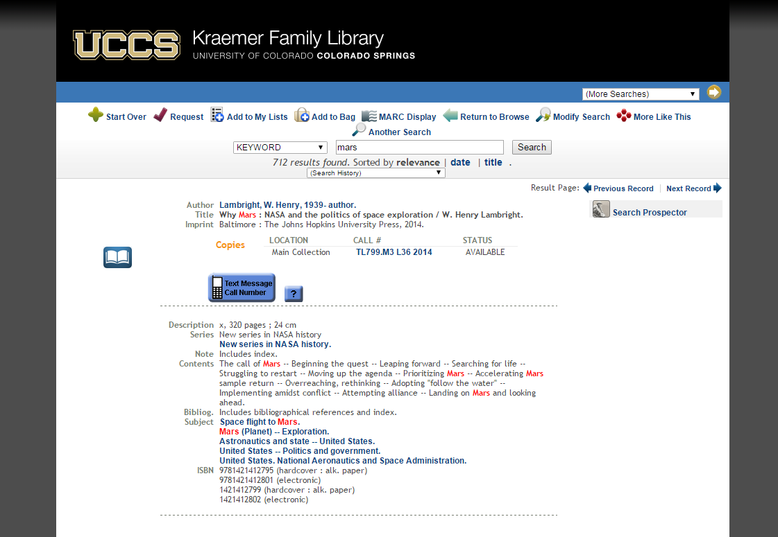
Item Record Page: Before

Slide 26
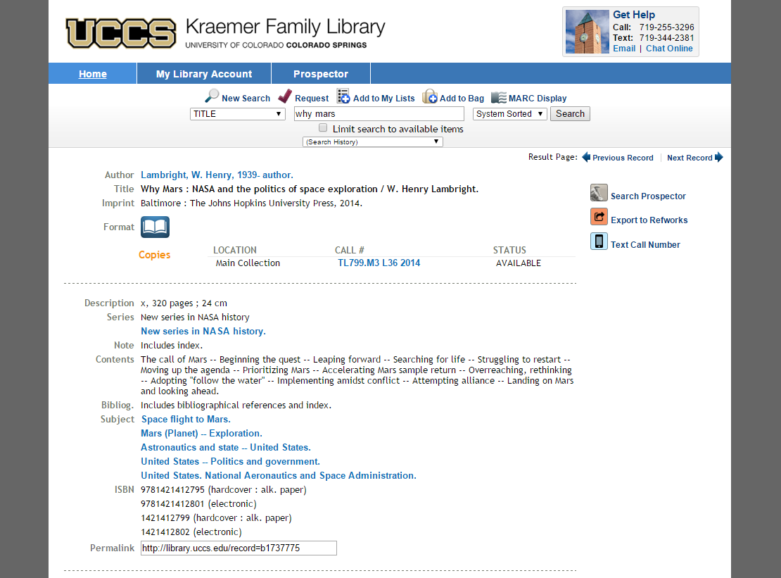
Item Record Page: After

Slide 27
Item Record Page: After

Slide 28
Customizing the Interface: Editing the styles.css File
Like most websites, III’s WebPAC separates content and style into separate HTML and CSS files
Color schemes, fonts, spacing, alignment, and other appearance settings are stored in the styles.css file

Slide 29
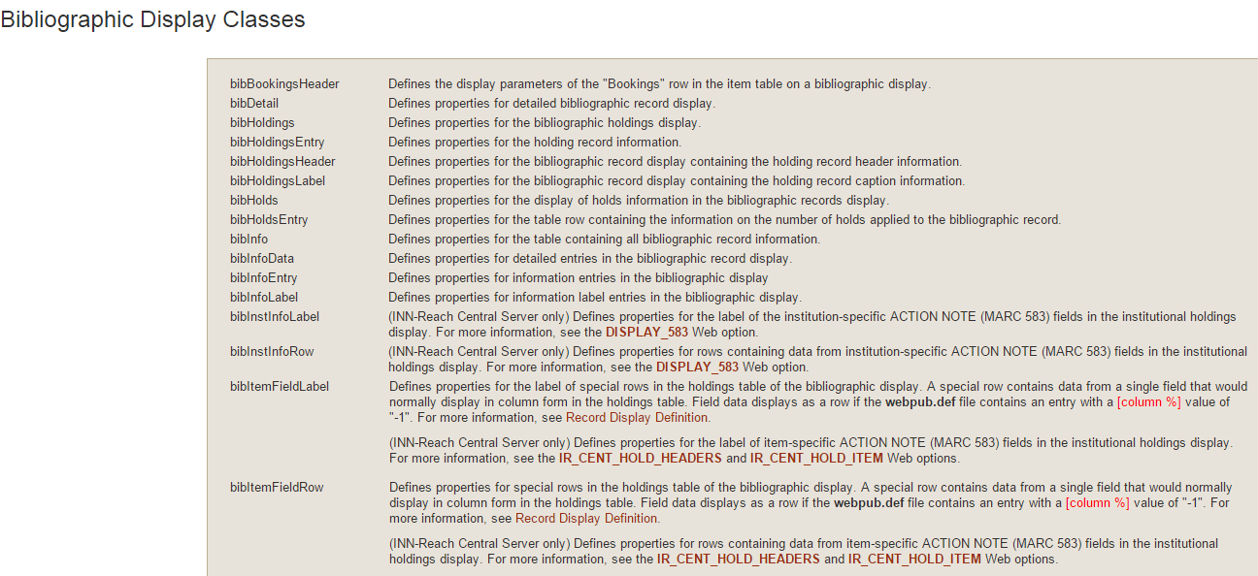
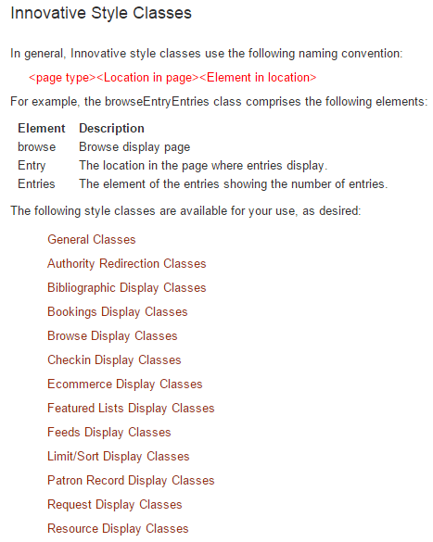
Customizing the Interface: Editing the styles.css File
Innovative’s WebPAC documentation describes each CSS class

Slide 30
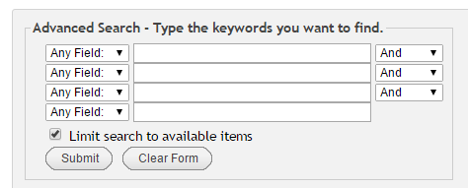
Limit Search to Available Items
Excludes any items that are checked out, missing, damaged, etc.
Uses the AVAILLIM Web Option

Slide 31
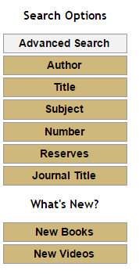
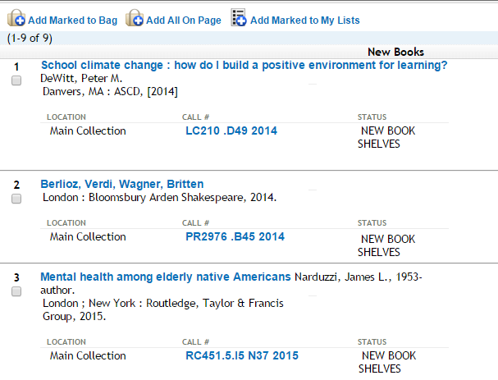
Featured Lists

Slide 32
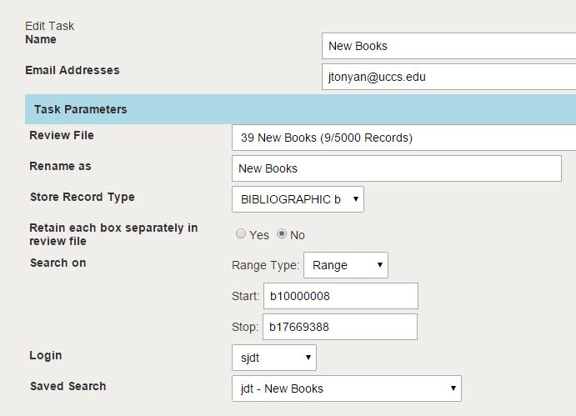
Featured Lists, cont.
I used Scheduler to run a saved search that looks for item records with a “New Book Shelves” status and saves them to a Review File…

Slide 33
Featured Lists, cont.
And then scheduled the task to run every morning

Slide 34
Featured Lists, cont.
I then specified the review file numbers in the FEATURED_LIST Web Option
And lastly placed links to the lists in our WebPAC
http://library.uccs.edu/search?/ftlist^bib39%2C1%2C0%2C3/mode=2

Slide 35
Permalinks
When you navigate to a bib record, the url is long, contains your search query, and isn’t necessarily permanent
http://library.uccs.edu/search?/tcosmos/tcosmos/1%2C17%2C20%2CB/frameset&FF=tcosmos&1%2C%2C3/indexsort=-
A permalink provides users with a shortened and, more importantly, permanent link to the bib record
http://library.uccs.edu/record=b1095320

Slide 36
Permalinks, cont.
Innovative provides this functionality with it’s ICON_RECORDLINK Web Option, but I wanted a little more control over it’s appearance and placement so I wrote my own JavaScript function

Slide 37
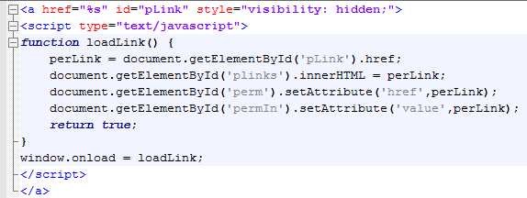
Permalinks, cont.
First, I store the system generated record link (%s) in a hidden link with a unique ID
Then, I use a JavaScript function to store the record link in a variable and assign it to another ID

Slide 38
Permalinks, cont.
Then, in the bib_display.html page, I assign the ID containing the record link to an input field.
Lastly, I use a JavaScript onclick event to select the url when the user clicks on the input field
All they have to do is right-click the url and copy it to their clipboard

Slide 39
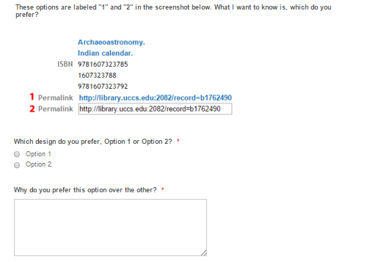
Permalinks, cont.
A/B tested two different versions of the permalink feature using a survey

Slide 40
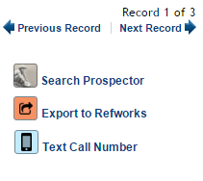
Export to RefWorks
RefWorks is a citation management tool that lets you import publishing information for books, articles, DVDs, etc.

Slide 41
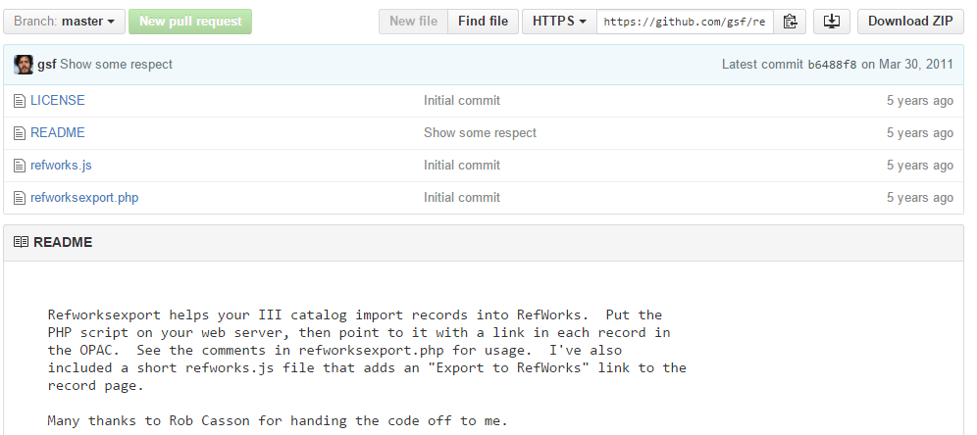
Export to RefWorks, cont.
https://github.com/gsf/refworksexport

Slide 42
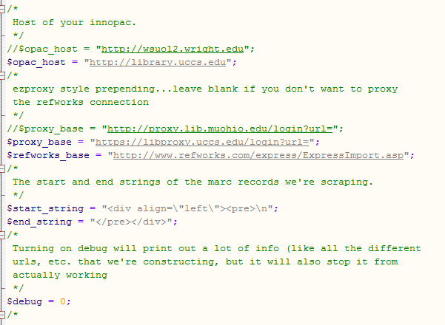
Export to RefWorks, cont.
PHP Script
Requires access to an external PHP server
Edit the PHP script, inserting your III server information, proxy server, etc.

Slide 43
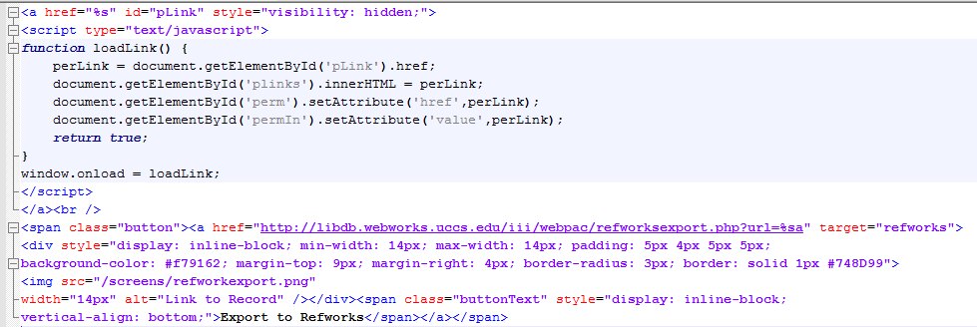
Export to RefWorks, cont.
Insert the required HTML into the ICON_RECORDLINK Web Option

Slide 44
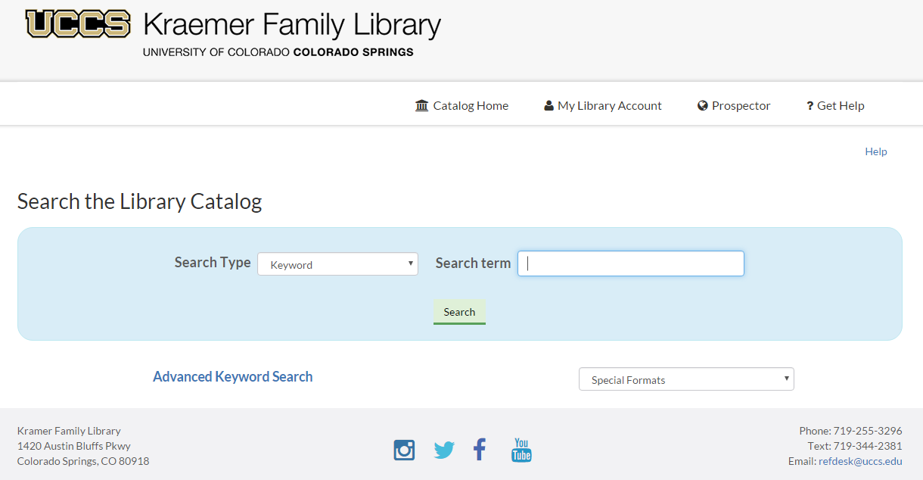
WebPAC Development: What’s Next?

Slide 45
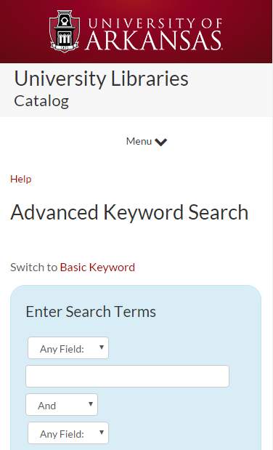
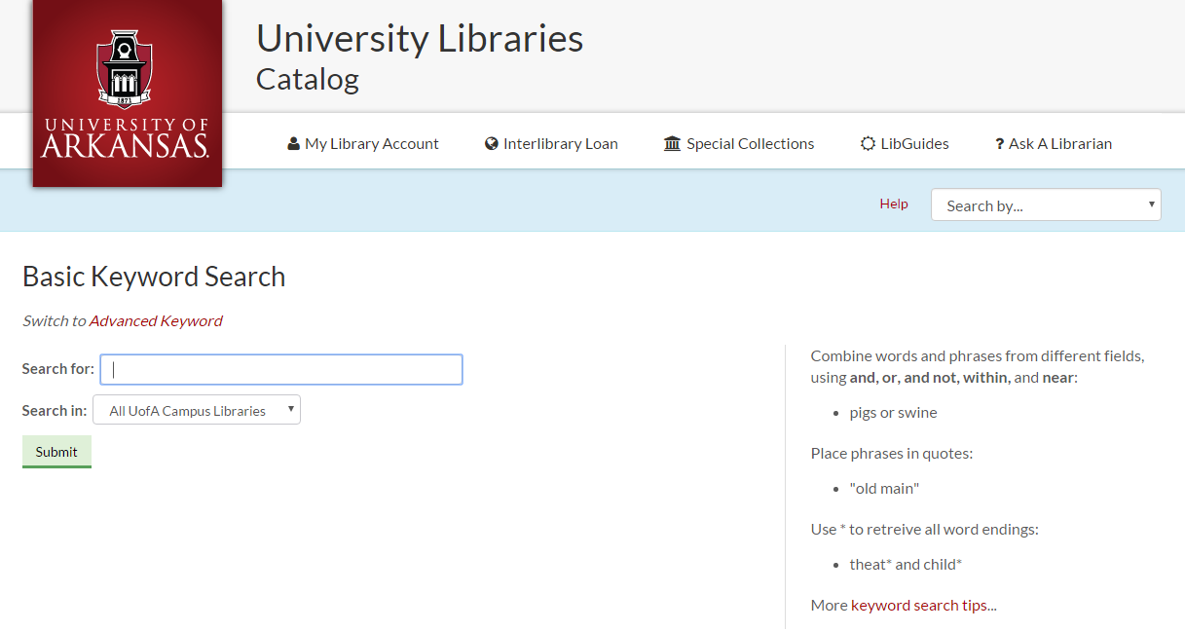
WebPAC Development: Responsive Example Set
http://innovativeusers.org/index.php?option=com_content&view=article&id=174&appParams[method]=Full+Record&appParams[id]=378

Slide 46
Using Google Analytics to Assess your WebPAC

Slide 47
Assessment: Google Analytics
We use Google Analytics to measure overall usage of our WebPAC as well as specific features we’ve implemented
Google Analytics is a free online tool that is easy to set up and configure
Requires a Google Analytics account and a Google Tag Manager account

Slide 48
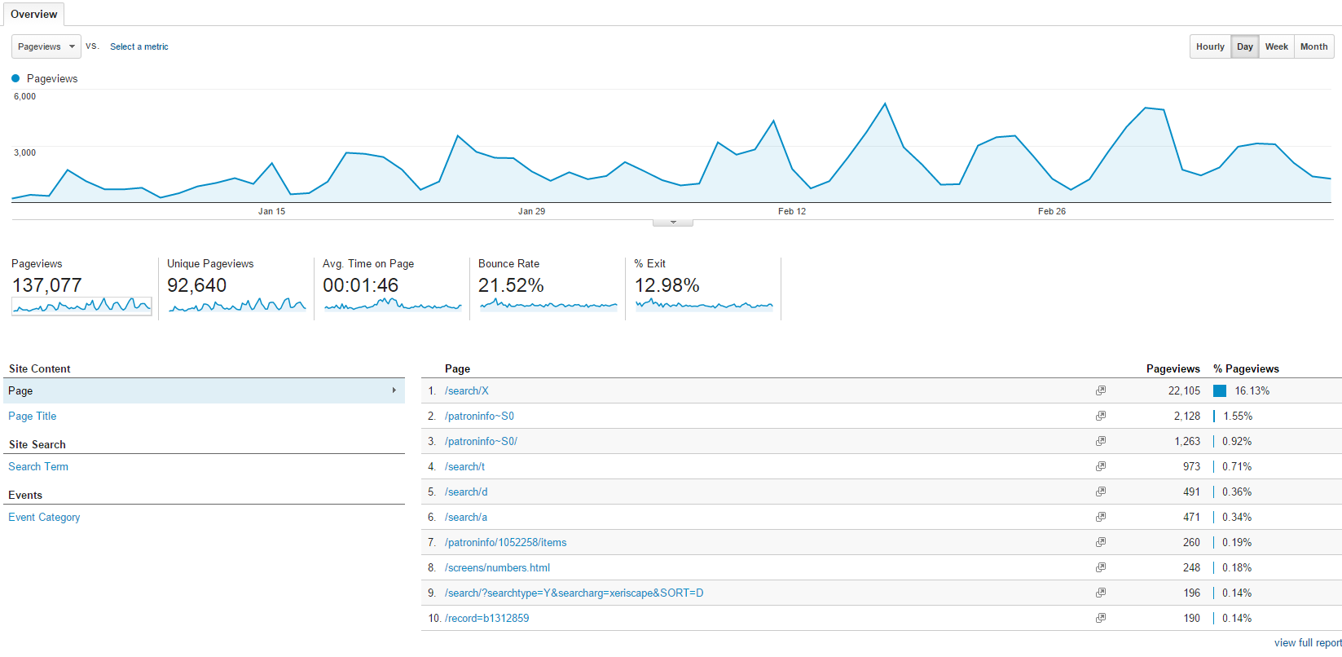
Assessment: Google Analytics, cont.
The Overview Report provides usage stats for your WebPAC and ranks its most popular pages

Slide 49
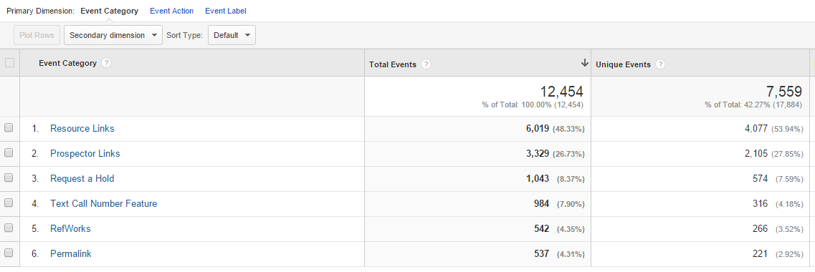
Assessment: Google Analytics, cont.
Event Tracking lets you track specific user behaviors in your WebPAC
Requires some configuration – you must define each event
Useful for evaluating whether or not a new feature is being used

Slide 50
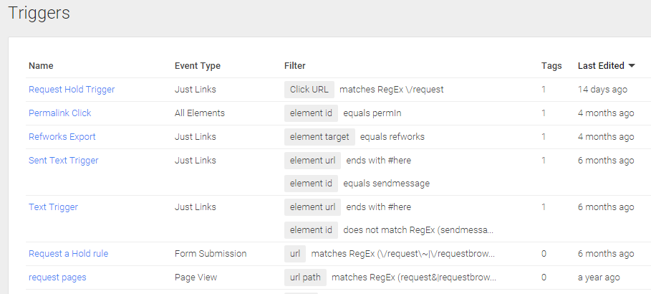
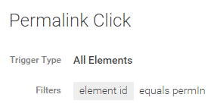
Assessment: Google Analytics, cont.
To configure Event tracking, define Triggers in Google Tag Manager
You can create triggers using URL matching, CSS element ID matching, and so on

Slide 51
Assessment: Google Analytics, cont.
The Site Search report lets you track all search queries in your WebPAC
Useful for collection development purposes
Statistics are anonymized, so that patron privacy is protected

Slide 52
Assessment: Google Analytics, cont.
The Site Search Category Report lets you see where users are performing searches
Are they using the Advanced Search page (X), Title search (t), etc.?

Slide 53
Questions?
Joel Tonyan
Email: jtonyan@uccs.edu
Twitter: @joeltonyan

