Slide 1
Hot, Hot, Hotspots!
Barbara Krueger, Deer Park (WI) Public Library
Kathy Setter, IFLS Library System, WI

Slide 2
The Need

Slide 3
St. Croix County
Notes:
Statistics on number of libraries, population, circ, income levels
11 public libraries in a county that is 736 square miles; two of the libraries are border communities that are in two counties. Others are close to other counties that are in the IFLS library system so have users from those counties use the libraries.
IFLS Library system is 10 counties and 53 libraries orf which 49 are members of the shared system.
Estimated population is 88,607; populations in the communities range from 16,000 to 216. Five of the communities have a population between 1,000 and 2,000. Hudson 14,000, NR 9,000 Baldwin 4,000 and Somerset 3,000.
Income levels Median Income $81, 124 with 4.7% in poverty
Circulation at the 11 libraries in 2019 was just over 1 Million. (1,023,056)
11 public libraries in a county that is 736 square miles
Estimated population is 88,607
Income levels Median Income $81, 124 with 4.7% in poverty
Circulation at the 11 libraries in 2019 was

Slide 4
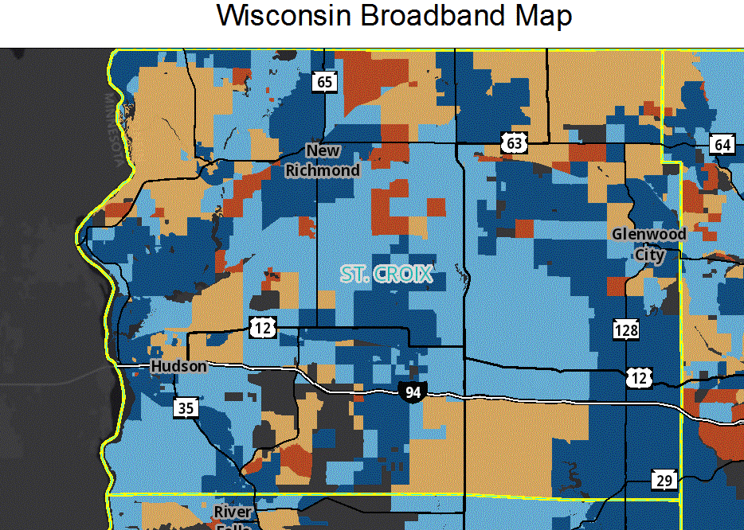
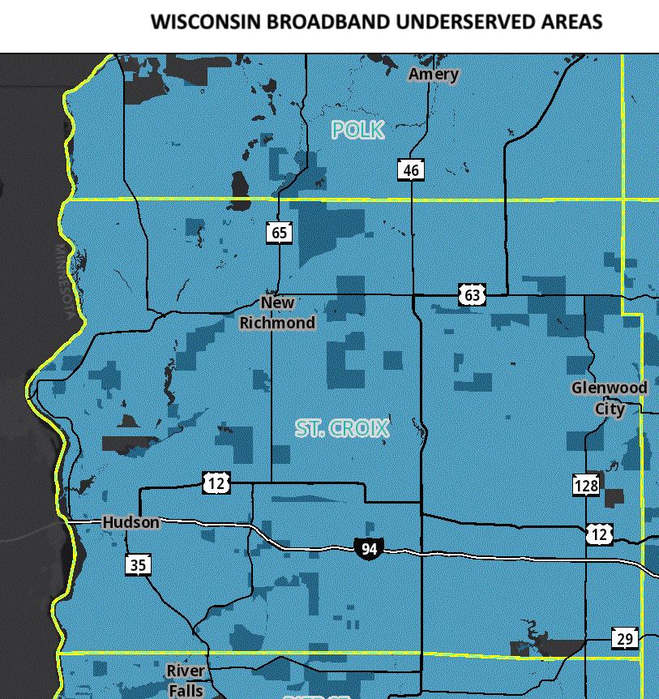
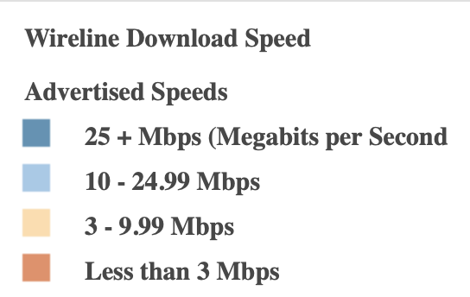
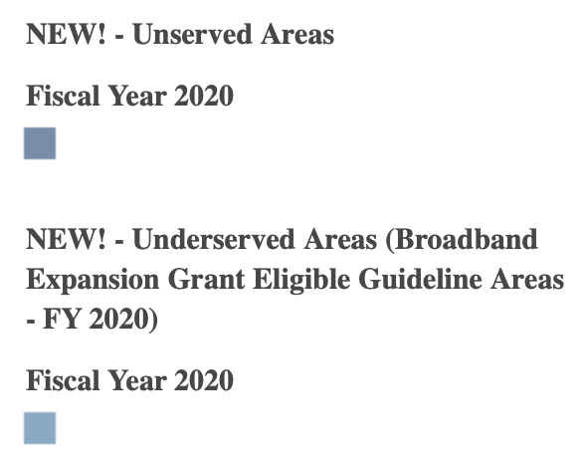
Why Hotspots?
Notes:
Describe what went into the decision to ask for hotspots for every library
The maps are from the Wi Public Service Commission website. Keep in mind that the speeds are advertised speeds so if someone is at the end of a DSL line their service may be slower. The second map sows that the majority of St. Croix County is an underserved area for broadband service. The wrong side of the digital divide.
Four of the libraries had added Wi-Fi hotspots to their circulating collections prior to the county funding which we’ll explain later. Library staff could see the need for internet access due to the increased demand of library public computers and free WiFi. Jennifer Rickard of Friday Memorial Library in New Richmond was aware of other libraries offering the hotspot service and thought it would be another opportunity to provide access in another way. Libraries in St. Croix County began adding hotspots in 2016. River Falls started with 5, New Richmond with 5, Roberts with 3, and Deer Park with 1.

Slide 5
Funding
Each library receives funding from the county based on their circulation to patrons who live outside of a municipality with a library.
How were the Wi-Fi hotspots were funded prior to this program?
Friends of the Library
Library Foundation
Library operational budget
St. Croix County Library Planning Committee – What can the county do for libraries?
Suggestion was made to fund Wi-Fi hotspots for each of the eleven libraries – decided on two for two years through T-mobile.
County board member took the proposal to the County Administration committee to use 2018 contingency funds for the for this pilot program at a total cost $15,840. – Approved October 15, 2018
County Board approved funding for 2021 when previous funding expired
Notes:
County Library Planning Committee – established by WI State Statute. Comprised of 2 County board members, 3 county library directors, and 2 at large public members. Try to represent the county geographically. Appointed by the County Board Chairman. Meets once or twice a year. Creates a 5-year Strategic Plan for the Libraries in the county.
The proposal was to fund two Wi-Fi hotspots for two years with T-mobile as the provider. That was the provider the four libraries already offering Wi-Fi hotspots were using. Jennifer Rickard had researched the providers for Friday Memorial Library the two libraries that added Wi-Fi hotspots after New Richmond said why re-invent the wheel.
2 year pilot program to provide 2 hotspots through T-Mobile to each of the 11 libraries at a cost of $360 per year per hotspot. [11 libraries X $360 X 2 years X 2 hotspots = $15,840] –
When the checks were received – up to each library how they handled the funds recommended to prepay for the two years once the first invoice received. Work with their municipal clerk on the payment.

Slide 6
The Project

Slide 7
Hotspots
Selecting a provider
Why re-invent the wheel - T-Mobile
Fair price - $29.40/month
Unlimited data with no throttling
Good coverage in majority of area
Communicating project to Library Directors
Funding by the county – procedure to request the funds
T-Mobile Government account contact
Links to shared materials
Notes:
How you chose which hotspots to order, companies used, prices
Followed River Falls (5) and New Richmond Libraries (Friday Memorial Library) (5) had been using T-Mobile since 2016.
Roberts in 2017 with , Deer Park Early 2018 began with 1.
T-mobile: As this is a government program there is no contract, month to month but they like a two-year commitment; explain throttling
Also, 30 day free trial so if the service does not work in an area the hotspots can be returned.
November 2018 libraries began rolling out the Wi-Fi HotSpots funded by St. Croix County

Slide 8
Hotspots - Setup
Shared via Google Drive
Hotspot policies
Checkout forms
Spreadsheet for managing the devices, including passwords
Hotspot case options
Shared via Canva
Marketing materials
Coordination of an informational newspaper article about the project
Seven area newspapers
Written by IFLS PR and Communications Coordinator
Notes:
What went into set up, contacting the company, etc.
The spreadsheet had T-Mobile contact information, links to portals for support, suspending service, details for each hotspot – IMEI, telephone number, call #, anything relevant to the hotspot, SSID, password, administrative password
Newspaper – Five of the libraries share one newspaper

Slide 9
Hotspots - Setup
Library responsibilities
Contact the T-Mobile account manager or other provider
Hotspots shipped directly to the owning library
Customize shared documents for their library
Have Library Board of Trustees approve Wi-Fi Hotspot Circulation Policy
Contact ILS administrator
Create Location Code
Setup Loan Rule
Ordering cases for the hotspots
Activation of the hotspot by owning library
Create bibliographic record for the hotspot(s)
Notes:
What went into set up, contacting the company, etc.
When contacting the Wi-Fi Hotspot Provider
Setup an account
Order the hotspot(s)
If the owning library staff requested assistance with the activation and setup process, I did so. Sometimes in person and sometimes over the telephone. Sometimes just wanted to have me available in case they had issues.
Duplicated an existing bibliographic record then tailored it for the owning library.

Slide 10
Hotspots – Shared Marketing
Notes:
Example of the tailoring that was done to shared marketing materials

Slide 11
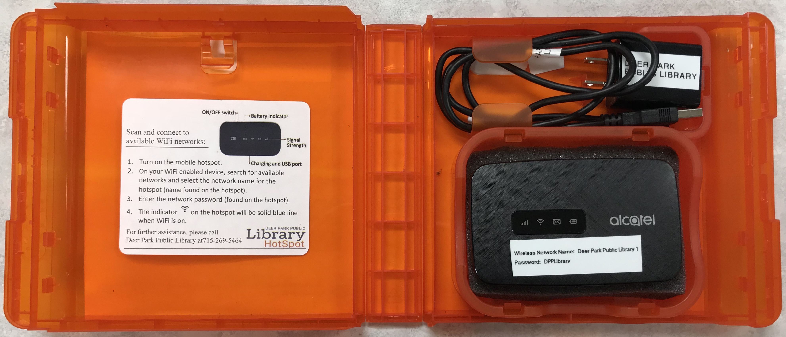
Hotspots – Ready to Circulate
Notes:
Outside of one of the cases and inside. – The case was from PlayAway View. Sturdy, visibility.

Slide 12
Hotspots - Issues
Equipment
Inserting the correct SIM card
Defective SIM cards
No cellular service in library area
Lack of a checklist of the steps that each library needed to complete
Confusion regarding type of account
Government program so a different web portal than the general retail site
Need to register the user name and password
Everyone not as enthusiastic about another technology item to manage
Monitoring due date to suspend service when not returned
Notes:
Describe some of the problems encountered with getting everyone up and running
SIM cards came with two sizes of SIMs on the same card. No instructions as to which one was to be used in the Hotspots. Some SIM cards were defective and needed to be replaced
Checklist was in my head
Confusion that this falls under the government unit of the provider not the retail website; need to setup a user name and password so if need to suspend service ready to do so or if equipment issues.
Technical understanding by some of the library directors and/or their staff.

Slide 13
The Rules

Slide 14
Loan Rules
Tried to be as uniform as possible
2 week checkout
2 libraries chose 1 week
No renewals
Holds allowed
Owning Library pickup
Fines $5/day
1 chose no fine
2 chose $1/day
Notes:
Even though several libraries are fine free for “regular” materials they chose to charge fines for hotspots

Slide 15
Loan Rule Options

Slide 16
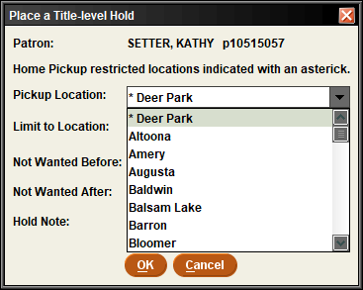
Home Pickup
When requesting from WebPac, if logged in first, only owning library shows as a pickup location
Patrons cannot change it in My Account
With the change to BibloCore as the discovery layer the home pickup element does not work
From Sierra, Home Pickup is indicated, but staff could change to another library (training needed here to make sure no one does that)

Slide 17
Bib Record
One per library
Decided on uniform title for ease of finding
Notes explaining rules

Slide 18
The Outcome

Slide 19
Success!
Notes:
Circ numbers, general feedback on having hotspots

Slide 20
Success!
Notes:
Circ numbers, general feedback on having hotspots

Slide 21
Circulation Issues
Sitting on hold shelf
Same users repeatedly
How to reach additional library users
Length of time on holds list
Funding in the future
Notes:
Problems encountered with patrons, having to deactivate a device, etc, things you would have done differently?

Slide 22
Questions?
Thank you!
Barbara Krueger bkrueger@deerparkpl.org
Kathy Setter setter@ifls.lib.wi.us

