Slide 1
Creative Conversion: Using Sierra PostgreSQL to Convert Barcode and OCLC Numbers to Bib Record Lists
Jason Fleming, Elisabeth Garner, Gary Moore

Slide 2
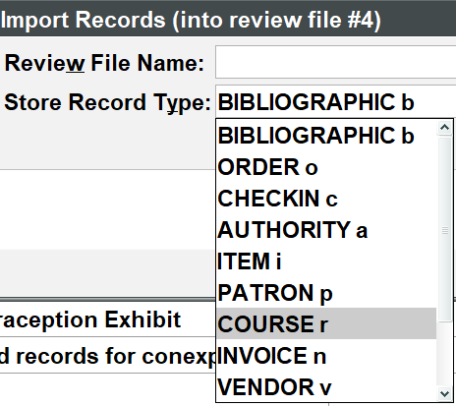
The need for a conversion tool
Sierra import options may seem generous but are missing some key data points used in our general workflow (barcode, OCLC#) <currently on Sierra 5.2>*

Slide 3
The Project(s) phase
Started off as a way to convert barcodes to item numbers in a batch process (2016)
Government Documents deselection application developed (defunct) that made use of this underlying query (2017) <defunct>
Inventory application created that made use of this underlying query (2017)
Streamlined Government Documents workflow to just needing OCLC# lists to be imported into SDA as Bib #'s. Modified barcode->item record# app to OCLC#->Bib (2020)
Put code in Github (2022) https://github.com/uncw-library/sierra-reports

Slide 4
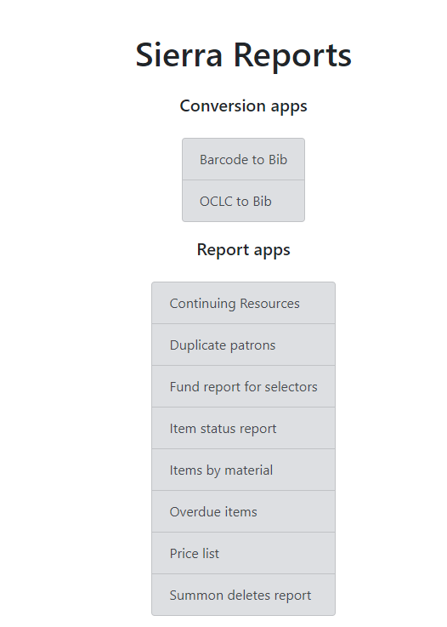
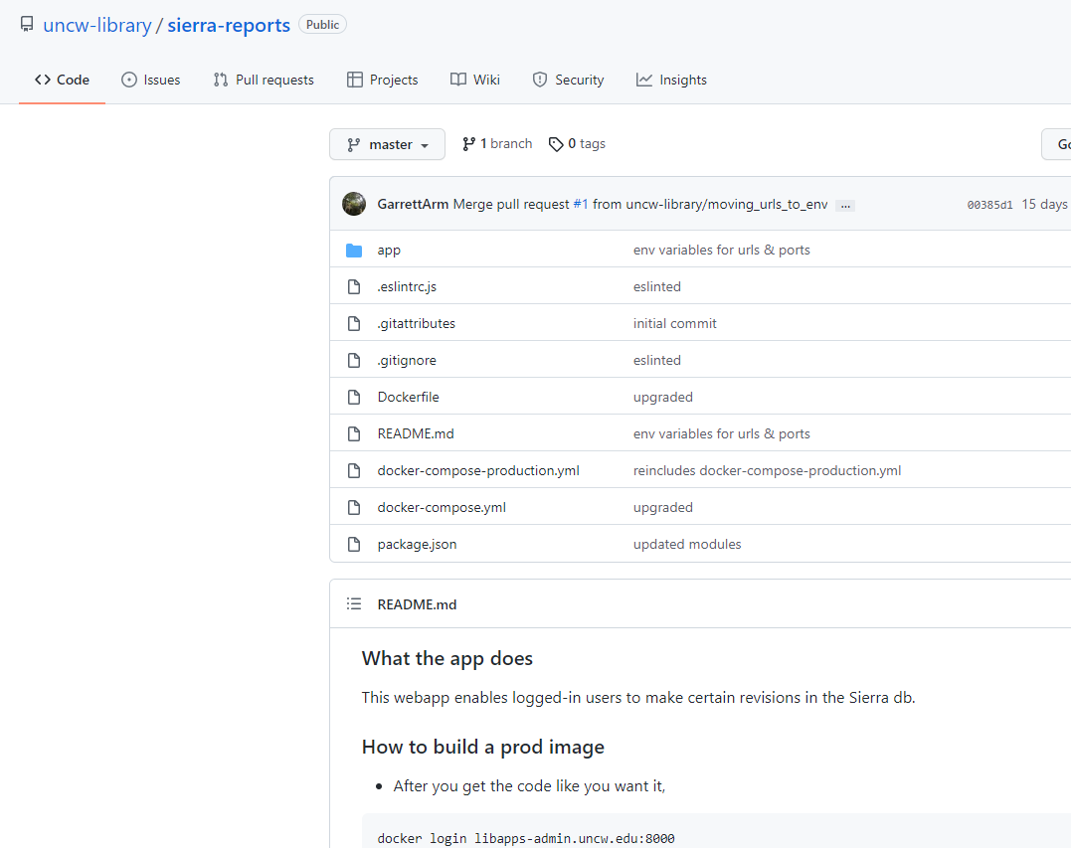

Slide 5
The Barcode to Bib Record to Review File Cycle
List of bib record numbers
List of barcodes
Review file in Create Lists
Conversion tool
Import records

Slide 6
Cataloging Conversion Workflow
I use the “Barcode to Bib” converter tool on an occasional basis
I, or a student or employee, will typically scan barcodes for items that need some sort of editing or action in Sierra.
Once we have a list of those barcodes saved into a text file, I can import the file into the conversion to, which generates a csv file with the bib and item record numbers
The next step is to save the record numbers as a separate txt file
From here, I can use the Import Records function in Create Lists to generate a review file from the record numbers
With the records in a Review File I can make the necessary edits to all of them

Slide 7
The OCLC to Bib Record to Review File Cycle
List of bib record numbers
List of OCLC numbers
Review file in Create Lists
Conversion tool
Import records

Slide 8
Government Documents Deselection Workflow
I use the “OCLC to Bib” converter tool on a weekly basis.
My student worker takes individual lists of SuDoc call numbers, (from items we have deselected), and then searches our catalog to see if we have print items associated with those call numbers.
If we do have those items in our catalog, she copies and pastes the OCLC numbers associated with those records on the same spreadsheet, in a separate column.
At this point, I copy and paste all the OCLC numbers she has provided, into a Notepad list. I then upload that list into Connexion in order to delete holdings on those records.
Next, I take that same Notepad list, and use the Converter tool to convert those OCLC numbers into their corresponding bib record numbers from our catalog.
This is how the tool has been so convenient and efficient to use. This allows my student worker to not have to go back and copy and paste the bib record numbers in a separate column. It saves us untold numbers of hours in our workflow to deselect the hundreds of thousands of documents we are currently weeding.

Slide 9
Additional thoughts
Can be useful for when you have the items in hand, and/or need to make batch edits on the fly
Can be useful if you have a list of barcodes from another process or report – e.g. a discard list from Collection Management or a list of missing titles from Circulation
Going from barcode to bib number can provide additional insights - such as seeing if other items are attached - and the bib number itself can tell you the relative age of a record (i.e. the higher the record number the more recently it was created)

Slide 10
Behind the Curtain (SQL)
SELECT 'b'||varfield_view.record_num||'a' as bib,field_content as oclc
FROM sierra_view.bib_view
LEFT JOIN sierra_view.varfield_view
ON sierra_view.varfield_view.record_id=sierra_view.bib_view.id
LEFT JOIN sierra_view.record_metadata
ON record_metadata.id=sierra_view.bib_view.id
WHERE sierra_view.varfield_view.marc_tag='001'
AND field_content IN (${params})

Slide 11
THANK YOU
Questions?

