Slide 1
Knitting Together a Comprehensive eBook Strategy
Lynn E. Gates, Kraemer Family Library

Slide 2
Create Your Pattern

Slide 3
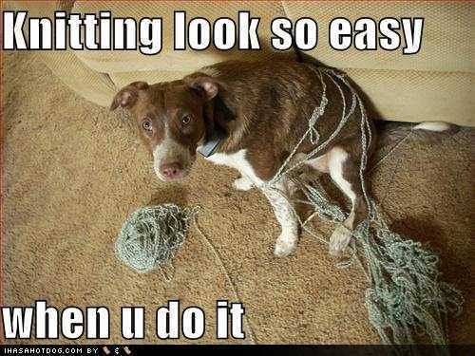
Know Your System
Do you have a PAC or a discovery layer or both? How are records displayed in each?
Can your vendor interface directly with your OPAC?
Do you need to add proxy statements to URLs?
Are there changes coming to your system that may affect record loading/maintenance?
Why are you loading records? for user access? for inventory purposes?
Notes:
PAC vs. Discovery layer: how records are imported/indexed/searched/displayed may impact information you add to records
Does a vendor have a way to integrate directly with you OPAC? (Polaris and OverDrive)
Do links need to have proxy statement added

Slide 4
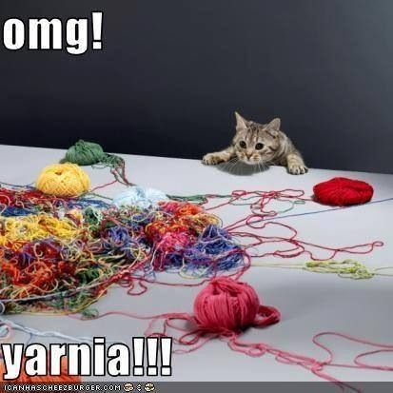
How Do You Get Your eBooks
Purchased Packages
Subscription Packages
PDA/DDA/ATO
Discovery
Purchased
Open Access Titles
Single-title
Packages
Single-title Purchases
Notes:
Where you get your ebooks may impact the information you need to include in records or tracking different parts of packages like discovery vs. purchased.

Slide 5
Are You Provider Neutral?
What is Provider Neutral?
“a single bibliographic record that describes all manifestations of an online resource regardless of which content publisher or aggregator is making the manifestation available.” (Provider-Neutral 2017)
“[puts] the emphases on the content of the resource rather than on the provider.” (Culbertson, Mandelstam, and Prager 2011
In other words, one record for one title with potentially lots of links.

Slide 6
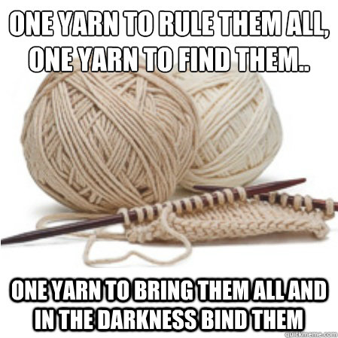
Provider Neutral: Pros & Cons
Advantages
Reduces duplicate records
Less confusion for users
Information is in one place
Disadvantages
Requires 100% reliable matchpoint
Staff time to maintain
Statistics gathering
Notes:
Advantages:
Fewer duplicates in the system helps both staff and users. Users coming in through the PAC or discovery layer don’t have to figure out if the multiple records are for different editions, years, etc. It also has the potential to hint that different links go to different platforms so if they have a poor experience at one link they might try another
Disadvantages:
Matchpoints aren’t reliable. Publishers reuse ISBNs, earlier works (and some publishers continue to) assigned multiple ISBNs based on format (Kindle, mobi, pdf, epub, etc.), multiple records in OCLC so OCLC number may not be sufficient or provided by vendor, Vendors many not provide a provider neutral record or an easy way to overlay records from a different source to create a PN record
No reliable matchpoints means more staff involvement in order to maintain provider neutral and ensure new records don’t duplicate existing.
Statistics can be complicated by not knowing which link was removed or added

Slide 7
Provider Neutral: Example

Slide 8
Gather Your Materials

Slide 9
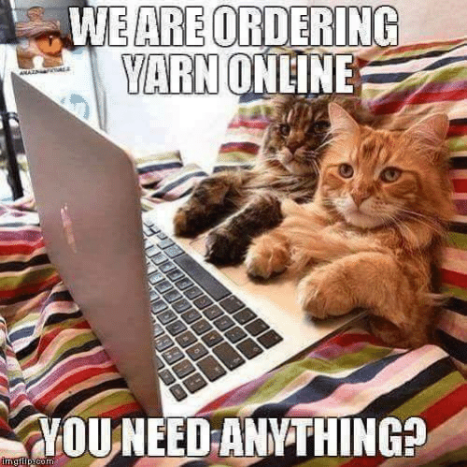
What Are Your Record Sources
Vendors
Knowledge Base (like Serials Solutions or WMS Collection Manager)
Individual download from a bibliographic utility (aka OCLC or Skyriver)
Manually created in ILS
Notes:
You may use more than one method, be aware of quality
For example, records from Serials Solutions don’t always contain an ISBN. Records from OCLC have lots of
Vendors: require checking regularly, some send emails
Knowledge Bases: WMS Collection Manager will create files of new, updated, merged, deleted on daily, weekly, monthly, or quarterly schedule that you choose

Slide 10
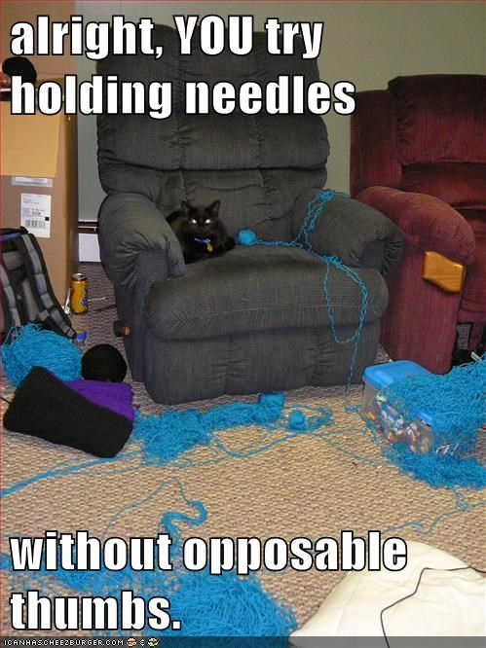
Tools for Batch Modifying Records
MarcEdit
https://marcedit.reeset.net/
OCLC WMS Collection Manager
Contact OCLC, included in cataloging subscription
MARCrecord-set-wrangler
https://github.com/UNC-Libraries/MARC-record-set-wrangler
Others?
Notes:
Most likely you will want to customize your records, add standard information, proxy statement, delete extraneous subject headings, add non-RDA elements (GMD to 245?)
You can also do some modifying using load profiles.

Slide 11
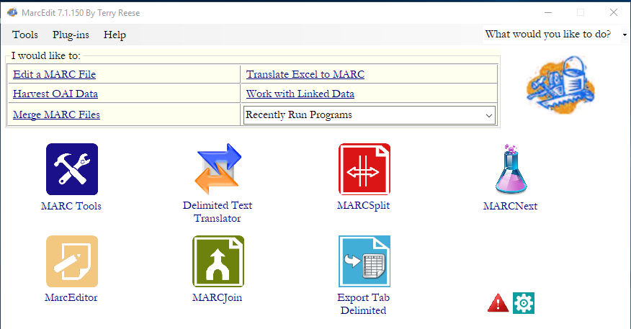
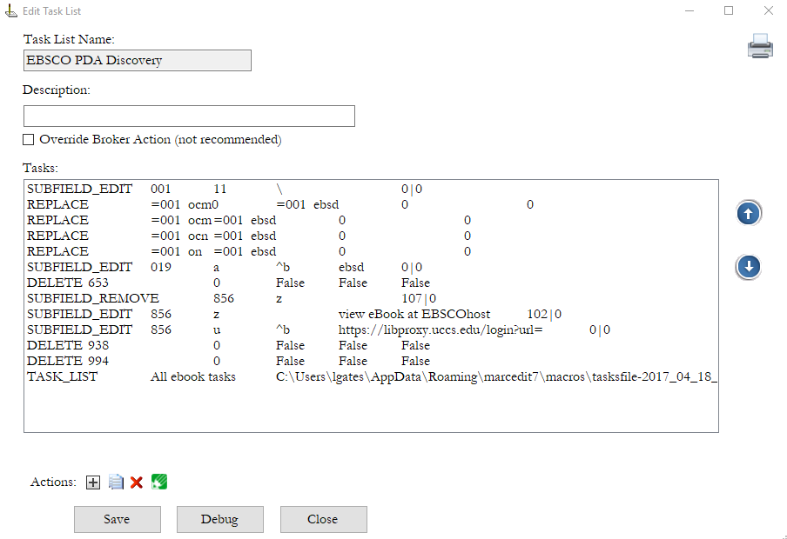
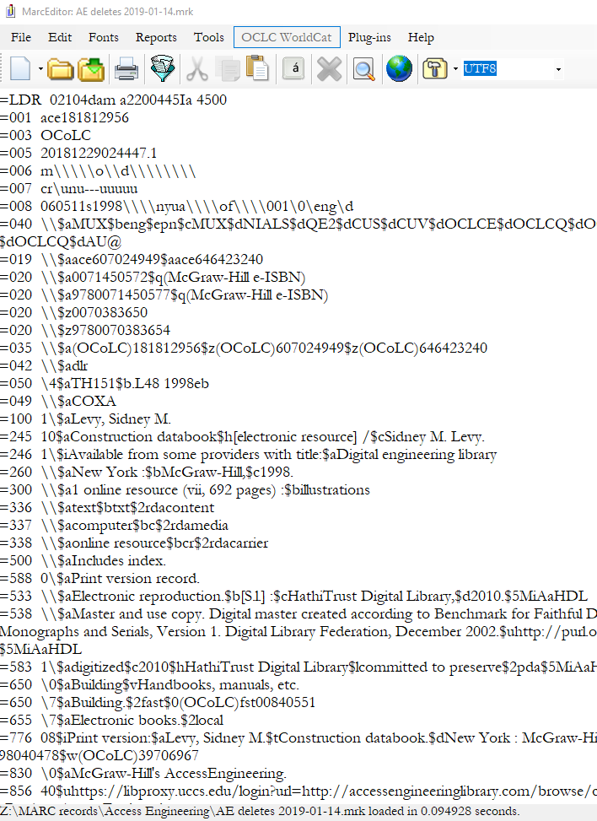
MarcEdit
Allows batch editing of a file
Create task lists
RDA Helper
Delimited text translator and export
File manipulation (split, join, sort, etc.)
MARC Validator
And lots, lots more
Notes:
Replace if options, Regex,

Slide 12
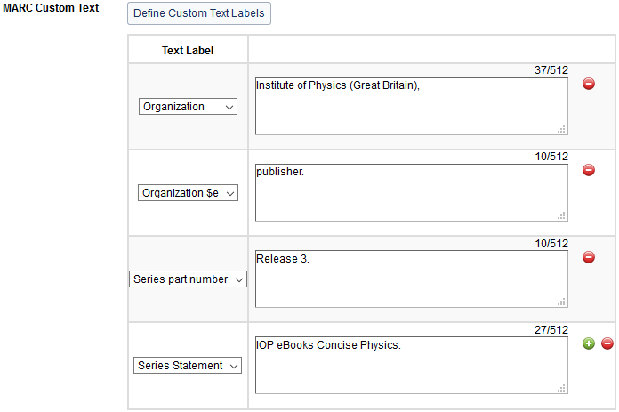
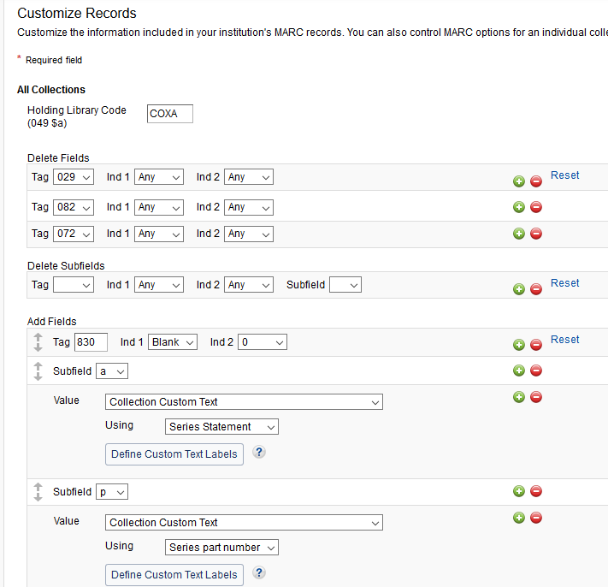
OCLC WMS Collection Manager
Manage eBook collections
Create custom collections
Customize records by adding or deleting fields, but customization is on every record in a collection

Slide 13
MARCrecord-set-wrangler
Work at the institution, workflow, or collection level
Compare files of MARC records to create mini files of new, updated, merged, and deleted records
Check information such as language of cataloging or lack of standard fields
Manipulate fields, like the 019 to make overlaying more reliable
Add MARC fields to records
Treat fields under authority control flexibly
And lots, lots more

Slide 14
Prepare to Cast On

Slide 15
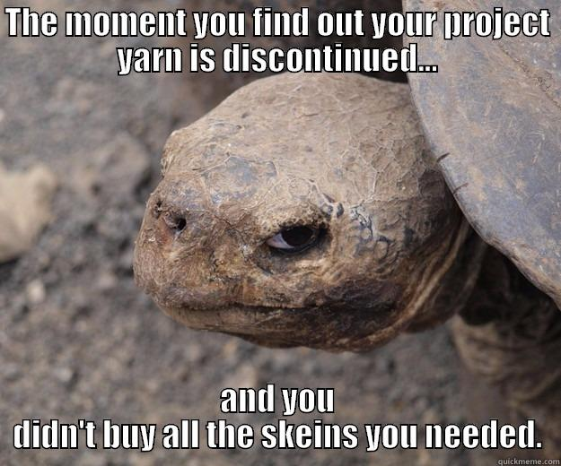
Prepare Your System
Do you need different load profiles?
Do you need new locations? item types? statuses?
Set-up bibliographic & item templates
Test your set-up
Notes:
Check your item and bib records, load profiles, etc. to make sure everything is ready to go ☺
Then test, test, test

Slide 16
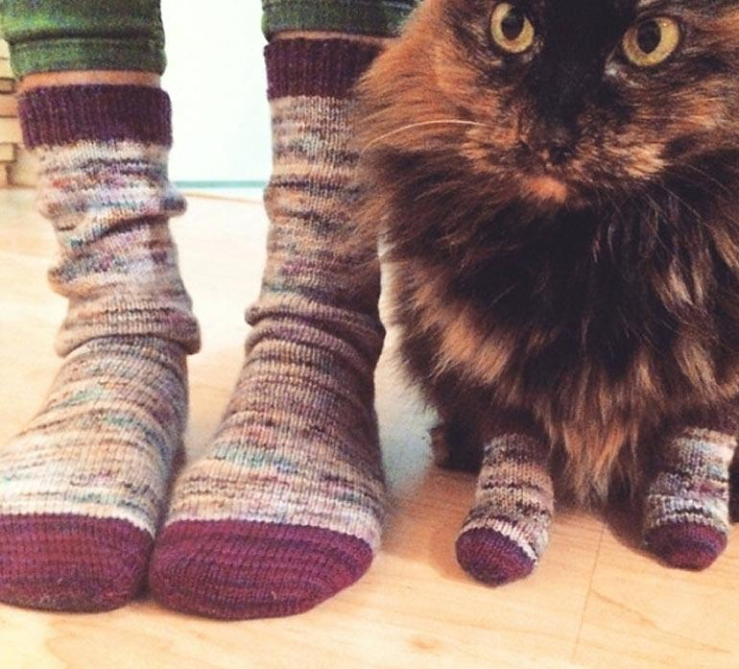
Common Record Edits Ideas 1
Add a prefix and/or suffix to the control number
Prevent unwanted overlays
Quickly identify the vendor and/or package
Compile records in system searches
Designate special statuses:
PDA discovery or purchase

Slide 17
Common Record Edits Ideas 2
Remove subject headings not used by the library
MESH
653
65X that have |2 bisach, swd, etc
The various versions of Electronic books (and add a standardized one)
Remove other fields that are not relevant:
506’s (access information) for other libraries
015, 037 $boverdrive (if not an Overdrive record), 084, 938, 994

Slide 18
Common Record Edits Ideas 3
Run RDA helper in MarcEdit
Add or remove GMDs
Add RDA fields
Add eb to the end of the call number to prevent duplicate call numbers
Replace common errors
double quotes in table of contents notes
Incorrect 006s

Slide 19
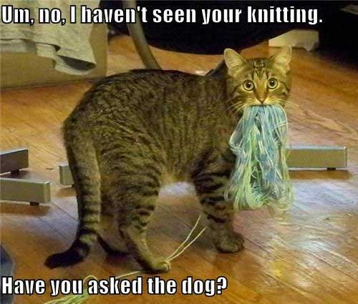
Common Record Edits Ideas 4
Information for your users
Number of licenses
Single user, unlimited, etc.
Public performance rights statements for streaming video
Standardized series or authors to make search more reliable
Link notes (856|z) that include the platform
Notes:
Think of all your users, beginning, experienced, super users who are familiar with various platforms, staff searchers.

Slide 20
Common Record Edits Ideas 5
Information for other departments (particularly acquisitions):
Marking purchased vs discovery
Funding type or other indication if permanent or subscription
License expiration statements for streaming video

Slide 21
Too Many Stitches?

Slide 22
Duplicate Records
If you subscribe or purchase more than one large package that are not publisher based, you will have duplicate records as there will be titles available from multiple vendors.
Are duplicate records really a problem? Maybe, maybe not, it’s going to depend on your system, set-up and users.
The number of duplicates will vary depending on package and by date within packages. While overall number of duplicates may be low and not of concern, an individual package may have quite a few.

Slide 23
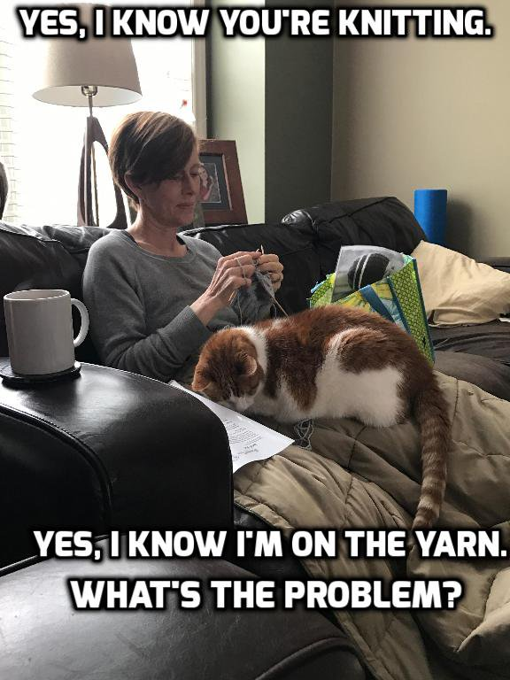
Things to Consider
Budgetary implications
Paying for same title multiple times
Collections with a high percentage of duplicates
Staff time & efficiency
Figuring out status of titles, troubleshooting
Complicated workflows to handle duplicates
Discovery & user experience
Confusion about number of copies
Potentially poor experience depending on platform

Slide 24
Potential Solutions to Duplicates
Rely on discovery layers
Many can merge titles/records to reduce duplication seen by users
Takes time and experimentation to set up
Not always reliable
Go provider neutral
Many knowledge bases can track and send one record for the same title
Staff time to maintain, with a reliable match point required
Statistic gathering can be difficult
Suppress records
Ease of tracking titles in a package
Ability to determine which record appears to users
Many ILS have reports to assist in finding duplicate records
Staff time to maintain

Slide 25
Write It All Down

Slide 26
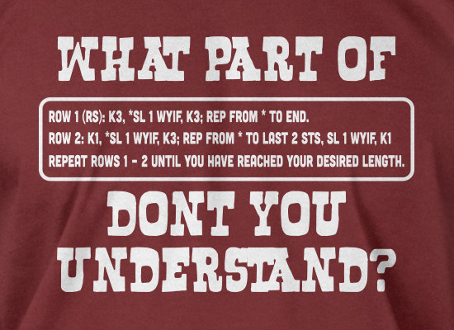
Document, Document, Document
What information do you want to have ready access to?
Where you get records form, along with login & passwords.
What edits you make to records.
Where edits are made.
Have other people review your documentation to make sure it makes sense.

Slide 27
Keeping Statistics
Remember that in general you are tracking the number of records in a package in your system.
Which may or may not be equal to the number of titles available.
There are lots of different ways track totals for eBooks purchased with different types of funds or for different areas of the collection.

Slide 28
References
Culbertson, Becky, Yael Mandelstam, and George Prager. 2011. Provider- Neutral E-Monograph MARC Record Guide. Washington, DC: Program for Cooperative Cataloging. http://loc.gov/aba/pcc/bibco/documents/PN-Guide.pdf
Provider-Neutral E-Resource: MARC Record Guide: P-N/RDA Version 2017. Washington, DC: Program for Cooperative Cataloging. http://www.loc.gov/aba/pcc/scs/documents/PN-RDA-Combined.docx

Slide 29
THANK YOU
Questions?
lgates@uccs.edu

