Slide 2
pgAdmin: Drilling Down
David Noe
ILS Specialist
Orange County Library System
Orlando, FL
noe.david@ocls.info
Notes:
Overview:
Introduction
Installing
Options
Object Browser
SQL pane
Properties
Tools
As we look at the client, we will look at how Sierra's data is
created and stored
where it is located
how to maximize the efficiency of your queries

Slide 3
Orange County Library System
Migrated to Sierra in late 2012
Metropolitan public library
Main downtown library and 15 branches
424K active cards in a county of 1.3M
~ 1.7 million items
~ 11.5M checkouts last year
~10% of that are requests delivered
~350 employees
Annual budget totals approximately $38.4 million

Slide 4
pgAdmin
pgAdmin is an open source administration and development tool developed by the PostgreSQL community
Version
4 v1.0 released late 2016
4 v1.3 released in March 2017
Using Version 3 v1.18 when I started working on this presentation
Considered to try to do this in 4, but sluggishness and crashing made it impossible.
Download at https://www.pgadmin.org/download/
Notes:
Go to pgadmin download page

Slide 5
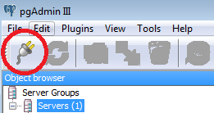
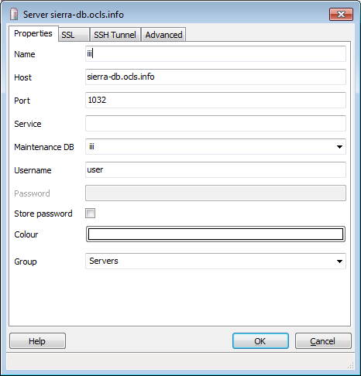
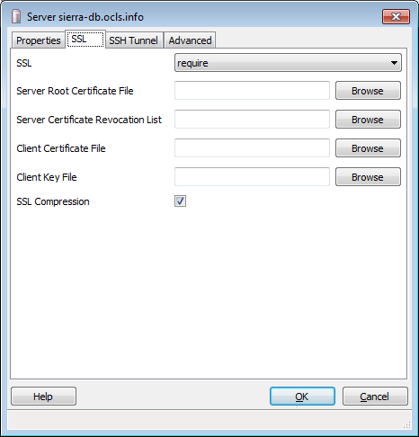
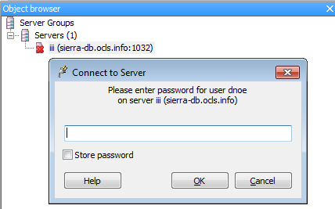
Getting Started – adding a database
Notes:
DON’T FORGET TO ALLOW USER PERMISION IN SIERRA ADMIN
Plug icon
Properties
name, host, port (5032), maintenance db, user
SSL
Require, ssl compression
Login

Slide 6
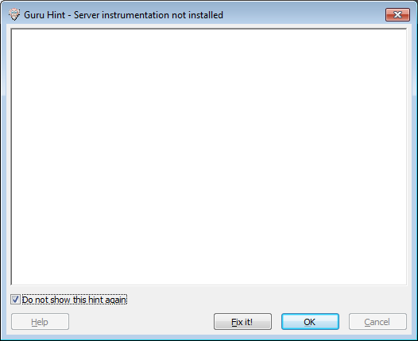
Getting Started – “Guru Hint” dialog
Select “Do not show this hint again.”
Notes:
We do not have sufficient permissions to install, so get rid of the distraction.

Slide 7
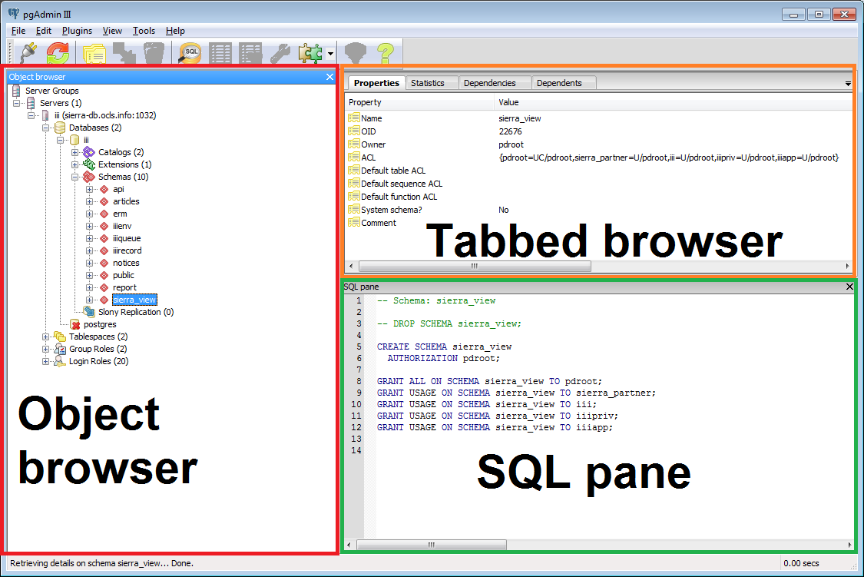
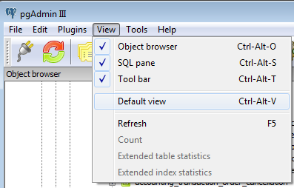
pgAdmin Main Window
Notes:
pgAdmin Main Window
Menu
Tools
Object browser
Tabbed browser
SQL pane

Slide 8
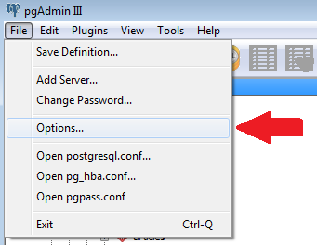
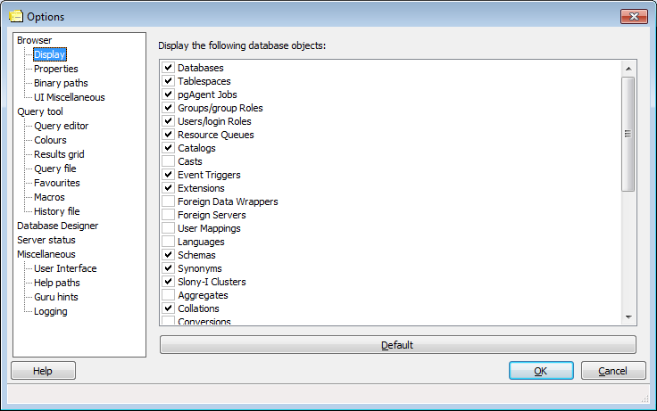
Menu >> Options
Notes:
File >> Options >>Browser

Slide 9
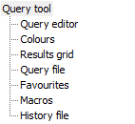
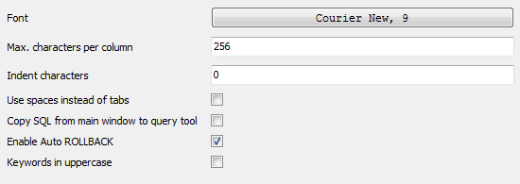
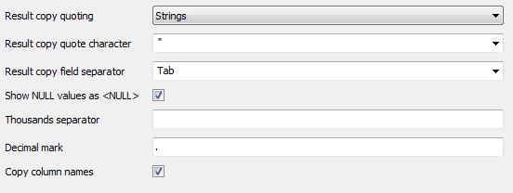
Menu >> Options >> Query tool Options
Query editor
Colours Foreground/Background, Caret, SQL Syntax Highlighting
Results grid
Notes:
File >> Options >>Query Tool>>Query editor
Font
Max characters per column - specify the max length of displayed in a column
Indent characters - specify number of characters to indent in SQL text boxes.
Use spaces instead of tabs –
Copy SQL from main window to SQL dialogue – demo
Enable Auto ROLLBACK - instruct query tool to execute a ROLLBACK if a query fails.
Keywords in uppercase – demo
File >> Options >>Query Tool>>Results grid(Output pane>>Data Output)
Result copy quoting – copy to clipboard None, Strings, All
Result copy quote character - no effect if Result copy quoting is set to None.
Result copy field separator - ; , | \t
Show NULL values as <NULL> -
Thousands separator -
Decimal mark -
Copy column names – demo
Helpful when pasting to docs; problematic when pasting single value into a form

Slide 10
Query tool Options - continued
Query file
Favorites, Macros
History File
Options >> Miscellaneous
Logging

Slide 11
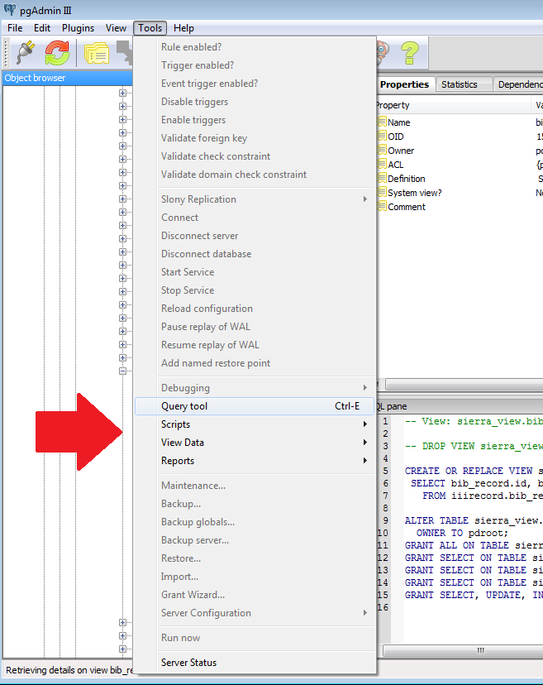
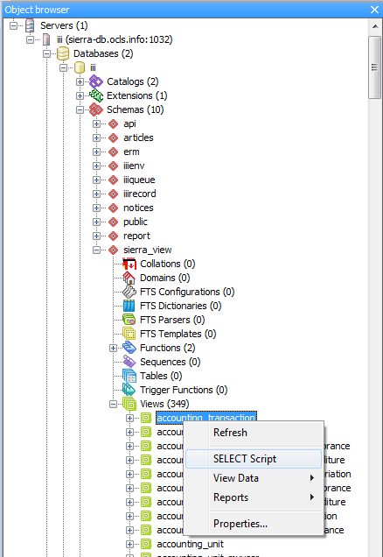
Tools
Toolbar
Menu
Object
Browser
Notes:
Many ways to get to query tools

Slide 12
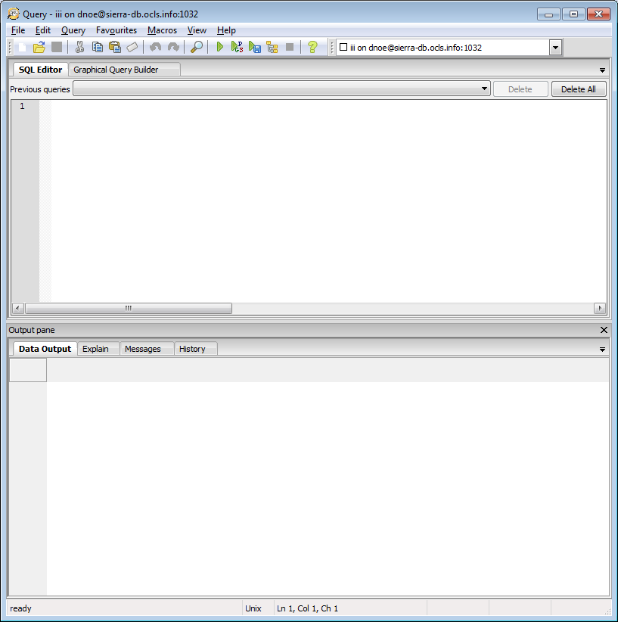
Query Tool
Menu: Tools>>Query tool
Ctrl+E
Toolbar

Slide 13
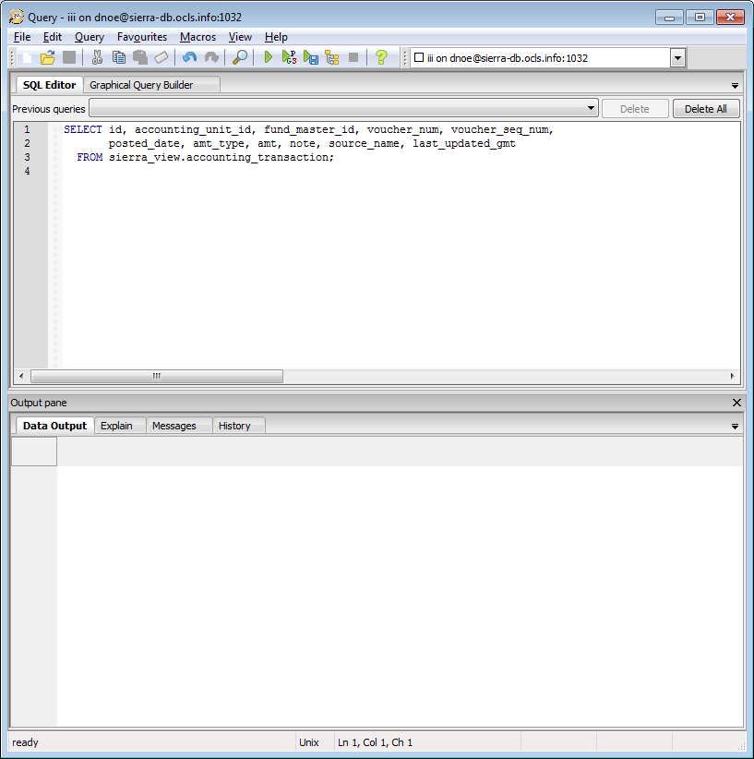
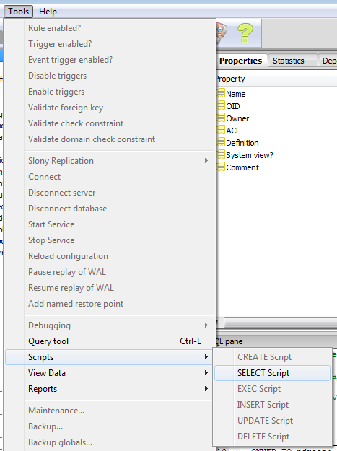
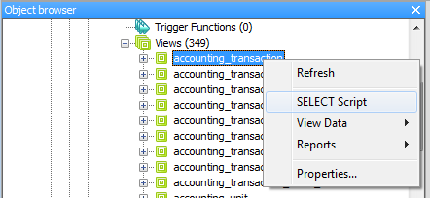
SELECT Script
Tools
Object
browser
Notes:
…and in Properties

Slide 14
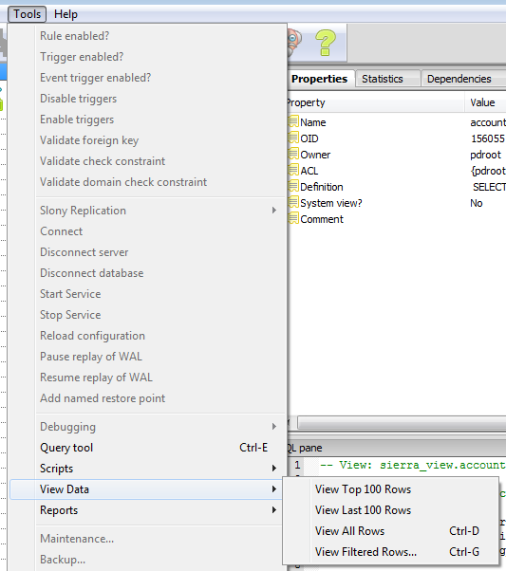
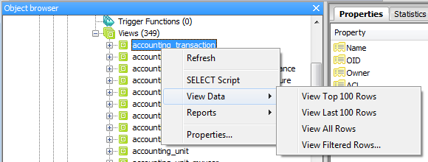
View Data/Apply Filter
Tools
Toolbar
Object
browser

Slide 15
View Data
View All Rows
View Top/Last 100 rows
Notes:
View Top/Last only seems to show top (in version I have been running) helpful for getting an idea on the fly of what’s stored in a table
Make sure to close these out when done as it takes up a connection

Slide 16
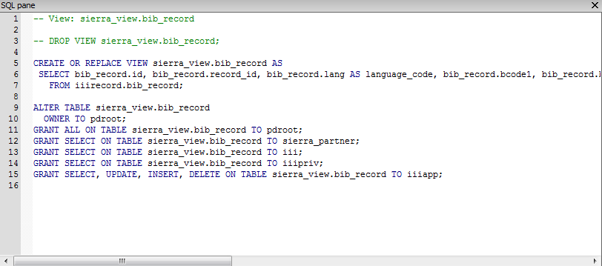
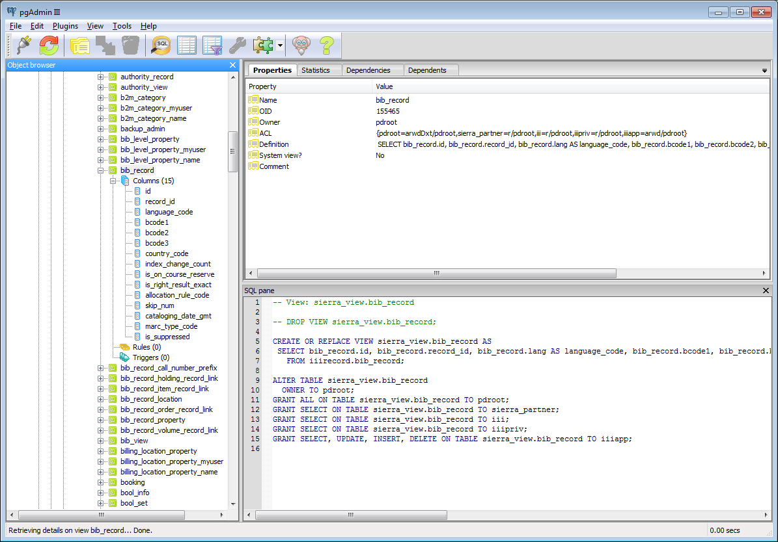
Object browser & SQL pane

Slide 17
SQL pane
“CREATE VIEW defines a view of a query. The view is not physically materialized. Instead, the query is run every time the view is referenced in a query.”
https://www.postgresql.org/docs/9.2/static/sql-createview.html
Notes:
CREATE OR REPLACE VIEW is similar, but if a view of the same name already exists, it is replaced. The new query must generate the same columns that were generated by the existing view query (that is, the same column names in the same order and with the same data types), but it may add additional columns to the end of the list. The calculations giving rise to the output columns may be completely different.

Slide 18
The Insufficient Permissions is the best band name ever.

Slide 19
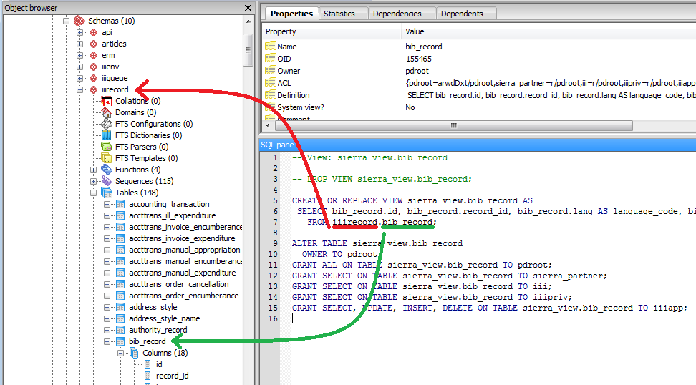
Schema.table
Notes:
After permission error, you can still read a great deal from the other schema.

Slide 20
Simple example table
iiirecord.bib_record_item_record_link
-- Table: iiirecord.bib_record_item_record_link
-- DROP TABLE iiirecord.bib_record_item_record_link;
CREATE TABLE iiirecord.bib_record_item_record_link
(
id bigint NOT NULL DEFAULT nextval('iiirecord.bib_record_item_record_link_id_seq'::regclass),
bib_record_id bigint NOT NULL,
item_record_id bigint NOT NULL,
items_display_order integer,
bibs_display_order integer,
CONSTRAINT pk_bib_record_item_record_link PRIMARY KEY (id),
CONSTRAINT fk_bib_record_item_record_link_bib_record FOREIGN KEY (bib_record_id)
REFERENCES iiirecord.bib_record (id) MATCH SIMPLE
ON UPDATE NO ACTION ON DELETE CASCADE,
CONSTRAINT fk_bib_record_item_record_link_item_record FOREIGN KEY (item_record_id)
REFERENCES iiirecord.item_record (id) MATCH SIMPLE
ON UPDATE NO ACTION ON DELETE CASCADE,
CONSTRAINT uc_bib_record_item_record_link UNIQUE (bib_record_id, item_record_id)
)
WITH (
OIDS=FALSE
);
ALTER TABLE iiirecord.bib_record_item_record_link
OWNER TO pdroot;
GRANT ALL ON TABLE iiirecord.bib_record_item_record_link TO pdroot;
GRANT SELECT ON TABLE iiirecord.bib_record_item_record_link TO iii;
GRANT SELECT ON TABLE iiirecord.bib_record_item_record_link TO iiipriv;
GRANT SELECT, UPDATE, INSERT, DELETE ON TABLE iiirecord.bib_record_item_record_link TO iiiapp;
-- Index: iiirecord.item_record_id_index
-- DROP INDEX iiirecord.item_record_id_index;
CREATE INDEX item_record_id_index
ON iiirecord.bib_record_item_record_link
USING btree
(item_record_id);
Notes:
The other schema will tell you if a column is indexed, which impact performance of views

Slide 21
More complicated views
-- View: sierra_view.circ_trans
CREATE OR REPLACE VIEW sierra_view.bib_view AS
SELECT br.id, md.record_type AS record_type_code, md.record_num, br.lang AS language_code, br.bcode1, br.bcode2, br.bcode3, br.country AS country_code, br.is_available_at_library, br.index_change_count, br.allocation_rule AS allocation_rule_code, br.is_on_course_reserve, br.is_right_result_exact, br.skip_num, br.cataloging_date AS cataloging_date_gmt, br.marc_type AS marc_type_code, brp.title, md.record_creation_date_gmt
FROM iiirecord.record_metadata md
JOIN iiirecord.bib_record br ON br.id = md.id
JOIN iiirecord.bib_record_property brp ON brp.bib_record_id = br.id
WHERE md.record_type = 'b'::bpchar AND char_length(md.campus_code::text) = 0;
ALTER TABLE sierra_view.bib_view
OWNER TO pdroot;
GRANT ALL ON TABLE sierra_view.bib_view TO pdroot;
GRANT SELECT ON TABLE sierra_view.bib_view TO sierra_partner;
GRANT SELECT ON TABLE sierra_view.bib_view TO iii;
GRANT SELECT ON TABLE sierra_view.bib_view TO iiipriv;
GRANT SELECT, UPDATE, INSERT, DELETE ON TABLE sierra_view.bib_view TO iiiapp;
Notes:
The more complicated the view, the more complicated your query by extension.

Slide 22
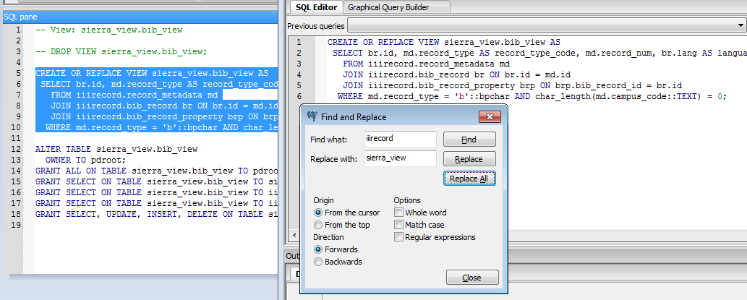
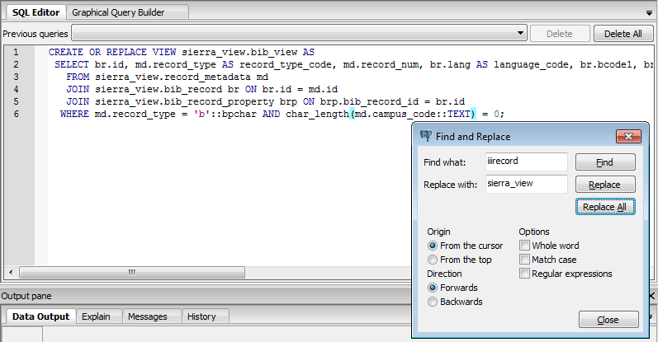
Slow to run but handy to copy
sierra_view.[record type]_view
Notes:
On the listserve I see people share queries using [record_type]_view views. Don’t. It’s slow. Join the tables you need for your self if possible.

Slide 23
CREATE INDEX
-- Index: iiirecord.bib_record_bcode3_idx
CREATE INDEX bib_record_bcode3_idx
ON iiirecord.bib_record
USING btree
(bcode3 COLLATE pg_catalog."default");
Notes:
Not everything you expect to be indexed is indexed.

Slide 24
CREATE INDEX - continued
CREATE TABLE iiirecord.varfield ...
CREATE INDEX fke4042a33309bb71e
ON iiirecord.varfield
USING btree
(field_group_id);
CREATE INDEX idx_varfield_field_type_tag_record_id
ON iiirecord.varfield
USING btree
(field_type_tag COLLATE pg_catalog."default", record_id);
CREATE INDEX idx_varfield_marc_tag
ON iiirecord.varfield
USING btree
(marc_tag COLLATE pg_catalog."default");
CREATE INDEX idx_varfield_record_id
ON iiirecord.varfield
USING btree
(record_id);
-- View: sierra_view.varfield
CREATE OR REPLACE VIEW
sierra_view.varfield AS SELECT varfield.id,
varfield.record_id,
varfield.field_type_tag AS varfield_type_code,
varfield.marc_tag, varfield.marc_ind1,
varfield.marc_ind2,
varfield.occ_num,
varfield.field_content
FROM iiirecord.varfield;

Slide 25
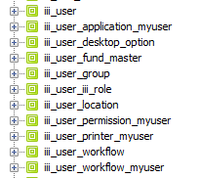
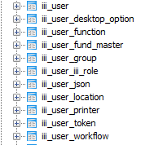
Tables not available in sierra_view
Notes:
Another problem
iii_user_desktop_option.desktop_option_id is included in the view, but the function is not named.

Slide 26
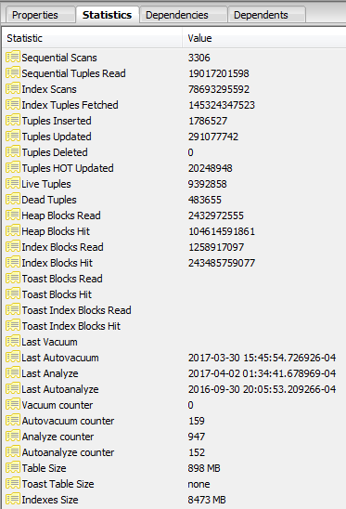
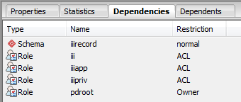
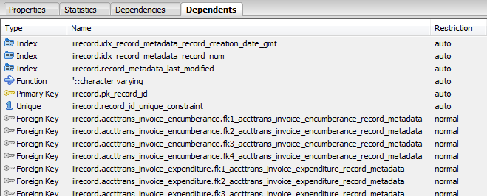
Tabbed Browser
Notes:
Not too much to learn here other than size relationships.
Much less to be gleaned in sierra_view

Slide 27
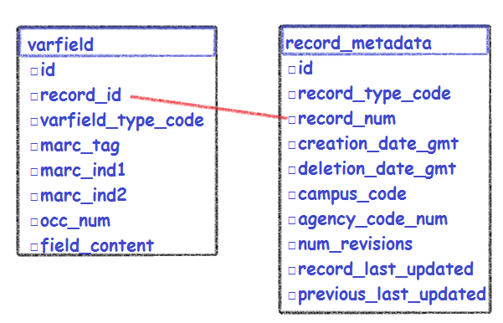
The Graphical Query Builder
So, yeah. There is a Graphical Query Builder; however, I know very little about it, so there is not much I can share with you.

Slide 28
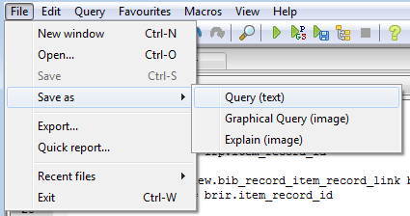
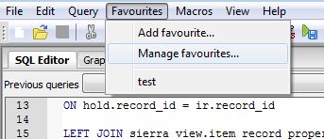
The SQL Editor Menu – saving work
The SQL Editor toolbar

Slide 29
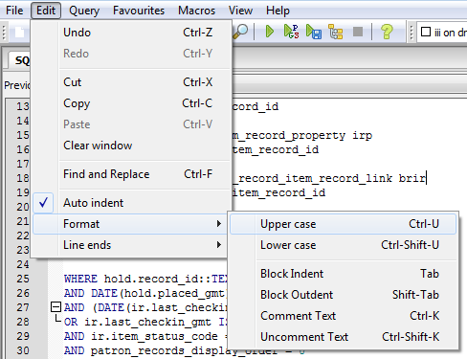
The SQL Editor Menu – editing queries
The SQL Editor toolbar
Notes:
Find and Replace
Upper/Lower Case
Block in/outdent
Comments
Line Ends

Slide 30
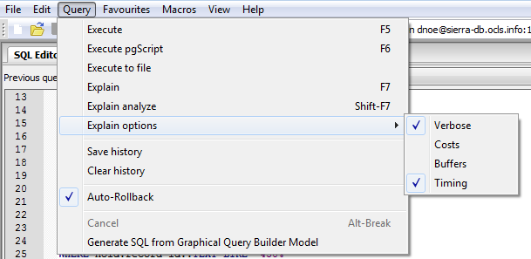
The SQL Editor Menu >> Query
The SQL Editor toolbar
Notes:
Execute
Pgscript
Execute to file
Explain
Explain analyze

Slide 31
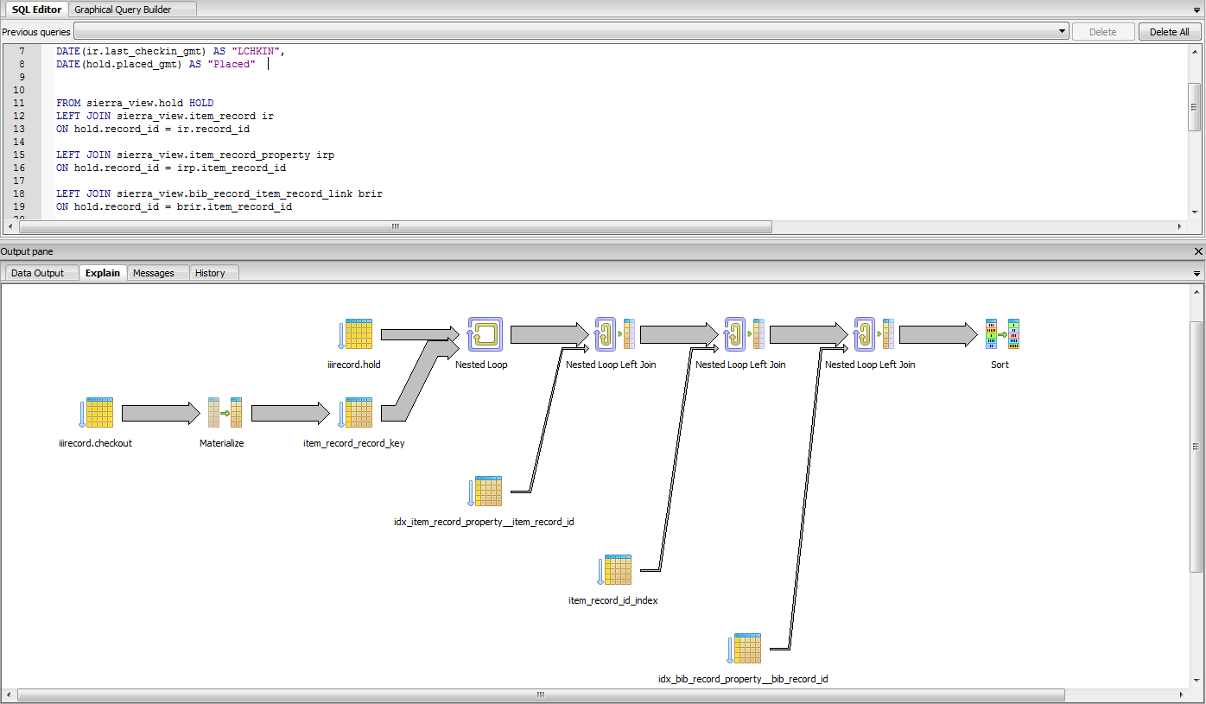
Query >> Explain analyze
Notes:
Explain and Explain Analyze are handy ways to visualize how the query is working.
Note that the thicker the line, the more expensive that process is.

Slide 32
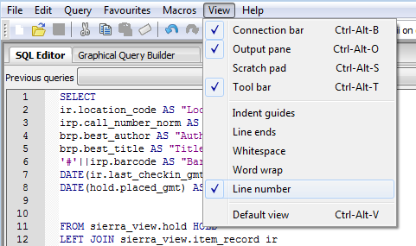
The SQL Editor Menu >> View

Slide 33
pgAdmin: Drilling Down
David Noe
ILS Specialist
Orange County Library System
Orlando, FL
noe.david@ocls.info

