Slide 2
Training Tips and Tools of the Trade
Laura Lazaraton

Slide 3
Basic Tips to Live By
Keep the training practical
When possible, use real-life examples
Allow time for practice and questions
Create thorough handouts
Create quick-reference cheat sheets and make them easily accessible
Have fun!

Slide 4
Searching the Catalog
Staff are trained on both Encore and Sierra
They must help customers learn how to use the catalog
Encore offers some things unavailable in Sierra
Sierra has the specific information often necessary to find/work with items
Searching is searching
Use the same searches so that they can compare the similarities and differences

Slide 5
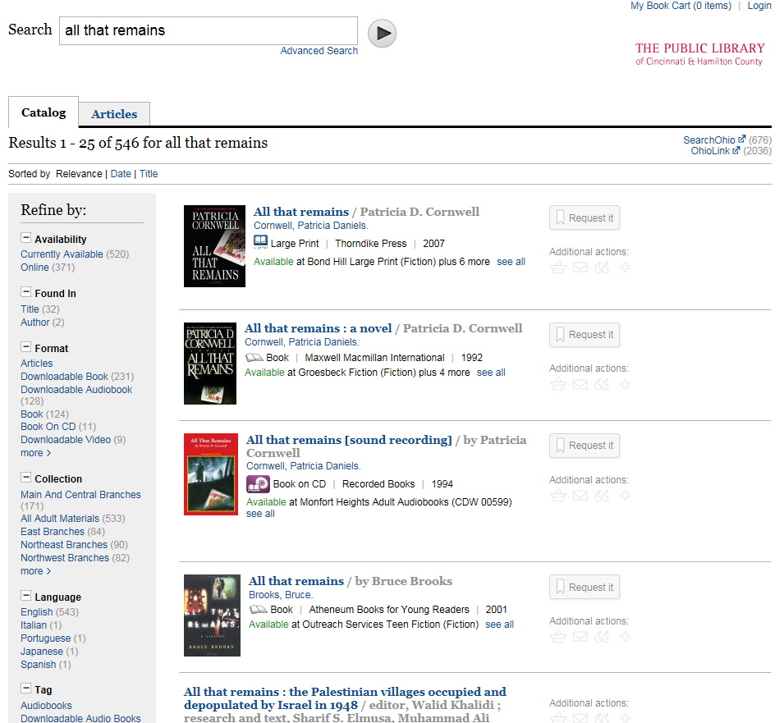

Slide 6
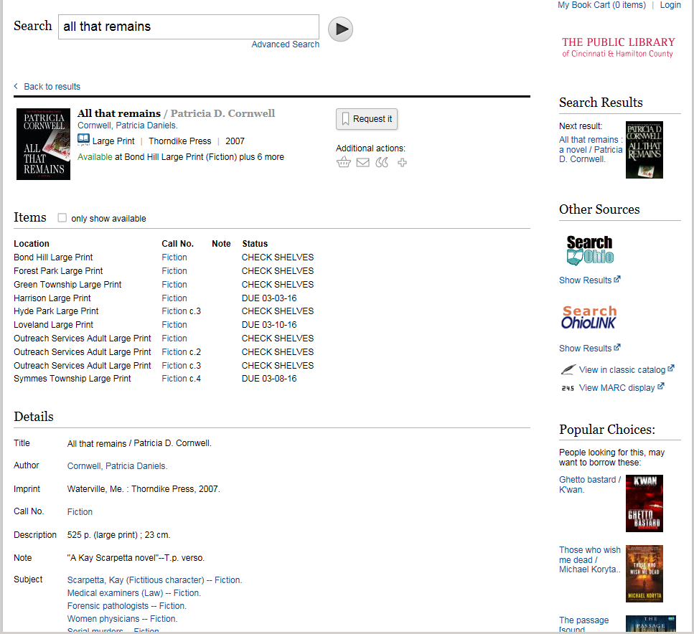

Slide 9
Circulation Guidelines
Start with an overview
Follow a logical progression
Emphasize the most important/most used functions
Mention common errors
Make suggestions to what is “safe” to practice on their own

Slide 10
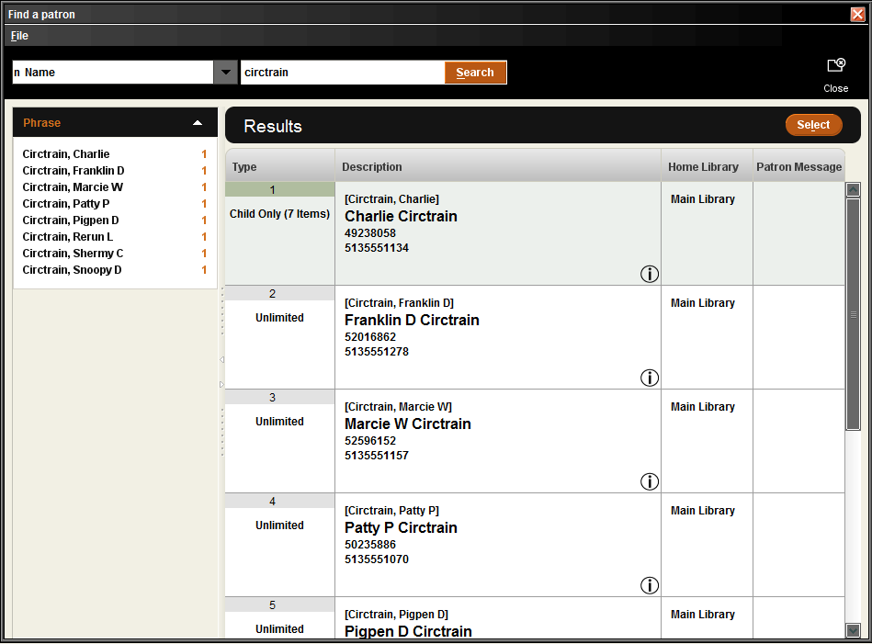

Slide 11
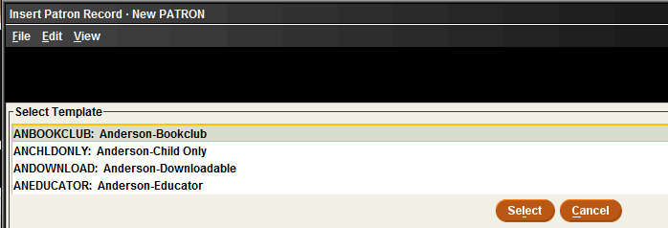
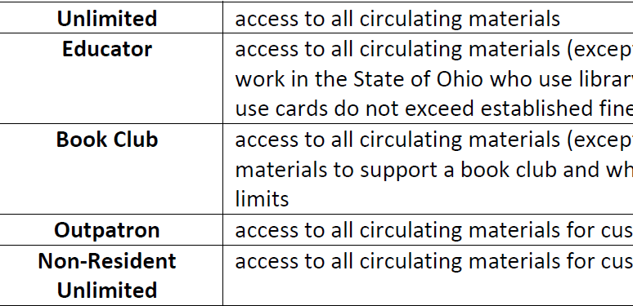

Slide 12
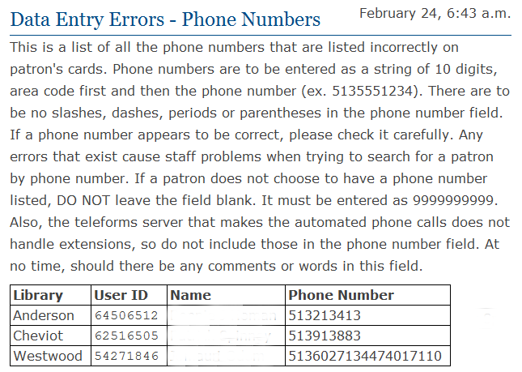

Slide 13
Serials Procedures
Very similar to teaching circulation
Start with an overview
Follow a logical progression
Display, create, check-in, modify
Mention problematic serials
Demonstrate how anything that is done immediately shows up to customers

Slide 14
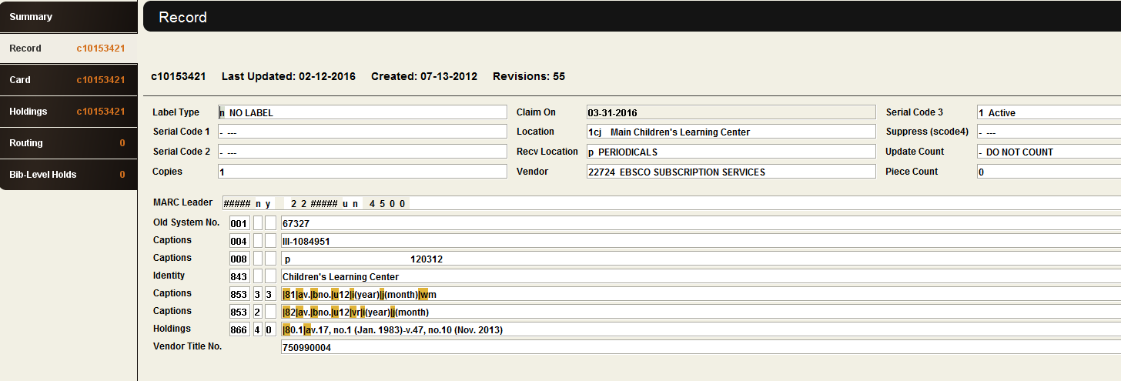

Slide 15
Handouts
Should be thorough
Step by step, when possible
Pictures and screenshots help visual learners
Use more as a resource than something to follow along with in class

Slide 16
Advanced/Refresher Classes
Advanced classes allow staff to learn the tricks of faster searching methods after they have become comfortable with the basics
Refresher classes allow staff to focus in on some of the problems they encounter, minor changes due to policy changes, and topics that may not have made sense the first time around
Both classes allow for review of original training and stressing of common mistakes/problems

Slide 17
Upgrade Training
Timing is everything
Focus on the major changes
Emphasize the improvements/advantages
Another opportunity to stress the common problems and mistakes

Slide 18
Quick Reference/Cheat Sheets
Keep them short and sweet
Can be extractions from other handouts
Create on demand/as needed
Perfect for minor changes

Slide 19
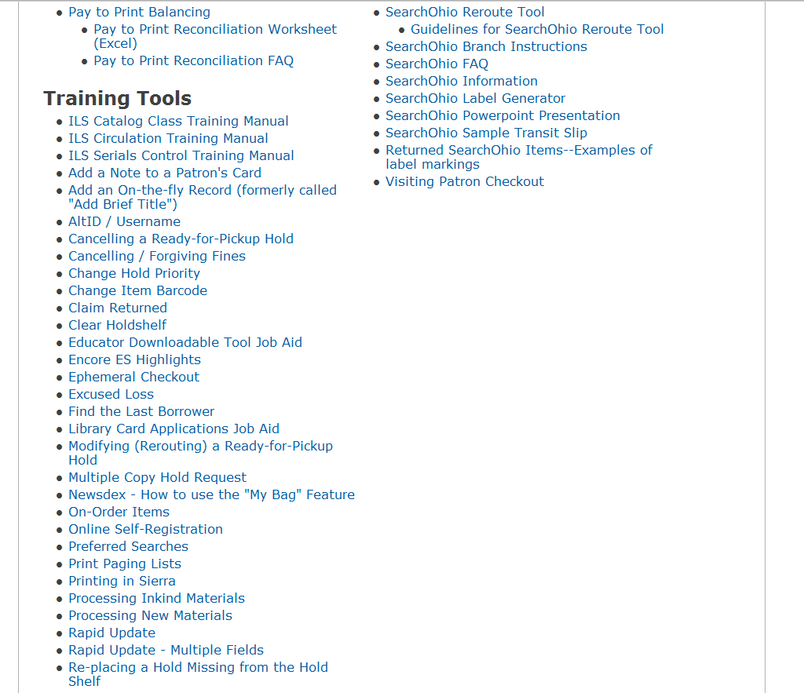

Slide 20
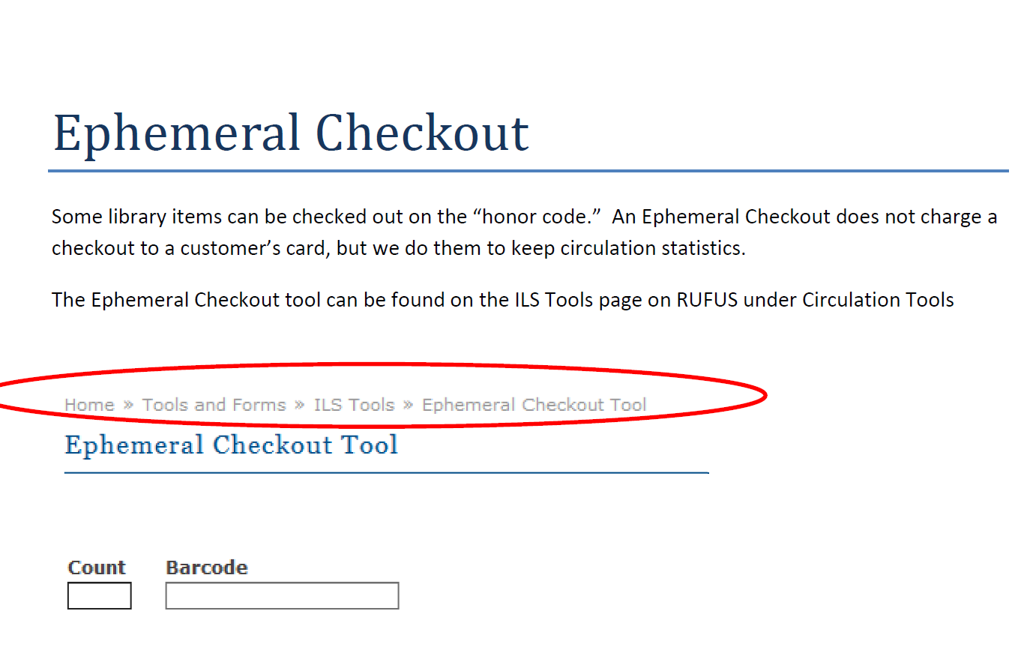

Slide 21
Competency Assessments
Staff take a catalog searching test at the end of class.
A circulation test is taken within first 90 days of employment
Passing rates were determined by administrators
Catalog
Librarians—90%
Library Assistants/Shelvers—80%
Circulation
All staff—90%
Technology core competencies were added later and are spaced through a 9 month period once employed

Slide 22
Questions?

