Slide 1
Sierra Inventory, without using Circa
Tammy Poquette, Marmot Library Network
Notes:
Marmot Library Network is a non-profit organization in Colorado that supports 35 libraries using the Sierra ILS. We support two Sierra servers. We call these servers MLN1 & MLN2. These servers are set up very differently. One example is that the MLN2 libraries never purchased Circa. For this reason, we had to come up with an alternative way to do inventory without using Circa.

Slide 2
Sierra Inventory, without using Circa
Notes:
Some of our MLN1 members are uncomfortable using Circa, so we needed to find a solution to assist them as well with inventory. In order to help our members with inventory, we use Import Records, Global Update, Rapid Update, and Create Lists. We are on Sierra 6.2 on both servers.

Slide 3
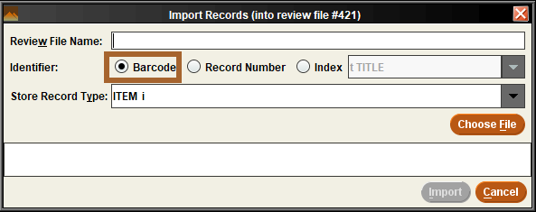
Scanning Item Barcodes
Import Records
Notes:
Libraries use Notepad to scan the barcodes of their items. They either send us the file or load it themselves. If they send the file to us, we use the Import Records Barcodes feature in Create Lists.

Slide 4
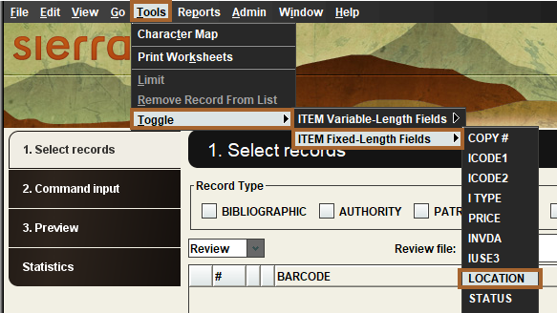
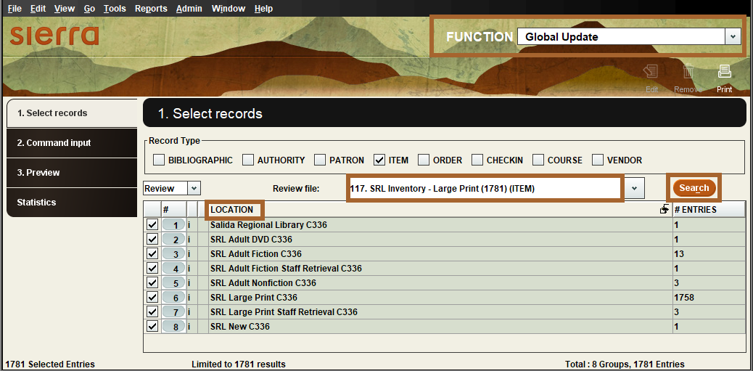
Global Update to Review Location
Notes:
The review file is viewed using Global Update to display the LOCATION.
Toggle to Location
Search the Location
Check if items need removal

Slide 5
Global Update to Remove Locations
Notes:
In the Global Update section, you can view the location of items that may not match your original settings.
You have the option to either change the location of these mismatched items or remove them from the review file entirely.
Be sure to check only the boxes for the items you want to remove, then click the Remove button.

Slide 6
Rapid Update or Global Update to Add Inventory Date
Notes:
Rapid Update to add the inventory date.
Tool
Rapid Update Options
Update Multiple Records

Slide 7
Rapid Update to Add Inventory Date
Notes:
Change Record Type to Modify from Bibliographic to Item
Search for your review file
Double-click in the box to bring up your field choices

Slide 8
Rapid Update to Add Inventory Date
Notes:
Search for the Inventory date fixed-length field (INVDA)
Click OK button

Slide 9
Rapid Update to Add Inventory Date
Notes:
This will put the Inventory date fixed-length field (INVDA) in the Field box.

Slide 10
Rapid Update to Add Inventory Date
Notes:
Double-click in the box next to Value to bring up your choices.

Slide 11
Rapid Update to Add Inventory Date
Notes:
In this case, our Value is bring up a calendar because the Inventory date field simply needs a date.
Click the OK button.

Slide 12
Rapid Update to Add Inventory Date
Notes:
Once you confirm the review file, the Field, and Value are correct, you can proceed to add the inventory date.
Click the Start button.

Slide 13
Rapid Update to Add Inventory Date
Notes:
You can see item details and the number of records being processed.
The system processes 25 records at a time.
You can always Stop the process if you see an issue.

Slide 14
Rapid Update to Add Inventory Date
Notes:
Your record processing is finished when the history number match the number of records in your review file.
You records will now have the inventory date.

Slide 15
Global Update to Verify Inventory Date
Notes:
I go back to Global Update to verify the inventory date (INVDA)
Bring up the review file.
Toggle to the INVDA
Note: if you did not purchase Circa, you may have to request to have Innovative add the Inventory date to your fixed-length fields in Global Update.

Slide 16
Global Update to Verify Inventory Date
Notes:
Once you toggle to the INVDA field, you could click the Search button.
You can view the inventory date for all the records in the review file.

Slide 17
Create Lists to Find Items Missing for Inventory
Notes:
You can create a saved search, Use Exiting Search, or use a JSON file with the terms needed to find items missing from the inventory.

Slide 18
Create Lists to Find Items Missing for Inventory
Notes:
Item Location
Inventory not within
Status equal to -
Due Date not exist
This ensures you only include items with the correct statuses.

Slide 19
Final Steps to Find Missing Items for Inventory
Notes:
I double-check the inventory date using Global Updates.
Toggle to INVDA and click the Search button.
If any searches contain empty fields, it indicates that there is no information available in those areas.

Slide 20
Final Steps to Find Missing Items for Inventory
Notes:
The library staff will use the review file to locate missing items. The inventory date will be added to any items found in this file. Items that are not located will be marked as missing and considered for replacement.

Slide 21
THANK YOU
Questions?

