Slide 1
Finding Messy Data: Create Lists and Excel
Mark Strang,
Manager, Library Information Technology Services
University Libraries
Bowling Green State University
Live Q&A, Tuesday, April 5, 2022

Slide 2
Land Acknowledgement
The region Bowling Green State University inhabits is in the Great Black Swamp and the Lower Great Lakes region. This land is the ancestral territory of the Wyandotte, Huron, Kickapoo, Erie, Miami, and Peoria. We recognize these historical and contemporary ties in our efforts to further the conversation around decolonizing history and honoring Indigenous individuals and communities who have been living and working on the land from time immemorial.
Map provided by: Native-Land

Slide 3
Terminology
The terms Create Lists, Lists, and Review Files are used interchangeably
for the function Create Lists in Sierra and Millennium

Slide 4
Agenda
BGSU unique info
BGSU Sierra information
Bibliographic & Item record suppression for INN-Reach Central Catalog
Bibliographic bcode3 use to remove records from Summon discovery layer
Review File Tools
Edit Existing Query
Saved Searches
Saved Sorts
Saved Lists
Saved Exports
Saving a Search
Applying Saved Export
! MARC Tag Query
Next & Previous record shortcuts
Exporting Records
Case Study: Examine DVDs in mmav Main A/V and mpav Browne Popular Culture Library A/V
Example Review File
Fields to export

Slide 5
Agenda
Excel Import
Excel 2016
Excel 365 Pro Plus
Text Import Wizard
Excel
Freeze Top Row
Filter Data
Count
Create a Sierra Review File from Excel

Slide 6
Agenda
Case study examples
CRC Shelf Reading List
092 Past Practices
Deleting Bibliographic Records
Regular Expressions Tips & Tricks
Finding the absence of data
Find Non repeatable field in Title 245 |b or |c
Find Title in all upper case
Find item barcodes not starting with A113
Training Resources for Create Lists
Innovative Sierra Training Website
Institutional Training Documents
YouTube Videos

Slide 7
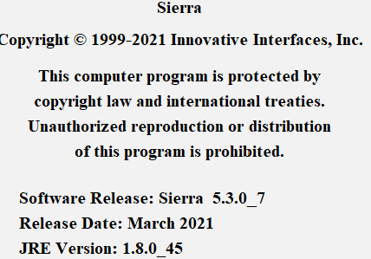
BGSU unique info
BGSU was on release Sierra 5.3.07 at the time this presentation was assembled
BGSU is hosted by Innovative with Amazon Web Services
Information covered in this presentation should be available to all with:
base Sierra implementation, no additional product from Innovative
Access to Excel 2016 or Microsoft 365 Pro Plus

Slide 8
BGSU unique info
BGSU is a founding member of the OhioLINK consortium
Library and other academic partners work collaboratively with OhioLINK - the Ohio Library and Information Network to offer the greatest breadth and depth of resources to our patrons at substantial savings to the State of Ohio. OhioLINK consists of 120+ member institutions.
OhioLINK also provides borrowing and lending to the Ohio public library network SearchOhio
SearchOhio, together with its partners, makes over 16 million items
available to the communities served by the library systems
Both consortia partners use Innovative INN-Reach module to share physical resources.
Notes:
Additionally we use I TYPE and Item Locations to block archival materials from being requested for hold shelf or by other patrons at other institutions

Slide 9
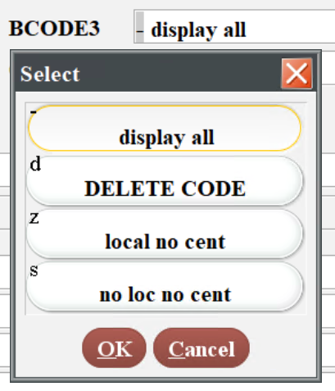
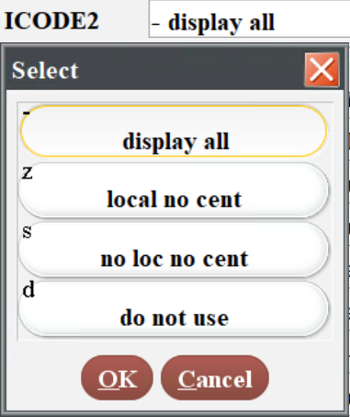
BGSU unique info
As a member of two statewide consortiums
We have bibliographic and item records we wish to contribute to central catalog
Main Stack Books; Main Stack Videos, etc.
We have bibliographic and item records we do not wish to contribute to the central catalog
Reserve Books; duplicative centrally purchase e-books, etc.
Staff are taught to use fixed fields to control this behavior and mistakes happen!
Bibliographic record: bcode3 Item record: icode2
- display all - display all
d DELETE CODE z local no central
z local no central s no local no central
s no local no central (do not display to users)
(do not display to users) d do not use
(phasing out)
Notes:
Additionally we use I TYPE and Item Locations to block archival materials from being requested for hold shelf or by other patrons at other institutions

Slide 10
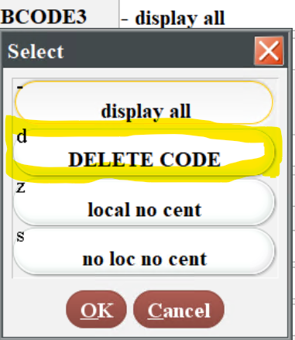
BGSU unique info
BGSU Jerome Library uses Summon as our Discovery Layer
Nightly we use Sierra scheduler to send bibliographic record updates to Summon (ProQuest)
We need to keep bibliographic records in our system after staff identify them to ensure that the delete record information is sent to discovery layer database
We achieve this with bibliographic bcode3 field:
Staff are not allowed to delete bibliographic records
Staff delete the item and all attached records, then change the bib bcode3 to d DELETE CODE
I use Delete Records to bulk delete bibliographic records after their 2-week update embargo
Use delete bib records with no attached records to ensure no accidentally deleted records
It can take a long time to cleanup records from past practices
Notes:
More on the monthly Bib record delete later in the presentation

Slide 11
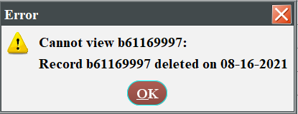
BGSU unique info
We know the system records that a record was deleted on a given date.
There is also a Sierra SQL table which is accessible with delete info.
It would be so much easier to let staff delete mistake records as they create them if we could use create lists to run a file on deleted records from the deleted on date.
Idea Lab Open Challenge
add record deleted and record deleted date as field create lists can search
https://idealab.iii.com/alwaysopen/Page/ViewIdea?ideaid=21986
Sometimes Good Ideas that get user support fail ☹ 02/17/22 email from Mike Dicus
(add record deleted and record deleted date as field create lists can search)
was closed as unsuccessful by Mike Dicus.
Reason: Create Lists is not designed to work with records that have already been deleted from the system.
The idea of working with deleted records should be re-considered in terms of workflows that could be used that do not require Create Lists functionality. This idea should be refined and can be re-submitted for further consideration.

Slide 12
Edit Existing Query
Edit Existing Query
Highlight existing review file and use Search Records button
Warning popup appears, click Edit existing query button

Slide 13
Review Files
Edit Existing Query
Popup window opens that lets you edit all the existing parameters!
Edit Existing Query is a Sierra 5.0 feature that was one of the best Idea Lab enhancements of all time!
Preserve browse query results by Jeremy Goldstein 09/12/2018
Get an account, submit your ideas, and vote during the challenges!

Slide 14
Review Files
Saved Searches
Save queries you have to repeat
I use it for my discovery layer export file!
We have our Sierra Scheduler product set up to use a saved search to export data to discovery layer
Notes:
More on the monthly Bib record delete later in the presentation

Slide 15
Review Files
We don’t use either of these but they exist:
Saved Sorts
Saved Lists

Slide 16
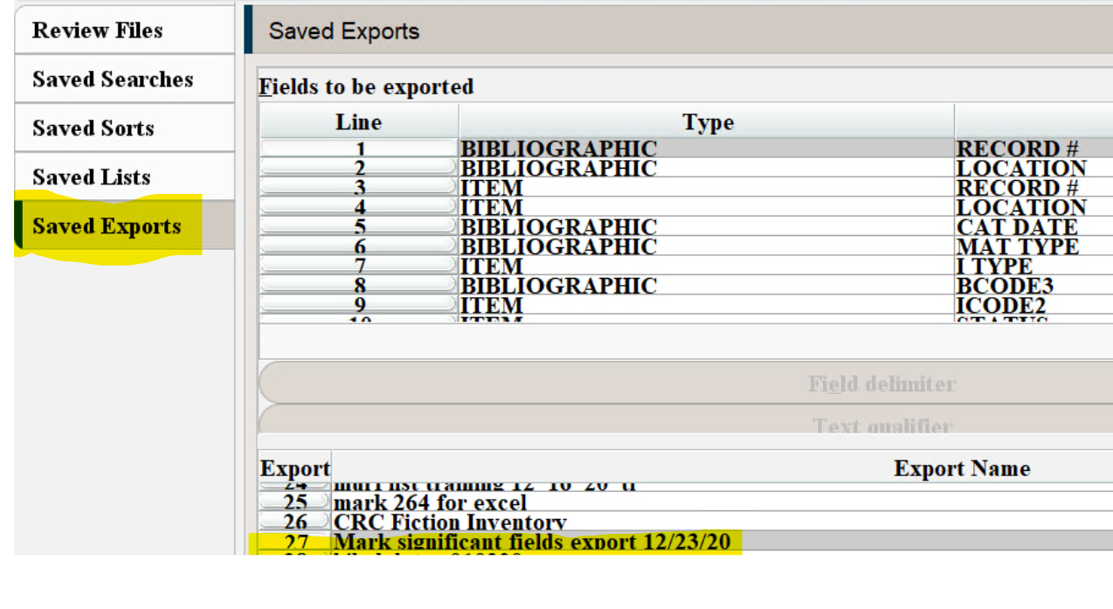
Review Files
Saved Exports
Save exports you have to repeat
Use this one extensively when it comes to exporting data into Excel!

Slide 17
Save Search
To save Seaches, Sorts, Lists, Exports
Highlight Review file and Search Records
Edit existing query

Slide 18
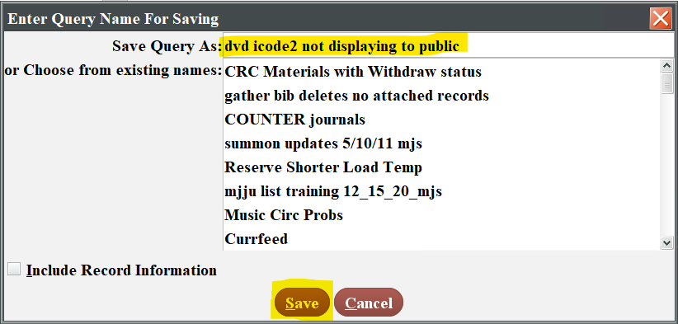
Save Search
To save a Search
In Edit existing query Save As
Name the Query and Save

Slide 19
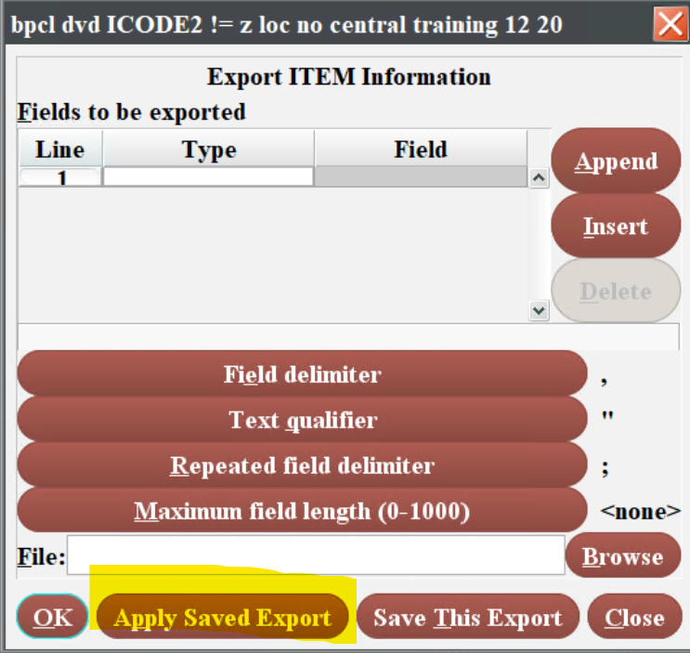
Access Saved Export
To access a saved Search, Sort, List or Export
Highlight review file and hit button for function, Export Records for example
A pop menu will appear, click on the Apply Saved Export button

Slide 20
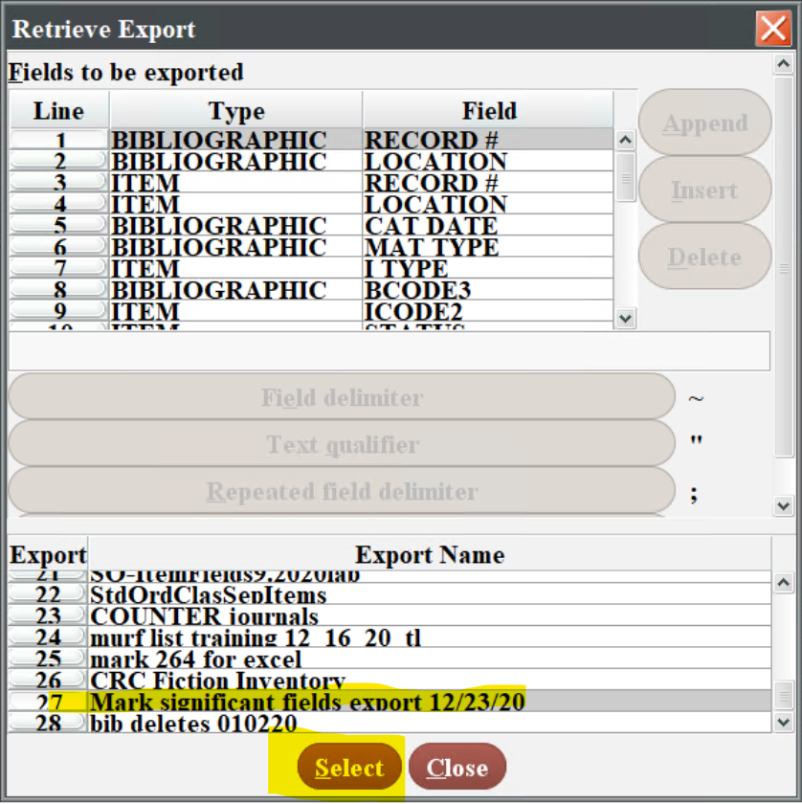
Access Saved Export
To access a saved Search, Sort, List or Export
In the Retrieve Export menu that appears highlight desired saved export, click Select, and the properties are imported!
Notes:
More on the monthly Bib record delete later in the presentation

Slide 21
! MARC Tag Query
You can find data by MARC Tag:
E-books are loaded from different providers
For remote access all URLs have our ezproxy.bgsu.edu prefix prepended
(we use 956 instead of 856 which was legacy OhioLINK programing to assist merging e-records)
Catalog - BGSU University Libraries
Racism in American Public Life by Johnetta B. Cole
ISBN: 9780813945637|qelectronic book Bib Record #: b65166334
Notes:
Identify the marc field to search and the subfield info:
956 indicators 40 subfield u

Slide 22
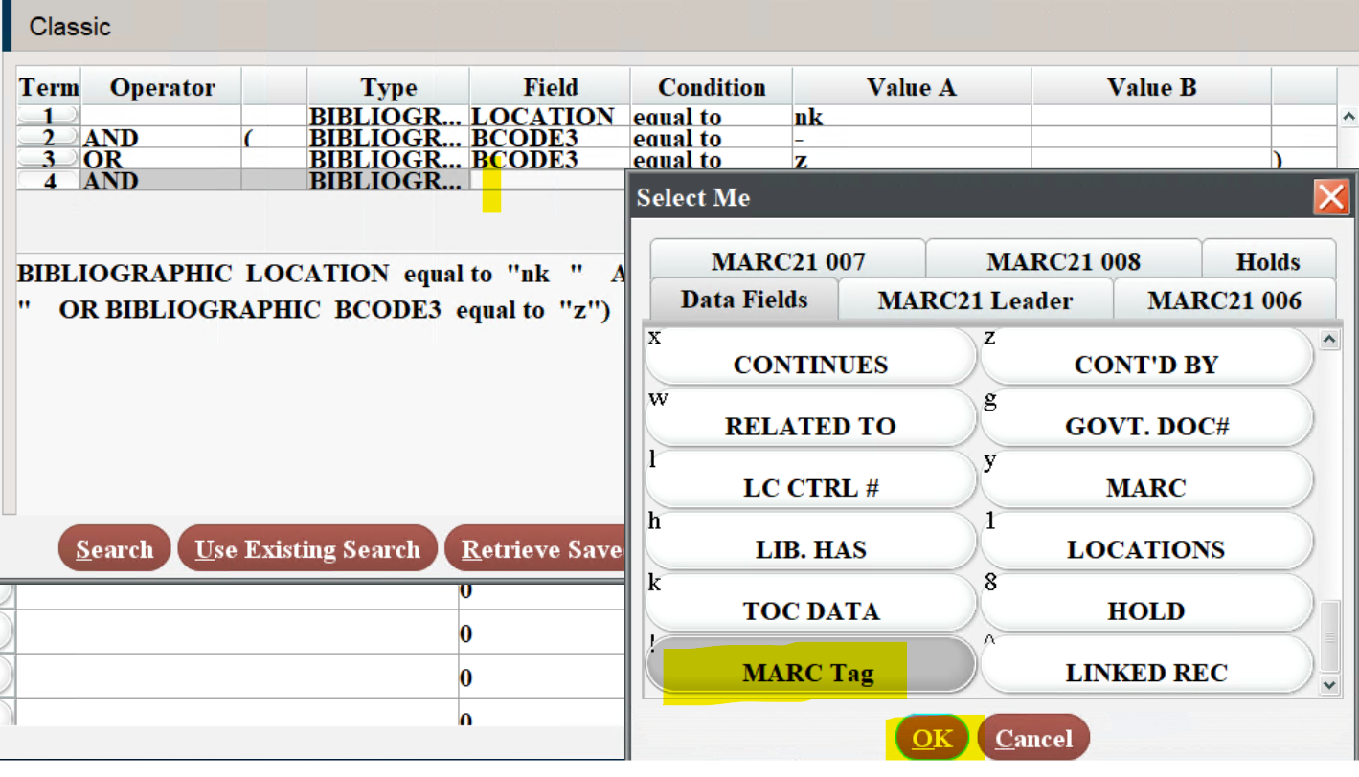
! MARC Tag Query
Find data by MARC Tag
Set Review File conditions:
Select field MARC Tag
Notes:
Bib Location: nk is what we use for internet resources
Bib bcode3 - and bcode3 z ensure that we get only resources currently available to the public

Slide 23
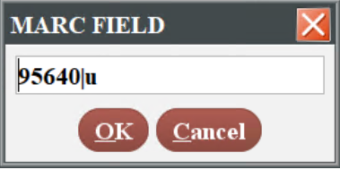
! MARC Tag Query
The MARC FIELD menu appears
Enter the field you want to search on: 95640|u
Click the OK button
Condition: has; Value: ezproxy.bgsu.edu
Notes:
If you want to find the absence of data in a string your pretty much out of luck. The “All Fields don’t have” and the “At Least one Field doesn’t have” don’t work very well.

Slide 24
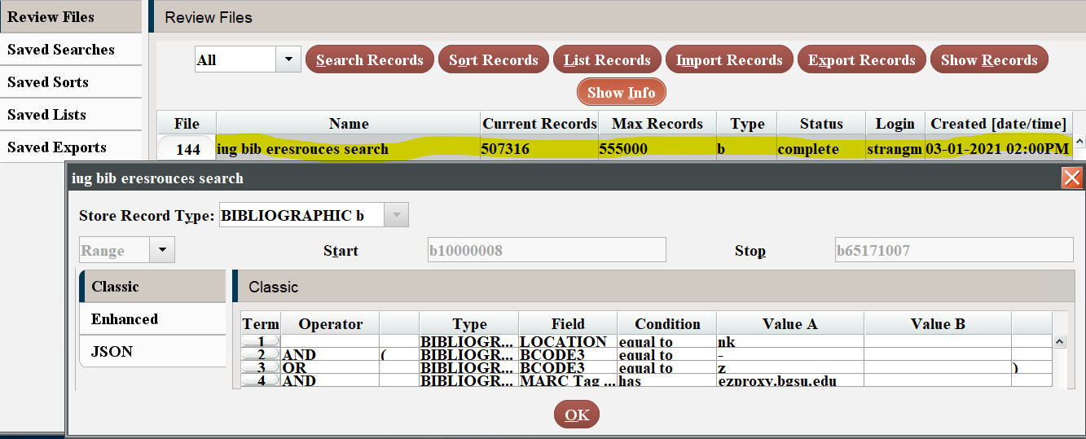
! MARC Tag Query
As of 3/1/21 BGSU has 507,316 electronic resource bib records with 956|u having ezproxy.bgsu.edu
BGSU loads most of our URLs from the Ex Libris/Summon 360 Knowledge Base
where we select e-resources for our discovery system holdings
Notes:
If you want to find the absence of data in a string your pretty much out of luck. The “All Fields don’t have” and the “At Least one Field doesn’t have” don’t work very well.

Slide 25
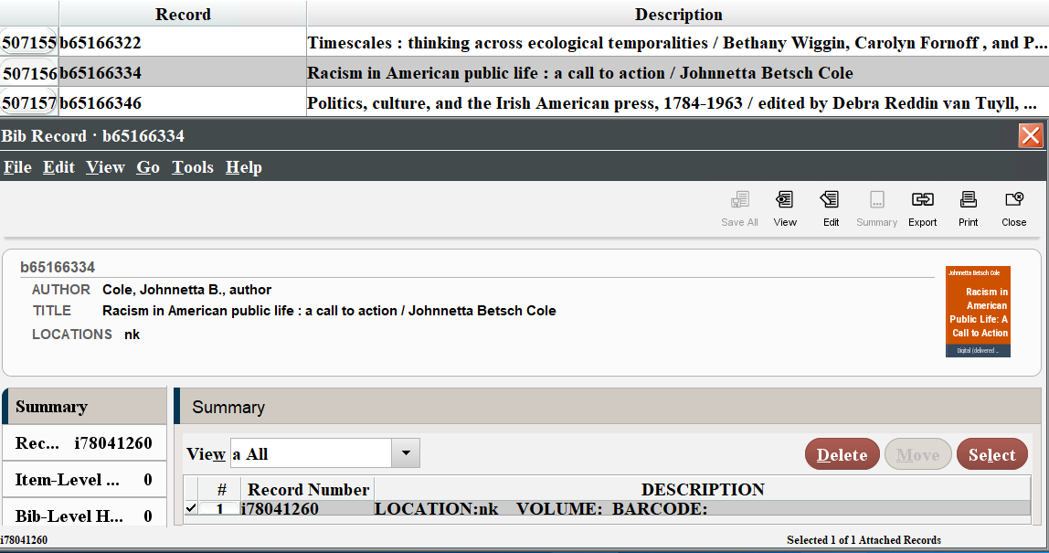
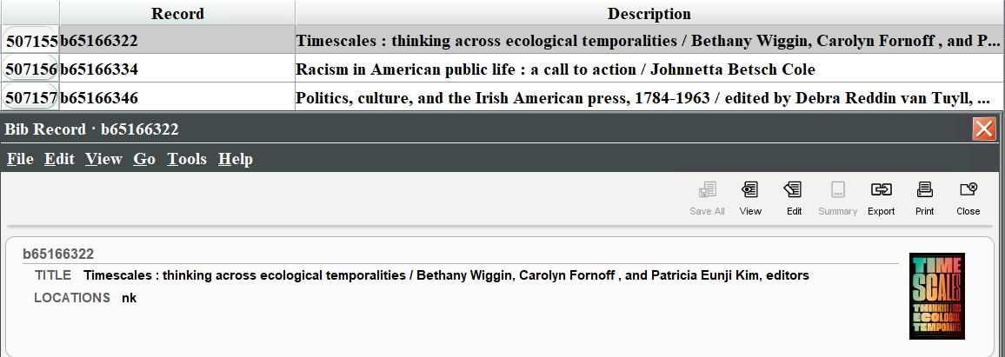
Review File: Previous record shortcut
Ctrl-] advances to the previous record up in review file

Slide 26
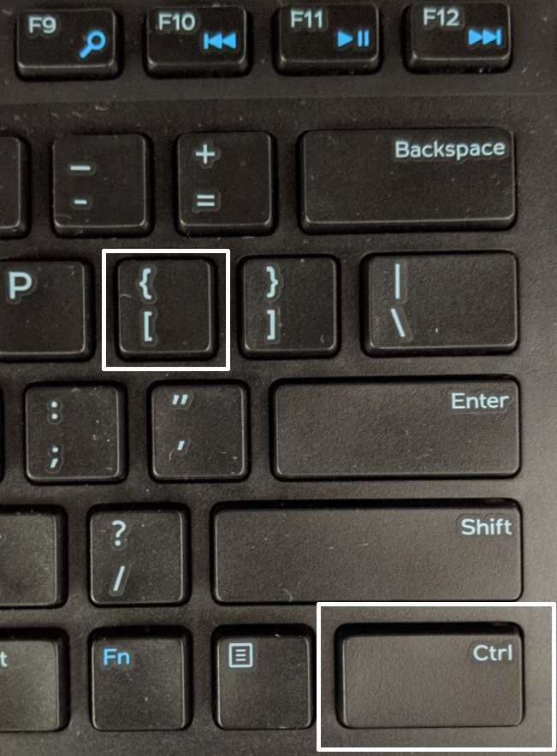
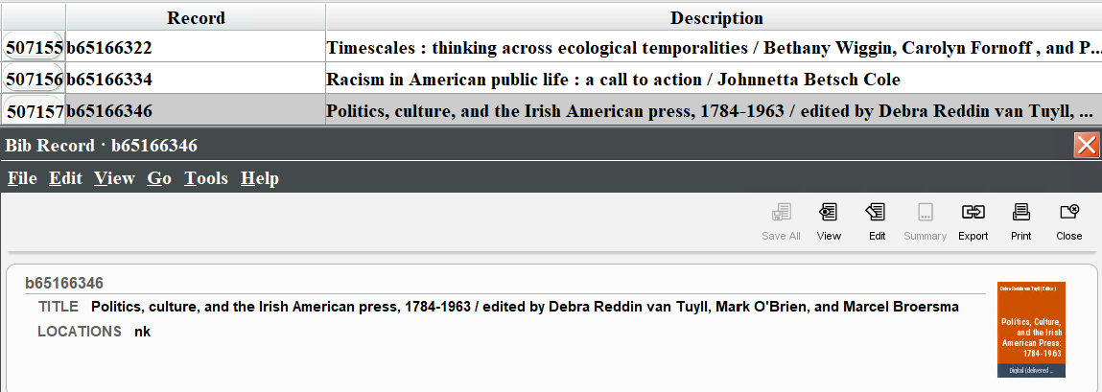
Review File: Next record shortcut
Ctrl-[ advances to the next record down in review file

Slide 27
Exporting Records
Case study: check DVDs in mmav Main A/V and mpav Brown Popular Culture Library
Review File: Item
Type: ITEM, Field: LOCATION, Condition: equal to, Value: mpav
OR Type: ITEM, Field: LOCATION, Condition: equal to, Value: mmav
Highlight Review File
Click Export Records

Slide 28
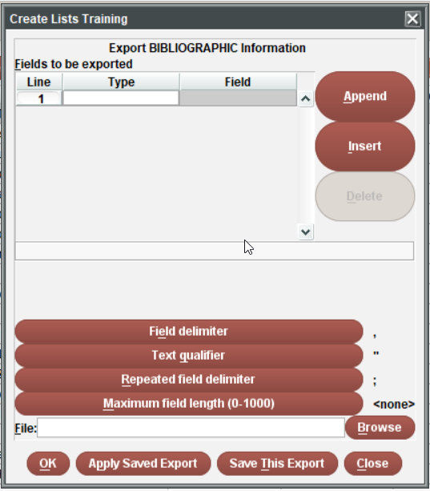
Exporting Records
“Fields to be exported” table
Enter Types and Fields to be exported to a CSV file
Double-click in the Type cell and choose a record type from the pop-up window.
Double-click in the Field cell and choose a field from the pop-up window.
Choose the Append button to add another field to be listed. Alternatively, choose the Insert button to add a field before the selected field
An almost unlimited number of fields may be selected
The fields will be listed in the order in which they appear in the
“Fields to be exported” table.
I prefer to export more fields rather than less so I can hide, sort, and filter in Excel. More data makes it easier to find outlier data that needs to be fixed.
(Exceptionally large review files, such as 50,000+ records with a lot of fields can take a while to download.)
I always include the item record # or bib record # in the fields I export so I can import the data back in

Slide 29
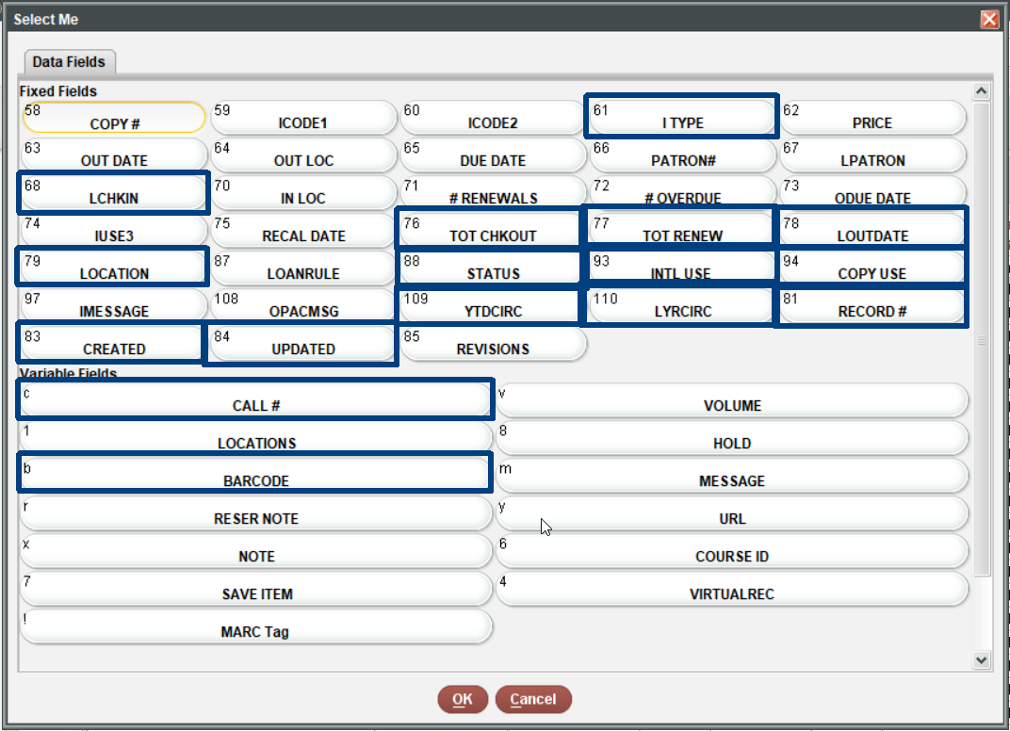
Exporting Records: Fields to export
Item record fields I find useful:

Slide 30
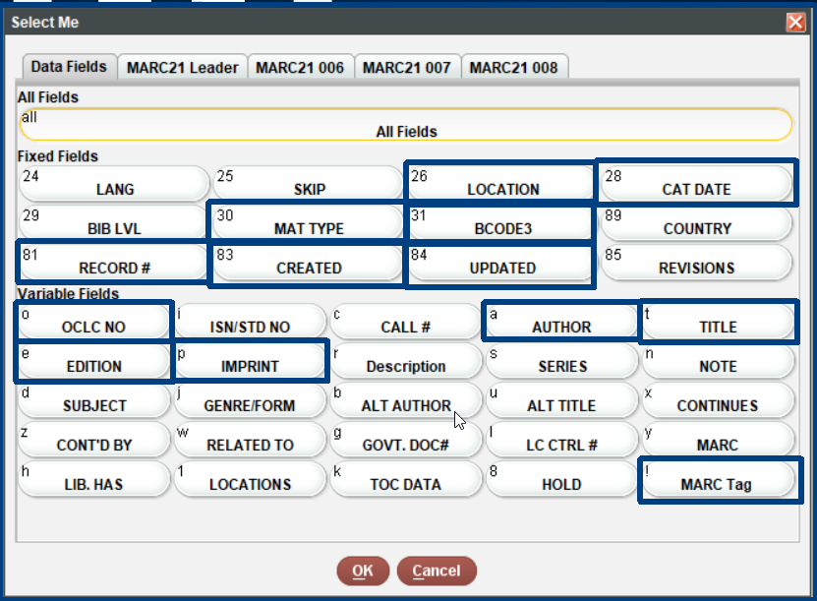
Exporting Records: Fields to export
Bibliographic record fields I find useful:
Notes:
The Imprint is a very useful field but not perfect way to get the copyright year of the monograph

Slide 31
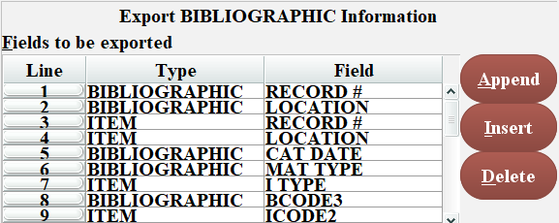
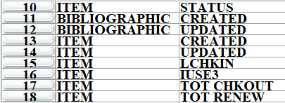
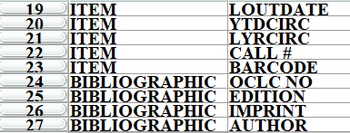
Exporting Records: Fields to export
Notes:
The Imprint is a very useful field but not perfect way to get the copyright year of the monograph

Slide 32
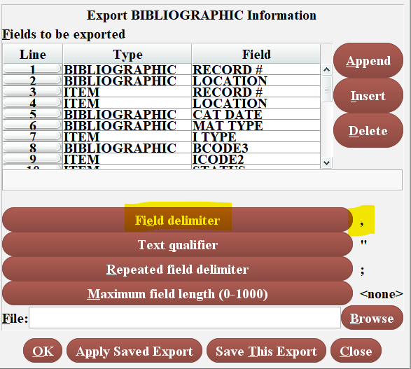
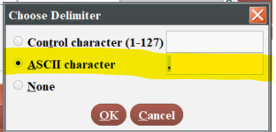
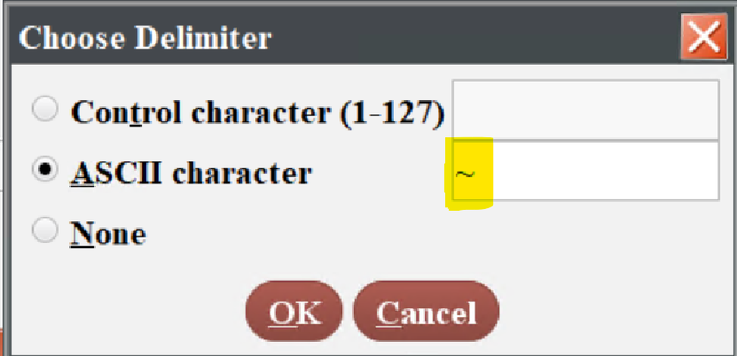
Exporting Records: Delimiter
Field delimiter: Standard delimiter for a CSV file is a “,” comma
Since a comma is frequently used in Titles I change my delimiter to:
“~” tilde which is rarely used in a title or elsewhere
“@” at-sign is another delimiter I sometime use
Click Field delimiter button and the Choose Delimiter popup appears
In the ASCII character box, use the keyboard to
enter the character "~" tilde

Slide 33
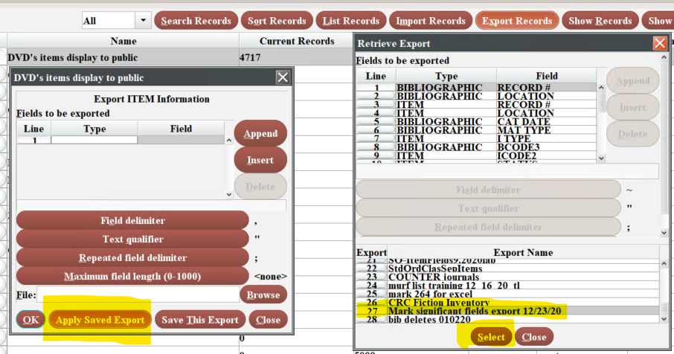
Exporting Records: Saved Export
Use the Apply Saved Export button
Select the "Mark significant fields export 12/23/20" row
Use the Select button
Notes:
I usually put the Title field last since it is generally the longest in my experience

Slide 34
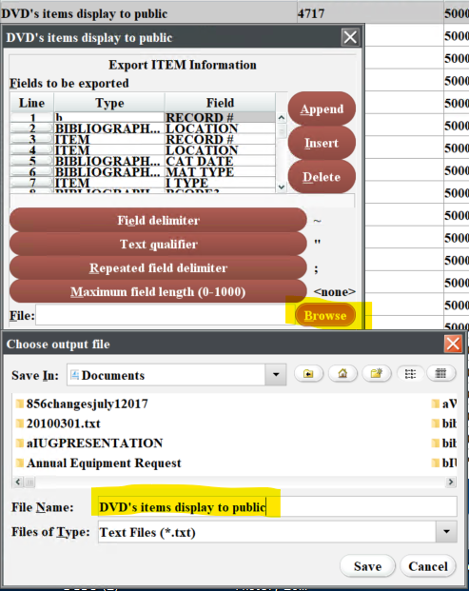
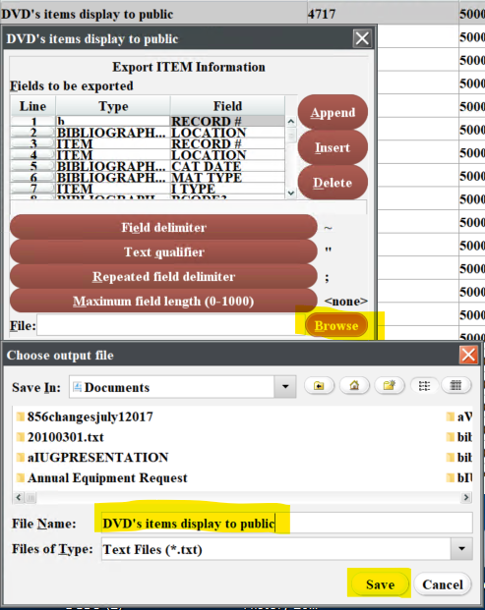
Exporting Records
Use the Browse button to choose file name and directory and then click Save

Slide 35
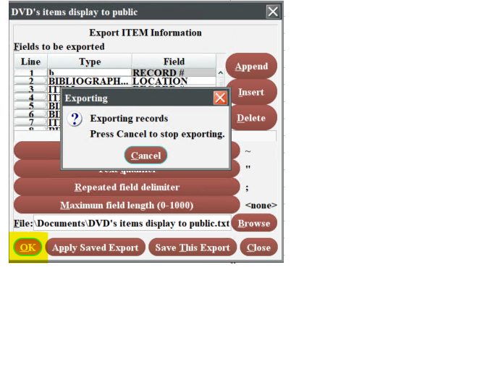
Exporting Records
Click the OK button, you will see the Exporting popup until the export is finished
The Exporting popup with the Cancel option will disappear when the export is completed

Slide 36
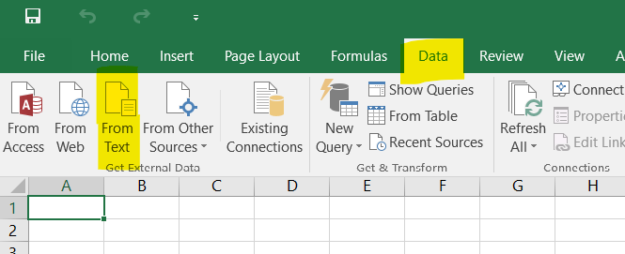
Excel Import: Excel 2016
Excel 2016
Put cursor in cell A1
Choose the Data from the ribbon row
Chllse From Text
I
If using Excel 365 Pro Plus advance two slides

Slide 37
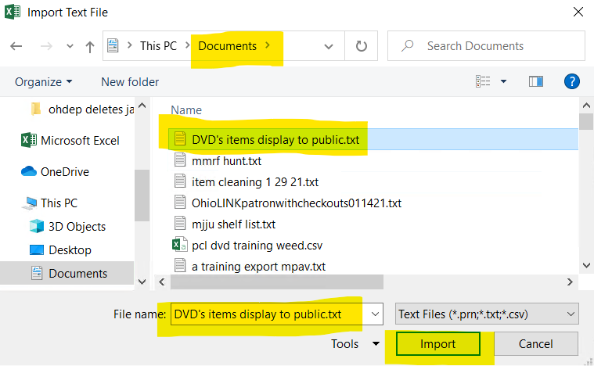
Excel Import: Excel 2016
Import Text File popup
Go to directory where you exported from Sierra
Highlight the file name and then use the Import button
Excell2016 users skip 4 slides and go to Text Import Wizzard

Slide 38
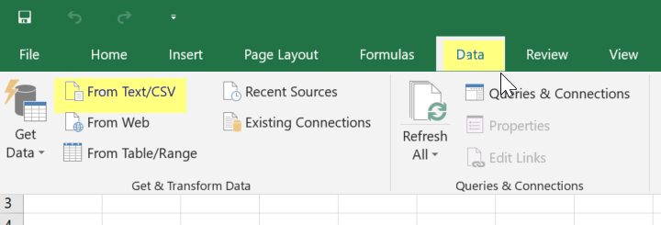
Excel Import: Microsoft Office 365 Pro Plus
Click on the Data ribbon
Choose the From Text/CSV button
If using Excel 2016 advance 4 slides

Slide 39
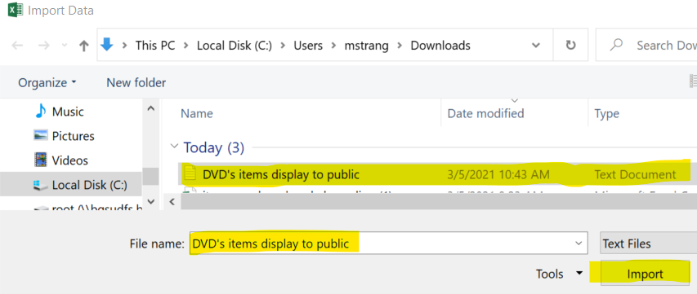
Excel Import: Microsoft Office 365 Pro Plus
Go to the directory where you saved the CSV
Highlight the file name
Use the Import button

Slide 40
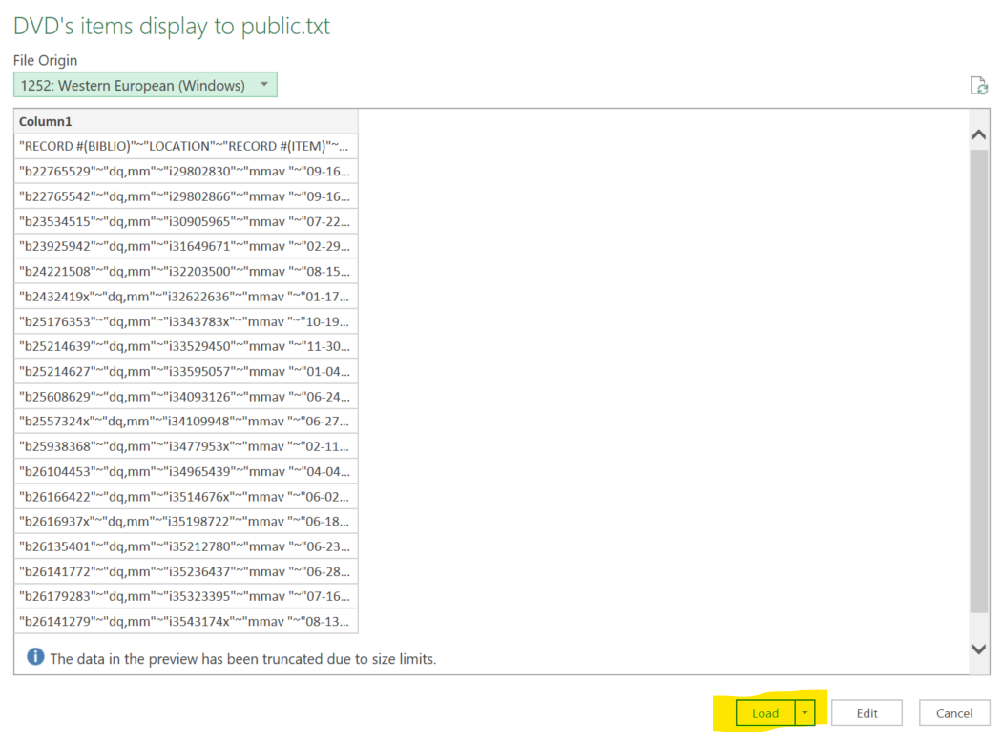
Excel Import: Microsoft Office 365 Pro Plus
You have to load the data into a single column first and then clean it up ☹

Slide 41
Excel Import: Microsoft Office 365 Pro Plus
Data Imports into a single column if you use any delimeter but "," for your CSV file
Under the Data ribbon click the “Text to Columns” button
Convert Text to Columns Wizard will appear
(this has the same appearance and functionality as Text Import Wizard in the next slides)

Slide 42
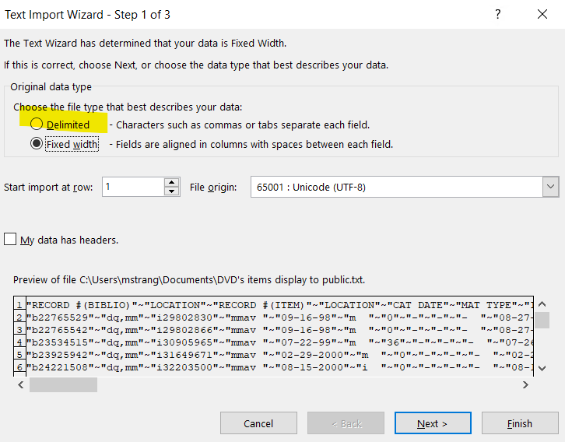
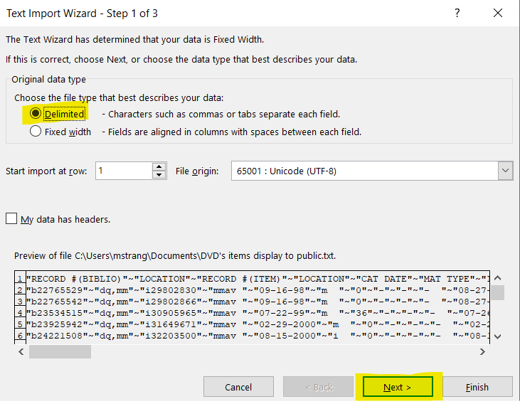
Excel Import: Text Import Wizard
Text Import Wizard – Step 1 of 3 popup
Change from “Fixed width”
Click on the "Delimited" option
Click Next

Slide 43
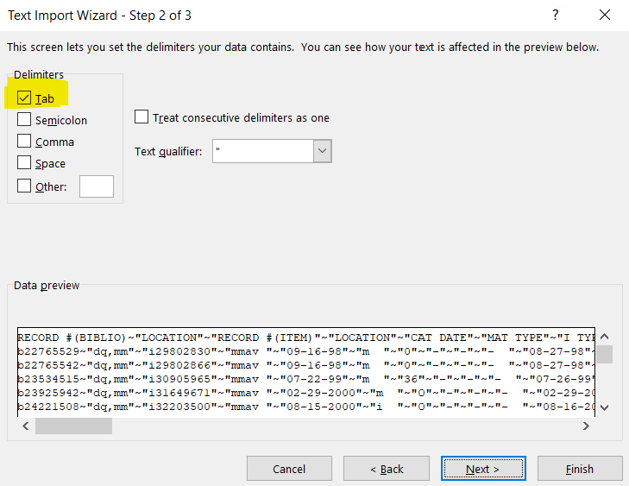
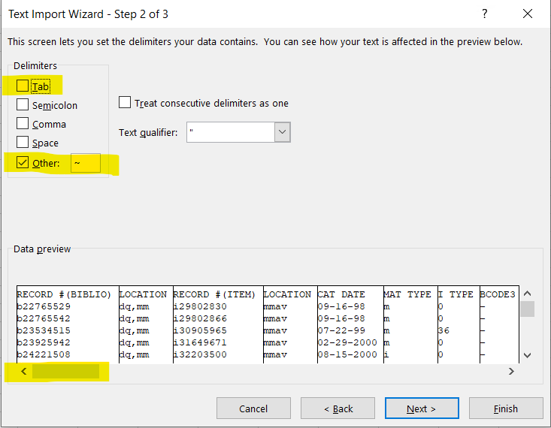
Excel Import: Text Import Wizard
Text Import Wizard – Step 2 of 3 popup
Uncheck the “Tab” box
Click “Other”
Enter tilde “~”
Use the scrollbar to see how your data lines up, title is at the end

Slide 44
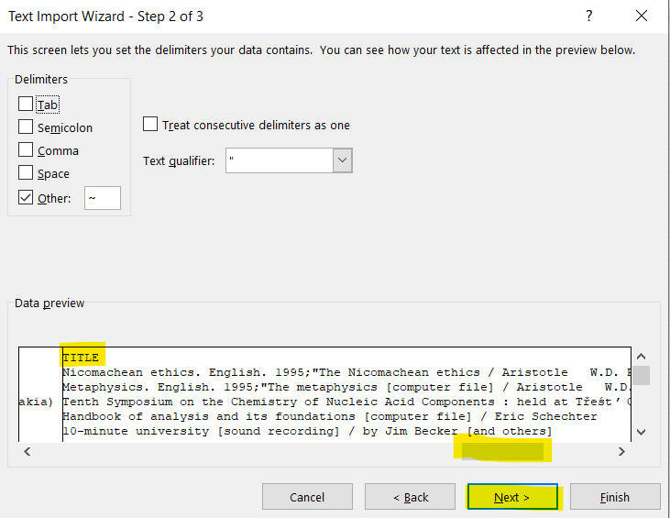
Excel Import: Text Import Wizard
Text Import Wizard – Step 2 of 3 popup
Use the scrollbar to see how your data lines up, title is at the end
Click Next

Slide 45
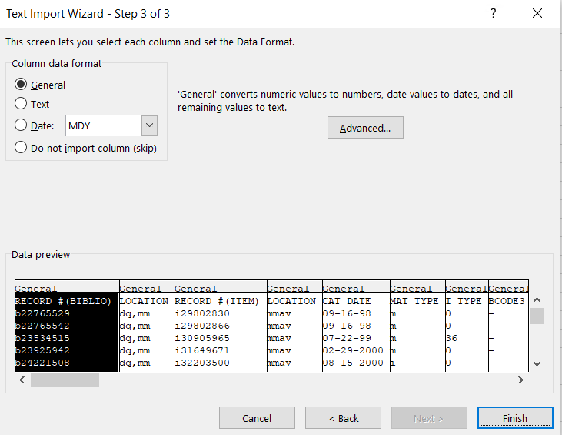
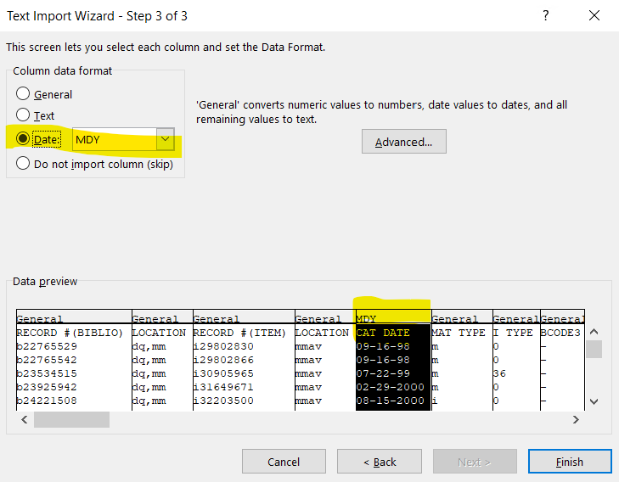
Excel Import: Text Import Wizard
Text Import Wizard – Step 3 of 3 popup
Change date columns from General to Date
Change columns with leading 0s to Text (no example in data set)
Highlight the CAT DATE column
Click the Date option
Click on Finish

Slide 46
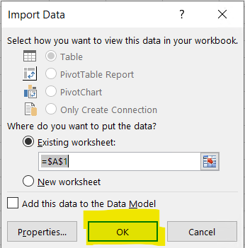
Excel Import: Text Import Wizard
Import Data popup
Ensure it will import into cell A1 with first line
Click OK

Slide 47
Excel Import
Example of columns created

Slide 48
Excel: Freeze Top Row
Highlight row 1
Choose the “View” ribbon across the top of Excel
Under the Window section choose “Freeze Panes”
Choose “Freeze Top Row”

Slide 49
Excel: Filter Data
Highlight row 1
Choose the “Home” ribbon across the top of Excel
Under the Window section choose “Sort & Filter”
Choose “Filter”
Down carrots will appear next to each column title

Slide 50
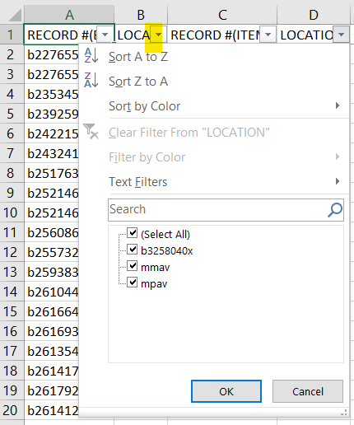
Excel: Filter Data
Click down arrow in the location column
(we know this is item location from where we put that field in the Sierra export menu)
The filter choices are:
Select All
b3258040x
mmav Main Stacks A/V
mpav Popular Culture Library A/V
Unclick all boxes except b3258040x
so we can see what is up with that data

Slide 51
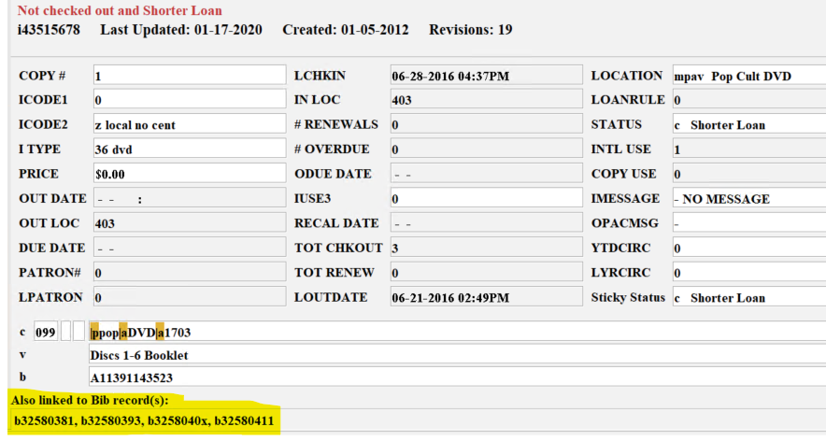
Excel: Filter Data
The result is 3 bibliographic records numbers and then the item record number under created.
Let's look it up in Sierra SDA Catalog Function:
The data is OK because we see the item is linked to 3 bibliographic records which is an acceptable local practice.

Slide 52
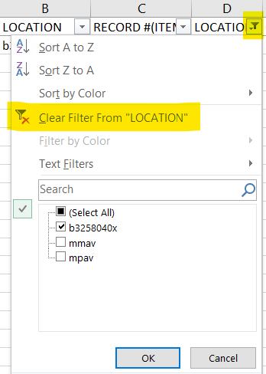
Excel: Filter Data
Remove filters by:
1) Click on filter and then use Clear Filter from “LOCATION”
2) Check and uncheck the (Select All) box
3) Choose the “Home” ribbon across the top of Excel Choose “Sort & Filter”
Click “Clear”

Slide 53
Excel: Count
To get a count of how many records apply to a given filter:
Add new row above row 1
Type the formula: =(SUBTOTAL(3,C3:C4719)
3 means COUNTA
C3 means reference 1 and is the first row of data that you want counted
C4719 means reference 2 and is the last row of spreadsheet

Slide 54
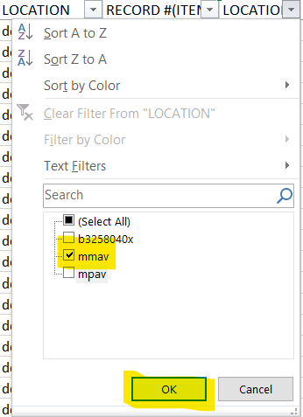
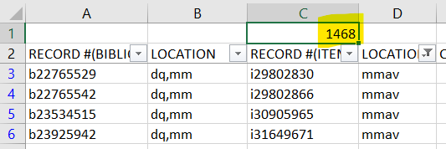
Excel: Count
Now filter by location mmav to find out how many DVDs are in the Main Stacks collection
Answer is 1,468

Slide 55
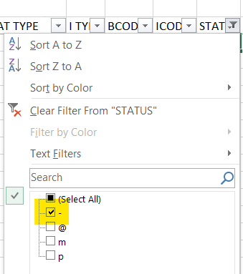
Excel: Count
Now filter by location mmav to find out how many DVDs are in the main stacks collection
To find out how many are currently available for checkout: In addition to the location filter add a STATUS filter of - “available”
With 2 filters we have 1,434 items available to the public

Slide 56
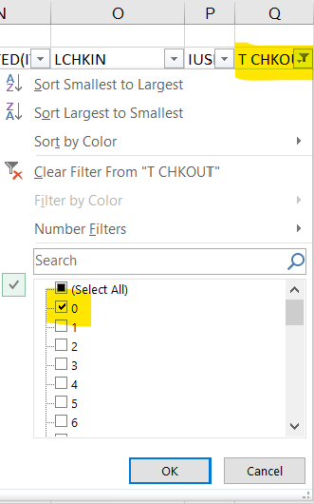
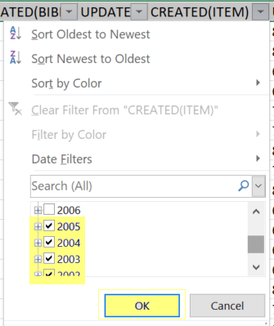
Create a Sierra Review File from Excel
Case study: Weed DVDs with 0 checkouts added before 2006
Excel filter Excel filter
Column Q - T CHKOUT Column K - CREATED(ITEM)
Select 0 Select years 2005 and before
Notes:
This particular task I’d normally just do in Sierra but using as a demo for moving data back into Review Files

Slide 57
Create a Sierra Review File from Excel
16 items exist with the filters of CREATED(ITEM) before 2005 and T CHECKOUT = 0
Notes:
This particular task I’d normally just do in Sierra but using as a demo for moving data back into Review Files

Slide 58
Create a Sierra Review File from Excel
Highlight the item record numbers from column C
Notes:
This particular task I’d normally just do in Sierra but using as a demo for moving data back into Review Files

Slide 59
Create a Sierra Review File from Excel
Paste the 24 item record numbers into column A in a new spreadsheet
In Excel, Save As to choose a name and directory to save the file
Save as type: CSV (Comma Delimited) (*.csv)
Notes:
This particular task I’d normally just do in Sierra but using as a demo for moving data back into Review Files

Slide 60
Create a Sierra Review File from Excel
Sierra: Create Lists; Highlight Review File; Import Records
Name Review File: DVD to weed
Store Record Type: ITEM i
Click Choose File
Select file:
Go to where you saved file
Highlight the .csv file
Click Load
Notes:
This particular task I’d normally just do in Sierra but using as a demo for moving data back into Review Files

Slide 61
Create a Sierra Review File from Excel
Import Records (into review file #1):
The item record numbers to be imported are listed
Click the Import button
You now have a Review File of the records from Excel
Modify records with Global Update as needed

Slide 62
Case Study: Shelf Reading List
Case Study: Curriculum Resource Center wants a shelf list of item holdings
Going to have student employee’s do an inventory of juvenile materials
Item Record List;
Type: Item; Field: LOCATION; Condition: equal to; Value A: mjju Juv Literature
AND Type: ITEM; Field: ICODE2: equal to; Value – Display All
OR Type: ITEM; Field: ICODE2: equal to; Value z local no central

Slide 63
Case Study: CRC Shelf Reading List
We have 32,314 items displayed to public as on-the-shelf in CRC juv literature
Next Sort Records by CALL #
Excel is not very good at sorting by LC Call #; Dewey Call #; etc.
Sort Records
Type: i
Field: CALL #
This will sort by LC Call # or Dewey Call # both of which Excel has issues sorting

Slide 64
Case Study: CRC Shelf Reading List
Export Records
“Apply Saved Export” Mark significant fields export 12/23/20
Pick directory and name of export
OK and file will export to your desktop.

Slide 65
Case Study: CRC Shelf Reading List
Import data into Excel following the previous explanation!
Insert an empty column A
Enter 1, 2, 3 in the rows of the first 3 records
Highlight the 3 records and use the AutoFill and Flash Fill feature to drag numbering pattern down the entire column of records
This number columns allows you to
Return to a call number sort in Excel
After you've sorted or filtered the
data.

Slide 66
Case Study: CRC Shelf Reading List
Select a column you don’t want to print in the shelf list
Right click with mouse and hit the Hide option

Slide 67
Case Study: CRC Shelf Reading List
Hide unnecessary columns for printing Organize column widths Put borders around cells Change page orientation to landscape Change to narrow margins Format cells width to fit on a sheet of paper
Dashed column indicates page break Print pages you want:

Slide 68
Case Study: 092 Past Practices
Staff or students can work off a computer or a printed copy to do inventory
You can also do a limited create list based upon the call # on the endcaps of your shelves!
WARNING! If the collection spans decades, then you might find past practices regarding the |b of your call number hindering your ability to get a good shelf list.
Current practice:
Past practice to print labels resulted in:

Slide 69
Case Study: 092 Past Practices
If you want to go hunting for this type of variance in call numbers:
Use the Export Records criteria of MARC Tag 092p |; 092 |a; 092 |b to get separate columns in Excel to quickly spot errors.

Slide 70
Case Study: 092 Past Practices
When imported into Excel, you'll see no |b
You can use filters to get a limited number of questionable records:
You can copy and paste the item record number into Sierra to pull them up one at a time to fix. Or you could use the item record number column and import the data into a review file to fix the problem records.

Slide 71
Case Study: Deleting Bibliographic Records
As mentioned earlier on staff cannot delete bibliographic records at BGSU. We do this to ensure syncing between our Sierra catalog and our Summon discovery layer.
Staff delete attached records and then change the bcode3 to d delete.
Once a record has been coded bcode3=d for 4 weeks it is time for me to delete it.

Slide 72
Case Study: Deleting Bibliographic Records
BGSU Jerome Library uses Summon as our Discovery Layer
Nightly we use Sierra scheduler to send bibliographic record updates to Summon (ProQuest)
We need to keep bibliographic records in our system after staff identify them to ensure that the delete record information is sent to discovery layer database
We achieve this with bibliographic bcode3 field:
Staff are not allowed to delete bibliographic records
Staff delete the item and all attached records, then change the bib bcode3 to d DELETE CODE
I use Delete Records to bulk delete bibliographic records after their 2-week update embargo
Notes:
More on the monthly Bib record delete later in the presentation

Slide 73
Case Study: Deleting Bibliographic Records
Review File Criteria:
BIBLIOGRAPHIC BCODE3 equal to d
AND BIBLIOGRAPHIC UPDATED less than 02-14-2021
AND BIBLIOGRAPHIC LINKED REC not exist to ITEM
AND BIBLIOGRAPHIC LINKED REC not exist to ORDER
AND BIBLIOGRAPHIC LINKED REC not exist to CHECKIN

Slide 74
Case Study: Deleting Bibliographic Records
Sierra Function: Delete Records
Delete the listed BIBLIOGRAPHIC record ONLY (if no other records attached)
Used to ensure nothing gets unintentionally deleted when accidents happen

Slide 75
Regular Expression Tips & Tricks
Finding the absence of data
Find Non repeatable field in Title 245 |b or |c
Find Title in all upper case
Find item barcodes not starting with A113
These Slides are things I learned from:
Richard Jackson, Huntington Library,
IUG 2021 Presentation:
“(Still) Playing With Matches: An Update to Using Regular Expressions in Create Lists”

Slide 76
Finding the absence of data
When it comes the value field leave it blank
BIBLIOGRAPHIC CREATED equal to leave blank

Slide 77
Finding the absence of data

Slide 78
Finding the absence of data
When you open Bib you see there is no created date:
And yes that’s not supposed to be possible to be missing the Created Date and yet it can happen.

Slide 79
Find Non repeatable field in Title 245 |b or |c
Use:
MARC Tag 245 matches |b.*|b
OR MARC Tag 245 matches |c.*|c
Result file

Slide 80
Find Non repeatable field in Title 245 |b or |c
Look at Bib and it was duplicate fields

Slide 81
Find Title in all upper case
String to find all caps in title
MARC Tag 245 matches(exact) (?e)^[^a-z]+(\|[bc][^a-z]+)*$
Exclude records marked for deletion
AND BCODE3 not equal to d

Slide 82
Find Title in all upper case
Bib record found in review file

Slide 83
Find item barcodes not starting with A113
ITEM LOCATION equal to mmmo
AND NOT ITEM BARCODE matches A113

Slide 84
Find item barcodes not starting with A113
Found barcode A 11360957697

Slide 85
Find item barcodes that are not 12 characters
ITEM LOCATION equal to mmmo
AND NOT ITEM BARCODE matches (?e).[12]

Slide 86
Find item barcodes not starting with A113
Found barcode A 1135874 which is too short and wrong for our institution

Slide 87
Find item barcodes not starting with A113
Found barcode A 1135874 which is too short!
Pull the book from the shelve to find correct barcode
And fix it in the item record
Complete barcode would be A1135847191

Slide 88
Conference Presentations
Cleanup/Maintenance Task You Can Do – No SQL Necessary,
Presentter Engagement 9:45-10:30 am; Fri, April 08
Alison Pruntel; Bee Bornheimer
Get & Transform Part II, 1:15 – 2:00; Fri, April 08, 2022
Julie Cole
Lunchtime Learning: Using Create lists to Import Records, 12:45-1:15 Wed, April 06
Innovative; Nazee Depp
Getting the Most Out of Your Data using Simply Reports and SQL,
Presenter Engagement 11:30-12:15; Thur, April 07
Innovative: Jason Boland

Slide 89
Training Resources for Create Lists
Innovative Sierra Training Website
Sierra Manual – web based access password free
Create Lists

Slide 90
Training Resources for Create Lists
Innovative Sierra Training Website
The Sierra Training and Learning Center
Create Lists are covered in the Reporting Tools section
Create Lists Anatomy – Searching
Database Cleanup: Using Create Lists to Find Problem Records - Mike McClellan 58:12 minutes
Innovative Webinar Recordings
Sierra Global Update: Strategies for Record Maintenance - Nazee Depp
Checking your Sierra system using Create Lists - Mike McClellan 58:13
Webinar: Sierra Database Cleanup - Mike McClellan 60:10
Webinar: Sierra SQL for Record Data Review - Jason Borland 51:24

Slide 91
THANK YOU
Questions?

