Slide 1
Simply LEAP through Inventory
Orion Township Public Library
Anne Barnard and Shannon Schmidt

Slide 2
Your Presenters: Anne Barnard and Shannon Schmidt

Slide 3
The History of Inventory at OTPL
Barcodes scanned and stored
Uploaded to previous ILS
Reports run
A third of holdings inventoried every summer

Slide 4
Polaris Inventory Manager
Software heavily relies on call number
Previous ILS only had one field for call number.
OTPL call numbers had location information and/or material type before Dewey number.
Staff with higher permissions needed to setup collection to be inventoried each time a staff member was going to do inventory.

Slide 5
Our first try at RFID Inventory
Problems
Metal Shelving
Missed tags
Items with multiple tags
Items with status other than “IN”

Slide 6
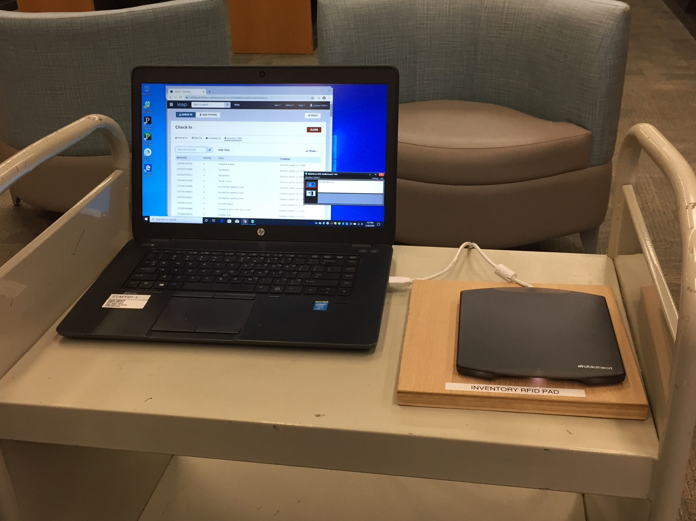
Equipment needed for RFID Inventory
Laptop
LEAP
RFID Pad with USB adapter

Slide 7
Simply Reports
Create an Item List Report
Output Columns: Item assigned branch abbreviation, Item assigned collection abbreviation, Item barcode, Item call number, Item last inventory date, Item shelf location, MARC author, MARC bibliographic record ID, MARC title, item last cko/renewal date, Item material type
Sort Columns: Item assigned branch abbreviation, Item assigned collection abbreviation, Item shelf location, MARC author
Check the Excel file box
Item General Filters: Assigned branch, Collection, Record status – Final, Circ status – In
Item Call Number Filters – Classification Number
Save the Report. It’s filters can be edited as you inventory different collections.

Slide 8
Staff Scheduling
Support Services clerks are each schedule for one – two hour shift per week. They inventory all print materials. We inventory Adult print collections one year and Youth print collections the next.
Pages/Shelvers’ are responsible for the inventory of all A-V materials. This is done annually.

Slide 9
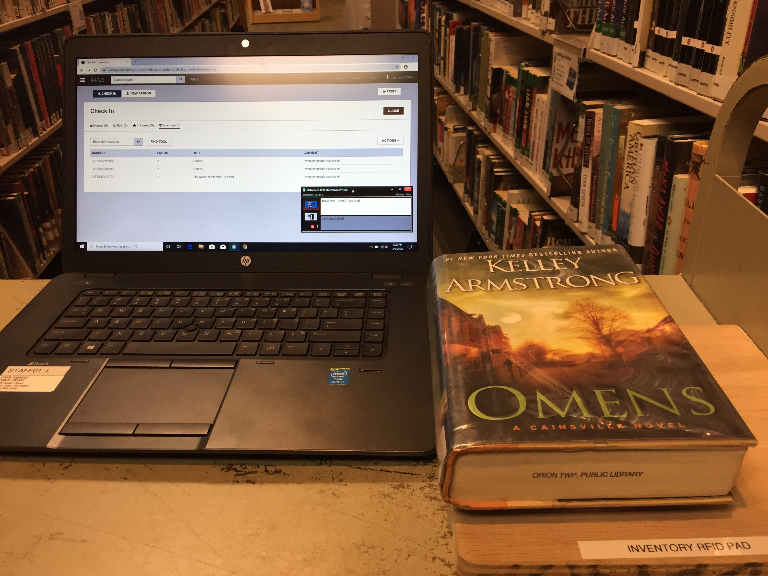
Inventory Process in the Stacks
Login to LEAP on laptop
Open Inventory Mode Check-in
Insert RFID USB
Scan items one at a time on the RFID pad
Exceptions will pop up, i.e. status other than in, put aside with note to fix
Keep track of call number field in collection to run report of missing items
When done with collection, run report in Simply Report

Slide 10
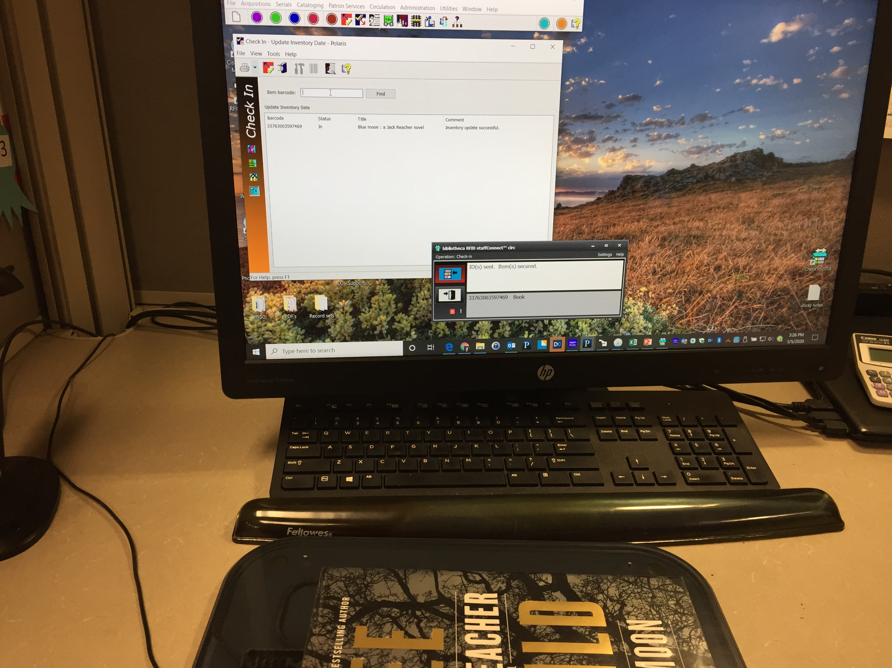
Inventory Process at Your Desk
Bring cart of items to desk that has an RFID pad and label printer
Inventory all items
Open Item Record to make sure call # and cutter are in correct field
Update spine label if necessary

Slide 11
Simply Reports - Editing
Edit an Item List Report
My Reports: Item List Reports, Select Inventory report and edit button, Select correct collection, Call number field and continue, Save report parameters
My Reports: Item List Reports, Check Inventory reports and Run Reports, Download Excel report and sort by last inventory date

Slide 12
Excel Report procedures
Inventory report for Feature DVD's call number H - K
Coll | Shelf Location | Call Number | Title | Item Barcode | Last Inventory Date
DVD | Feature | HAPPY-GO-LUCKY | Happy-go-lucky | 33763002065617 | 7/7/2017 10:41
DVD | Feature | HAPPY TEXAS | Happy Texas | 33763001768682 | 5/6/2018 10:41
DVD | Feature | INTERPRETER | The interpreter | 33763001439367 | 11/6/2018 11:03
DVD | Feature | JACK AND JILL | Jack and Jill | 33763002245482 | 3/6/2020 11:07
DVD | Feature | JOHNSON FAMILY VACATION | Johnson family vacation | 33763002240392 | 3/6/2020 11:10
DVD | Feature | KARATE KID | The karate kid | 33763002222671 | 3/6/2020 11:13
Look for items not inventoried on shelves
Items that are found, use Inventory mode check in
Items not found, change item status to misplaced or your current missing status
Fill out Inventory tracker with collection, call number field, and how many were misplaced

Slide 13
Tracking Inventory Progress
Inventory tracker is completed by staff member doing inventory
What’s been done and what’s next
Staff accountability
 | SUBSET | DATE INVENTORIED |  | REPORT DONE | # MISSING | CLERK
ADULT
Anime | all | 12/11/2018 |  | yes | 0 | lb
BluRay (youth & adult) | all | 12/29/2018 |  | yes | 0 | lb
Feature DVD | A-C | 12/12/2018 |  | yes | 5 | lb
Feature DVD | D-G | 12/13/2018 |  | yes | 6 | lb
Feature DVD | H-K | 12/13/2018 |  | yes | 5 | lb
Feature DVD | L-M | 12/15/2018 |  | yes | 6 | lb
Feature DVD | N-P | 12/19/2018 |  | YES | 2 | cs
Feature DVD | Q-S | 12/21/2018 |  | yes | 4 | lb
Feature DVD | T | 12/21/2018 |  | yes | 3 | cm
Feature DVD | U-Z | 12/27/2018 |  | yes | 8 | lb
TV Series | A | 1/4/2019 |  | yes | 0 | lb
TV Series | B-F | 1/4/2019 |  | yes | 0 | lb
TV Series | G | 1/4/2019 |  | yes | 0 | lb
TV Series | H-Q | 1/7/2019 |  | yes | 1 | lb
TV Series | R-S | 1/7/2019 |  | yes | 0 | lb
TV Series | T-Z | 1/8/2019 |  | yes | 0 | lb
Foreign DVD | all | 1/8/2019 |  | yes | 0 | lb
Non-fic DVD | 000-299 | 1/8/2019 |  | yes | 0 | lb

Slide 14
Pro’s & Con’s
Pro’s
Physical holdings match Polaris
Does not require extensive staff training
Portable equipment that can be taken into the stacks
Can also be done at any staff workstation that has an RFID pad.
Mis-shelved items are located making it easier for patrons to find items where they should be
Con’s
Items with a status of other than “in” do not get their inventory date updated
USB is powered by laptop, therefore battery drains faster

Slide 15
THANK YOU
Questions?
Anne Barnard - abarnard@orionlibrary.org
Shannon Schmidt - sschmidt@orionlibrary.org

