Slide 2
Summon and Sierra at Chalmers
Chalmers University of Technology
12,000 students, 1,000 doctoral students and 2,500 researchers and administrative staff
Focus on engineering, architecture and maritime education
Notes:
Chalmers in in Gothenburg, in the west of Sweden. Founded 1829
We have 12.000 students, 100 PhD students and 2.500 researchers and administrative staff
The university focuses on engineering, architecture and maritime education

Slide 3
Summon and Sierra at Chalmers
The library:
Library of the year in Sweden 2016!
Staff of 60 people
Media budget: 2.6 million dollars
98% of the budget goes to e-resources
Notes:
Library of the year 2016
Staff of 60, these include 8 systems developers, 35 librarians
2.6 million dollars media budget
98% of the budget goes to e-resources
Sierra. Will go into procurement of LSP and discovery this summer

Slide 4
Summon and Sierra at Chalmers
Mapping:
No surprises = default mapping
Notes:
Will not talk about mapping since we use the default mapping and no one at the library remembers anything about this…

Slide 5
How to load automatically with Scheduler
Create a saved search in Create lists in Sierra with all the records you want updated, added or deleted
Create a task in Scheduler that runs the saved search and outputs the records via FTP
Create a job in Scheduler that determines how often this is done
Notes:
How does it work?
A list is created every 24 hours with all updated bibrecords we want either updated, added or deleted from Summon
1. Create a saved search in Create lists that retrieves all the records you want updated, added or deleted
2. Create a task in Scheduler that runs the saved search and outputs the records via FTP
3. Create a job in Scheduler that determines how often this should be done

Slide 6
Create lists
Updated in the last 24 hours and BCODE3 = -, “delete”, “suppress” or “do not weed”
This excludes all records with other BCODE3’s that we don’t want in Summon
Notes:
How does it work?
A list is created every 24 hours with all updated bibrecords we want either updated or deleted from Summon
This excludes all records we don’t want in summon

Slide 7
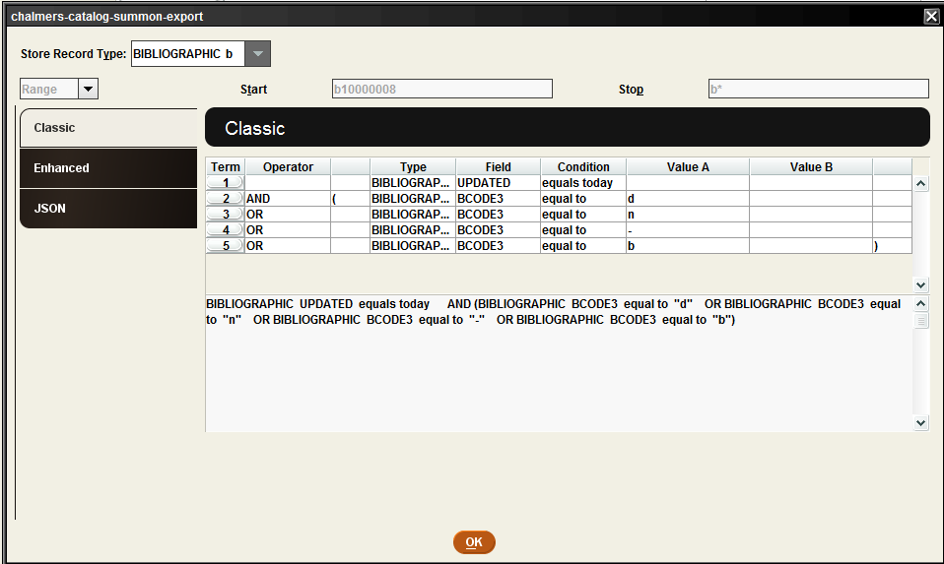
Create lists
Notes:
Truncate the range of the records to search
Updated relative dates, “today”
We use BCODE3 to select the records we want added, updated or deleted

Slide 8
Loading with scheduler
Scheduler then uses task type “Output MARC records” and puts a list on a ftp server
The information from BCODE3 gets converted to MARC field 998 |f
All bibliographic records with 998 |f “d” or “n” get deleted in Summon
Notes:
Task in Scheduler.
Output MARC records and puts records on FTP server
The info from BCODE3 gets converted to MARC field 998 subfield f
All bibrecords with 998 subfield f equals d-delete or n-suppressed get deleted in Summon

Slide 9
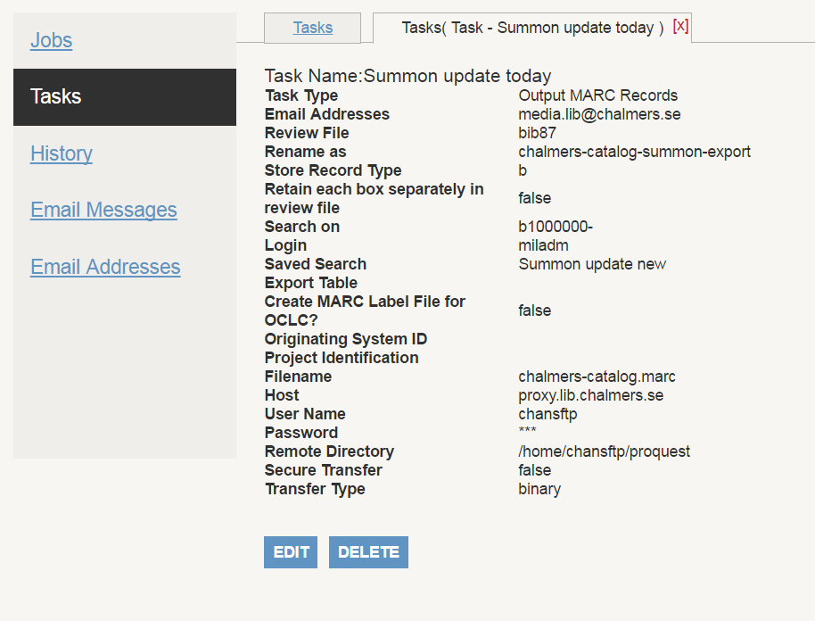
Tasks in Scheduler

Slide 10
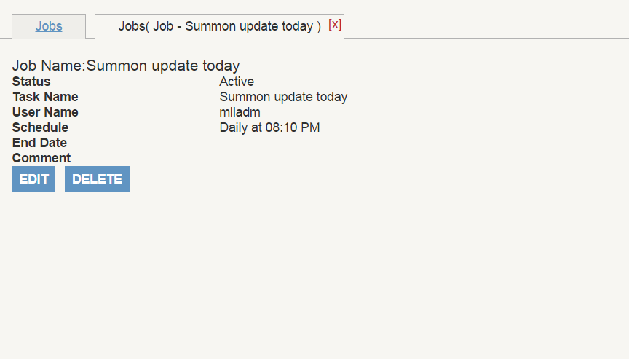
Jobs in Scheduler
Summon update today, every day at 8:10 PM (after closing hours)
This activates and schedules the task

Slide 11
Tweaking Summon
Printed journals with no items, how to request?
Do we really want the patrons to request from the stacks?
Who cares!? Well, the patrons…
Notes:
How do we handle the printed journals without items?
Do we really want the patrons to request them? Cost of ordering from external source vs. cost of manpower?
The patrons doesn’t care about these issues, they think it’s weird if they can’t request our materials

Slide 12
Summon and Sierra at Chalmers
Solution:
Inserted URL to the bib record to a form for requesting
But then it’s a e-journal! All bib records with 856 automatically forwarding patrons to the URL
Exceptions in Summon
Populating the form with data from the webpac
Notes:
Insert a URL to a form for requesting in the bibrecord
But Summon automatically forwards all to the destination of the URL
Have a exception made in the mapping, making print journals with URLs go to the Webpac instead.
Populate the form with data from the webpac

Slide 13
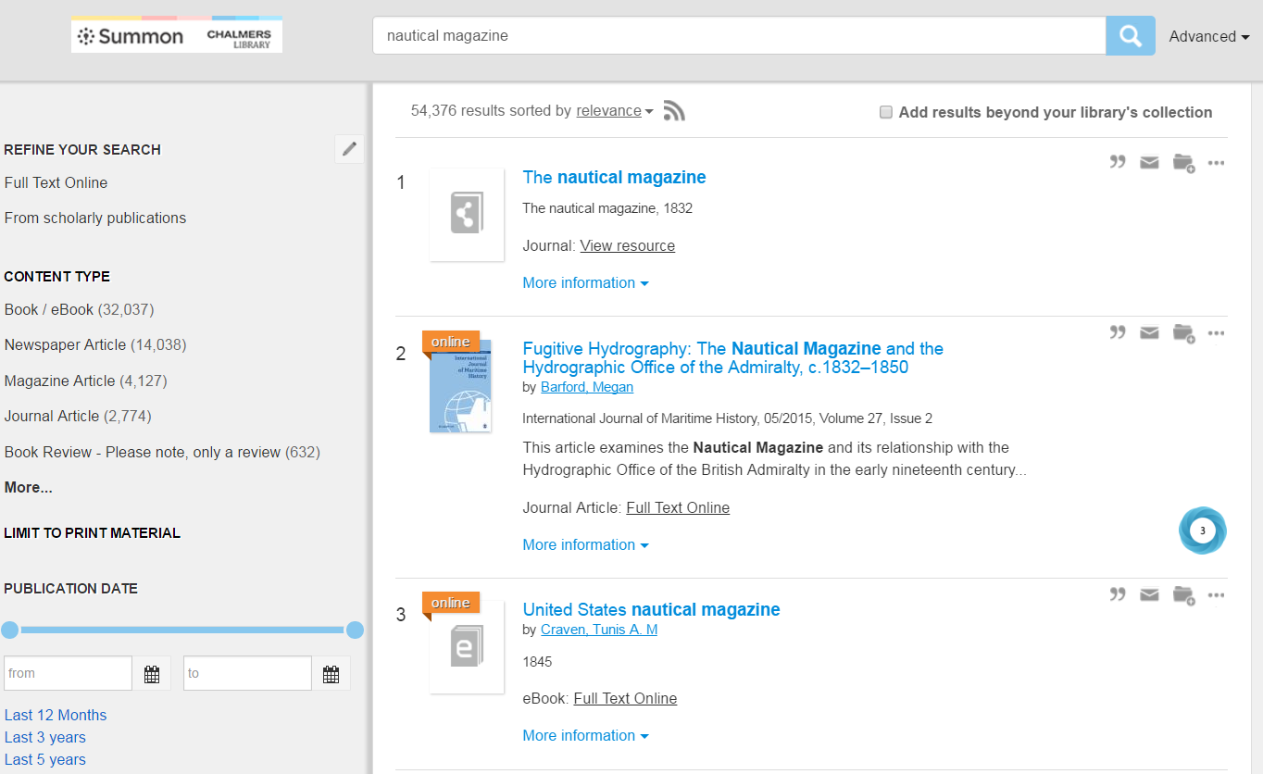
Notes:
This is how it looks in Summon

Slide 14
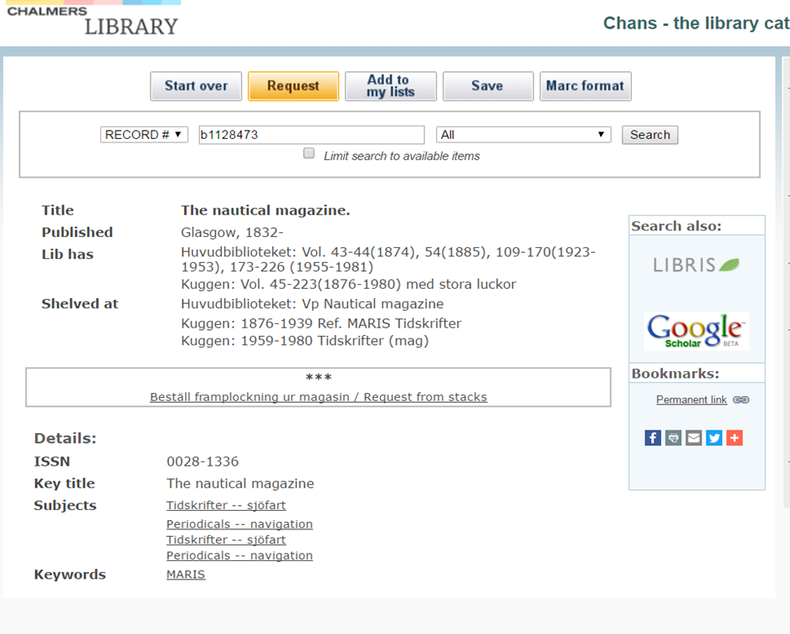
Notes:
Forwarded to the webpac

Slide 15
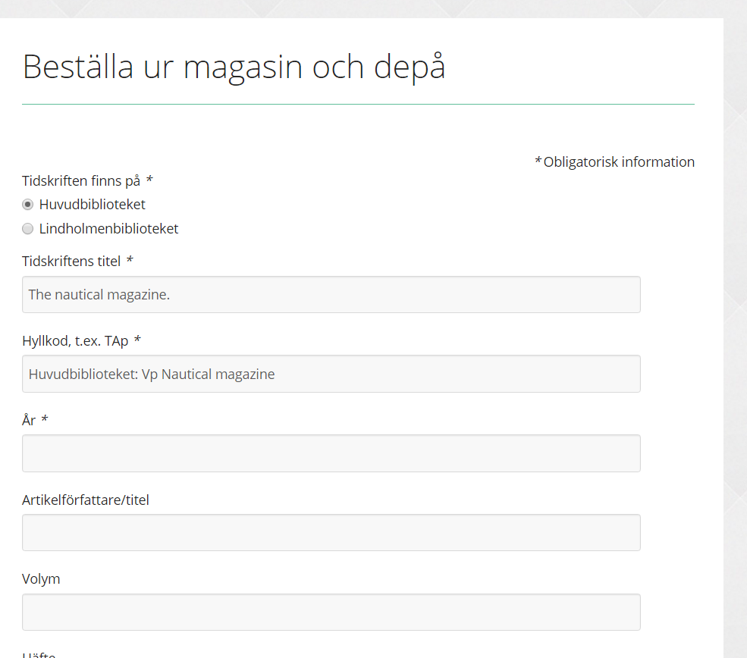
Notes:
Clicks the link an the form automatically is filled in with info about title and shelfcode

Slide 16
<div style="display:none">
<div id="cthbtitel">
<!--{recordinfo:t}-->
</div>
<div id="cthbplacering">
<!--{recordinfo:j}-->
</div>
</div>
<script>
var titel = document.getElementById("cthbtitel").getElementsByClassName("bibInfoData")[0].innerText;
var placering = document.getElementById("cthbplacering").getElementsByClassName("bibInfoData")[0].innerText;
var newurl = "http://www.lib.chalmers.se/framplockning?title=" + titel + "&shelf="+placering;
var a = document.querySelectorAll('a[href="http://www.lib.chalmers.se/framplockning"]')[1];
a.setAttribute('href',newurl);
a.setAttribute('target','_new');
a.removeAttribute('onclick');
</script>

Slide 17
Any questions?
siska.humlesjo@chalmers.se

