Slide 1
Using SQL to Populate LibInsight
Rob Behary, MBA, MLS Head of Systems and Scholarly Communications Gumberg Library, Duquesne University

Slide 2
What this presentation will cover
Reasons to consider populating LibInsight
System prerequisites
Approaches to data extraction with SQL
Data cleaning
Data storage
Uploading data to LibInsight
Presenting data within LibInsight

Slide 3
What this presentation is NOT
A comprehensive guide to SQL (see previous IUG presentations on SQL for getting started)
A comprehensive guide to LibInsight (this presentation will highlight the setup tips that work best for analyzing and presenting data)

Slide 4
Reasons to consider populating LibInsight
Importance of Data Visualization
Provides a way to tell the library’s story in a clear way
Allows for greater transparency
Allows for a standard platform where all library data can be shared
Potential for comparison between different datasets
Affordable in comparison to Tableau or Power BI
Easy way to engage library employees in data analysis and collection
Interface familiar to many users (LibGuides, LibAnswers, LibCal)

Slide 5
System Prerequisites
The following are prerequisites to using LibInsight
Software:
License to LibInsight – Typically an inexpensive addon to the SpringShare suite
Sierra subscription with access to SQL
PGAdmin or other tool for accessing a PostgreSQL database
Excel or similar spreadsheet software
LibInsight Dataset and Dashboard
Important note: Be sure to harvest transaction-based data before it times out on the server (there is a time limit based on your systems preference of when circulation transactions expire)
Expertise:
Basic skills with uploading and downloading file
Ability to modify SQL queries
Ability to manipulate spreadsheets
Some design skills for data visualizations (I’m still working on this one)

Slide 6
Approaches to data extraction with SQL
PostgreSQL is very well documented https://www.postgresql.org/docs/
Sierra’s SQL community is very kind about sharing queries that only need slight modification. For example: https://github.com/UNC-Libraries/III-Sierra-SQL/wikiSierra DNA shows the tables available within Sierra (requires login): https://techdocs.iii.com/sierradna/
Fig 1. Screen capture of SierraDNA

Slide 7
Data Cleaning
It is helpful to have your data in a format that will be clear to users
Substitute Sierra system codes with their description values (for example patron code number with the descriptive label for the patron code)
Use a standard date format and make sure to be consistent (for example: DD/MM/YYYY)
Look for anomalies in your data before uploading (different versions of PGADMIN for example may introduce errors in converting to CSV files)
Fig 2. Example of consistent date format and difference between Transaction Type Code and Transaction Type descriptive label

Slide 8
Data Storage
Plan a place to retain your source data
While it is possible to download and extract data from LibInsight, having a backup for source data is wise for several reasons:
Migration away from LibInsight in the future
Use of data to feed other institutional systems (such as university Institutional Research systems)
Hedge against mistakes/accidental deletions within LibInsight
IMPORTANT: Always check your institutions data governance policies before storing any data
IMPORTANT: Always comply with regulations for handling Personally Identifiable Information (PII)

Slide 9
The Process for Populating LibInsight
Prepare the SQL query
Connect to the server with PGADMIN
Use the Query Tool to paste the SQL query and execute the query
Download the resulting query as a CSV file to an appropriate storage area
Check the data to make sure there are no errors
Upload the CSV file to LibInsight

Slide 10
Prepare the SQL Query
The following are prerequisites to using LibInsight
Do not start the SQL query from scratch! Google searches will reveal plenty of sites to start with
Prepare the SQL query in a text editor (NOTE: The query used for this presentation will be available with comments)
Fig 3. Illustration of partial SQL code used in the query for circulation transactions

Slide 11
Connect to the SQL Server
Query Editor
Note: You may use any utility, but PGAdmin is illustrated here
Paste the query from the text file into the Query Tool editor and execute the Query
The output will be displayed as a table below
Resulting Table
Fig 4. Input and output areas of PGAdmin when executing the prepared query

Slide 12
Export the resulting CSV file to a saved area
Export Tool
Note: You may use any utility, but PGAdmin is illustrated here
Use the export tool to save the resulting query
Gumberg Library uses Duquesne University’s institutional subscription to box.com which is compliant with the university’s data storage policies
Fig 5. Exporting the output from PGAdmin

Slide 13
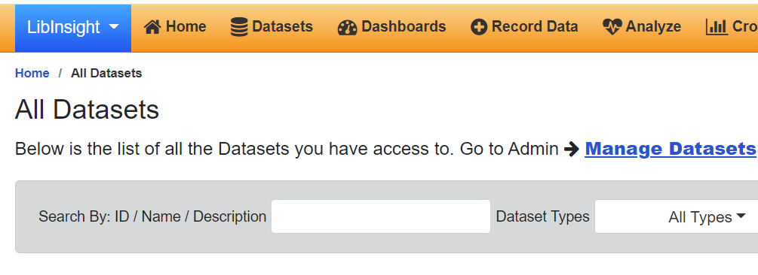
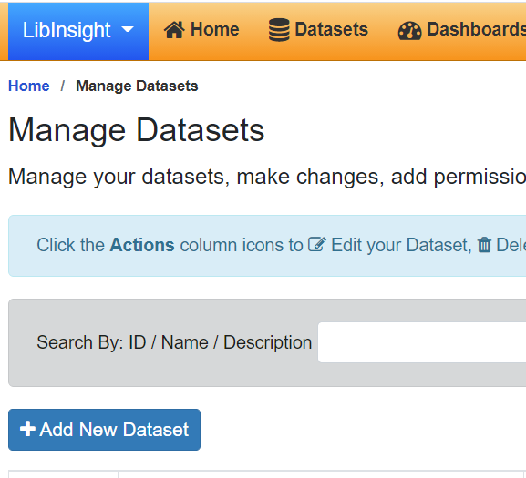
From within LibInsight Create a Custom Dataset
Custom datasets provide the most flexibility and allow for individual fields to be defined
Datasets
From “Manage Datasets” Select “Add New Dataset”
Manage Datasets
Add New Dataset
Fig 6. Creating a New Dataset

Slide 14
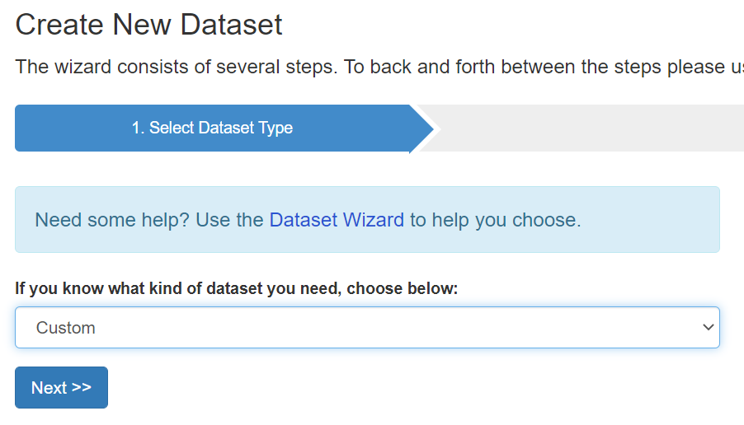
From within LibInsight Create a Custom Dataset
Custom datasets provide the most flexibility and allow for individual fields to be defined
Select the dataset type Custom
Manage Datasets
Fig 7. Dataset Type

Slide 15
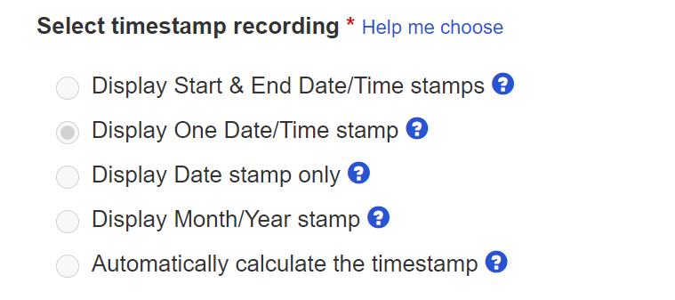
Date Stamps
Date stamp options can be tricky. Be sure your dates are always in a consistent and standard format
In the “Select timestamp recording” we have found that the “Display One Date/Time stamp” option works best
Export Tool
Fig 8. Screen capture of the select timestamp recording from LibInsight

Slide 16
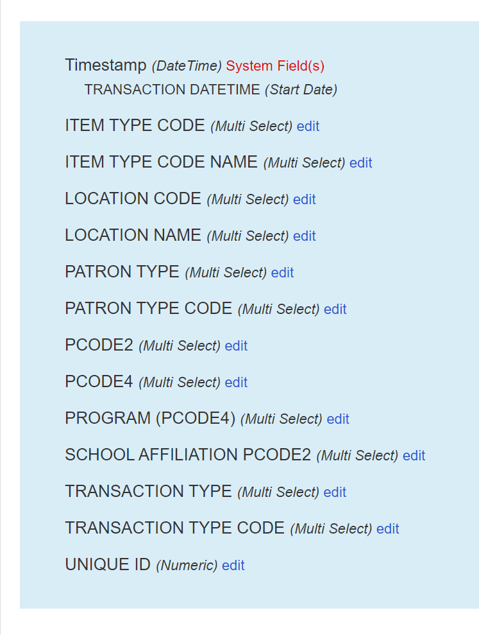
Adding and Editing Fields
When editing or adding fields, make the fields with code values and code names “Multi Select”
Multi Select fields will allow you to present and analyze data in the most comprehensive way.
Multi Select fields are appropriate for all fields except for date fields and Unique Identifiers
Fig 9. Multi Select Fields

Slide 17
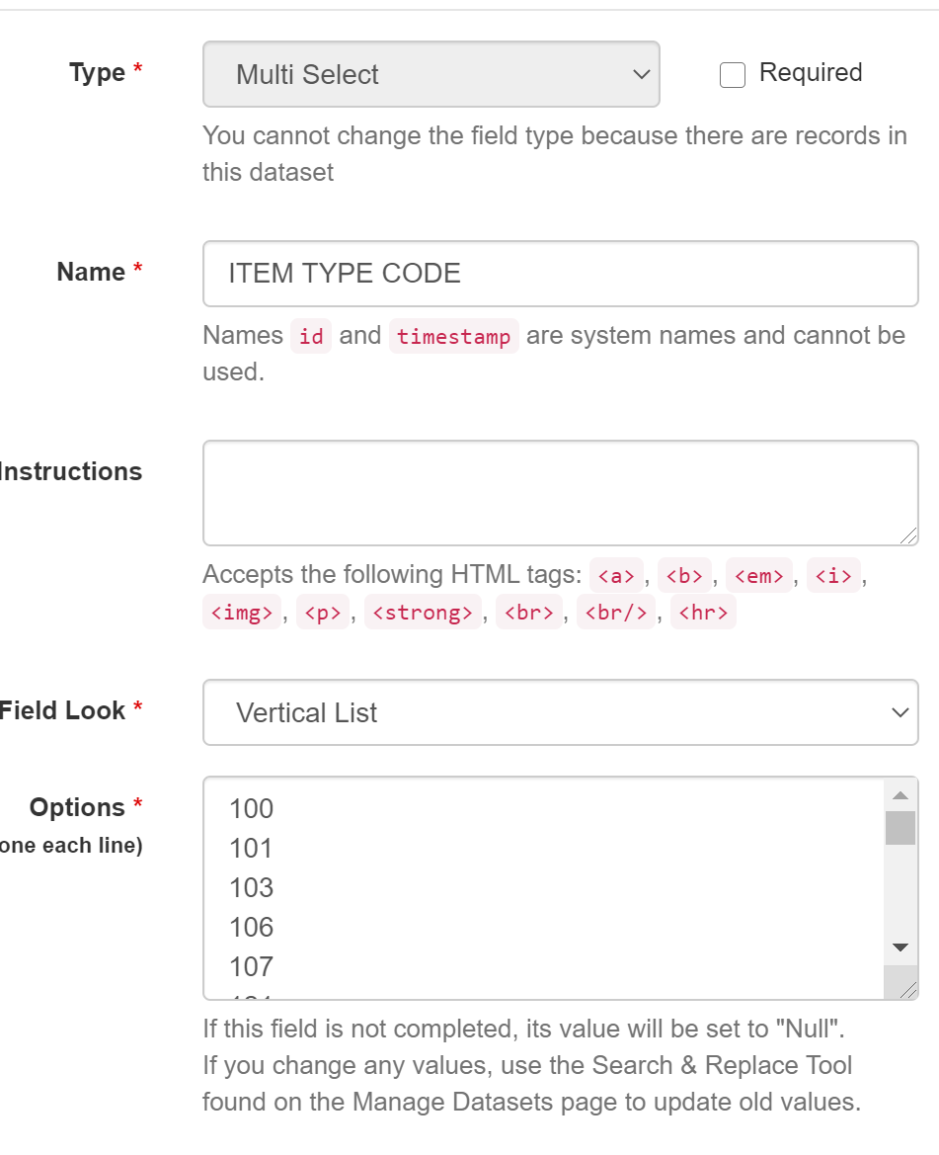
Multi Select Fields
Multi Select fields require extra work, but the work pays off
You must populate the Options area with all possible values for your fields
Use the codes or code names from the SQL output and identify all unique values
Populate the options areas with the appropriate codes or names
Fig 10. Multi Select Fields Options Area

Slide 18
Adding your data
Click to upload your data
Once you have finished creating your dataset you are now ready to upload your data
Fig . Uploading data to Libinsight
Select Upload File
Fig 11. Multi Select Fields Options Area

Slide 19
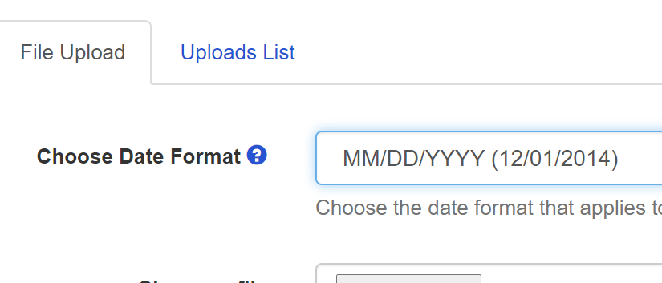
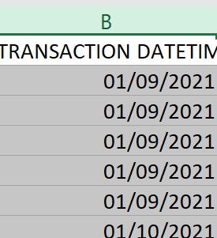
Adding your data
Be sure that your date fields match the date selected in LibInsight
Fig 12. Matching the date formats

Slide 20
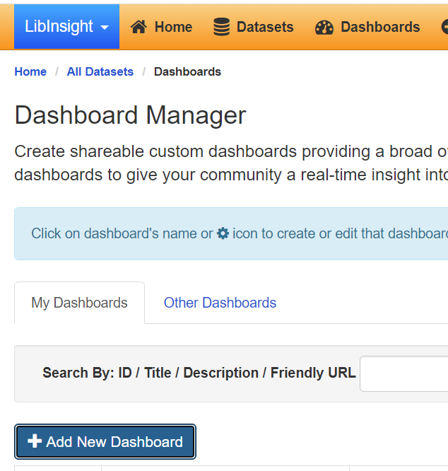
Creating the Dashboard
You are now ready to create a dashboard!
Go to the Dashboard Manager in Libinsight
Select Add New Dashboard
Fig 13. Creating the dashboard

Slide 21
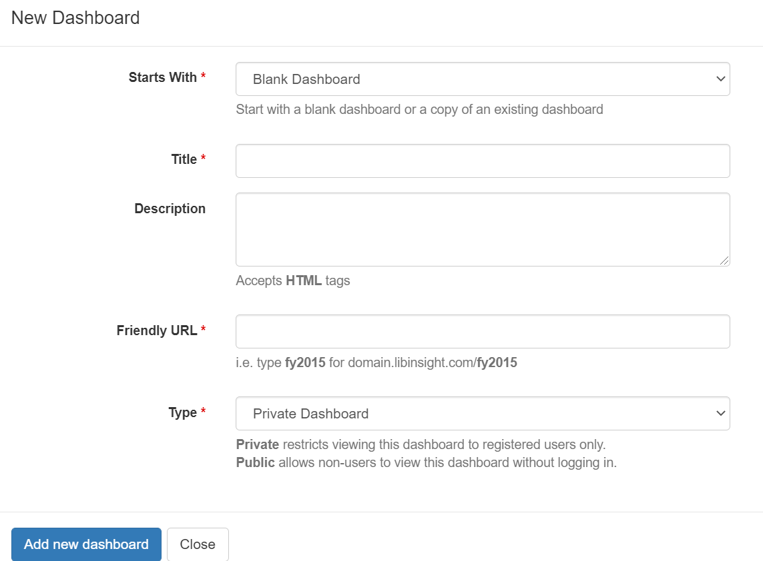
Creating the Dashboard
You are now ready to create a dashboard!
Populate the Title
Give your dashboard a friendly URL
Decide who can see your dashboard
Fig 14. Dashboard Options

Slide 22
Editing the Dashboard
Change the dashboard options
You can now add information from your dataset to the dashboard
Name of Dashboard
Friendly URL
Add elements to the dashboard
Fig 15. Dashboard Elements

Slide 23
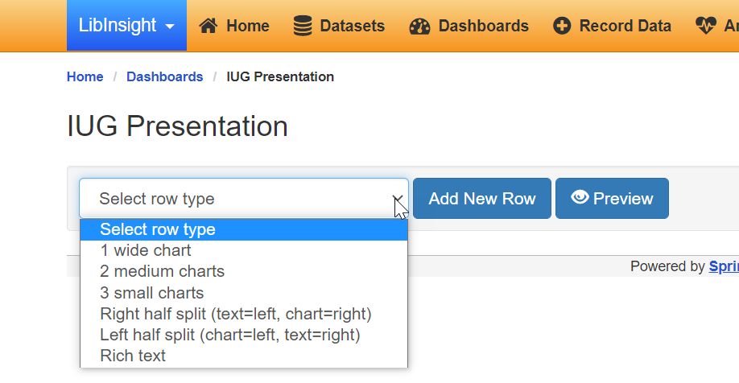
Editing the Dashboard
Add a row by selecting from the available row types
Select a row type and click add new row
Fig 16. Adding Rows

Slide 24
Editing the Dashboard
Select a row type and click add new row
A default chart will appear.
Fig 17. Default chart

Slide 25
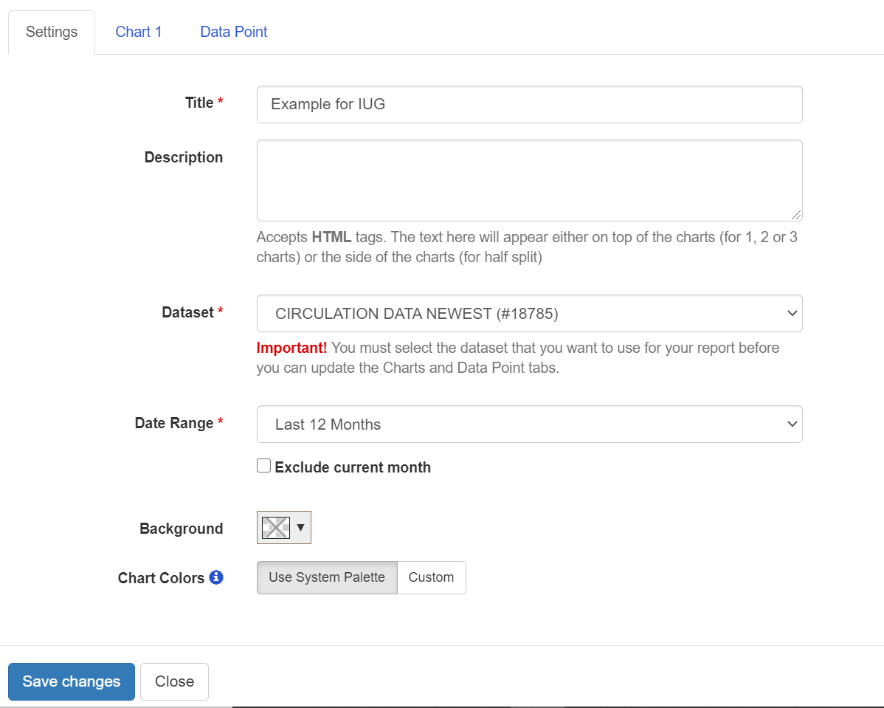
Editing the Dashboard
The Settings Screen
Fig 18. Settings Screen

Slide 26
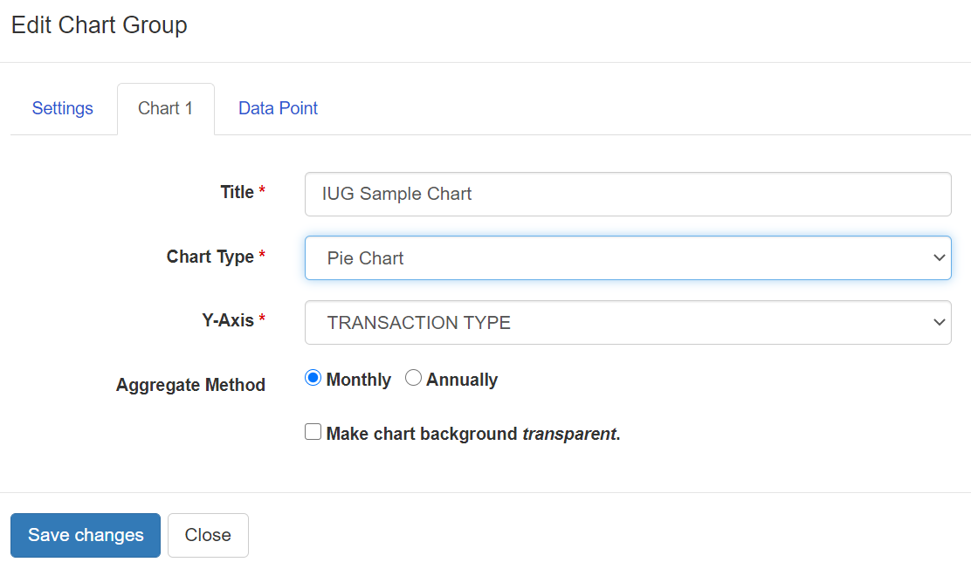
Editing the Dashboard
The Chart Group
Fig 19. Chart Group

Slide 27
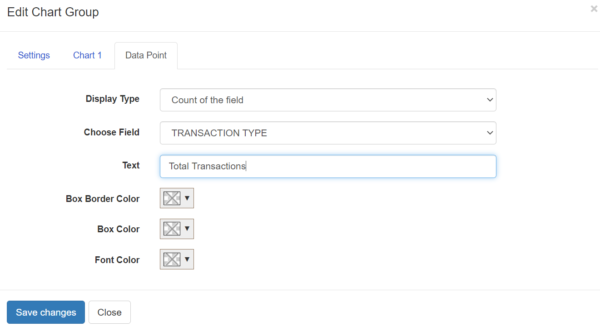
Editing the Dashboard
Data Point
Fig 20. Data Point

Slide 28
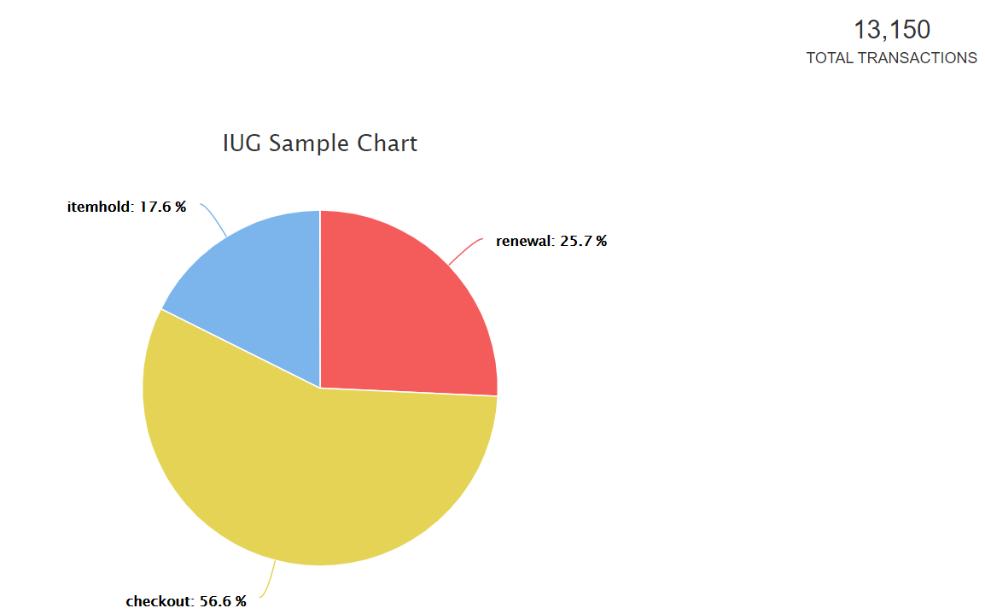
Resulting Chart
The resulting chart
Fig 21. Pie Chart

Slide 29
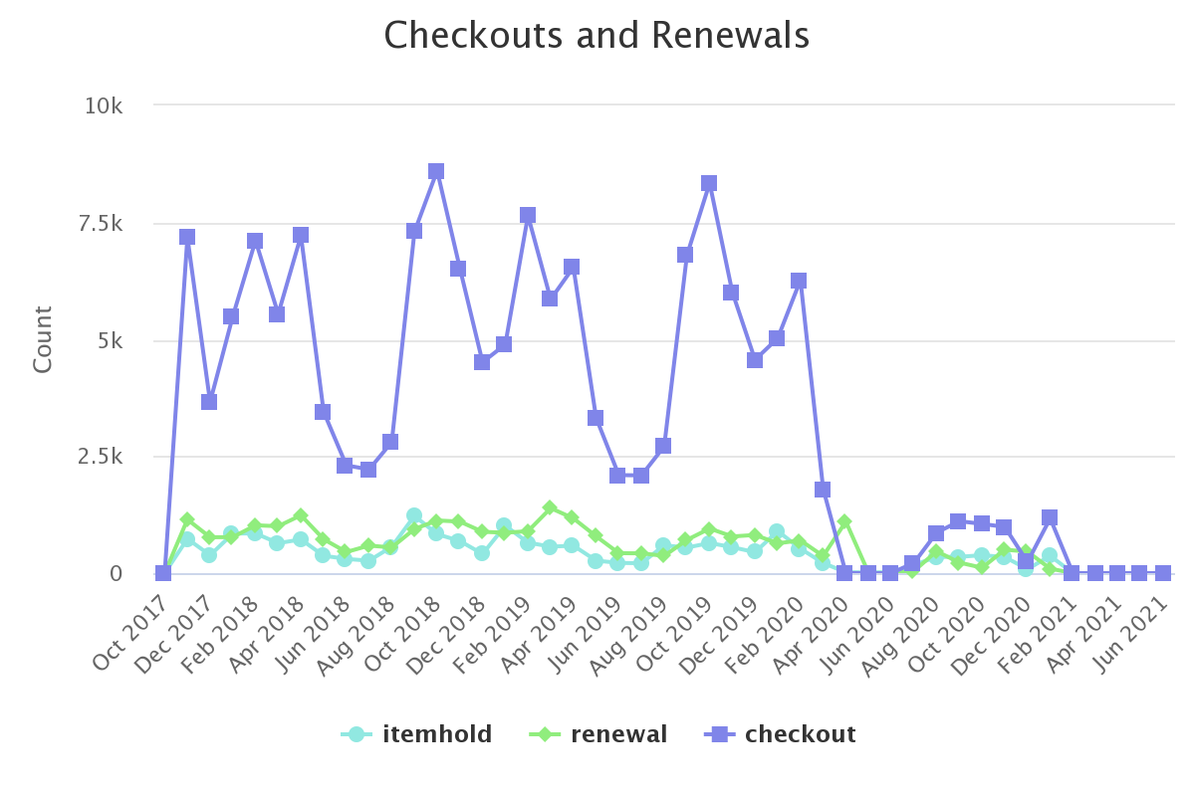
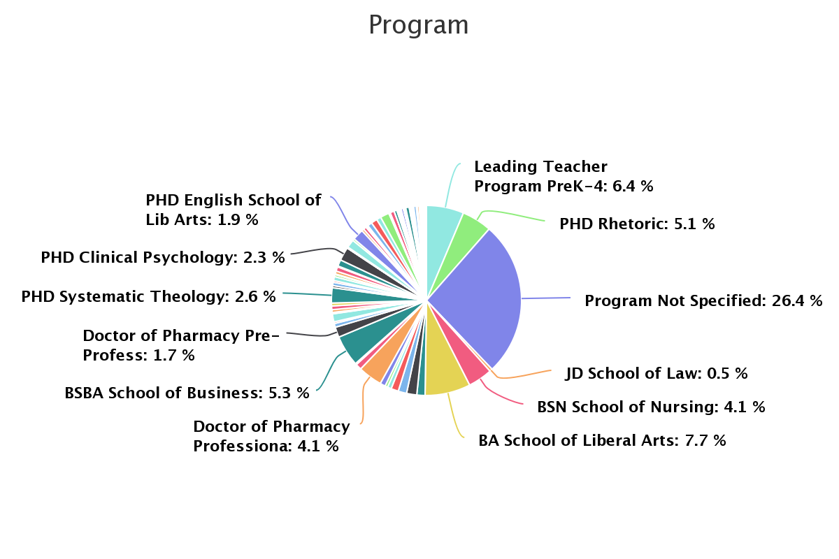
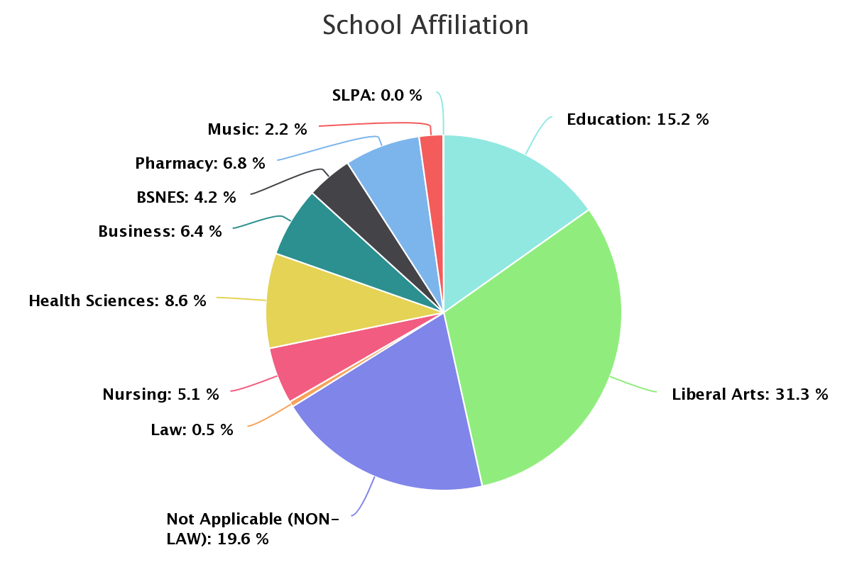
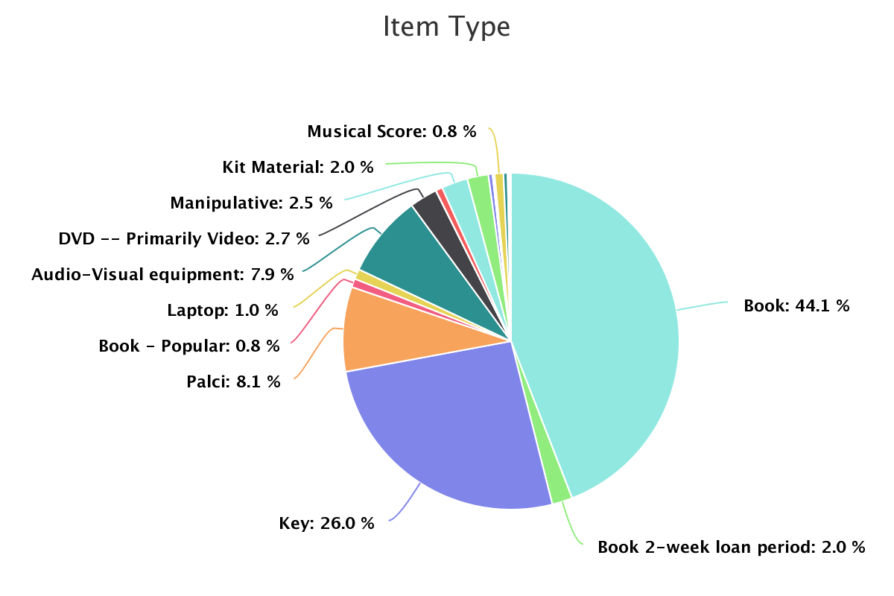
Summary
You will now be able to analyze your data in LibInsight. Individual dashboards will allow you to analyze data based on the characteristics from the Multi Select Fields
Fig 22. Sample Dashboards

Slide 30
THANK YOU
Rob Behary
beharyr@duq.edu
https://orcid.org/0000-0002-2878-7867

