Slide 1
CREATING
EFFECTIVE
CYBERSECURITY
03.15.25
IUG2025 / Creating Effective Cybersecurity
Alan McCarthy-Behler, Sec+, MCSA, PMP
The Metropolitan Museum of Art

Slide 2
Why “Creating Effective Cybersecurity?”
Why “Creating Effective Cybersecurity?”

Slide 3
"In cybersecurity, the single most important factor is action. A secure system is one that has been constantly adapted and protected from ever-evolving threats."
– Bruce Schneier
Why “Creating Effective Cybersecurity?”
https://www.statista.com/chart/30870/share-of-worldwide-cyber-attacks-by-type/

Slide 4
Why “Creating Effective Cybersecurity?”
This presentation
is not about phishing and
passwords (I’m sorry)
- Haiku at IUG2025

Slide 5
Data and Data Security
Data and Data Security

Slide 6
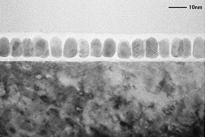
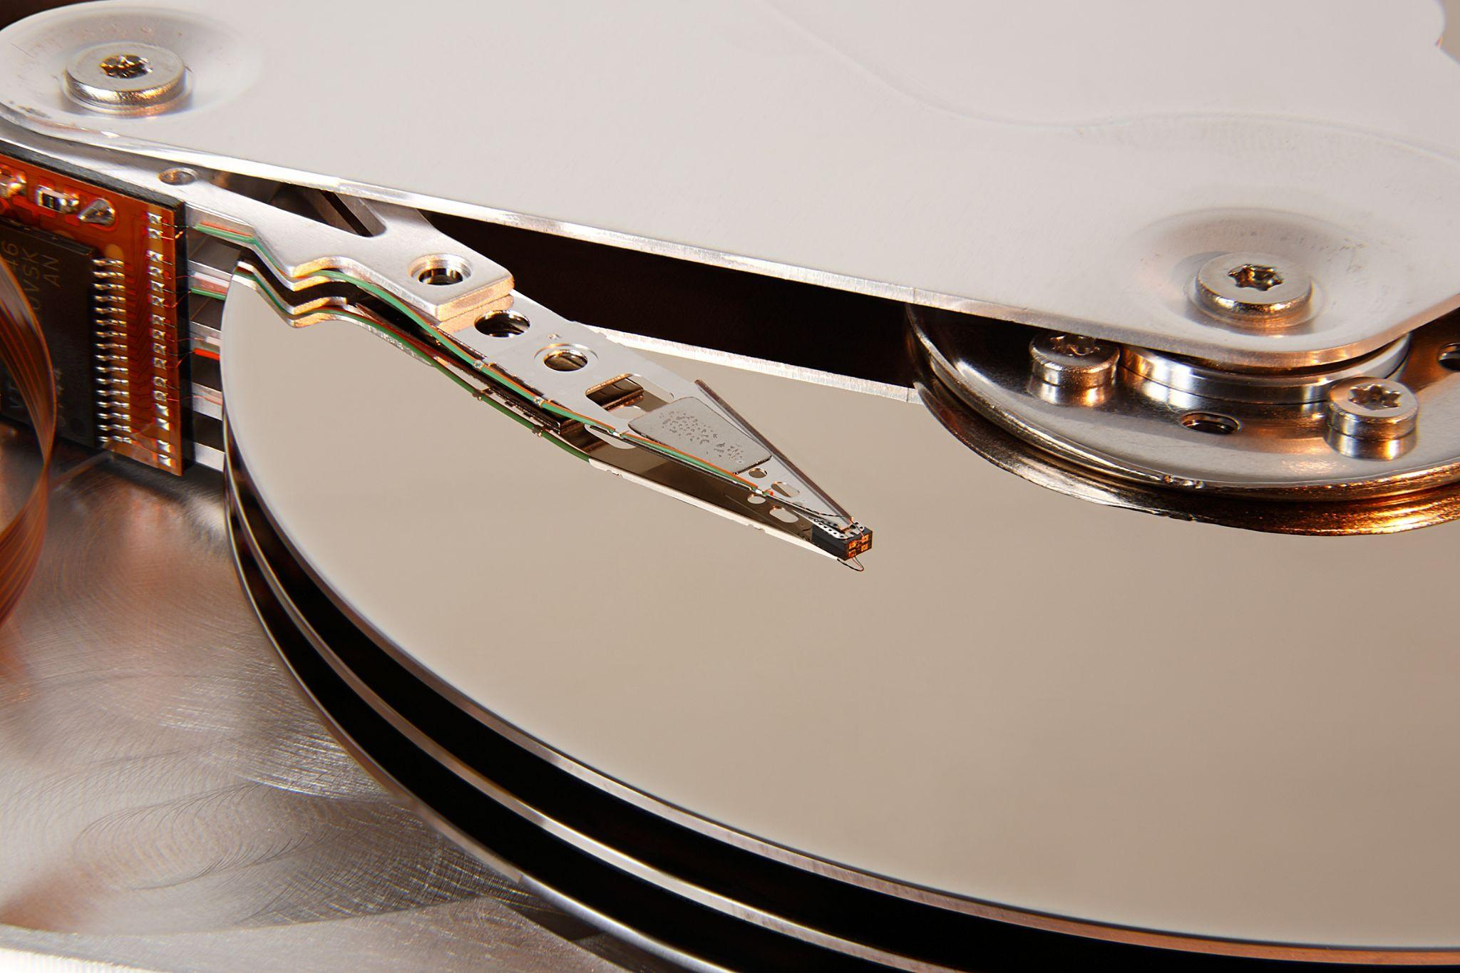
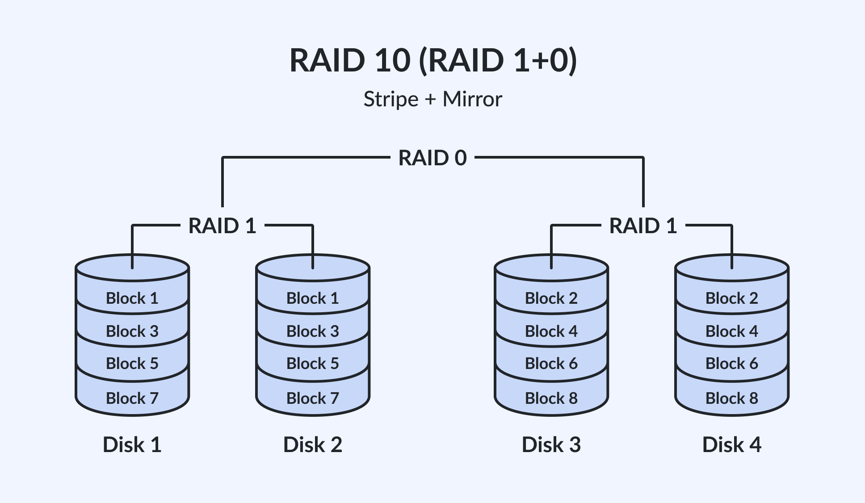
“Information, in any form, on which computer programs operate.” - Oxford Dictionary of Computing
“Data exists in three states: data at rest, data in transit and data in use.” - Wikipedia
Data and Data Security
About Data:

Slide 7
Data and Data Security
The PLAN:
Discover what data exists
Rank data in order of impact
Discover security around data
Decide how much risk is too much
Apply remediation

Slide 8
The Audit: Step 1
The Audit: Part 1

Slide 9
The Audit: Step 1
The Audit: Part 1
Discover what data exists
Rank data in order of impact
Discover security around data
Decide how much risk is too much
Apply remediation

Slide 10
Impact
“The magnitude of harm that can be expected to result from the consequences of unauthorized disclosure of information, unauthorized modification of information, unauthorized destruction of information, or loss of information or information system availability.”
-NIST SP 800-34 Rev. 1
The Audit: Step 1

Slide 11
Data Governance
“”A set of processes that ensures that data assets are formally managed throughout the enterprise…”
-CNSSI 4009-2015 from NSA/CSS Policy 11-1
The Audit: Step 1

Slide 12
The Audit: Step 1
Clear Agenda
Right People

Slide 13
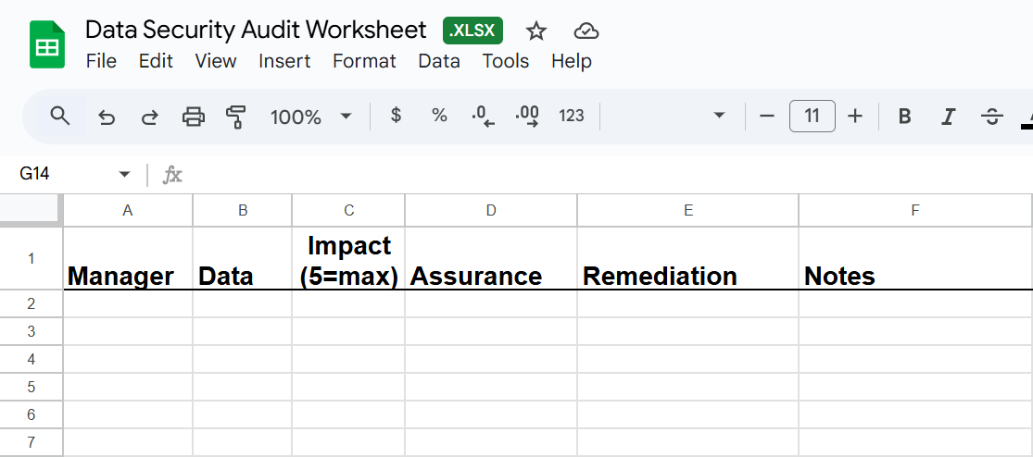
The Audit: Step 1

Slide 14
The Audit: Step 1
Question(s) #1: What programs do you use on your work computer? Why?
Question #2: What would happen if {program xyz} stopped working?

Slide 15
The Audit: Step 2
The Audit: Part 2

Slide 16
The Audit: Step 2
The Audit: Part 2
Discover what data exists
Rank data in order of impact
Discover security around data
Decide how much risk is too much
Apply remediation

Slide 17
The Audit: Step 2
Email Everybody
“As part of a recent initiative, [Library Name] is conducting a review of the security protocols followed by our key vendors. Given the importance of our partnership, we would appreciate your assistance in providing some security-related information.
Could you kindly share how frequently you perform database backups and if you adhere to any specific security standards or frameworks? This will help us ensure that we can maintain a secure and compliant environment, and I can report the relevant details to my colleagues.”
Example:

Slide 18
The Audit: Step 2
Sample Data

Slide 19
ISO27001
ISO27001

Slide 20
ISO27001
“ISO, the International Organization for Standardization, brings global experts together to agree on the best way of doing things – for anything from making a product to managing a process. As one of the oldest non-governmental international organizations, ISO has enabled trade and cooperation between people and companies the world over since 1946.”
-ISO Webpage

Slide 21
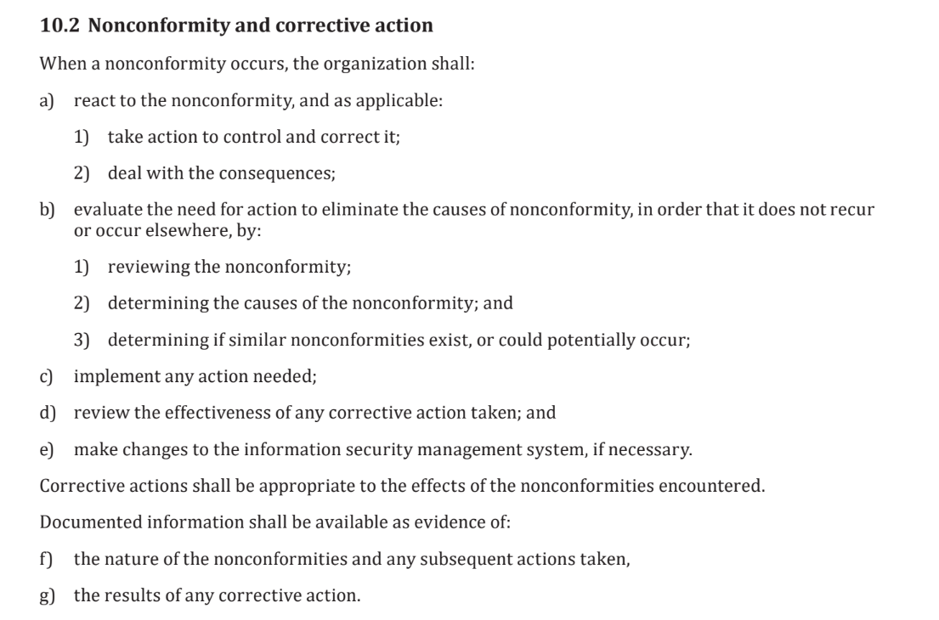
ISO27001
ISO27001
Section 10
Subsection 2

Slide 22
The Audit: Step 3
The Audit: Part 3

Slide 23
The Audit: Step 3
The Audit: Part 3
Discover what data exists
Rank data in order of impact
Discover security around data
Decide how much risk is too much
Apply remediation

Slide 24
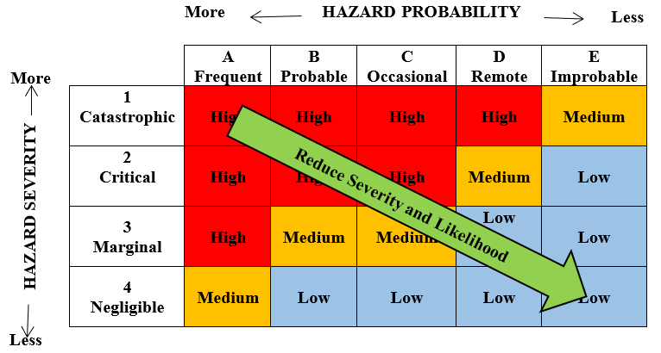
The Audit: Step 3
Risk
"A measure of the extent to which an entity is threatened by a potential circumstance or event, and typically a function of: (i) the adverse impacts that would arise if the circumstance or event occurs; and (ii) the likelihood of occurrence”
-NIST SP 800-137

Slide 25
The Audit: Step 3
Risk Response Strategies
Avoid Risk
Mitigate Impact/Probability of a Risk
Transfer Risk
Actively Accept Risk
Passively Accept Risk
Escalate Risk

Slide 26
The Audit: Step 3
-OR-
What is the value of my data? What is the cost of losing access?

Slide 27
The Audit: Step 3
"The single biggest problem in communication is the illusion that it has taken place."
-George Bernard Shaw

Slide 28
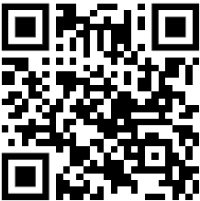
Questions & Answers
Q & A
Downloads Available Here

Slide 29
Questions & Answers
Email Us
Alan McCarthy-Behler
Alan.McCarthy-Behler@metmuseum.org
Stephanie Thero
sthero@yrl.ab.ca

