Slide 1
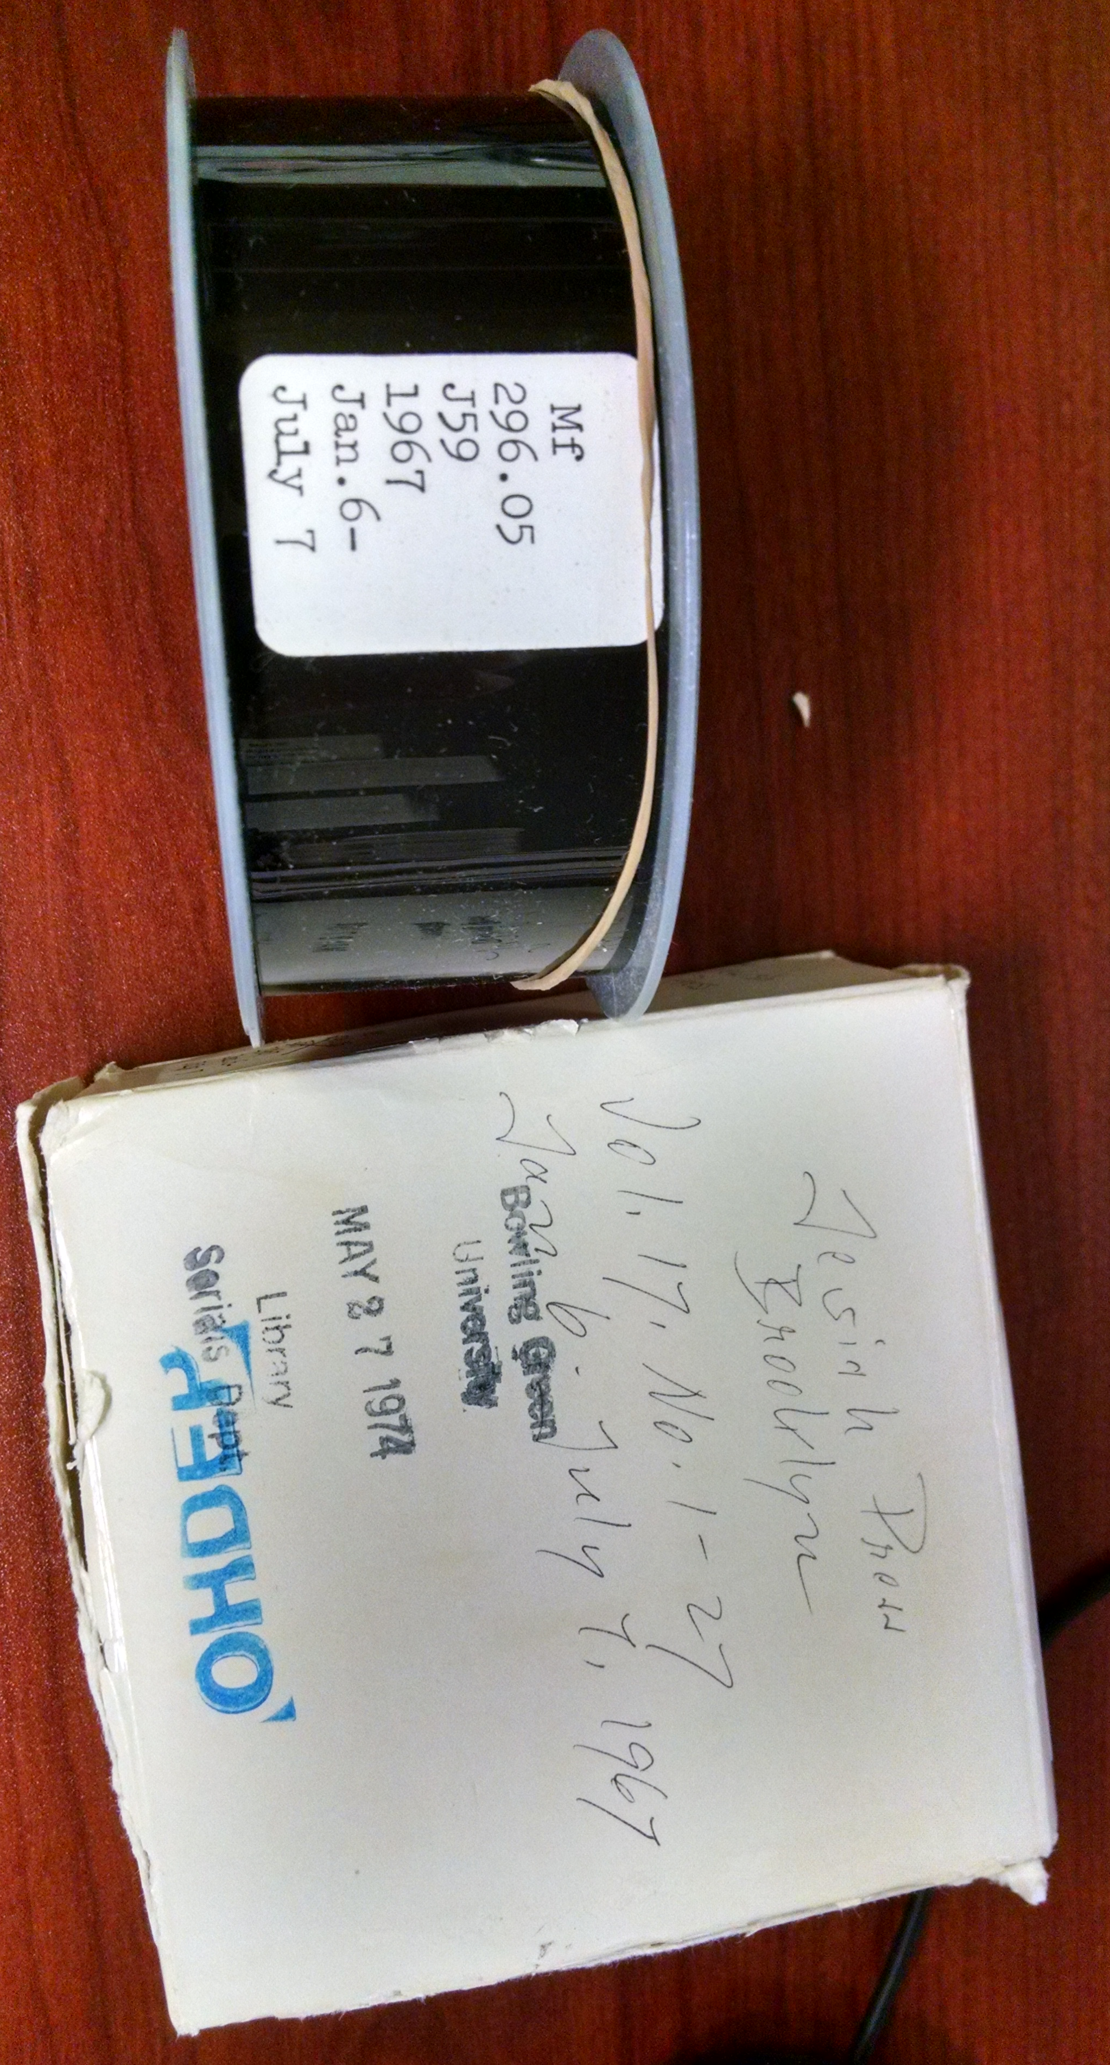
MarcEdit, Excel, and You: Data Entry outside the ILS to create Bibliographic records or Item Records
Training Room 4 OH-IUG2106
Friday, October 7
2:30-3:20
Mark Strang, Manager, LITS
University Libraries, BGSU

Slide 2
This presentation will cover the workflows that BGSU has developed for creating records for following:
Creating Item records for Microfilm Reels.
Creating Bib and Item records for our Sam Pollock Pamphlet Collection. This information had been entered into an Access Database on a staff members desktop workstation a decade ago.
Creating brief Bib and Item records for 45rpm records.
Notes:
BGSU approach to big cataloging
Back in 2004 or 2005 five our worked with our Music Library to develop a way to create brief bib and order records from spreadsheets the vendor Music Library Subscription Service
Sent us to order upcoming cd releases from.
For more extensive coverage about the 45 rpm project you can look at the IUG website under the IUG2016 conference presentations.

Slide 3
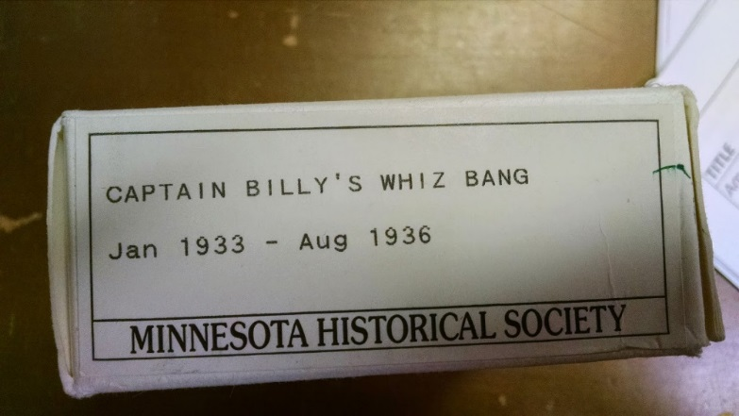
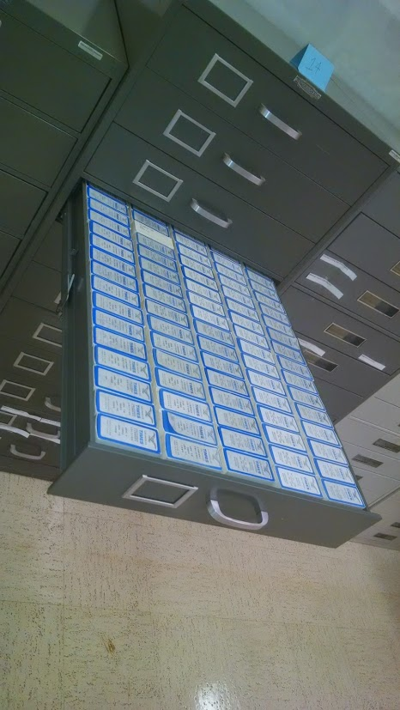
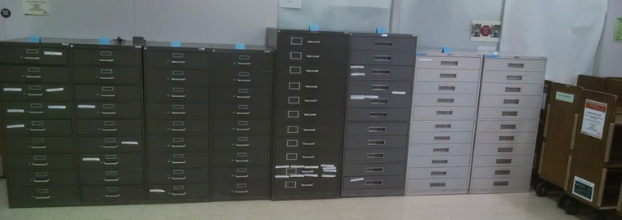
Microfilm OHDEP Item Records Project
In spring of 2014 BGSU UL Collection Development librarians identified some 10,694 reels of microfilm that we wanted to move from our building to the regional remote storage facility we manage. We wanted to contribute these items the statewide depository system catalog.

Slide 4
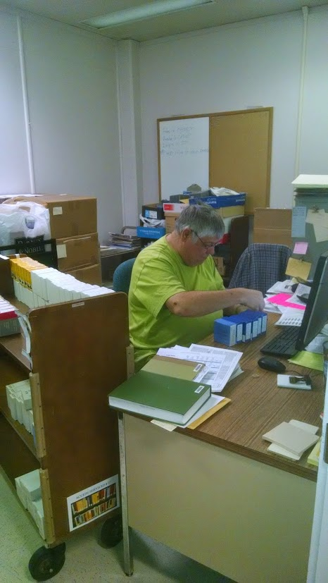
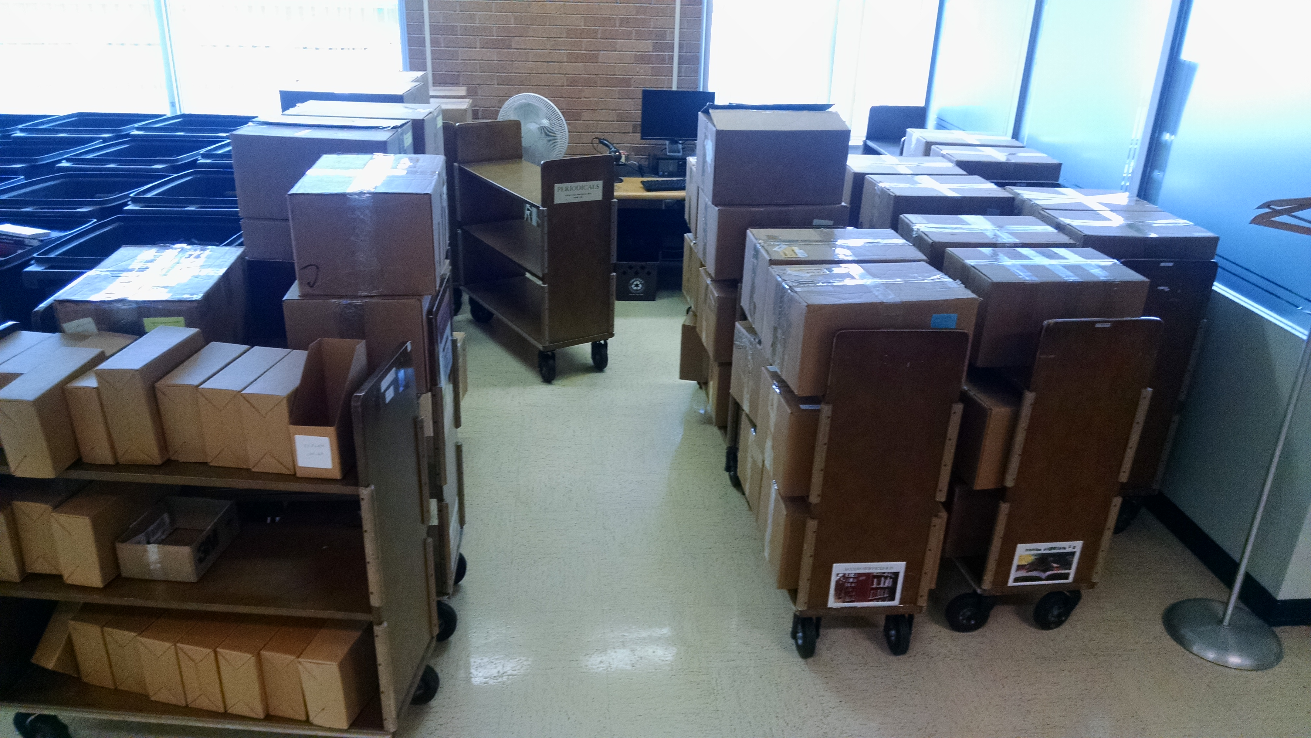
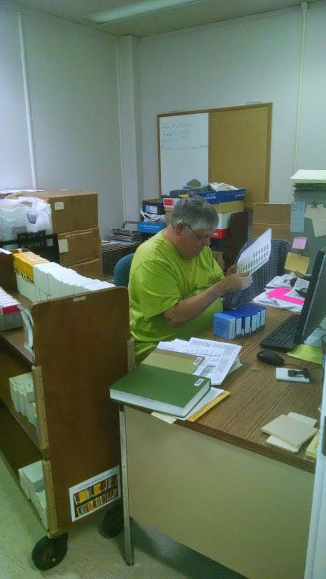
Microfilm OHDEP Item Records Project
Problem: We had never made item records nor barcoded our microfilm and it was going to be necessary to have item records with barcodes so we could transfer them to OHDEP catalog!
Using the Excel process I will outline, three staff members started the barcoding and data entry on 4/7/15 and completed the 10,694 reels of film for this project on 8/19/15. Staff were not exclusively assigned to this project, however they completed the work in 94 work days.

Slide 5
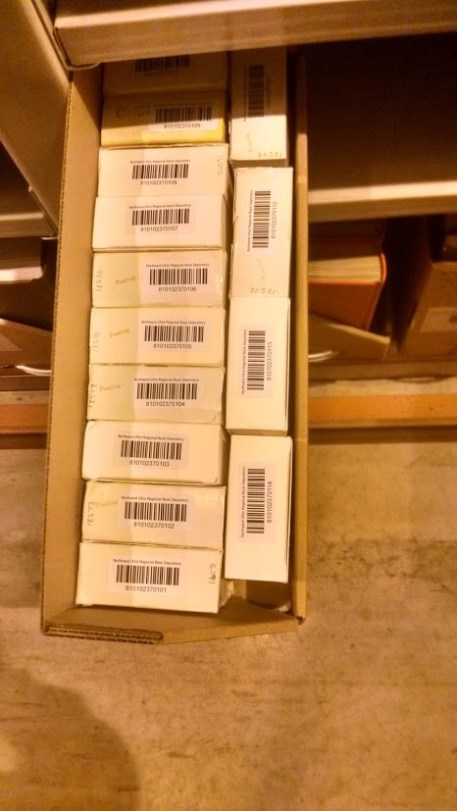
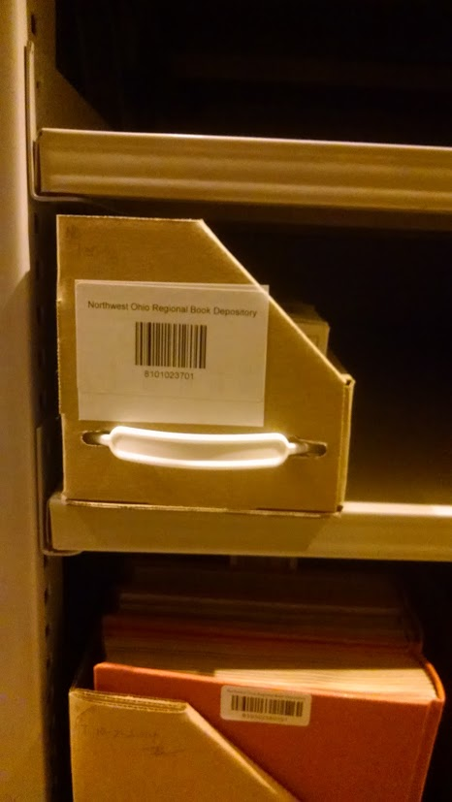
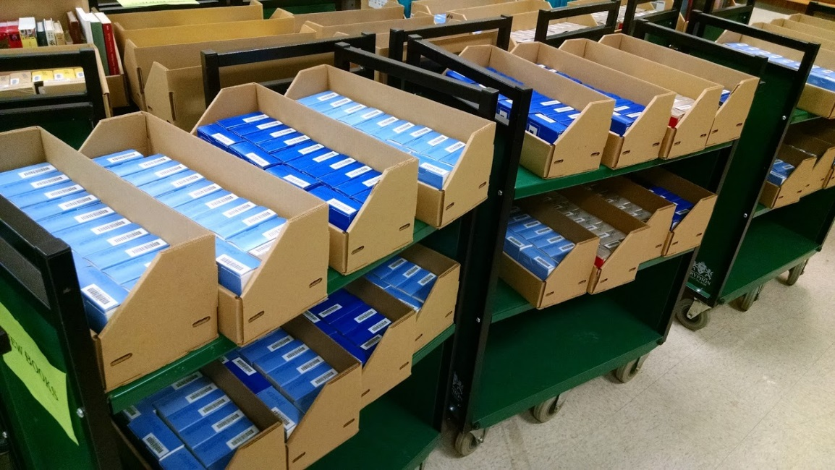
Microfilm OHDEP Item Records Project
Microfilm at it’s new Home in the Northwest Ohio Regional Book Depository

Slide 6
Microfilm OHDEP Item Records Project Software used:
Microsoft Excel 2013
MarcEdit 6.0 by Terry Reese
Delimited Text Translator
Marc Editor
Innovative Load Profile Training
Sierra Record Templates / Millennium Record Templates
Sierra Data Exchange / Load Records - Rel 2.1.0_4
Polaris ILS - Rel. 5.0.385 / Full Import

Slide 7
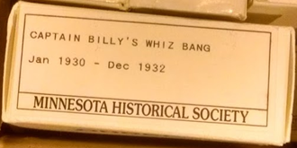
Microfilm OHDEP Item Records Project - Excel Data
Identify what data you’ll need to create item records:
oclc #
Barcode
Reel Start Date
Reel End Date

Slide 8
Analyze Data for Excel Data Entry
Column 1 | OCLC # (001) | [staff entered from ILS]
Column 2 | Barcode () | [staff entered with wand barcode reader]
Column 3 | ( | [excel fill]
Column 4 | Film Start Date | [staff entered]
Column 5 | - | [excel fill]
Column 6 | Film End Date | [staff entered]
Column 7 | ) | [excel fill]
Column 8 | Holdings info | excel formula: =C$&D$&E$&F$&G4
(Note: Microsoft Excel Online does not want to let you enter formula start with = cell number. Use desktop version.)

Slide 9
Excel
Minimize Data Entry:
Barcode (Wand Scanner),
Manual Keyboard Enter:
Reel Begin Date
Reel End Date
Set standard format you want for display: (3 letter month day, year)

Slide 10
Excel
Use Excel Formula’s to combine data:
=C$&D4&E4&F4&G4
Data Entry Quality Control is much easier when staff only enter begin date and end date in separate column’s

Slide 11
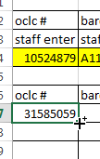
Excel
https://support.office.com/en-za/article/Fill-data-automatically-in-worksheet-cells-74e31bdd-d993-45da-aa82-35a236c5b5db
Use Excel’s Auto Fill feature to fill cells with data that follows a pattern or that is based on data in other cells
Highlight cell and move big + to lower right hand corner: once you have small + you can drag to fill data.

Slide 12
Microfilm OHDEP Item Records Project - Excel Data

Slide 13
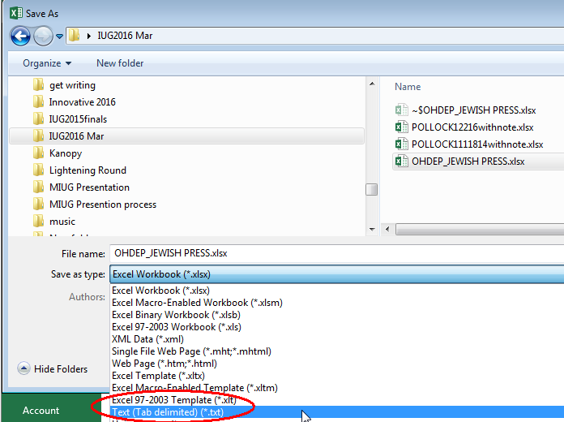
Microfilm OHDEP Item Records Project - Excel Data
In Excel use the save as Text (Tab delimited) (*.txt)
Save as Text (Tab delimited) (*.txt)

Slide 14
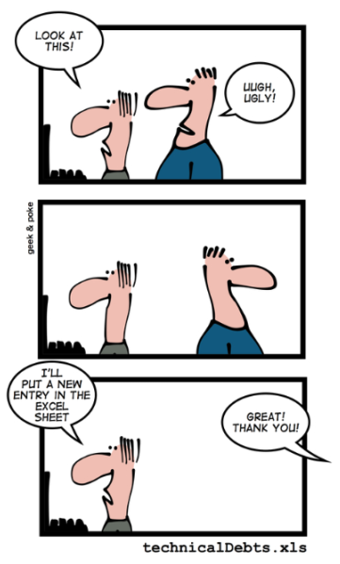
Questions?
www.geek-and-poke.com
http://geek-and-poke.com/?offset=1387617651494

Slide 15
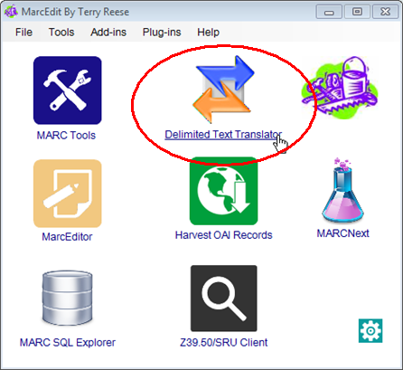
MarcEdit by Terry Reese http://marcedit.reeset.net/ Use the Delimited Text Translator
Delimited Text Translator

Slide 16
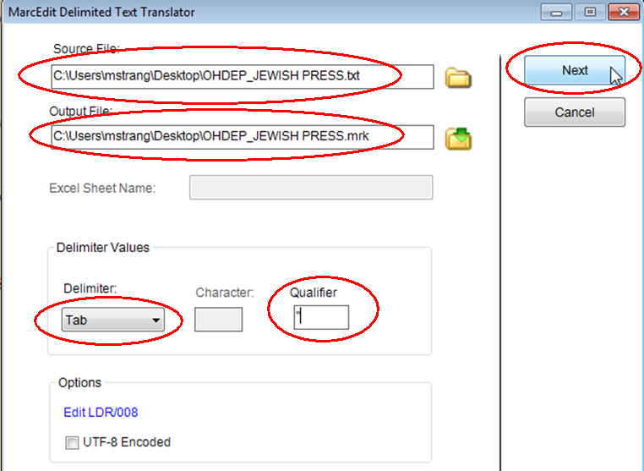
MarcEdit by Terry Reese http://marcedit.reeset.net/
Open Delimited Text Translator
Enter Source file folder & name
Enter Output file folder & name
(change the extension to .mrk)
Delimiter: Tab
Qualifier: “
Click on Next
If you get a weird error message make sure you closed the Excel document you are trying to process!

Slide 17
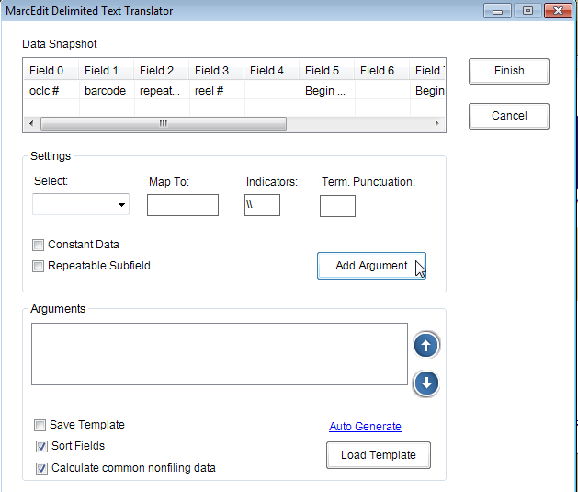
MarcEdit by Terry Reese http://marcedit.reeset.net/
Now the Excel columns need to be translated into Fields and Marc values the fields will have.
Column 0 to become:
Marc 949 subfield a
Column 8 to become:
Marc subfield c

Slide 18
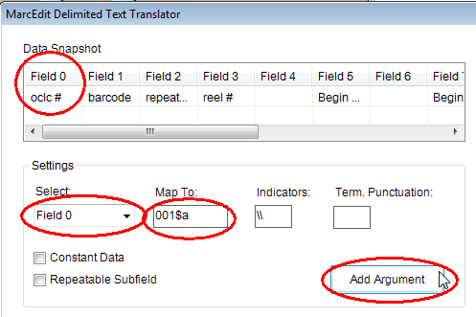
MarcEdit by Terry Reese http://marcedit.reeset.net/
Enter Data Select:
Field 0
Map To:
001$a
Press Add Argument

Slide 19
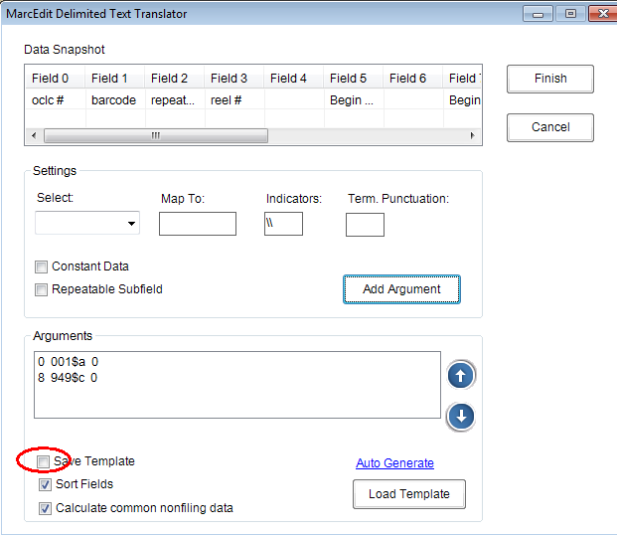
MarcEdit by Terry Reese http://marcedit.reeset.net/
To save a template,
checkmark the Save Template box.
Then, when you hit the Finish button, you will be prompted to Save Template as .mrd file

Slide 20
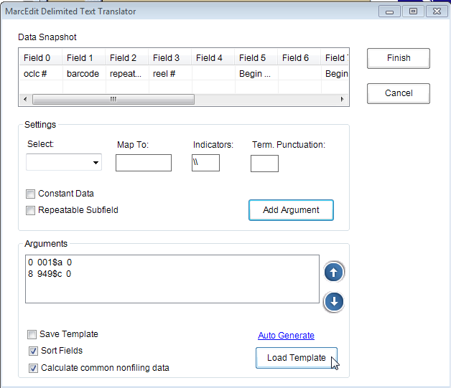
MarcEdit by Terry Reese http://marcedit.reeset.net/
Once you have saved a template you can simply push Load Template to reload the settings.

Slide 21
MarcEdit
Excel Column | MarcEdit Delimited Text Translator | Sierra Load Table

Slide 22
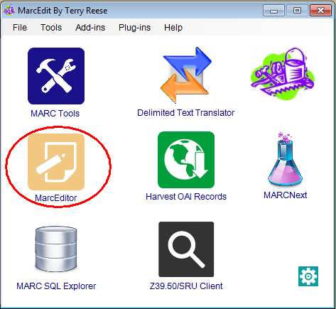
MarcEdit by Terry Reese http://marcedit.reeset.net/ MarcEditor
MarcEditor

Slide 23
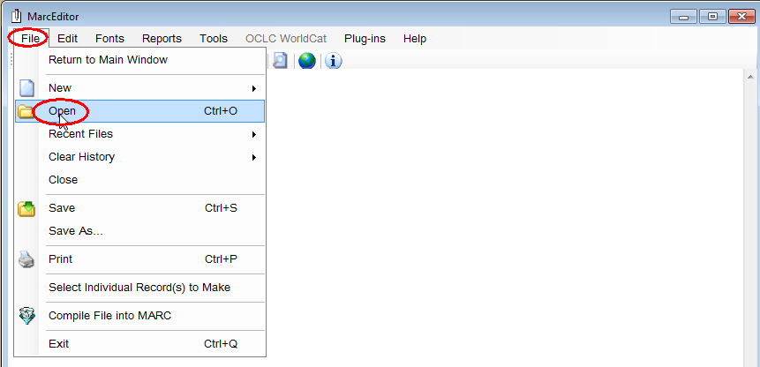
MarcEdit by Terry Reese http://marcedit.reeset.net/
Using MarcEditor, open the .mrk file you created.

Slide 24
MarcEdit by Terry Reese http://marcedit.reeset.net/
Using MarcEditor open the .mrk file you created.

Slide 25
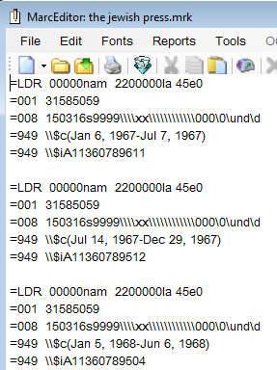
MarcEdit by Terry Reese http://marcedit.reeset.net/
Using MarcEditor open the .mrk file you created
The Excel columns are now in Marc fields!
Spot check your data.
If present delete the top two rows from the Excel file which contain column labels. Otherwise, your first two .mrk Marc records will be the column names.

Slide 26
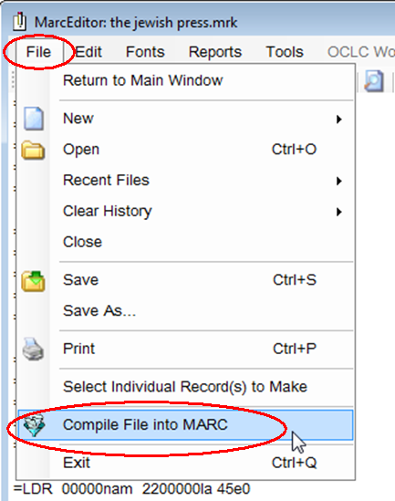
MarcEdit by Terry Reese http://marcedit.reeset.net/
Save as .mrc file by using Compile File into MARC
Under File use the Compile File into Marc
Compiled file is ready for loading into catalog!

Slide 27
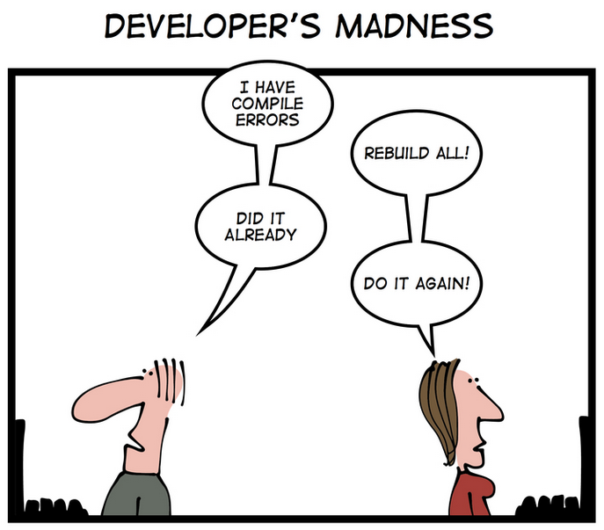
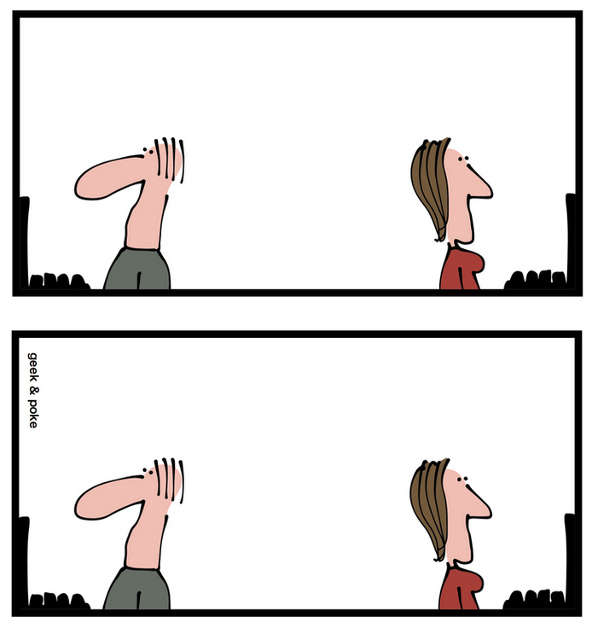
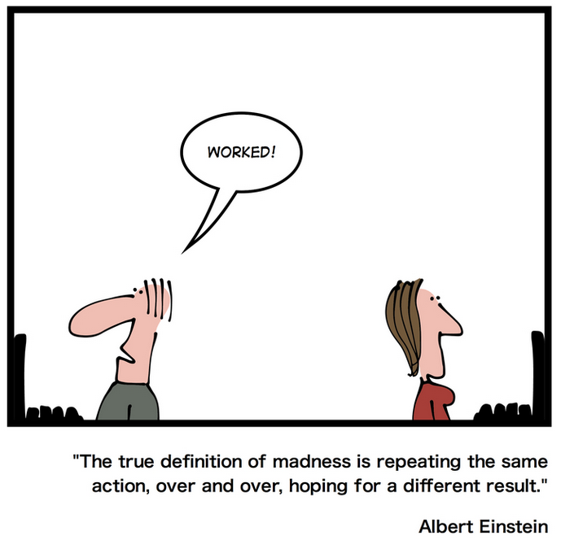
Questions?
www.geek-and-poke.comhttp://static1.squarespace.com/static/518f5d62e4b075248d6a3f90/t/54799076e4b0464e56d369f0/1417252988494/?format=750w

Slide 28
Load Profile Training ----- Innovative workshop
Upon completion of this course, the user will be able to:
Understand the structure of the Innovative database including:
Innovative record structure
Variable- and fixed-length fields in each record type
Field values for fixed-length fields
Understand the load profiles already in place on the system
Update existing load profiles for the following record types: bibliographic, authority, patron, item, order and holdings. All record types need to be provided in MARC format.
Create new load profiles for the following record types: bibliographic, authority, patron, item, order and holdings. All record types need to be provided in MARC format. * Description from CSDIRECT
Check the Innovative supportal for course options

Slide 29
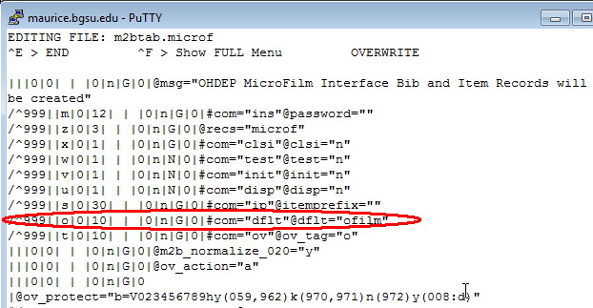
Load Profile Training
We copied our basic approval plan loader m2btab.pcat to m2btab.must for this project. Next we made minimal changes to the .microf and changed the default item record template since we were only creating item records!
(A resourceful and daring person could just rename their default templates for bib and item records and that might work)

Slide 30
Default Templates
No Default Bib Record Template necessary since we have a good Bib Record. We updated from OCLC record to overlay on for this project.
Sierra
=> Admin
=>Settings
=>Record Templates
Record Type: Bibliographic
Default Bib: mustbib

Slide 31
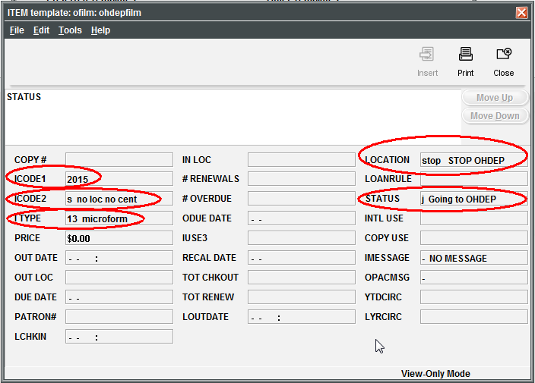
Default Templates
Sierra
=> Admin
=>Settings
=>Record Templates
Record Type: Item
Default Bib: ofilm

Slide 32
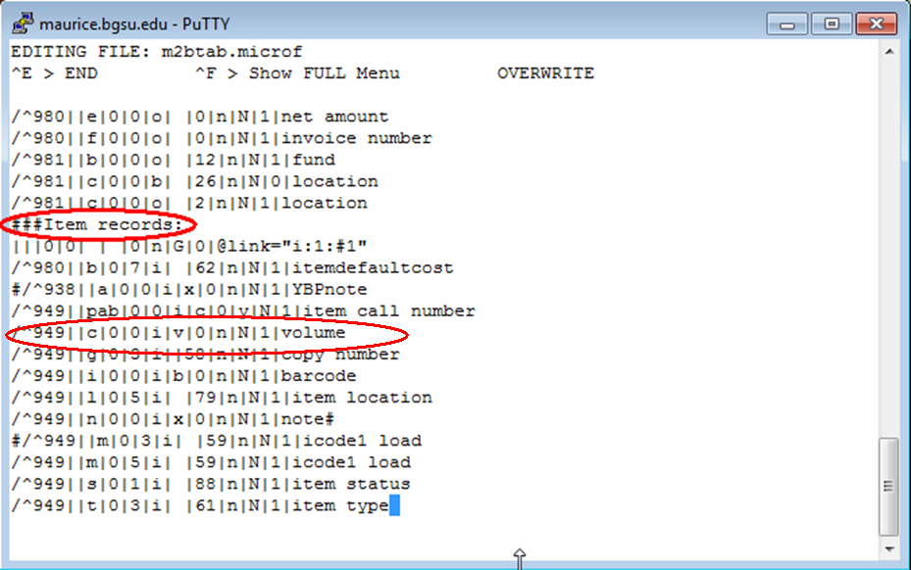
Load Profile Training
The Loader lines that determine which marc record fields drop into item record fields.

Slide 33
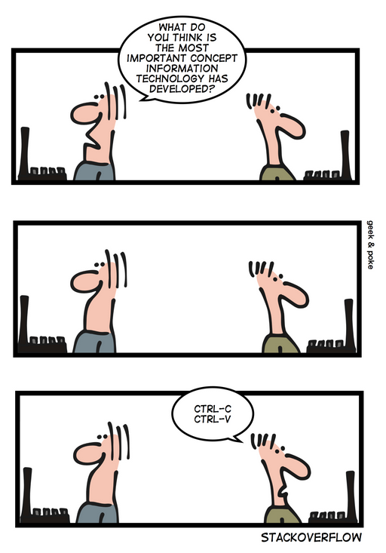
Questions?
www.geek-and-poke.com
http://s3.media.squarespace.com/production/2129687/19317774/.a/6a00d8341d3df553ef017ee7e988b6970d-pi

Slide 34
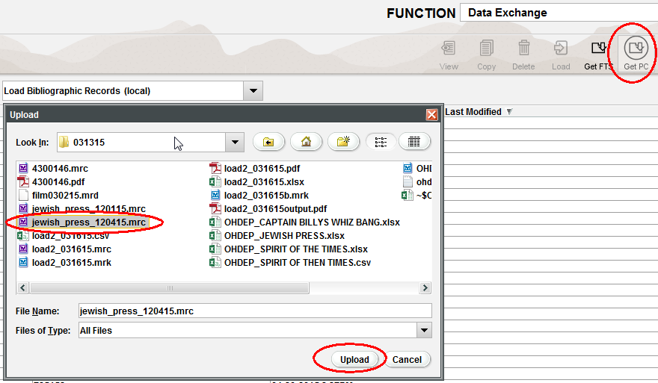
Sierra Data Exchange
Sierra Data Exchange; Select Process: Load Bibliographic Records (local)
Use Get PC, and then highlight saved file and click Upload

Slide 35
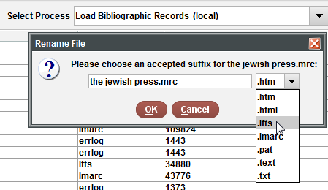
Sierra Data Exchange
Choose the suffix: .lfts
Highlight file with .lfts ending and use Prep in Sierra

Slide 36
Sierra Data Exchange
Click Start
When Prep is completed you’ll see the screen above

Slide 37
Sierra Data Exchange
Highlight file: Presentation Copy of 645Swanspl.mrc.lmarc
Choose Load
Select Loader: in our case: (T) LOAD ohdepfilm MARC file

Slide 38
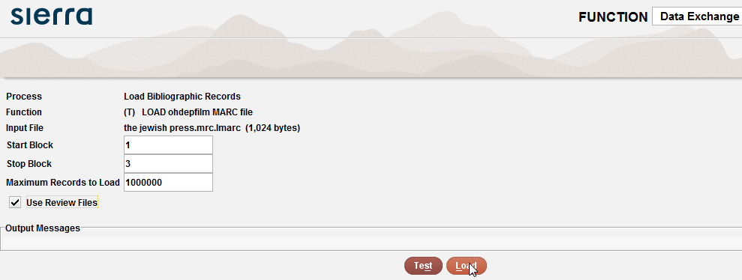
Sierra Data Exchange
checkmark the Use Review Files box
(So you will be able to review the loaded data in a review file)
Click Test first and if no errors click Load

Slide 39
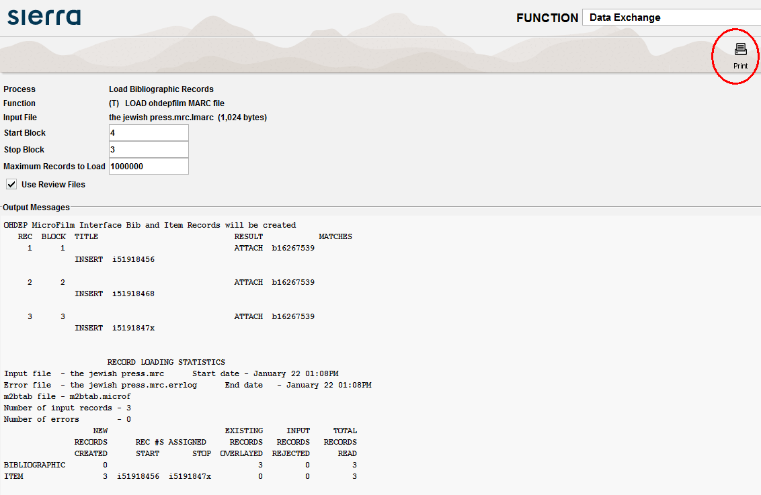
Sierra Data Exchange
Load Statistics screen
We Print these to a Windows .pdf file printer just in case we ever need to backtrack an issue

Slide 40
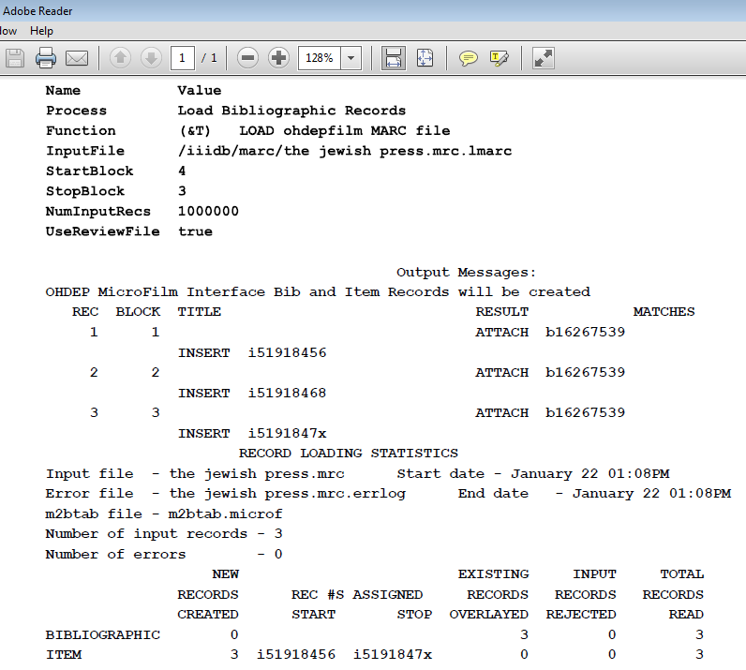
Sierra Data Exchange
Our .pdf file

Slide 41
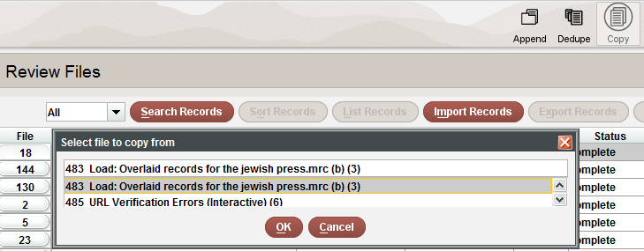
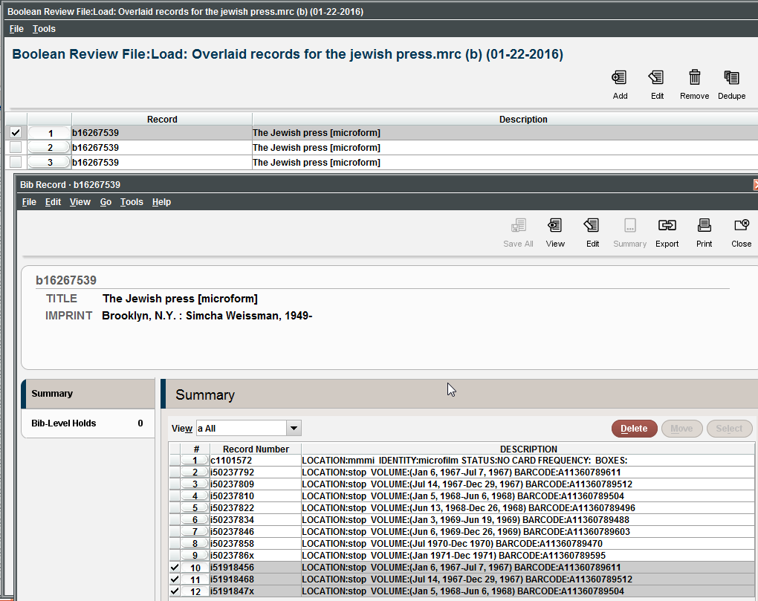
Sierra Create Lists
To create review file of loaded data (if you check marked the box earlier!)
In Create Lists, highlight and empty list, Click Copy, and then scroll down until you find the “Load: inserted records” for your file name.
(I always keep track of the number of records made and then search for that!)

Slide 42
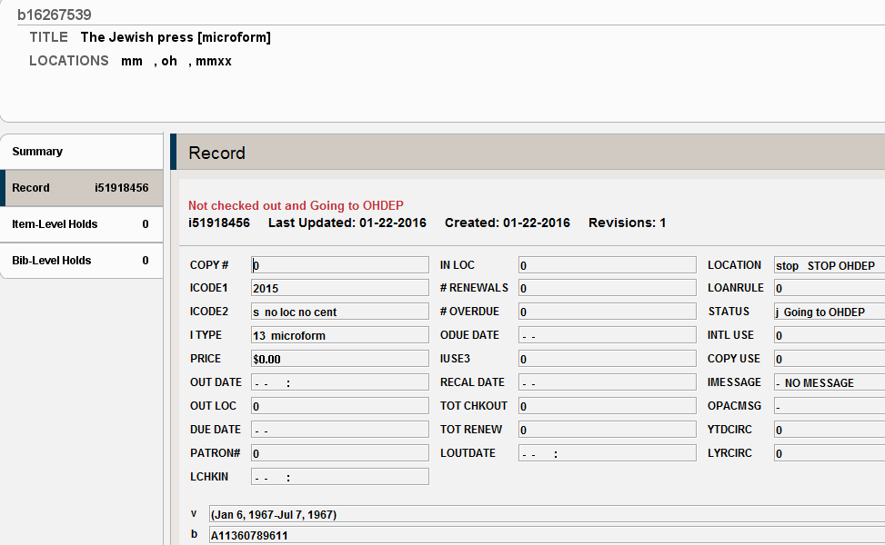
Sierra Item Record Created

Slide 43
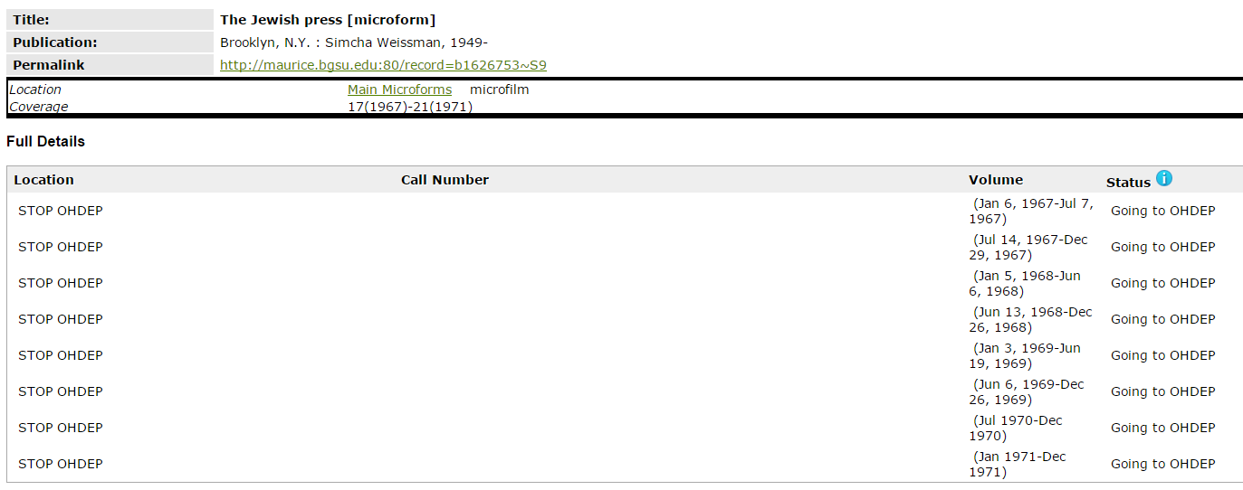
Public Web View
WebOPAC view of record we just created!
http://maurice.bgsu.edu:80/record=b1626753~S9

Slide 44
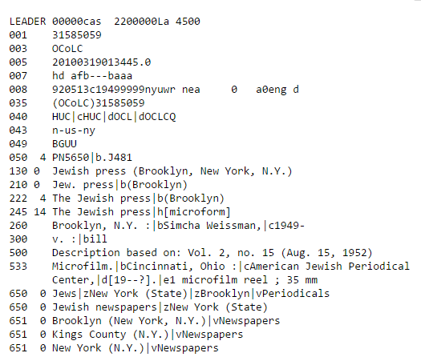
Public Web Marc View
http://maurice.bgsu.edu:80/record=b1626753~S9
WebOPAC Marc record view of the record we just created!

Slide 45
OHDEP catalog
We use an export record loader that Innovative wrote to export records
Staff at OhioLINK then uses an Innovative loader to load the records into the OHDEP Innovative catalog
http://ohdep.ohiolink.edu/record=b1929443~S0

Slide 46
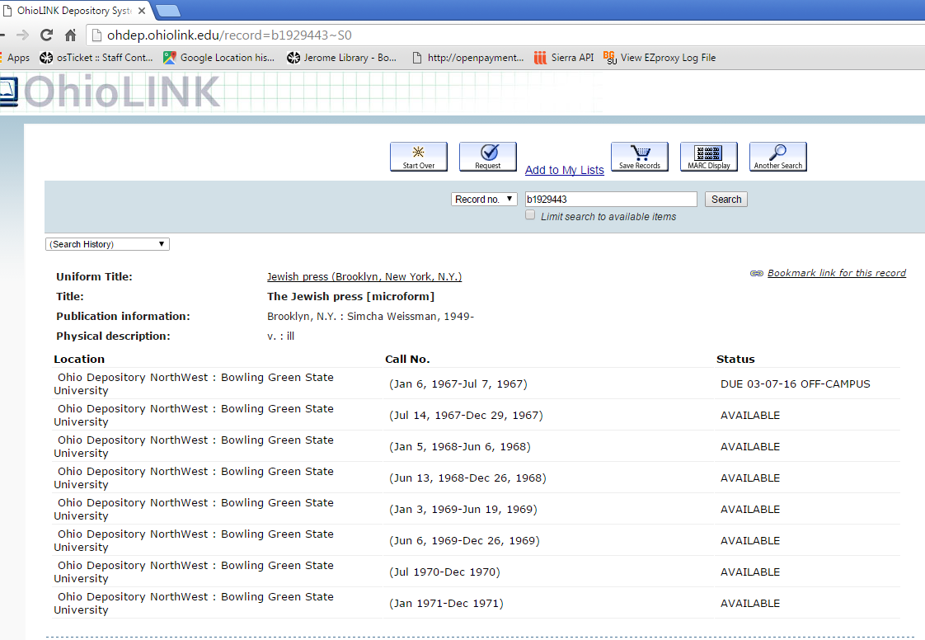
Public Web View
OHDEP catalog is not for public consumption
Users find materials via central OhioLINK catalog
http://ohdep.ohiolink.edu/record=b1929443~S0

Slide 47
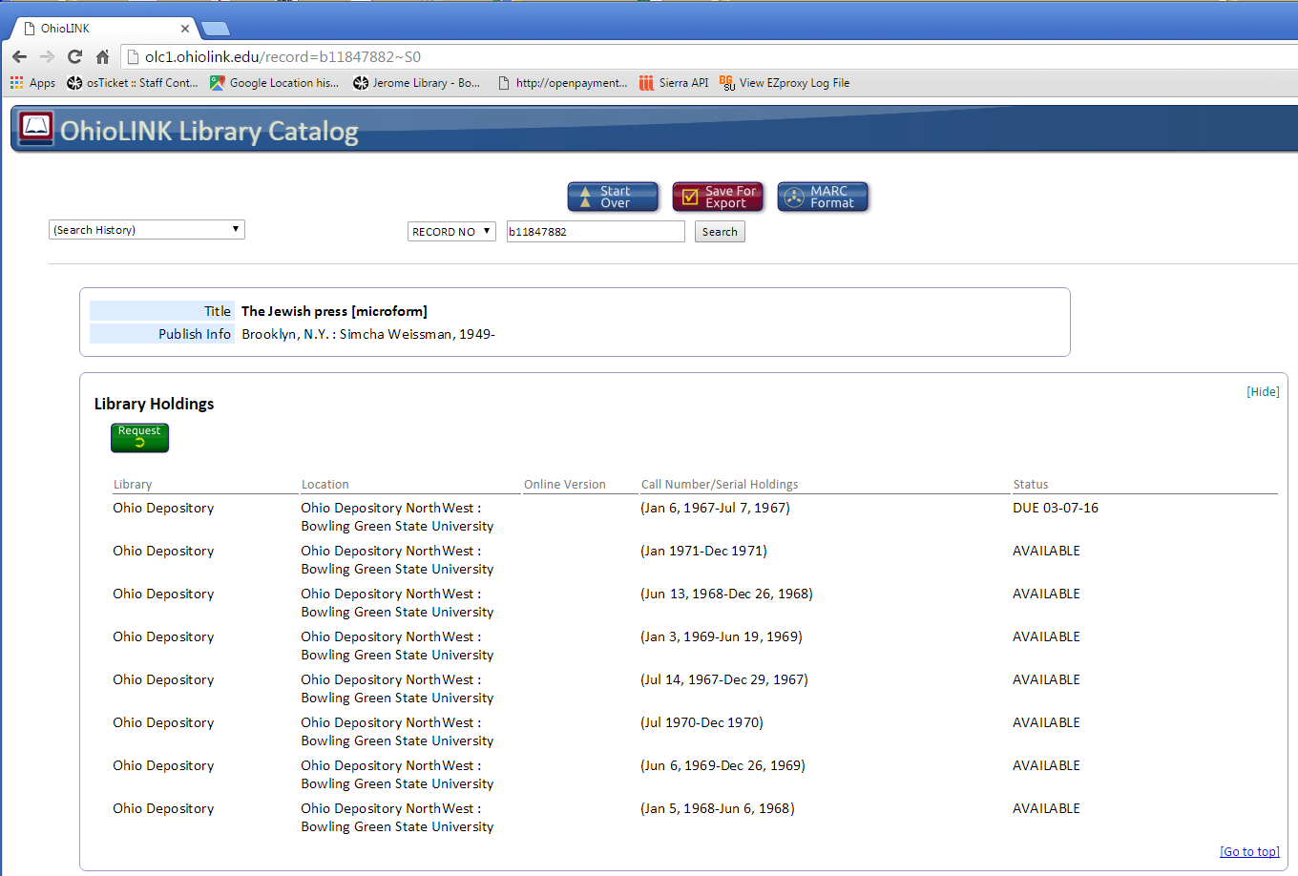
Public Web View
OhioLINK catalog!
http://olc1.ohiolink.edu/record=b11847882~S0

Slide 48
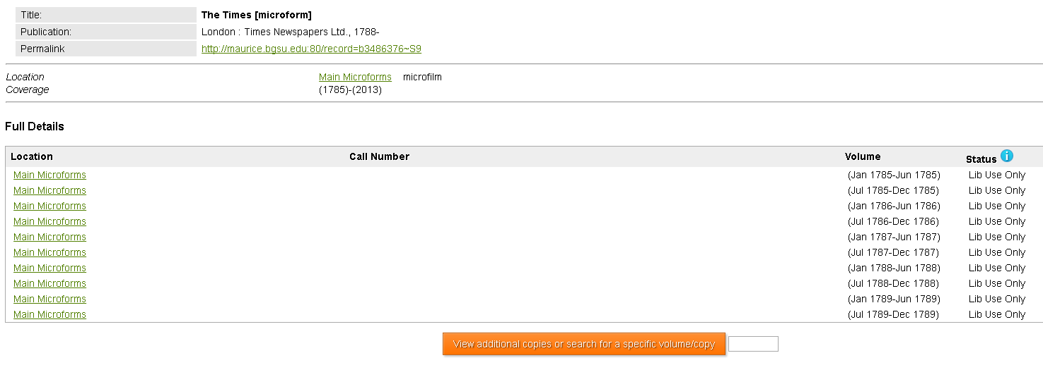
In-House Microfilm Titles
The Times [microfilm]
2,363 item records for reels of film created 09/29/16
http://maurice.bgsu.edu/record=b3486376~S9
The Times [microfilm]
2,363 item records for reels of film created 09/29/16

Slide 49
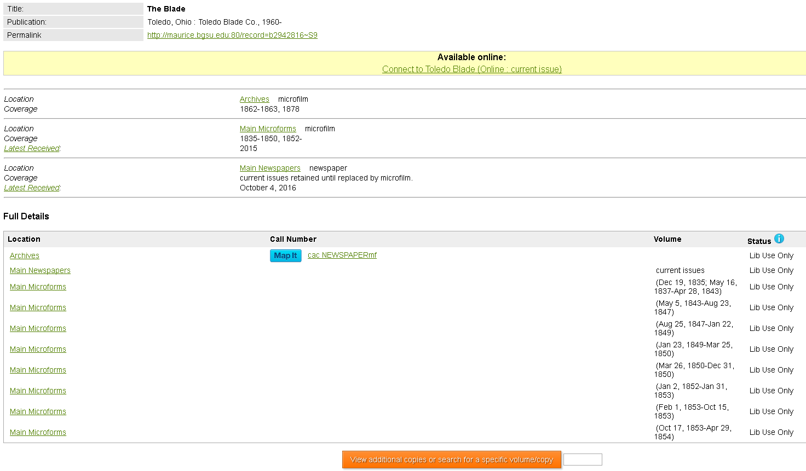
In-House Microfilm Titles
The Toledo Blade [microfilm]
1,750 item records for reels of film created
http://maurice.bgsu.edu:80/record=b2942816~S9

Slide 50
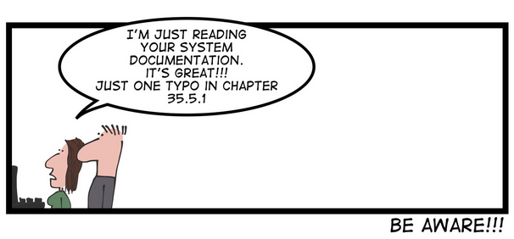
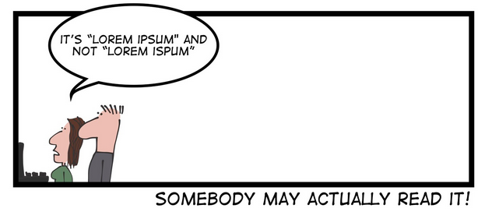
Questions?
www.geek-and-poke.com
http://static1.squarespace.com/static/518f5d62e4b075248d6a3f90/t/55df767fe4b0109239455328/1440708230004/?format=1500w

Slide 51
Microfilm OHDEP item records project - Polaris
With the MarcEdit loading into Millennium or Sierra I was able to have a marc file of multiple bib record entries each with it’s own 949 item record information to create separate item records.
Kellie Conner with Innovative Polaris confirmed my discovery that with Polaris import profile “…if there are duplicate records in the import profile, Polaris won’t overlay one after the other after the other. You would need to put all your new item records on one bib and with multiple 949’s and then that one will overlay and create the item records.
So the Polaris steps are a bit more theoretical for this project!
May not be as time saving as they were for Sierra.

Slide 52
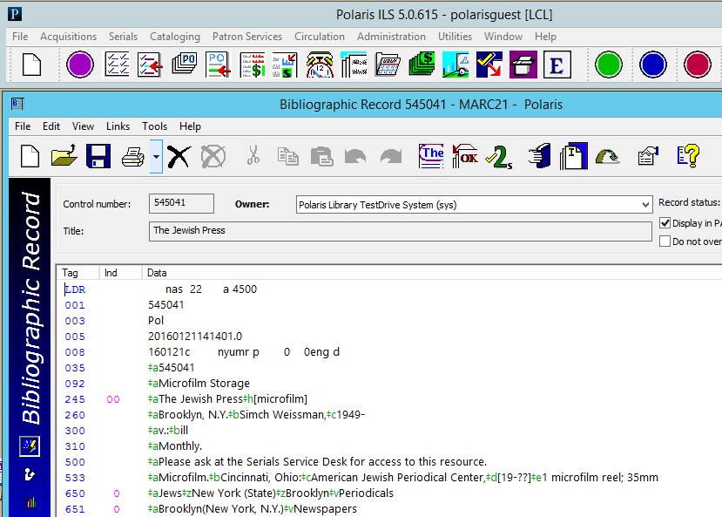
Microfilm OHDEP item records project - Polaris
First Create your Bibliographic record in
Polaris. The system will create a 001Control Number
In the case of my title “The Jewish Press” the Bib control number is 545041

Slide 53
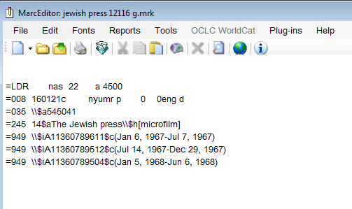
Microfilm OHDEP item records project - Polaris
In MarcEdit
1) Enter the Marc 035|a with the Polaris bibliographic control number
2) Redo your .mrk file to have one bib and then several 949 lines for each item record you want to create

Slide 54
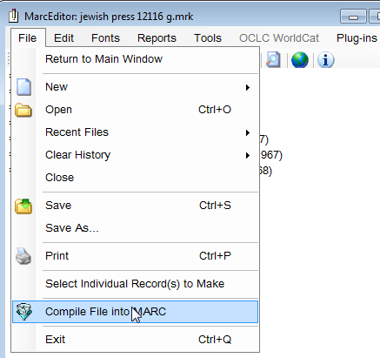
Microfilm OHDEP item records project - Polaris
In MarcEdit under File hit
Compile File into Marc

Slide 55
Microfilm OHDEP item records project - Polaris
Save your file, then transfer the file to the Polaris server.
(On the Polaris training server) I had to email the .mrc file to myself and then use the browser option to open my email and download it.)

Slide 56
Microfilm OHDEP item records project - Polaris
Define the item record template you want to have control the item record properties not defined in your MarcEdit file

Slide 57
Microfilm OHDEP item records project - Polaris
Under
Utilities
Importing
Profile Manager
you will create your profile, mine is Mark Jewish Press

Slide 58
Microfilm OHDEP item records project - Polaris
Define Bibliographic Records tab
Checkmark
Perform Duplication Detection
Use profile defined duplicate detection rules
Copy over rule:
Incoming 035 =a = existing 001
Check
Reject incoming record; add MARC retention tags to database record

Slide 59
Microfilm OHDEP item records project - Polaris
Click the circled box to get the Retain MARC Tags Dialog box to open,
Enter 949 in Tag: box

Slide 60
Microfilm OHDEP item records project - Polaris
Define Item Records tab
Holdings tab number: 949 since that is where I put data in MarcEdit file
Enter
Barcode: i
barcode info
Volume Number: c
This is where I stored volume info in MarcEdit
Check other boxes on left and choose your item template (for fields that are missing) in this case
MarkIUG Jewish Press

Slide 61
Microfilm OHDEP item records project - Polaris
Define your record sets: Select Bibliographic Record Set & Item Record Set
Click Import
A record set is something like a review file in Millennium and Sierra

Slide 62
Microfilm OHDEP item records project - Polaris
The Import Jobs Queue
Will open and tell you when your job is completed.
Click on the line of your job to see the import report

Slide 63
Microfilm OHDEP item records project - Polaris
The Import Report is useful in telling you what happened during the import and what went wrong

Slide 64
Microfilm OHDEP item records project - Polaris
Open your
Record Sets
I search by
Creation Date
since I don’t know my way around Polaris

Slide 65
Microfilm OHDEP item records project - Polaris
The record sets show what’s attached

Slide 66
Microfilm OHDEP item records project - Polaris
Bib Record after import
Notice the 949 added to bottom of record

Slide 67
Microfilm OHDEP item records project - Polaris
Bibliographic Linked Item Records

Slide 68
Microfilm OHDEP item records project - Polaris
Barcode
Item Record View
Volume info:

Slide 69
Microfilm OHDEP item records project - Polaris
Public view from within Polaris software

Slide 70
Microfilm OHDEP item records project - Polaris
http://testdriveprod.polarislibrary.com/Polaris/search/searchresults.aspx?ctx=1.1033.0.0.6&type=Keyword&term=the%20jewish%20press&by=KW&sort=RELEVANCE&limit=TOM=*&query=&page=0&searchid=2
Web Browser: Keyword Search View

Slide 71
Microfilm OHDEP item records project - Polaris
http://testdriveprod.polarislibrary.com/Polaris/search/searchresults.aspx?ctx=1.1033.0.0.6&type=Keyword&term=the%20jewish%20press&by=KW&sort=RELEVANCE&limit=TOM=*&query=&page=0&searchid=2
Web Browser: Availability View

Slide 72
Microfilm OHDEP item records project - Polaris
http://testdriveprod.polarislibrary.com/Polaris/search/searchresults.aspx?ctx=1.1033.0.0.6&type=Keyword&term=the%20jewish%20press&by=KW&sort=RELEVANCE&limit=TOM=*&query=&page=0&searchid=2
Web Browser
Full View

Slide 73
Questions?
http://static1.squarespace.com/static/518f5d62e4b075248d6a3f90/t/5618244de4b0b6c33369b832/14

Slide 74
Sam Pollock Pamphlet Collection

Slide 75
Sam Pollock Pamphlet Collection
Approximately 4,000 pamphlets that here processed by Marilyn Levinson, Manuscripts Curator, Center for Archival Collections; James Kaser, doctoral candidate in American Culture; and Pam Boehm, student assistant, BGSU Center for Archival Collections back in the 1990’s.
An extensive collection of over 4000 pamphlets on topics such as civil rights, socialism, Marxism, labor, the I. W. W., and foreign relations forms an important part of the Pollock Collection.
A Finding Aid was created for the pamphlet but the accession list lived in a database file on a personal desktop: https://lib.bgsu.edu/finding_aids/items/show/835

Slide 76
Pollack Pamphlet Collection Software used:
Microsoft Access 2013
MarcEdit 6.0 by Terry Reese
Delimited Text Translator
Marc Editor
Innovative Load Profile Training
Sierra Record Templates / Millennium Record Templates
Sierra Data Exchange / Load Records - Rel 2.0.1_6
Polaris ILS - Rel. 5.0.385

Slide 77
Access Database
Pollack Pamphlet Collection

Slide 78
Access Database
Export into Excel

Slide 79
Access Database
Export into Excel
In Excel added column with a note describing item, then saved file as a tab delimited .txt file.

Slide 80
Excel
Identify columns of data as to the Marc Record field you want them to go into.

Slide 81
Analyze Excel Data
 | Field Name | Marc Record
Column 1 | Title | 245
Column 2 | Author | 100
Column 3 | Place | 300 |a
Column 4 | Publisher | 300 |b
Column 5 | Date | 300 |c
Column 6 | Topic | 650
Column 7 | Number | 099|a
Column 8 | Note | 541|a
Column 9 | Local Note | 590
Column 10 | Barcode | 090|p
(Note: Microsoft Excel Online does not want to let you enter formula start with = cell number. Use desktop version.)

Slide 82
Questions?
http://static1.squarespace.com/static/518f5d62e4b075248d6a3f90/t/55e80a86e4b0936846c82ea7/1441270414139/?format=1500w

Slide 83
MarcEdit by Terry Reese http://marcedit.reeset.net/
Delimited Text Translator

Slide 84
MarcEdit by Terry Reese http://marcedit.reeset.net/
Open Delimited Text Translator
Enter Source file folder & name
Enter Output file folder & name
(change the extension to .mrk)
Delimiter: Tab
Qualifier: “
Click Next
If you get a weird error message make sure you closed the Excel document you are trying to process!

Slide 85
MarcEdit by Terry Reese http://marcedit.reeset.net/
Now the Excel columns need to be translated into Fields and given what Marc value the Fields will have.
Column 0 to become:
Marc 245 subfield a
Column 1 to become:
Marc 100 subfield a
Column 2 to become:
Marc 300 subfield a

Slide 86
MarcEdit by Terry Reese http://marcedit.reeset.net/
Create template for each column
Choose the Field you want to define from the pull-down menu

Slide 87
MarcEdit by Terry Reese http://marcedit.reeset.net/
Enter Data Select:
Field 0
Map To:
245$a
Press Add Argument
(The order of the arguments matters for the final Marc Record Load Display! We had issue with |a and |b not being loaded in proper order due to the order they were placed in the argument)

Slide 88
MarcEdit by Terry Reese http://marcedit.reeset.net/
Enter Data Select:
Field 0
Map To:
100$a
Press Add Argument
(The order of the arguments matters for the final Marc Record Load Display! We had issues with |a and |b not being loaded in proper order due to the order they were placed in the argument)

Slide 89
MarcEdit by Terry Reese http://marcedit.reeset.net/
Once you have entered all the arguments:
Checkmark Save Template
Load Template
You’ll be asked to save template as an .mrd file
After that you can just reload template

Slide 90
MarcEdit by Terry Reese http://marcedit.reeset.net/
Once you have entered all the arguments and saved them as templates you can simply push the Load Template button to get them back!

Slide 91
MarcEdit by Terry Reese http://marcedit.reeset.net/
Excel Column | MarcEdit Delimited Text Translator | Sierra Load Table
Delimited Text Translator puts 1 * when you group lines together
We put in 4 **** to handle articles

Slide 92
MarcEdit by Terry Reese http://marcedit.reeset.net/
Excel Column | MarcEdit Delimited Text Translator | Sierra Load Table
(The order of the arguments matters for the final Marc Record Load Display! We had issues with |a and |b not being loaded in proper order due to the order they were placed in the argument)

Slide 93
MarcEdit by Terry Reese http://marcedit.reeset.net/
Highlight and right mouse click on rows you need to combine into one Marc field
Once you hit Join Items
a * wildcard shows they are joined
Once template is loaded, click Finish.

Slide 94
MarcEdit by Terry Reese http://marcedit.reeset.net/
MarcEditor

Slide 95
MarcEdit by Terry Reese http://marcedit.reeset.net/
Using MarcEditor open the .mrk file you created

Slide 96
MarcEdit by Terry Reese http://marcedit.reeset.net/
The Excel columns are now in Marc Fields!
Spot check your data.
Delete the top two rows in Excel which contain column labels. Otherwise your first two .mrk file lines will have the column names in them!

Slide 97
MarcEdit by Terry Reese http://marcedit.reeset.net/
Save as .mrc file by using Compile File into MARC
Under File use
Compile File into Marc
Saved file is ready for loading into catalog!

Slide 98
Questions?
http://static1.squarespace.com/static/518f5d62e4b075248d6a3f90/t/553ab9e1e4b0c687eb37c4f5/1429912039427/?format=1500w

Slide 99
Load Profile Training
We copied our basic approval plan loader m2btab.pcat to m2btab.must for this project. Next we made minimal changes to the .must and then changed the default bib and item record templates.
(A resourceful and daring person could just rename their default templates for bib and item records and that might work)

Slide 100
Default Templates
Sierra
=> Admin
=>Settings
=>Record Templates
Record Type: Bibliographic
Default Bib: pollbib

Slide 101
Default Templates
Sierra
=> Admin
=>Settings
=>Record Templates
Record Type: Item
Default Bib: pollitem

Slide 102
Load Profile Training
The Loader lines that determine which Marc record fields drop into item record fields.

Slide 103
Questions?
http://static1.squarespace.com/static/518f5d62e4b075248d6a3f90/t/566f514e0ab377e17ad4cc43/1450135892625/?format=750w

Slide 104
Sierra Data Exchange
Sierra Data Exchange; Select Process: Load Bibliographic Records (local)
Use Get PC and then highlight saved file, Click Upload

Slide 105
Sierra Data Exchange
Choose suffix: .lfts
Highlight file with .lfts ending and use Prep in Sierra

Slide 106
Sierra Data Exchange
Click Start
When Prep is completed you see the following

Slide 107
Sierra Data Exchange
Highlight File: pollackwithnote020916.mrc.lmarc
Choose Load
Select Loader: in our Case (R) LOAD pollack MARC file

Slide 108
Sierra Data Exchange
Checkmark the Use Review Files box
(to review loaded data in a review file)
Click Test first and if there are no errors click Load
Load Statistics screen
# of records should match # from Marcedit!

Slide 109
Sierra Data Exchange
Load Statistics screen
We print these to a Windows .pdf file printer just in case we ever need to backtrack an issue

Slide 110
Sierra Create Lists
To create review file of loaded data (If you check marked box earlier!)
In Create Lists highlight and empty list, click Copy, then scroll down until you find the “Load: inserted records” for your file name
(I always keep track of the number of records made, then search for that!)

Slide 111
Sierra Bib Record Created
Record Templates for fixed field default information
Sierra
=> Admin
=>Settings

Slide 112
Sierra Item Record Created
Sierra
=> Admin
=>Settings
=>Record Templates for fixed field default information.

Slide 113
Public Web View
http://maurice.bgsu.edu:80/record=b3657469~S9
WebOPAC view of record we just created!

Slide 114
Public Web Marc View
http://maurice.bgsu.edu:80/record=b3657469~S9
WebOPAC Marc record view of record we just created!

Slide 115
Public Summon Discovery Layer View
http://bgsu.summon.serialssolutions.com/search?s.q=What+Hitler+wants&spellcheck=true#!/search?ho=t&l=en&q=What%20Hitler%20wants

Slide 116
Questions?
www.geek-and-poke.com
http://static1.squarespace.com/static/518f5d62e4b075248d6a3f90/t/55df767fe4b0109239455328/1440708230004/?format=1500w

Slide 117
Polaris
Utilities
Importing
Full Import
Polaris Training server access provided by:
Dennis Todd, Senior Sales Engineer, Innovative Interfaces, Syracuse, NY
Assisted me with this process at dennis.todd@iii.com

Slide 118
Polaris
Highlight your profile
Click add to load the file you wish to upload.

Slide 119
Polaris
MarkPollock template
Bibliographic Records tab

Slide 120
Polaris
MarkPollock template
Item Records tab
Click Import

Slide 121
Polaris
Click Add
Select file to load
Click Open to select file
Click Import at bottom of window to import

Slide 122
Polaris
Processing Screen
Click refresh button until finished

Slide 123
Polaris
Status: Completed
Records Read: 8
Records Created: 16
Double click highlighted load / import to see: import report

Slide 124
Polaris
Import report is a .pdf file
File load name
Submitted date
Scroll to bottom to see statistics
Time
Bib records created
Item records created
Total records created

Slide 125
Polaris
Cataloging
Bibliographic Records
Creation date
Search

Slide 126
Polaris
Double Click:
What Hitler wants

Slide 127
Polaris
Click the green bent arrow button to get to item record

Slide 128
Polaris

Slide 129
Polaris: Public View
http://testdriveprod.polarislibrary.com/Polaris/search/

Slide 130
Polaris: Public View
http://testdriveprod.polarislibrary.com/Polaris/search/searchresults.aspx?ctx=1.1033.0.0.6&type=Keyword&term=what%20hitler%20wants&by=KW&sort=RELEVANCE&limit=TOM=*&query=&page=0&searchid=2

Slide 131
Polaris: Public View
http://testdriveprod.polarislibrary.com/Polaris/search/title.aspx?ctx=1.1033.0.0.6&pos=1

Slide 132
Questions?
http://static1.squarespace.com/static/518f5d62e4b075248d6a3f90/t/5618244de4b0b6c33369b832/1444422738776/?format=1500w

Slide 133
Cataloging 45-RPM Records
Hidden Collections Grant
Getting to the Core: Cataloging 45-RPM Records
Cataloging of approximately 64,800 45-RPM recordings of popular music.

Slide 134
Getting to the Core: Cataloging 45-RPM Records
Data entry performed by student assistants

Slide 135
Software used:
Microsoft Excel 2013
Columns & Formulas
MarcEdit 6.0 by Terry Reese
Delimited Text Translator
Marc Editor
Innovative Load Profile Training
Sierra Record Templates / Millennium Record Templates
Sierra Data Exchange / Load Records - Rel 2.0.1_6
Polaris ILS - Rel. 5.0.385
Microsoft Office Online / 365 Team Site

Slide 136
Excel
Identify columns of data you
want for records and what
students will enter

Slide 137
Excel
Column 1 | Main Performer Single Artist -Side A (100) | [student entered]
Column 2 | Main Performer Group-Side A (110) | [student entered]
Column 3 | Song Title-Side A (245) | [student entered]
Column 4 | Song Title-Side B (245 :|b) | [student entered]
Column 5 | Label Name (028 02 |b) | [student entered]
Column 6 | Label Number-prefix letters | [student entered]
Column 7 | Label Number-publisher number | [student entered]
Column 8 | Label Number-DJ, promo | [student entered]
Column 9 | Copy 2 | [student entered]
Column 10 | Label Number (028 02 |a) combined | excel formula : =F3&" "&G3&" "&H3
Column 11 | Subject Heading (650) | [student entered]
Column 12 | Physical Description (300) | same for all: 1 sound disc :|b analog, 45 rpm ;|c 7 in.
Column 13 | GMD (245 |h) | same for all: [sound recording]
Column 14 | Access Information 500|a | same for all: Please ask at the Music Service Desk on the 3rd Floor of Jerome Library for access to this title.
Column 15 | Call Number | same for all: Uncat 7/45
Column 16 | Call Number 099a | excel formula: =O3&" "&E3&" "&G3&" "&H3
(Note: Microsoft Excel Online does not want to let you enter formula start with = cell number. Use desktop version.)

Slide 138
Excel Data

Slide 139
Excel
Use Excel Auto Fill feature to fill cells with data that follows a pattern or that is based on data in other cells.
Highlight two rows you want to duplicate, double click on the plus and all the rows below will be copied!
https://support.office.com/en-za/article/Fill-data-automatically-in-worksheet-cells-74e31bdd-d993-45da-aa82-35a236c5b5db

Slide 140
Excel
Once Spreadsheet is populated with data, Save As:
Text (Tab delimited (*.txt)

Slide 141
Questions?
www.geek-and-poke.com
http://static.squarespace.com/static/518f5d62e4b075248d6a3f90/t/51a9b970e4b0c88fb20001a7/1370077560997/clippy.jpg?format=500w

Slide 142
MarcEdit by Terry Reese http://marcedit.reeset.net/
Delimited Text Translator

Slide 143
MarcEdit by Terry Reese http://marcedit.reeset.net/
Open Delimited Text Translator
Enter Source file folder & name
Enter Output file folder & name
(change the extension to .mrk)
Delimiter: Tab
Qualifier: “
Next click on
Edit LDR/008

Slide 144
MarcEdit by Terry Reese http://marcedit.reeset.net/
Before After
We changed the Leader as follows:
LDR 00000nam 2200000Ia 45e0 => LDR 00000njm 22000002a 4500
008 s9999\\\\xx\\\\\\\\\\\\000\0\und\d => 008 s9999\\\\xx\\\\\\\\\\\\\00\\\eng\d
Click OK

Slide 145
MarcEdit by Terry Reese http://marcedit.reeset.net/
Sierra
MAT TYPE
LANG
MARC 008 date
Before nam a = book format
\und\ Undertermined
After
njm j = Sound Recording
\eng\ English
load current date

Slide 146
MarcEdit by Terry Reese http://marcedit.reeset.net/
Open Delimited Text Translator
Enter Source file folder & name
Enter Output file folder & name
(change the extension to .mrk)
Delimiter: Tab
Qualifier: “
Click Next
If you get a weird error message make sure you closed the Excel document you are trying to process!

Slide 147
MarcEdit by Terry Reese http://marcedit.reeset.net/
Now the Excel columns need to be translated into Fields and what Marc value the Fields will have
Column 0 to become:
Marc 100 subfield a
Column 1 to become:
Marc 110 subfield a
Column 2 to become:
Marc 245 subfield a

Slide 148
MarcEdit by Terry Reese http://marcedit.reeset.net/
Create template for each column by hitting
Add Argument
button

Slide 149
MarcEdit by Terry Reese http://marcedit.reeset.net/
Enter Data
Select:
Field 0
Map To:
100$a
Press Add Argument
(The order of the arguments matters as to the final Marc Record Load Display! We had issue with |a and |b not being loaded in proper order due to the order they were placed in the argument)

Slide 150
MarcEdit by Terry Reese http://marcedit.reeset.net/
Once you have entered all the arguments and saved them as a template you can simply push the Load Template button to get them back!

Slide 151
MarcEdit by Terry Reese http://marcedit.reeset.net/
Excel Column | MarcEdit Delimited Text Translator | Sierra Load Table
Load 245 |b into Alternate Title
Delimited Text Translator puts 1 * when you group lines together
We put in 4 **** to handle articles

Slide 152
MarcEdit by Terry Reese http://marcedit.reeset.net/
Excel Column | MarcEdit Delimited Text Translator | Sierra Load Table
(The order of the arguments matters for the final Marc Record Load Display! We had issues with |a and |b not being loaded in proper order due to the order they were placed in the argument)

Slide 153
MarcEdit by Terry Reese http://marcedit.reeset.net/
Notice the *****
these wildcards remove articles
A * is also generated when you group arguments
Once template is loaded click Finish.

Slide 154
MarcEdit by Terry Reese http://marcedit.reeset.net/
MarcEditor

Slide 155
MarcEdit by Terry Reese http://marcedit.reeset.net/
Using MarcEditor open the .mrk file you created

Slide 156
MarcEdit by Terry Reese http://marcedit.reeset.net/
Using MarcEditor open the .mrk file you created
The Excel columns are now in Marc fields!
Spot check your data.
We delete the top two rows in Excel which contains column labels. Otherwise your first two .mrk file lines will have the column names in them!

Slide 157
MarcEdit by Terry Reese http://marcedit.reeset.net/
Save as .mrc file by using Compile File into MARC
Under File use the Compile File into MARC
Saved file is ready for loading into catalog!

Slide 158
Questions?
www.geek-and-poke.comhttp://static1.squarespace.com/static/518f5d62e4b075248d6a3f90/t/54799076e4b0464e56d369f0/1417252988494/?format=750w

Slide 159
Load Profile Training
We copied our basic approval plan loader m2btab.pcat to m2btab.must for this project. Next we made minimal changes to the .must and then changed the default bib and item record templates.
(A resourceful and daring person could just rename their default templates for bib and item records and that might work)

Slide 160
Default Templates
Sierra
=> Admin
=>Settings
=>Record Templates
Record Type: Bibliographic
Default Bib: mustbib

Slide 161
Default Templates
Sierra
=> Admin
=>Settings
=>Record Templates
Record Type: Item
Default Bib: mustitem

Slide 162
Load Profile Training
The Loader lines that determine which Marc record fields drop into item record fields

Slide 163
Load Profile Training
The Loader lines that determine which Marc record fields drop into item record fields

Slide 164
Load Profile Training
The Loader lines that determine which Marc record fields drop into item record fields

Slide 165
Questions?
www.geek-and-poke.com
http://s3.media.squarespace.com/production/2129687/19317774/.a/6a00d8341d3df553ef017ee7e988b6970d-pi

Slide 166
Sierra Data Exchange
Sierra Data Exchange; Select Process: Load Bibliographic Records (local)
Use Get PC, highlight saved file, click Upload

Slide 167
Sierra Data Exchange
Choose suffix .lfts
Highlight file with .lfts ending and use Prep in Sierra

Slide 168
Sierra Data Exchange
Click Start
When Prep is completed you see the following.

Slide 169
Sierra Data Exchange
Highlight file: Presentation Copy of 645Swanspl.mrc.lmarc
Choose Load
Select Loader: in our case: (X) LOAD must MARC file
Fun Fact:
This image predates our Sierra 2.1.0_4 update!

Slide 170
Sierra Data Exchange
checkmark the Use Review Files box
(to review loaded data in a review file)
Click Test first and if no errors click Load

Slide 171
Sierra Data Exchange
Load Statistics screen
We Print these to a Windows .pdf file printer just in case we ever need to backtrack an issue

Slide 172
Sierra Create Lists
To create review file of loaded data (If you check marked box earlier!):
In Create Lists, highlight and empty list, click copy, then scroll down until you find the “Load: inserted records” for your file name
(I always keep track of the number of records made and then search for that!)

Slide 173
Sierra Bib Record Created
Sierra
=> Admin
=>Settings
=>Record Templates for fixed field default information.

Slide 174
Sierra Item Record Created
Sierra
=> Admin
=>Settings
=>Record Templates for fixed field default information.

Slide 175
Public Web View
http://maurice.bgsu.edu:80/record=b3967621~S9
WebOPAC view of record we just created!

Slide 176
Public Web Marc View
http://maurice.bgsu.edu:80/record=b3967621~S9
WebOPAC Marc record view of record we just created!

Slide 177
Public Summon Discovery Layer View
http://bgsu.summon.serialssolutions.com/search?s.q=What%27s+gonna+happen+when+summer%27s+done&spellcheck=true#!/search?ho=t&fvf=ContentType,Audio%20Recording,f&l=en&q=June,%20July,%20and%20August:%20%20palisades%20park

Slide 178
Questions?
www.geek-and-poke.com
http://static1.squarespace.com/static/518f5d62e4b075248d6a3f90/t/55df767fe4b0109239455328/1440708230004/?format=1500w

Slide 179
Polaris
Utilities
Full Import
Polaris Training Server access provided by:
Dennis Todd, Senior Sales Engineer, Innovative Interfaces, Syracuse, NY
Assisted me with this process: dennis.todd@iii.com

Slide 180
Polaris
Choose: Polaris default
Note: This Loader using the exact MarcEdit process we use, will not create Item records and the bib records created will have some errors in them.

Slide 181
Polaris
Click Add
Select file to load
Click Import button at bottom of screen

Slide 182
Polaris

Slide 183
Polaris

Slide 184
Polaris

Slide 185
Polaris

Slide 186
Polaris: Public View
http://testdriveprod.polarislibrary.com/Polaris/search/searchresults.aspx?ctx=1.1033.0.0.1&type=Keyword&term=June,%20July,%20and%20August&by=KW&sort=RELEVANCE&limit=TOM=*&query=&page=0&searchid=2

Slide 187
Polaris: Public View
http://testdriveprod.polarislibrary.com/Polaris/search/title.aspx?ctx=1.1033.0.0.1&pos=1

Slide 188
Sound Recordings
2 Projects:
CLIR Hidden Collections Grant for 45-RPM Records
Students started data entry into Excel: May, 2015
44,863 45’s completed (10/06/16)
Uncataloged lps project
Students started data entry a into Excel: April 2013
65,919 completed (10/06/16)
For More Information Contact:
Patty Falk
Music Catalog and Metadata Librarian
Music Library and Sound Recordings Archives
Bowling Green State University
pkfalk@bgsu.edu

Slide 189
Questions?
Thank You!
Mark Strang
mstrang@bgsu.edu

Slide 190
Questions?
www.geek-and-poke.com
http://static.squarespace.com/static/518f5d62e4b075248d6a3f90/t/51a9b970e4b0c88fb20001a7/1370077560997/clippy.jpg?format=500w

Slide 191
Microsoft 365 TeamSite
Microsoft Teamsite
Used for project file sharing
Office 365 (Excel) used by students for data entry
(Previous projects used Dropbox but BGSU Central IT outlawed this program due to Dropbox terms of service agreement)

Slide 192
Microsoft TeamSite
MLSRA (Patty) has control over access to all documents, folders, and sharing to student workers in TeamSite for project.
Students use same password as their campus email

Slide 193
Microsoft TeamSite
Students do data entry via
Office 365
Excel online
All updates saved as well as 4 file revision history

Slide 194
Microsoft TeamSite
Patty downloads files to desktop for processing
1) Online Excel has issues with entering = part of formula properly
2) MarcEdit cannot access Teamsite files for processing.
3) Microsoft TeamSite and Office 365 are works in progress that change frequently, but the student data entry into Excel has stayed consistent

Slide 195
Questions?
www.geek-and-poke.com
http://static.squarespace.com/static/518f5d62e4b075248d6a3f90/t/51c22ff2e4b09c37644db13c/1371680764953/descartes-heisenberg.jpg?format=750w

