Slide 1
What is SvS? Sierra via Summon, of course!
Susan Johns-Smith & Brent D. Cook

Slide 2
Sierra via Summon
Where are We Now?
Currently Planned
Future Considerations
How to Make it * Really * Zing! ?

Slide 3
Sierra via Summon - Where are We Now?
Functioning With CAS
Using both barcode/PIN and Active Directory Authentication
Placing Holds
Reviewing Patron Record
Observing Fines / Messages
Real Time Availability of Items

Slide 4
Currently Planned Development

Slide 5
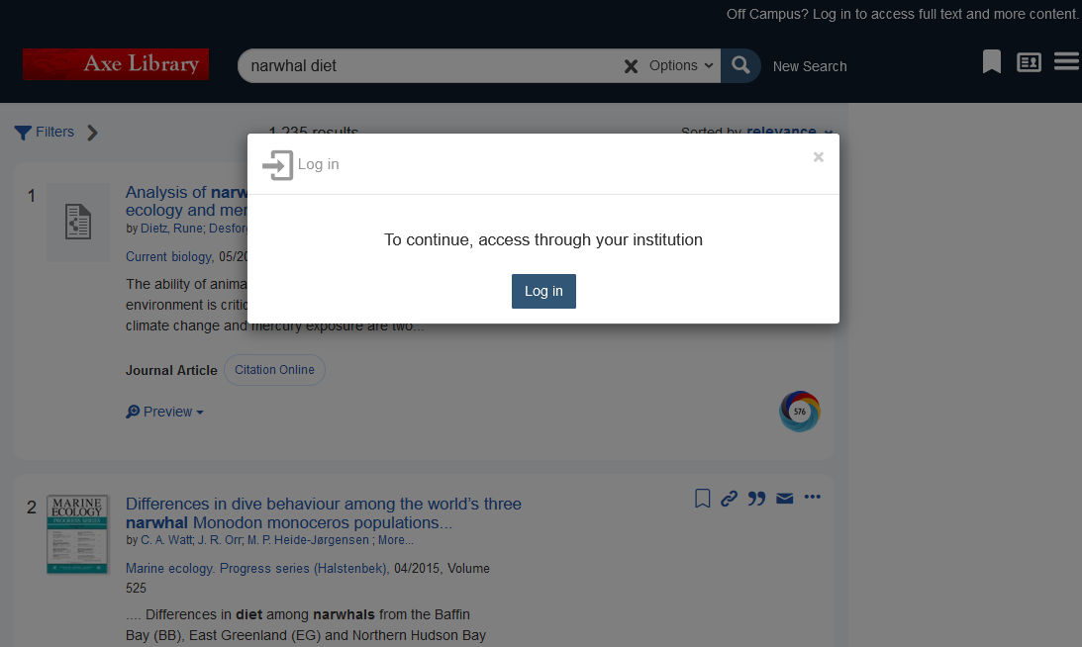
Sierra via Summon – Currently Planned
Ability to log into Sierra via Summon using SAML authentication
Add SAML integration to the current Sierra via Summon integration
Will support both CAS and SAML
First step in additional improvements for authentication

Slide 6
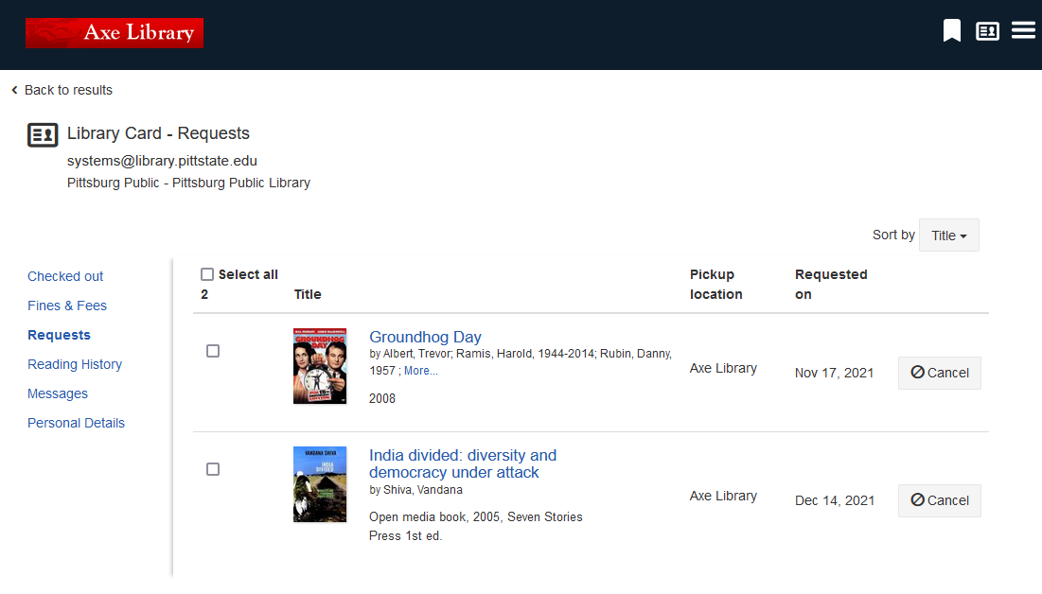
Sierra via Summon
Provide Ability to Configure elements displayed in the My Library Card page
Ability to turn sections on or off
Ability to set order of displayed sections

Slide 7
Sierra via Summon – Potential Additional Functionality
Saved Searches via Sierra login
Multi-type Authentication Support (CAS and SAML for the same institution)
The ability to freeze a request (via the /patrons/holds endpoint)
A link to view library events
Ability to display the patron's library card expiration date
Seamless Synchronization
Continued improvements based on customer feedback
This development will be completed after the first phase of requirements are done and as capacity and time allows.

Slide 8
Things to Work On

Slide 9
Sierra via Summon – Things to Work On
Holds appear to be “copy returned soonest”
Do not appear to be item-level, but bib-level only – not reading institutional preferences
Public Notes ? OPAC messages
Other Patron Messages > Blocks > Notifications
Still Room for Improvement and Accuracy

Slide 10
Sierra via Summon – Future Considerations
Missing Reserve Book Room Functionality
Course / Instructor –
Item Call Number displays but searching among courses or instructors, or using facet / function on “course material” > not so great
Need to stay within Summon to do end-user searching of course and instructor

Slide 11
Sierra via Summon – Future Considerations
Data Management –
Catalog updates need to synch quickly to Summon
Scheduler seems inadequate for the task
Is not just a matter of outputting the database
Needs to honor the suppressed statuses and non-display statuses
Needs to be able to quickly update patron changes

Slide 12
Sierra via Summon – Future Considerations
Expectation of seamless synchronization
> not yet achieved

Slide 13
Sierra via Summon – Kudos
Grateful for where we are
Development, and working with developers has been both rewarding and productive
Customers and developers have gotten off to a great start

Slide 14
Sierra via Summon – How to Make it Zing!?
Additional Work Needs to Continue
We need to push to a complete “package”
Patron “empowerment” is only one piece of the puzzle

Slide 15
Sierra via Summon – How to Make it Zing?!
Scope Independence (display, patron features)
Develop Side Panels for ILS navigation
Minimize reliance on Encore or Webopac for more information (bib display, patron info)

Slide 16
Sierra via Summon
All said, we’ve made remarkable progress
Are we having FUN YET?
Of Course!

Slide 17
Sierra via Summon - Kudos
Summon Working Group (SWG, or SPWG)
Advocating for all products using Summon
Representation listens, as well as Product Management
https://el-una.org/working-groups/summon360-link-working-group/

Slide 18
Sierra via Summon – Setup for More Information
An overview and specifics on getting your instance of SvS set up can be found on the Ex Libris Knowledge Center under:
Summon Product Documentation >> Configuring The Summon Service >> Summon: Sierra via Summon Integration
https://knowledge.exlibrisgroup.com/Summon/Product_Documentation/Configuring_The_Summon_Service/020Configurations_within_the_Summon_Administration_Console/Summon%3A_Sierra_via_Summon_Integration

Slide 19
THANK YOU
Questions?

Slide 20
THANK YOU
Susan Johns-Smith,
sjohnssmith@pittstate.edu
Brent Cook,
Brent.Cook@exlibrisgroup.com

