Slide 1
Messy, Messy Records
The Who, How, and When of Polaris Bibliographic Record Clean-up and Maintenance
C Mulder, Charlie Rosenthal, Elaine Sloan, Eleanor Crumblehulme

Slide 2
Enlisting help with metadata projects
C Mulder

Slide 3
Clinton-Macomb Public Library
Suburban library with 3 locations, serving a population of 185,000+
Collection Management Department
1 librarian manager
3 paraprofessional copy catalogers
10-14 part time pages
Hours available for bib clean-up: never enough

Slide 4
Monthly SQL Clean-ups
Missing call number
Alpha characters in item record class field
Audiobooks without number of discs
EDI orders not released/sent
On-order for 6+ months
Items weeded not deleted & deleted not weeded
Etc.

Slide 5
Book Series Project - The Problem
But how do I know what order to read them in?

Slide 6
Book Series Project - The Solution
245 Field Edits
Update cataloging workflow
Tackle the backlog
Enlist help!
Write very specific instructions
Old 245:
New 245:

Slide 7
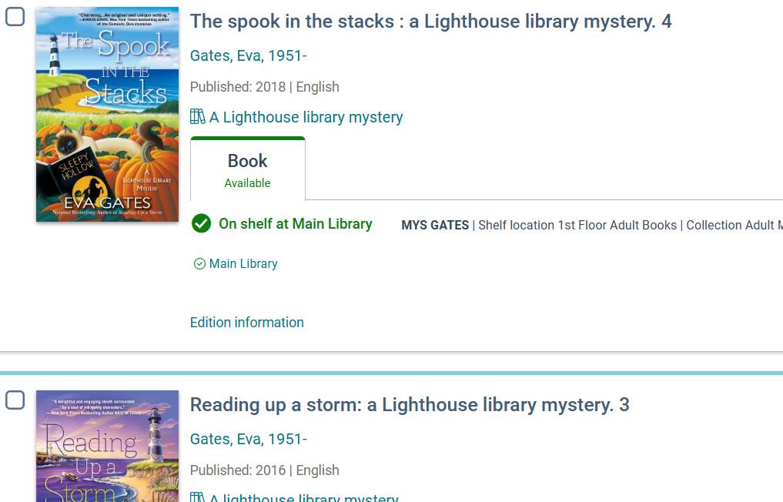
Book Series Project - The Result

Slide 8
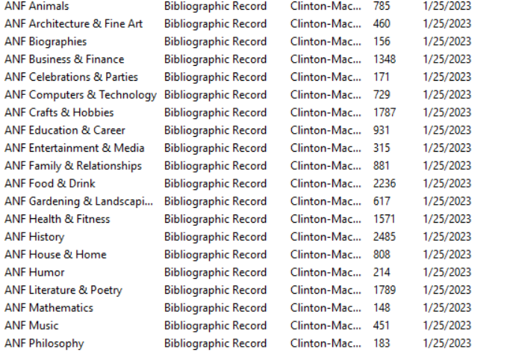
Nonfiction Classification
Record sets & more record sets!

Slide 9
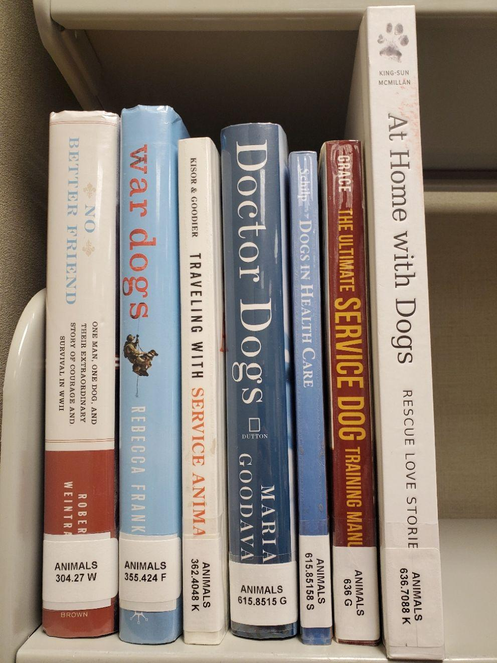
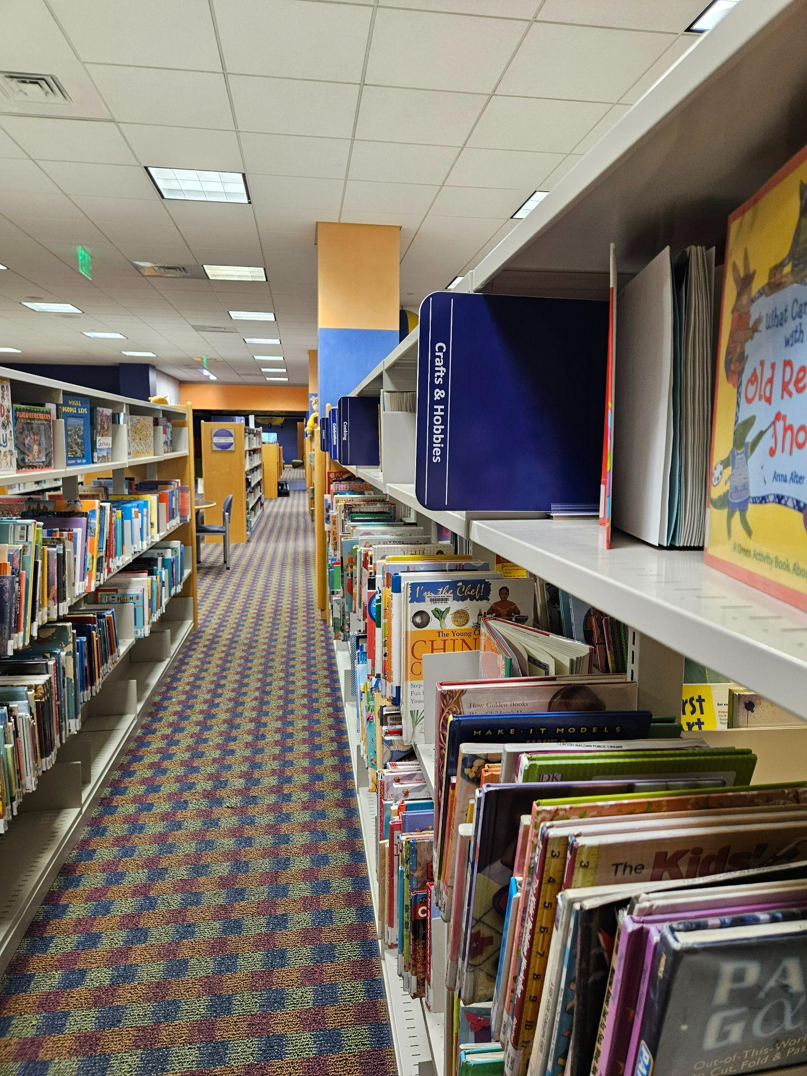
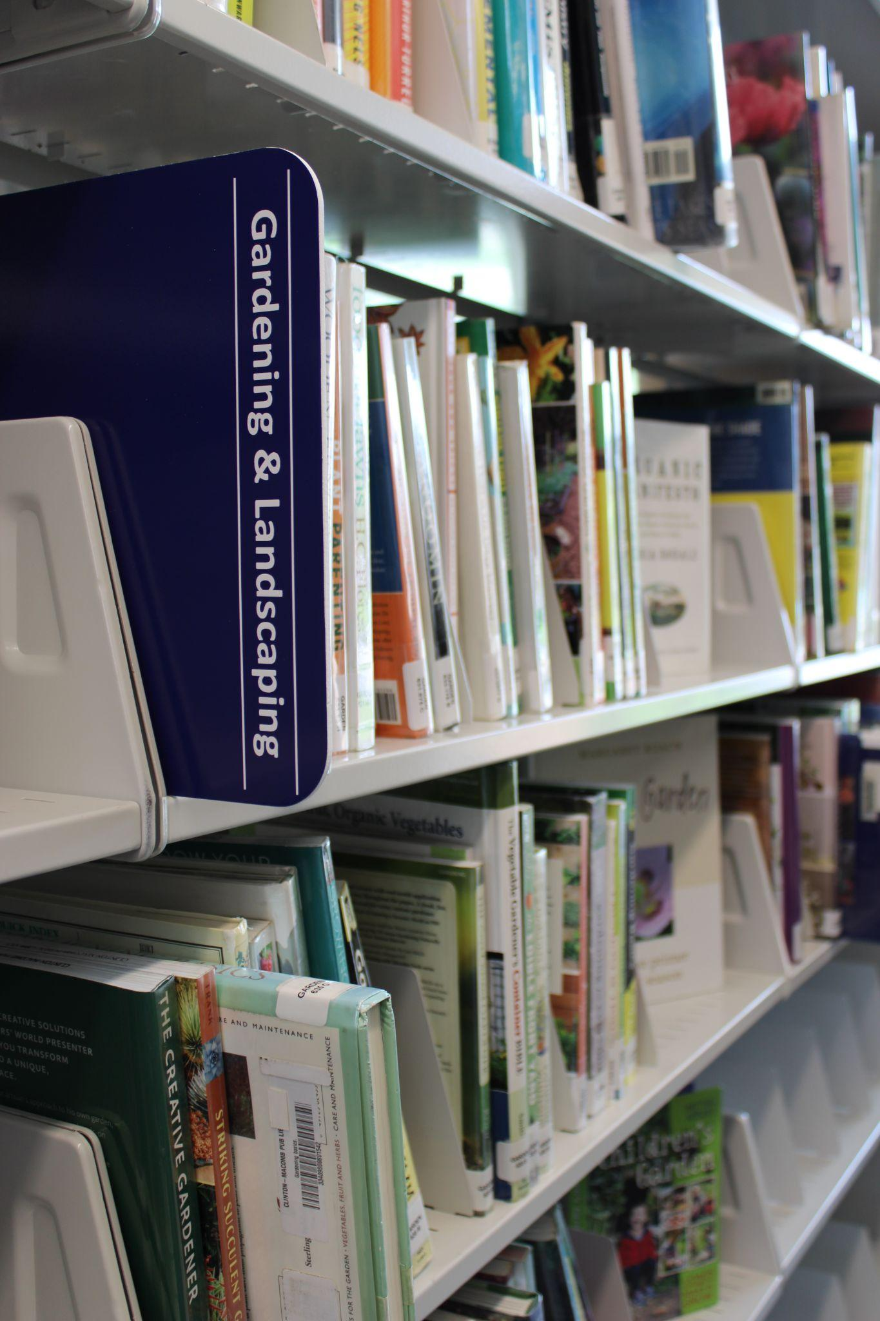

Slide 10
DVDs and Graphic Novels in the 700s seemed like a good idea at the time
Charlie Rosenthal

Slide 11
Prince William Public Libraries
Suburban library in Northern Virginia (35 miles southwest of Washington DC)
12 branches and 1 bookmobile
Service population of 480,000+
Materials Services Division (27 people total: 20 full-time, 7 part-time)
Made up of: Couriers, Acquisitions, Selection, Cataloging, and Physical Processing
Cataloging unit: 5 full time staff :1 MLS cataloging supervisor, 4 non-MLS library technicians
Me: Charlie Rosenthal, Senior Librarian in Selection / Cataloging
I’m on our org chart in Selection, but I sit with the catalogers (they’re more fun!). I select our Overdrive titles and catalog things

Slide 12
DVD: Dewey Video Disc?
Prior to September 2006, we only purchased non-feature film DVDs (non-fiction, documentary type titles).
All of these got a DVD Dewey # label on the spine
Ken Burns’ The Civil War: DVD 973.73 Civ

Slide 13
Feature films
When we started adding a few feature films, they all got the same call numbers:
Standalone films:
DVD 791.4372
Motion Pictures > Films > Single Films
Compilations:
DVD 791.4375
Motion Pictures > Films > Two or more films

Slide 14
TV shows
Same with TV shows, they all got the same call numbers:
Single TV show:
DVD 791.4572
Television Programs > Single programs
Compilations:
DVD 791.4575
Television Programs > Two or more programs

Slide 15
Old to new
Old Call Number | New Call Number
DVD 791.4372 | DVD Fic
DVD 791.4375 | DVD Fic
DVD 791.4572 | DVD TV Fic
DVD 791.4575 | DVD TV Fic
DVD 791.4372 For
DVD Fic Forrest
DVD 791.4572 Cas
DVD TV Fic Castle

Slide 16
Implementing the change: Spring 2013
We had ~14,000 items to change (7 years of past practice)
Sent two catalogers to each branch (we had 3 fewer branches in 2013) with a laptop and label printer
Changed all the DVDs on the shelf: updated item records, printed and applied new labels, updated 092 call number in bib records
Left instructions for staff on how to change DVDs that weren’t on the shelf at time

Slide 17
Success? Success!
Every DVD got changed in a few months
Were able start having Midwest do much of our DVD cataloging and processing shortly after with this new simplified classification scheme
Keys: having a plan, creating and sharing clear documentation and how-tos, encouraging follow up questions afterwards

Slide 18
Graphic Novels: Art is Art
Graphic novels / manga are in our nonfiction collections with a 741.5 call number Arts & recreation > Design & related arts > Drawing and drawings > Special applications > Comic books, graphic novels, fotonovelas, cartoons, caricatures, comic strips
J 741.5 Pil
YA 741.5 Kis
741.5 Nag

Slide 19
Something needs to change. But what?
Many branches already shelving graphic novels in their own separate shelving section
Hugely popular: Makes our non-fic circ look really great
~22,000 items to consider, spread over 12 branches and a bookmobile

Slide 20
Graphic Novels / Manga Advisory Group (GNMAG)
System wide group made up graphic novel / manga reading staff members and Materials Services leaders created to discuss options
Lots of ideas, little consensus:
Manga separated out?
Group by/Cutter by? author? Series? creator? character? Volume number?
Add anything to 245 or 490/8xx to ensure similar series and titles are consistent and easy to find?
Where does Maus go? How about Garfield?
Change the existing collection (~22,000 items)? Start new procedure only for new titles or new series?

Slide 21
Ongoing: What’s been decided so far
Created new collection codes in Polaris:
Graphic Novel
Juvenile Graphic Novel
Young Adult Graphic Novel
Replacing 741.5 with GN
Sticker:
We’ll see!

Slide 22
Who’s in charge here? Wrangling consortium cleanup
Elaine Sloan

Slide 23
Lynx Library Consortium
Eleven distinct libraries in Idaho, some with branches and/or bookmobiles
Mix of library districts and cities
Noncentralized – we share the catalog but each library selects, catalogs and is responsible for processing their own material
Cataloging group was more of an ad hoc organization by committee, with problems being fixed using a ‘whack a mole’ method
Consortium has one official employee, and he is not a cataloger (but he’s great at writing reports!)
My role: Cataloging Librarian at Boise Public, and chosen to help our administrator with data points for new consortium cataloging reports
Notes:
Prior to re-doing the consortium agreement and hiring a consortium administrator, cataloging was handled via committee with no clear leader. This meant that duplicate bibs, volume number problems, and other cataloging issues that caused problems on a consortium level were handled by whoever found the problem and were not always fixed by the library that may have caused the problem. We also didn’t have access to a uniform way to find items or bibs causing problems for our customers–it was more of a ‘as they are run across’ system, which was not effective.

Slide 24
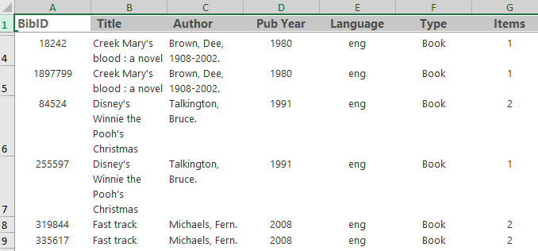
Problem: Duplicate bibs
Match point highlights:
Column names (bibID, title, author, pub year, language, and TOM) as well as publisher
Abridged items are excluded when listed in the 500 and 250 tags
Excluded MP3 format when listed in the 500 and 538 tags
Notes:
Duplicate bibs had long been a problem in the consortium, and even prior to migrating to Polaris in 2016 the directors had wanted us to use the same record for paperbacks and hardcovers, and to merge records whenever possible. To that end, we created a bibliographic matching guide that was attached to our consortium cataloging agreement, but by 2024 when the new consortium agreement was created, it was outdated and duplicate bibs were once again a large issue. To combat that, Brad Smith, our Lynx administrator, worked on a report to identify bibliographic records that were possible duplicates. It took some revisions, but eventually we worked out match points and Brad wrote a SQL query that would produce a report for each library based on if that library has holdings under one of the possible duplicates. Each library is expected to run the report on a regular basis and mark bibs they’ve checked by adding a 905 tag, a subfield a, a value of ‘checked’, and a subfield 5 with the library code.

Slide 25
Results–slow but steady
Reports have only been available for about two months in their final format, but each library is working on fixing their lists.
When a bib has been checked, a 905 tag is added with a subfield a of ‘checked’ and a subfield 5 of the library who checked it.
The query will exclude any bib with a 905 tag the next time it is run, regardless of which library runs the report.
Example:
Notes:
As with all database maintenance work, if it’s not causing immediate noticeable problems, it’s pushed to the back burner. However, this is the first time any of our libraries have been able to find duplicate bibs in any meaningful and standardized way, and I’m excited for all of us to incorporate this report into our regular workflow.

Slide 26
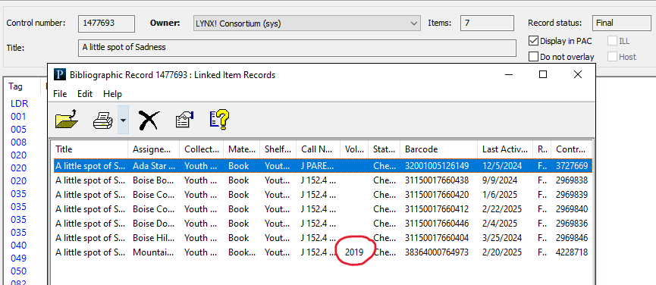
Problem: Volume fields in items creating separate holds queues
While there are 7 items on this bib, only the one with volume information will fill holds
Fixing the item doesn’t fix the holds queue; holds must be deleted and replaced manually
Notes:
When we set up Polaris our consortium chose to only allow item specific holds on items that have volumes. So when Polaris sees any item attached to a bib with volume field information, it changes to a specific item hold. If the volume information is entered on an item that shouldn’t be treated as a serial and is attached to a monograph record, only that item will fill holds. We knew this was a problem but weren’t sure how widespread it was, because we didn’t have a standardized method to find these items and fix the holds queues. This was another problem we were fixing using the whack-a-mole method.

Slide 27
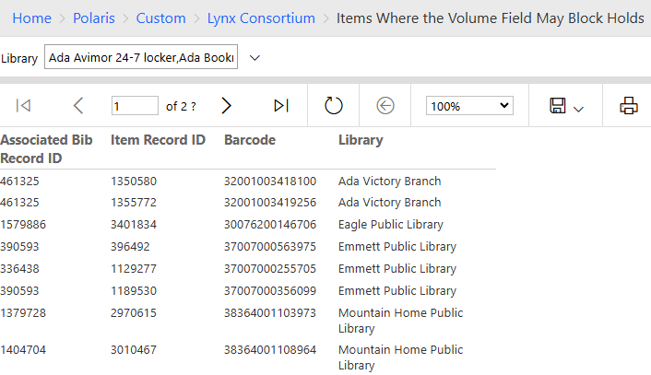
Finding those pesky volume numbers
Volume report is designed to be filtered by library
Contains Bib ID, Item Record ID, Barcode, and Library
Notes:
Once again, Brad created a report that can be run by each library, so now they are responsible for their own items as well as fixing the holds queues and making sure customers will get the items they want more quickly. He also wrote two additional reports to look for items that might incorrectly have or be missing volume information to prevent any holds issues in the future.

Slide 28
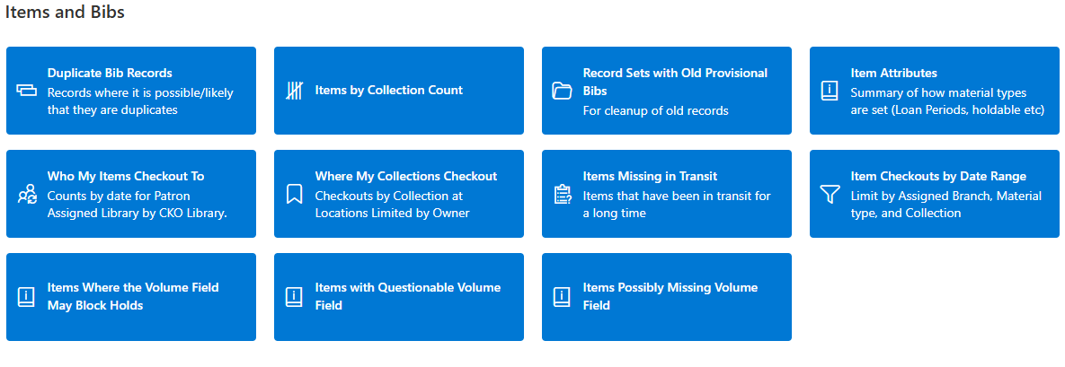
Reports to the Rescue!
Notes:
In addition to the duplicate bibs report and the volume fields blocking holds reports, Brad has created other helpful item and bib reports that any cataloger in the consortium can access–either through reporting services or directly through the improved Lynx Staff Hub. Enabling each library to run their own reports has removed the idea that one person is ‘responsible’ or ‘in charge,’ and will hopefully empower all the consortium catalogers to know where they can look to fix problems and find issues in their portion of the catalog.
Note: If anyone is interested in the SQL for any of these reports, we are happy to share it with you.

Slide 29
Identifying full bibs in a consortial catalogue:
Systems support of cataloguing workflows
Eleanor Crumblehulme

Slide 30
SILS Consortium
12 public (multi-branch) member libraries, plus provincial office (PLLO).
Some urban, municipal libraries, some regional libraries.
Polaris instance is shared, and bibs are owned at the system level (by the consortium).
Each library does their own selection and purchasing; cataloguing (bib editing) is restricted.
Most bibs are imported (or created manually) as brief. These bibs are identified by PLLO staff and replaced.
3 of the member libraries import some full bibs; 2 of those also have staff with bib editing permissions.
New full bibs are sent to Backstage Library Works (previously Marcive) for additional processing and authorities maintenance.

Slide 31
Systems Administration and the Catalogue
I am one of two Systems Librarians for the consortium.
We don’t do cataloguing, but we work with cataloguers individually and through committees to help support their work through system settings, reports, and customized processes.
We maintain a custom process for identifying brief bibs and sending them to PLLO cataloguers through report subscriptions.
We work with Backstage.
We work with our web developer to make sure that the bib data and the search features are aligned.

Slide 32
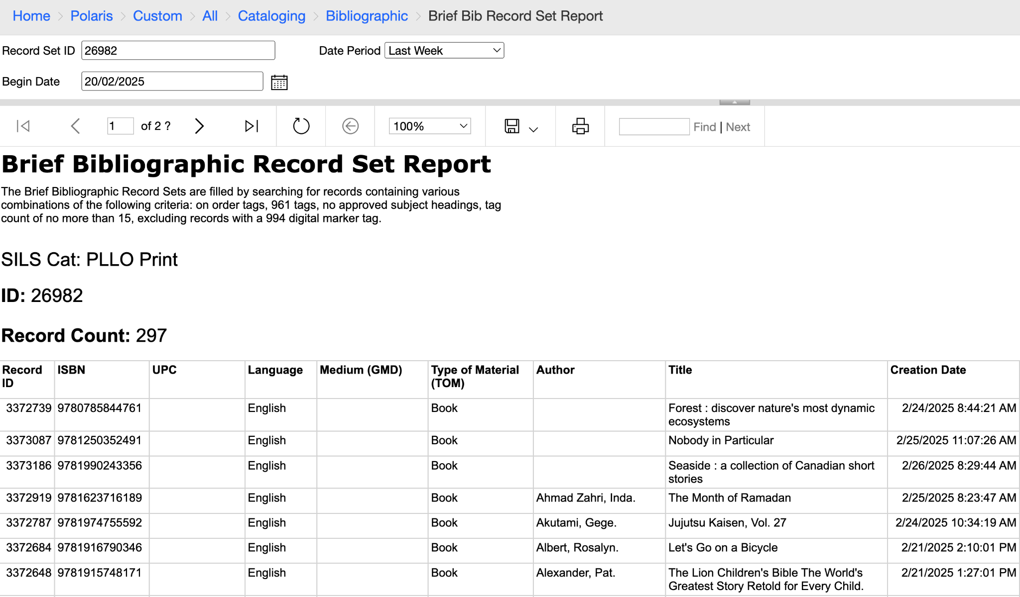
Example brief bib report

Slide 33
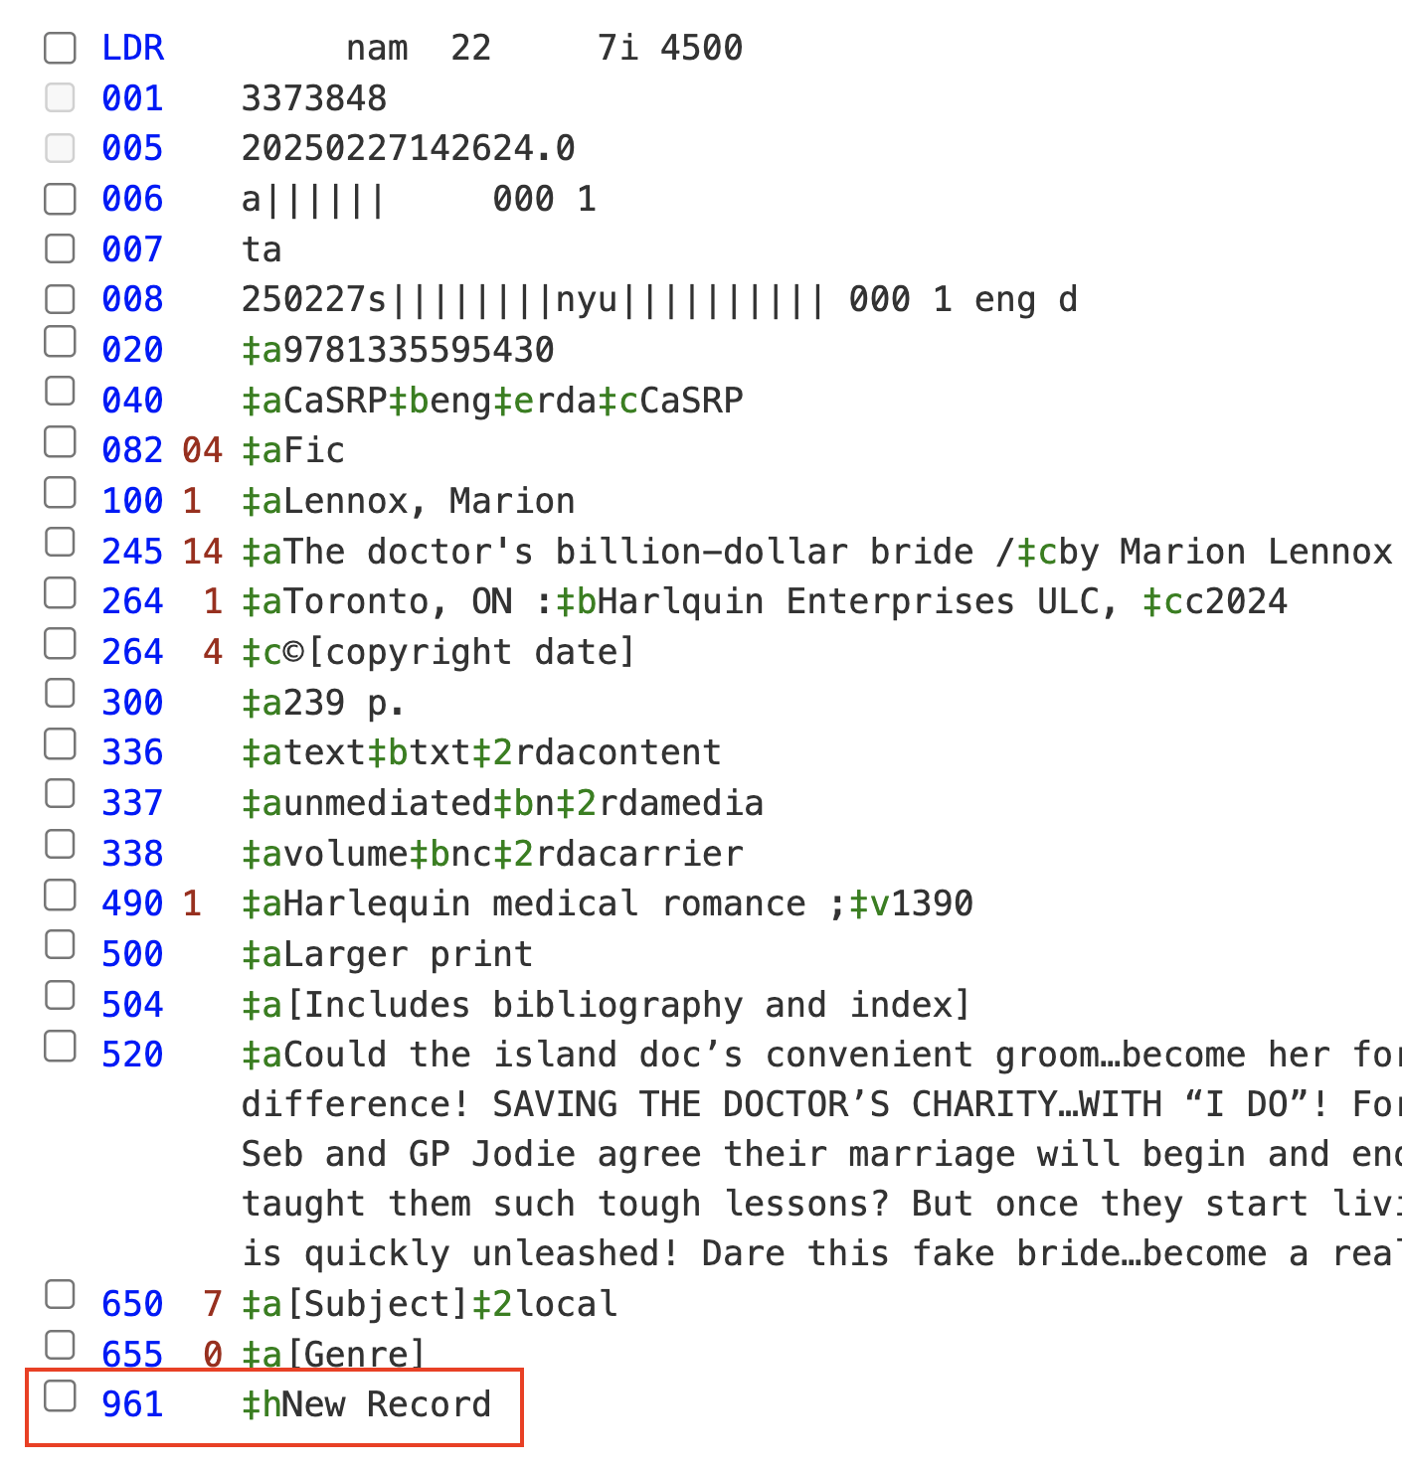
How we used to do it
Identifying brief bibs by adding a 961 tag:
Tag applied by vendors for imported brief bibs and by library staff for manually created bibs.
Tag content varied and contains no meaningful metadata.
Tag not added to all brief bibs.
Tag not always removed when bibs are overlaid with full bibs.

Slide 34
What is a full bibliographic record?
Criteria:
Total tag count
650 tag count (and indicators)
Absence of on-order tags
Querying on various combinations of these criteria, we discovered:
Some bibs that met full criteria still had 961 tag
Some bibs that were still brief lacked a 961 tag

Slide 35
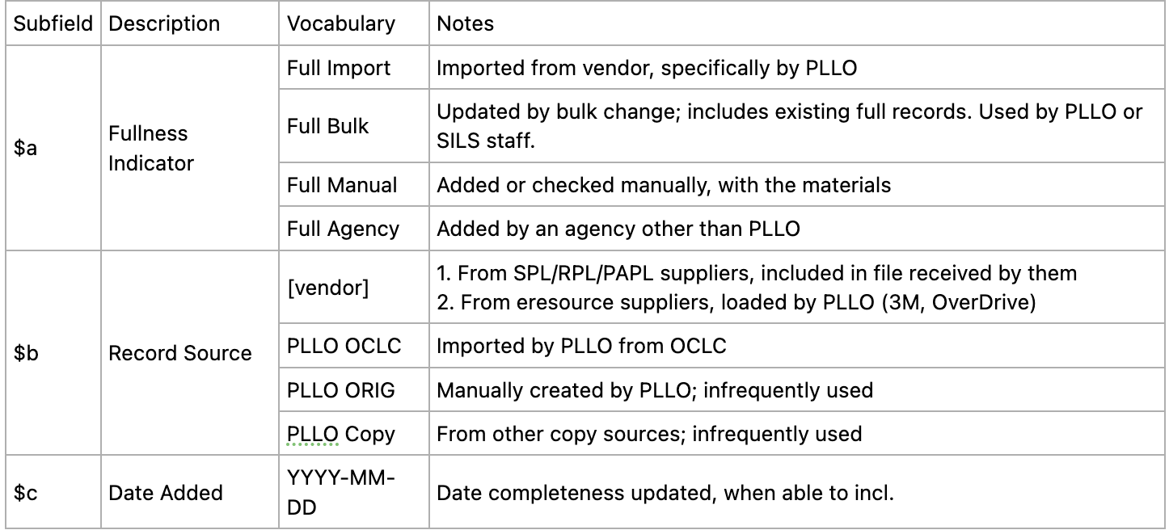
How we do it now
Shift focus from tagging brief bibs to tagging full bibs.
965 tag on full bibs
Meaningful metadata that we can report on
Update brief bib report:
Uses tag count criteria
Excludes bibs with 965

Slide 36
Result and remaining work
Results:
Much more accurate reports of brief bibs sent to PLLO cataloguers
Ability to report on metrics related to the source of full bibs, which site provided them, and the overlay rate of full bibs
We’ve added an additional 966 tag with metadata to mark bibs that have been processed by Backstage
To-Do:
Assess accuracy of 965 coverage; when can we stop relying on complex criteria?
When can we remove existing 961 tags?
Clean-up the small number of bibs with both 961 and 965 tags

Slide 37
THANK YOU
Questions?
C Mulder, cmulder@cmpl.org
Charlie Rosenthal, crosenthal@pwcgov.org
Elaine Sloan, esloan@cityofboise.org
Eleanor Crumblehulme, ecrumblehulme@sasklibraries.ca

