Slide 1
Using Sierra REST API to Load Patrons
Pam Childers – Indiana Wesleyan University

Slide 2
How To Automate the Patron Load?

Slide 3
Previous Patron Upload Process
A SQL query ran on the library’s dataset which outputs a csv file that was manually uploaded via Data Exchange
This is a scheduled event, and the file is placed in a shared network directory and updated daily.
\\iwufiles\common\LIBRARY\Patron Load
Library_Patrons.txt
This was a full overlay of the records that took quite a bit of time each day. Although the file was output daily, it required that the systems librarian upload it each day.

Slide 4
Automating the Patron Load
Scheduler and FTP
University is moving away from using FTP due to security issues
Sierra Patron API
Ellucian Colleague – the ERP system has a new API integration piece – Ellucian Ethos
IT just purchased a subscription to Jitterbit to use for API integration between the Colleague and other entities

Slide 5
REST APIs
The decision was made to use APIs to upload the data.
Things to consider:
How would we determine if the user didn’t exist in Sierra?
How would we update patrons?
How would we communicate that the load ran and how many users were added?

Slide 6
The Patron Load Process
Ellucian Colleague – (Enterprise Resource Planning) ERP
Ellucian Ethos - API interface for Colleague
DM-Library – Data Mart for library change information
Innovative Sierra – (Library Service Platform ) LSP
Jitterbit – Integration tool

Slide 7
Importing and Updating the Data
Data from Colleague is extracted each night and compared with the DM-LIBRARY Datamart. New records are added, and changed records are updated
The new and revised records have their dates changed
The Jitterbit integration tool queries the DM-Library DataMart for any record changed in the last two days for synchronization between the Colleague and Sierra

Slide 8
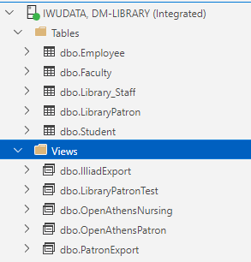
Sierra Update Record Process
Retrieve all records from DM-Library – dbo.LibraryPatron table with a changed date in the LastUpdateDate field within the last two days
Loop through each row returned from the query

Slide 9
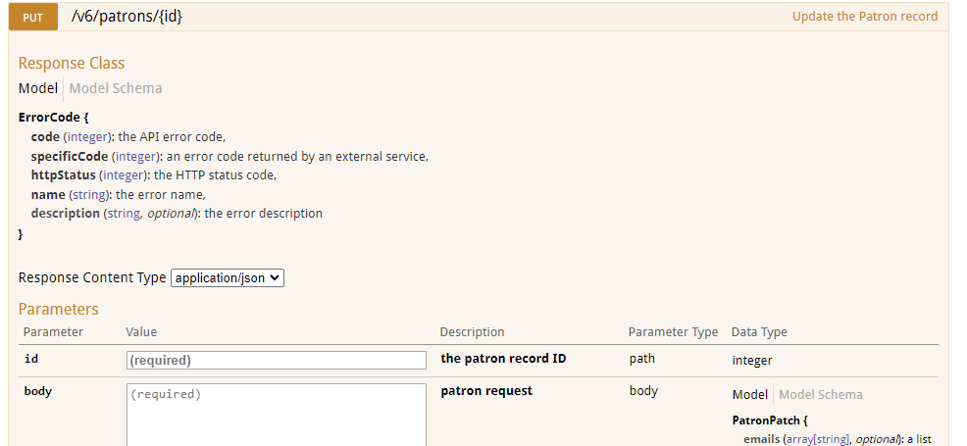
Sierra Update Process
Check for the Colleague ID -- UNIQUE ID in Sierra Patron Record
If found, return the Sierra Patron ID to use with the /v6/patrons PUT API call to update the record

Slide 10
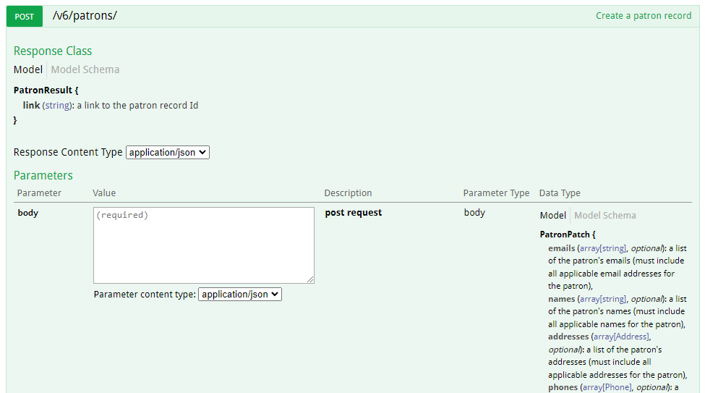
Sierra Create Record Process
If a patron record is not found in Sierra then, use the /v6/patrons POST API call to create a new patron record in Sierra using the data from dbo.LibraryPatron table in DM-Library

Slide 11
Patron ID to Colleague
Once the new patron records are created in Sierra, then the patron ids are passed back to Colleague and stored in the Alternate IDs section of the record and has the Type SIERR Sierra
This way the patron id is stored in Colleague as the Colleague ID is stored in Sierra

Slide 12
Colleague Update Process
Colleague update process
Retrieve all records from DM-Library without a Sierra ID field populated
Loop through each row returned from the query
Check for the record in the Sierra system by looking up the SIS ID
Update Colleague Alt Credential field with the Sierra ID value returned using the Ethos altCredentails API

Slide 13
Sierra API -- Swagger
All the components of the Sierra API may be seen and tested in Swagger. You will need to have a Client Key and Client Secret.
If you want to test using the Sandbox, then you will need to contact Innovative support for a Sandbox Client Key and Client. Please note: the Sandbox in Swagger is for the most recent version of Sierra. If you have an older version of Sierra, then your live Swagger may differ in functionality
The address for the Swagger Sandbox is:
https://sandbox.iii.com/iii/sierra-api/swagger/index.html
Information on the Sierra API may be found at Developer: Sierra Developer Network
https://innovative.libguides.com/Developer/Sierra

Slide 14
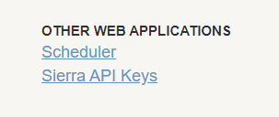
Sierra API -- Swagger
You may generate API keys and client secrets for your system’s API for Swagger by going to Sierra Admin.
API key generation is located under OTHER WEB APPLICATIONS in the admin.
Select Sierra API Keys, then on the next screen select the CREATE NEW button

Slide 15
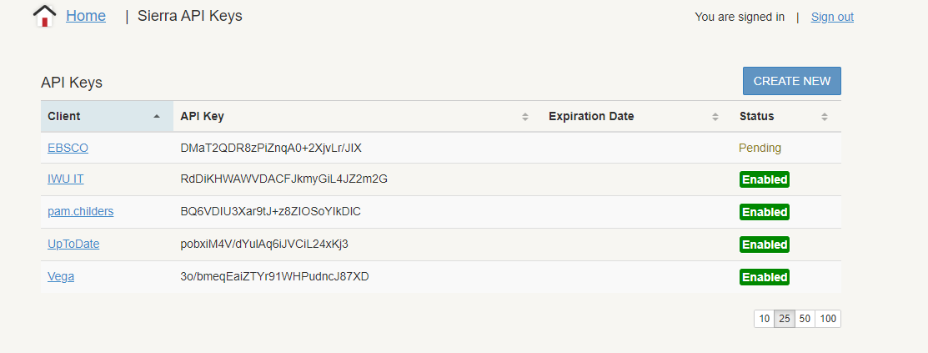

Slide 16
patrons: The Patron API in Swagger

Slide 17
patrons: PUT /v6/patrons/{id}

Slide 18
patrons: POST /v6/patrons/{id}

Slide 19
Jitterbit – Integration Tool
The remaining slides go through the processes used to integrate all of entities using Jitterbit.
Jitterbit uses a component palette to represent the various processes used in the integration.
Below is an example operation:

Slide 20
Jitterbit – Integration Tool
Jitterbit is used to integrate the processes between the DataMart and 2 APIs.
There are two scheduled workflows in the Jitterbit integration project:
Sierra update process
Colleague update process

Slide 21
WORKFLOW 1

Slide 22
BUILD DOCUMENTATION
WORKFLOW 1 -- AUTHENTICATION
Operation 1.0 Authenticate to the Sierra system and save the token for API calls.
Operation 1.1 Authenticate to the Ethos system and retrieve a token or refresh an existing token during session

Slide 23
WORKFLOW 2

Slide 24
WORKFLOW 2 – UPDATE SIERRA PATRON INFO
OPERATION 2.0 – Create-Update Patron Control
Operation 2.0 contains the script that controls the order of operation Sierra patron update.
Looks here first for code that sets up the following processing.
The scheduled job calls this operation.

Slide 25
WORKFLOW 2 – UPDATE SIERRA PATRON INFO
OPERATION 2.1 – Build Email Results
Operation 2.1 builds the final report of records created.
Its location as the second operation is deceptive in that it is the final operation called by the script. By positioning it here, the visual layout is much cleaner.

Slide 26
WORKFLOW 2 – UPDATE SIERRA PATRON INFO
OPERATION 2.2 – Get New-changed Patrons records
Operation 2.2 is the initial query for new and changed records from the DM-Library data source.
The transform loads the rows of data into a local variable for row looping in the next operation.

Slide 27
WORKFLOW 2 – UPDATE SIERRA PATRON INFO
OPERATION 2.3 – Process Patron New Row
Operation 2.3 Reloads the rows from the database query and uses a transform to loop through each row.
A script is included in this transform that does the processing of the rows.

Slide 28
WORKFLOW 2 – UPDATE SIERRA PATRON INFO
OPERATION 2.4 – Check for Sierra Record
Operation 2.4 This operation calls the Sierra Patron API to determine if the person is already in the database.
If the person exists, the transform will save the Sierra ID.
If the person is not found, this operation errors and is captured by the calling script

Slide 29
WORKFLOW 2 – UPDATE SIERRA PATRON INFO
OPERATION 2.5 – Put Changed Patrons
Operation 2.5 Sierra record update process
The transform builds the JSON body for the PUT API
The script logs the results of the PUT

Slide 30
WORKFLOW 2 – UPDATE SIERRA PATRON INFO
OPERATION 2.6 – Sierra Record Create Process
Operation 2.6 Sierra Record create process
The transform builds the JSON body for the POST API
The script logs the results of the POST

Slide 31
WORKFLOW 2 – UPDATE SIERRA PATRON INFO
OPERATION 2.7 – Put Error Capture OPERATION 2.8 – Send Put Error
Operation 2.7 Captures any errors generated by the PUT update request. It then stores the information in a local variable. Operation 2.8 The PUT error variable is recalled so that the transform can built it into the body of the email.
The transform builds the email TO, CC, BCC, Subject, and Body JSon structure for the email target object.

Slide 32
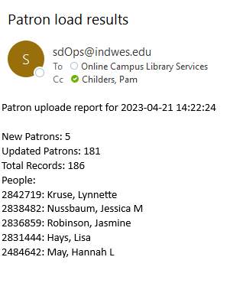
Example Email

Slide 33
WORKFLOW 3

Slide 34
WORKFLOW 3 – PROCESS PATRON ID TO COLLEAGUE
OPERATION 3.0 – Process Controller
Operation 3.0 Is the controller script for this workflow 3 and the update workflow 4. It is call by the job scheduler.
The script sets up all variables, order of operation, and error processing for this workflow.

Slide 35
WORKFLOW 3 – PROCESS PATRON ID TO COLLEAGUE
OPERATION 3.1 – Get Patron Updates from DM-LIBRARY
Operation 3.1 This operations queries the DM-Library data source for all records that don't contain a valid Sierra ID number.
The transform stores all the rows returned into a local variable array.

Slide 36
WORKFLOW 3 – PROCESS PATRON ID TO COLLEAGUE
OPERATION 3.2 – Process Patron Updates
Operation 3.2 This operation retrieves the variable array of row returned from the query and process each row with the transform providing the row looping and operation calls.

Slide 37
WORKFLOW 3 – PROCESS PATRON ID TO COLLEAGUE
OPERATION 3.3 – Patron Find
Operation 3.3 This operation looks up the person in the Sierra database and if a match is found hands off the record update work to the Record update workflow.

Slide 38
WORKFLOW 4

Slide 39
WORKFLOW 4 – UPDATE COLLEAGUE ALT CREDS
OPERATION 4.0 – Sierra ID to Colleague Op Ctr
Operation 4.0 This controller script manages operation calls and error processing.
Workflow 3 controller script calls this operation as part of the Sierra to Colleague ID update process.

Slide 40
WORKFLOW 4 – UPDATE COLLEAGUE ALT CREDS
OPERATION 4.1 – Get Colleague Person Info
Operation 4.1 Retrieves the current personCredential information from Ethos so the new Sierra ID can be merged with the current Alternate IDs

Slide 41
WORKFLOW 4 – UPDATE COLLEAGUE ALT CREDS
OPERATION 4.2 – Write Person Alt Credentials to Colleague
Operation 4.2 Updates the Colleague record with the retrieved and new Alt Credentials. It also logs the results of the update.

Slide 42
WORKFLOW 5

Slide 43
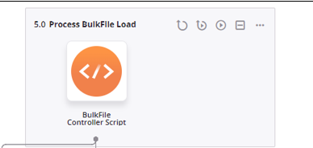
WORKFLOW 5 – BULKFILE LOAD
OPERATION 5.0 – Process BulkFile Load This workflow is currently not in use due to an issue with the bulk file load API. However, we believe we will be implementing this soon.
Operation 5.0 Process controller script loading a bulk data file via an API.

Slide 44
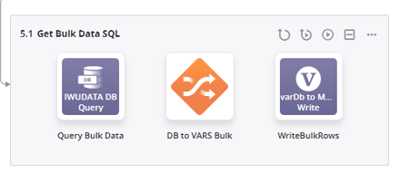
WORKFLOW 5 – BULKFILE LOAD
OPERATION 5.1 – Get Bulk Data SQL
Operation 5.1 Retrieves the contents of the DataMart for creating the file's body.
Stores database results in a local variable for use in a later operation.

Slide 45
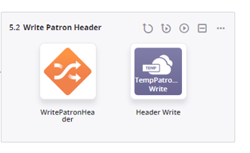
WORKFLOW 5 – BULKFILE LOAD
OPERATION 5.2 – Write Patron Header
Operation 5.2 Create the output file's head row and creates a temporary working file. The Sierra bulk file upload process requires a wrapper before and after the data file.

Slide 46
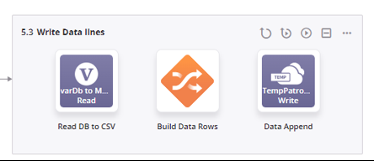
WORKFLOW 5 – BULKFILE LOAD
OPERATION 5.3 – Write Patron Header
Operation 5.3 Appends the database row data from the SQL table read in 5.1 to the temporary working file

Slide 47
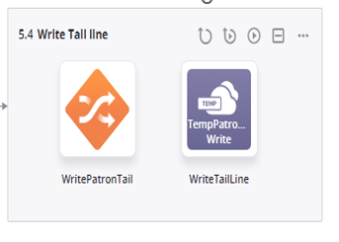
WORKFLOW 5 – BULKFILE LOAD
OPERATION 5.4 – Write Tail Line
Operation 5.4 Appends the closing tag line to create a valid file for API upload.

Slide 48
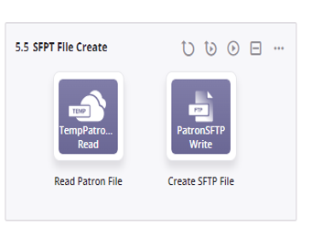
WORKFLOW 5 – BULKFILE LOAD
OPERATION 5.5 – SFPT File Create
Operation 5.5 This is a temporary operation to send the working file to an SFTP server.

Slide 49
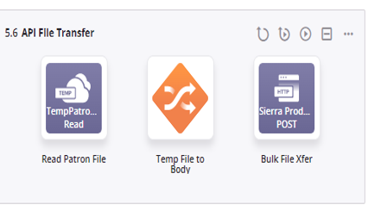
WORKFLOW 5 – BULKFILE LOAD
OPERATION 5.6 – API File Transfer
Operation 5.6 This transfers the working file to Sierra using the Bulk File Transfer API

Slide 50
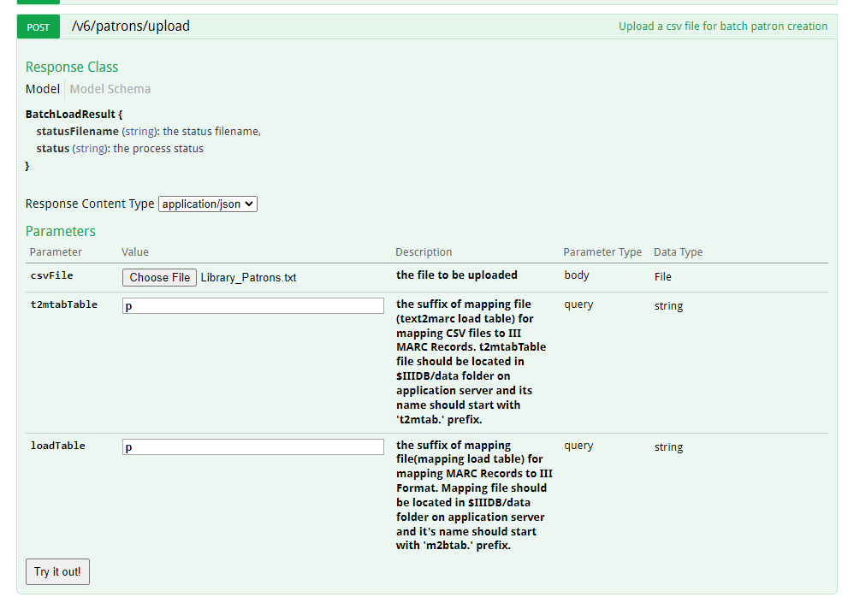

Slide 51
THANK YOU
Questions?

