Slide 2
Managing EDI Invoices
Yu-Lan Chou, Santa Clara City Library

Slide 3
Using Electronic Invoices
M/S supports different methods of electronic invoice and approval processing, all accessible from “Import Invoices”
  Extended Approval Plan Interface
  Handles firm orders for monographs and monographs received on approval. May use vendor-specific load tables to create item records.
  EDIFACT Invoicing
  Process EDIFACT invoices provided by vendors.
  Electronic Serials Invoicing
    For processing serial invoices only.

Slide 4
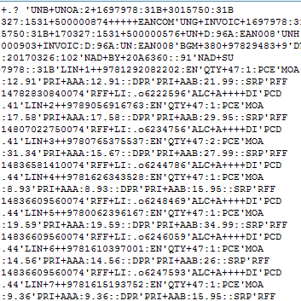
Managing EDI Invoices
Set up data details with vendors
  Use list price?
  Retain list price information?
  Additional cost to include?
  Invoice format
    By account/PO/Ship to
    By fund
    By location
    Summary invoice

Slide 5
Import EDI Invoices
FTP -- make sure invoices are in the right folder
Duplicate invoice dialog – no record-specific information
Each invoice file can hold up to 500 lines
Action column “Skip” means there is a problem with invalid FUND/LOCATION, no value in ORD TYPE, record not found, or the record has more than 50 paid fields.
Data correction (Accept/Reject tab, double click the order record number in the table)
FUND/LOCATION field using the “Edit Group” option

Slide 6
Managing EDI invoices
Post loading procedures
Reports tab
  Summary
  Report
  Duplicates/Error Log
  Marc Log
Fund activity report/voucher report
Browse invoices

Slide 7
Managing EDI invoices
Further actions to consider
  Reduce the number of invoices
  Options to streamline the procurement process
  Output voucher
  Electronic payment
  Auditing requirement
  Ability to store scanned invoices?

Slide 8
Questions?
ychou@santaclaraca.gov

