Slide 1
Implementing i-tiva Telephone System
Jenny Zhou

Slide 2
Agenda
Why we switched
What to prepare
Statistics and Reports
Support system
VOIP

Slide 3
Why We Switched
We used TM3 system (later replaced by i-tiva) before migrating to Sierra and were satisfied with it.
Teleform missed a lot of phone calls to patrons, even when the system showed it had called. We tried working with Innovative but the problem still existed.
Teleform asked for separate computers for outbound and inbound phone calls, i-tiva only needs one. You can install both MESSAGE and CONNECT system on one server.
I-tiva has easier statistics reports and email delivery.
Notes:
Talking tech start to work with Innovative at the beginning of 2015. They have worked to solve the major problem with Innovative SIP2 setting that allow i-tiva to communicate with sierra app server and get call list. We start the conversation for process at November 2015 and implement the system around Feb 2016.
MESSAGE is similar to Teleforms Telephone Notification (TNS), sample voice
CONNECT is similar to Telephone Renewal System (TRS), sample voice
Show the i-tiva with Innovative Sierra - Features April 2017 file

Slide 4
What to Prepare: Server
i-tiva cannot operate in a virtualized environment unless it is an SMS only system. MESSAGE and CONNECT functionality requires a Dialogic JCT card and Dialogic does not support a virtualized environment with these cards.
Server with Windows Server 2012 or 2008 R2
Server network name cannot be changed after installation
The system MUST NOT be on an Active Directory Domain. It is mandatory for the system to be installed and operated while not associated with a Microsoft Active Directory Domain.
Set up Static IP, DHCP might work too
Backup the server
using remote SQL server (i-tiva 2.5 comes with Microsoft SQL Server 2014 Express Edition)
Setup a local administrator account for to install and operate i-tiva
Notes:
All the documents: http://i-tivadownloads.talkingtech.com/index.html
Network server name cannot changed after installation (It can be done but would be a support task that is not covered under your maintenance contract. This is why we advise to set the system to the correct name to begin with.)
Please refer to i-tiva_2-5_System_Requirements technical file
The document also talks about antivirus and firewall

Slide 5
What to Prepare: Dialogic Card
Dialogic Card: PCI (Not PCI Express), different size, 13” card (6.6” card for PCI express)
We used our previous dialogic card D4PCIUFW that we purchased from Innovative in 2014
You do not need to install the drivers for the card, this is taken care of as part of the i-tiva installation
We kept the TNS system while setup i-tiva, so patron still got phone notice when we using the TRS dialogic card and a new server to setup i-tiva system
Notes:
All the documents: http://i-tivadownloads.talkingtech.com/index.html
Pg 20 Show the i-tiva_2-5_System_Requirements technical file

Slide 6
What to Prepare: Phone Line
To set up call forwarding to reach an operator, Call Forwarding should be enabled on the line.
Our Centrex line needs to dial 9 then the number we want it forwarded to.
Example, 9.5193542940
One of our branches is long distance to call, i-tiva can manage the long distance call down to the exchange level, so we can set 519-852 as allowed while blocking other long distance calls.
Notes:
All the documents: http://i-tivadownloads.talkingtech.com/index.html
Pg 22 Show the i-tiva_2-5_System_Requirements technical file

Slide 7
What to Prepare: Ports to Open
The connections to/from Sierra typically are:
MESSAGE/TNS Database: TCP Port 1031 (import through API)
CONNECT/SIP2: 5550
These could change to reflect the local configuration and environment.
Remote Tools that are not associated with the connection to Sierra that will open ports on i-tiva:
TCP Port 80: Web based Configuration Tools
TCP Port 1433: Express Reporting software.
TCP Port 2004: i-tiva recording if using (can be disabled)
Remote Access Tool (Depending on what you’re using, configuration etc.) We use LogMeIn Rescue for support
External Connections that i-tiva will make:
SMTP Port 25: Emailed Reporting

Slide 8
SIP2 – CONNECT system
Ask Innovative to set up SIP2 account for i-tiva, search for service commitment: adjust logins for SIP2 or Express Lane at support site. Give them the necessary information.
For example:
Login Name: itiva
Full Name: Talkingtech i-tiva
Statistics Group: 700
Locations Served: None
Notes:
Library can use this stats group number in Circulation Activity Report to see how many renews are made through i-tiva system. For year to date, we only have 161 with group 700, for 2016 we have about 211 call in renews. Everage call out number is 2500-3000 per month.

Slide 9
Admin Corner Settings
Add to Limit Network for selfcheck (for inbound call)
A>A>L>
N > Limit NETWORK access
06 > SELFCHECK
Edit location map for i-tiva in Admin Corner (for outbound call):
C > CIRCULATION subsystem
T > Edit TNS location map file
TNS Locations Location Codes
01 > bl bl blad blch blya

Slide 10
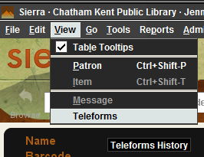
Admin Corner Settings – Call History
At patron account screen, staff can see the call history that is generated by i-tiva or teleform system
To change the setting:
A > ALTER system parameters
S > SYSTEM codes
O > Set system OPTIONS
C > Circulation options
097 > Teleforms History: number of days to save patron information..........365
Innovative recommends setting this option to 14 days or fewer. Larger numbers may result in problems due to an overly large telephone notification History database. CKPL is a small system, 365 days works for us.

Slide 11
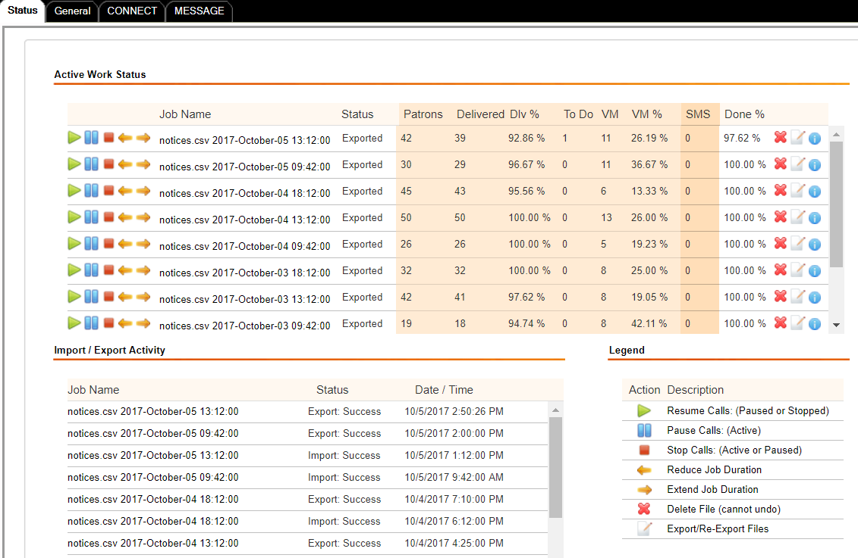
Configuration
http://your domain name/configurationtool/Default.aspx
Check Status

Slide 12
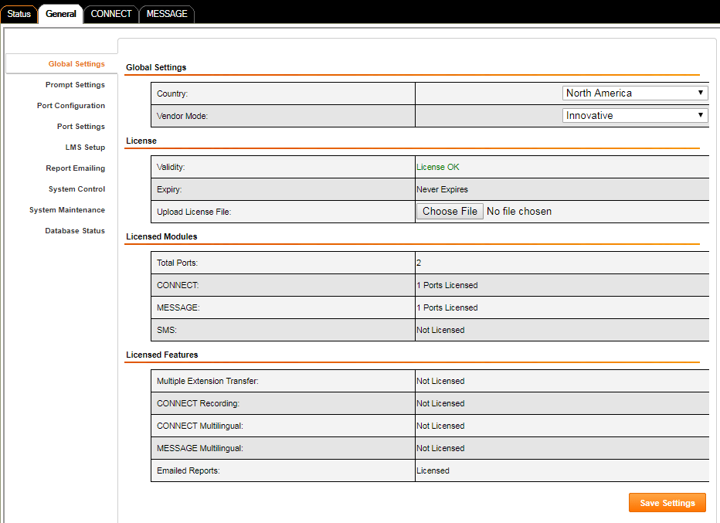
General Configuration
General setting

Slide 13
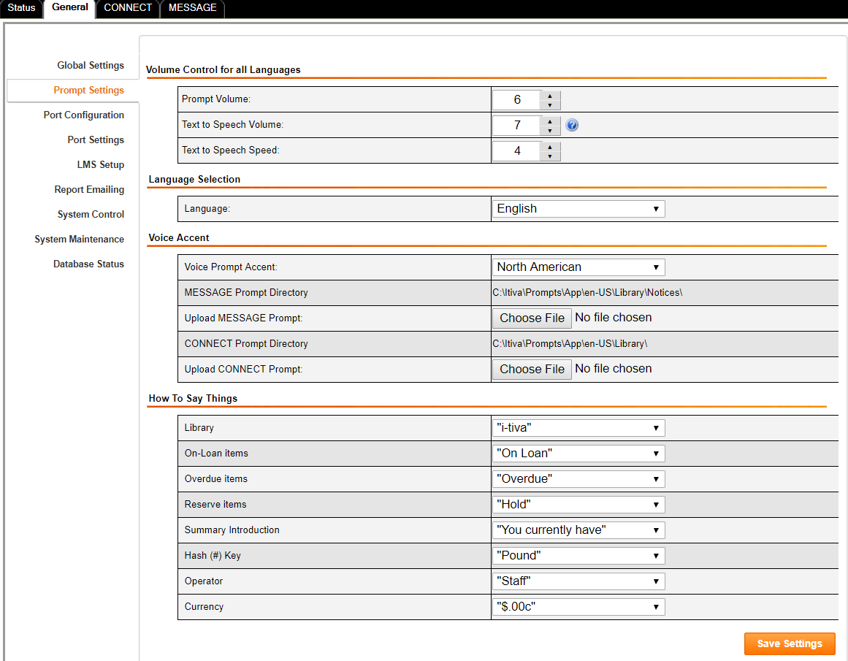
General Configuration
Set up prompt

Slide 14
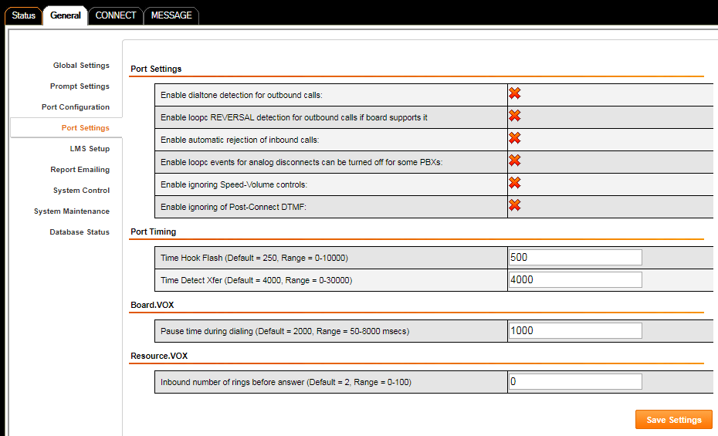
General Configuration
Port Configuration

Slide 15
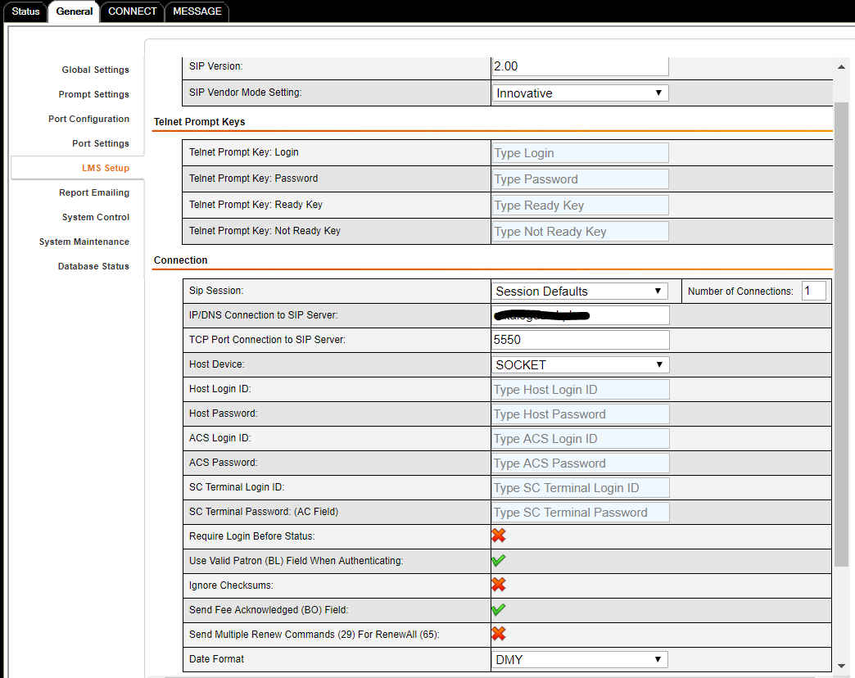
General Configuration
LMS Setup
Use your sierra server
domain name or IP
Notes:
Date format etc

Slide 16
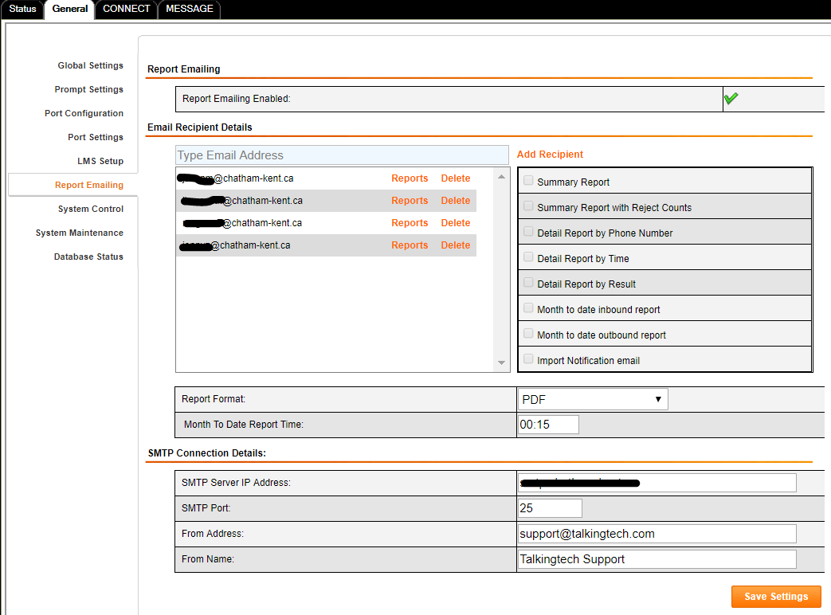
General Configuration
Set up email reporting

Slide 17
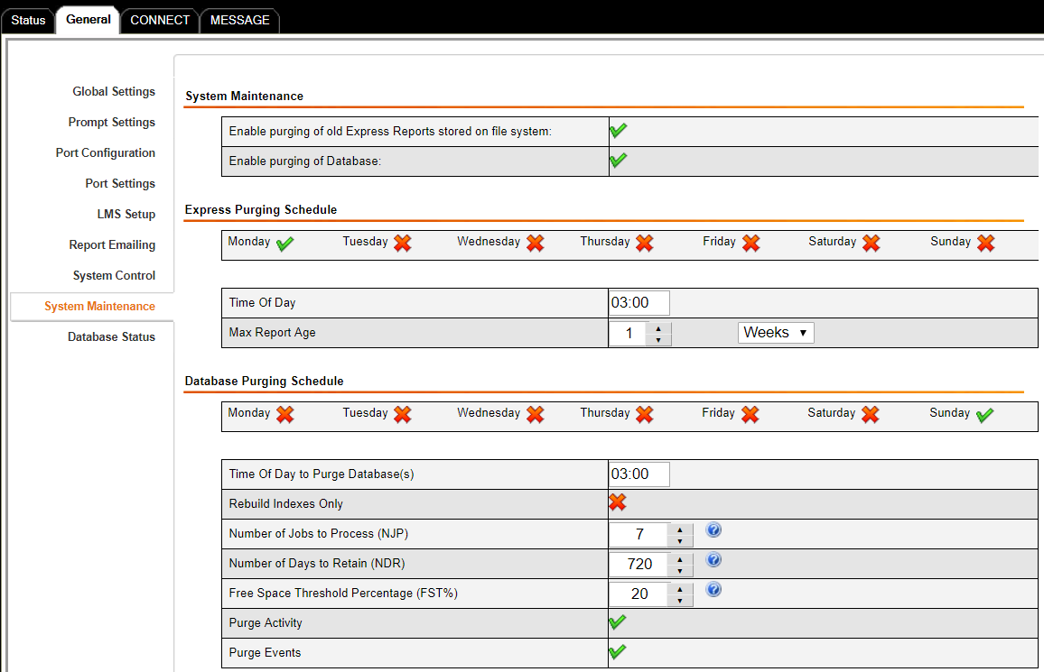
General Configuration
Set up data retention
Notes:
LMS: library management system, in system control, you can stop and resume the service for message and connect.

Slide 18
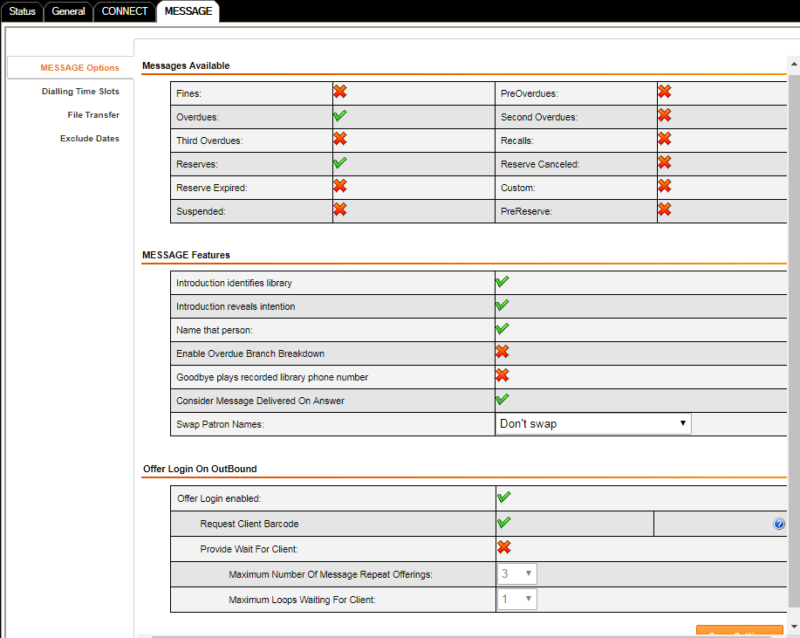
MESSAGE Configuration
Notes:
File transfer location, how to transfer etc, exclude holiday and library closed date

Slide 19
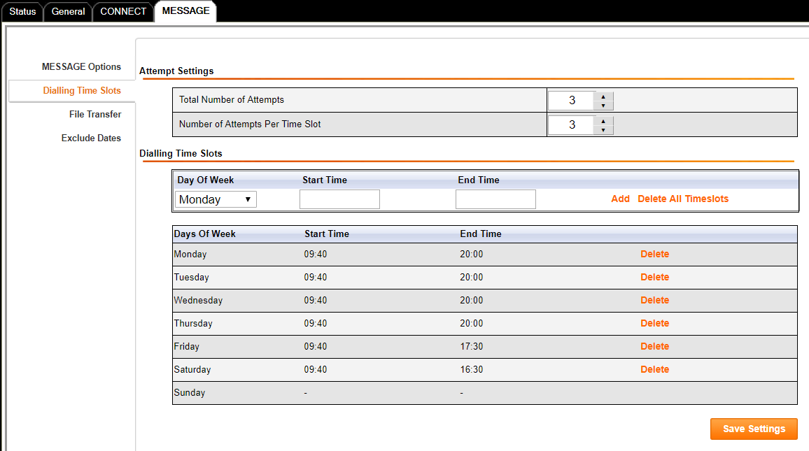
MESSAGE Configuration
Notes:
File transfer location, how to transfer etc, exclude holiday and library closed date

Slide 20
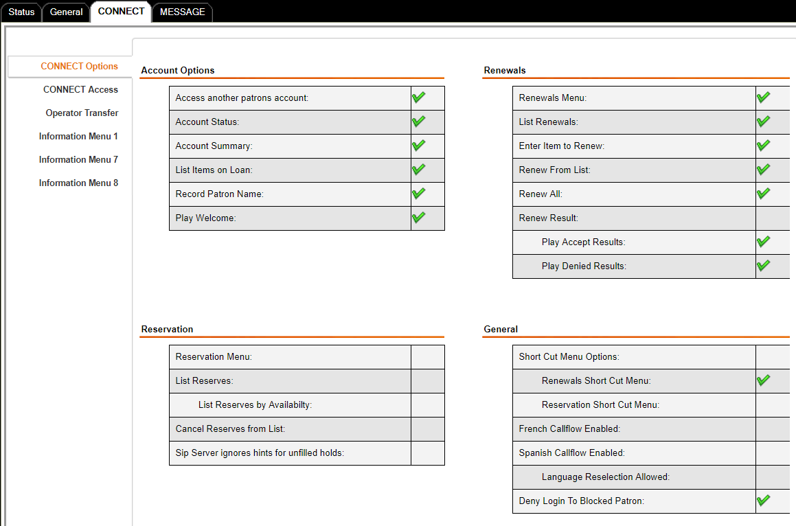
CONNECT Configuration
Notes:
Enable or disable functions

Slide 21
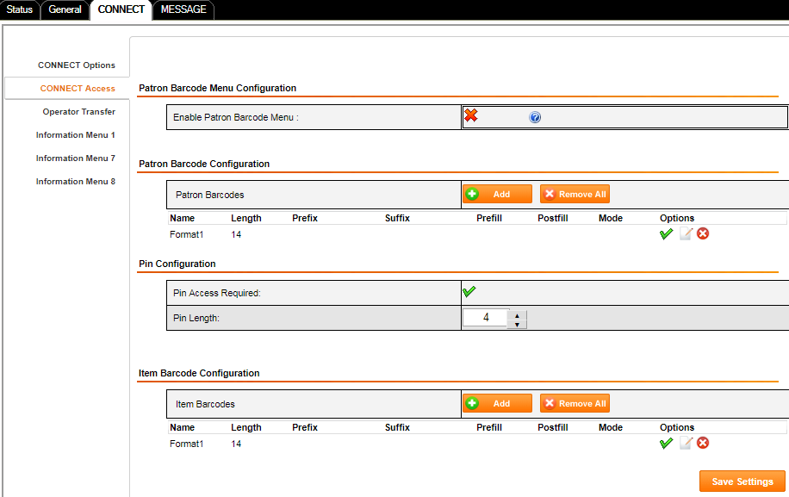
CONNECT Configuration
Notes:
Access setting for dial to main phone line, format of patron and item barcode, pin etc.

Slide 22
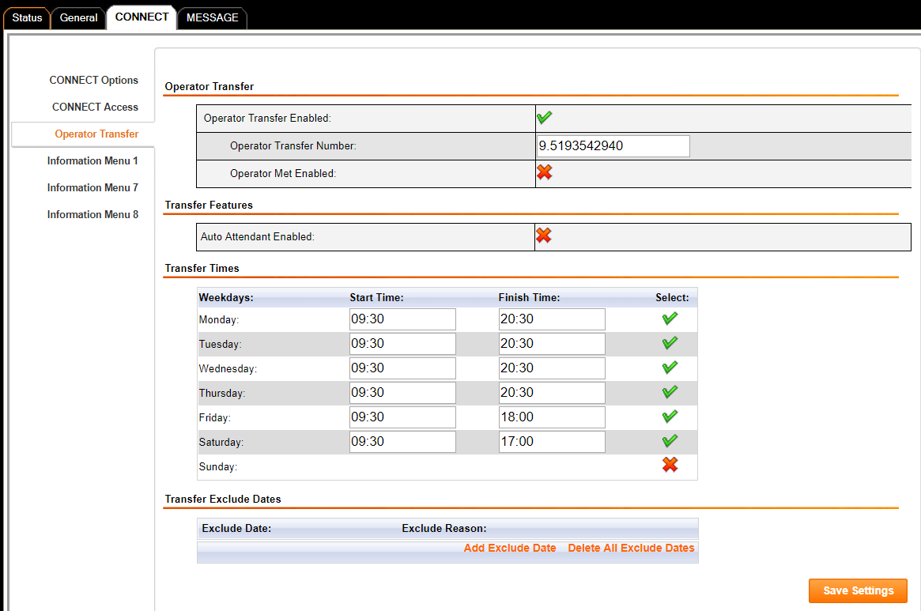
CONNECT Configuration
Notes:
Access setting for dial to main phone line, format of patron and item barcode, pin etc.

Slide 23
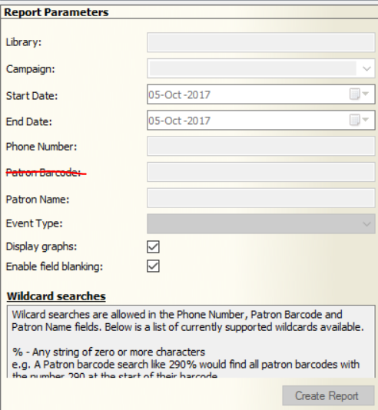
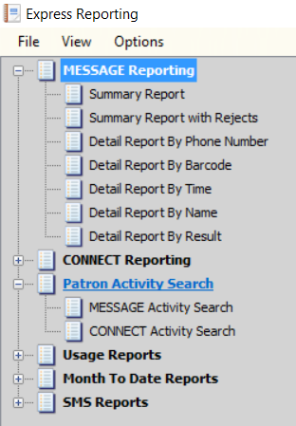
Statistics and Reports
Express Reporting
Notes:
You can export report by result and found all the patron has no dial tone, no answer etc to correct the patron account, for example Intercepted number, out of service.
APPENDIX B - MESSAGE CALL RESULTS of i-tiva_2-5_User_Guide.pdf

Slide 24
Support Channels
Email: support@talkingtech.zendesk.com
Phone: 1-866-737-9013 (call for urgent issues)
You can also ask TALKINGtech to create an account for you on its website https://talkingtech.zendesk.com so you can track your tickets.
You can find some useful documents at
http://i-tivadownloads.talkingtech.com/index.html

Slide 25
Known issue: Server power down problem
When server power down even it’s a scheduled one, the service may not start correctly because the dlSystem.ini file may bot have the correct hardware VOX board ID.
To solve the problem, usually restart the server will make the dlSystem.ini file associate the latest C:\Itiva\Trace\ptTDLOGS\ TLG file and get the correct hardware ID. If restart server does not work, you may have to manually change the ID in dlSystem.ini file to match the TLG file and restart the service.

Slide 26
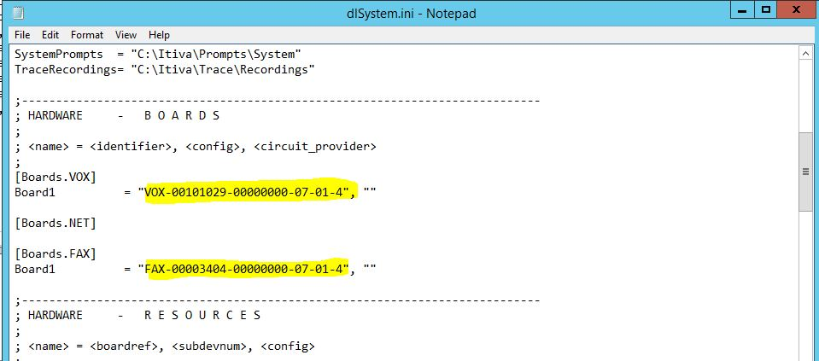
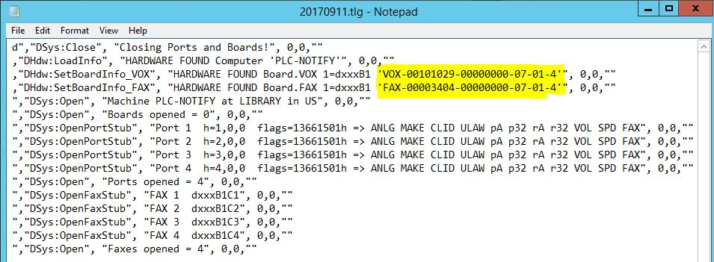
Known issue: Server power down problem
These two IDs should be the same

Slide 27
VOIP?
TALKINGtech does not natively support VoIP. Here is their response:
Our problem with VoIP is that there are many different protocols and configurations (Codecs) that can be used. Since we could expect many library networks to have a wide range of VoIP technologies, vendors, and configurations, this would not only make it a challenge for us to support this wide range from a technology perspective, but also a challenge to setup and configure each unique environment.
To keep things simple, we will continue to use analogue.
What we typically suggest to any site that wants to go with VoIP is to use an ATA (Analogue Telephone Adaptor) or Media Gateway device that you know supports your network and VoIP configuration/protocol. You likely already have such devices that you know work, and you are the experts in your VoIP setup and configuration. You would be responsible for setting up and configuring the ATA devices for the network. …

Slide 28
VOIP?
The downside is that we would no longer fully support the telephony at your system. What this means is that if there is a telephony issue, we will look at it, but if it turns out to be an issue with the VoIP system then we may charge for the investigation and possible fix (or ask you to fix it). Conversely, any issues with analogue (from a Telco) are completely supported by TALKINGtech and we will resolve them the best we can (within reason) as part of the maintenance that you pay.
The primary reason for this is that there is a level of quality that we can expect from the Telco, where VoIP lines / technologies / configuration are not created equal and being provided poor lines can negatively affect the performance of i-tiva. Having said that, if you use a regular phone through the ATA device and the quality is equivalent to a PSTN phone line (e.g. timing, clear) then i-tiva should have no problems with the ATA phone. And VoIP technology has come a very long way and many customers have successfully implemented i-tiva with VoIP using an ATA or Media Gateway Device. In fact, my complete test environment is operating via VoIP.

