Slide 2
SQL Searching in the Find tool, or How To Find What You Didn't Know You Could
Session N02
JT Whitfield
Librarian (AV cataloger)
Renee Patterson
Technical Services Administrator
Alachua County Library District
(Florida)

Slide 3
SQL: What is it, and how do you say it?
SQL stands for “Structured Query Language”
It can be pronounced
As if it was being spelled out (“Ess-kyew-ell”)
or
“Sequel”
Notes:
There are many “flavors” of SQL. Polaris uses Microsoft SQL Server. The version of SQL Server depends on the version of Polaris.
Since “Sequel” has the fewest syllables, I will use this pronunciation. ☺

Slide 4
What we will cover in our brief time together:
A brief overview of Polaris's database structure.
SQL in the Find Tool and the basics of a SQL query.
Limiting your search.
Searching in multiple tables by using joins.

Slide 5
Polaris's database structure
Polaris uses a Relational Database structure.
A relational database can be defined as one in which data is stored in a number of tables.
--and--
Data in one table can be linked to another by the use of a common “key.”

Slide 6
Polaris's database structure: A key by any other name…
A key can be thought of as a control number for that element.
Polaris's database tables usually use the term “ID” (ItemRecordID, PatronID, etc.)
but the Find Tool (Normal mode) may refer to a:
“Control number” (bibliographic and item records)
“Record ID” (patron records)
“Invoice ID” (invoices)
Notes:
The page icon in the lower left indicates that the supplementary document includes:
A cross-reference between Normal Find Tool terms and Polaris database IDs, along with other information, such as instructions on accessing Polaris's database help files.

Slide 7
Polaris's database structure: Saving space with IDs
Using relationships expressed by IDs, the database can be kept much smaller than if the full information about an element had to be stored repeatedly in a table.
AssignedBranchID = 7
takes up much less space than
AssignedBranch = “Catalina Magdalena Hoopensteiner Keinerdiner Hogan Logan Bogan Memorial Library”
Notes:
Multiplying that by the thousands of items that may be assigned to Branch 7 shows how much more space would be needed (81 characters times 5,000 vs. 1 character times 5,000), not to mention how long it may take to modify the records.
If you modify the branch's name in the Organizations table, the changed name will show for all linked items.

Slide 8
An example of (some of) the relationships created by a checkout
Organizations
BibliographicRecords
ItemCheckouts
CircItemRecords
PolarisUsers
Patrons
Notes:
BibliographicRecords = Title, Author, etc.
CircItemRecords = Barcode, Item Call Number, etc.
Patrons = Patron's name, Barcode
Organizations = Where the item was checked out
PolarisUsers = Staff member who checked the item out.

Slide 9
Important things to remember
IDs are (mostly, but not always) unique for that type of element, but the same values are used for many different types of IDs.
A “record” in Polaris can be split among two or more tables.
A table may have many occurrences of a particular ID.
Notes:
For example, the StatisticalCodes table may contain duplicate IDs. These are combined with the OrganizationID to make them unique, but if one branch's StatisticalCodeID #1 does not have the same description as another branch's #1, you will need to specify the items' AssignedBranchID in your query to make sure you get the right #1.
There can be a PatronID 11, a BibliographicrecordID 11, an ItemRecordID 11, a CollectionID 11, an Invoiceid 11, etc.
Item records are in CircItemRecords and ItemRecordDetails
Bibliographic records are in BibliographicRecords, BibliographicTags, and BiblographicSubfields
Patron records are in Patrons, PatronRegistration, PatronAddresses
ItemCheckouts will have the PatronID for each item checked out. BibliographicTags will have the BibliographicRecordID for each MARC field in the record.

Slide 10
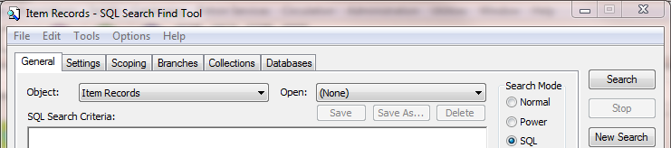
Going beyond a Normal (or Power) search with SQL
Some examples of data that is not searchable via a Normal or Power search:
Historical activity on item records.
Non-indexed MARC fields in a bibliographic record.
The title or author of a deleted bibliographic record.
Purchase order lines for a specific branch's orders.
Patron account information from a deleted (and purged) item record.
This and more can be found using a SQL search.
Notes:
The supplementary document includes sample queries for these examples.

Slide 11
Elements of a SQL query (in the Find Tool)
SELECT (Which ID do you want? PatronID, ItemRecordID, etc.)
FROM (Which table(s) or view(s) do you want to look in? Patrons, BibliographicRecords, etc.)
WHERE (What are the criteria for your search?)
Notes:
***Make sure you are searching in the right kind of object (patron records, item records, etc.). It may be possible to search for ItemRecordIDs in a Patron search, but you will retrieve PATRONS whose IDs are the same as the ItemRecordIDs!
The WHERE part is not strictly required, but if you don't use it, Polaris will try to find ALL of the items, bib records, etc. in the database. Not very useful.
(If you try this, the Find Tool should only give you the first 1,000 records, or whatever the Retrieval Limit is.)
Views, which are more or less virtual tables that combine and/or aggregate data from other tables, can also be searched.
There can be multiple criteria in the WHERE clause, linked together by Boolean operators (AND, OR, NOT). More on this later.

Slide 12
A SQL query example
SELECT ItemRecordID
FROM CircItemRecords with (nolock)
WHERE AssignedBranchID = 10
Notes:
These items could be found with a Regular or Power search, but starting out with queries that can be replicated in other types of search allows you to compare the results. If the results are different, see if you can figure out why they are and adjust your query accordingly.
The phrase"with (nolock)" may not be necessary with modern SQL queries, but I include it in the off chance a query might lock records (and keep others from modifying them).
Letter case is not important in these queries, but punctuation and syntax are. The line breaks in the example are just to show the separate elements and are not necessary.
Text string searches are also not case sensitive, but it is possible to do a case-sensitive and/or accent-sensitive search (see the supplementary document). (It does add a layer of complexity to the query, and may be rarely if ever needed.)

Slide 13
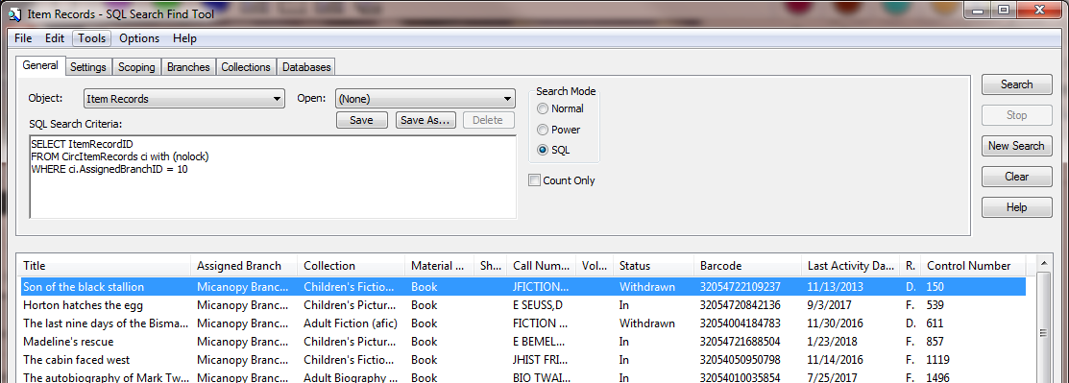
The same SQL query in the Find Tool.
Notes:
You can save a query to use later (helpful if you look for the same things often). You can also modify an existing query before running it and then save it with another name.
Note: Saved SQL queries are not user-specific. Your library may want to come up with a naming convention to identify which user or department created the query.

Slide 14
Operators for the WHERE clause
= Equals AssignedBranchID = 10
<> Does not equal ItemStatusID <> 4
> Greater than FirstAvailableDate > '01/01/2018'
< Less than LastCheckoutRenewDate < '01/01/2015'
>= Greater than or equal to (includes the value and greater than)
<= Less than or equal to (includes the value and less than)
Operators may not work with all types of data (numbers, dates, text strings) but many do work with more than one type.
Notes:
Dates and strings need to be placed within single quotes. (SQL treats the slashes in a date as if they were division operators.)

Slide 15
Operators for the WHERE clause continued
IN ( ) a list of possible values HomeBranchID IN (3,4,7,10)
NOT IN ( ) exclude these values PatronCodeID NOT IN (2,5)
IS NULL no data (not the same as 0) FirstAvailableDate IS NULL
IS NOT NULL has any data ChargesAmount IS NOT NULL
BETWEEN an inclusive range PublicationYear between 1998 and 2018
LIKE ' ' contains this text string CallNumber LIKE 'DVD E SES'
NOT LIKE ' ' string is not there MARCLanguage not like 'eng'
Notes:
IN and NOT IN: Place the numbers in parentheses, with commas between them. Again, IS NULL is NOT the same as having a zero.
BETWEEN: The data is greater than or equal to the starting value and less than or equal to the ending value. “BETWEEN 1 and 10”
LIKE and NOT LIKE: Place the text string in single quotes. If you are pasting a query from a document, make sure that you do not have "smart quotes" because Polaris does not interpret them correctly. (You will get an error message.)

Slide 16
Boolean operators to join criteria
AND The criteria on each side of the AND must be true.
OR The criterion on one side or the other of the OR must be true.
NOT The criterion after the NOT must be false.
Notes:
Parentheses can be used to group joined criteria.
This can be very important if you use multiple criteria and an OR.
(If you do not group with parentheses, the query will look for what is before the OR, and what is after the OR. )
(Searching for items with AssignedBranchID = 5 (10,000 items) AND AssignedCollectionID = 10 (7,000 items) OR StatisticalCodeID = 33 (4,000 items) will find all items that match the first two criteria, or match the third one.
300 items that have both AssignedBranchID =5 and AssignedCollectionID = 10 plus all 4,000 items with StatisticalcodeID = 33 results in 4275 uinique items. (25 items meet all three)

Slide 17
An example of how to use > and < with text strings
SELECT BibliographicRecordID
FROM BibliographicRecords with (nolock)
WHERE BrowseCallNo > 'FICTION A'
AND BrowseCallNo < 'FICTION E'
Notes:
This will find any bibliographic record's call number that starts with FICTION (FICTION AARON,J) that comes before FICTION EARLY,J.
You can, in effect use the letter Z to truncate.
If you use 'FICTION AA' and 'FICTION ADDZ', you will find any call number that starts with AA and comes before ADE, including AABE,M and ADDISON,K on either end of your range.

Slide 18
Truncation in text strings
The percent sign % is the equivalent of the asterisk * in a Normal search. It is used to match zero or more characters.
MARCBrowseTitle LIKE 'gone with the%' (or '%with the wind', 'gone % wind', or even '%with%wind').
The underscore _ is used to match any single character.
MARCBrowseTitle LIKE 'iron_ _ _d' will find 'ironwood' or 'ironweed' but not 'iron your clothes on your bed' ('iron%d' would find that).
Notes:
Spaces are important. If you include a space, the query will also include the space.

Slide 19
Using joins to search in multiple tables
If you join tables with identical field names, you need to specify which table you are referring to. You can use the full table name, but it is quicker to use an alias or shortcut. These are usually a couple of characters long. Even if there are no overlaps in field names, aliases can help you keep track of which tables you are using.
SELECT ci.ItemRecordID FROM CircItemRecords ci with (nolock)
JOIN BibliographicRecords br (nolock) ON (br.BibliographicRecordID = ci.AssociatedBibRecordID) WHERE ci.AssignedCollectionID = 3
AND br.Browseauthor like 'Anderson,%'
In this example ci is used for CircItemRecords and br is used for BibliographicRecords.
When joined to a field name, a period is used between the alias and field.
Notes:
There must be an equivalent key in each table that represents the same entity, in this case, the BibliographicRecordID and the AssociatedBibRecordID in their respective tables.
The order of the join will not make a major difference in most cases, but it is a good idea to be consistent.
The supplementary document includes a number of ID equivalents for joining tables.

Slide 20
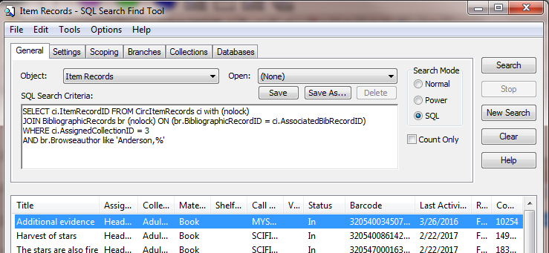
Using joins: How it looks in the Find Tool
Notes:
To get any results, there must be at least one item with AssignedCollectionID of 3 that is linked to a bibliographic record whose BrowseAuthor starts with "Anderson" and a comma.

Slide 21
A join, visualized
Most joins between tables create an intersection between two tables. Any data in one table that is not linked to data in the other table by an equivalent ID will be excluded.
TableA
TableB
(JOIN)
Notes:
This means that there must be a data in a key to join on in both tables. (If you are searching for ItemRecordIDs and you join to ItemRecordHistory but there are no entries for a particular item, you will exclude those items.)
It is possible to use outer joins when absolutely necessary. This will include all of one of the tables, but none of the data in the other table that does not overlap with the first table. The need for an outer join in the Find Tool should be rare, so these joins are not covered in this presentation.

Slide 22
“Bridge” joins
In some cases you may be able to join TableA to TableB by an equivalent ID and then TableB to TableC by another equivalent ID.
TableA
TableB
TableC
(JOIN)
(JOIN)
BibliographicRecords
BibliographicTags
BibliographicSubfields
This join allows you to search by Bib call number ('CD%') and subfield e ('composer%') without specifying the tag number.
Notes:
You do not need to include any criteria that refer to TableB in the query.
TableB can be referred to as a "bridge table." As with other joins, if there is not an overlap that links data in TableA to TableC via TableB that data will not be retrieved by the query.

Slide 23
Nested SELECT statements
Nesting a “sub-select” statement can be useful when you want to limit your query to the contents of a record set.
SELECT ItemRecordID FROM CircItemRecords with (nolock) WHERE AssignedCollectionID = 10
AND ItemRecordID IN
(SELECT ItemRecordID FROM ItemRecordSets with (nolock) WHERE RecordSetID = 12345)
This method can also be used to omit the record set from the query by using AND ItemRecordID NOT IN.
Notes:
The "sub-select" statement can contain other limiting criteria, but these limits should be placed in a single select statement unless absolutely necessary.

Slide 24
Another way to exclude using EXCEPT
SELECT AssociatedBibRecordID FROM CircItemRecords with (nolock) WHERE AssignedCollectionID = 10
EXCEPT
SELECT AssociatedBibRecordID FROM CircItemRecords with (nolock) WHERE AssignedBranchID in (2,3)
Notes:
Note that you need to select the same type of ID in both SELECT statements.
This query excludes any Bibs with items assigned to 2 or 3. If this criterion was in the main select statement, bibs with an item assigned to another branch would be included, even if another linked item was assigned to 2 or 3.
You could also use a nested select statement:
…AND AssociatedBibRecordID NOT IN
(SELECT AssociatedBibRecordID from CircItemRecords with (nolock) WHERE
AssignedBranchID in (2,3))

Slide 25
Searching for dates
You can enter a specific date.
WHERE FirstAvailableDate >= '01/01/2018'
(Dates in Polaris include times, so FirstAvailableDate = '01/01/2018' will not find much, if anything.)
To get an entire day, add an additional date criterion.
WHERE FirstAvailableDate >= '1/1/2018' AND FirstAvailableDate < '1/2/2018' (Less than the second date will include everything up to the last millisecond of the first date.)
Notes:
Dates can include leading zeroes as in the upper example, or they can be omitted as in the lower one.
The supplementary document includes a list of dates and what they mean, taken from Polaris database help.

Slide 26
Searching for dates: Relative dates
The DATEADD function can be used to find a relative date.
WHERE FirstAvailableDate >=DATEADD(dd,90,'01/01/2018') (dd,90 means 90 days after the date, for 90 days before, use dd,-90)
Adding the GETDATE function will find a date relative to the present.
WHERE FirstAvailableDate >=DATEADD(dd,-30,GETDATE())
(GETDATE also includes time, so it can omit part of a day's activity)
Notes:
You can also use mm for months and yyyy for years (hh for hours, mi for minutes, ss for seconds). There are other options as well.
Remember that most dates in Polaris are dates and times. Adjust your query accordingly or add the time after the date. (To get everything up to the last millisecond or two of an hour, use .999. (For example, '01/15/2018 23:59:59.999')

Slide 27
Searching for dates: Just the date
To remove the time from the GETDATE function, you can add the DATEDIFF function to the criterion.
WHERE FirstAvailableDate >=DATEDIFF(dd,0,DATEADD(dd,-90,GETDATE())
This should search from the start of the date 90 days from yesterday through the present.

Slide 28
Searching for Bibliographic records using data in MARC subfields
This can be useful if you need to find bibs that contain data in non-indexed fields. It also searches for data in deleted bib records.
SELECT br.BibliographicRecordID FROM BibliographicRecords br with (nolock)
JOIN BibliographicTags bt (nolock)
ON (br.BibliographicRecordID = bt.BibliographicRecordID)
JOIN BibliographicSubfields bs (nolock)
ON (bt.BibliographicTagID = bs.BibliographicTagID)
WHERE br.RecordStatusID = 1
AND bt.TagNumber = 538
AND bs.Data like '%5.1%'
Notes:
This query looks for final (not deleted) bibliographic records that have 5.1 (quadraphonic or surround sound). It would also find software requirements of 5.1.1. Like other keyword-type searches, you may get more than you expect.
You can select the BibliographicRecordID in BibliographicTags, but if you need to select only final or deleted records (RecordStatusID = 4), BibliographicRecords must be included in the query.

Slide 29
Dealing with duplicates
Depending on the query, the Find Tool may display multiples of results.
There are 2 basic methods to handle this:
Use SELECT DISTINCT to limit your query to a single copy of each ID or
Add the results to a record set.
Notes:
For example, if you are searching for bibliographic records by information in item records, you may "find" the bibliographic record once for each item you find.
Record sets are designed to hold only one instance of a particular ID, so attempting to add duplicates will automatically exclude them.

Slide 30
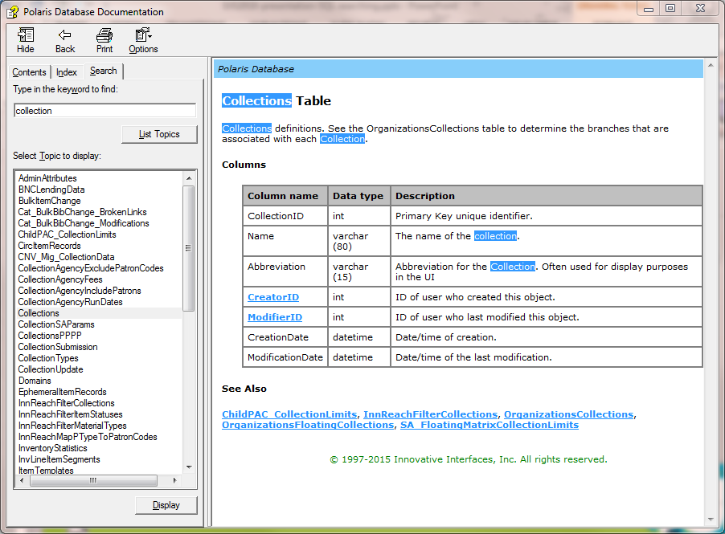
Database help
The Polaris Database Repository (version 5.0-5.5) is a very useful tool. It can be downloaded from https://iii.rightanswers.com/portal/ss/?taxonomypath=Downloads%2F%2FPolaris%2F%2FDatabase+Help&tabid=2#t=kbResults
Notes:
The supplementary document includes information on accessing Polaris's database help.
The Database repository includes an index and keyword search. Clickable links in the main body take you to the "primary" table for that element. See Also Links take you to related tables.
(When first downloaded, the .chm file may open with no data because the file is "blocked." Instructions on unblocking the file (Windows 7) are included in the supplementary document.)

Slide 31
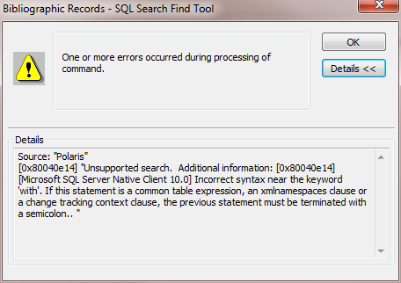
Final thoughts
Error messages can be somewhat cryptic, but usually result from a typo or missing punctuation.
If you paste a query from another source (text document, website, etc.) be careful of "smart quotes" and "--" used for comments.
Notes:
The supplementary document includes information about some common error messages and what they may mean.
Polaris does not understand smart quotes.
The Find Tool treats SQL queries as one long string of text, so a double-hyphen used to "comment out" something will actually treat everything after and below the hyphens as a comment.

Slide 32
What (I hope) we covered in our time together:
A brief overview of Polaris's database structure.
SQL in the Find Tool and the basics of a SQL query.
Limiting your search.
Searching in multiple tables by using joins.

Slide 33
Questions?
A copy of this presentation and a supplementary document should be attached to the presentation in the IUG app, and may also be included with the program description on the conference web page.
Our email addresses are: jwhitfield@aclib.us ; rpatterson@aclib.us.
Thanks!

