Slide 1
Resource Sharing
ILL support for Innovative Libraries : ILL Module, NCIP, Article-Reach, INN-Reach
Frank Dubisz (Azusa Pacific University)
John de La Fontaine (Occidental College)

Slide 2
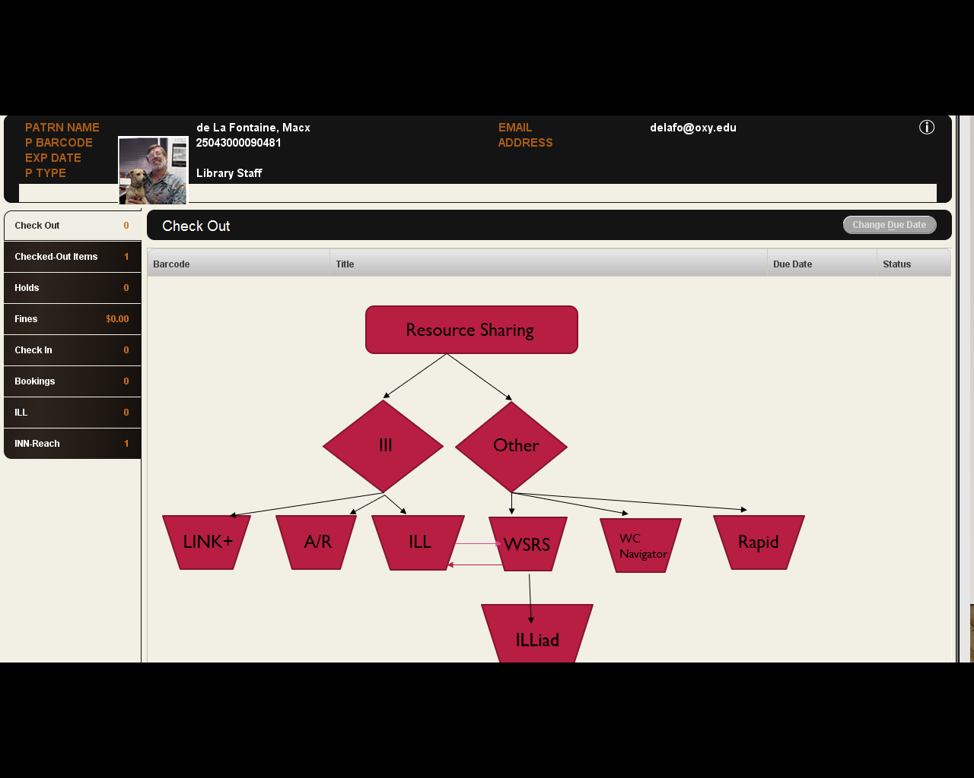
Integrated
Solutions

Slide 3
ILL Module
Borrowing requests only
Works in tandem with OCLC Resource Sharing (ftp)
Patrons can see request status on their patron record

Slide 4
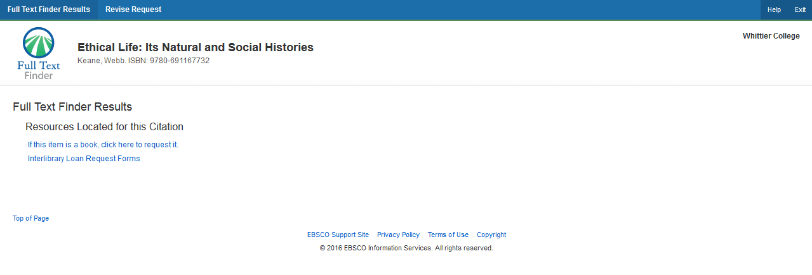
Interlibrary Loan Module discover / request

Slide 5
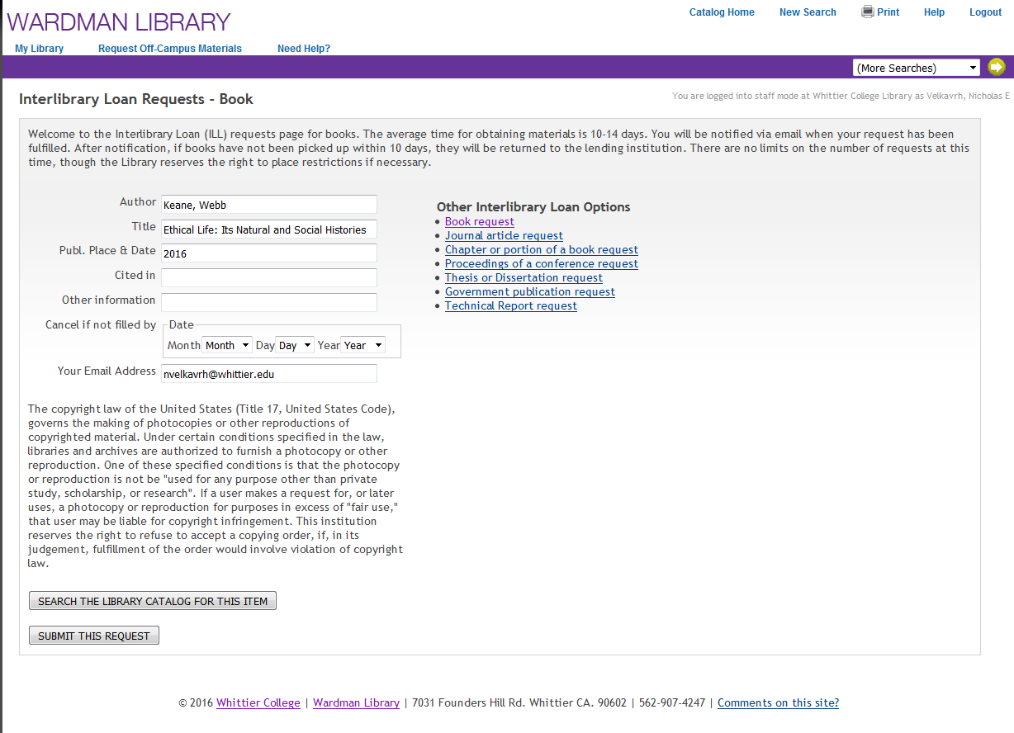
Completed form
Chance to check Catalog

Slide 6
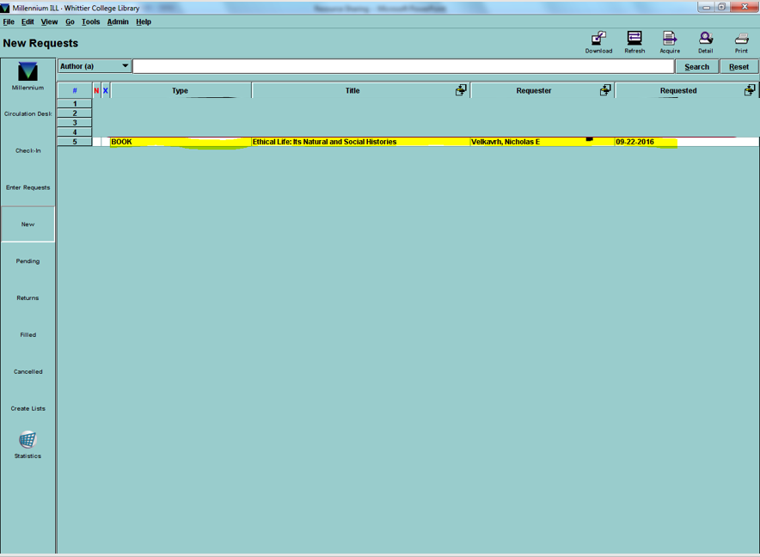
New request queue in ILL module
Staff Side

Slide 7
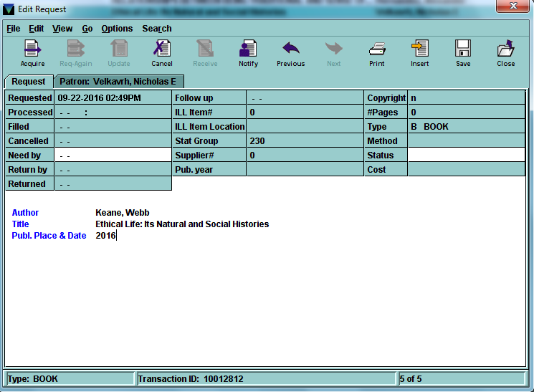
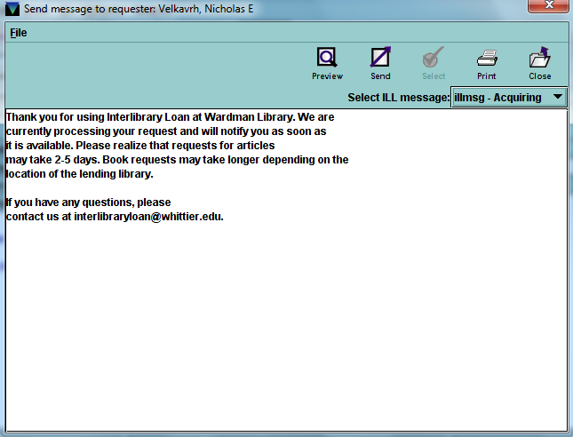
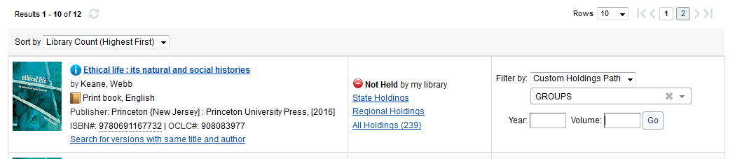
Request display … Acquire
Notify patron request has been received
Request status is visible in Patron record
ACQUIRE request to OCLC

Slide 8
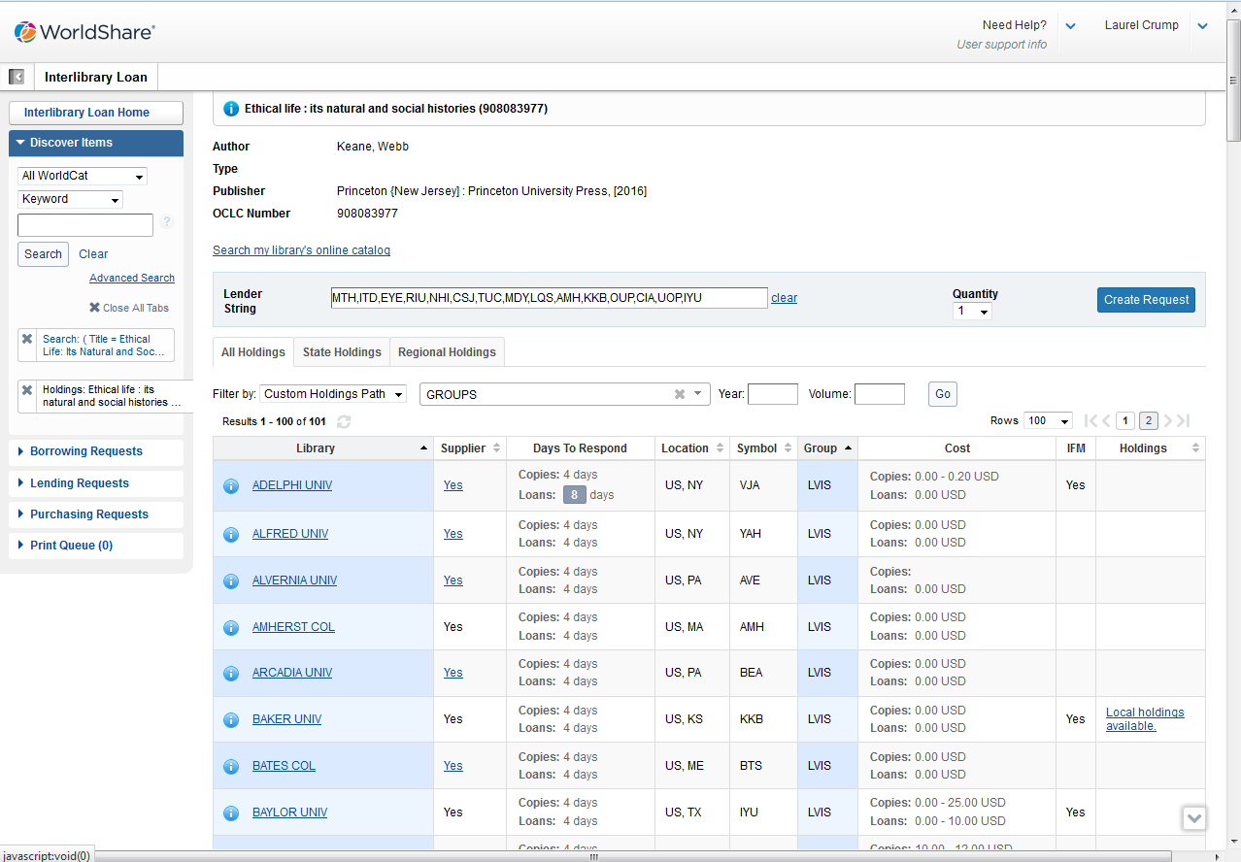
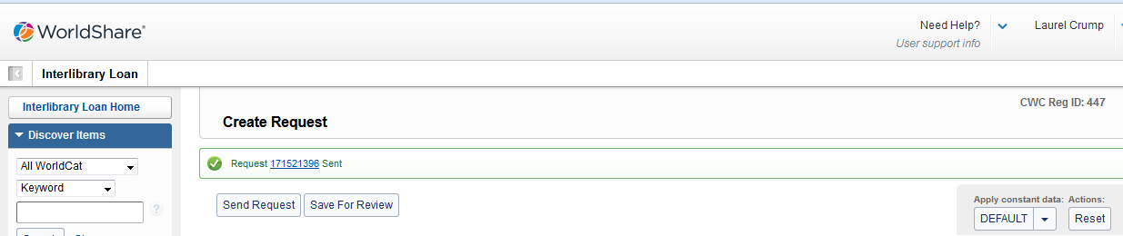
ON OCLC – find lenders & Submit

Slide 9
Pending queue in ILL module
After ACQUIRING the request is put into PENDING

Slide 10
Receive request in ILL module
When RETURNABLE is received, request is updated and put into RETURNS – Circulation take over -- Update OCLC to Received
When ARTICLE is received , request is updated and put into FILLED – Update OCLC to Received -- Information is available in STATISTICS for Copyright reporting

Slide 11
Return returnable in ILL module
When RETURNABLES returned update request to FILLED

Slide 12
NCIP
One way messaging from non-innovative platforms

Slide 13
NCIP
Basic Messages:
  Look up patron
  Accept Item (Borrowing)
  Return Item (Borrowing)
  Check out item (Lending)
  Check in item (Lending)

Slide 14
NCIP
Systems working with III NCIP:
  WorldCat Navigator
  Illiad
  OCLC Relais D2D
  Etc.

Slide 15

Article-Reach
Unmediated access to articles worldwide
20+ independent institutions
50+ Institutions in the Mobius consortium
(Missouri, Iowa, Kansas, Oklahoma, Texas)
Notes:
Thank you to Alliant for preparing these slides for an earlier presentation.
A little about APU - APU students have access to more than 140 online databases, including 46,000 electronic journals, 130,000 ebooks (EBSCO eBook Collection,NetLibrary), a 24/7 reference chat service, and LAPU library tutorial guides. Our systems include …
Classic OPAC and ILS through Innovative Sierra
Discovery through Innovative Encore interfacing with EBSCO EDS platform
Knowledge Base & Link Resolver through EBSCO
Authentication and Access through OpenAthens
A little about me – I was hired over 15 years ago to help with the migration from the legacy system to Innovative Millennium.
I have been honored with the award for 15 years attendance – but never gave back with a presentation. Thank you John for inviting me to join you on stage today!
A little about ArticleReach processing – our ILL team headed by Larry Handy does the processing for AR requests, so I will try to be an accurate voice for how Larry and his team do this.
Because our holding information for electronic resources is not stored in our catalog, we are only making available our print holdings in the AR Union Catalog.
Other institutions have sharing clauses in their contracts that allows for ejournal sharing – and their ejournal holdings are maintained in the catalog which will then allow for those articles to be made available in the AR Union Catalog.

Slide 16
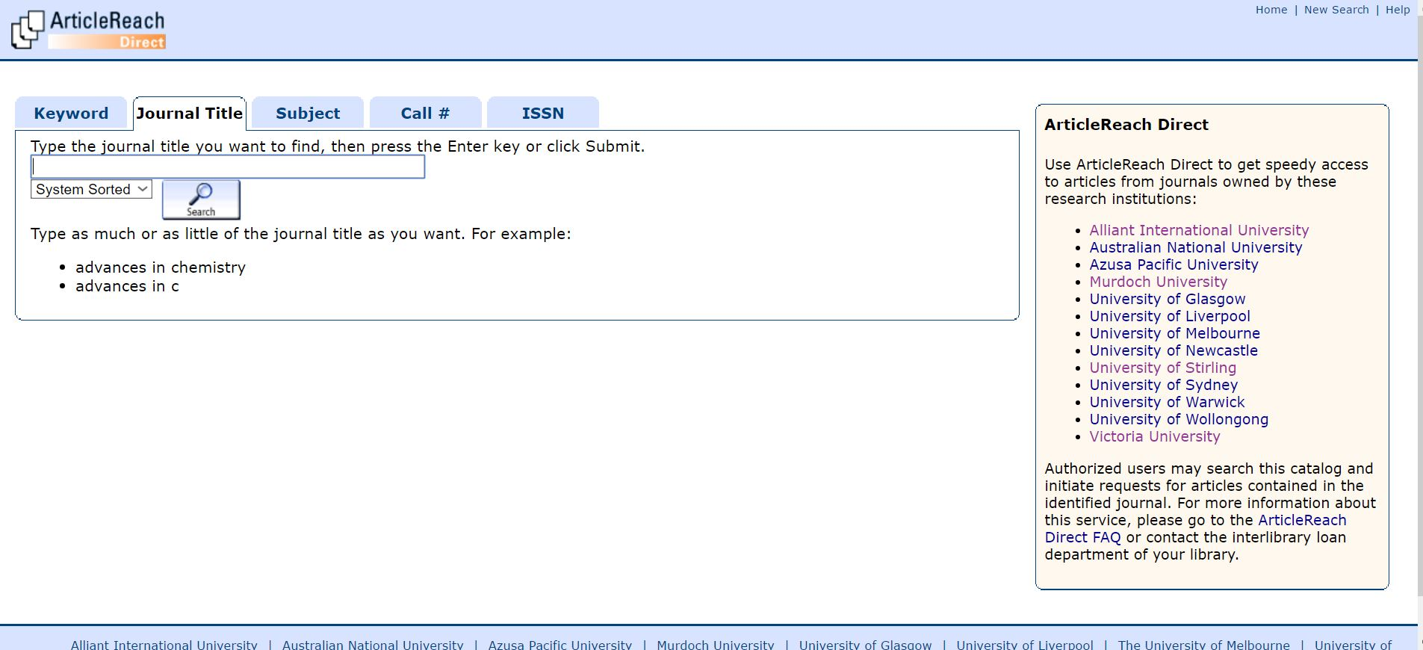
Patron Interface – Union Catalog
Notes:
FTF is our primary interface. We use Discovery / Encore to send patrons to AR.

Slide 17
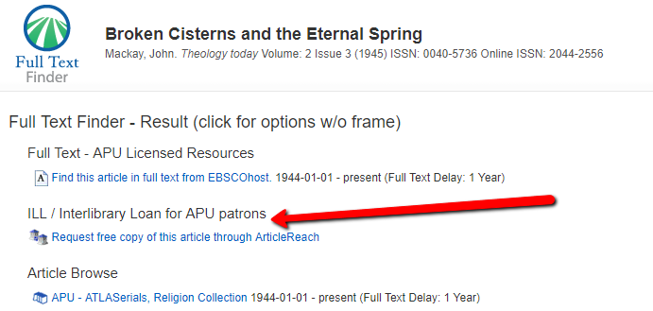
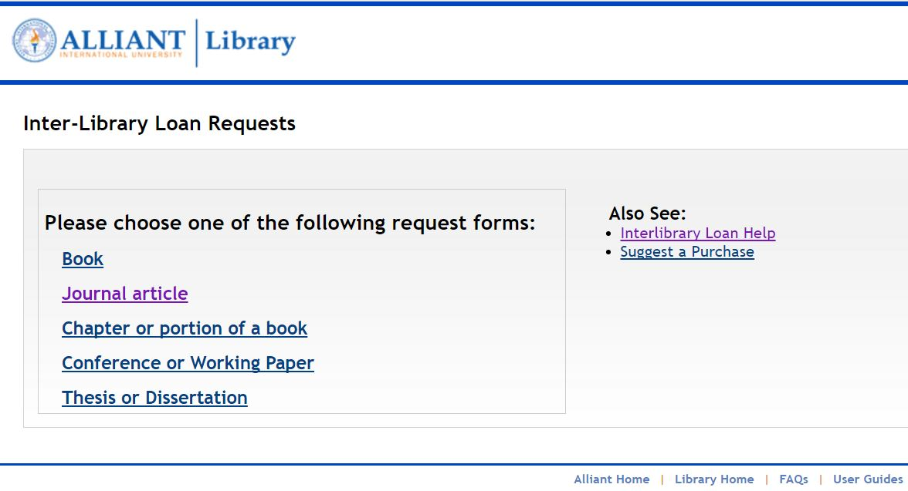
Patron Interface – Link Resolver
Notes:
Always present a link to AR through the LinkResolver – even if FT is available

Slide 18
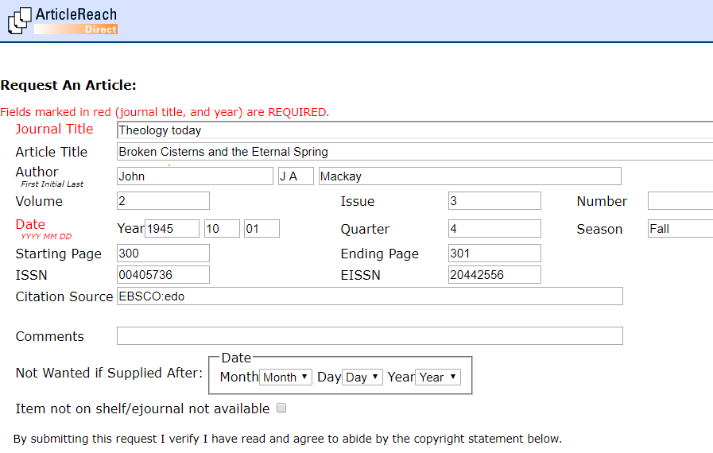
Patron Interface – Link Resolver
Notes:
After authentication, the metadata is all filled out – simply after click “Submit”

Slide 19
Article Fulfillment Process
Acceptance
  Confirm article is available
    Online Requests (for APU patrons only)
    Paper Journal Requests
Production
  Pull article
  Scan article to create PDF (document to folder)
  Proof PDF for quality
  Send PDF of article to ArticleReach via Dropbox
Notes:
Honor online only for APU patrons

Slide 20
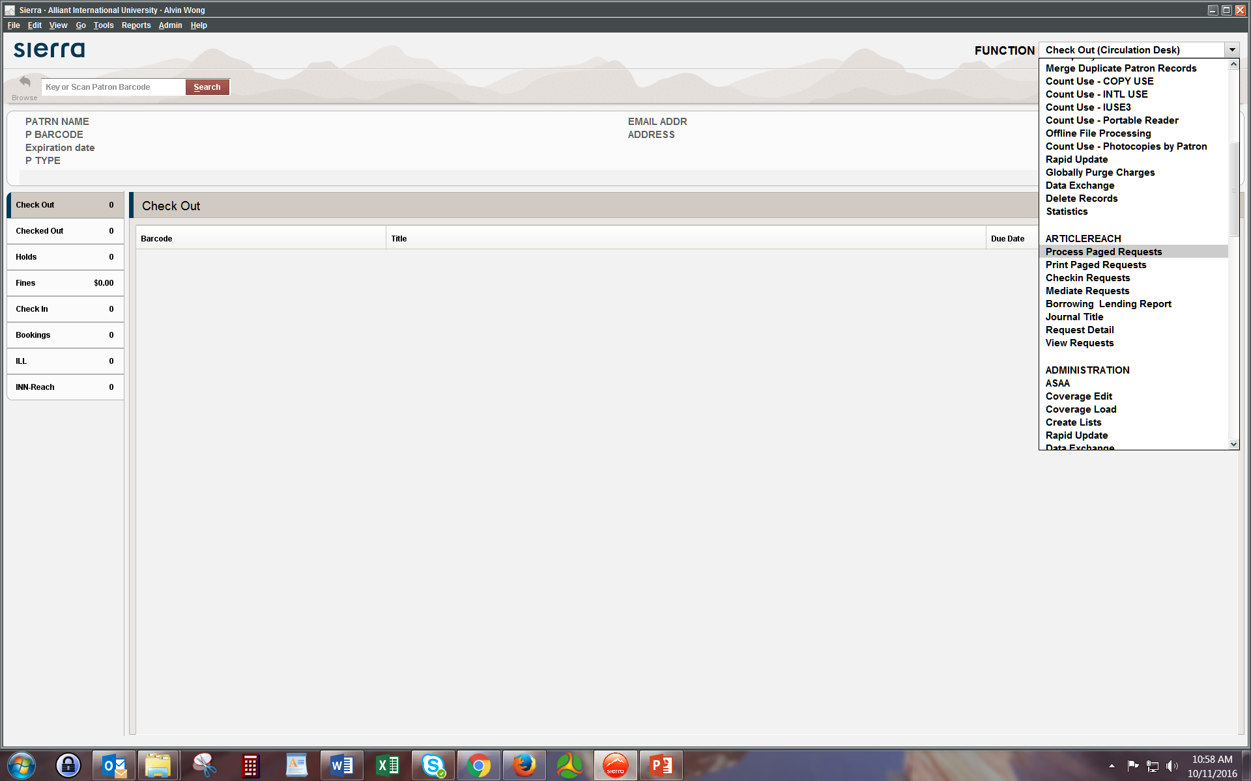
Article Reach Process - Sierra
Notes:
From the Sierra Function drop-down …

Slide 21
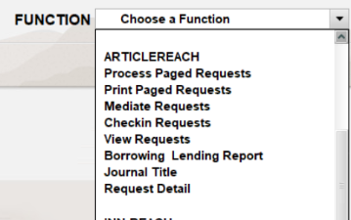
ArticleReach - Function
Notes:
Selecting Process Paged Requests

Slide 22
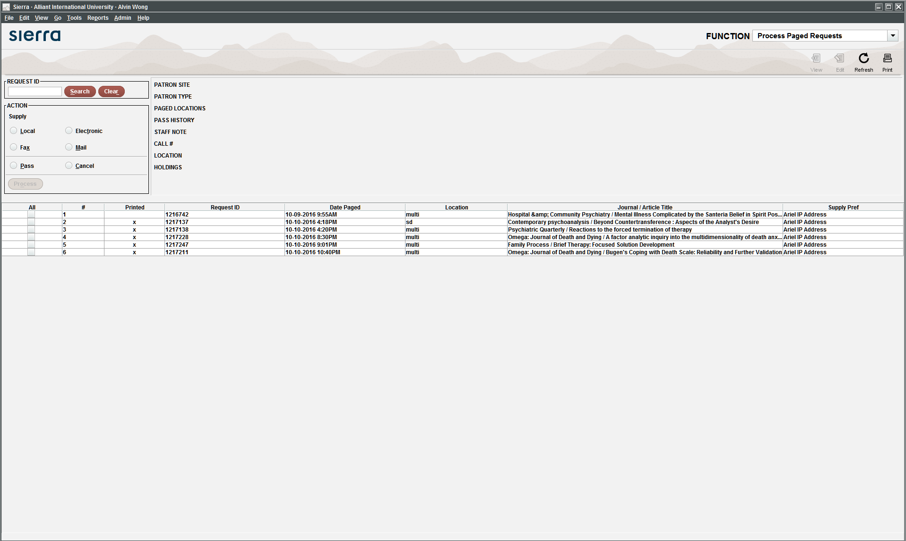
Article Reach – Process Paged Requests

Slide 23
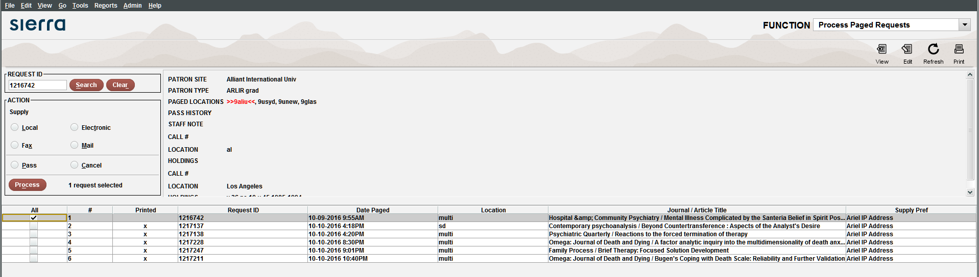
Check Shelf Sheet -
(Select item, Click View)

Slide 24
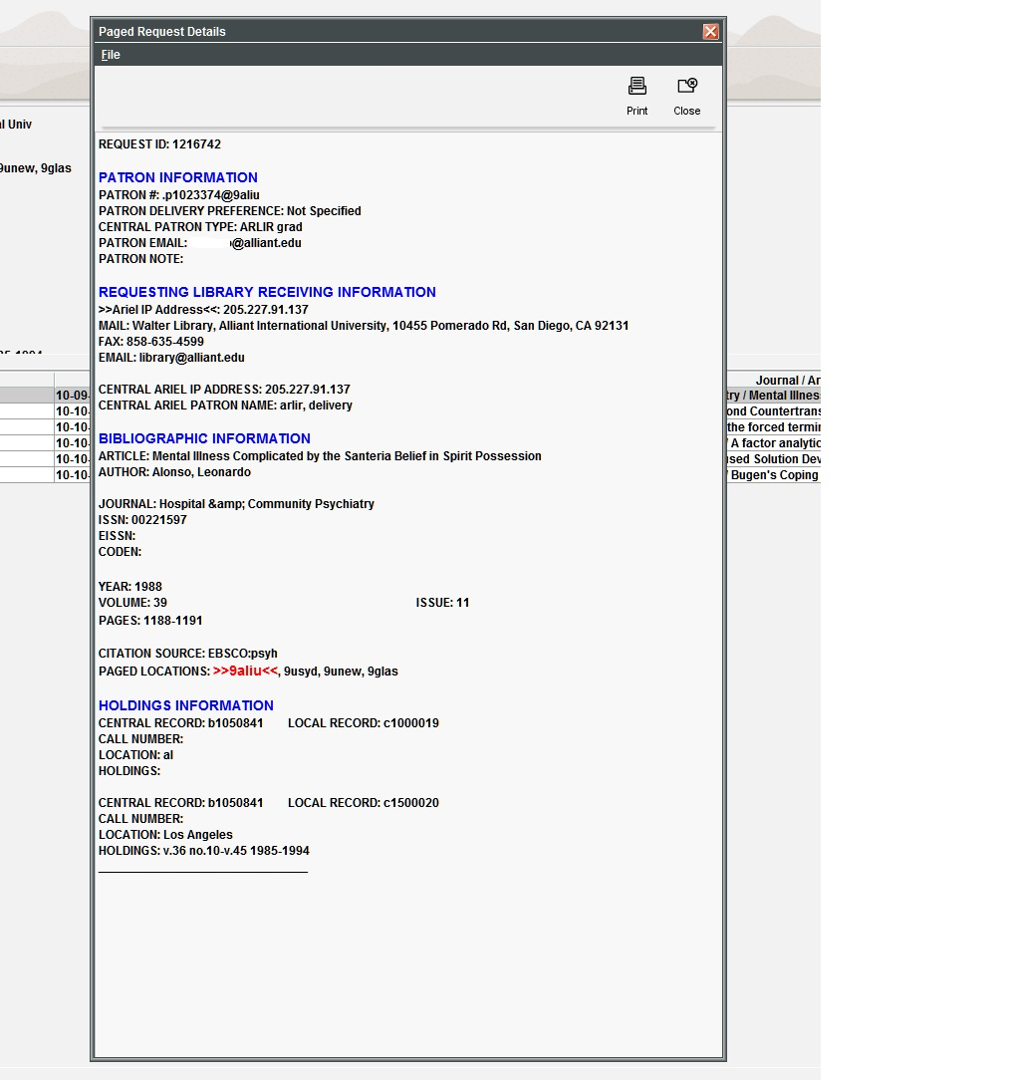
Process – Print Search Slip (included as cover page of the PDF sent to patron)
Notes:
Typically this cover sheet is included in the PDF that is sent to the patron

Slide 25

After confirming the paper journal is here,
Accept request by printing:

Slide 26
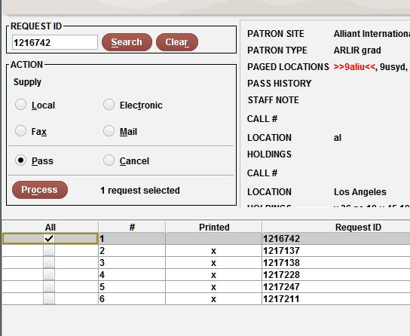
If Not Available – Pass
(Select, then in Action box select “Pass” and click button “Process”)

Slide 27
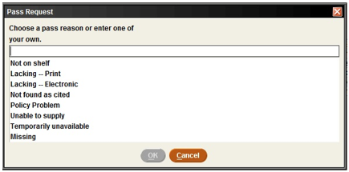
Leave explanation on next box

Slide 28
ArticleReach Production
Create/Provide PDF copy:
If online, download PDF and send to Library Drive AR Folder
If paper journal, Pull from paper Serials and Scan to Library Drive AR Folder
Proof (missing pages, cropped pages, poor readability)
Note: PDF file name = ArticleReach Request ID
Notes:
Requires the initial sheet as 1st page / cover – AR Paging Slip – includes barcode
Note if rescan requested by patron, must just use the em / ILL interfacing to make contact with the original sender

Slide 29
ArticleReach Production
Send to ArticleReach for delivery
  Open Dropbox account (setup specifically for ArticleReach) with browser
  Drag & Drop into Dropbox
Cleanup
  Go back to Library Drive AR Folder and drag delivered request into “Processed” subfolder.
  Wait for a few seconds for it to load and then disappear
Completed
Notes:
#3 should be after cleanup

Slide 30
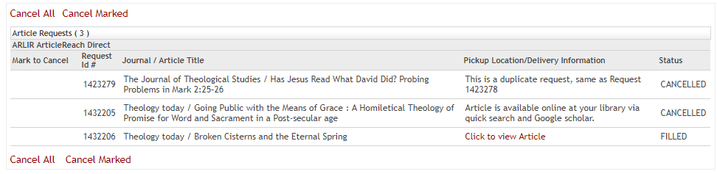
Patron Interface – Link Resolver
Notes:
Patron record view

Slide 31
ArticleReach – Enhancements
Allow for AR to reference our full KB so that APU patrons will be directed to our ILL team if ejournal holdings are requested
Allow for AR to reference a KB of Open Access resources which would auto-direct patrons to the full text
Build a reference of standard contracts with vendors that include ILL options so all institutions can open up ejournal access
Notes:
>>end / improvement suggestions
1) currently our print holdings are indexed in the AR Union Catalog - unfortunately an APU request for an ejournal holding that we also subscribe to does not land in our TODO unless no one else has it.
It would be ideal if our electronic holdings could also be indexed so that if an APU patron does slip in a request, it will be intercepted and redirect immediately to our APU ILL team
I know that the III KB is already being synchronized with the EBSCO KB - so there could be a simple solution to integrate that into the AR KB as a fallback/secondary KB for APU patrons only, perhaps?
2) another wish list is for an index of OpenAccess resources that could auto-provide
APU has intentionally included OA resources so that our FTF finder is providing links.
3) I am not familiar with contracts with online databases, but the ILL option clause would probably be a standard that could be documented and shared so that level of ejournal sharing could dramatically be enhanced
an alternative process is to encourage any new contracts for online databases to include an ILL clause

Slide 32


INN-Reach
Built-in borrowing of returnables from group partners

Slide 33
LINK+
6.8 million titles; 20.6 million volumes;
591K requests; 93% fill rate

Slide 34
68 members (42 public, 26 academic)
- 5 more coming
Academy of Art University (San Francisco)
Alameda County Library
Alliant International University
  San Francisco, Fresno, Irvine, Los Angeles, Sacramento, San Diego
Amador County Library
Azusa Pacific University
Belvedere-Tiburon Library
Benicia Public Library
Berkeley Public Library
Biola University
Calaveras County Library
City College of San Francisco
College of Marin
Contra Costa County Library
CSU Long Beach
Dixon Public Library
Fresno Pacific University
Hayward Public Library
Larkspur Public Library
La Sierra University
Livermore Public Library
Lodi Public Library
Loma Linda University
Loyola Marymount University
Marin County Free Library
Mill Valley Library
Mission Community College
Mount St. Mary's University
Mountain View Public Library
Napa County Library
Napa Valley College
Oakland Public Library
Occidental College
Oceanside Public Library
Pacific Union College
Palo Alto City Library
Pleasanton Public Library
Richmond Public Library
Sacramento Public Library
Saint Mary's College of California
San Anselmo Library
San Diego County Library
San Francisco Public Library
San Joaquin Delta College
San José Public Library
San Mateo City Library
San Mateo County Library
San Rafael Library
Santa Clara City Library
Santa Clara University
Sausalito Public Library
Solano Community College
Solano County Library
St. Helena Public Library
Stanislaus County Library
Stockton San Joaquin County Public Library
Tuolumne County Library
Sunnyvale Public Library
University of La Verne
University of Nevada, Reno
University of San Francisco
University of the Pacific
West Valley Community College
Whittier College
Yolo County Library

Slide 35
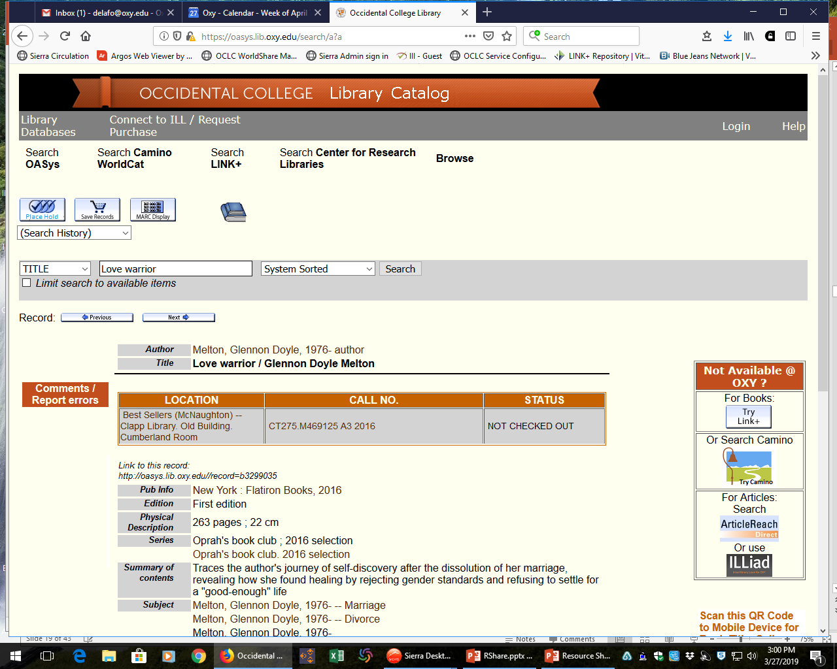

Slide 36
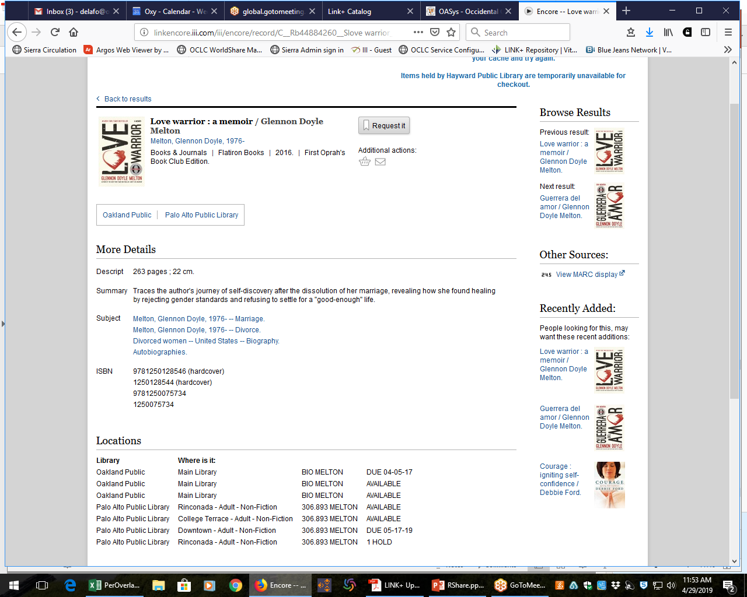
LINK+ / Circuit (INN-reach) : Discovery

Slide 37
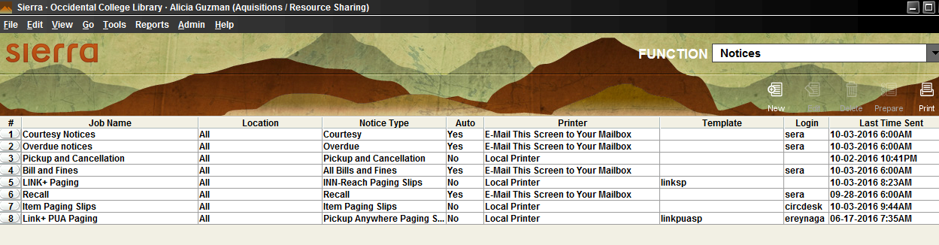
Lender: Produce Paging slips – SIERRA (Millennium)

Slide 38
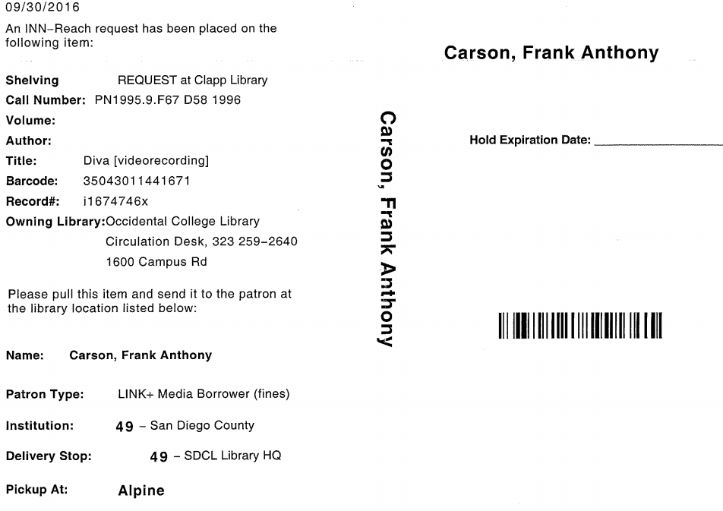
Page item; Check Out; Ship items via courier

Slide 39
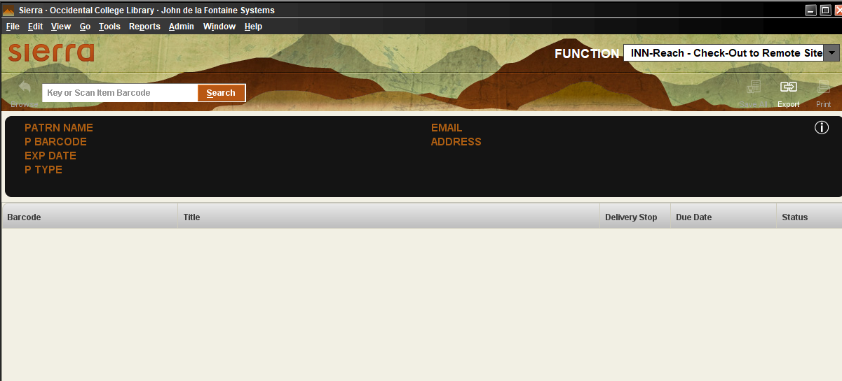
Check Out to Remote Site

Slide 40
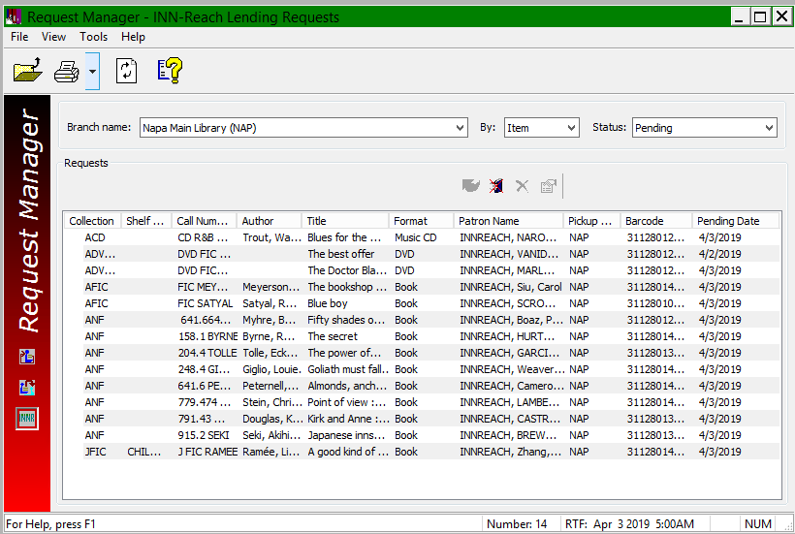
Lending - Polaris
Courtesy: Napa Public Library

Slide 41
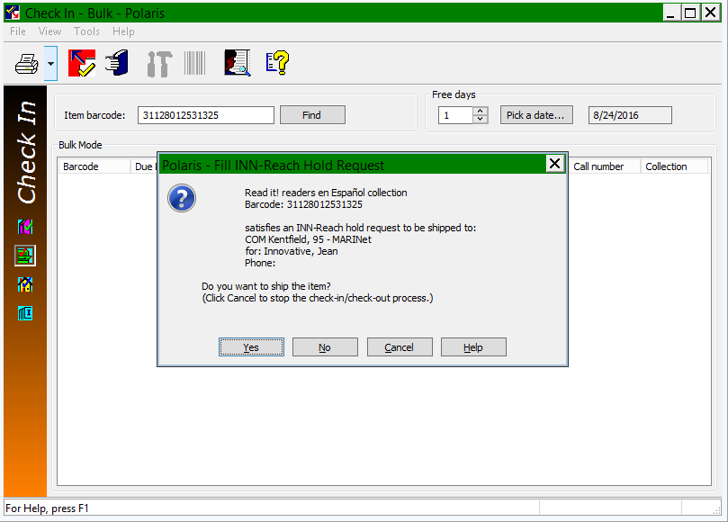
Lending - Polaris
Courtesy: Napa Public Library

Slide 42
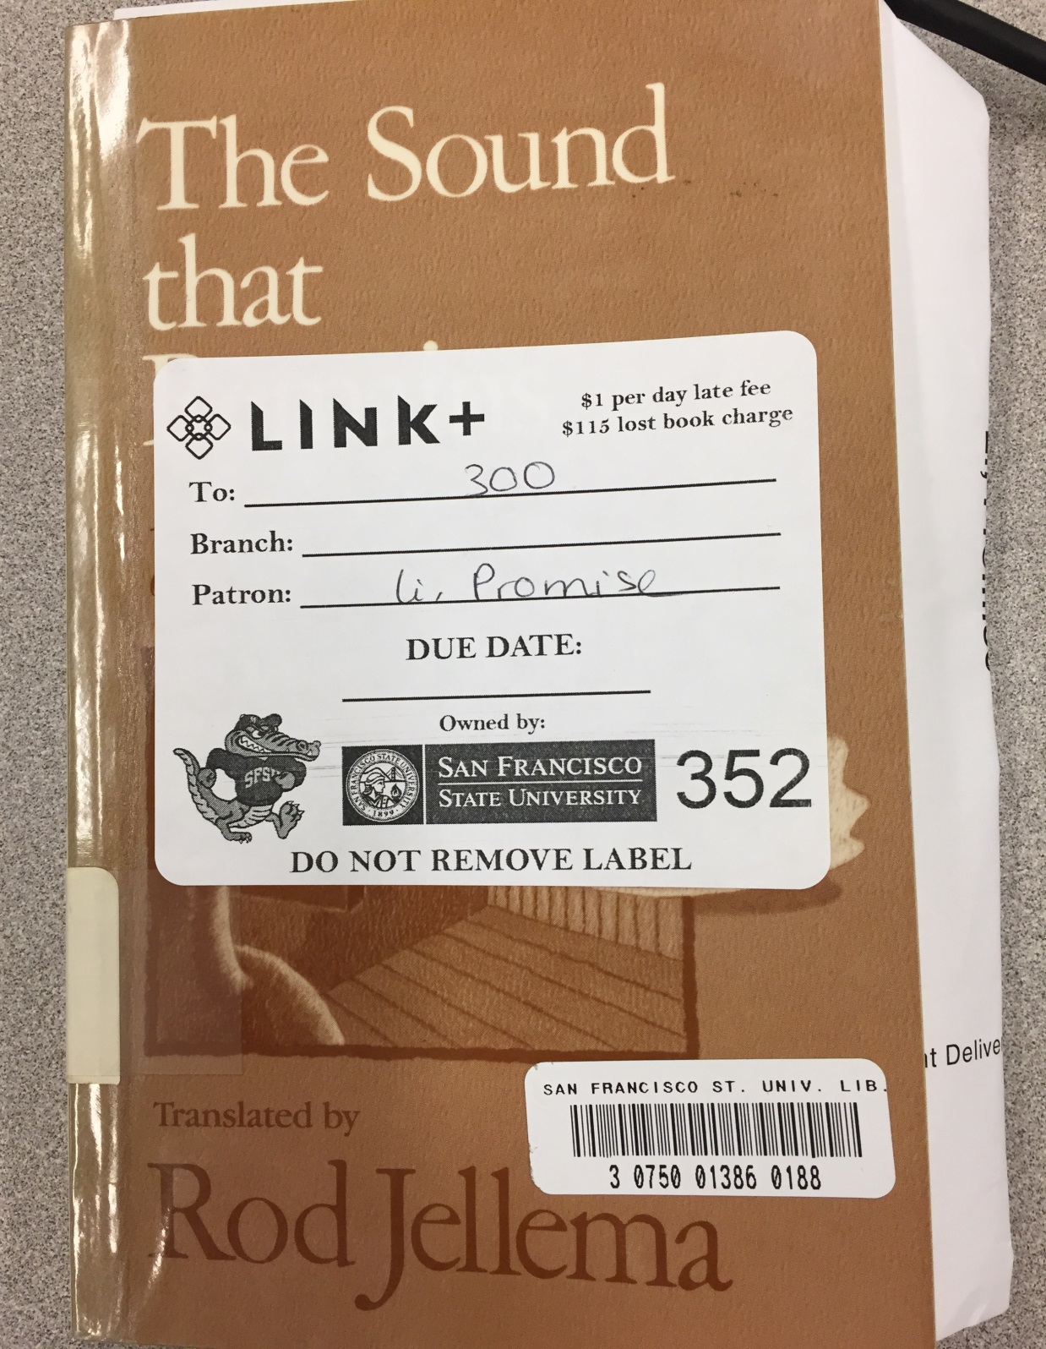
Borrower: Check In item in Sierra / Millennium / Polaris

Slide 43
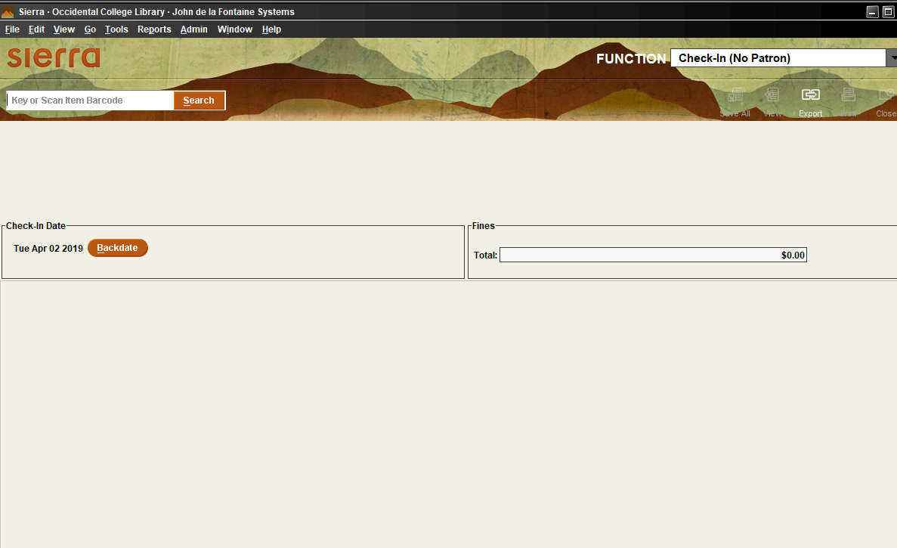
Receiving a LINK+ book (Borrowing Library) –
Sierra / Millennium

Slide 44
Send Notices = Patron knows item has arrived

Slide 45
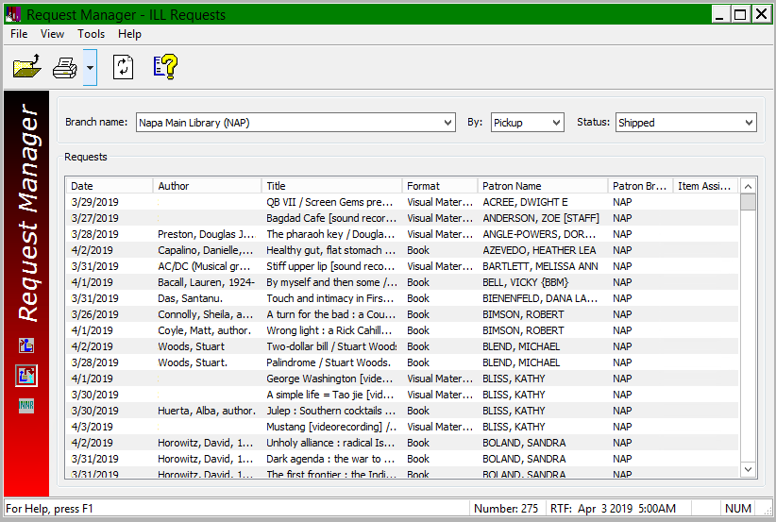
Receiving a LINK+ book (Borrowing Library) –
Polaris

Slide 46
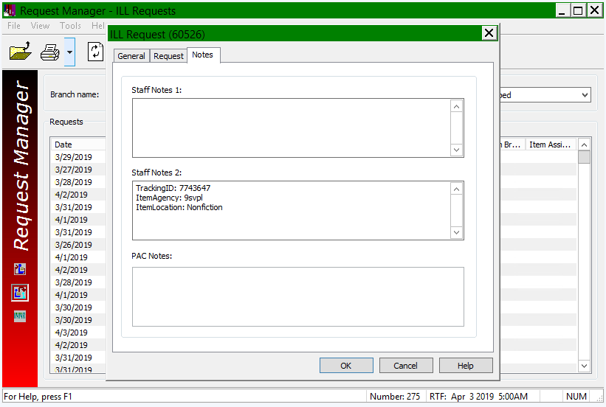
Receiving a LINK+ book (Borrowing Library) –
Polaris

Slide 47
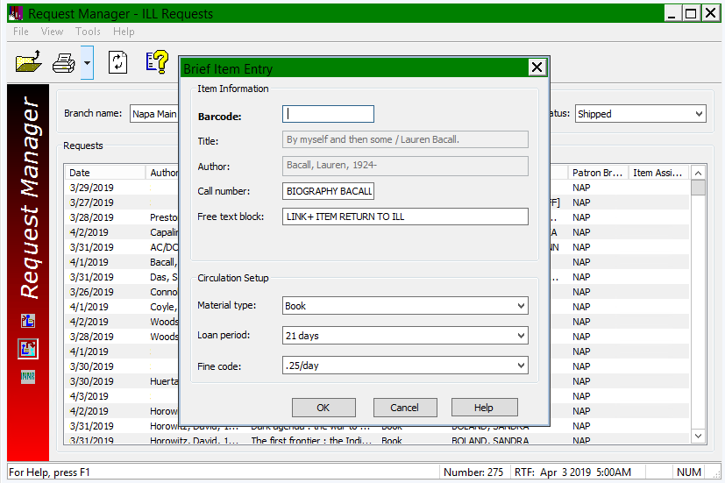
Receiving a LINK+ book (Borrowing Library) –
Polaris

Slide 48
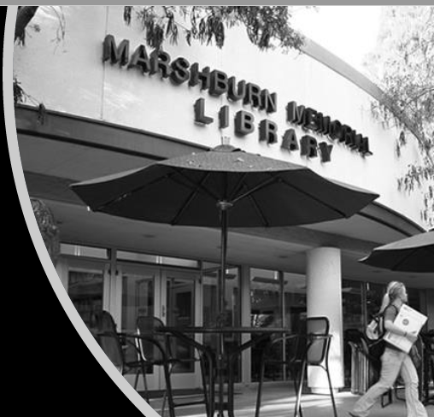
Patrons Love LINK+
“The Link + system is like sitting down in front of a terminal and having access to the entire world of available information. As a walking question mark and life-long learner, I can explore resources not directly stored at my local community library. The "link" from my community to other learning communities is very much appreciated! Thank you!”
“LINK+ is far faster and much easier than other ILL methods. Our requests for other physical ILL items plummeted to almost zero after implementing LINK+. Our patrons are much happier with LINK+ than they were with other ILL methods. Undergraduate students who never would have requested an ILL item now regularly do so through LINK+.”
“Our regular ILL patrons have all shifted over to LINK+ and they’re ecstatic about the change. It’s so much faster and easier than ILL. We rarely make ILL requests now. There are also many more patrons who are using LINK+ as compared to ILL. LINK+ ROCKS!!!!!”

Slide 49
Thank You !
Frank Dubisz
(fdubisz@apu.edu)
John de La Fontaine (delafo@oxy.edu)

