Slide 1

Introducing ChiliPAC

Slide 2

Key ChiliPAC features
User and staff booklists and bookshelves
List discoverability and sharing
Individual user profiles
Staff picks and recommendations
Catalog enhancements
Works with Innovative Encore and Polaris PowerPAC
Single sign-on comes with barcode/PIN login to the catalog, no separate account required

Slide 3
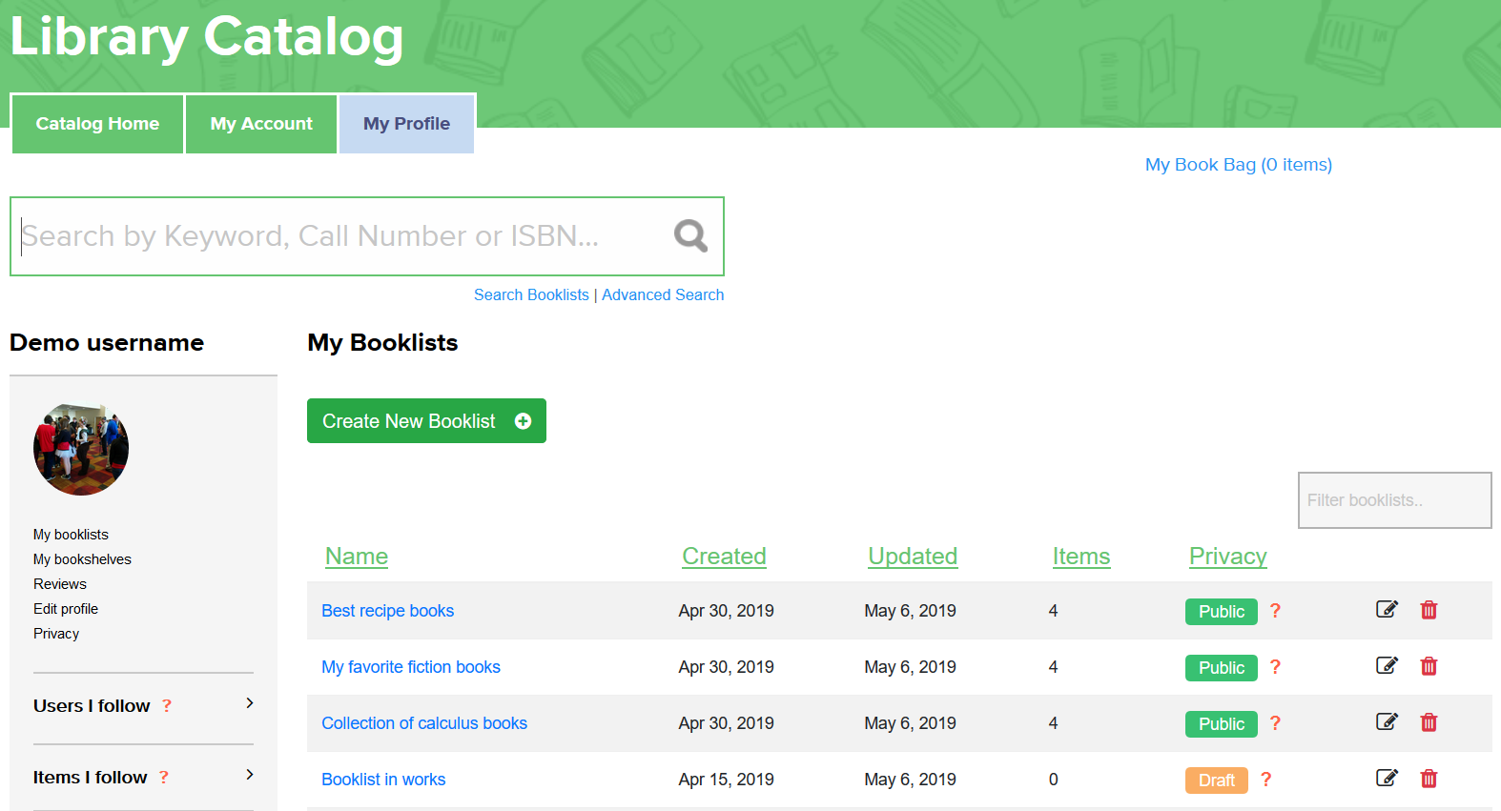
Booklists
Create booklist for any purpose or patron reference inquiry
Staff users may set custom link for booklist to share
Booklists have display statuses:
  Have it in Draft status while in works not shared with anyone
  Set it to Private to share with specific users knowing the link
  Set it to Public to share with anyone, make the lists discoverable publicly
Add items real-time from library’s collection on booklist management page or while browsing catalog using search results and item details pages
Add electronic resources or websites
Add annotations to booklist items

Slide 4
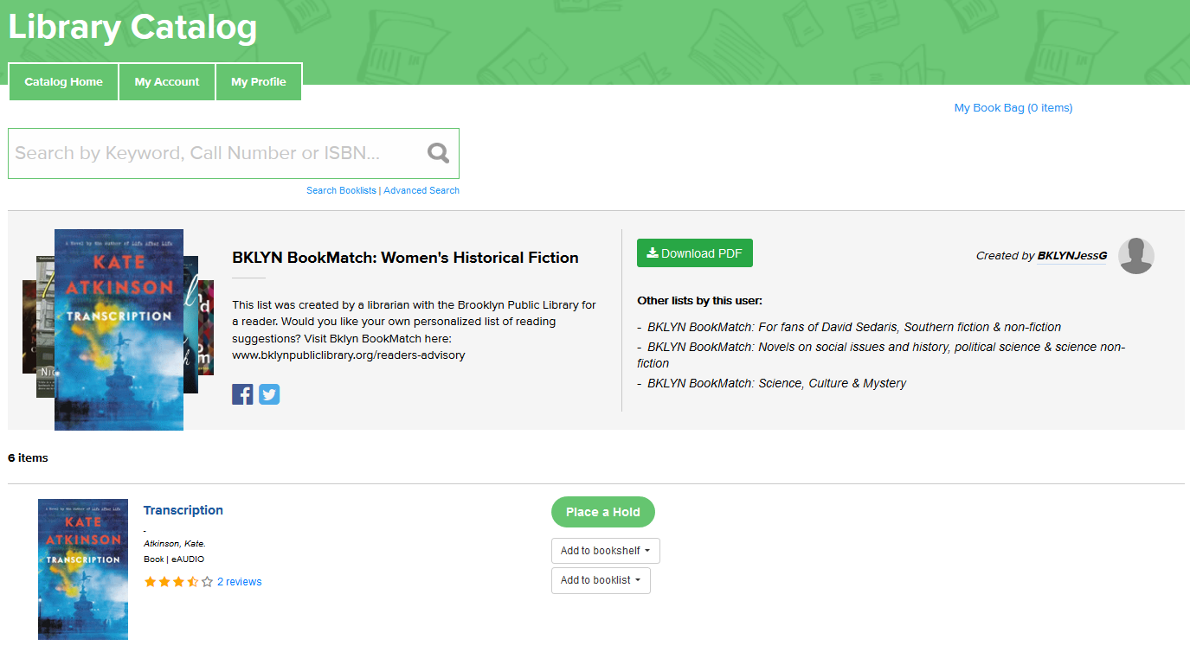
Booklists sharing
Each Public and Private booklist gets a permanent link accessible publicly without logging on to catalog
Staff users can create custom links to shared booklists
Booklist is downloadable as PDF
Users can go to booklist item details for more information, see reviews for items, place a hold or add item to their own booklists or bookshelves
Go to booklist author’s profile to see other booklists and bookshelves of the user
Booklist links are sharable on Facebook, Twitter, e-mail or other means

Slide 5
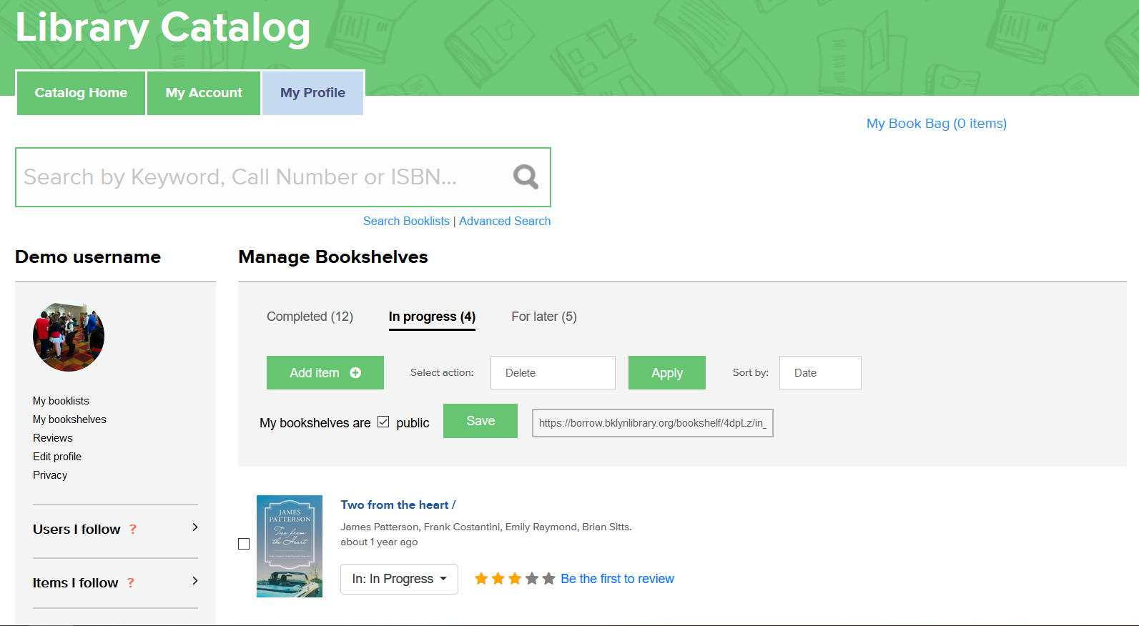
Bookshelves
Main purpose for user own use, but users may choose to share bookshelves for other users visiting their profile as well as using a dedicated permanent link accessible publicly
Three types of bookshelves:
  Completed
  In Progress
  For later
Add items real-time from library’s collection on booklist management page or while browsing catalog using search results and item details pages

Slide 6
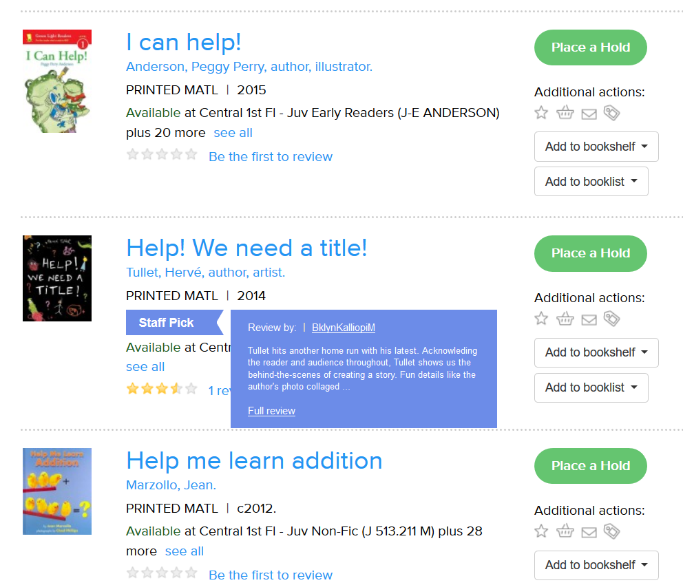
Staff Picks and Recommendations
Staff users are identified automatically by their login to the catalog
Items with staff review get a Staff Pick or Staff Recommendation flag depending on rating of the item
Moving mouse over the flag, users see latest staff review for the item

Slide 7
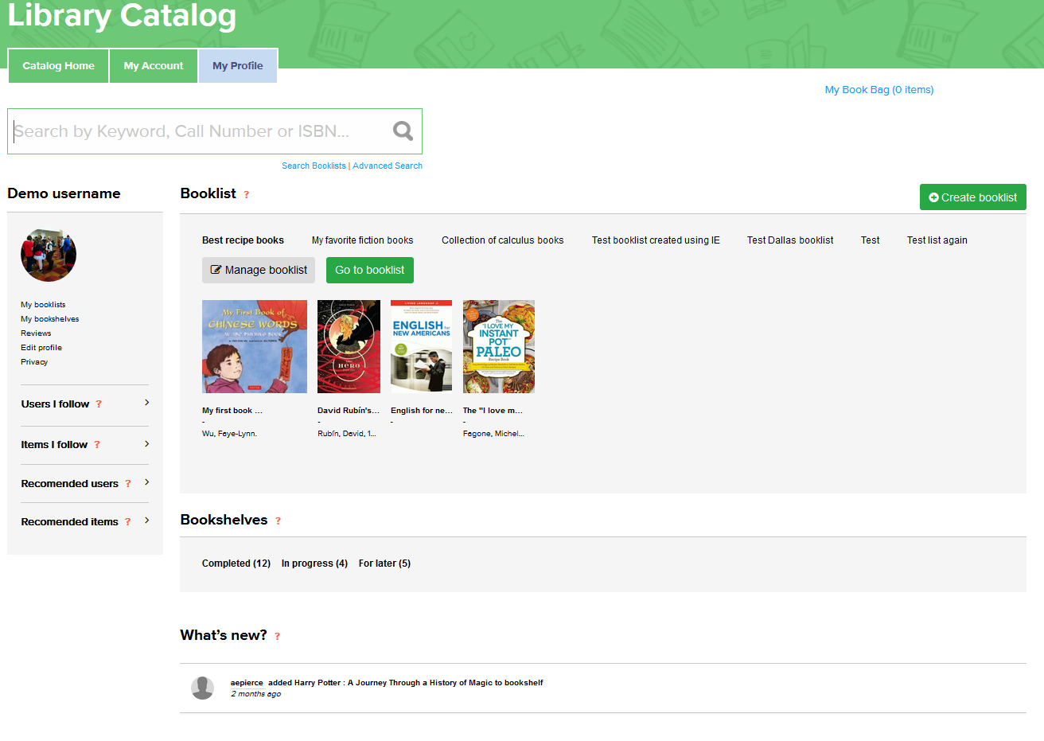
User Profiles
Each user gets profile just by logging in to the catalog using barcode/PIN, no additional account creation required
Users can set their privacy settings and choose what they are sharing with other users
Users can manage their booklists, bookshelves, and their profile information such as avatar and nickname
Users see a timeline of updates for other user and item events that they have chosen to follow

Slide 8
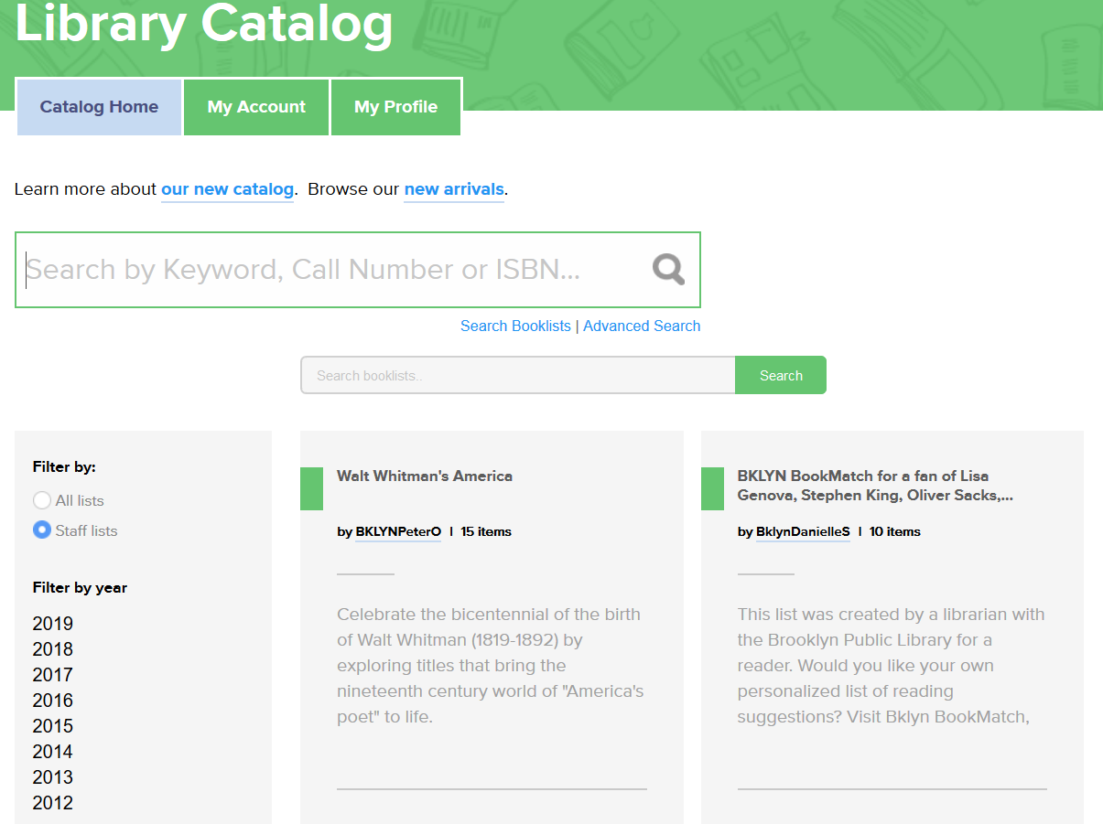
Other ChiliPAC Features
There are multiple other ChiliPAC features and enhancements:
Item cover art rivers of user generated conent such as – Staff booklists, Staff picks and recommendations, Recently reviewed and rated items
Booklist search – discover booklists by staff or other users from within or outside your own library
See booklist search results on facets of search results page
See connected users that have interacted with each items and which booklists these items are appearing on
Different APIs – to display Reviews, Ratings and Booklists on website or other library systems
Additional search results – discover users and items based on user interaction
Following activities of other users and items

Slide 9
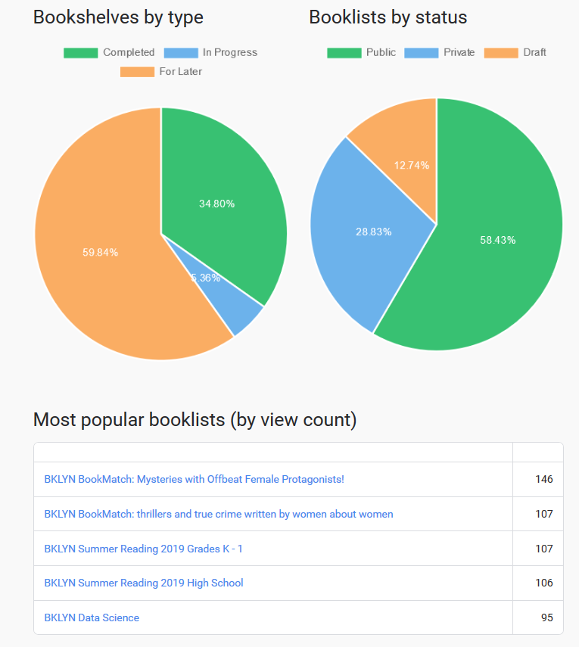
ChiliPAC Analytics
ChiliPAC offers multiple analytics data and analysis options on user activity data such as:
Counts of user activities such us booklists create, items added to bookshelves and booklists
Statistics of where most holds coming from
Most popular items and booklists by different criteria
All data available to be queried based on select timeframes
Analytics data can be extracted for download and used in other analytics tools using common reference points such as item ID from librarys bibliographic collection

Slide 10
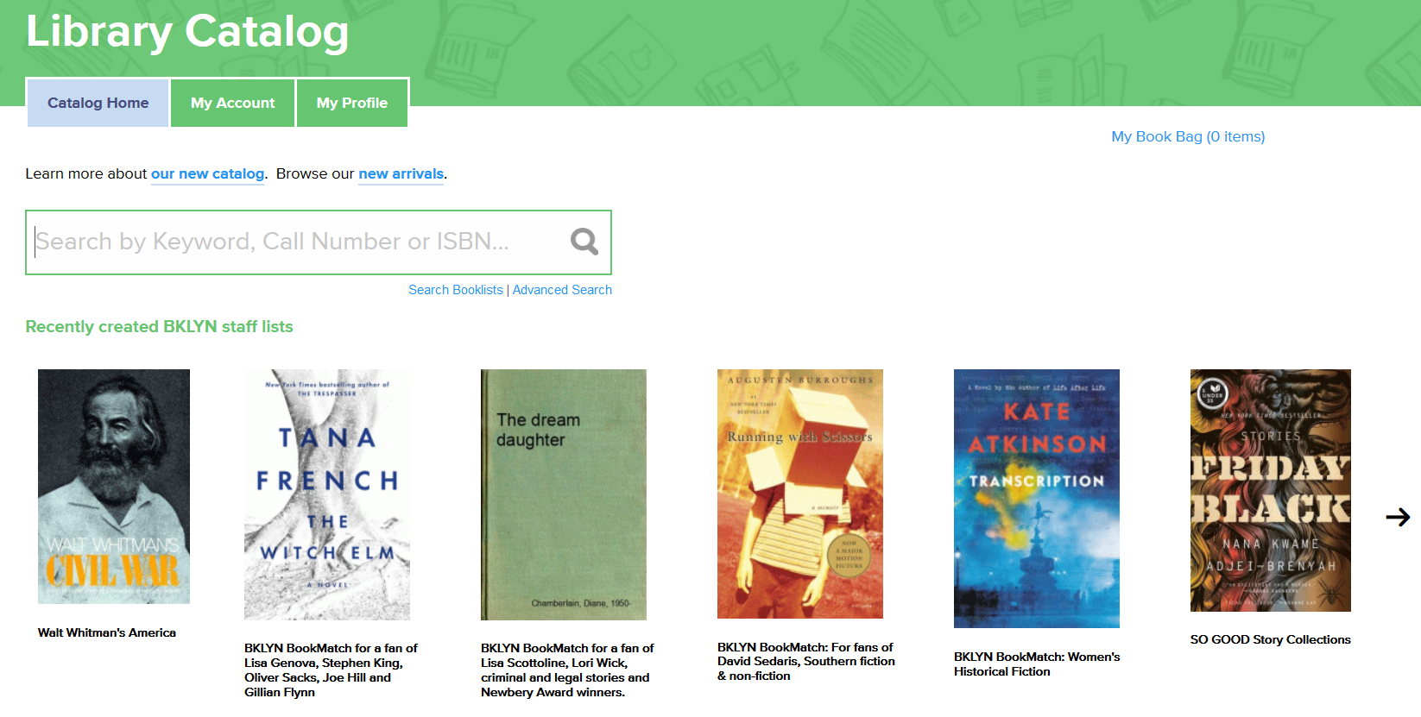
ChiliPAC Information
We are happy to hear from you!
Please visit www.chilifresh.com for additional information on ChiliPAC and other ChiliFresh catalog enhancements
Fill out the Contact us or Request Demo form or e-mail us to info@chilifresh.com to schedule a demo for your library or if you have any questions or comments

