Slide 1
PowerPAC Adjustments: Easy Changes, Big Results
Matt Hammermeister, Pinnacle Library Cooperative
Debra Wischmeyer, CCS
Mieko Fujiura-Landers, CCS

Slide 2
About Us
CCS and Pinnacle are library consortia from the Chicago suburbs
CCS
30 member libraries, 9 staff
Serves 437,600 patrons
Polaris customer since 2018
Pinnacle
6 member libraries, 2 staff
Serves 200,000 patrons
Polaris customer since 2012

Slide 3
PowerPAC Adjustments: Easy Changes, Big Results
Small updates can have a big impact!
Our changes came from
Needs of our member libraries
Experimenting with settings and files
Recommendations from user testing

Slide 4
Web Parts

Slide 6
Use Web Parts To
Promote Collection
New titles
Library of things
Award books
Featured database/resource
Promote Library Services
Online card application
Interlibrary loan requests
Event calendar
Suggest a purchase
Seasonal/Special Events
School reading lists
Summer reading
Voter registration info
Connect With Users
Library socials
Newsletter/email signup

Slide 7
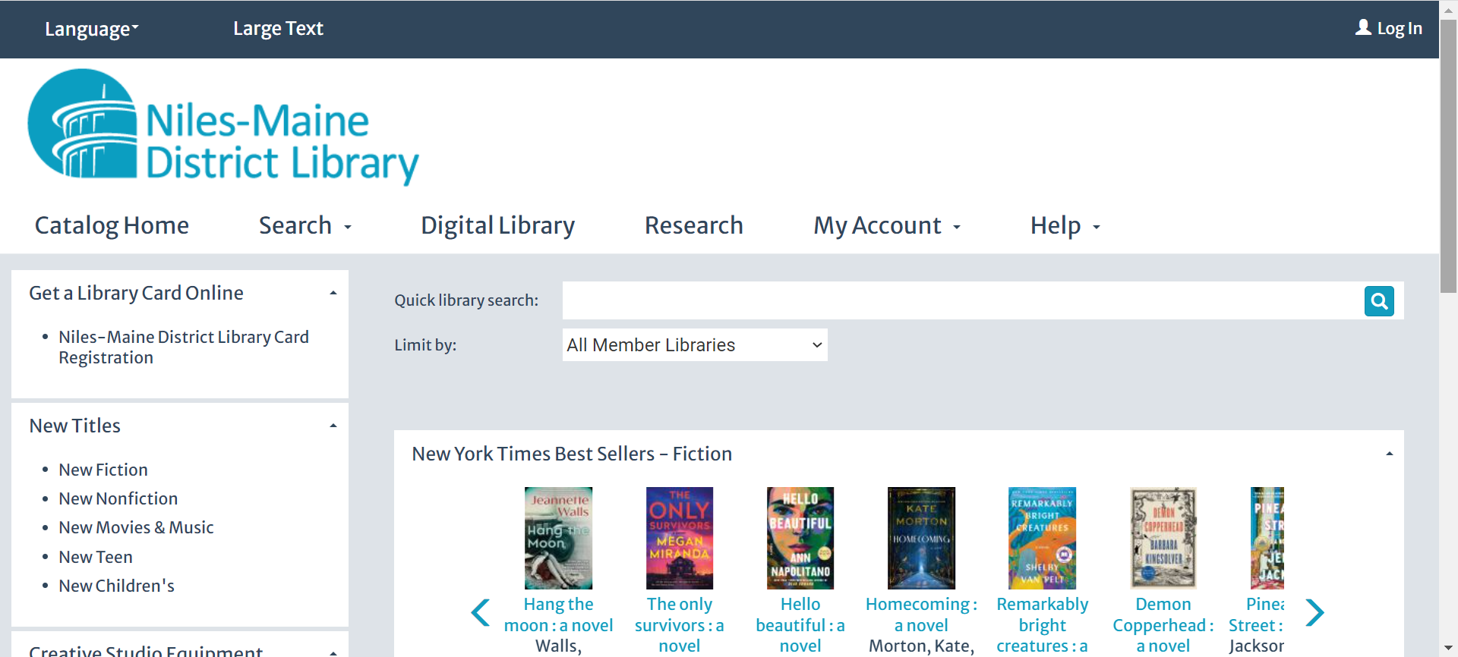
Web Part Engagement
Between October 2020 and mid-April 2023, Niles-Maine's "New Titles" Web Part logged 3,240 patron engagements

Slide 8
Web Part Types
Three types of data elements in user defined Web Parts:
Title Search
URL
Free Text

Slide 9
Web Part Type: URL
Link to a Record Set
Link to the contents of a bib record set
Polaris Help File Reference:
"Create a URL Link to a Record Set in the PAC"

Slide 10
Web Part Type: URL
Link to Record Set
BRANCH ID
https://ccs.polarislibrary.com/polaris/view.aspx?ctx=45&brs=3178
RECORD SET ID

Slide 11
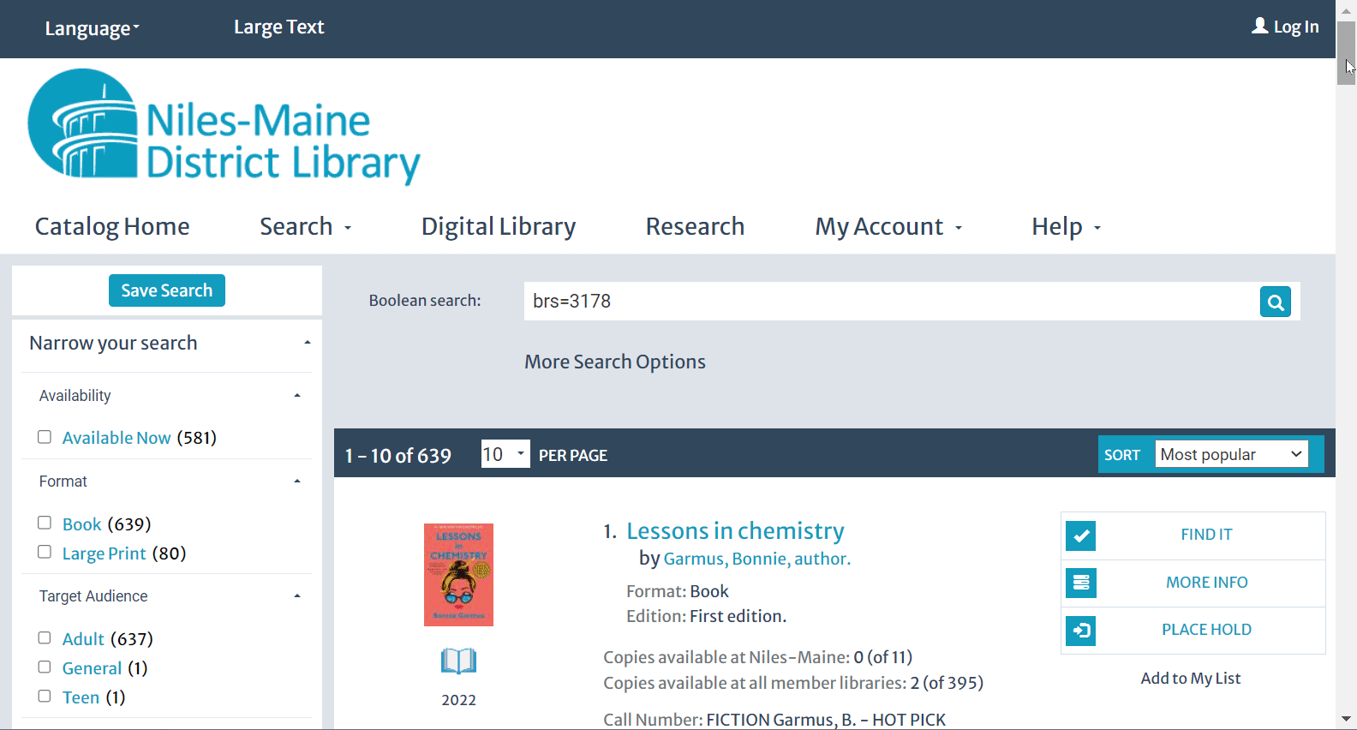
Web Part Type: URL
Link to Record Set

Slide 12
Web Part Type: URL
Link to a Search
Use Access Points to create deep links to custom search results
Polaris Help File Reference:
"PAC CQL Commands and Access Points"
"Deep Links to Polaris PowerPAC and Mobile PAC"

Slide 13
Web Part Type: URL
Link to a Search
Example Search for Urdu (LA=URD) titles
BRANCH ID
https://ccs.polarislibrary.com/polaris/search/searchresults.aspx?ctx=5&type=Boolean&term=(LA=URD)&by=KW&sort=PD&query=&page=0
ACCESS POINT

Slide 14
Web Part Type: URL
Link to a Search
Example Search for Urdu (LA=URD) titles
https://ccs.polarislibrary.com/polaris/search/searchresults.aspx?ctx=5&type=Boolean&term=(LA=URD)&by=KW&sort=PD&query=&page=0
ACCESS POINT

Slide 15
Web Part Type: URL
Link to a Search
Example Search for Urdu (LA=URD) titles
https://ccs.polarislibrary.com/polaris/search/searchresults.aspx?ctx=5&type=Boolean&term=(LA=URD)&by=KW&sort=PD&query=&page=0
ACCESS POINT

Slide 16
Web Part Type: URL
Link to a Search
Example Search for Urdu (LA=URD) titles
https://ccs.polarislibrary.com/polaris/search/searchresults.aspx?ctx=5&type=Boolean&term=(LA=URD)&by=KW&sort=PD&query=&page=0
ACCESS POINT

Slide 17
Web Part Type: URL
Link to a Search
Example Search for Urdu (LA=URD) titles
BRANCH ID
https://ccs.polarislibrary.com/polaris/search/searchresults.aspx?ctx=5&type=Boolean&term=(LA=URD)&by=KW&sort=PD&query=&page=0
ACCESS POINT

Slide 18
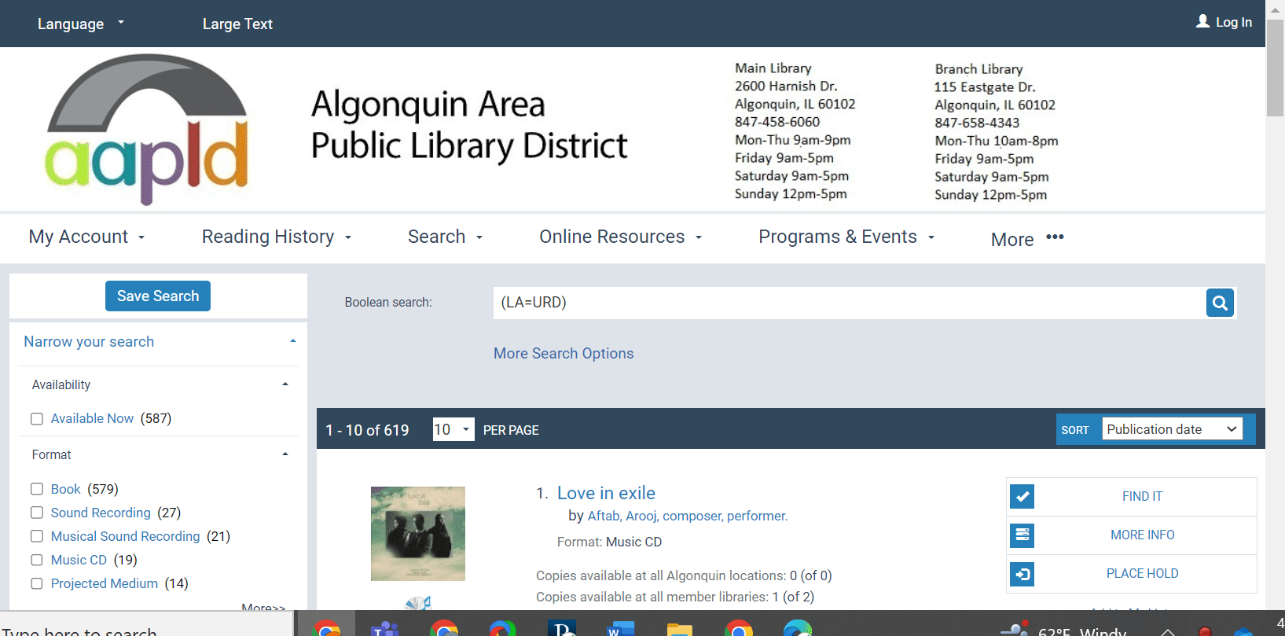
Web Part Type: URL
Link to a Search

Slide 19
Web Part Type: Free Text
Use HTML for Simple Formatting
Use basic HTML in a free text web part to enhance formatting
Examples:
Create visual hierarchy by formatting subheadings
Have both linked and non-linked text in a single web part
Use an image in place of text

Slide 20
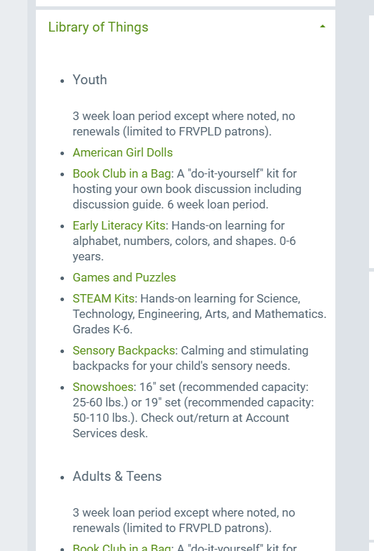
Web Part Type: Free Text
Use HTML for Simple Formatting
Create subheadings
<p><h5><b>Youth</b></h5></p>
<p>3 week loan period except where noted, no renewals (limited to FRVPLD patrons).</p>

Slide 21
Web Part Type: Free Text
Use HTML for Simple Formatting
Create subheadings
<p><h5><b>Youth</b></h5></p>
<p>3 week loan period except where noted, no renewals (limited to FRVPLD patrons).</p>

Slide 22
Web Part Type: Free Text
Use HTML for Simple Formatting
Create subheadings
<p><h5><b>Youth</b></h5></p>
<p>3 week loan period except where noted, no renewals (limited to FRVPLD patrons).</p>

Slide 23
Web Part Type: Free Text
Use HTML for Simple Formatting
Create subheadings
<p><h5><b>Youth</b></h5></p>
<p>3 week loan period except where noted, no renewals (limited to FRVPLD patrons).</p>

Slide 24
Web Part Type: Free Text
Use HTML for Simple Formatting
Both linked and non-linked text
<a href="http://ccs.polarislibrary.com/polaris/view.aspx?ctx=23&brs=164188">Book Club in a Bag</a>
: A "do-it-yourself" kit for hosting your own book discussion including discussion guide. 6 week loan period.

Slide 25
Web Part Type: Free Text
Use HTML for Simple Formatting
Both linked and non-linked text
<a href="http://ccs.polarislibrary.com/polaris/view.aspx?ctx=23&brs=164188">Book Club in a Bag</a>
: A "do-it-yourself" kit for hosting your own book discussion including discussion guide. 6 week loan period.

Slide 26
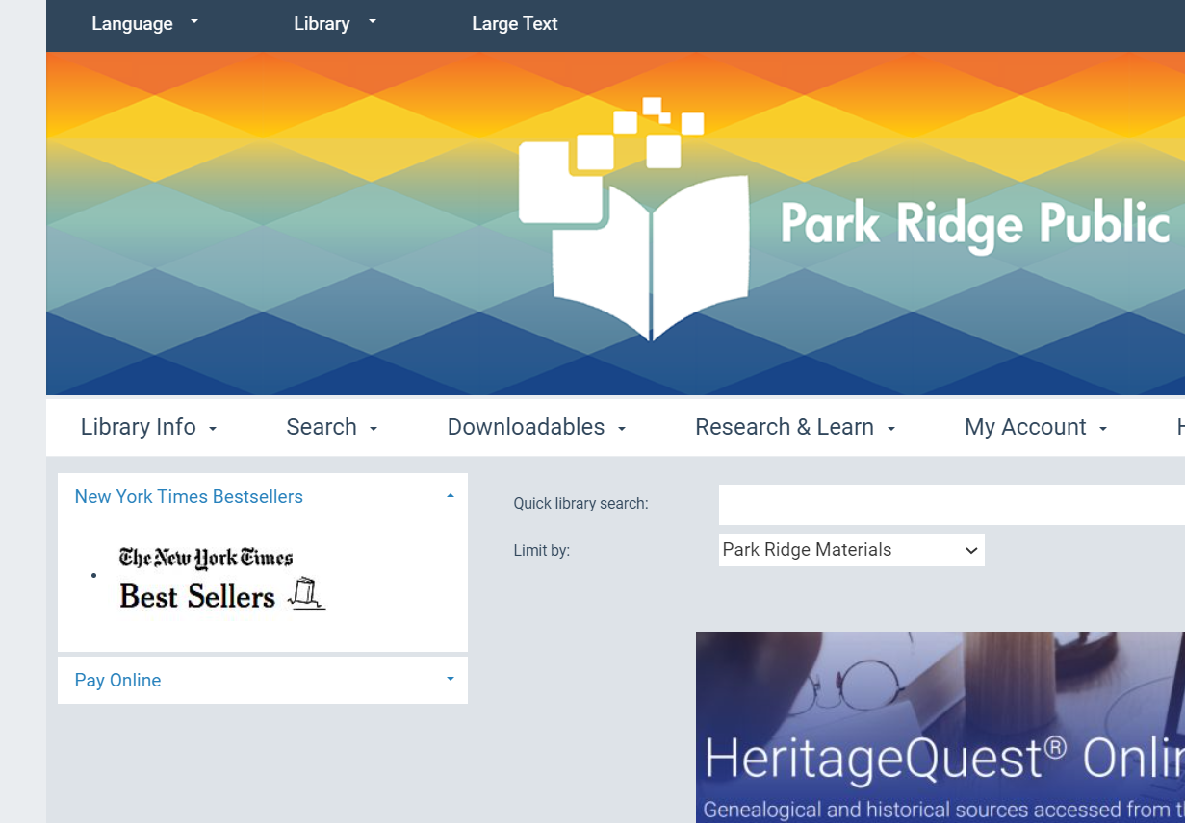
Web Part Type: Free Text
Use HTML for Simple Formatting
Use an Image In Place of Text
<a href="https://www.nytimes.com/books/best-sellers/" target="_blank"> <img src="https://ccs.polarislibrary.com/polaris/custom/themes/PRK/images/nyt2.jpg" alt="New York Times"> </a>

Slide 27
Web Part Type: Free Text
Use HTML for Simple Formatting
Use an Image In Place of Text
<a href="https://www.nytimes.com/books/best-sellers/" target="_blank"> <img src="https://ccs.polarislibrary.com/polaris/custom/themes/PRK/images/nyt2.jpg" alt="New York Times"> </a>

Slide 28
Web Part Type: Free Text
Use HTML for Simple Formatting
Use an Image In Place of Text
<a href="https://www.nytimes.com/books/best-sellers/" target="_blank"> <img src="https://ccs.polarislibrary.com/polaris/custom/themes/PRK/images/nyt2.jpg" alt="New York Times"> </a>

Slide 29
Web Part Type: Free Text
Use HTML for Simple Formatting
Store Image in PAC Custom Folder

Slide 30
Hold Status Modifications

Slide 31
Hold Status Modifications
Original Hold Status | % Correctly identified | Updated Hold Status
Active | 59% correct 41% incorrect | Requested
Pending | 17% correct 78% incorrect 5% no answer | Locating
Suspended | 17% correct 79% incorrect 4% no answer | Paused
Expired | 24% correct 72% incorrect 4% no answer | Unable to Fill

Slide 32
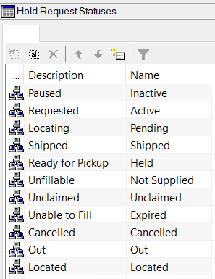
Hold Status Modifications
Update Hold Statuses in
System Administration
Database Tables>Hold request Statuses>Modify>Update Description

Slide 33
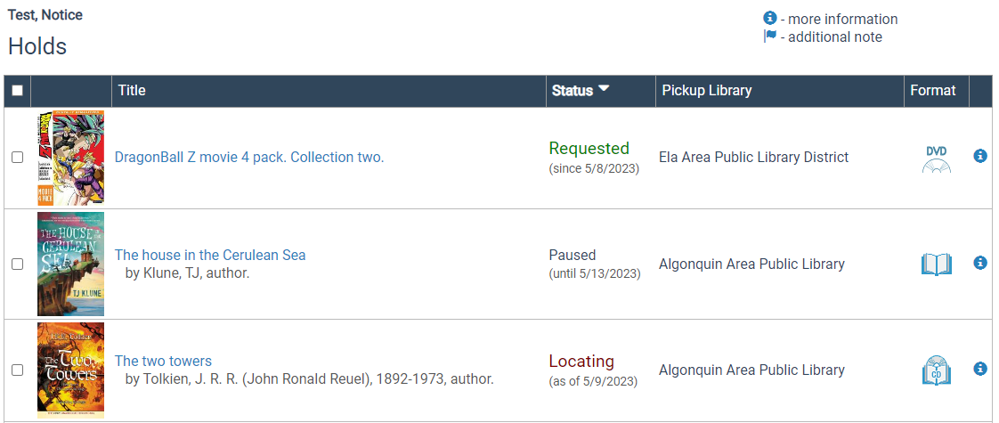
Hold Status Modifications

Slide 34
Adjusting PowerPAC “Limit By” Options

Slide 35
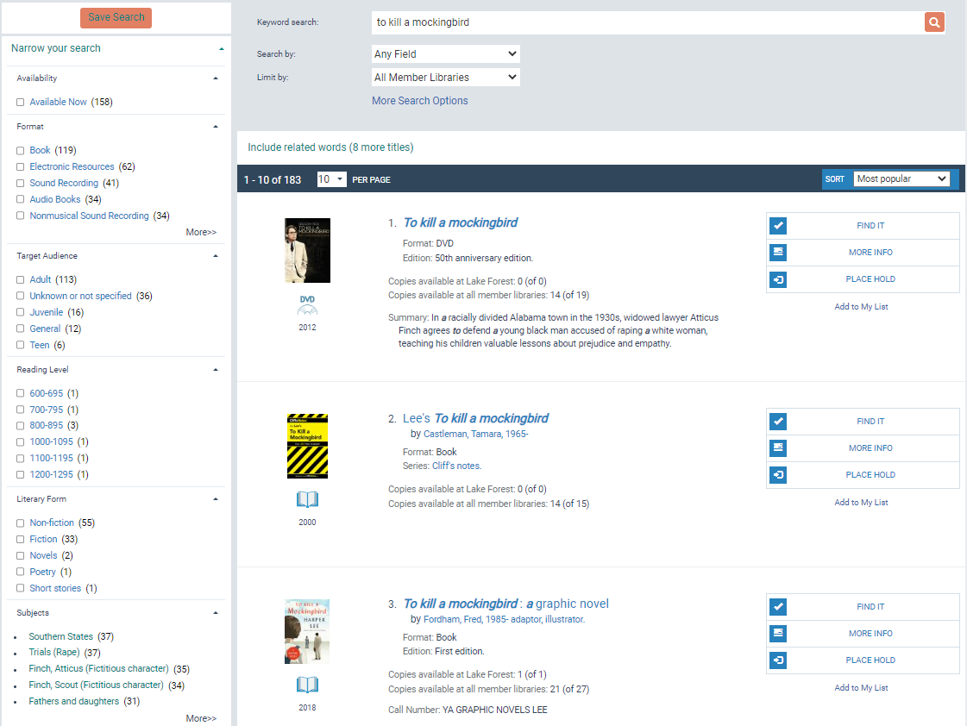
Adjusting “Limit By” Options
User Testing showed that patrons’ reading pattern focused on center of page

Slide 36
Adjusting “Limit By” Options
Patrons did not use the format facet when searching

Slide 37
Adjusting “Limit By” Options
Patrons DID use format limits if included in “Limit By” drop-down menu

Slide 38
Adjusting “Limit By” Options
In a consortium environment, our users also preferred to default to “All Member Libraries” instead of searching just their own library

Slide 39
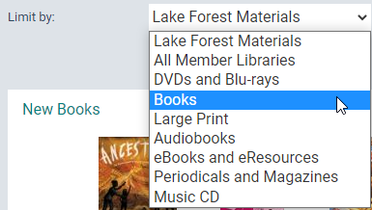
Adjusting “Limit By” Options
Limit By Recommendations
All members should default to “All Member Libraries”
Libraries should include format limits, esp. Book, DVD/Bluray

Slide 40
Adjusting “Limit By” Options
Modifying PAC Limit Bys
Sys Admin > Branch > Policy Tables > PAC Limit By Display > Insert or Modify
Use CCL codes to configure

Slide 41
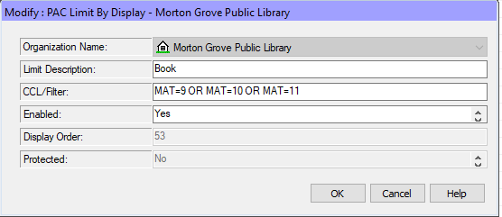
Adjusting “Limit By” Options
Example Limit By
CCL/Filter: MAT=9 OR MAT=10 OR MAT=11
List of CCL codes on supportal

Slide 42
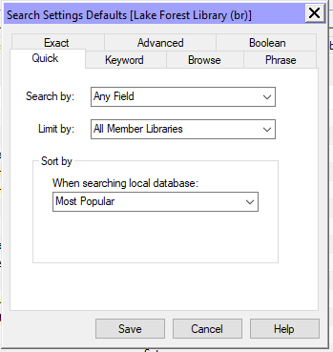
Adjusting “Limit By” Options
Changing Default Limit By
Sys Admin > Profiles > PAC > Search Setting Defaults > Limit By

Slide 43
Modifying the PowerPAC Header

Slide 44
Modifying the PowerPAC Header
During user testing, patrons struggled to reset the catalog after a search

Slide 45
Modifying the PowerPAC Header
Recommendation #1: Library logo displayed in the PowerPAC links to the catalog home page.

Slide 46
Modifying the PowerPAC Header
Recommendation #2: Add “Catalog Home” and “Library Website” links to header

Slide 47
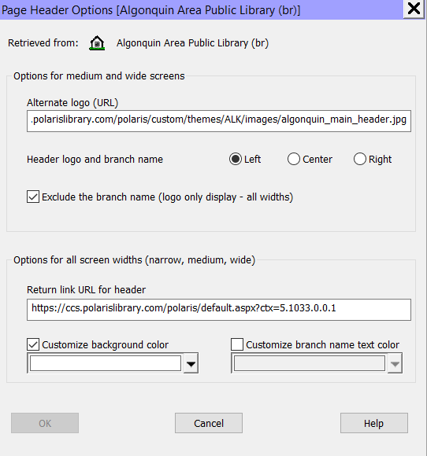
Modifying the PowerPAC Header
Modifying Header Image URL
Sys admin>Branch>Profiles>PowerPAC>Page Header Options
Update return link URL for header to PowerPAC url

Slide 48
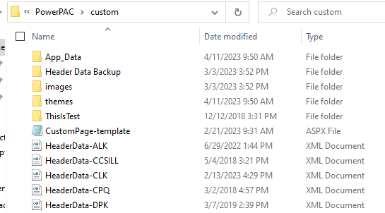
Modifying the PowerPAC Header
Modifying Header Links
1. Copy the HeaderData.xml file into the PowerPAC>Custom folder

Slide 49
Modifying the PowerPAC Header
Modifying Header Links
MAIN TAB
SUB TAB

Slide 50
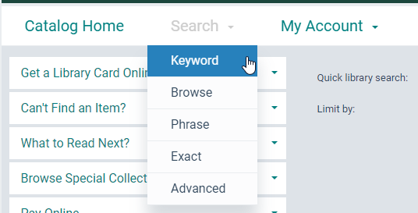
Modifying the PowerPAC Header
Modifying Header Links
MAIN
TABS
SUB TABS

Slide 51
Modifying the PowerPAC Header
Modifying Header Links
In the headerdata.xml file:
Locate where you would like the new element to appear
Add a new Main or sub tab, or edit existing element as needed
Save changes
Reload PAC
Test in training environment first when possible; headers can be quirky!
Innovative recommends adding a language string to make updates to headers easier. See solution 160930528369388 on the supportal for more help!

Slide 52
Alert Banner

Slide 53
Alert Banner – Modify site.master file

Slide 54
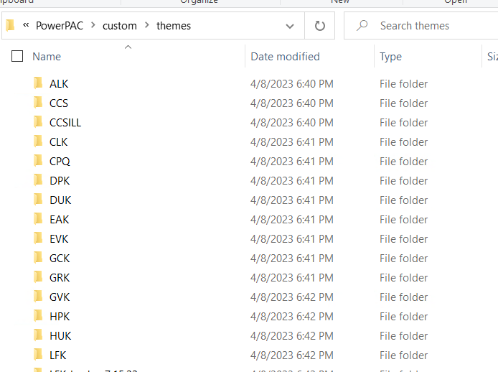
Alert Banner – Modify site.master file
CCS libraries each have their own custom PAC theme
Custom PAC theme folder includes copy of default site.master
Insert banner code into site.master file
Learn more about creating custom themes in the PAC Customization Guide!

Slide 55
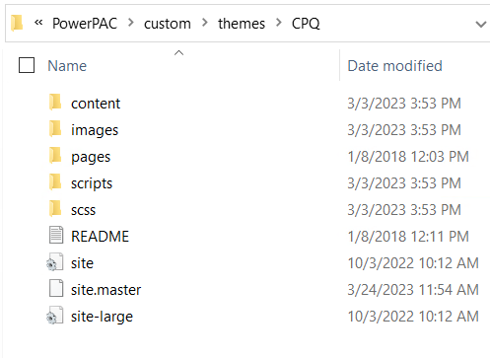
Alert Banner – Modify site.master file
CCS libraries each have their own custom PAC theme
Custom PAC theme folder includes copy of default site.master
Insert banner code into site.master file
Learn more about creating custom themes in the PAC Customization Guide!

Slide 56
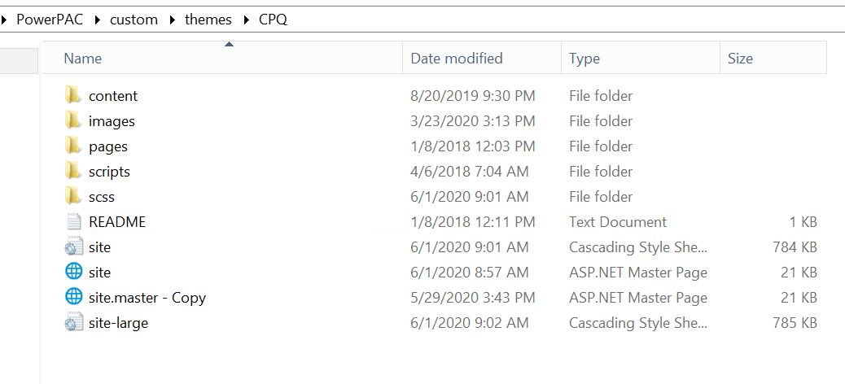
Alert Banner – Modify site.master file
Steps
Open PowerPAC Files> Custom > Themes>THEME
Copy existing site.master file for backup
Open site.master file

Slide 57
Alert Banner – Modify site.master file
Steps
Edit site.master file to insert banner code
Modify code as needed
Save file

Slide 58
Alert Banner – Modify site.master file
Banner appears immediately

Slide 59
Alert Banner – Modify site.master file
Comment out the banner to hide

Slide 60
Alert Banner Using Language Strings

Slide 61
Alert Banner Using Language Strings
Pinnacle has one shared theme for all six libraries
Changes made via PAC files will be applied to all sites
Created branch-specific alert banners with language strings in WebAdmin.

Slide 62
Create Language String in WebAdmin
In WebAdmin, create a custom language string.
It can be blank for now…

Slide 63
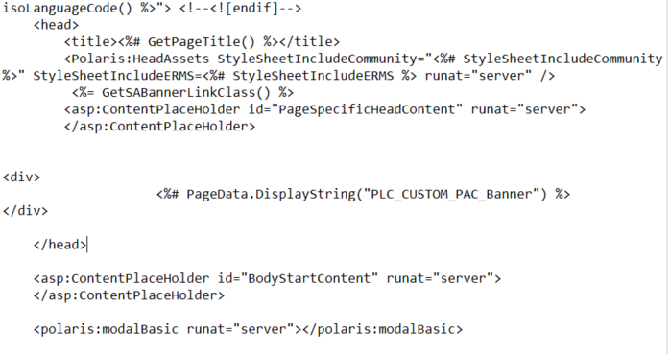
Add Language String to PAC Files
Modify the PowerPAC site master file
PowerPAC/site.master
At the end of the header, add a reference to the custom language string created previously

Slide 64
Edit the Language String in WebAdmin
Back in WebAdmin, customize the language string as needed.
Can be changed at the system, library, or branch level.

Slide 65
‘Suggest a Purchase’ Button Using Custom Language Strings

Slide 66
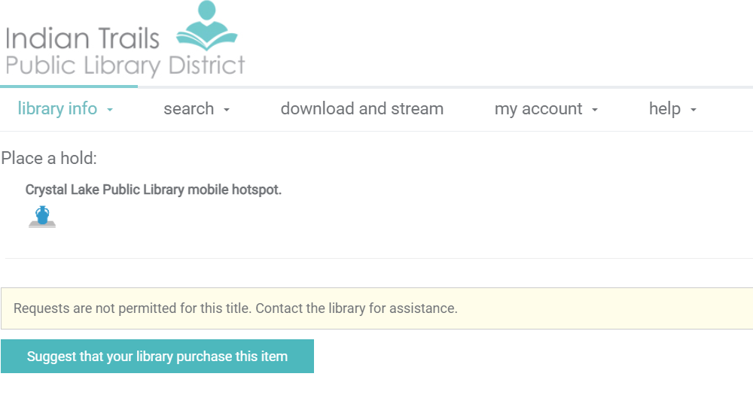
‘Suggest a Purchase’ Button
Libraries use a purchase suggestion button when patron cannot place a hold or has no search results

Slide 67
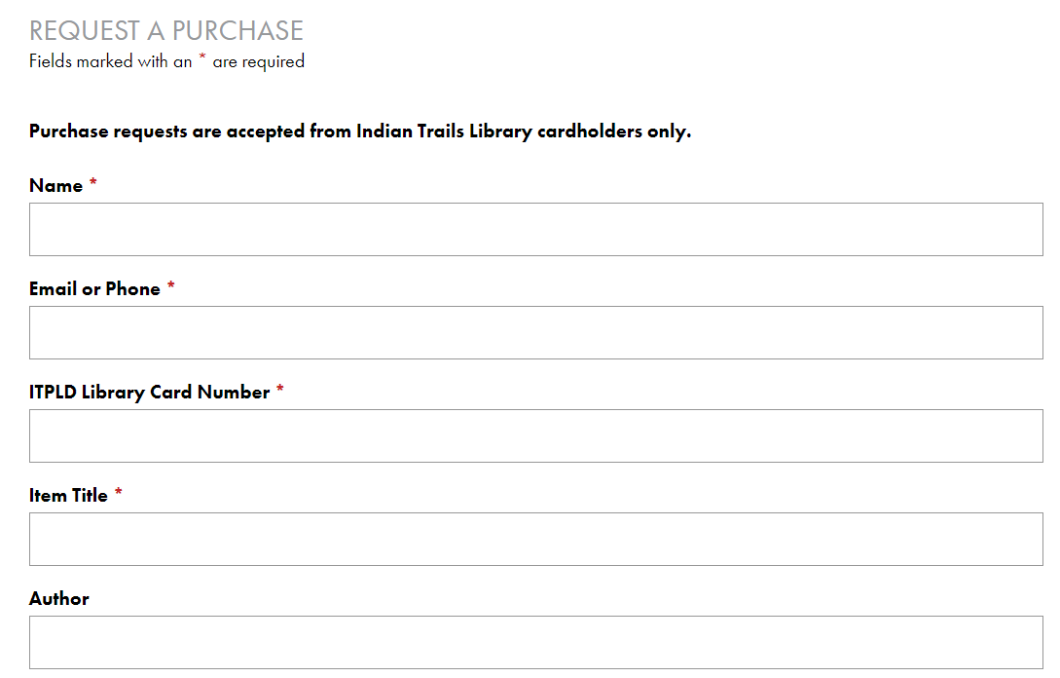
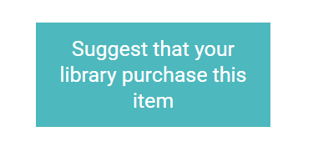
‘Suggest a Purchase’ Button
Button links out to library’s purchase suggestion form

Slide 68
‘Suggest a Purchase’ Button – Patron blocked from hold

Slide 69
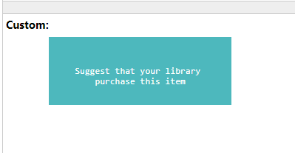
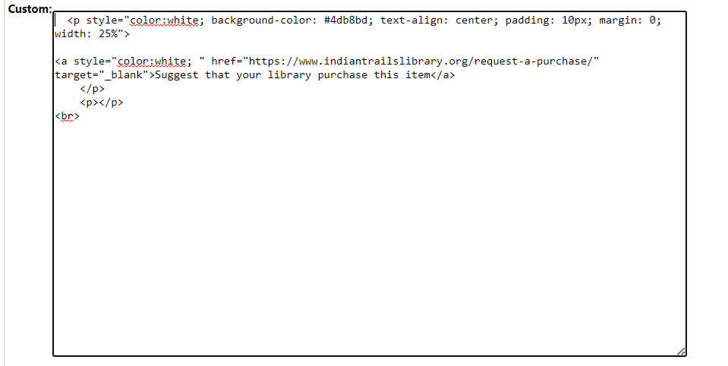
‘Suggest a Purchase’ Button – Patron blocked from hold
Create a custom language string
In Webadmin, create a custom language string*
Insert button code
Save string
*See documentation on Polaris WebAdmin Tool

Slide 70
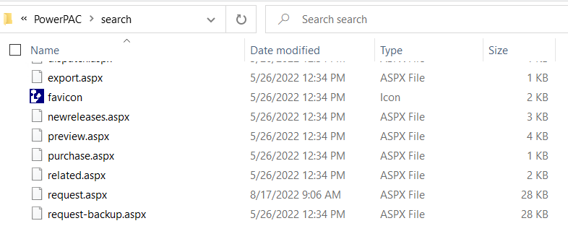
‘Suggest a Purchase’ Button - Patron blocked from hold
Insert language string into Search>request.aspx file
Open PowerPAC Files
Open Search folder
Copy and back up “request.aspx file

Slide 71
‘Suggest a Purchase’ Button - Patron blocked from hold
Insert language string into Search>request.aspx file
Place code into PowerPAC\search\request.aspx file
Save request.aspx file
Reload PAC

Slide 72
‘Suggest a Purchase’ Button – Patron blocked from hold
Button will appear when patron is blocked from placing a hold

Slide 73
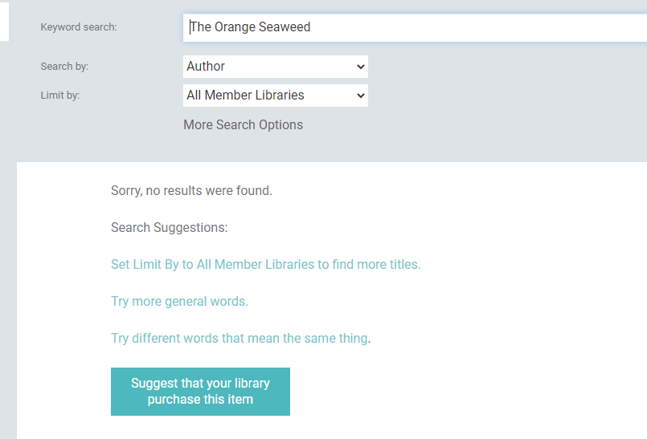
Suggest a Purchase Button – No Results Found
Button can also be added when search turns up no results

Slide 74
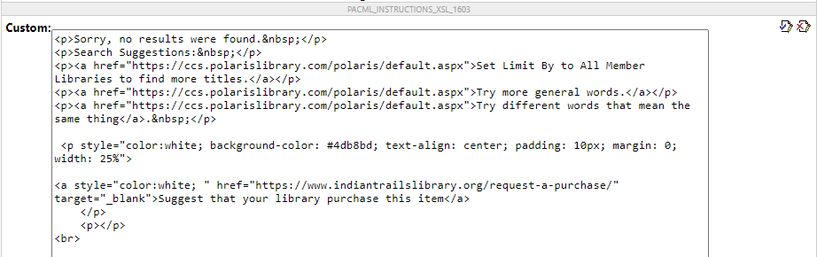
Suggest a Purchase Button – No Results Found
Modify PAC string
In Webadmin, edit string called PACML_INSTRUCTIONS_XSL_1603
Insert HTML code for button
Can be changed at the system, library, or branch level.
Save string and reload PAC

Slide 75
Suggest a Purchase Button – No Results Found
Button will appear when search turns up no results

Slide 76
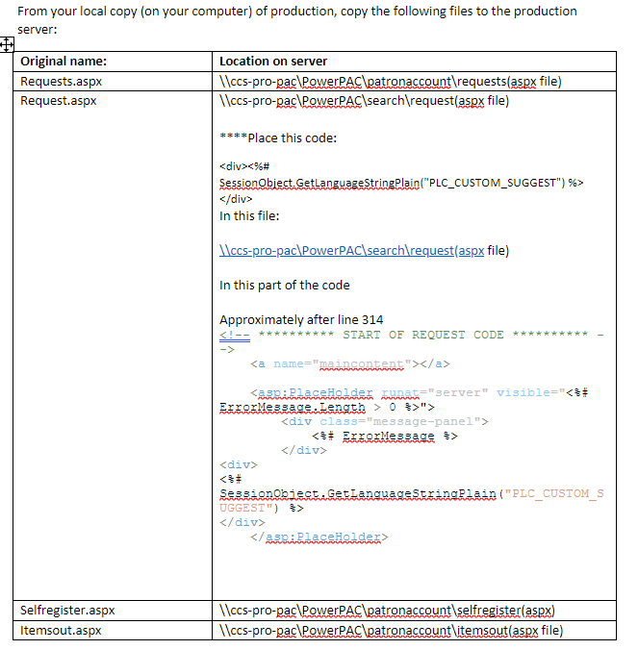
Managing Upgrades
Back up your custom PAC work!
Unless in the custom folder, will be lost during upgrades
CCS’s ‘PowerPAC Upgrade Guide’ makes it easy to restore custom elements post-upgrade
Attend “Conquer your ILS Upgrade” on Saturday at 10:30!

Slide 77
Adding Chat Widget with Javascript

Slide 78
Adding Javascript Chat Widget
Unique Management provides chat services for all six of our libraries
Chat widget on OverDrive site, library websites and the Polaris PowerPAC
Vendor provided short bit of JavaScript to be added to every page
Need a way to add a chat widget to all PAC pages
Different widget for each library

Slide 79
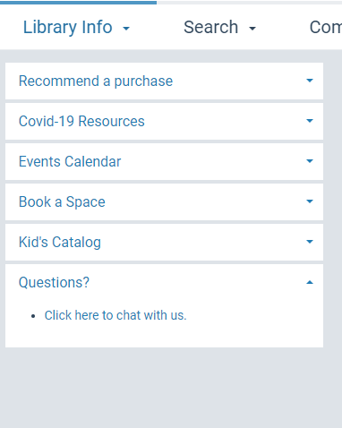
Adding Javascript Chat Widget
Currently, no way to add custom JavaScript to all pages of the OPAC through SA.
Some customers added a link as a Dashboard, but we wanted the widget to display

Slide 80
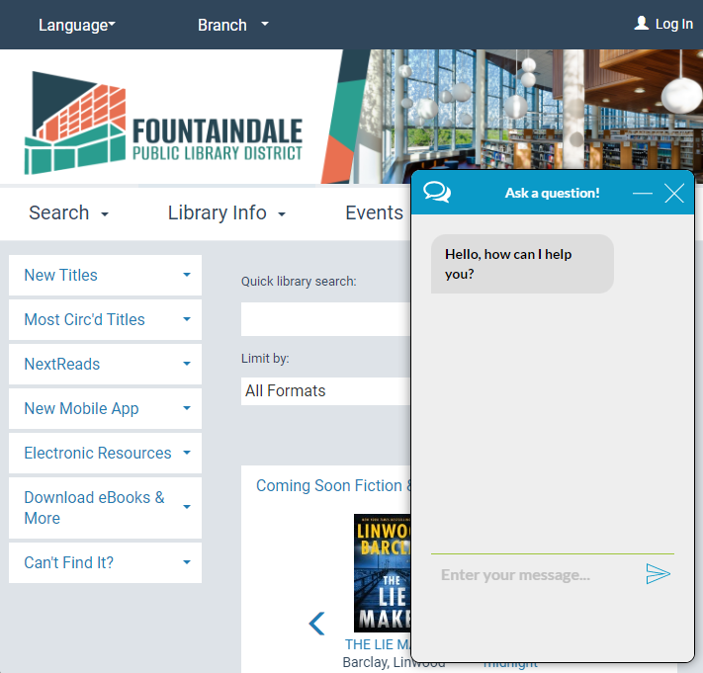
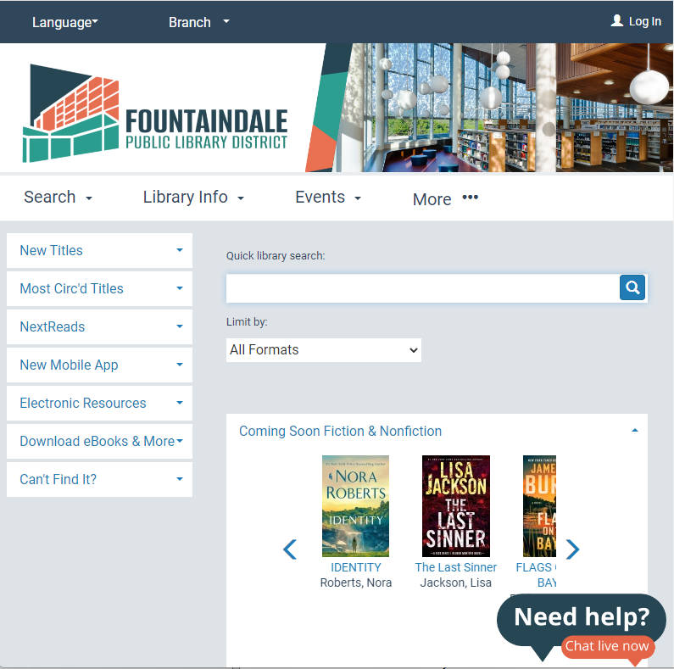

Slide 81
Placing the Javascript in the PAC Footer
Placed the JavaScript code in the footer
Footer appears on every page
Enables the chat session to continue if user navigates to another page on the catalog.

Slide 82
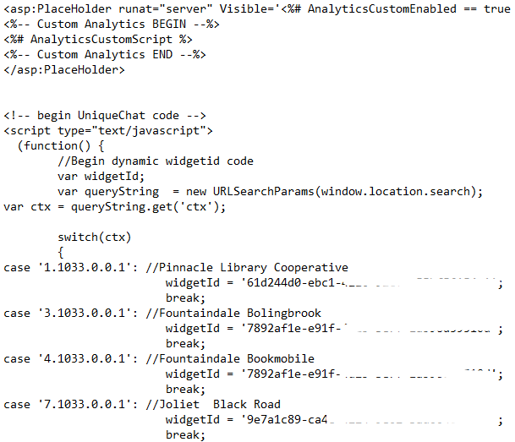
Modifying the PAC Footer
Modify the PAC Footer
PowerPAC/usercontrols/footerassets
Added chat widget code as a script at the end of the footerassets file

Slide 83
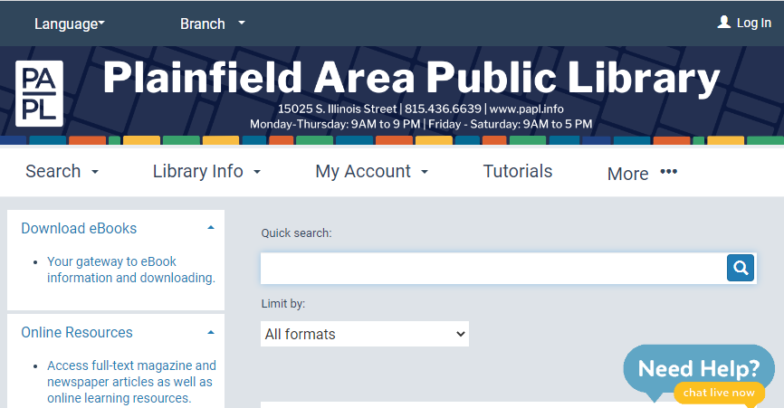
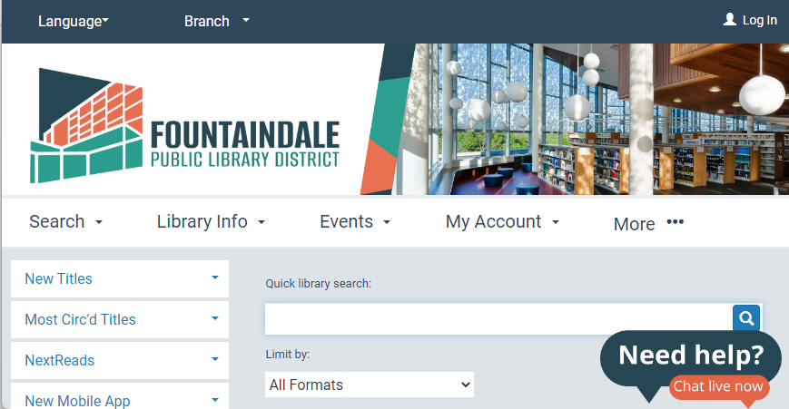
Customized Widgets For Each Branch
Vendor modified the chat widget to include a “switch” based on the URL’s ctx value.
If ctx = 3, then library A’s widget
If ctx = 6, then library B’s widget
…

Slide 84
Follow On Search for External Interlibrary Loan Service

Slide 85
Find More Illinois
All six Pinnacle libraries participate in “Find More Illinois”
Interlibrary loan platform that uses AutoGraphics’ ShareIT
Not integrated into the catalog like OCLC is
Users search the database on an external site.
NCIP sends request information back to Polaris database.

Slide 86
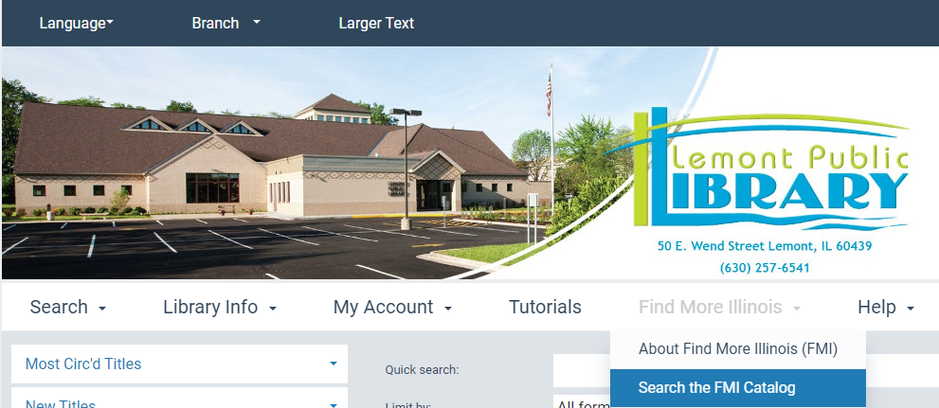
Making FMI More Visible
Modify header navigation to add link
3 new custom language strings

Slide 87
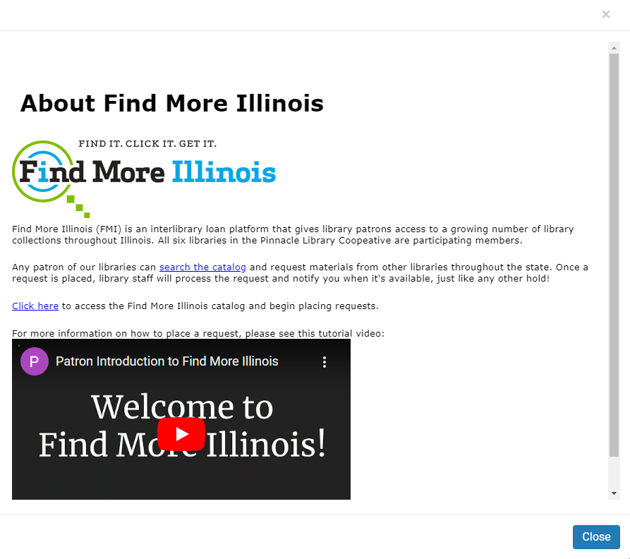
Header Navigation
Also added an “about” article that opens in a modal window
Copied functionality from the “help” section
Slightly modified the “Site” master file
Default: if menuOption equal to 99 (“Help”), open link in modal window
Changed to: if menuOption equal to 98 or 99 (“FMI” or “Help”), open in modal window.
Added Help file to PowerPac/Custom/Pinnacle/Help/

Slide 88
Making FMI More Visible
Modified the “No results found” page to include follow-on search to Find More Illinois website.
If user’s search gives no results, the page will give the option to:
Re-do the search in OCLC WorldCat
Integrated. PAC will change database to z39.50 WorldCat Search
Perform search in Find More Illinois
External. Script will take the user’s search terms and perform the exact same search in FMI’s website.

Slide 89
Modifying “No Results Found” Page
Once again, vendor provided javascript code to be added to the PAC.
PowerPAC/usercontrols/footerassets
Code takes user’s search terms and appends a URL-encoded search in vendor’s interface
Re-used the ctx “switch” from the chat widget so that the PAC branch determines which instance of the FMI interface the patron is taken to.
Some small css adjustments in the css theme so bulleted lists display better

Slide 91
THANK YOU
Questions?

Slide 92
Resources and How-To
Suggest a Purchase Button
PowerPAC Custom Banner (individual themes)
PowerPAC Custom Banner (shared theme)
Web Part Tips
Suggested Polaris Help Files or Guides
CCL Codes (iii Supportal link – login required)
Create a URL Link to a Record Set in the PAC
Deep Links to Polaris PowerPAC and Mobile PAC
How to add a new header element in the PAC (iii Supportal link – login required)
PAC CQL Commands and Access Points
PAC Customization Guide
Polaris Web Admin Tool Guide

