Slide 1
Jquery (Javascript) to enhance WebOpac
Kwangsoo Han
Systems Librarian
Community College of Baltimore College
khan@ccbcmd.edu
IUG Conference 2016

Slide 2
Javascript (Parent of JQuery)
JavaScript is the programming language of HTML and the Web run within a Web browser
Basic Trio of the Web
HTML to define the content
CSS to specify the layout
Javascript to program the behavior

Slide 3
JQuery
JQuery is a fast, small, and feature-rich JavaScript library.
JQuery makes things easier: to perform many common scripting functions
Element Selection (Traversal) / Manipulation
Event Handling
Animation
Ajax

Slide 4
jQuery vs Javascript
jQuery
$ (‘body’) .css (‘background’, ‘#ccc’);
JavaScript
Function changeBachground(color) {
Document.body.style.background = color;
}
Excerpt from https://blog.udemy.com/jquery-vs-javascript/

Slide 5
How to use:
Starting with the load of the jQuery library
Local load
<head> <script src=“/screens/jquery-1.12.0.min.js"></script> </head>
Remote load
<script src="//code.jquery.com/jquery-1.10.2.js"></script>

Slide 6
jQuery Selectors : $( )
Selector | Example | Selects
* | $("*") | All elements
#id | $("#lastname") | The element with id="lastname"
.class | $(".intro") | All elements with class="intro"
.class,.class | $(".intro,.demo") | All elements with the class "intro" or "demo"
element | $("p") | All <p> elements
el1,el2,el3 | $("h1,div,p") | All <h1>, <div> and <p> elements
:first | $("p:first") | The first <p> element
:last | $("p:last") | The last <p> element
:even | $("tr:even") | All even <tr> elements
:odd | $("tr:odd") | All odd <tr> elements
Excerpt from http://www.w3schools.com/jquery/jquery_ref_selectors.asp

Slide 7
Examples in the CCBC catalog
Hide an Element
Replace Text/HTML
Form behavior
Facet Interface
AutoComplete
‘Did you mean?’ (SpellChecker)

Slide 8
Hide an element (1)

Slide 9
Hide an element (2)

Slide 10
Hide an element (3)
* Target Element in HTML:
<span class="button" id="holdthisitem">……………..</span>
* jQuery to Hide:
var targetRequestButtonDiv = $("span[id='holdthisitem']");
targetRequestButtonDiv.css('visibility','hidden');
targetRequestButtonDiv.css('height','0px');

Slide 11
Replace a Text/HTML (1)
- Changed the status from ‘Check Shelves’ to ‘At Reserve Desk’.

Slide 12
Replace a Text/HTML (1-1)
//this code works for bib_display.html
var itemTrs = $(".bibDisplayItemsMain tr.bibItemsEntry");
if(itemTrs.length >0) {
var itemLocation = "";
var itemStatus = "";
for(k=0;k<itemTrs.length;k++) {
itemLocation = $(".bibDisplayItemsMain tr.bibItemsEntry:eq(" + k + ") td:eq(0)").text();
itemStatus = $(".bibDisplayItemsMain tr.bibItemsEntry:eq(" + k + ") td:eq(2)").text();
if(itemStatus.indexOf("CHECK") > 0 || itemStatus.indexOf("ON") > 0)
itemStatus = "Avail";
else
itemStatus = "";
//display change for status 'At Reserve Desk' when an item location is a Reserve item
if(itemLocation.indexOf("Reserve") >= 0 && itemStatus == "Avail") {
$(".bibDisplayItemsMain tr.bibItemsEntry:eq(" + k + ") td:eq(2)").text("AT RESERVE DESK")
}
}//End of for
}//End of if

Slide 13
Replace a Text/HTML (2)
Notes:
//add an id to td in bib_display.html and this id will be treated in style.css
$("div.bibDisplayUrls table.bibLinks td").attr('id','catEbook');
/* CSS (style.css) To make ebook link more visible */
td#catEbook { height: 25px;
background-color: #09C; }
td#catEbook a:link{font-size: 14px;
color: #FFF;
text-decoration: underline;
font-family: Verdana, Geneva, sans-serif;
font-weight: bold; }
td#catEbook a:hover{
color: #CCC;
text-decoration: none;
}

Slide 14
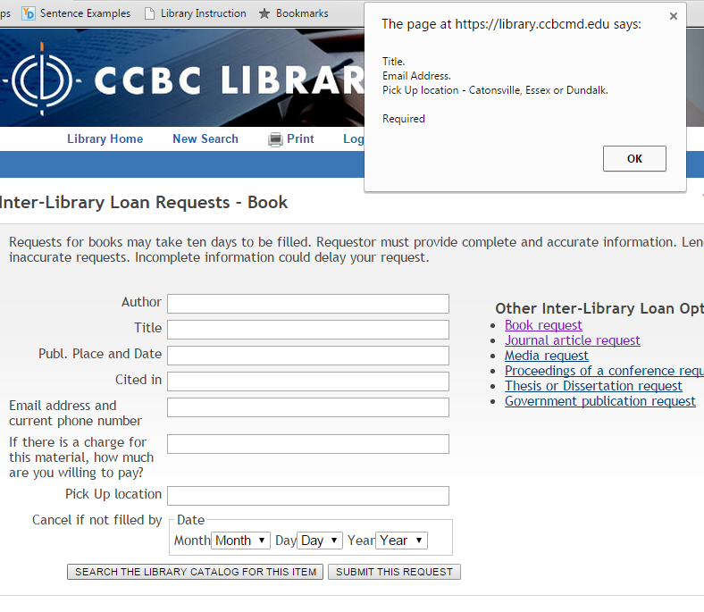
Manipulate Form Behavior
Notes:
$(document).ready(function(){
$( "form:first" ).submit(function( event ) {
var errorMsg = "";
//$( "form:first" ).submit();
if($.trim($("#main1").val()).length == 0)
errorMsg = "Title. \n"
if($.trim($("#info0").val()).length == 0)
errorMsg += "Email Address. \n"
if($.trim($("#info2").val()).length == 0)
errorMsg += "Pick Up location - Catonsville, Essex or Dundalk. \n"
if(errorMsg == "")
$( "form:first" ).submit();
else
alert(errorMsg + "\nRequired");
event.preventDefault();
});
})

Slide 15
Facet Interface (Narrow search results)
Notes:
//part of codes in http://library.ccbcmd.edu/screens/ccbcJavascript2.js
filter_dundalkonly_URL = baseURL
+ rawKeywords + "&searchscope=2"
+ "&Da=" + (yearExists=='no' || yearExists==null || yearExists==''?"":startYear)
+ "&Db=&SORT=D"
+ (materialtype!=''?'&m='+materialtype:"");
var numofdandalkResults = getNumofResults(filter_dundalkonly_URL);
filter_dundalkonly = "<a href='"
+ filter_dundalkonly_URL
+ "' onclick=\"javascript: ga('send','pageview','/narrowresults/dundalk');\""
+ ">Dundalk Only (" + numofdandalkResults + ")</a><br />";
strOutput = (searchscope!=2&materialtype!='q'? "<dd>"+ filter_dundalkonly+ "</dd>":"");
targetFacet.append(strOutput); //push out a line ‘Dundalk Only’ under ‘Narrow your results’
//function to get a number for a query
function getNumofResults(targetURL)
{
var outstring = "0";
$.ajax({
url: targetURL,
type: 'get',
dataType: 'html',
async: false,
success: function(data) {
var htmlString = data;
var $htmlDoc = $( htmlString );
var itags = $htmlDoc.find('i');
var placeholderlabel = "td[title='briefcit_facet_placeholder']";
var placeholder = placeholderlabel + ':eq(0)';
var targettd = $(placeholder);
for(i=0;i<itags.length;i++)
{
outstring = itags.eq(i).text();
if(outstring.indexOf("results") >= 0)
{
var strPos = outstring.indexOf("results"); // strip off the number of results i.e. "<i>27 results found.</i>"
outstring = $.trim(outstring.substring(0,strPos));
break;
}
else if(outstring.indexOf("result found") >= 0 )
{
var strPos = outstring.indexOf("result found");
outstring = $.trim(outstring.substring(strPos-2,strPos-1));
break;
}
else
outstring = "0";
}//End of for
}
});//End of ajax
return outstring;
}

Slide 16
Autocomplete (1)
Autocomplete (Google, Bing API, typehead.js, Bloodhound)
Other college sites: NCSU (home grown), Rutgers (very small pool), University of Illinois Undergraduate Library (Apparently Google)
Notes:
//the base code that I used found at http://jsfiddle.net/LxXJz/
$(function () {
$("#hulk").autocomplete({
source: function (request, response) {
console.log("source");
$.ajax({
url: "http://api.bing.net/qson.aspx?Query=" + encodeURIComponent(request.term) + "&JsonType=callback&JsonCallback=?",
dataType: "jsonp",
/*data: {
"Query": request.term,
"JsonType": "callback",
"JsonCallback" : "?"
},*/
success: function (data) {
console.log("success!");
var suggestions = [];
$.each(data.SearchSuggestion.Section, function (i, val) {
console.log("suggestion: " + val.Text);
suggestions.push(val.Text);
});
response(suggestions);
}
});
}
});
});

Slide 18
Notes:
//Fully developed code is in mainmenu.html
//functions are in http://library.ccbcmd.edu/screens/ccbcJavascript6.js
<script type='text/javascript'>//<![CDATA[
$(window).load(function(){
$(function () {
$("#ebscohostsearchtext").catcomplete({
select: function( event, ui ) {
checklocalentry(ui.item.value, 'y');
},
minLength: 3,//search after three characters typed in
source: function (request, response) {
var suggestions2 = [];
if(request.term.length >2)
{
suggestions2 = getLocalCourses(request.term);
response(suggestions2);
}
$.ajax({
url: "//api.bing.net/qson.aspx?Query=" + encodeURIComponent(request.term) + "&JsonType=callback&JsonCallback=?",
dataType: "jsonp",
/*data: {
"Query": request.term,
"JsonType": "callback",
"JsonCallback" : "?"
},*/
success: function (data) {
$.each(data.SearchSuggestion.Section, function (i, val) {
var bingSingleData = [];
bingSingleData["category"] = "Popular Keywords";
var modifiedSuggestion = applyStopWords(val.Text, request.term);
if(modifiedSuggestion != "" && modifiedSuggestion != request.term)
{ bingSingleData["label"] = modifiedSuggestion; suggestions2.push(bingSingleData);
}
if(i>9)
return false;
}); //end of each
response(suggestions2);
} //end of success
});//end of ajax
}
});
});
});//]]>
</script>
<!-- End Autocomplete for Smart Search Box -->

Slide 19
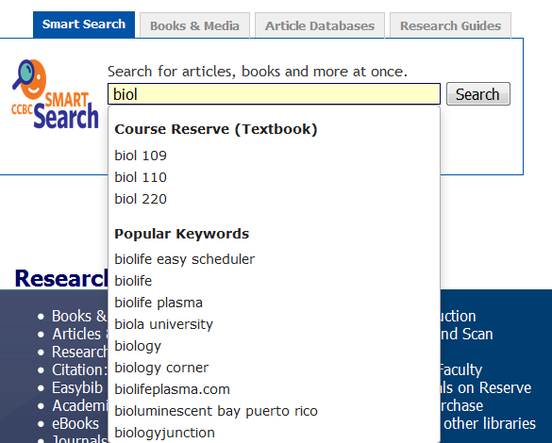

Slide 21
Did you mean? (SpellChecker) [1]

Slide 22
Did you mean? (SpellChecker) [2]
Notes:
//code in srchhelp_X.html
<div class="pageContentInner">
<!--{msg}-->
<!-- Start: javascript for 'Did you mean' -->
<div id='spellsuggest'></div>
<script type="text/javascript">
$(document).ready(function(){
if($("div.pageContentInner h2").text() == "NO ENTRIES FOUND")
{
var currentURL = document.URL;//get the current URL
var arr_URLpieces = currentURL.split("&");// split the current URL
var searchkeyword = '';
for(i=0;i<arr_URLpieces.length; i++)
{
var URLpiece = arr_URLpieces[i];
var temp01 = URLpiece.split("=");
if(temp01[0].indexOf('SEARCH') > 0)
{
searchkeyword = temp01[1];
searchkeyword = searchkeyword.replace("(", "");
searchkeyword = searchkeyword.replace(")", "");
searchkeyword = searchkeyword.replace(/%20/g, ' ');
}
}//end of for
//run Google Analytics
ga('send','pageview','/NO ENTRIES FOUND/' + searchkeyword);
//alert(searchkeyword);
//var spellService = "http://api.bing.net/json.aspx?AppId=APIKey&Query=" + encodedText + "&Sources=Spell&Version=2.0&Market=en-us&Options=EnableHighlighting&JsonType=callback&JsonCallback=SearchCompleted";
// $.getScript(spellService);
//event.preventDefault();
$.ajax({
url: "http://api.bing.net/qson.aspx?Query=" + encodeURIComponent(searchkeyword) + "&JsonType=callback&JsonCallback=?",
dataType: "jsonp",
/*data: {
"Query": request.term,
"JsonType": "callback",
"JsonCallback" : "?"
},*/
success: function (data) {
// console.log("success!");
//console.dir(data);
var suggestions = [];
var outputString = "";
//add local suggestions by kwangsoo
var localsuggestion = addLocalSuggestions(searchkeyword);
if(localsuggestion != '')
suggestions.push(localsuggestion);
//add suggestions from bing
$.each(data.SearchSuggestion.Section, function (i, val) {
//console.log("suggestion: " + val.Text);
var modifiedSuggestion = applyStopWords(val.Text, searchkeyword);
if(modifiedSuggestion != "" && modifiedSuggestion != searchkeyword)
suggestions.push(modifiedSuggestion);
});//end of $.each
if(suggestions.length > 0)
{
var countSuggestion = 0;
var totalnumberofsuggestions = suggestions.length;
if(totalnumberofsuggestions >= 1)
totalnumberofsuggestions = 1;
for(i=0;i<totalnumberofsuggestions;i++)
{
if(suggestions[i].toLowerCase() != searchkeyword.toLowerCase() && searchkeyword.split(' ').length >= suggestions[i].split(' ').length )
{
outputString += composeURL(suggestions[i]) + "&nbsp;&nbsp;" ;
if(i%5 == 0 && i > 0)
outputString += "<br /> " ;
countSuggestion++;
}
}
if(countSuggestion > 0)
$("#spellsuggest").append("Did you mean:" + outputString);
}//end of if
}//end of success:function
}); //end of ajax
}//end if
function composeURL(keywords)
{
var currentURL = document.URL;//get the current URL
var start_keywords = currentURL.indexOf("(") ;
var end_keywords = currentURL.indexOf(")") ;
var firstpart_URL = currentURL.substring(0,start_keywords+1);
var endpart_URL = currentURL.substring(end_keywords);
var newURL = firstpart_URL + escape(keywords) + endpart_URL;
var newLink = "<a href='" + newURL + "' onClick='javascript: ga(\"send\",\"pageview\",\"/Did you mean/" + keywords + "\");'>" + keywords + "</a>";
return newLink;
}
})//end $(document).ready(function()
function applyStopWords(bingSuggest,userKeyword)
{
var newText=bingSuggest;
if(userKeyword.indexOf('used ') < 0 && bingSuggest.indexOf('used ') == 0)
{
newText = bingSuggest.substr(5);
}
if(newText.match(/pdf$/) != null || newText.match(/quizlet$/) != null || newText.match(/book$/) || newText.match(/edition$/) != null || newText.match(/edition\ssolution[s\b|\b]$/) || newText.match(/edition\s[0-9]+rd|nd|th$/) || newText.match(/edition\sanswer[s\b|\b]$/) || newText.match(/answer\skey$/) != null || newText.match(/[0-9]+th$/) != null || newText.match(/[0-9]+nd$/) != null || newText.match(/[0-9]+e$/) != null || newText.match(/ ed$/) != null || newText.match(/[0-9]+$/) != null || newText.match(/^movie/) != null || newText.match(/test bank$/) != null || newText.match(/pdf free$/) != null || newText.match(/torrent$/) != null || newText.match(/free download$/) != null)
{
newText = "" ;
}
newText = newText.replace("you ve ", "you've ");
//return newText;
return newText;
}

