Slide 1
Enhance Your Collection with Customer Drive Acquisitions
Rohini Bokka Technical Services Manager rbokka@naperville-lib.org
Karen Toonen Collection Development Librarian ktoonen@naperville-lib.org

Slide 2
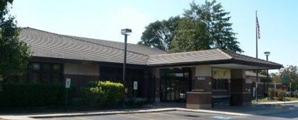
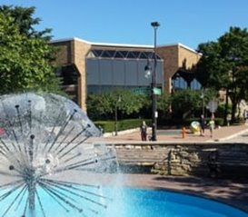
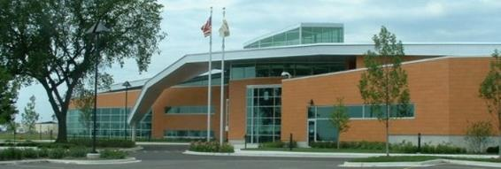
Naperville Public Library
12 Years!

Slide 3
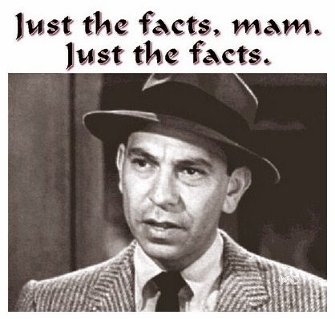
NPL Statistics
~70K Active Cardholders
~1.5M Library Visitors, or 4,000+ everyday
~3.8M Total Checkouts
(2nd in IL behind Chicago PL)
$2.5 Million Materials Budget

Slide 4
Enhance Your Collection with CDA
Why Customer Driven Acquisitions (CDA)
The Process
What Becomes CDA
Putting CDA into Sierra
Buying CDA from Sierra
Clean up CDA from Sierra
Conclusion

Slide 5
We Started CDA in 2016
Customer-responsive focus
Better customer service
Fewer missed titles
Reduces need to fill out Materials Request
Wider variety of materials
Double check assumptions
Fill gaps in collection
Better reflect community in holdings

Slide 6
What Becomes CDA

Slide 7
Multiple Models
Vendors can create based on profiles
Chicago Public Library
Gail Borden Public Library
Supplement normal process
Non-reviewed pre-publication items
Specific subjects, topics, or BISACs

Slide 8
NPL Builds own CDA
Started w/ Adult Nonfiction, added Adult Fiction, then all print
More control over content & quality
More control over budget & time
Ability to experiment

Slide 9
Putting CDA into Sierra

Slide 10
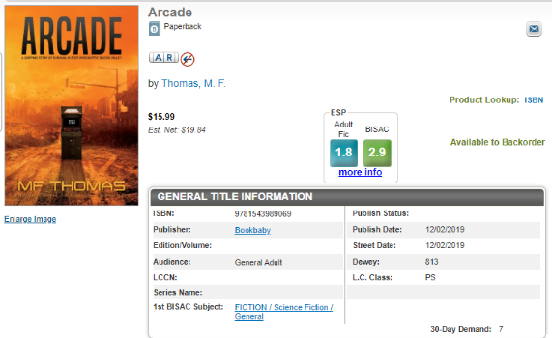
Pre-Grid with Unique Fund Code

Slide 11
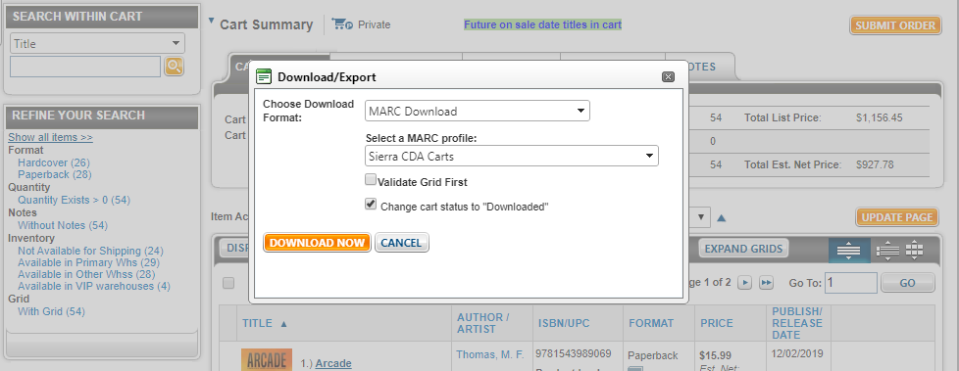
Downloading MARC from Vendor

Slide 12
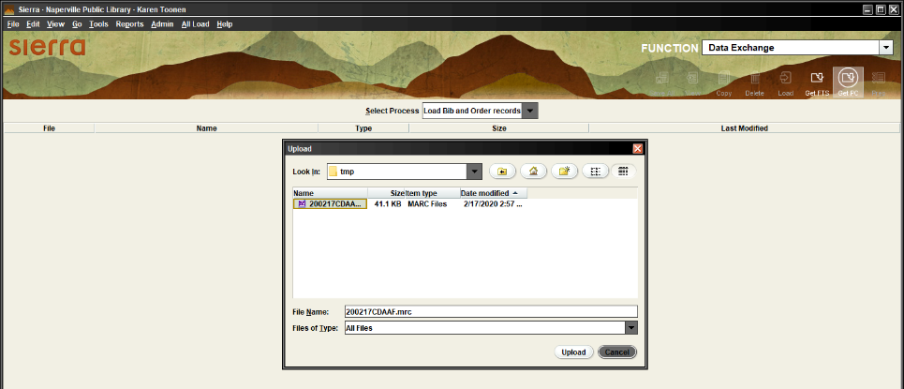
Loading into Sierra

Slide 13
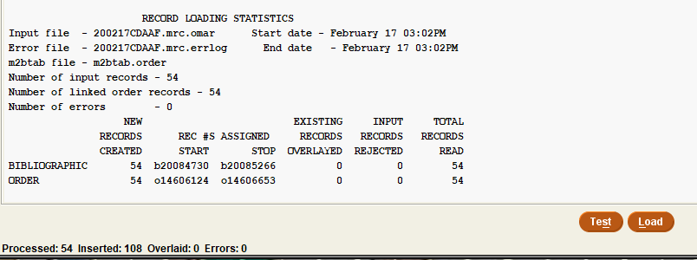
Refresher: Loading into Sierra (Long Way)
Load Bib & Order Records
Upload MARC
Chose the *.ofts, and Prep
Chose the *.omarc, and Test, then Load

Slide 14
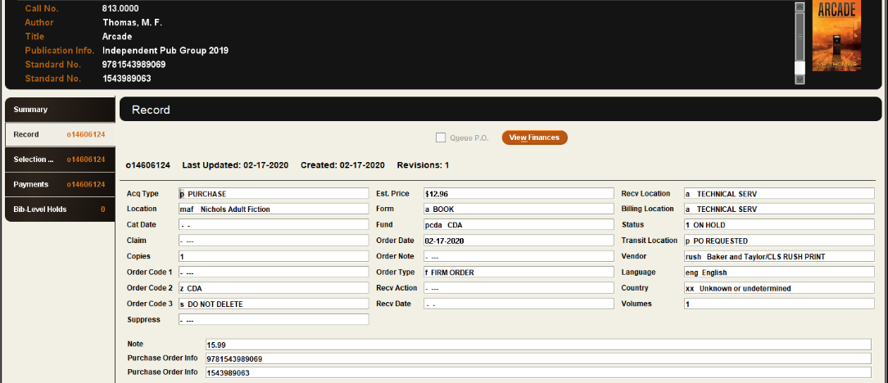
Temporary Records: Sierra View

Slide 15
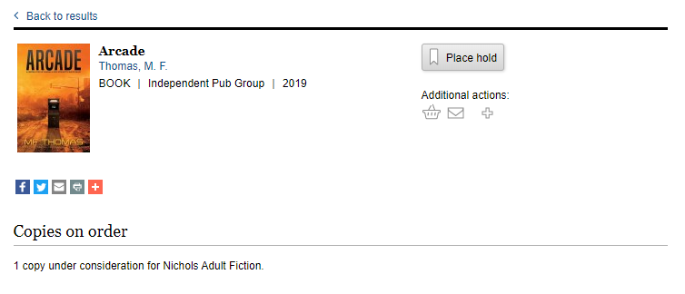
Temporary Records: Encore View

Slide 16
Buying CDA from Sierra

Slide 17
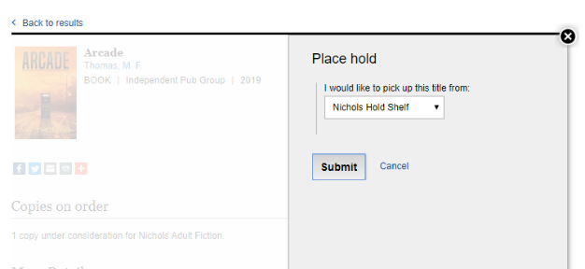
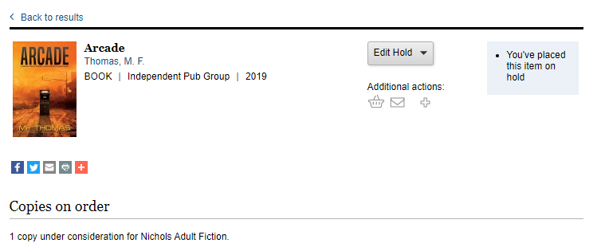
Customers Place Hold: Encore View

Slide 18
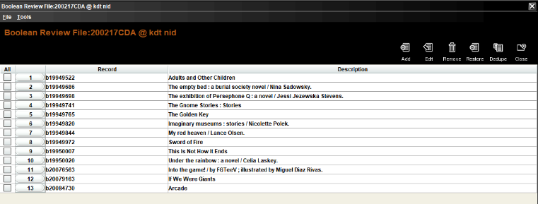
Sierra Side: Create List

Slide 19
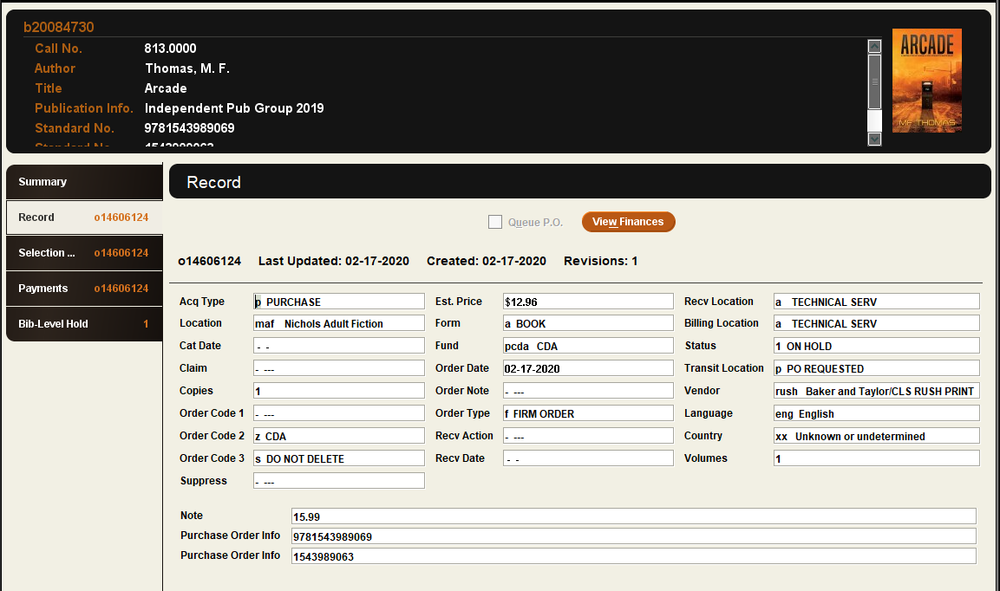
Sierra Side: CDA with Hold

Slide 20
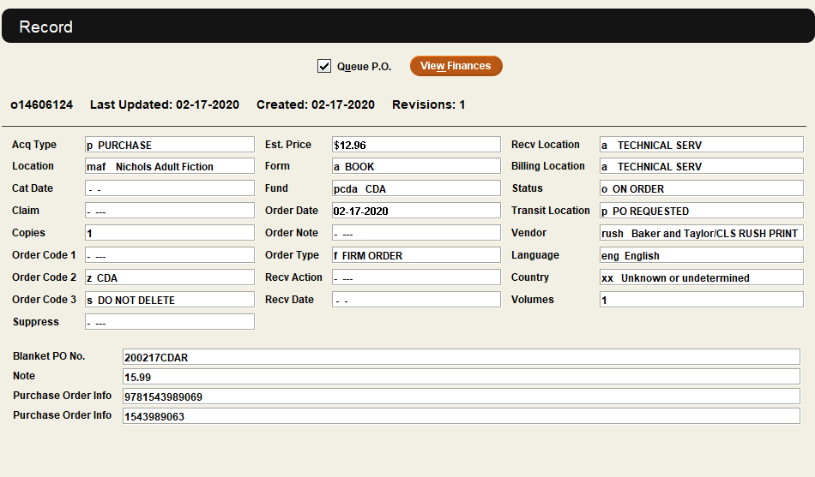
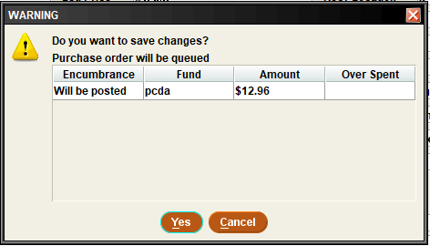
Sierra Side: Creating Purchase Order

Slide 21
Sierra Side: Sending Purchase Order

Slide 22
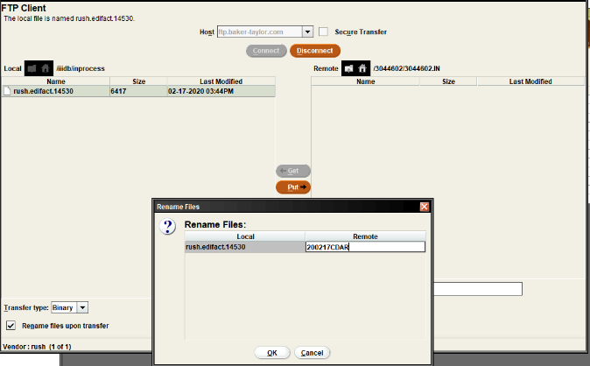
Refresher: Sending Purchase Order
Print/Send Orders
# purchase orders to FTP from drop down
Click FTP, then FTP all
Connect to Vendor
Rename PO →
Disconnect FTP
Screenshot order! Before Deleting entries

Slide 23
Cleaning up CDA from Sierra

Slide 24
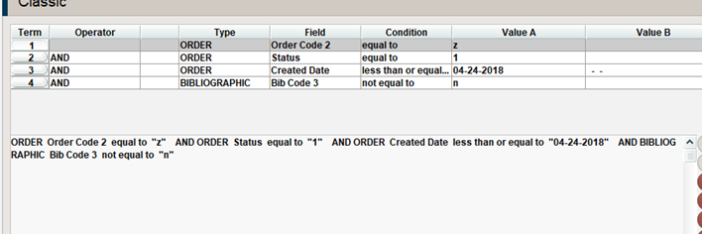
Cleaning up
Create List
Originally 6 months – Now doing 4 months
Delete Records

Slide 25
Conclusion

Slide 26
What We’ve Learned
Nonfiction over Fiction
If you load a cookbook, holds will come!
Adult > Teen > Children’s
In 2018, uploaded 12,000 titles & 18% requested

Slide 27
Total Budgeted per Year

Slide 28
What We’ve Learned

Slide 29
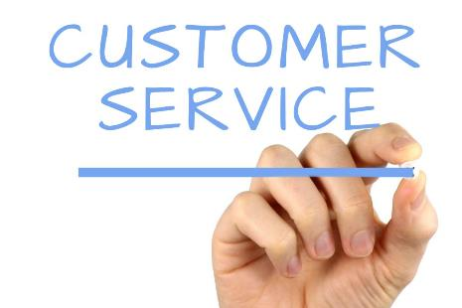
Reasons to Have CDA
Focus on customer needs
User friendly! They just place a hold!
You can control
How much
What materials
Implementation

Slide 30
Portable to Other Libraries
Adaptable to other other ILS
Same benefits for other library types

Slide 31
Questions?
Rohini Bokka Technical Services Manager rbokka@naperville-lib.org
Karen Toonen Collection Development Librarian ktoonen@naperville-lib.org

