Slide 2
The night the lights went out in London
A cautionary tale
@wvrent david.mitchell@lpl.ca

Slide 3
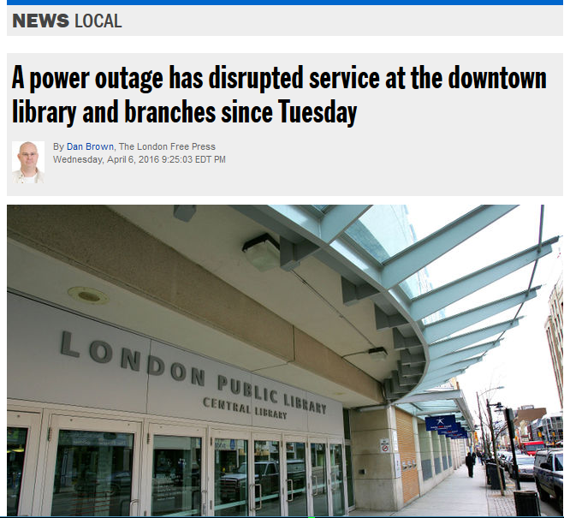
Making headlines

Slide 4
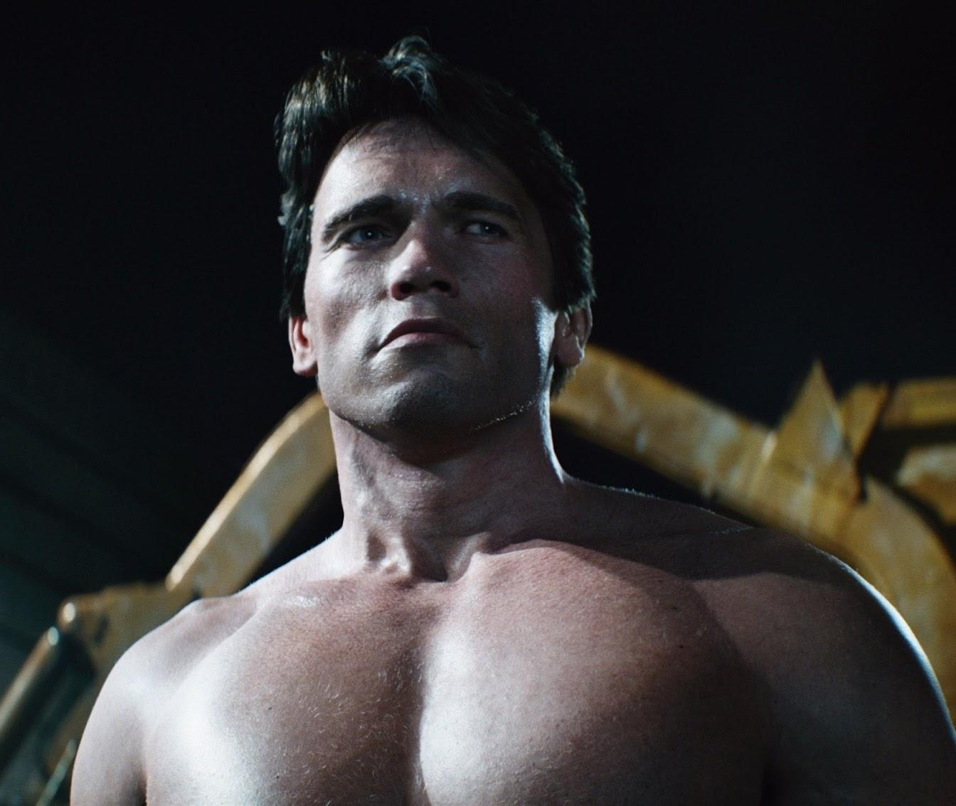
What happened?

Slide 5
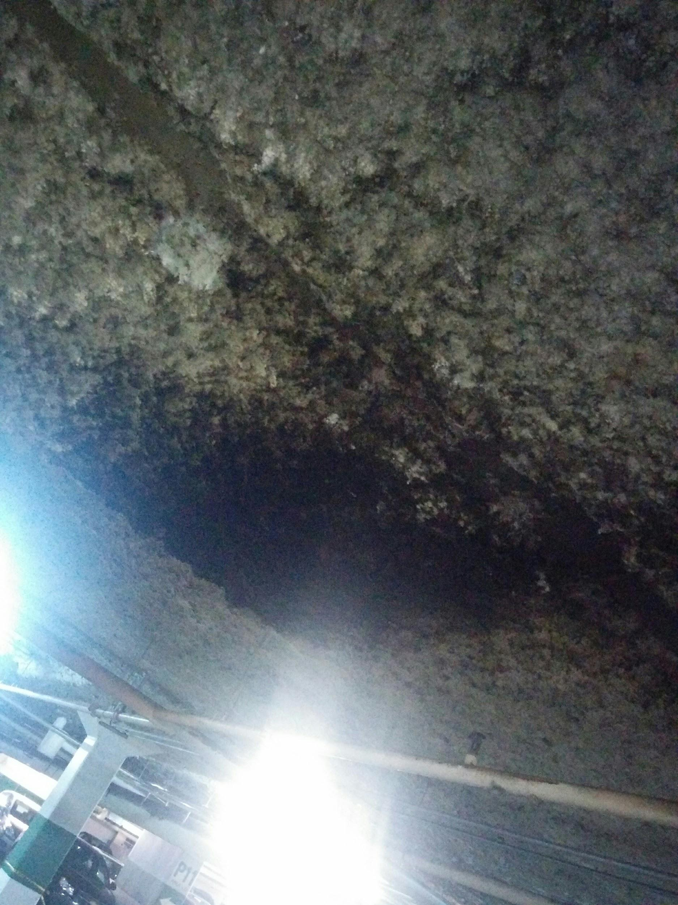
If it looks like a duct and arcs
like a duct
Feeder duct bus
Layers of sandwiched copper
3000+ Amp capacity
Evaporated in a fraction of a second
30 years old
Outside of our physical building

Slide 6
Star of the show
THE INTERNET!
Branch
Branch
Branch
Branch
Branch
Centralized data center
Internet (filtering & shaping)
Wireless
Catalogues
Backups
Email
File and Print services
Authentication
Financial & HR systems
Websites & Intranet
Telephones
Branch
Branch
Branch
Central
Branch
Branch
Branch
Branch
Branch
Branch
Branch
Branch

Slide 7
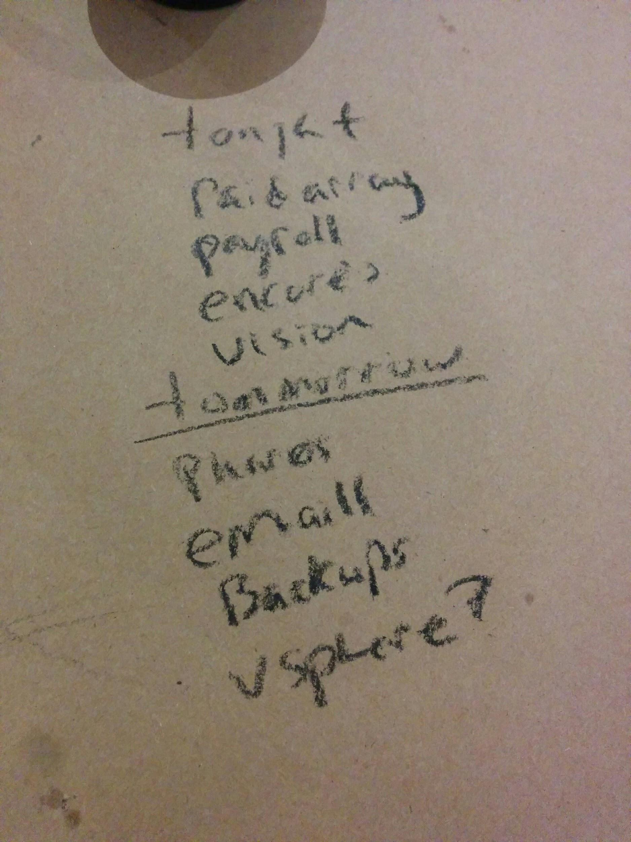
Plan to fail
don’t fail to plan

Slide 8
Always have an
understudy
THE INTERNET!
Branch
Branch
Branch
Branch
Branch
Emergency data center
Becomes the new “Central”
Ready to roll
< 5 hours essential services
< 24 hours for everything else
Branch
Branch
R.I.P Central
Branch
Branch
Branch
Branch
Branch
Branch
Branch
Branch
Branch

Slide 9
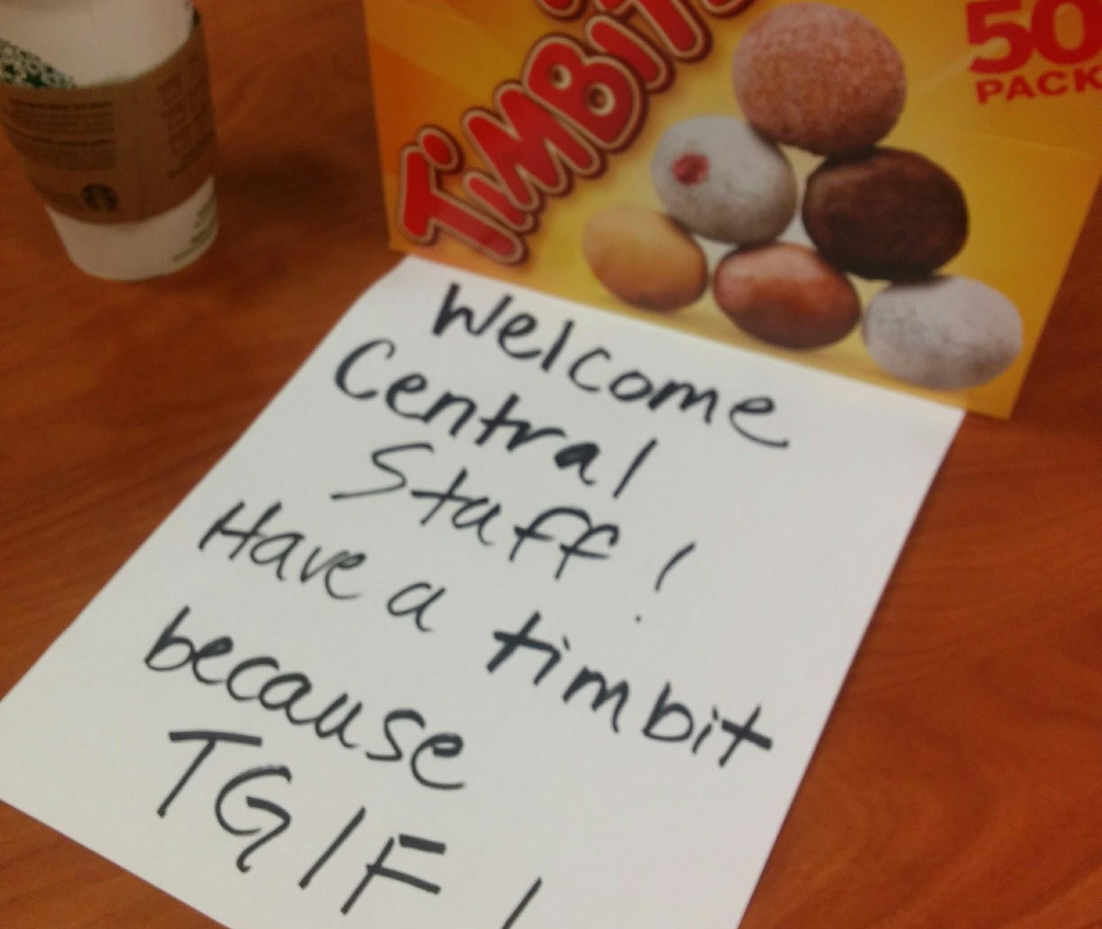
What went right?
All levels of staff were all-stars!
Public service interruption was minimized
Minimal loss of data

Slide 10
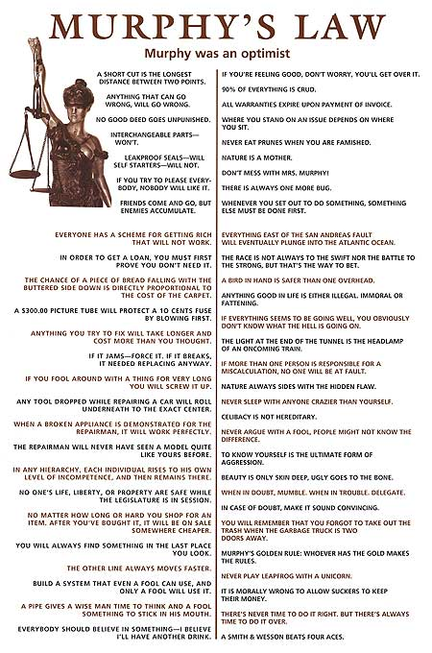
You can always count on the uninvited guest

Slide 11
What went wrong?
THE INTERNET!
Branch
Branch
Branch
Branch
Branch
DR power failure
Rebuild not repair
Opening both Central and DR
Rolling blackouts
Firewall changes
Spam attack!
Equipment failures
Branch
Branch
Branch
Branch
Central
Branch
Branch
Branch
Branch
Branch
Branch
Branch

Slide 12
What did we learn?
@wvrent david.mitchell@lpl.ca
Improved DR bandwidth
Power strategies
Backup frequency
Restore processes
Test/lab environment
Expand critical definition
Cleanup of data center
Internet security
V2 of the disaster plan

Slide 13
Thank you!
@wvrent david.mitchell@lpl.ca

