Slide 1
Polaris Libraries Using Vega:
From Implementation to Patron Usage
Anne Barnard, ILS Coordinator, Orion Township Public Library
Kathy McKinney, Coordinator of Automation, Farmington Community Library

Slide 2
Agenda
Introductions
Administrative Set Up
Patron View while Searching
MARC Roll-Up
Cool Features
Bookshelf
Saved Searches
Showcases
Upcoming Features

Slide 3
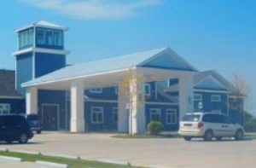
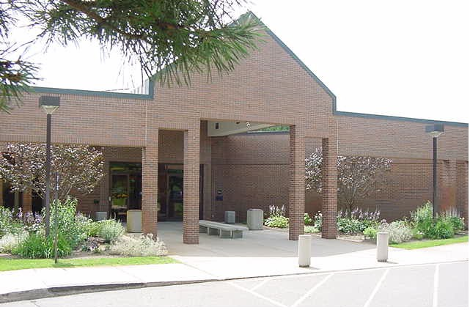
Orion Township Public Library
Located in Michigan (Metro Detroit area)
2 branches
Service population = 38,206 (Charter Twp of Orion and Village of Lake Orion)
Physical holdings = 132,135
Circulated 458,296 items in 2021
Went live with Vega February 2022

Slide 4
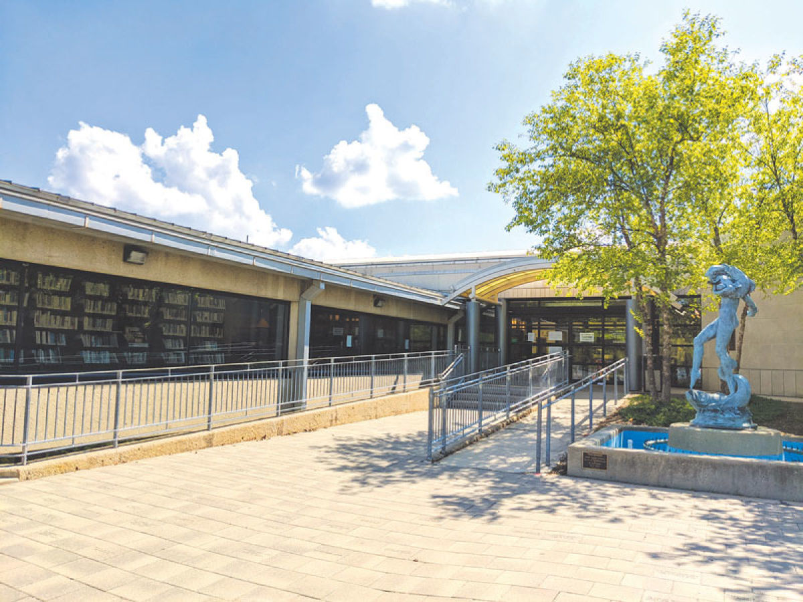
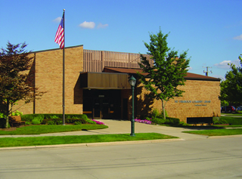
Farmington Community Library
Located in Michigan (Metro Detroit area)
2 branches
Serves a population = 91,777 (Cities of Farmington Hills and Farmington)
Physical holdings = 288,272
Circulated 549,132 items in 2021
Went live with Vega in October 2021

Slide 5
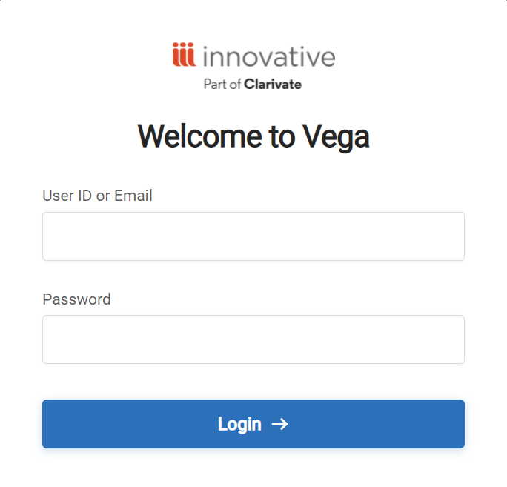
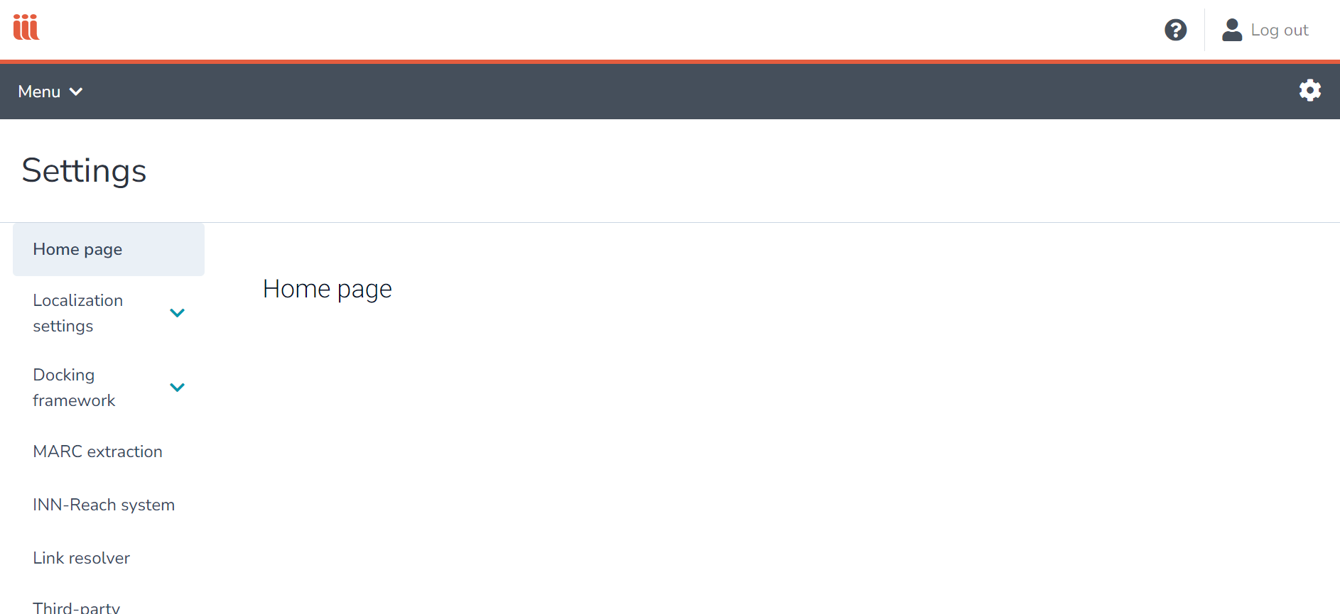
Admin Login

Slide 6
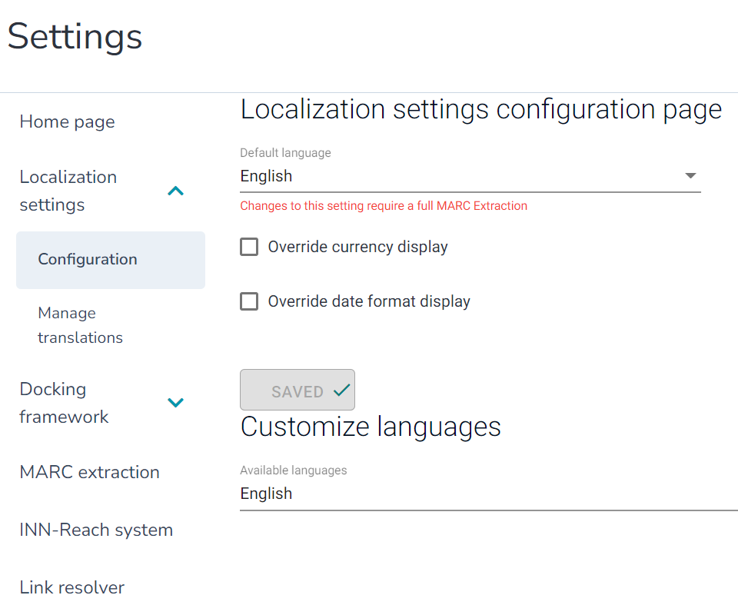
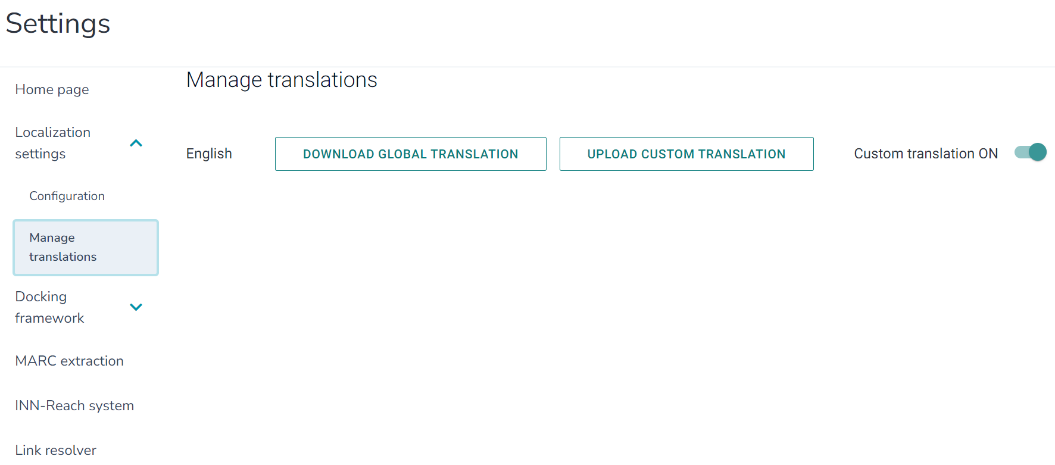
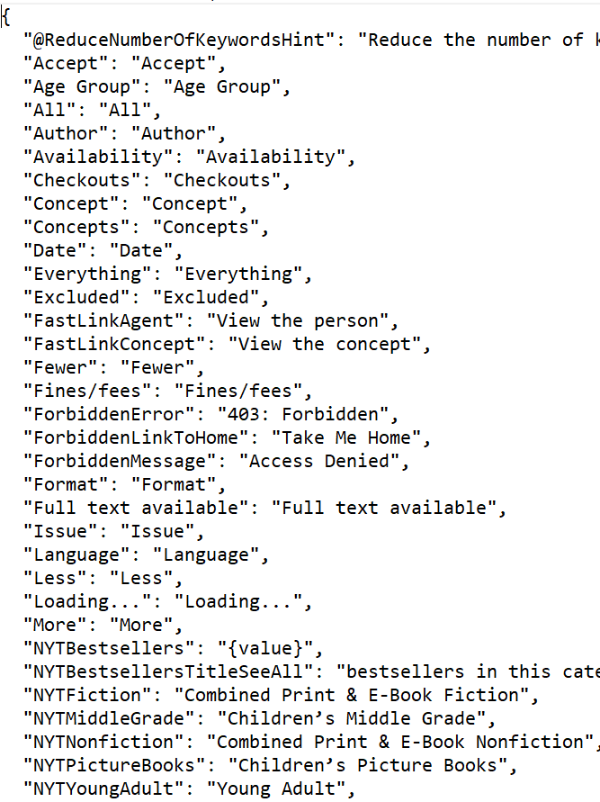
Localization Settings

Slide 7
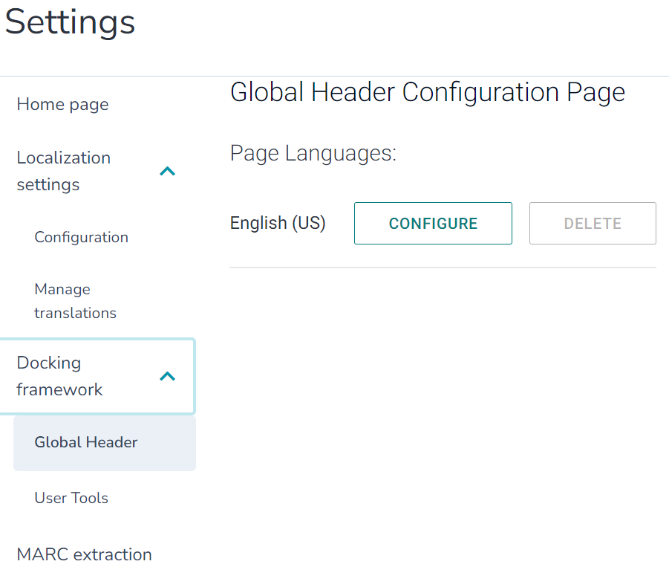
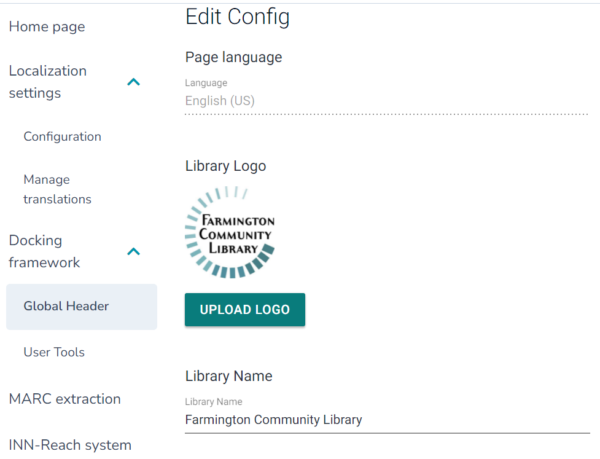
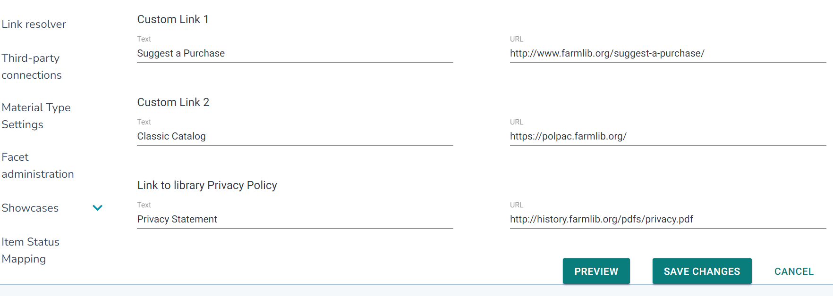
Docking Framework – Global Header

Slide 8
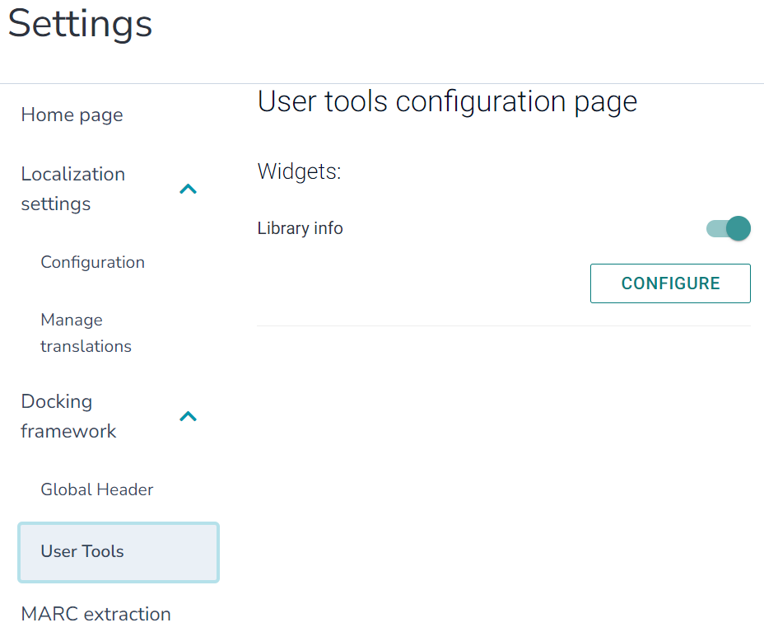
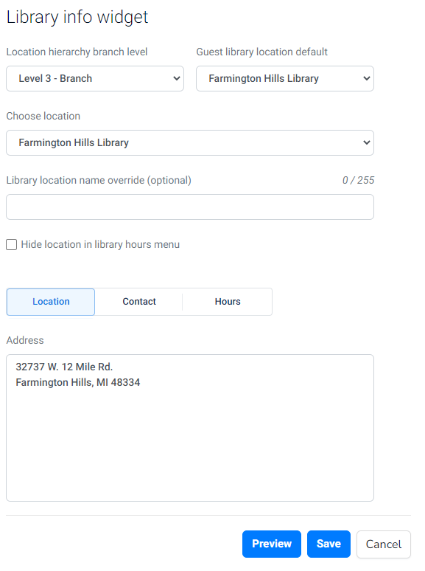
Docking Framework – User Tools

Slide 9
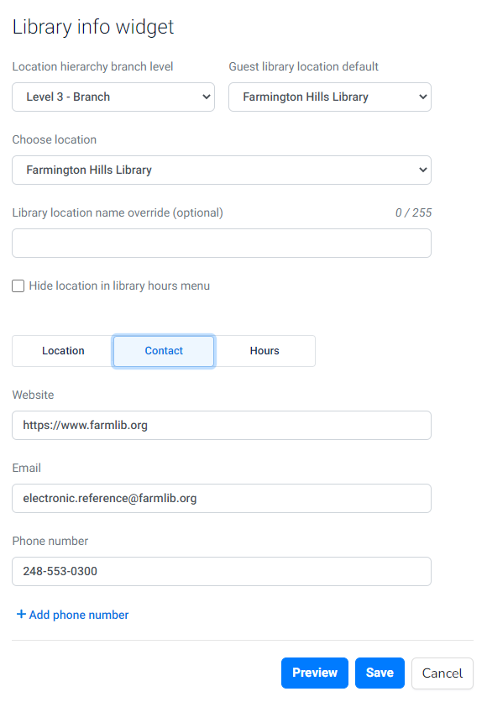
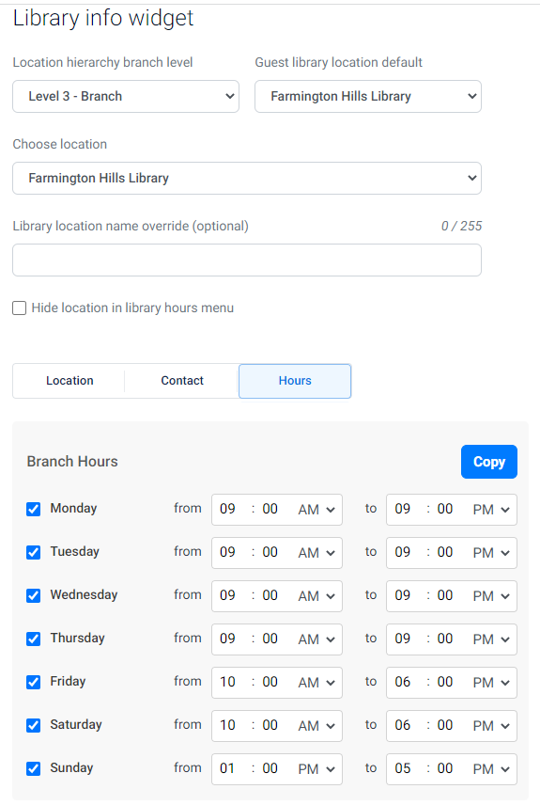
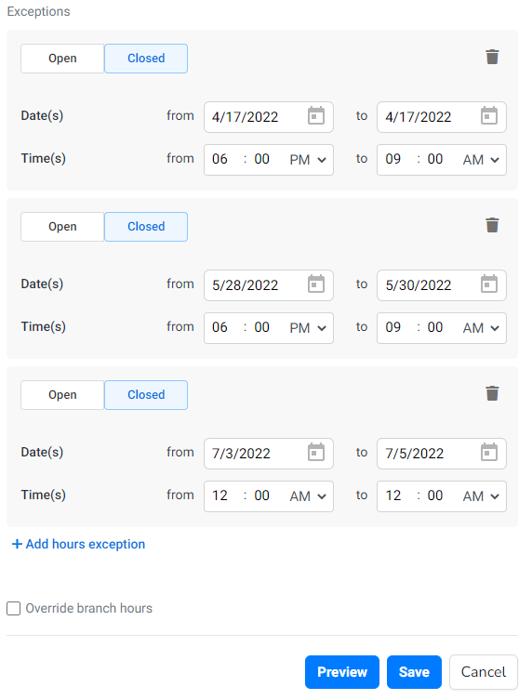
Docking Framework – User Tools

Slide 10
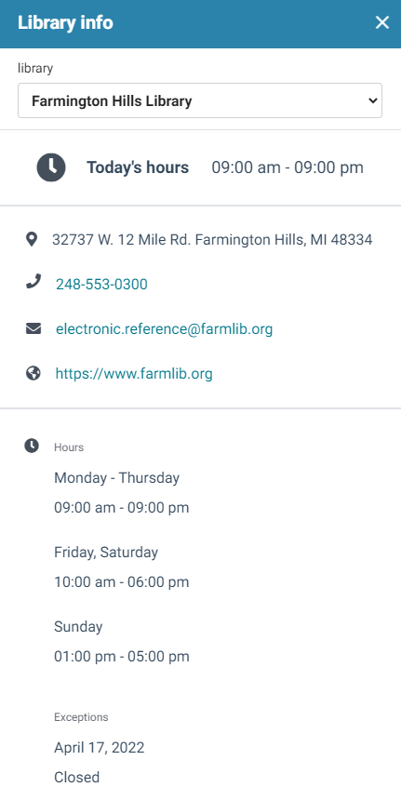
Docking Framework – Preview

Slide 11
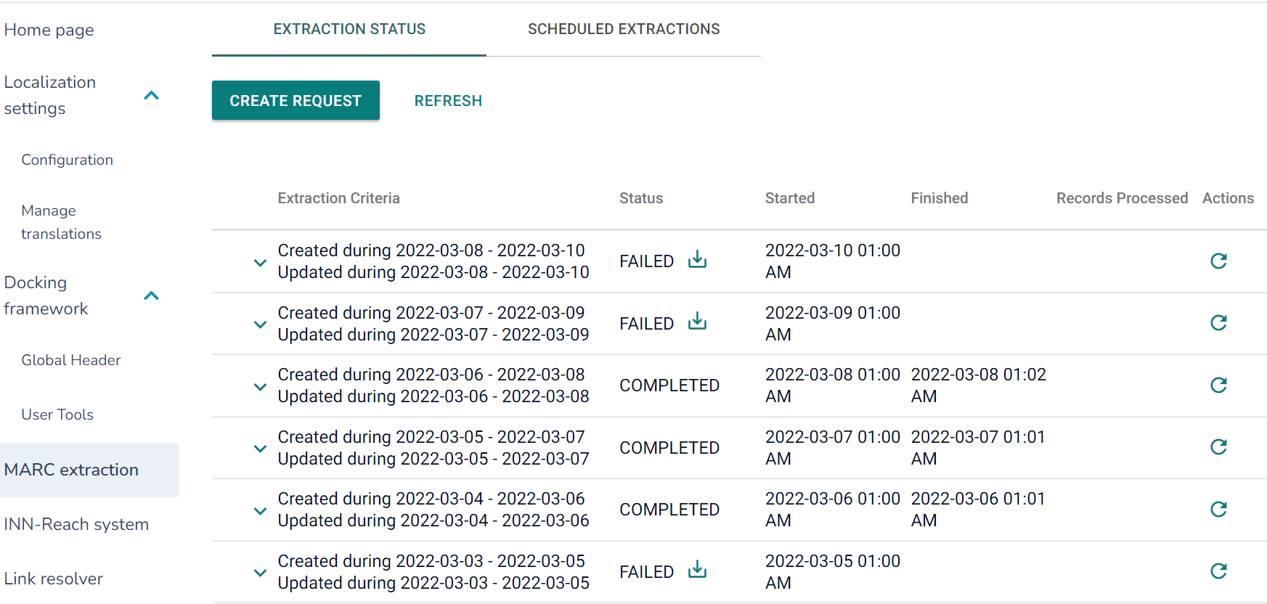
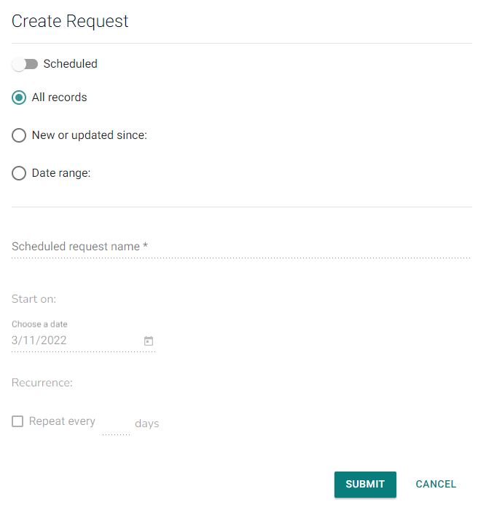
MARC Extractions – Extraction Status

Slide 12
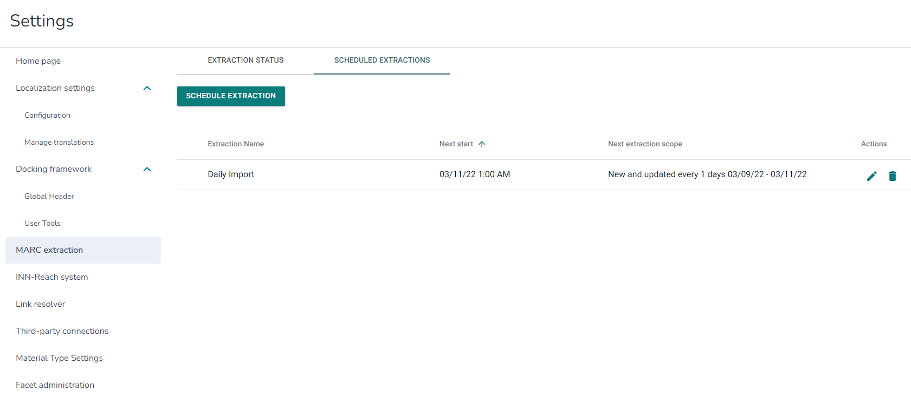
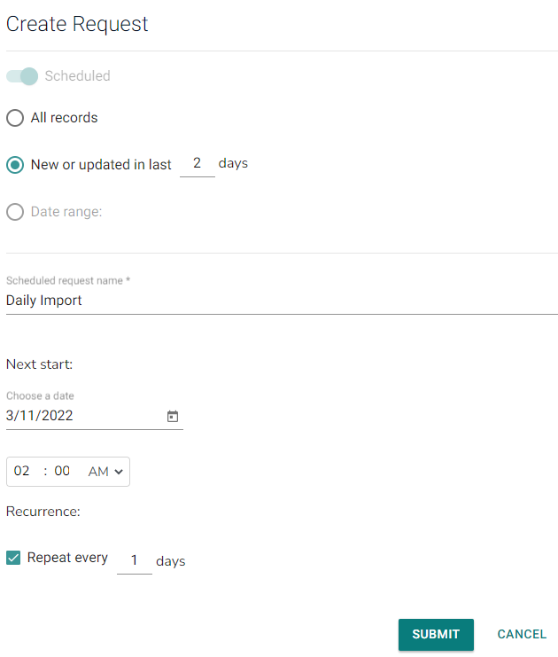
MARC Extraction – Scheduled Extractions

Slide 13
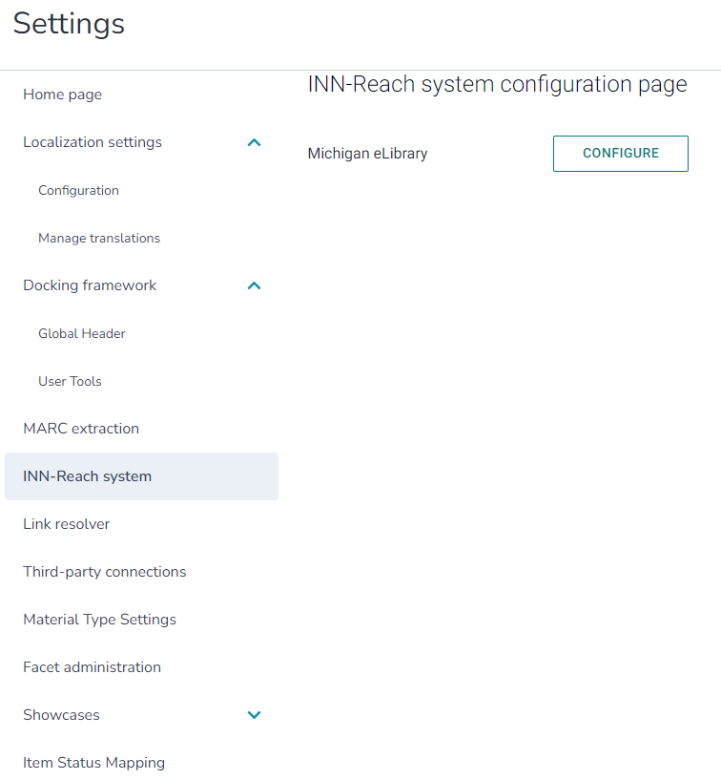
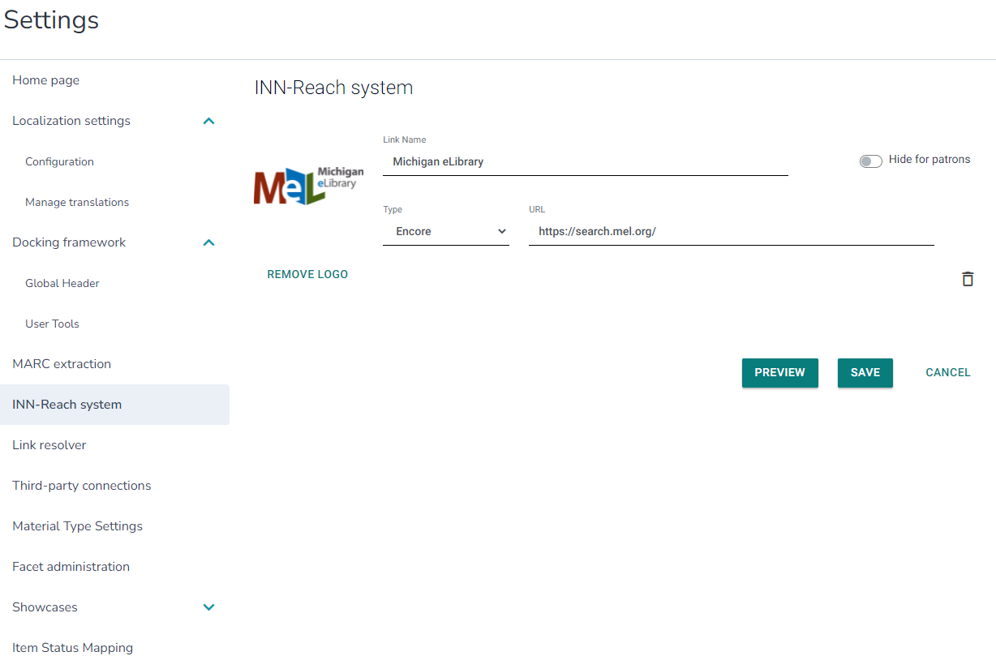
INN-Reach System

Slide 14
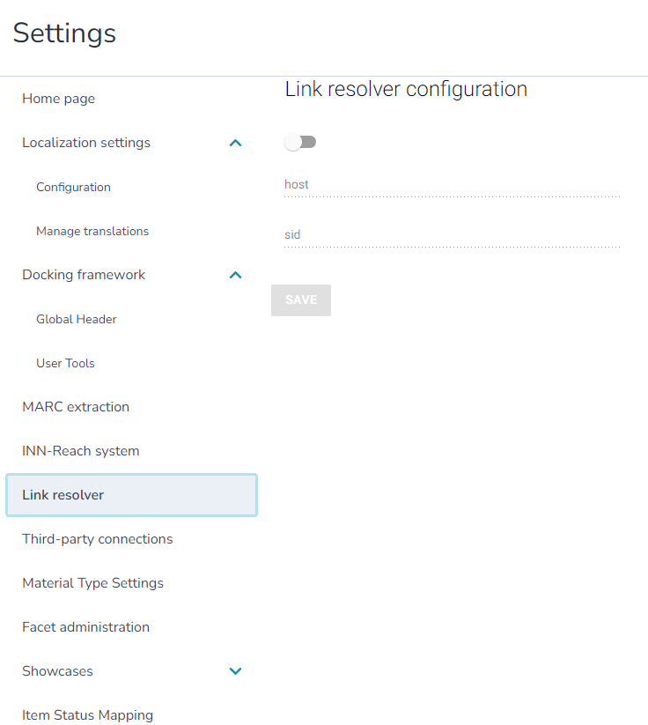
Link Resolver

Slide 15
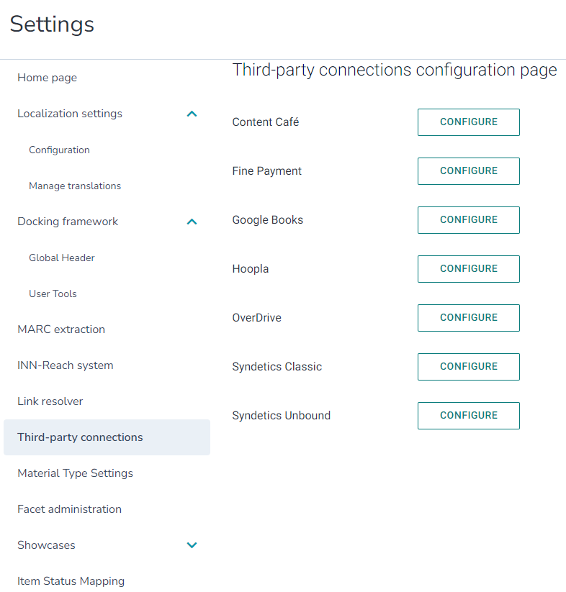
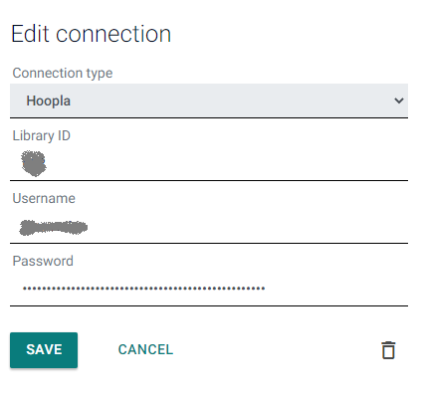
Third-Party Connections

Slide 16
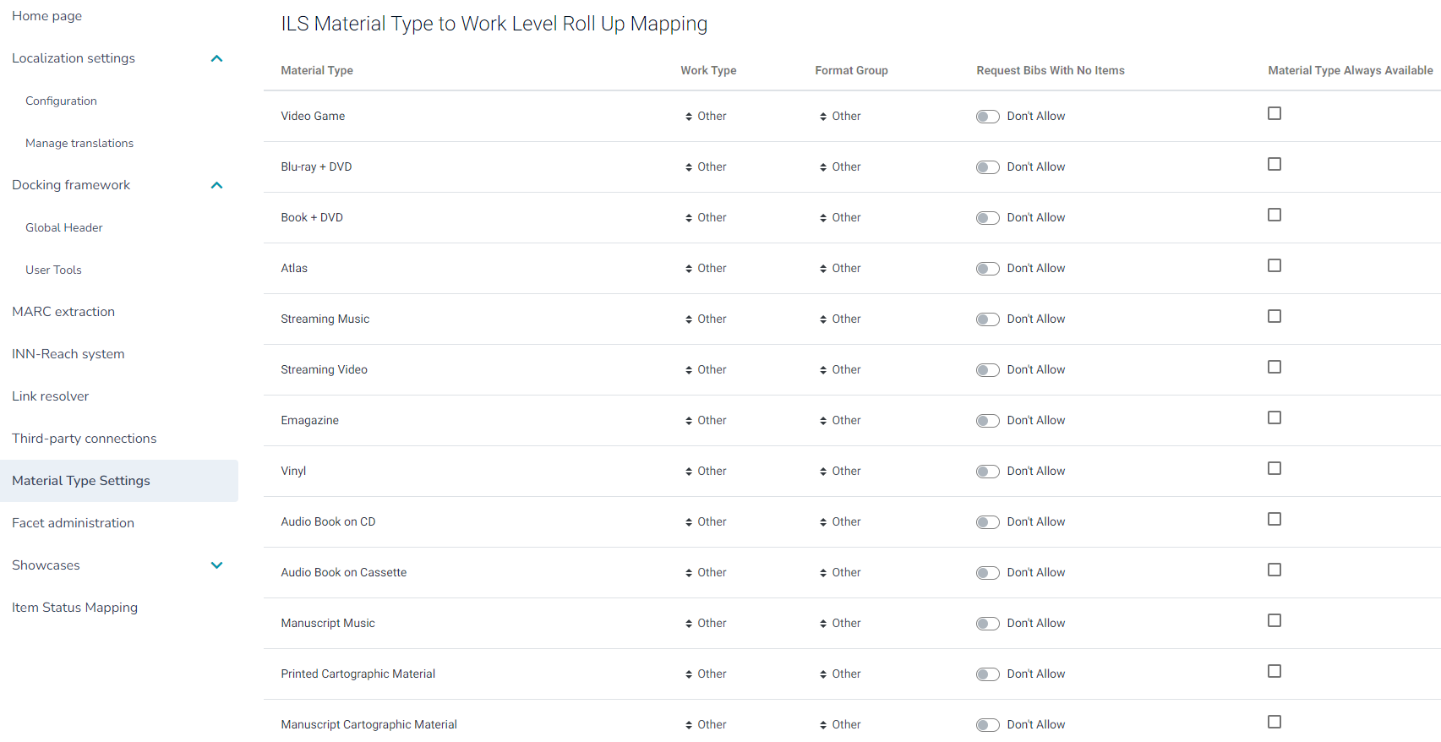
Material Type Settings

Slide 17
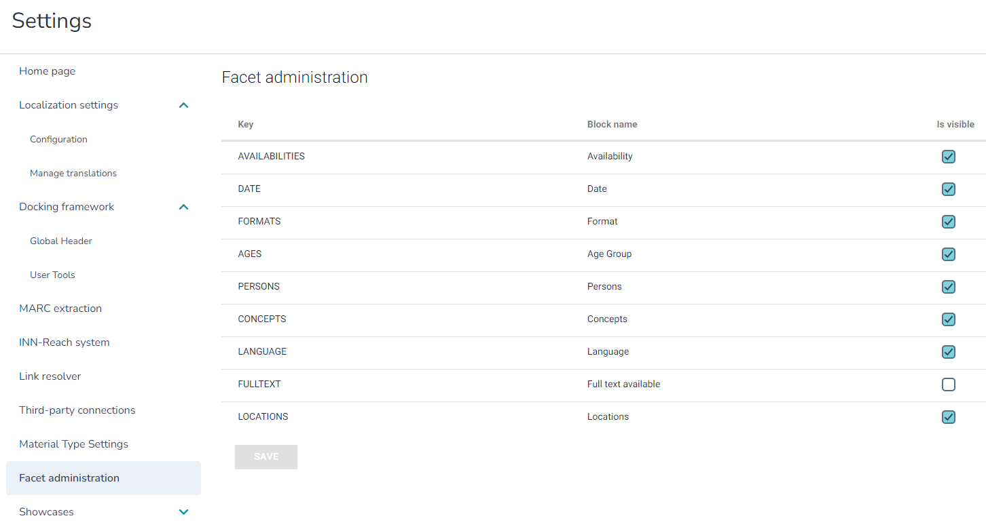
Facet Administration

Slide 18
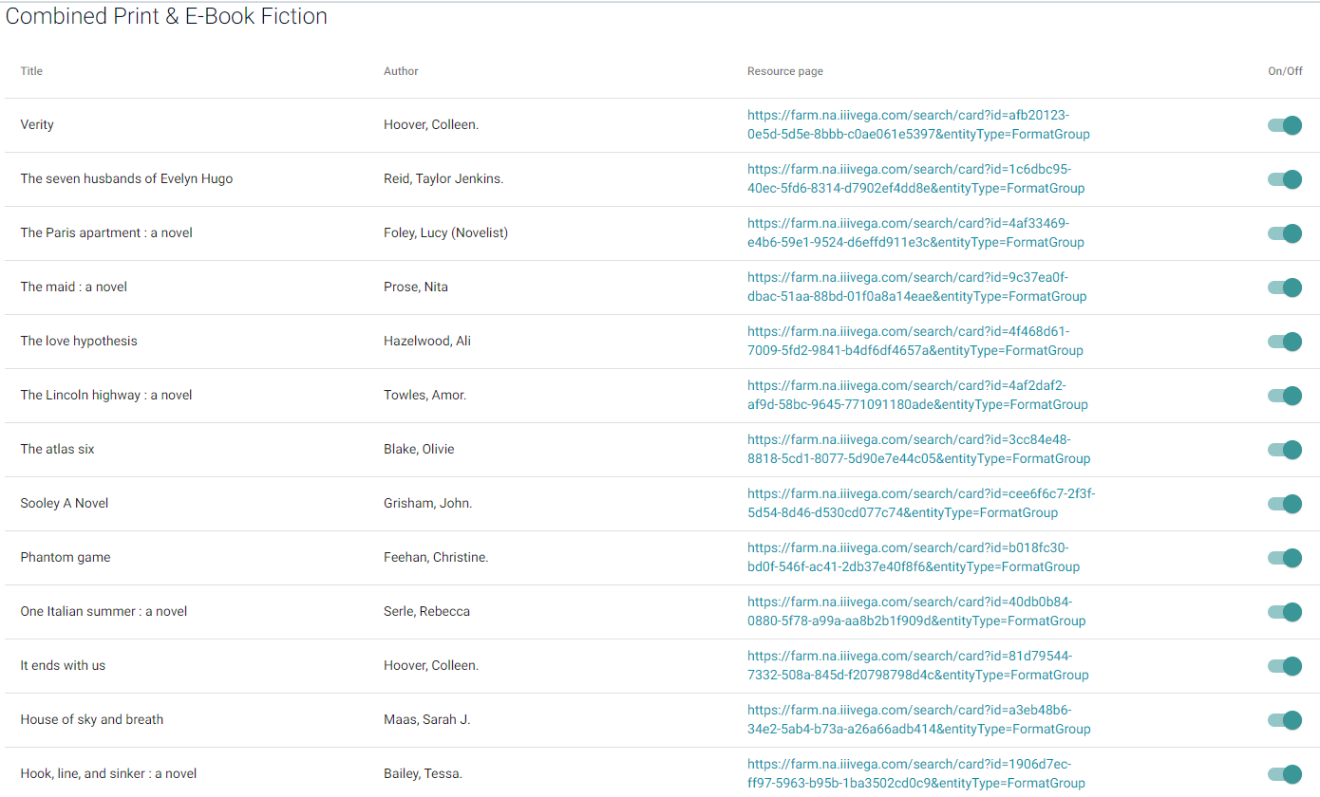
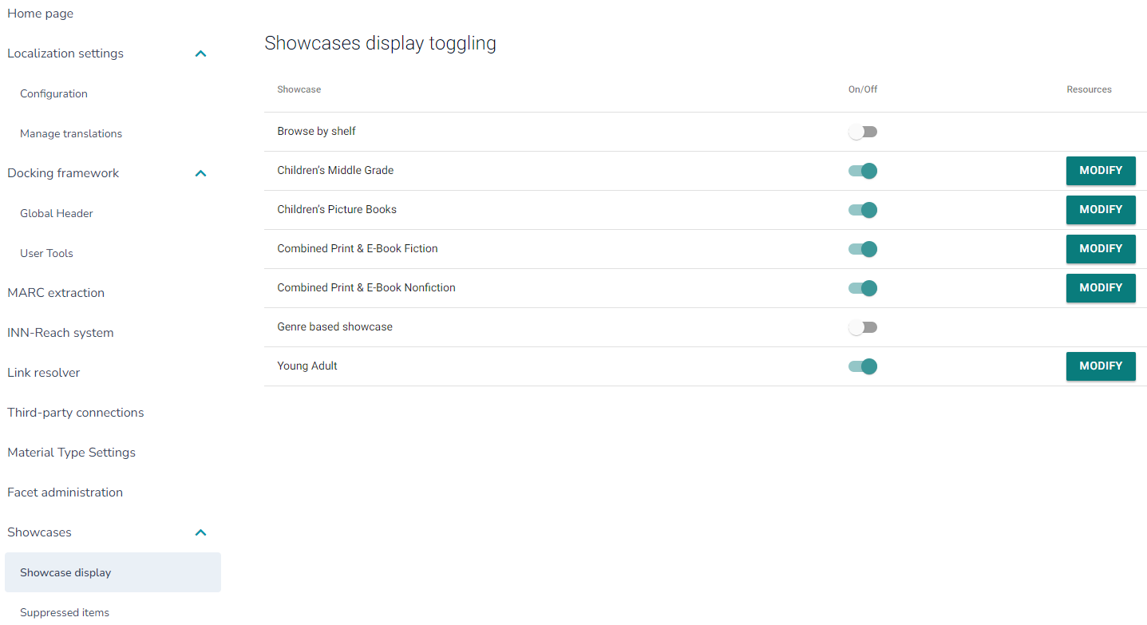
Showcases - Display

Slide 19
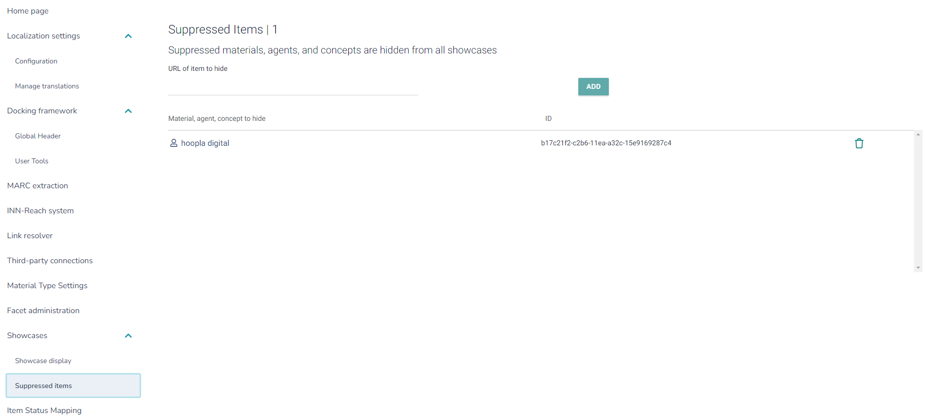
Showcases – Suppressed Items

Slide 20
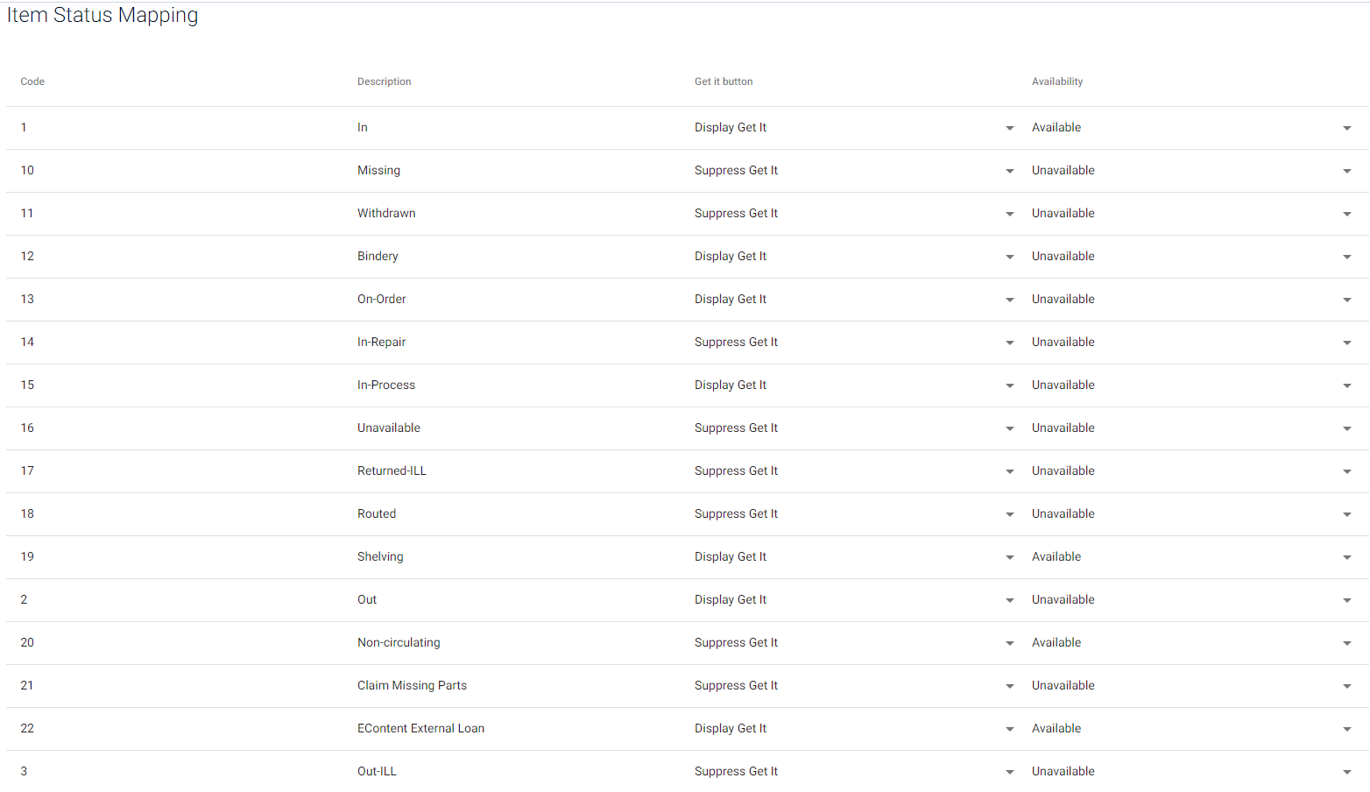
Item Status Mapping

Slide 21
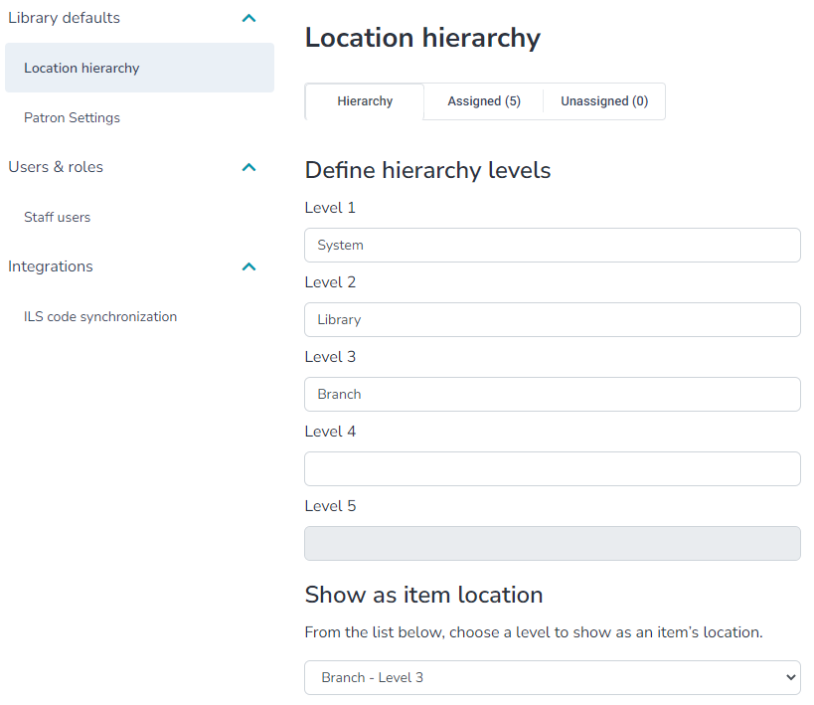
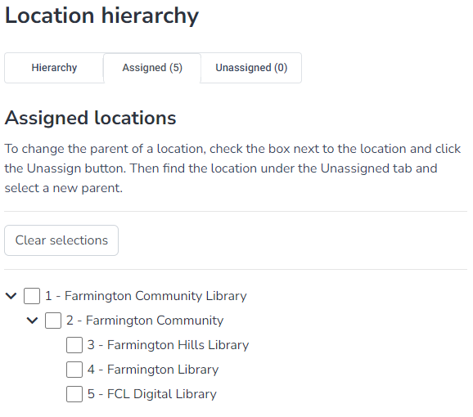
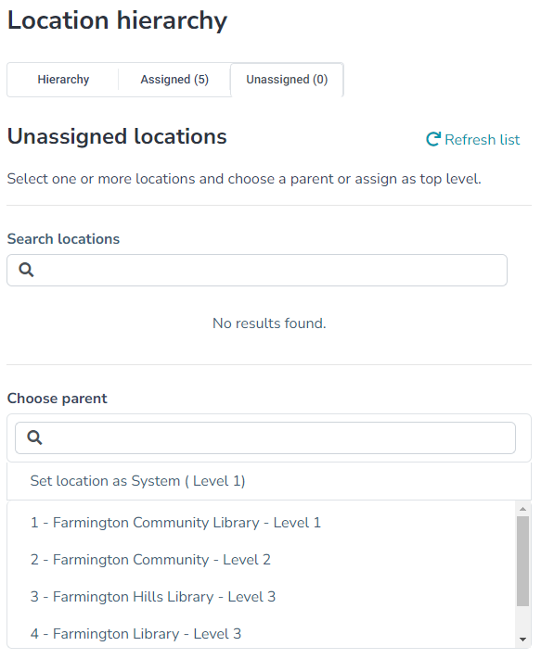
Library Defaults – Location Hierarchy

Slide 22
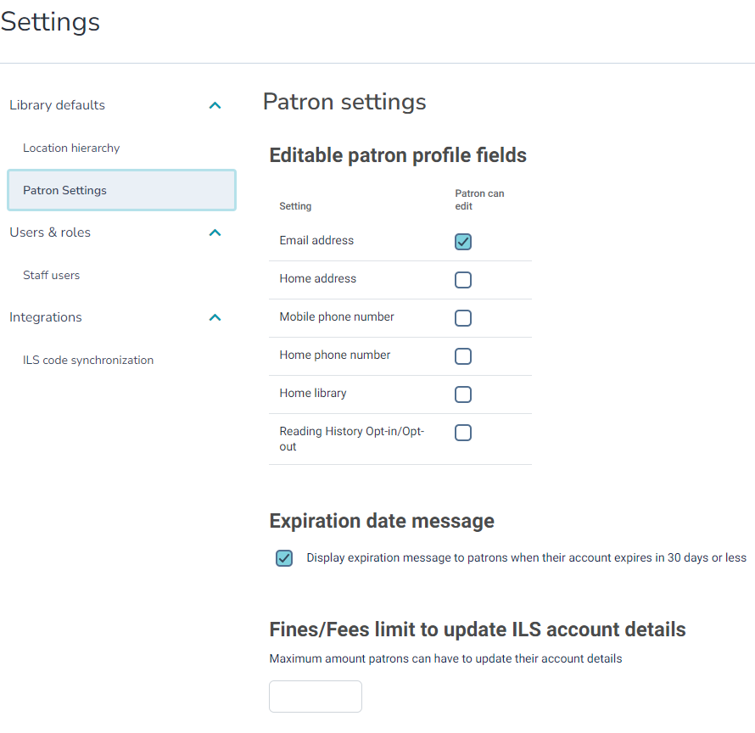
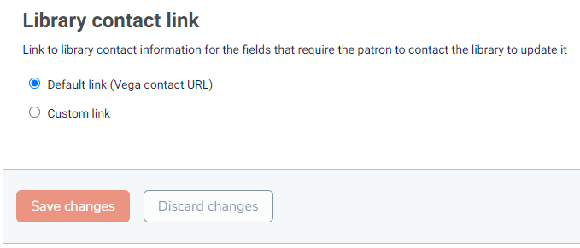
Library Defaults – Patron Settings

Slide 23
Users & Roles – Staff Users

Slide 24
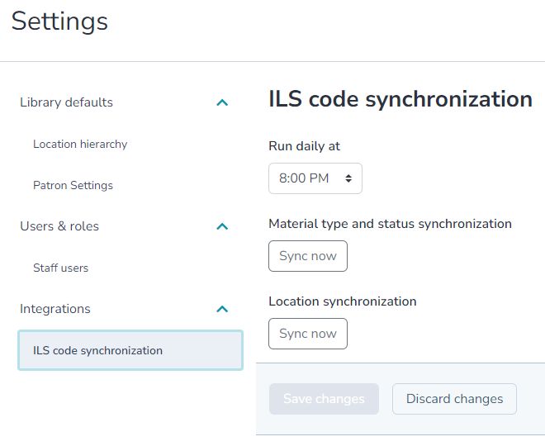
Integrations – ILS Code Synchronization

Slide 25
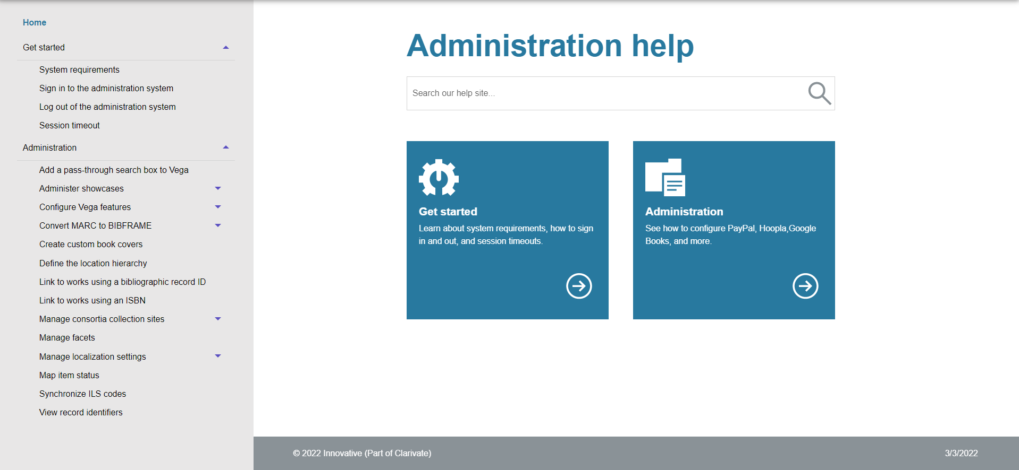
Administration Help

Slide 26
“Only librarians like to search, Everyone else likes to find.”
Roy Tennant

Slide 27
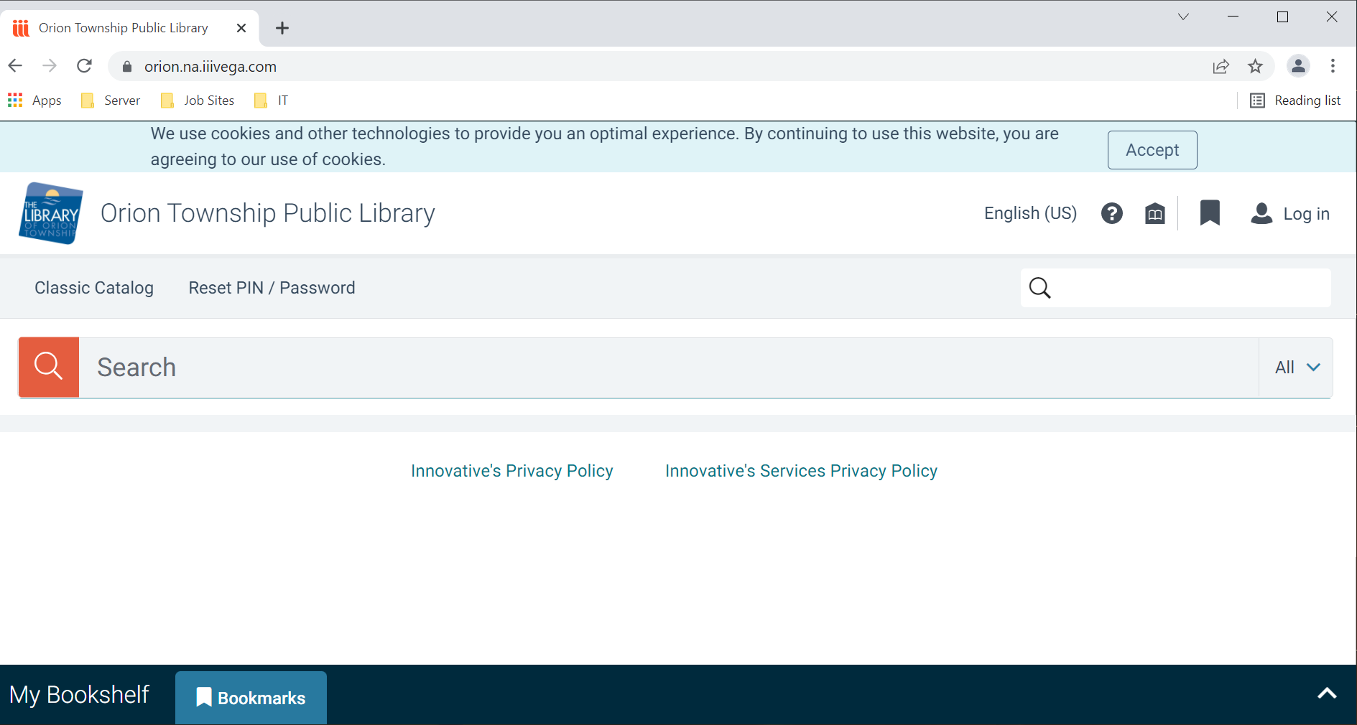
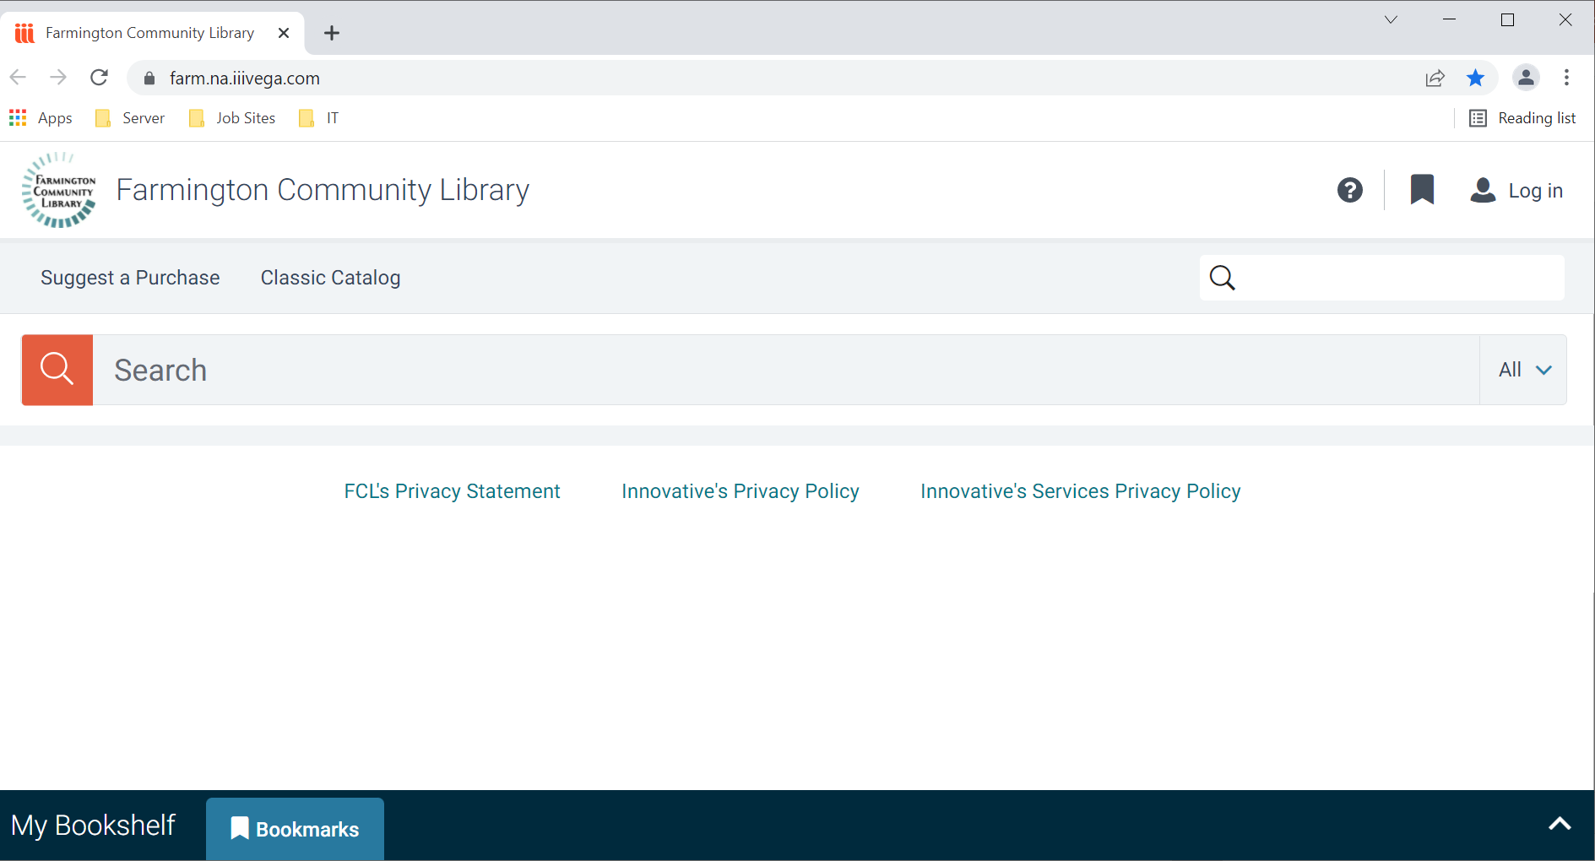
Patron View – Vega Home Page

Slide 28
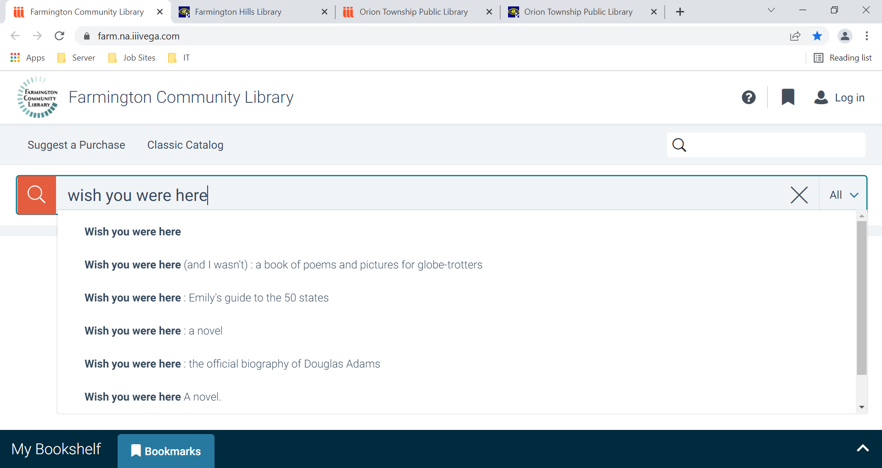
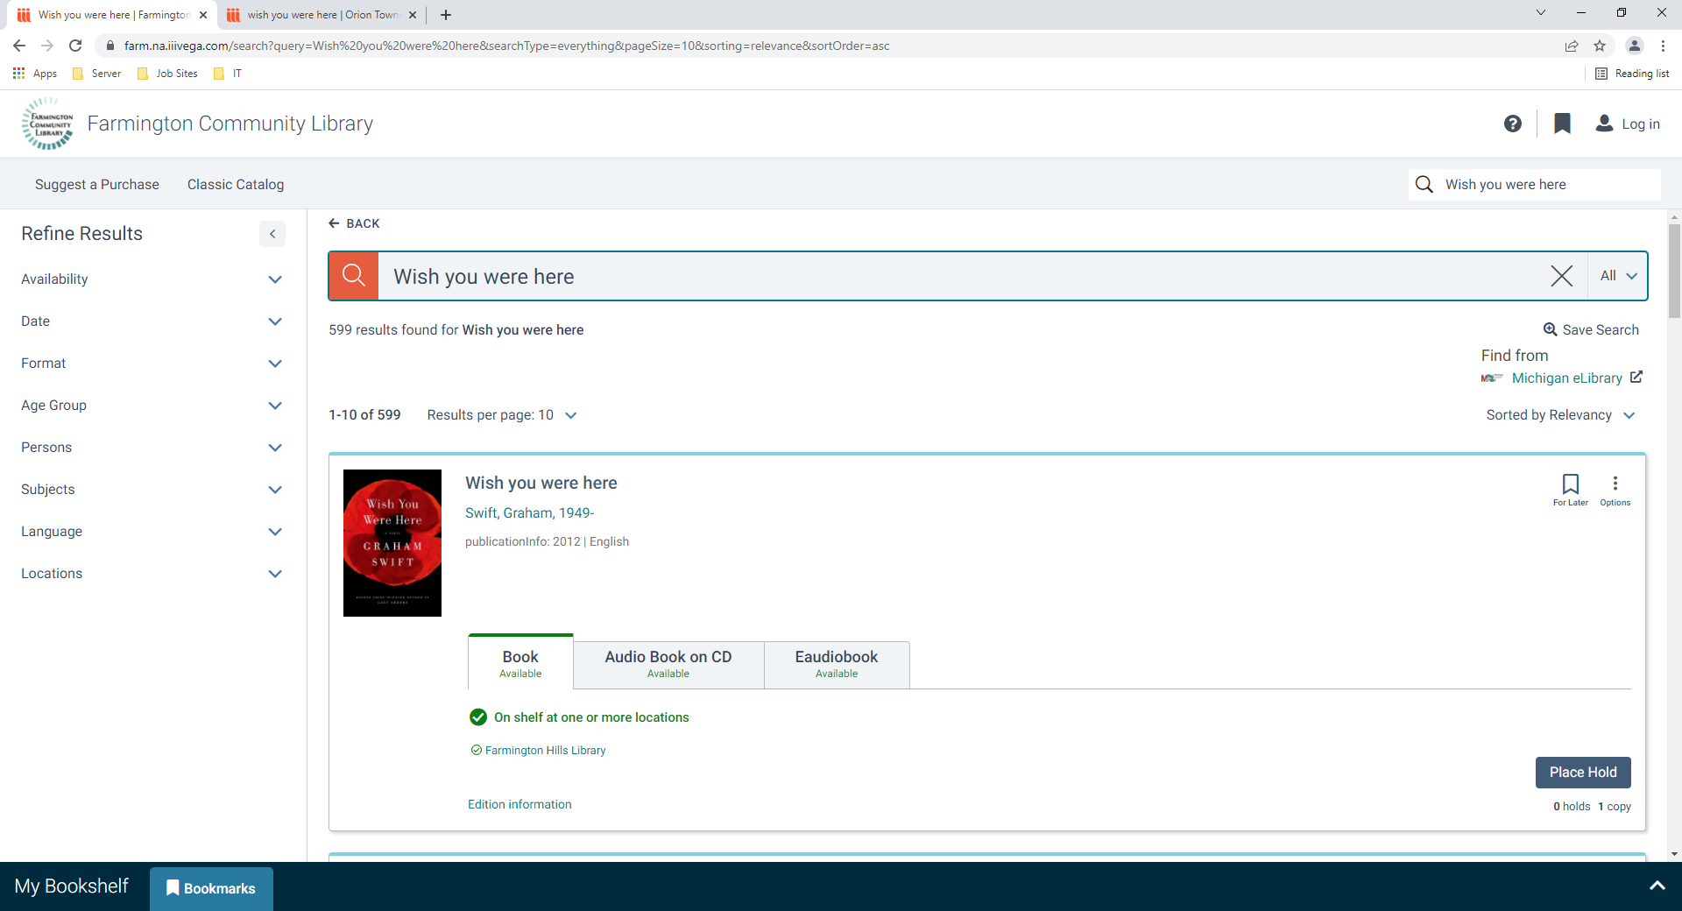
Searching

Slide 29
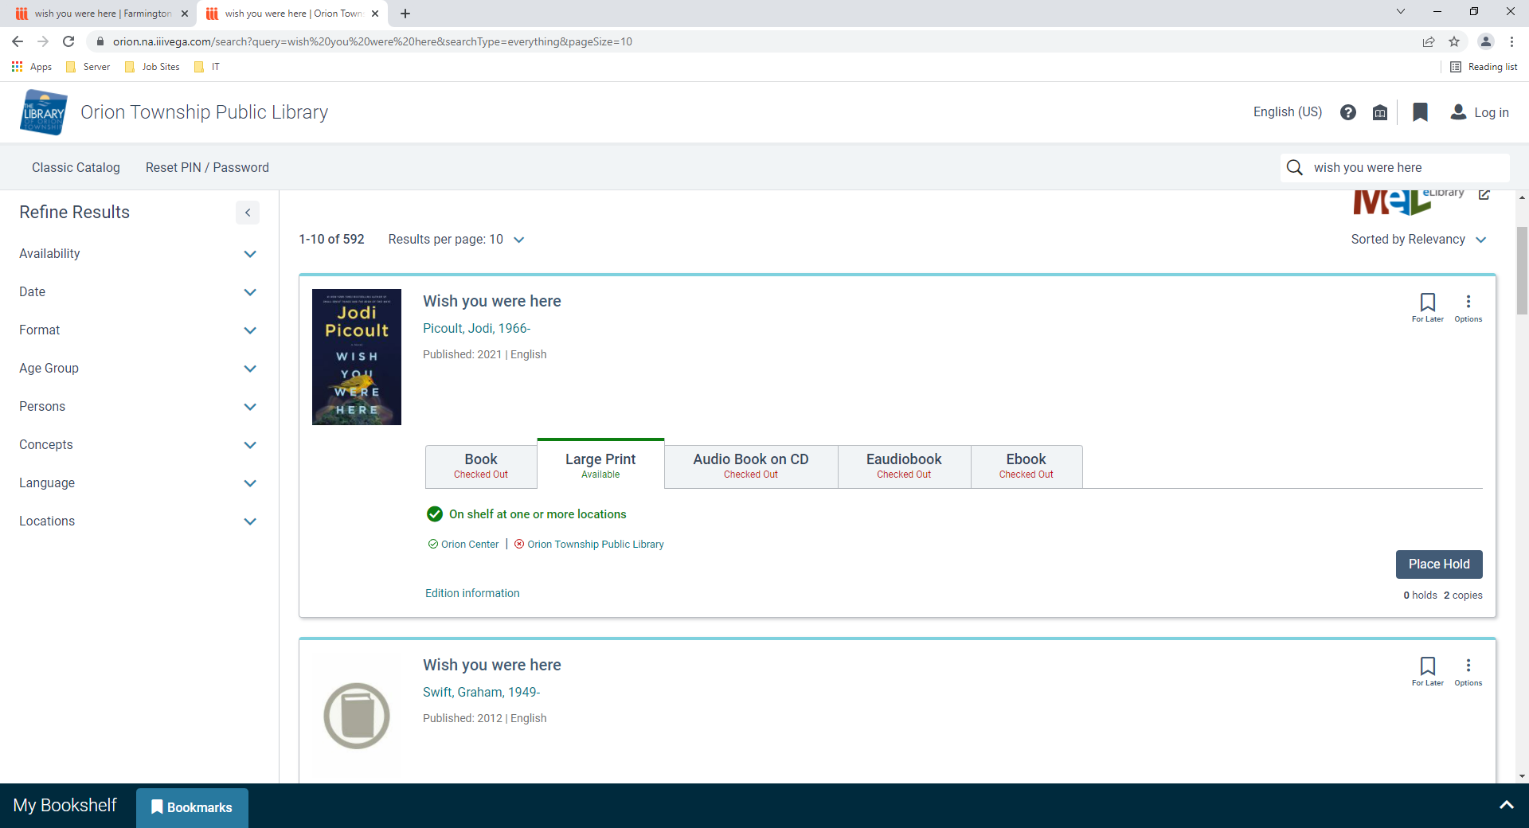
Searching – For Later and Options
For Later: Bookmark this for future use.
Options: Email the Title, Publication Date, and Author
Export Citation gives options of where to export the citation and in what format it is needed

Slide 30
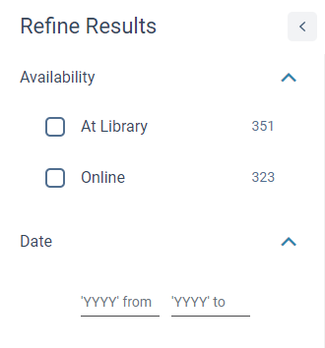
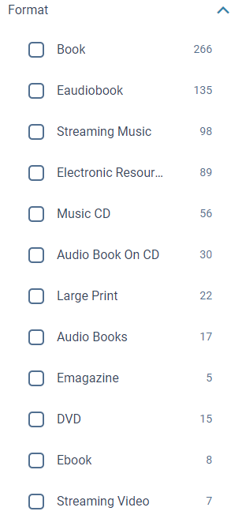
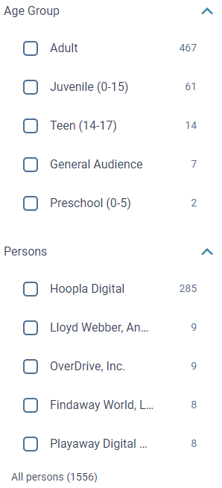
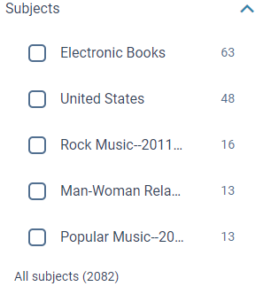
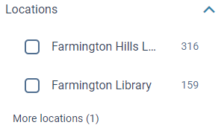
Searching Facets – Refine Results

Slide 31
Search Results - Excerpts

Slide 32
Search Results – Edition Info and Related

Slide 33
Search Results – Contributors & Topics

Slide 34
Search Results - Details

Slide 35
Search Results – Professional Reviews

Slide 36
Search Results – Book Profile & About the Author

Slide 37
Bookmarks

Slide 38
Saved Search

Slide 39
Searching – INN-Reach

Slide 40
Patron Information – My Bookshelf - Checkouts

Slide 41
Patron Information – My Bookshelf - Holds

Slide 42
Patron Information – My Bookshelf – Fines & Fees & Profile

Slide 43
Bookmarks

Slide 44
Saved Search

Slide 45
Showcases

Slide 46
Showcases

Slide 47
Widget

Slide 48
Contact Information
Anne Barnard Kathy McKinney
Orion Township Public Library Farmington Community Library
abarnard@orionlibrary.org Kathy.McKinney@farmlib.org
248-287-8011 248-848-4316

Slide 49
THANK YOU
Questions?

