Slide 1
Migrating to AWS
From ideation to launch in six months
Victor Zuniga
Poudre Libraries

Slide 2
ONCE UPON A TIME…
Notes:
Brief introduction about PRPLD and the goals to make this happen
Ask yourself: what is your goal?
What you want your audience to do with the information you’re sharing
Good self-reflecting question to start and guide the presentation. It may be a good idea to ask the question back to the audience at the end of the presentation.

Slide 3
PLANNING

Slide 4
AWS CLOUD MIGRATION PROCESS
Cloud assessment
Proof of concept
Data migration
Application migration
Leverage the cloud
Optimization
Notes:
Cloud assessment
Proof of concept
Data migration
Application migration
Leverage the cloud
Optimization

Slide 5
CLOUD ASSESMENT
Cost
Architecture
Security

Slide 6
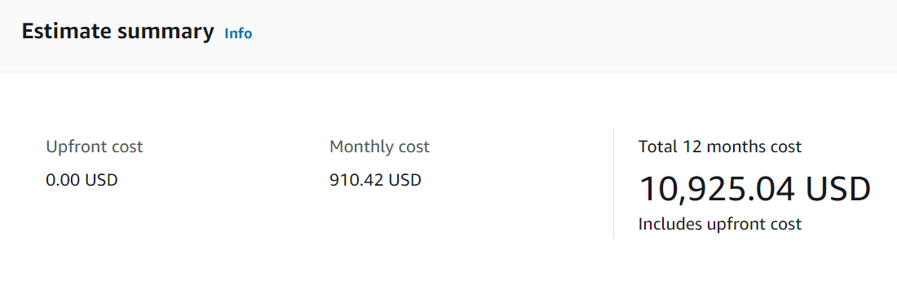
CLOUD ASSESMENT
Assess Cost
  AWS price calculator
    AWS -- EC2 Instance Savings Plans (a.k.a. Reserve Instances)
    Elastic Block Storage (EBS)

Slide 7
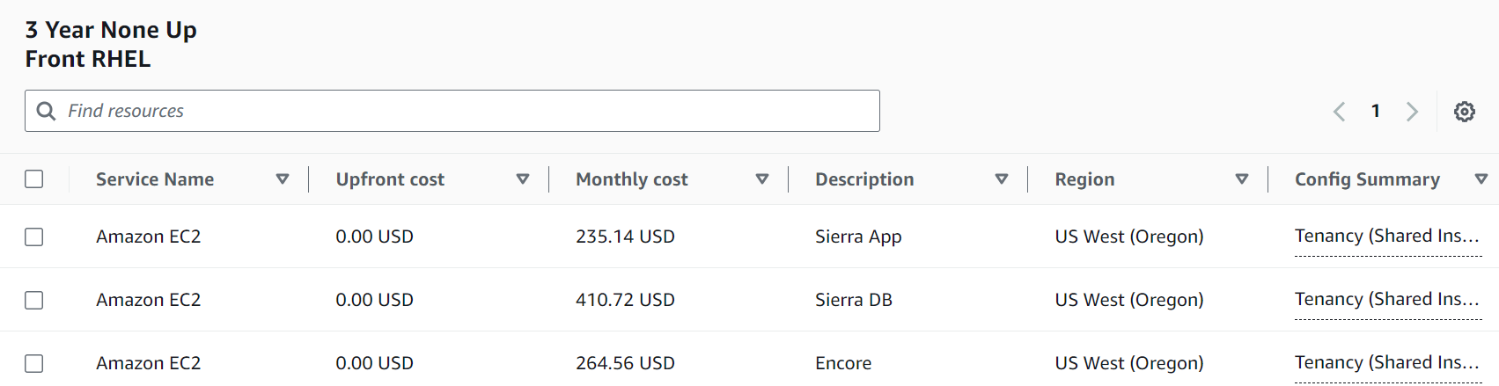
PRICE CALCULATOR

Slide 8
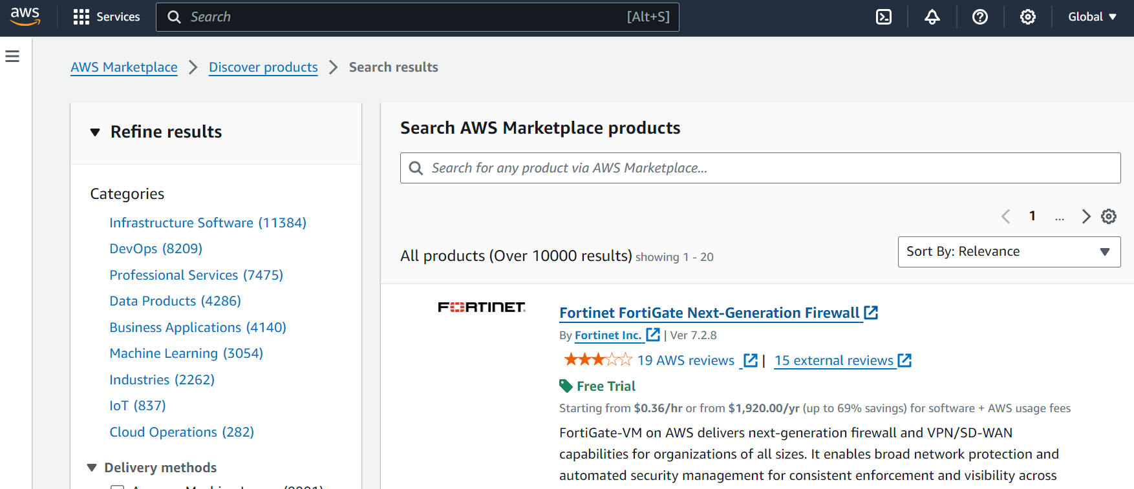
AWS MARKETPLACE

Slide 9
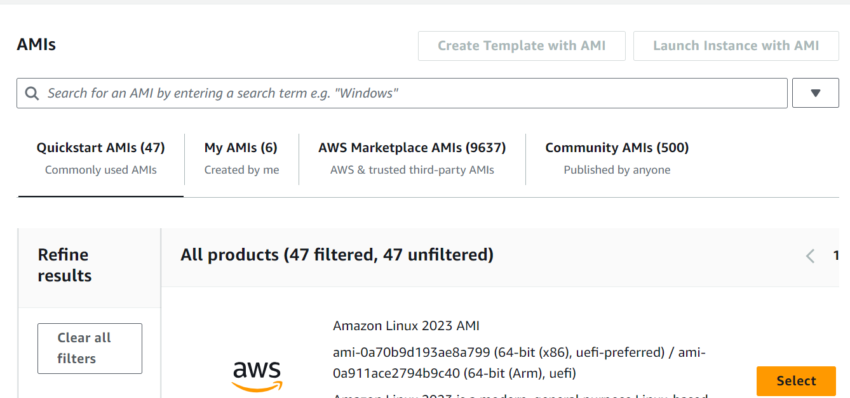
AWS MARKETPLACE: AMI CATALOG

Slide 10
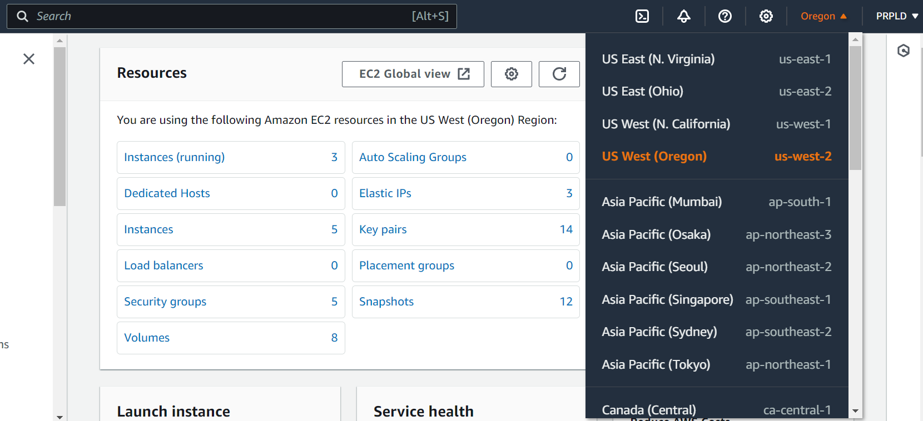
AWS REGION

Slide 11
CLOUD ASSESMENT: ARCHITECTURE
Assess Architecture
    AWS Console

Slide 12
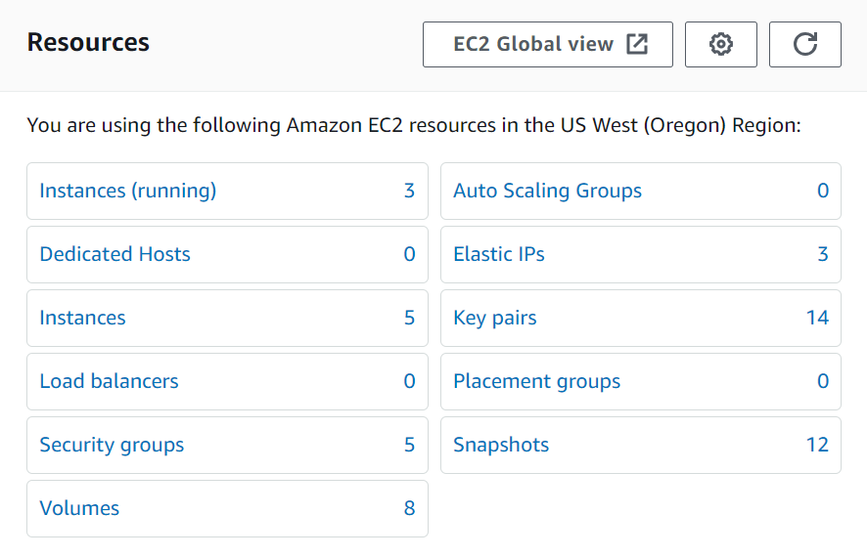
EC2 DASHBOARD

Slide 13
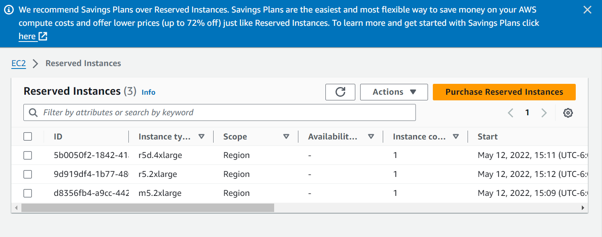
RESERVED INSTANCES

Slide 14
ELASTIC BLOCK STORAGE (EBS)

Slide 15
CLOUD ASSESMENT: SECURITY
  IAM
    An AWS Identity and Access Management (IAM) user is an entity that you create in AWS. The IAM user represents the human user or workload who uses the IAM user to interact with AWS. A user in AWS consists of a name and credentials.
    More information
  Security Groups
    A security group controls the traffic that is allowed to reach and leave the resources that it is associated with. For example, after you associate a security group with an EC2 instance, it controls the inbound and outbound traffic for the instance.
    More information

Slide 16
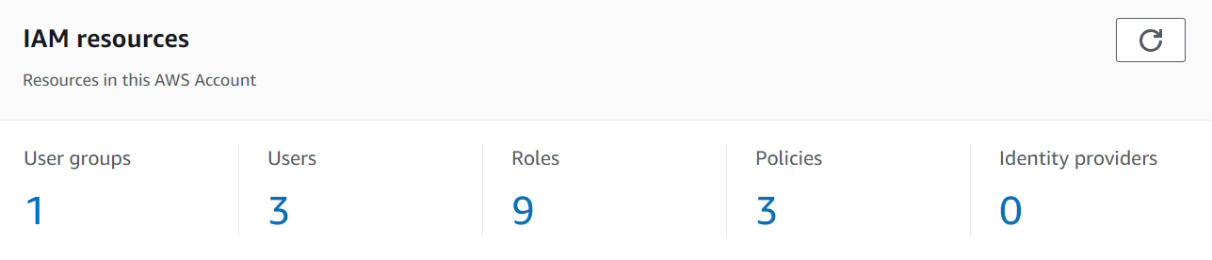
CLOUD ASSESMENT: SECURITY | IAM

Slide 17
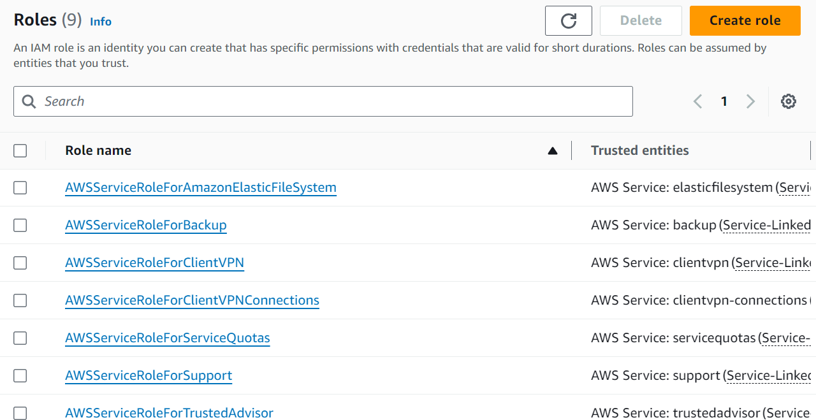
CLOUD ASSESMENT: SECURITY | IAM

Slide 18
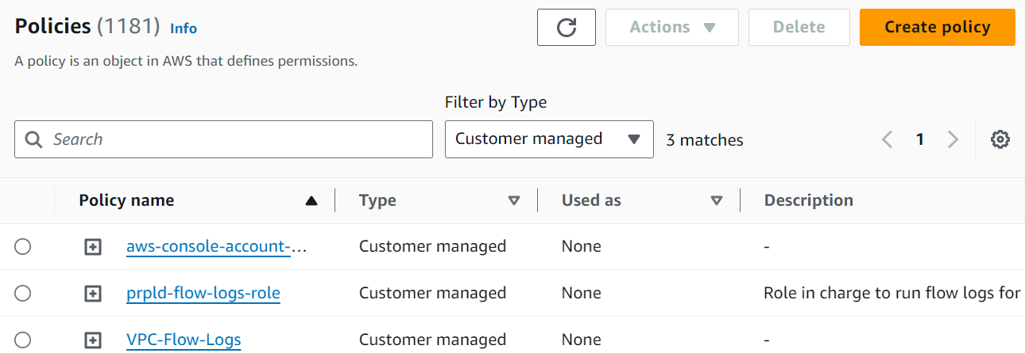
CLOUD ASSESMENT: SECURITY | IAM

Slide 19
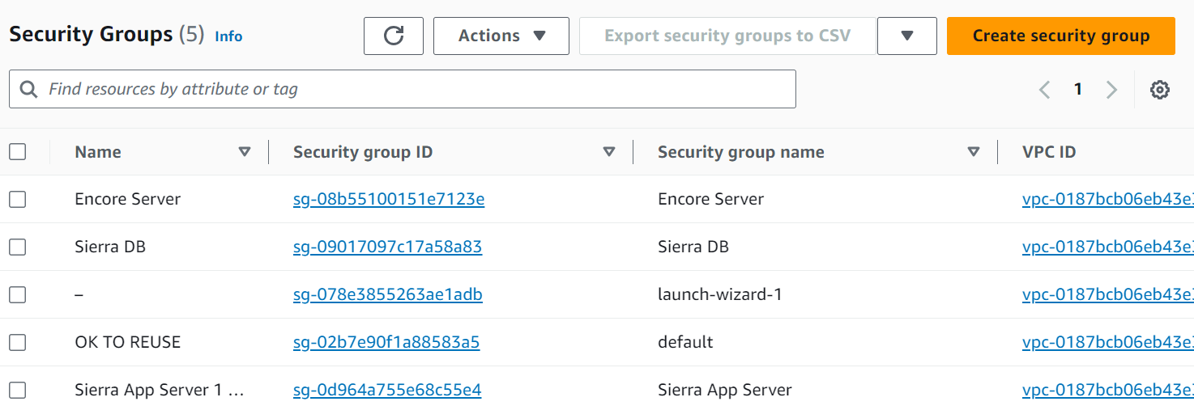
CLOUD ASSESMENT: SECURITY | SECURITY GROUP

Slide 20
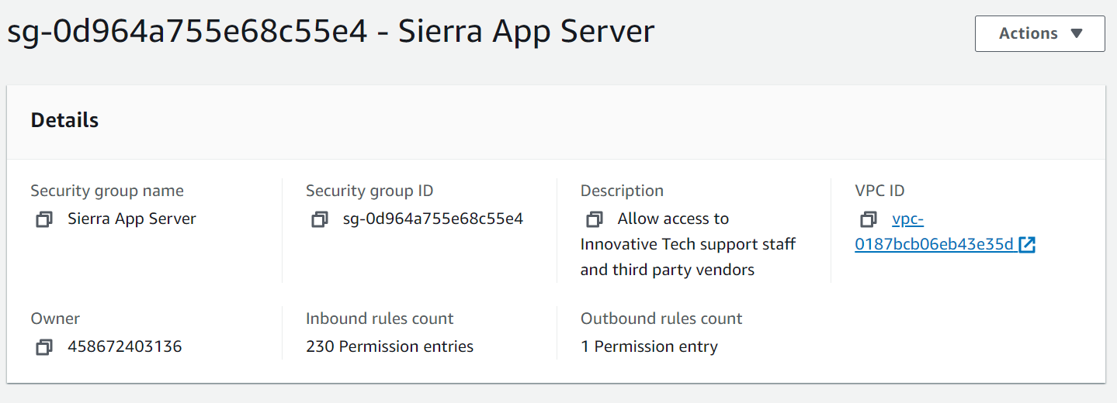
CLOUD ASSESMENT: SECURITY | SECURITY GROUP

Slide 21
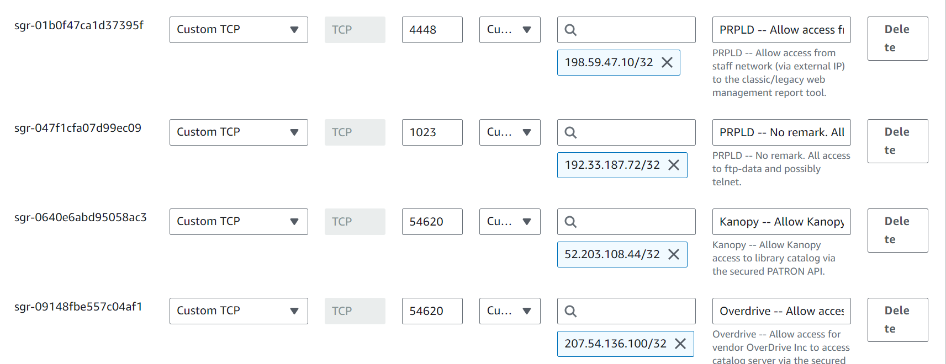
CLOUD ASSESMENT: SECURITY | SECURITY GROUP

Slide 22
PROOF OF CONCEPT
Learn AWS
Build a Pilot
Build Support within the organization

Slide 23
DATA/SERVER CONFIGURATION AND MIGRATION
Leverage different storage options
  Root volume vs. EBS volumes
Initial configuration
  Install all the necessary software utilities and dependencies on all 3 servers

Slide 24
APPLICATION MIGRATION
III migration specialist starts migrating the data from your system into the new servers.
  Typically, 3-5 hours
Strategy
  Once the data has been transferred over, III will start:
    Enabling the existing (or new) IP address on each server
    Testing communication between servers and their availability to patrons (i.e. Classic catalog, Discovery catalog, etc)
    Ensuring the application server can read/write back to the database server
    After the migration, we had to enable SIP2 93 Login Support feature for our Self-checkout machines (Express Lane) and AMH systems (3M/Bibliotheca)
      Libraries can use these messages to configure a SIP2 connection to use a valid, Innovative created SIP2 login bypassing the login configured by IP address in the Limit Network Access table. This workflow may be necessary for hosted sites as connections are routed through a single IP address which can cause SIP2 connections to be limited to using only one SIP2 login unless the 93/94 messages are used.

Slide 25
LEVERAGE THE CLOUD
Auto-scaling
Automation
Elasticity
High Availability
  Selection of a nearby region ensures faster response

Slide 26
OPTIMIZATION
Utilization
Monitoring
Efficiency
Performance
Snapshots (Backup)
  A snapshot is an incremental backup, which means that we save only the blocks on the device that have changed since your most recent snapshot. This minimizes the time required to create the snapshot and saves on storage costs by not duplicating data.

Slide 27
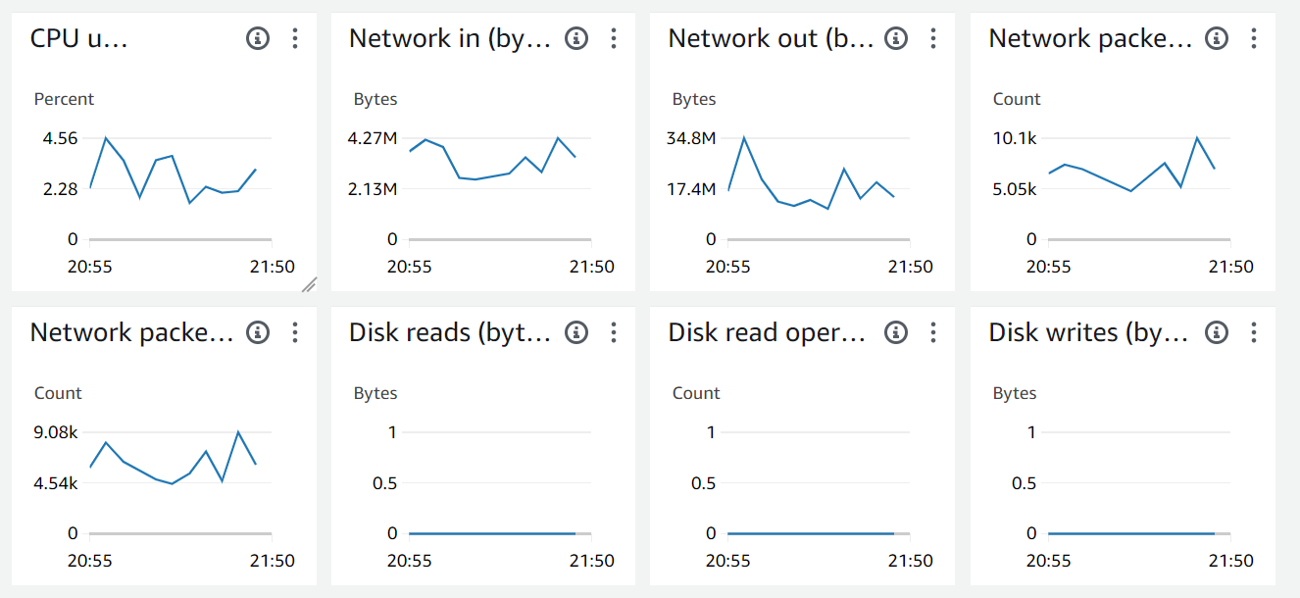
OPTIMIZATION: MONITORING

Slide 28
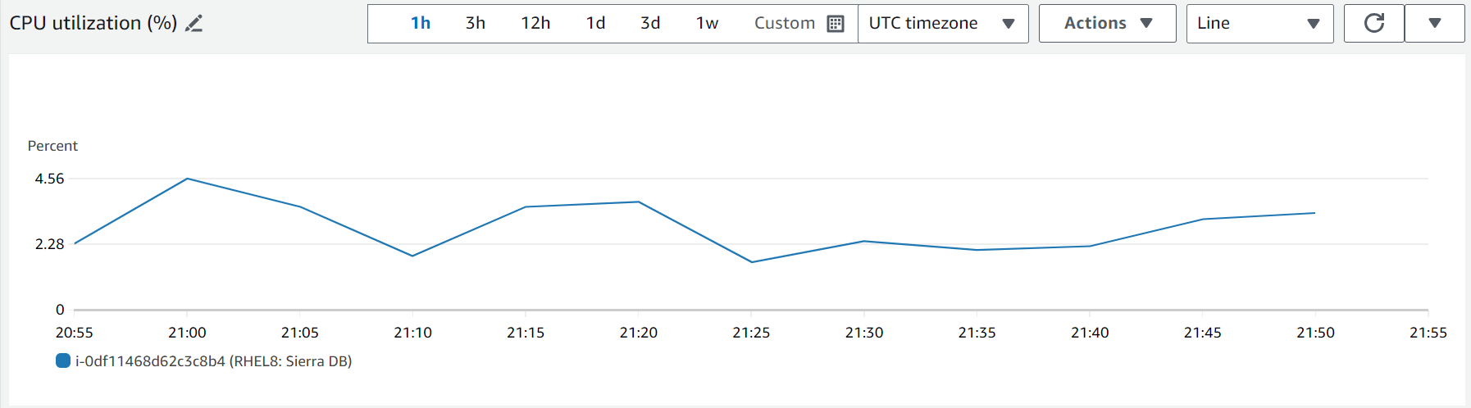
OPTIMIZATION: MONITORING

Slide 29
Lessons learned
If possible, allow yourself extra time to research and learn
Start early in the morning
In addition to email, make sure to exchange phone number with the migration specialist
Plan as much as possible but ready for the unexpected
  Issues will come up, make sure you have enough support
If you have self-checkout stations and/or AMH systems in your library coordinate ahead of time so additional vendors (other than Innovative) can be ready to assist you when the system comes back up

Slide 30
THANK YOU
Questions?
vzuniga@poudrelibraries.org

