Slide 1
Your Ideas
The Innovative and IUG Enhancements Processes
The Enhancements Leadership Team

Slide 2
The Enhancements Leadership Team
IUG
Innovative
Julie Cole (incoming)
Eleanor Crumblehulme (outgoing)
Sarah Frieldsmith (outgoing)
Katie LeBlanc (incoming)
Kathy Setter (outgoing)
Kat Cuff (Vega)
Mike Dicus (Sierra)
Gabrielle Gosselin (Polaris)
Samantha Quell (Polaris)

Slide 3
Outline
Part 1: Idea Exchange
All Innovative users add ideas to Idea Exchange.
All Innovative users vote for and prioritize ideas.
Part 2: Member Exclusive Enhancement Process (MEEP)
Workflow
Working Groups
Voting
Implementation

Slide 4
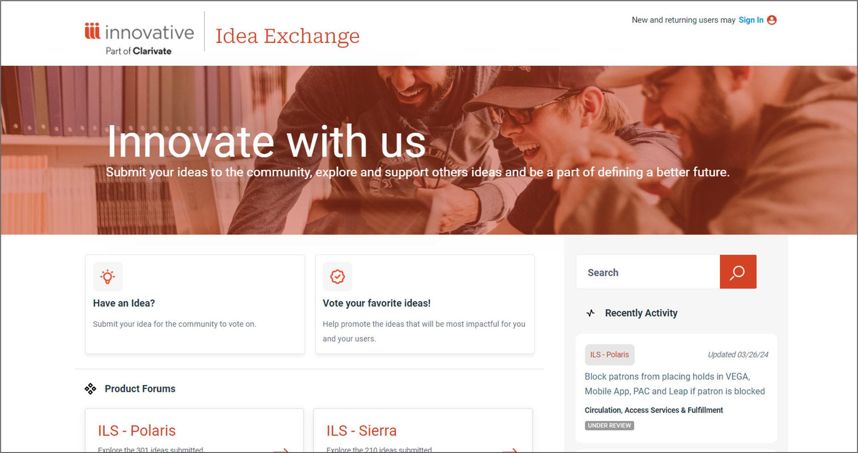
www.ideas.iii.com

Slide 5
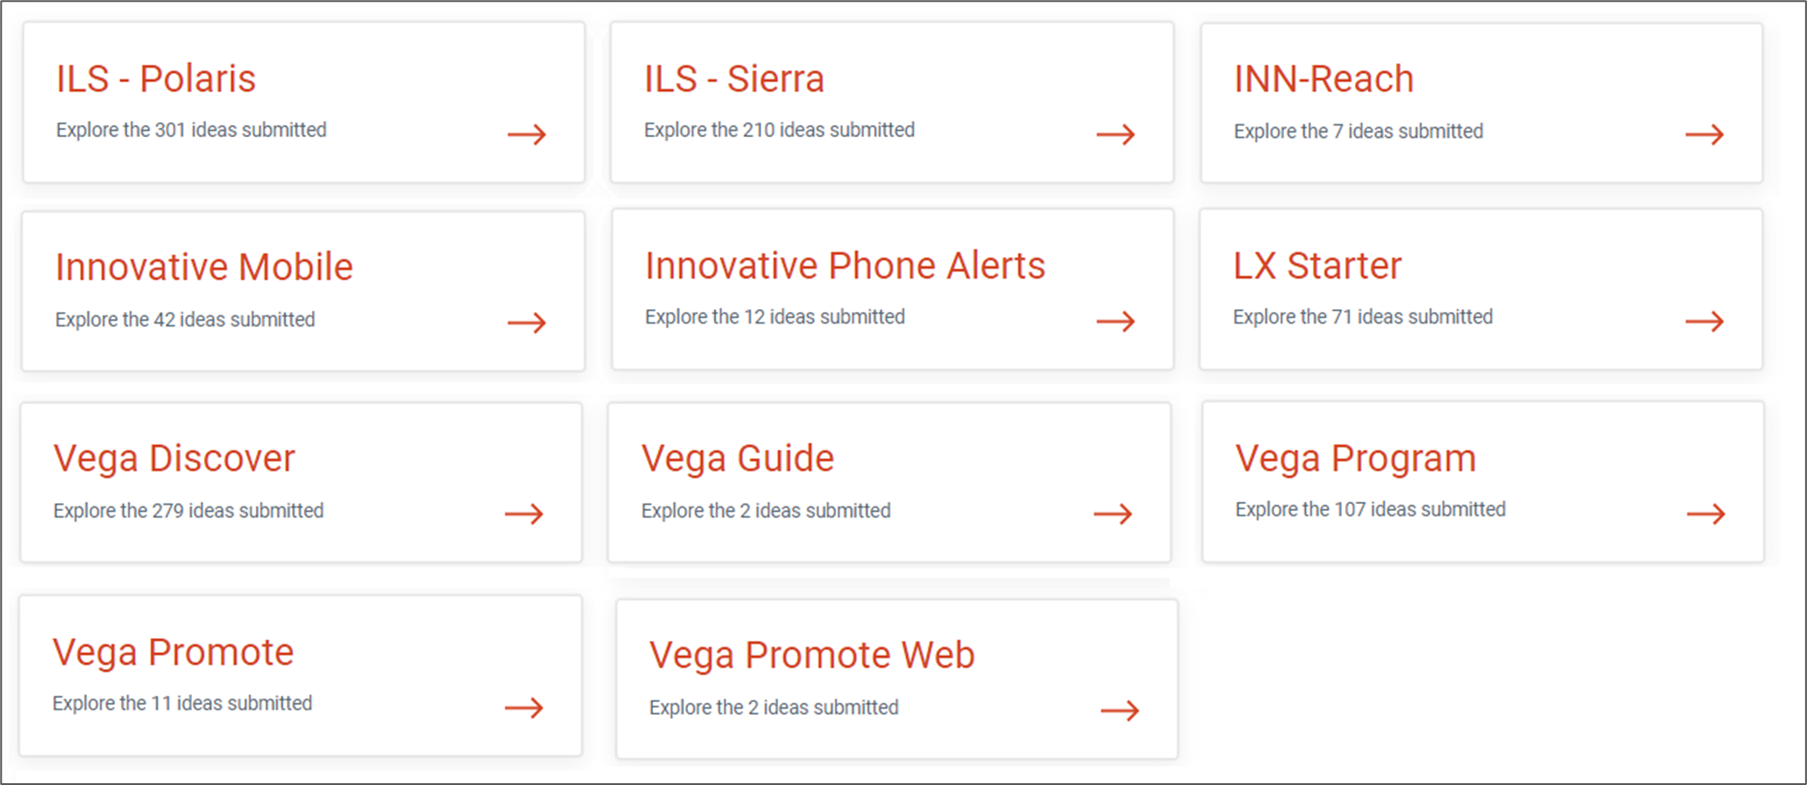
Forums

Slide 6
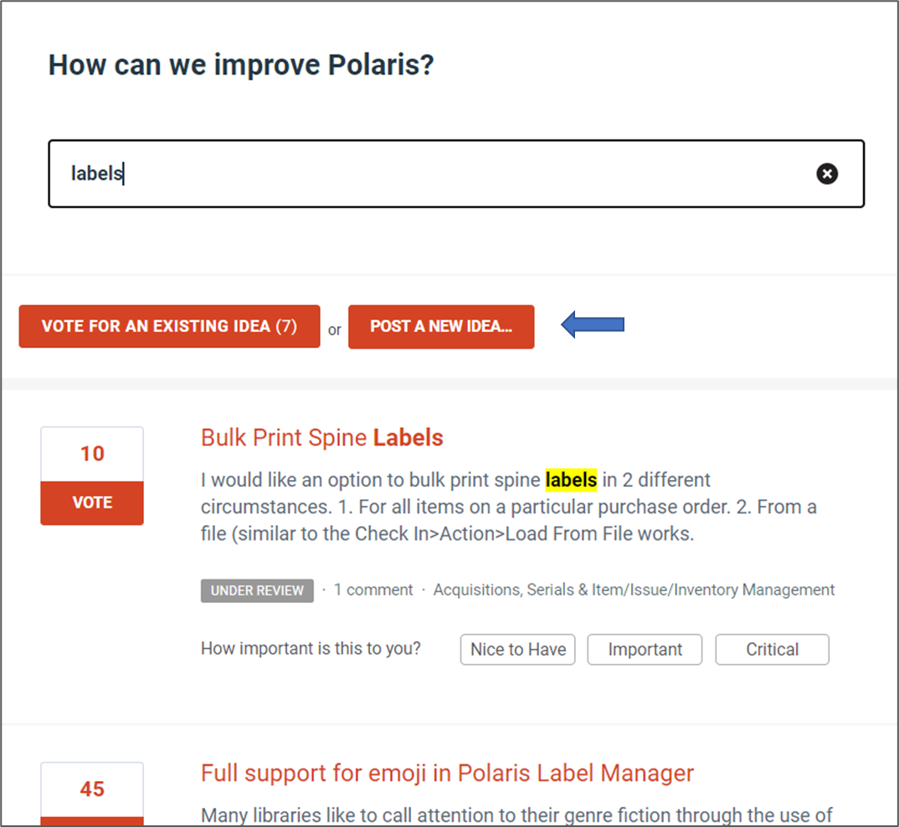
Submit an Idea
Search
Create

Slide 7
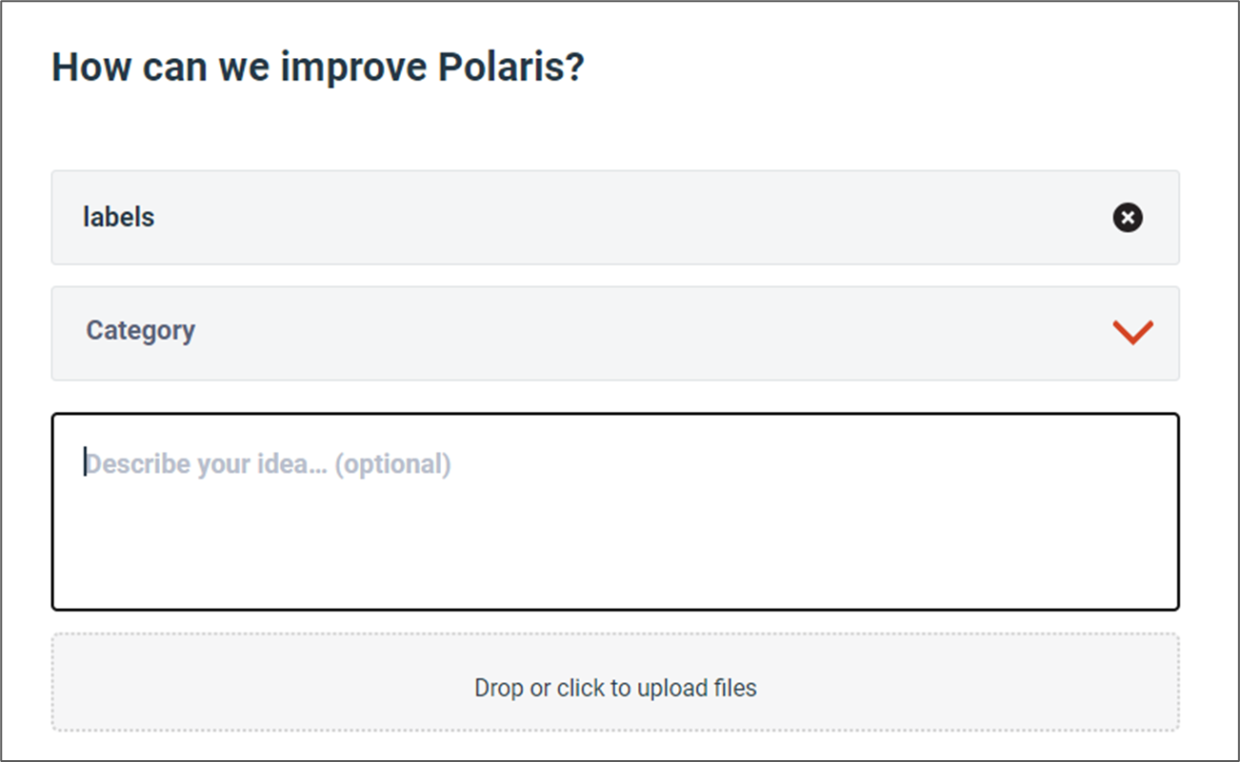
Submit an Idea

Slide 8
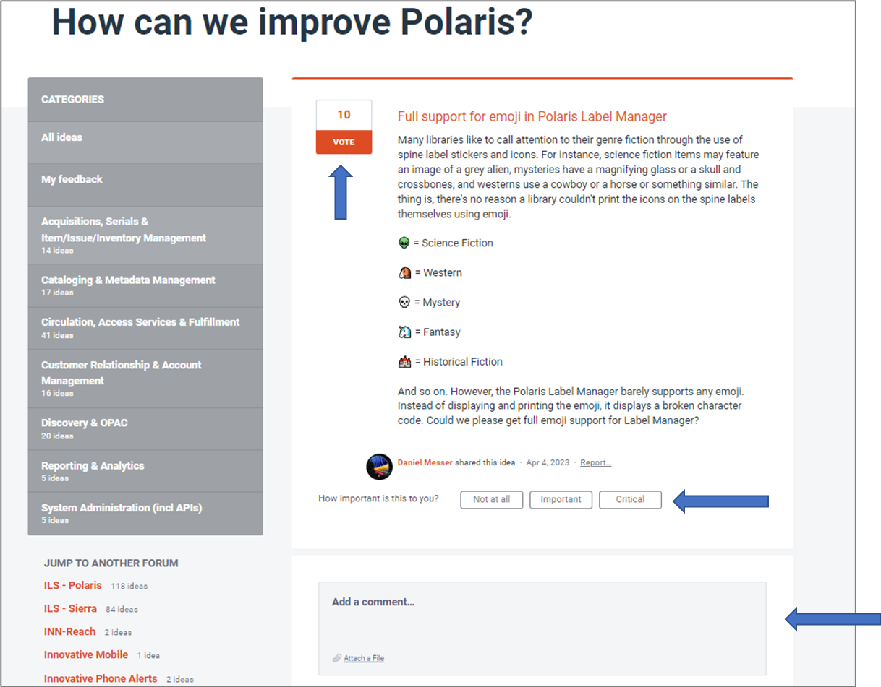
Support an Idea
Vote
Prioritize
Comment

Slide 9
MEEP
In December 2023, the Innovative Users Group (IUG) and Innovative, Part of Clarivate, announced an IUG Member Exclusive Enhancement Process.
Volunteer Working Groups are established for each product
Working Groups select candidate ideas per cycle and define the requirements
Product owners assign point values to each idea based on development effort; each annual cycle has a maximum number of points set aside for the winning ideas
IUG members vote to prioritize ideas for implementation
Innovative commits to deliver enhancements within 12 months
Product owners will follow-up with Working Groups to ensure each feature is implemented in a way that meets the requirements laid out in the selected idea

Slide 10
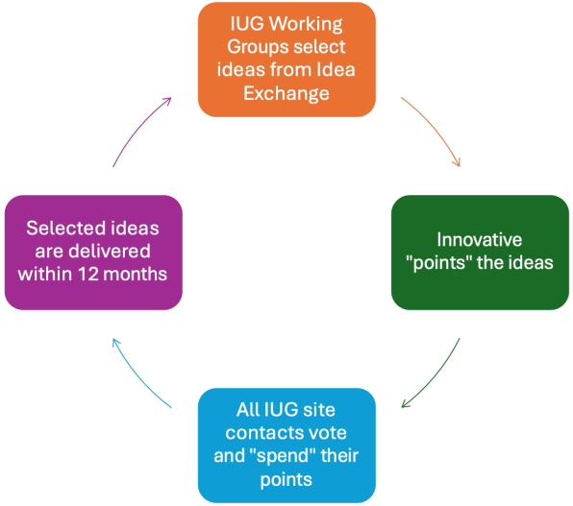
MEEP
Ideas are pulled from submissions by the IUG
community and prioritized by the community.
The Innovative product teams have input during the pointing process to ensure that the implementation of the winning ideas can be smoothly incorporated during their development process.

Slide 11
MEEP
There is a working group for each product covered by the MEEP agreement:
LX Starter
Polaris
Sierra*
Vega Discover
Vega Promote
*Sierra: Per Clarivate, the Sierra MEEP process will not include ideas related to the products listed below: Circa, Course Reserves, Decision Center, Encore, ERM, Express Lane, INN-Reach, Innovative Phone Alerts, Mobile Worklists, SMS Alerts, WAM, WebBridge Link Resolver, WebPAC.
However, related ideas can still be selected from Idea Exchange by product managers to include in the product roadmap.

Slide 12
MEEP
Each Working Group consists of 4-12 people.
Their jobs include:
Selecting ideas from Idea Exchange for the voting ballot
Submitting these ideas to their product contacts at Innovative for sizing
This process may involve consultation with the product contacts to help define ideas
Submitting the sized ideas to the IUG Steering Committee to be added to the ballot
Following the voting period, meeting with the product contacts to confirm the winning ideas
Meeting with the product contacts as during implementation to ensure the features meet the requirements laid out in the ideas

Slide 13
MEEP
2024/25 Working Group Members - Thank You!
LX Starter
Kevin French
Bob Gaydos
Eva Nottage
Kayla Payne
Betsy Raczkowsky
Gerald Reyes
Shannon Schmidt
Jeff Tate
Eric Young
Polaris
Lauren Arnsman
Anne Barnard
Katie Fearnley
Justin Megahan
Amy Mihelich
Susan Millwater
Nicole Murphy
Izzy Oneiric
Lynn Reynish
Erin Shield
Amy Spurrier
Jason Tenter
Sierra
Kimberly Allen
Rebecca Bealer
Shawn Farrell
Xumei Ge
Jeremy Goldstein
Matthew Hill
Adam Hornsey
Kristina Johnston
Phil Shirley
Pam Skittino
Nicole Turzillo
Elizabeth Wright
Vega Discover
Jennifer Briggs
Matthew Etzel
Eileen Keller
Celia Mulder
Alison Pruntel
Allison Sartwell
Steve Saunders
Elaine Sloan
Elizabeth Smith
Bill Taylor
Eric Young
Vega Promote
Michele Dimond
Jeff Garver
Kayla Payne
Julianne Smith

Slide 14
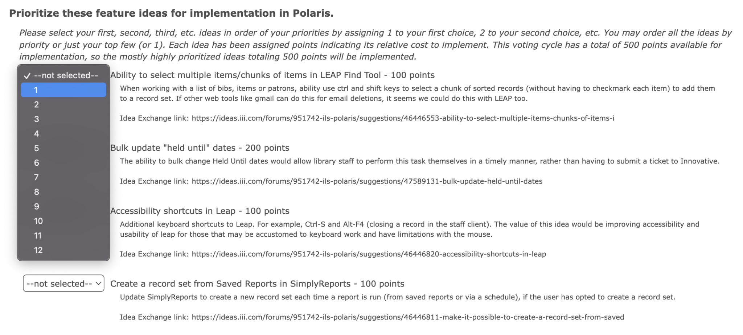
MEEP
The ideas that are selected by the working groups and sized by the product contacts are put to a vote by IUG members
The Site Contact for each IUG member organization receives an election ballot
Voters rank the eligible ideas according to their priorities

Slide 15
MEEP
The first MEEP voting cycle was completed recently for Sierra and the first Polaris vote has just started!
The winning ideas for Sierra 6.3 are:
Add record to list
Clear Jarcache files upon first run of the SDA after an upgrade
Create Lists to Global/Rapid Update button
Reduce time for patron record payment lock
The Sierra Working Group members will be starting another cycle of idea selection for 6.4 and 6.5 in a few months.
The voting for LX Starter, Vega Discover, and Vega Promote will be announced in the coming months.

Slide 16
MEEP
Enhancements Overview: https://www.innovativeusers.org/enhancements_overview.php
Idea Exchange FAQ: https://www.innovativeusers.org/idea_exchange_-_faq.php
MEEP Overview: https://www.innovativeusers.org/member_exclusive_enhancement_p.php
Contact the Enhancements Leadership Team at enhancements@innovativeusers.org
(Find all these resources at innovativeusers.org, under the Enhancements menu)

Slide 17
THANK YOU
Questions?

