Slide 1
Library Data Analysis Economy Class
Data analyzed by Selina Wang, Oberlin College
selina.wang@oberlin.edu
Software created by Glenn Manino
glennmanino@hotmail.com

Slide 2
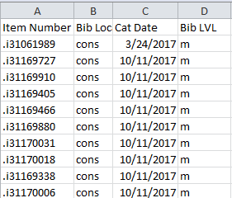
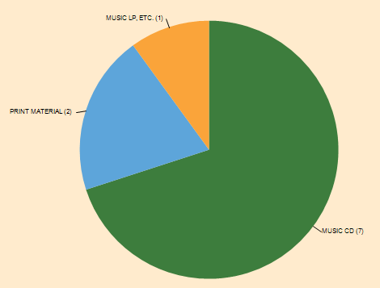
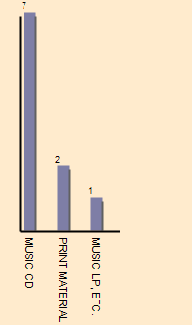
The Basic Process
MARC Records
Spreadsheet Format
Analysis
001 ssib019074118
003 WaSeSS
005 20180312092402.0
006 m d
007 cr n
008 180312s2010 ||||||||o|||||||| ||||| d
035 |a(WaSeSS)ssib019074118
040 |aWaSeSS|cWaSeSS|dWaSeSS
245 00|a"...and then she died"|h[electronic resource] :|bIndonesia Maternal Health Assessment /|cWorld Bank.
260 |a[S.l.] :|b[s.n.],|c2010.
300 |a1 online resource.
500 |aTitle from content provider.
506 |aLicense restrictions may limit access.
710 1 |aWorld Bank.
856 40|zClick here for full
Use Innovative Export Tables, b2mtab and b2mtab-pur, to add Bib, Item and Order records to MARC File
Use MarcExtract or other tool to build spreadsheet from MARC
Use OBLIque or other methods to analyze spreadsheet and create reports

Slide 3
Sample Charts
Several sample charts follow.
These were created using MarcExtract to convert MARC files to spreadsheet format. OBLIque was then used to analyze the spreadsheet data.

Slide 4
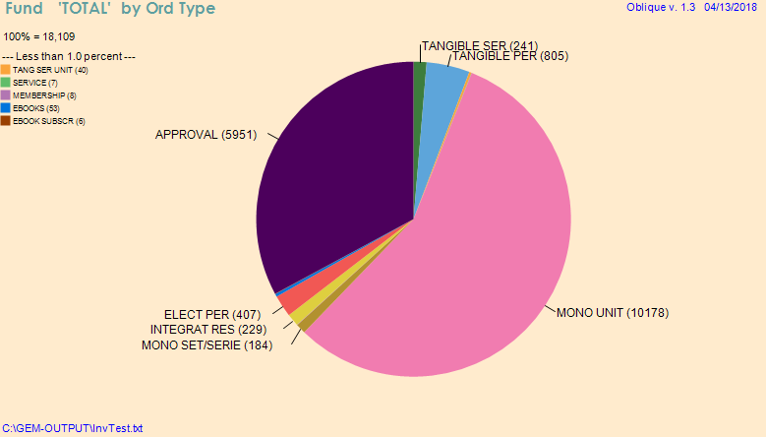
Fund by Order Type

Slide 5
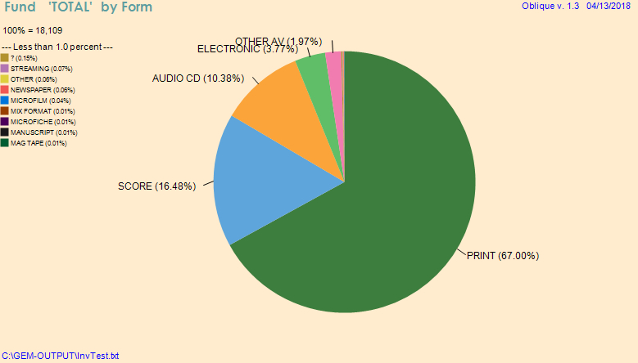
Fund by Form

Slide 6
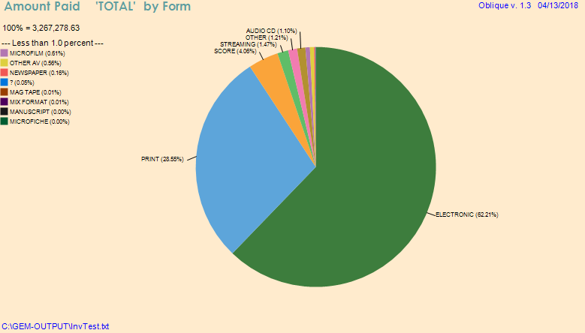
Expenditure by Form

Slide 7
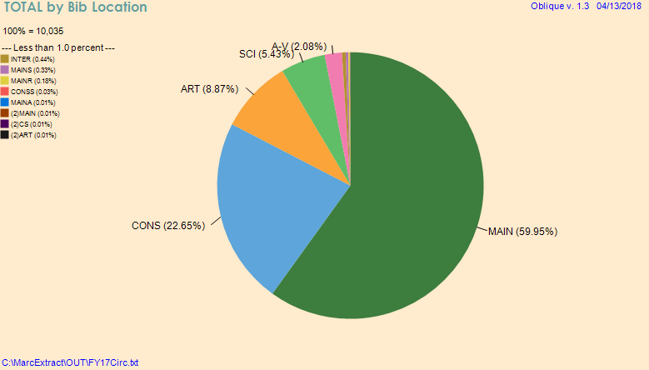
Total Checkouts by Bib Location

Slide 8
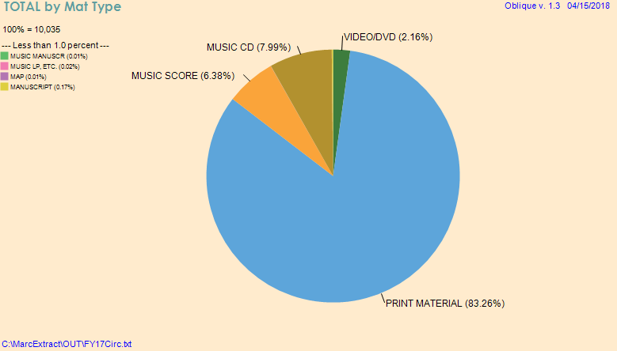
Total Checkouts by Material Type

Slide 9
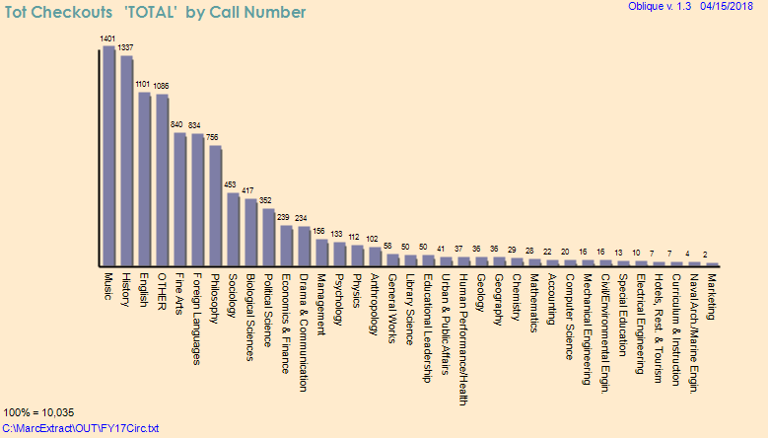
Total Checkouts by Subjects

Slide 10
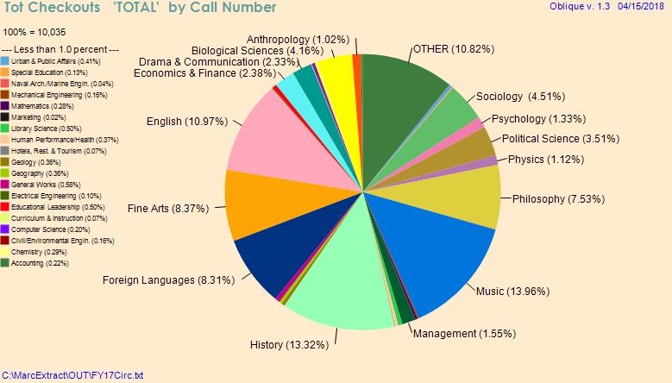
Total Checkouts by Subject (%)

Slide 11
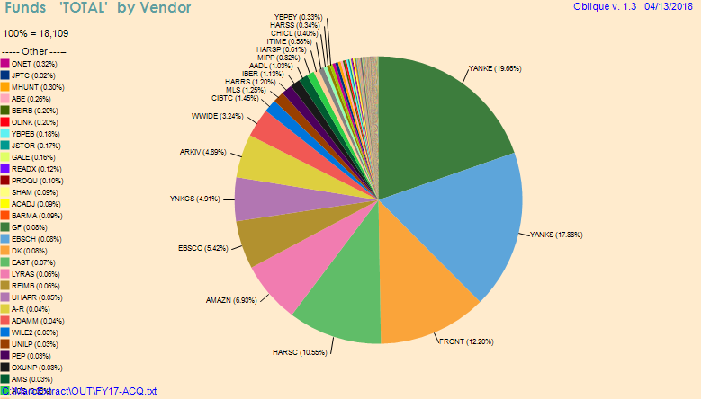
Fund by Vendor

Slide 12
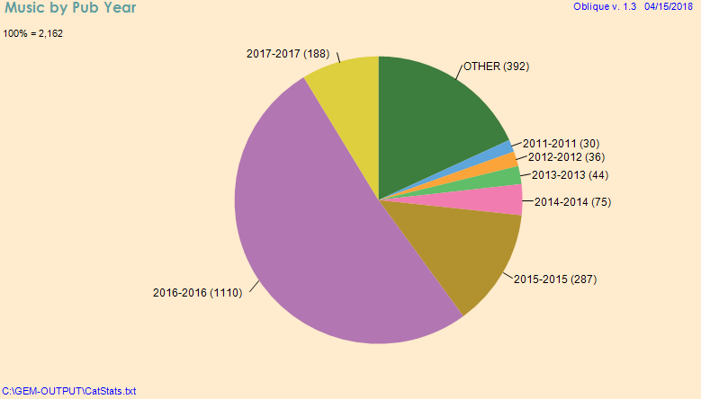
Music Items Cataloged by Pub Year in FY17

Slide 13
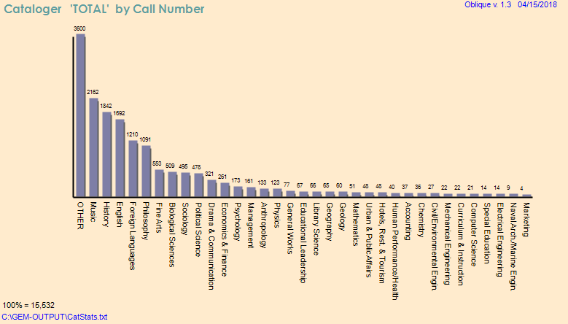
Total Cataloged by Subject in FY 17

Slide 14
Downloads:
OBLIque1.3i version:
https://oberlincollegelibraries.box.com/s/pljjzqbvexwmk0hcls6ap0fv508xy2mm
MarcExtract1.2i version:
https://oberlincollegelibraries.box.com/s/9ebl6us65tjwtra1q7lrf5m1pbckaur0
MarcExtract1.3i version:
https://oberlincollegelibraries.box.com/s/nmf89v75r2ngjybscbcwak0yvqkxvrq1

Slide 15
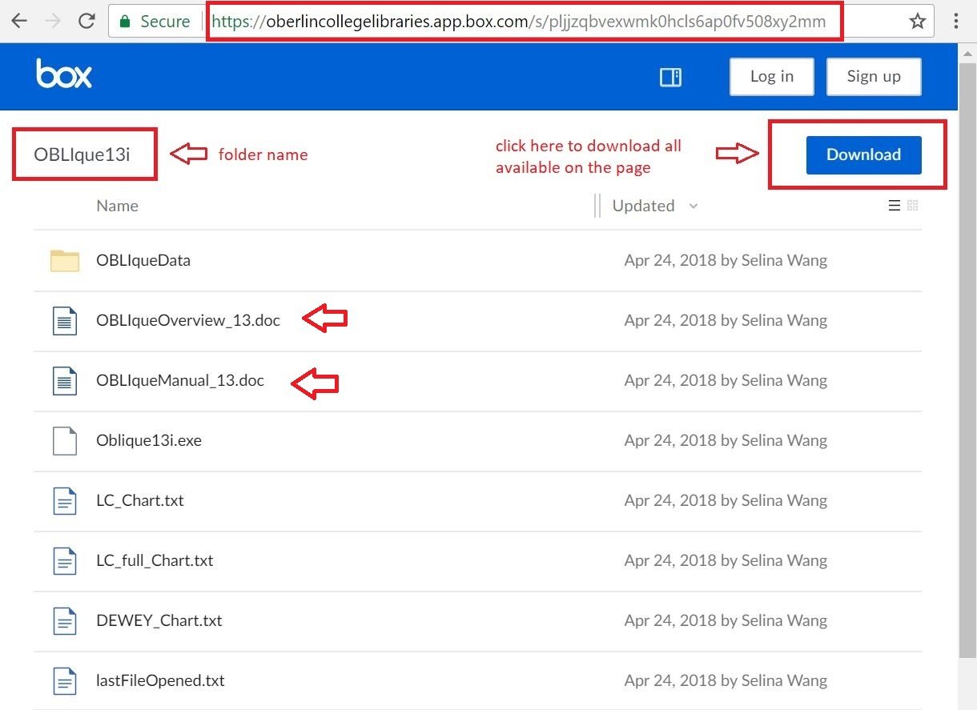
OBLIque Download Page

Slide 16
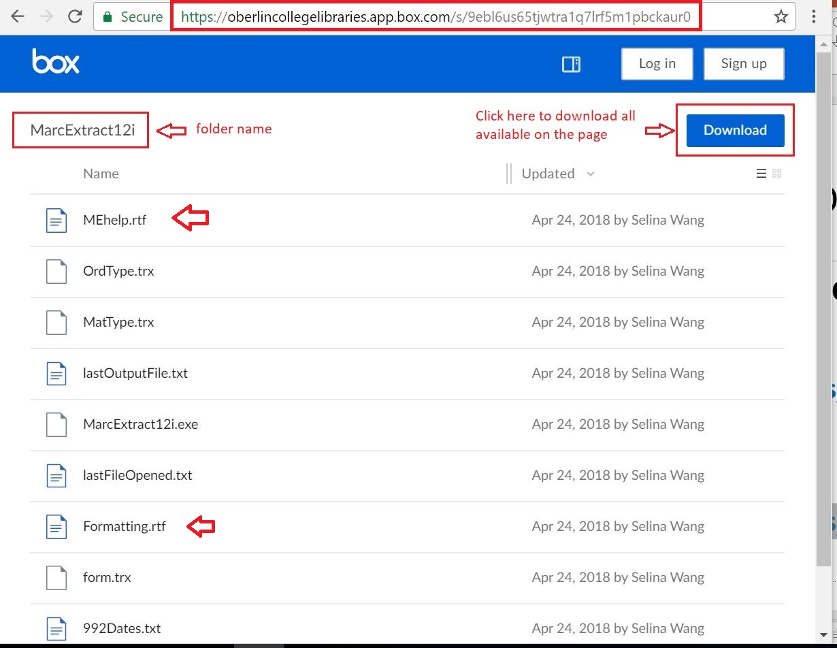
MarcExtract Download Page

Slide 17
Installation Instructions - 1
For MarcExtract1.2i or 1.3i:
Download the MarcExtract12i or 13i folder;
When done, open the folder and locate the marcextract12i.exe file;
Make a shortcut to this file and drag it to the desktop.
MarcExtract allows you to read two help files from the main window:
Click “General” to see an overview of MarcExtract.
Click “Formatting” for help on using formatting commands that allow you to modify the data that is returned from your MARC files.
The files MEhelp.rtf and Formatting.rtf can be printed (with Word or Wordpad) to obtain a hard copy of the instructions.

Slide 18
Installation Instructions - 2
For OBLIque1.3i:
Download the OBLIque13i folder;
When done, open the folder and locate the Oblique3i.exe file;
Make a shortcut to the file and drag it to the desktop.
There are two .doc files that provide instructions for using OBLIque.
Read OBLIqueOverview_13.doc first for the big picture.
Read ObliqueManual_13.doc for more comprehensive instructions.

Slide 19
Questions or comments:
glennmanino@hotmail.com
OR
selina.wang@oberlin.edu

