Slide 1
APIs and the Discovery Layer:
Streamlining workflows for patrons and staff
Kelly Kobiela, Marquette University
kelly.kobiela@marquette.edu
Notes:
Disclaimer – not on technological aspects of APIs

Slide 2
Background
Marquette University
  Private Jesuit University
  8,400+ undergraduates, 3,200 graduate
  83 majors, 68 doctoral and masters programs
  30 librarians, 30 staff
    5 person Library IT team
I started at Marquette University as Systems Librarian in February 2018
When I started, work on one of our APIs had already been started
Notes:
Ask the audience: Who is using APIs

Slide 3
A Tale of Two APIs
Patron Functionality API
  Connects EBSCO Discovery Service to Sierra
    Place holds/requests
    Renew from EDS
EDS Harvesting API
  Harvests our catalog into EDS
    Take over weekly manual process

Slide 4
Patron Functionality API
Original workflow to put holds on books from EDS
  Search for the book in EDS
  Click on item link to catalog
  Click on Request
  Log into Sierra account
Desired workflow
  Search for book in EDS
  Click Request
  Log into account

Slide 5
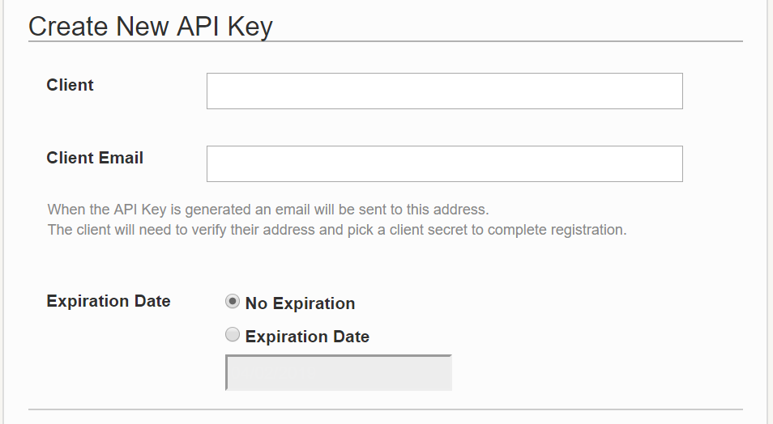
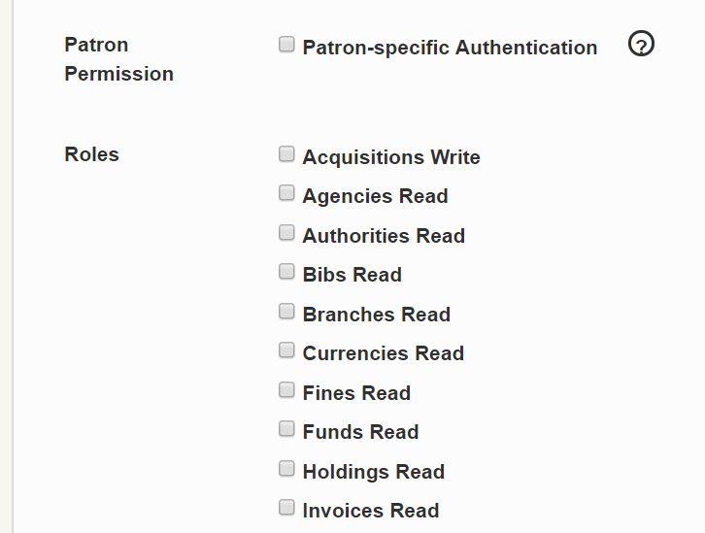
Patron Functionality API
Worked started on this API in Mid-2017
Holds only turned into all patron functionality
A lot of the work has been done by III and EBSCO
They needed: Sierra API Key for EBSCO, our catalog URL, test credentials and examples

Slide 6
Patron Functionality API
First roadblock
  We used to have Encore
  The Sierra API was redirecting to our old Encore URL
  We worked with III; they cleaned up all references to Encore
Second roadblock
  API only worked with Title-level holds
  We had Item-level holds

Slide 7
Patron Functionality API
Largest part of the project – switching from Item-level to Title-level holds
  Had to coordinate main library and Law library
    Law library had not done holds before
  Had to coordinate with semester schedule
  Actual work to change = very easy
  Work involved to make sure everything works = so much time
The API still has a lingering issue with bib vs item record numbers for titles where both libraries own a copy
Notes:
https://search.ebscohost.com/login.aspx?authtype=uid&user=aup89&password=UNWI105093&custid=s6222150&profile=pef

Slide 8
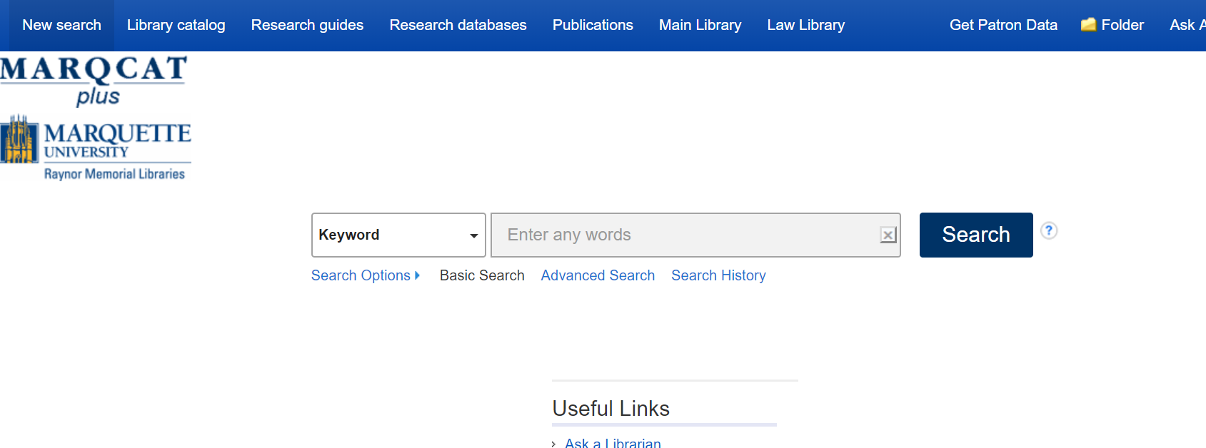
Patron Functionality API

Slide 9
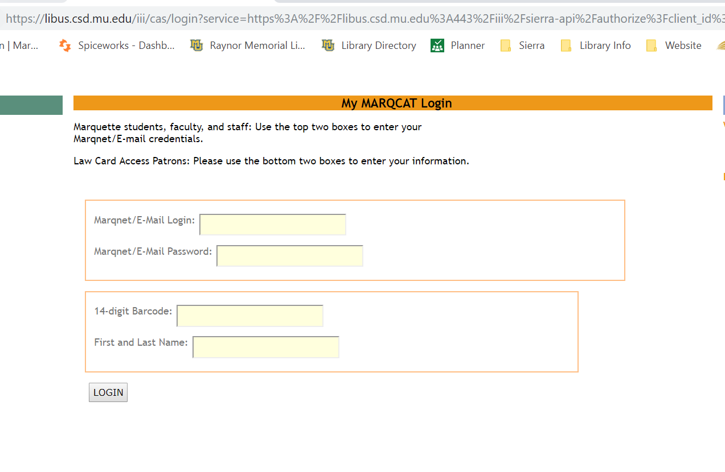
Patron Functionality API

Slide 10
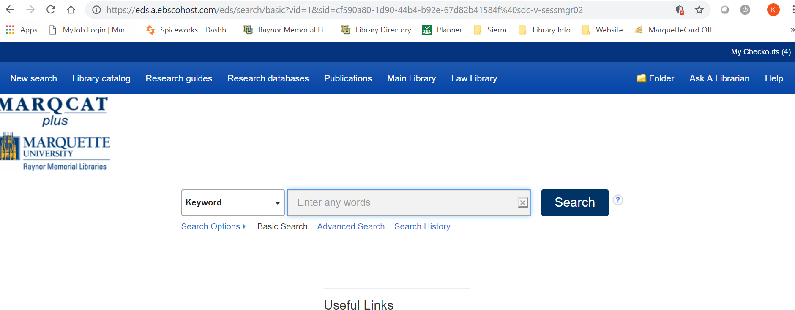
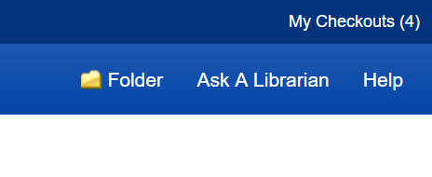
Patron Functionality API

Slide 11
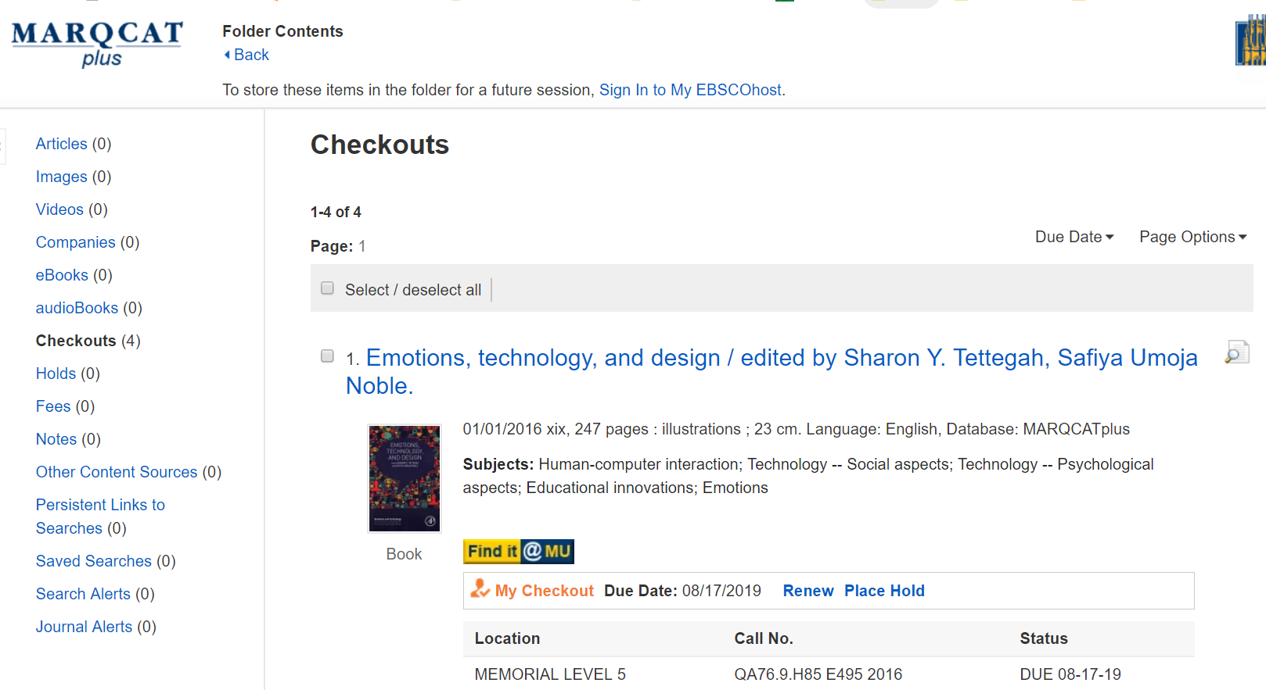
Patron Functionality API

Slide 12
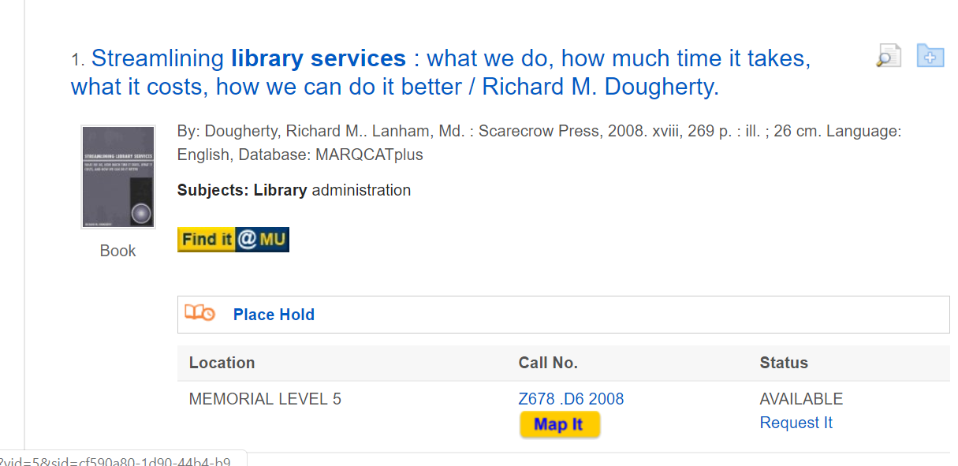
Patron Functionality API

Slide 13
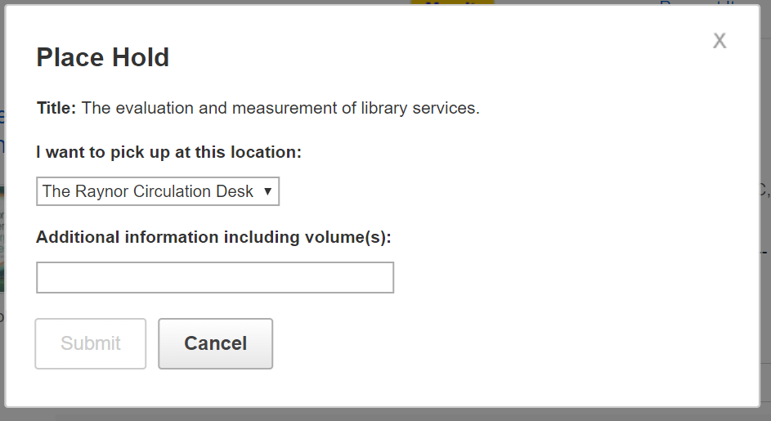
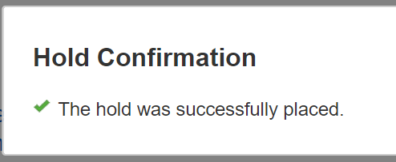
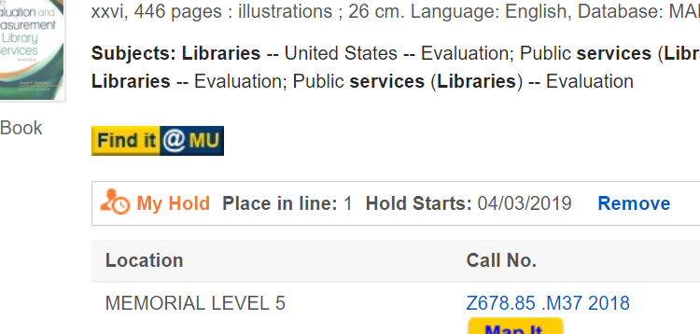
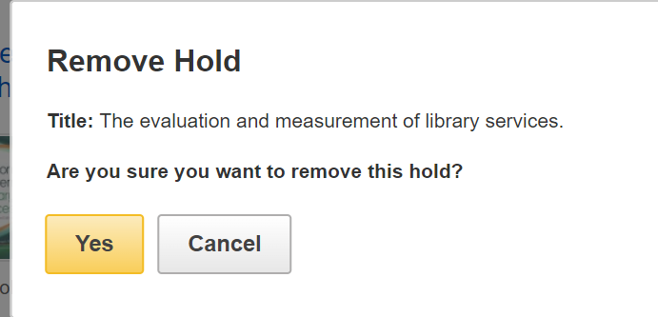
Patron Functionality API

Slide 14
Patron Functionality API
Not active to patrons yet
What is still not working?
  In cases where both libraries own a copy, the hold is not being placed
    III has not been able to replicate this error on their end
    They are testing within our catalog now
The good news
  We have a request it button in the RTAC box that works
    It sends patrons over to WebPac
  It forced us to move to Title-level holds

Slide 15
Harvesting API
Current Workflow: Every week we send an update to EBSCO
  Additions
  Deletions
    Item record is marked with a D in a special field
  Changes
Yearly/multiple times a year full loads
We had expressed an interest in trying out Harvesting our catalog into EDS when it was mentioned as a possibility
We were contacted by EBSCO to beta test

Slide 16
Harvesting API
Since we already had our catalog in EDS, we just had to update some information instead of going through the entire questionnaire
  Normal EDS custom catalog questionnaire
  Had phone call with EBSCO to confirm our lookup table and URL fields
Also needed API key, etc. as above
Our Cataloger, Calli Neumann did most of the work for this
  She was the person doing the weekly loads
  As a cataloger, she knew all the fields we needed

Slide 17
Harvesting API
First roadblock
  Our output tables did not work
    Cannot edit own export tables
    EBSCO worked with iii
Second roadblock
  The harvester ran into an error with one bib record, which caused it to fail
    No one could find anything wrong with that record
    EBSCO made an enhancement to skip records with errors

Slide 18
Harvesting API
We made it to testing phase
  EBSCO tested and notified us that our testing would happen
However…EBSCO decided not to release the Harvesting API widely
  They told us that we would be able to use it
  It did not have the scaling capabilities needed to be rolled out
And then….

Slide 19
Harvesting API
We got an email from EBSCO asking if we would be interested in beta testing a EDS Harvesting API
After confirming that we were already doing that…
Within two weeks the III Harvester was added to our EDS test profile and is working

Slide 20
Harvesting API
Test searching is working well
Some clarifications we confirmed:
  Full harvest will occur once a week
  Daily incremental harvests will happen
  Withdrawn items will be removed in the full harvest
Still waiting to confirm what codes will be used to determine withdrawn items

Slide 21
Lessons Learned
I had to continually check in with EBSCO to get updates
  Every time I asked, they said they had still be working on it, but no proactive updates were really given to us without asking for them
  Only got emails when there was a problem
  Work WAS being done – I just wanted more communication
Changing from item-level to title-level holds is MUCH harder that it looks on paper
  Maybe not as difficult with only one branch/library
  We ran into seemingly every problem under the sun

Slide 22
Lessons Learned
Managing expectations is vital
Whatever level of communication you are doing, do more!
  At one point I started checking in with circ staff every day on issues with holds instead of waiting for them to bring problems to me
These processes made me want to jump more into APIs
  Especially ones we do ourselves so we have more control

