Slide 1
Summer in the Stacks: Our Joint Efforts on Weeding
Missouri Southern State University
Hong Li
Technical Services Librarian
Kayla Reed
Access Services Librarian

Slide 2
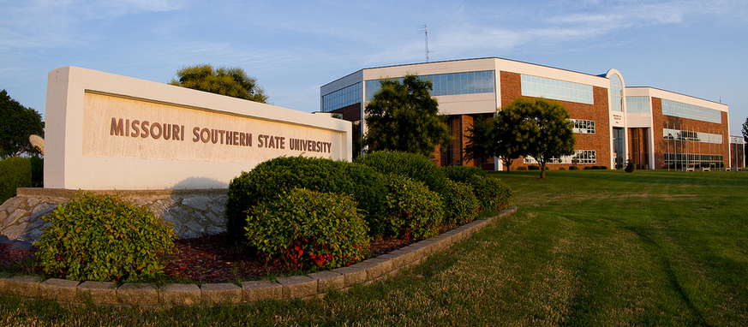
Missouri Southern State University
Missouri Southern State University (MSSU) is located in Joplin, Missouri
MSSU has four schools with nearly 140 academic programs leading to both undergraduates and graduates degrees, and an enrollment of over 6,000 students​
MSSU has an estimated 200 faculty members​

Slide 3
George A. Spiva Library
Medium-sized academic library, a MOBIUS Consortium member​
Sierra (ILS), Summon (discovery tool), Intota (ERM), LibGuides, and A-Z Database list​
Over 20 different collections stored in a four-floor building​
Over 360,000 items in various formats (books, periodicals, microforms, and multimedia)
Online resources including 500+ databases, 400,000+ e-books (ProQuest Ebook Central, EBSCO, JSTOR Open Access, OverDrive, Sage, etc. and thousands of e-journals

Slide 4
De-selection @ MSSU Library
Part of the Library Collection Development Policy
De-Selection Process:
“It is the responsibility of school deans and department chairs, as part of their allocation fund, to ensure that faculty work with library staff to deselect items from the library collection in their teaching/research areas prior to program review or accreditation visit.”
De-Selection Procedure
Library staff will contact department chairs and teaching faculty to discuss the de-selection policy and address concerns and questions.
Library staff will remove materials and place them on a cart for withdrawal.
Last major weeding occurred to main collection was due to a tile replacement project in 2013. Hundreds of damaged materials were deselected.

Slide 5
The start of the Liaison Program
In 2018 the library formed a Liaison Program and a matching committee.
Each librarian assigned departments.
Libguide created: http://libguides.mssu.edu/LiaisonProgram
Everyone agreed that Faculty should help with review and de-select….but how do we get them over here?
Guess we’ll just never weed.

Slide 6
Introduction of Summer in the Stacks

Slide 7
An idea from the Liaison Program Committee
What does everyone want more of……
The committee decided to offer extra funds to faculty who weeded their collections, with the specific focus on departments that were under review.
$25 per hour up to 20 hours per department. Can be divided between faculty​ members.
2 initial departments (English and Kinesiology) were chosen to test this idea….

Slide 8
Workflow between Subject Liaisons and faculty members
Librarians created a list of items based on the agreed de-selection criteria
Publication dates
Checkout stats
Physical condition
Librarians shared the modified spreadsheet with the faculty members to give them a heads-up

Slide 9
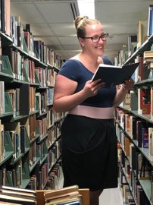
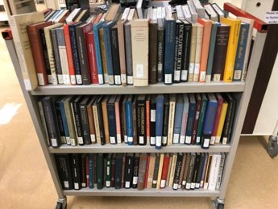
Shared responsibilities
Initial lists indicated which books got put on carts, which were sent to Technical Services Department (TS) for withdrawing
Faculty members browsed the book carts in TS and made final decisions on the weeding items
Faculty came to the main collection and reviewed the rest of the books in the stacks.

Slide 10
Results:
Over 3600 books pulled from the P's for English​
3 total faculty members weeded 3 different sections​, spending a total of 20 hours in the stacks.
At least 5-600 items faculty pulled for being obsolete to the curriculum.
Kinesiology Subject Librarian removed 469 items with publication dates older than 10 years with ZERO checkouts from GV call number ranges​
5 Faculty members pulled an additional 266 items deemed obsolete or no longer relevant to current curriculum
Faculty didn’t necessarily want lists. Most preferred just going to the stacks and pulling.
More departments wanted in! History joined in and withdrew……

Slide 11
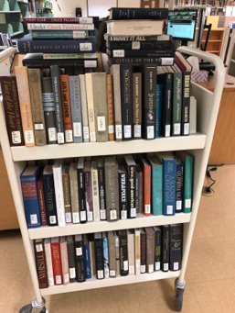
Withdrawal Process in Technical Services Department

Slide 12
Work procedures within the Technical Services Department
May 13, 2019, first day starting withdrawing books
Records withdrawn in the library’s ILS, Sierra
Created a macro for the TS student to work independently
Assigned appropriate permissions to allow the student to edit records as needed (e.g., check-in, bib, order record)
Trained the student to get her familiar with the weeding process
Explained the weeding policy to the student as needed (e.g. last copy policy)
Required reporting any problems in a timely manner
Quality control of the withdrawn records and fixed errors to ensure the integrity of the library database
Global update
Weekly EBS batch input reports
Authority work as necessary

Slide 13
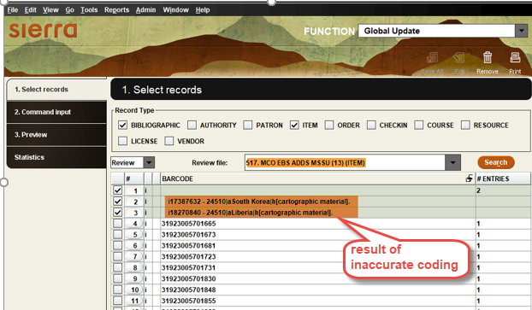
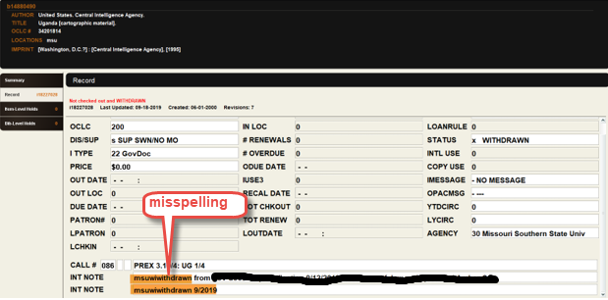
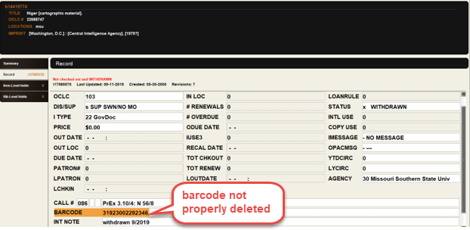
Examples of errors

Slide 14
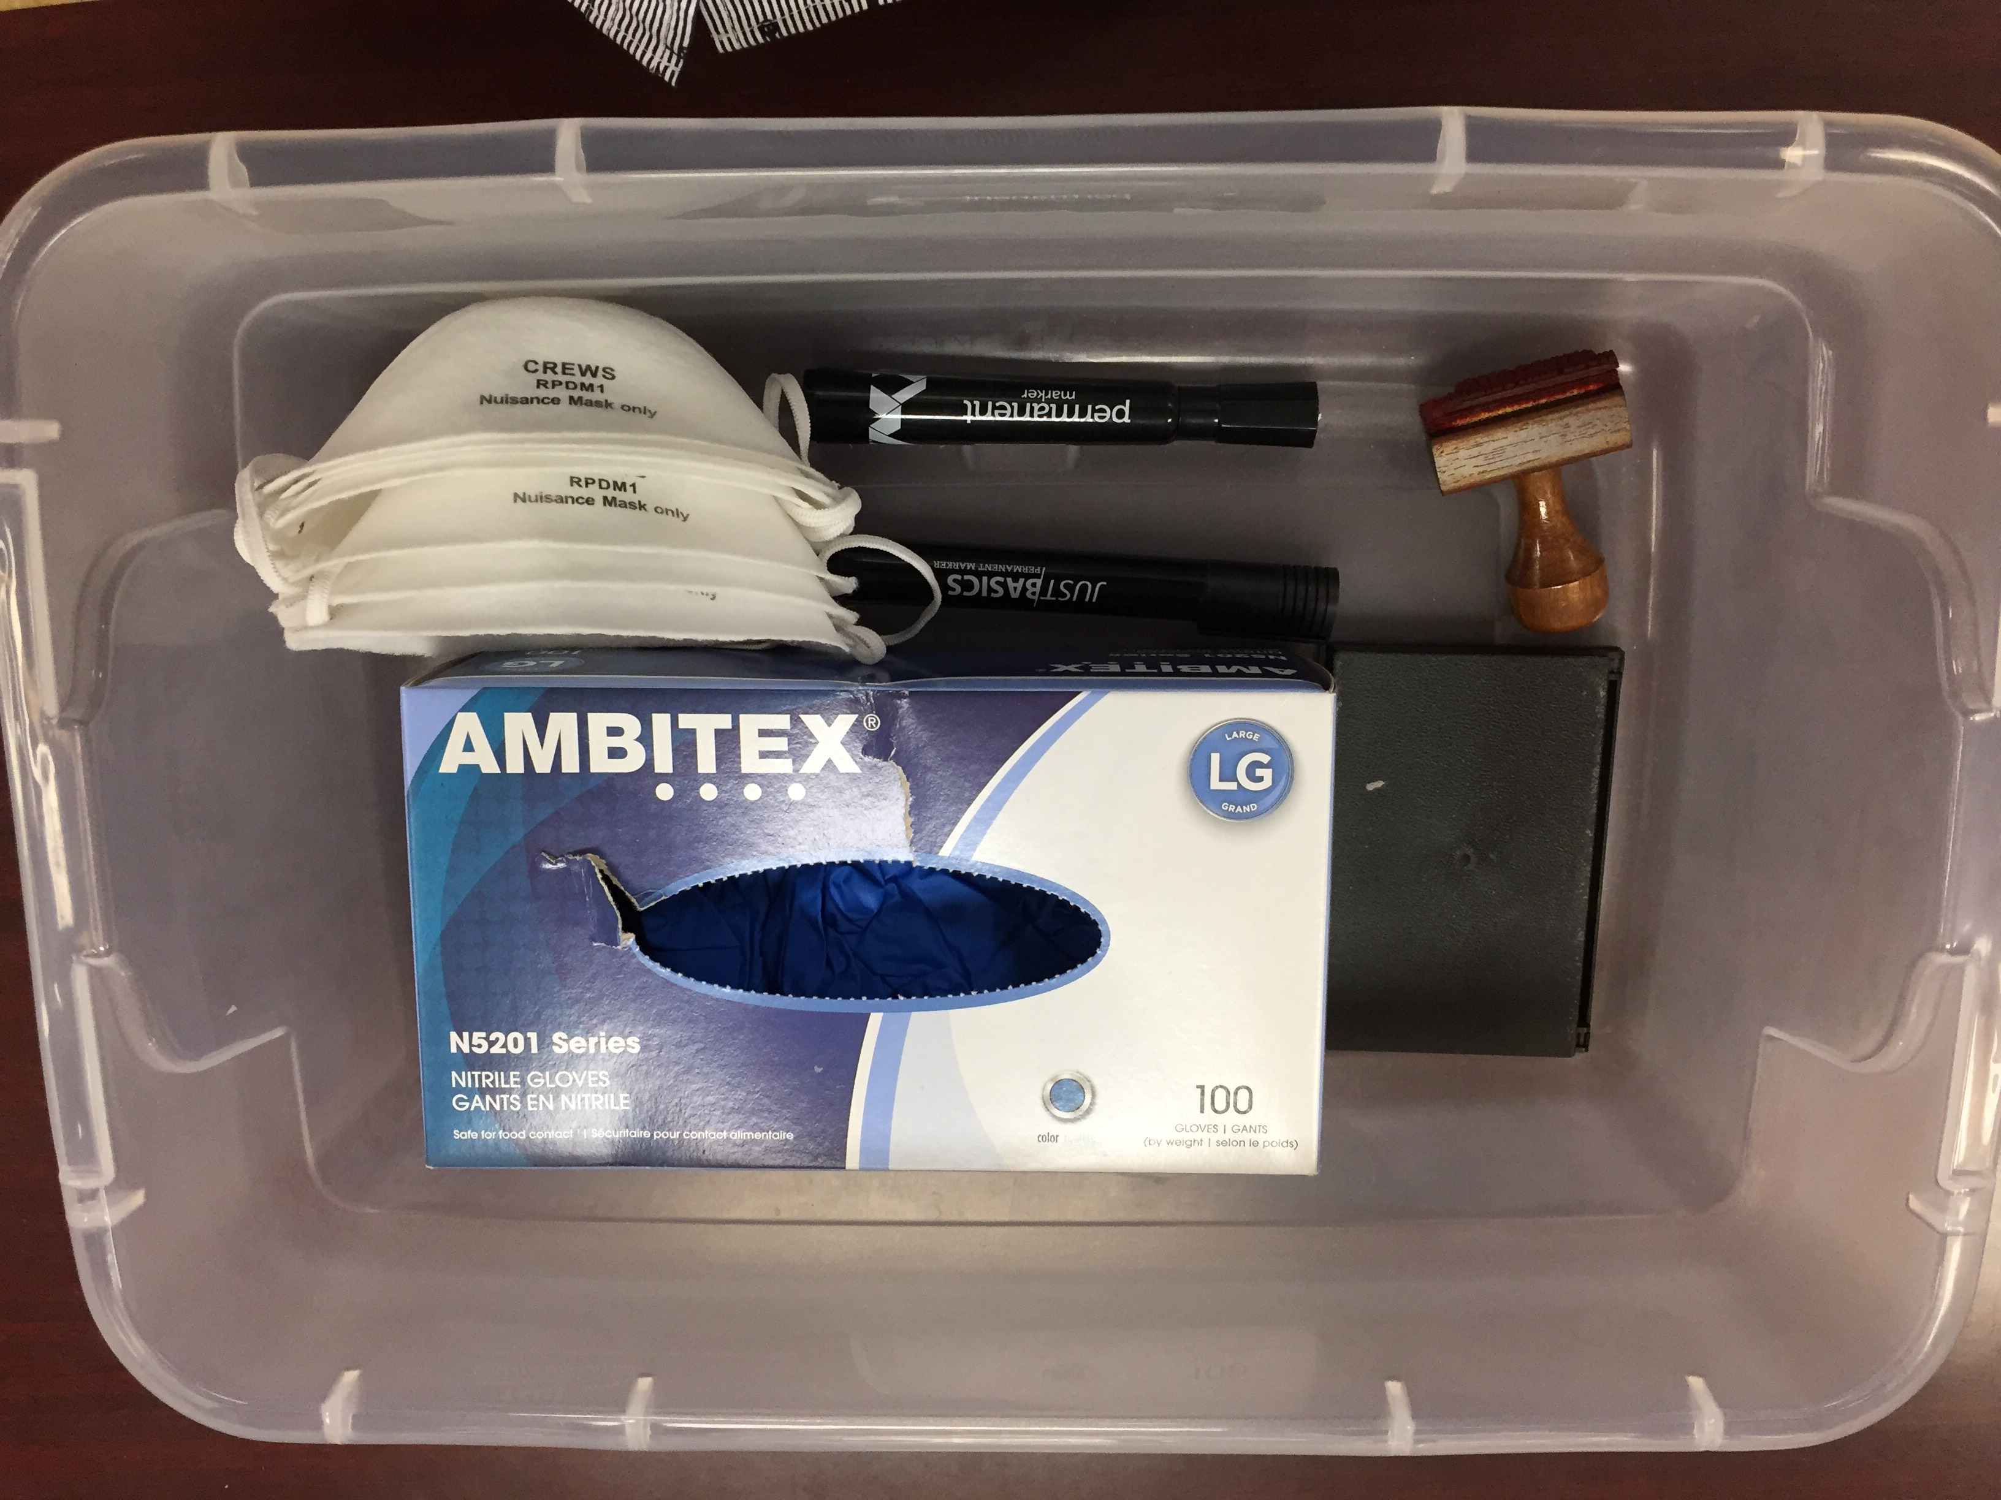
Physical processing of withdrawn items
Part-time clerks voluntarily participated in the weeding project
Training on physical processing (e.g., remove labels, stickers, and pockets)
Provided tools and supplies at workstations
Daily check on to answer questions
Physically removed out of the library
Contacted the Physical Plant staff to pick up
withdrawn materials for recycling

Slide 15
Summary of the weeding project
5,622 books withdrawn from main collection by August 22, 2019
$ fund to five faculty members
Freed 20-30 shelves on the second floor for potential use
Positive feedback from the faculty members involved
Lessons learned
Collaboration with different groups of people
Clarification of workflow
Importance of organized workstations
Timely communication with people participating in the project
Oversight of the progress of the project
Things needed attention

Slide 16
Questions?

