Slide 1
How Do I Get the Barcodes Into the System?
Using Sierra’s “Compare Inventory to Shelflist” for an Inventory Project
Leslie J. Collie, M.M., M.I.S
IUG 2022 Annual Conference
April 6, 2022

Slide 2
Topics
Benefits of an inventory project
Circa vs. “Compare Inventory to Shelflist”
Inventory projects at the University of Memphis
Step-by-step guide, including:
Workflow options
Generating the Inventory Report
Interpreting & acting on the report

Slide 3
What’s on the shelves vs. what’s in your database
What’s missing AND what’s been found
Beneficial to end users, including:
Inter-Library Loan Departments
Collection Management
Circulation
Most important: your patrons!
The benefits of an inventory project

Slide 4
Circa vs. “Compare Inventory to Shelflist”
Circa
“Compare Inventory to Shelflist”
Browser-based application
Requires configuration beforehand
Inventory issues uncovered one at a time
Multiple ways to address issues by staff
Unlimited scans per session
Inventory date updated automatically
Used via Admin Corner
No set-up; reports based on database
Issues seen from a “bird’s eye view”
All information generated by one person
5,000-item limit
Inventory date updated after the report is generated

Slide 5
Circa: benefits & drawbacks
Relatively easy to learn & use
Able to address most off-shelf statuses in real time
High potential for human error
No way to track cleared/modified statuses later
“Creative” decisions
No way to catch shelving issues

Slide 6
“Compare Inventory to Shelflist”: benefits & drawbacks
Requires more technical knowledge/training
More time-consuming on average for one person
Ability to address multiple issues at once
More centralized control

Slide 7
Inventory projects at the University of Memphis Libraries
Different workflows and systems spanning decades.
Most recent began in 2016
Roughly 1.5-year disruption starting in March 2020
Circa used as a workaround in the absence of a Systems Librarian
Formally restarted in December 2021 between semesters, still ongoing
https://foursquare.com/uofmlibraries;
Uploaded by Iantuition S. on 09/20/2012

Slide 8
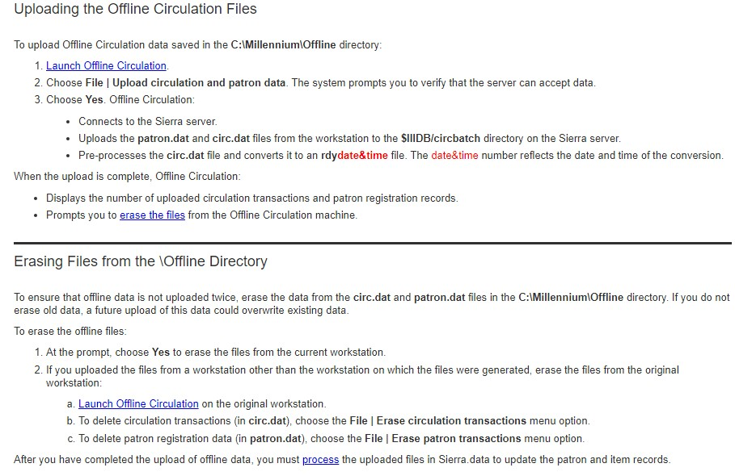
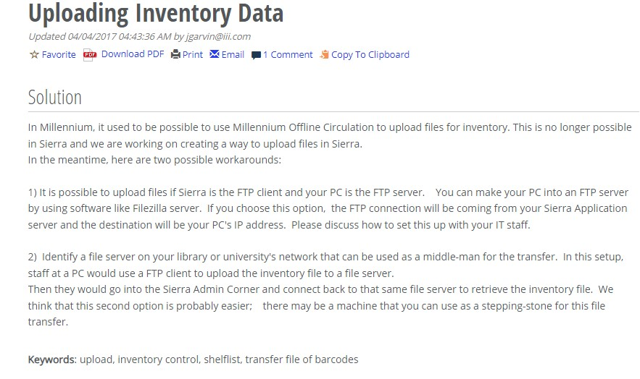
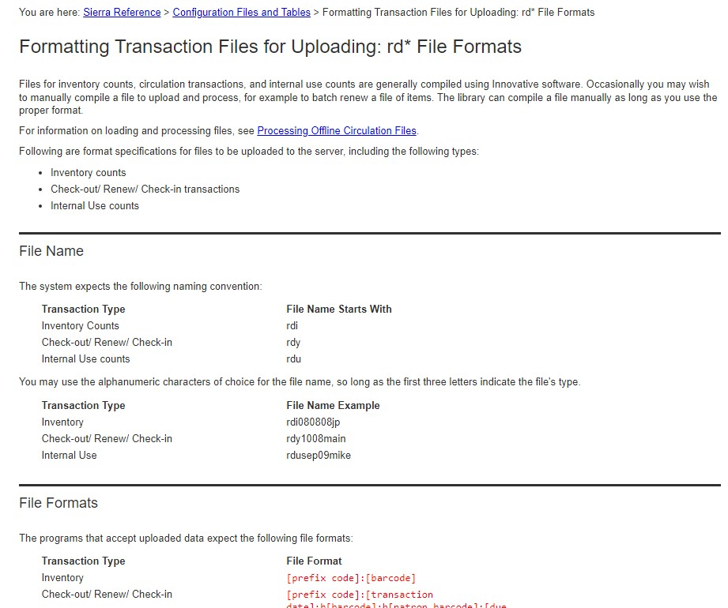
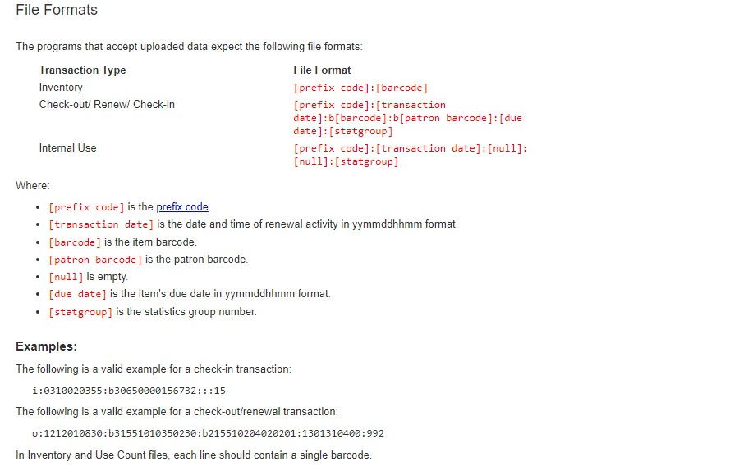
So much documentation, so little time
https://iii.rightanswers.com/portal/app/portlets/results/viewsolution.jsp?solutionid=170222180131237&page=1&position=1&q=uploading%20barcodes
https://csdirect.iii.com/sierrahelp/Default.htm#sril/sril_rd_file_formatting.html
https://csdirect.iii.com/sierrahelp/Default.htm#sgcir/sgcir_offlne_offlineupload.html

Slide 9
HOW DO I GET THE BARCODES INTO THE SYSTEM???
Download and Install Sierra Offline Circulation (Supportal Solution instructions): https://iii.rightanswers.com/portal/app/portlets/results/viewsolution.jsp?solutionid=180201164817671&page=1&position=5

Slide 10
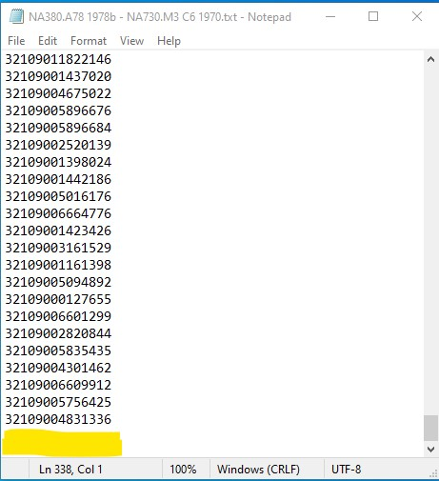
Formatting the barcode file
Files should be “.txt” extension only
Line breaks & incomplete barcodes will cause errors in Admin Corner
Delete before processing

Slide 11
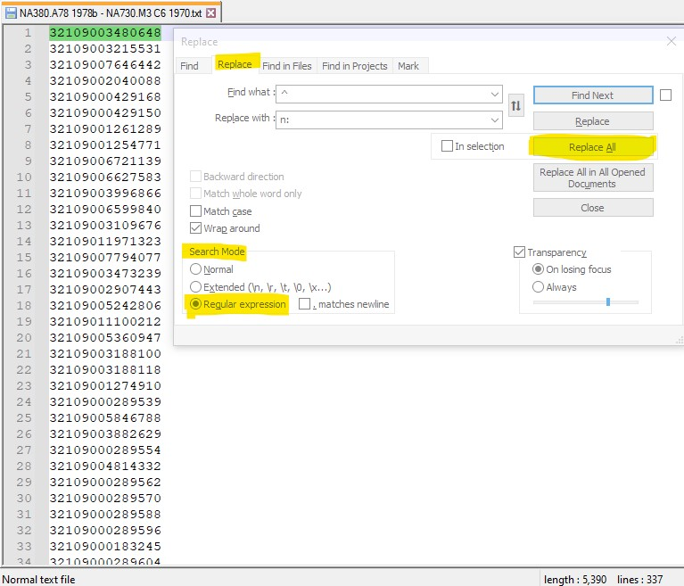
Using Notepad+ + to edit files
Notepad+ + download page: https://notepad-plus-plus.org/downloads/
Ctrl+F→Replace tab
Search mode: regular expression
Find what: ^
Replace with: n:
Click “Replace All”

Slide 12
F & R results & saving the file
This PC→Local Disk (C:)→Sierra Desktop App→Offline
Use this file name ONLY: circ.dat

Slide 13
Processing your file in Sierra Offline Circulation
File→Upload circulation and patron data
First pop-up: click Yes
Second pop-up: click OK to confirm barcode count
Third pop-up: clear or retain circ.dat?

Slide 14
Navigation in Admin Corner
Admin Corner menu paths may vary
C CIRCULATION subsystem→P PROCESS PC transactions→Input Sierra credentials→C COMPARE inventory to shelflist→C COMPARE file of barcodes to shelflist
Should see at least one file beginning with “rdi,” the date you uploaded the file via Offline Circulation, and the total number of barcodes.
C→P→[prompted for Sierra credentials]→C→C

Slide 15
Preparing to run your report
Option “I”: related to “Locations served” setting in account profile (Administration Application)
Choose “A” if your library doesn’t use this account setting.
Potential message: “The system has searched through the next 5000 items…” Choose “y.”

Slide 16
At long last: the report!
More barcodes = longer wait time
Page through the report (F & B) here or print/send to your email address
Two prompts after selecting Q:
Update inventory date? (y/n)
Clear inventory file? (y/n)

Slide 17
Report summary

Slide 18
“ERR msh”

Slide 19
Inventory statuses https://csdirect.iii.com/sierrahelp/Default.htm#sadmin/sadmin_admin_corner_inventory_status.html?TocPath=Sierra%2520Administration%257CAdmin%2520Corner%257CCompare%2520inventory%2520to%2520shelf%2520list%257C_____1

Slide 20
Go forth & inventory!
Image source: https://knowyourmeme.com/memes/the-more-you-know

