Slide 1
Bachelor No More:
Merging Another Sierra User into Your System
Notes:
Karen introduces program

Slide 2
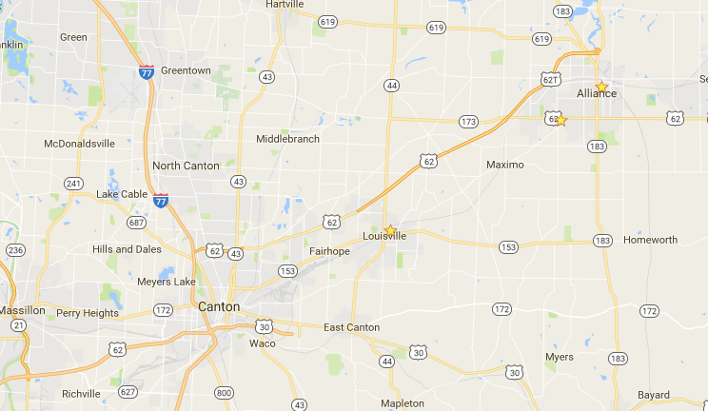


Background
Notes:
Each person introduces self – how long worked at library, automation background

Slide 3
The Pre-Nup
Responsibilities of each party
Spell out financial obligations
  Equipment purchases
  Fines collections
  Maintenance fees

Slide 4
Determining Fees
Location | Population | Borrowers | Annual Circ | Holdings
RPL | 37,478 | 27,549 | 327,186 | 260,809
LPL | 18,769 | 10,075 | 158,057 | 160,866
Percentages | 68% / 32% | 73% / 27% | 63% / 37% | 62% / 38%

Slide 5
The Pre-Nup
Terms of agreement
Termination arrangements
Patrons with multiple cards
Hours of operation
Troubleshooting procedures
Holiday closings

Slide 6
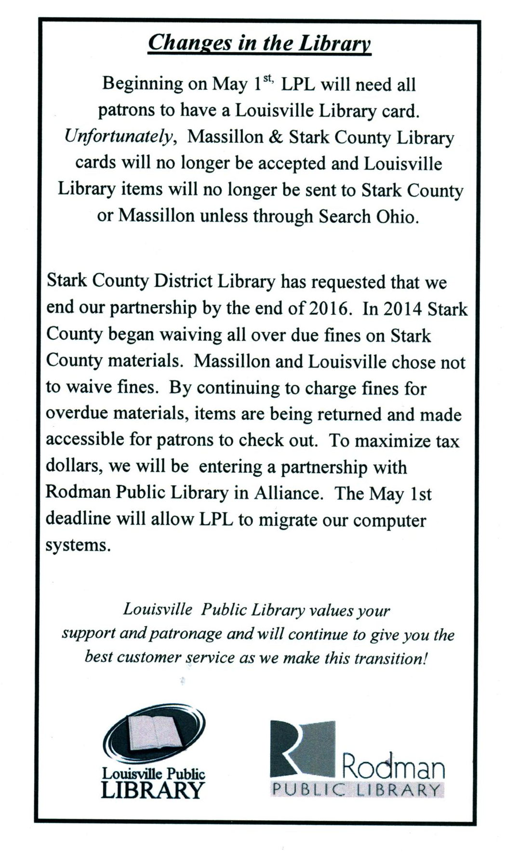
Getting the Word Out

Slide 7
Getting to Know You
The Courtship

Slide 8
Hardware
Rodman
  Server
    Installed January 2013
    Determined to be big enough
  Teleforms
    1 calling line
    1 overdue message
    2 pickup messages

Slide 9
Hardware
Louisville
  1 Express Lane

Slide 10
How Do You Do…?
What materials circ to which patrons?
How long do your materials circulate?
What is your fine/notice structure?
Will our patrons be able to borrow your materials?
Whose cataloging takes priority?
Where are your call numbers?
Notes:
Karen

Slide 11
Taking Inventory
Products owned
  Get itemized list with maintenance costs
Need to buy additional?
Changes in procedures

Slide 12
Products Owned - Rodman
Inventory
Quick Click/EDI Ordering
Z39.50
INN-View Authority service
Reference Database

Slide 13
Products Owned - Louisville
EDI invoicing
Online patron registration
Express Lane
Collection Agency
Encore

Slide 14
A Chance to Grow
Learning new ways to do things
  Finding cataloging records
  Withdrawals
  Batch renewals
  EDIFACT ordering/Importing invoices
Staying with some old ways
  Label printing
Notes:
LPL cataloging by attaching to Stark records or copy-paste from other catalogs
LPL would scan records to be deleted to count use field – Stark would delete – now doing on their own
LPL renewals for school collections were done manually – now by using RPL’s bookmobile batch procedure
RPL had Quick Click ordering, LPL was used to importing invoices – now both have both procedures
LPL Label printing prior to merger – Would type up the info in Word – too much new at one time!

Slide 15
A Chance to Grow
Inventory
Sharing a bookmobile stop
Sharing items between libraries
Credit card payments
Notes:
RPL had Circa inventory module, LPL had never inventoried collection
Bookmobile – new outreach service for LPL
Used to service a school on the border of districts – LPL gather books, deliver to RPL
LPL had 66% unique titles when merging with RPL – Expanded RPL collection of items before having to go to SOH
Credit card payments went into one pot with SLIC – RPL insisted on separate PayPal accounts. Accepting payments at circ desk procedures

Slide 16
Adapting to Each Other
New location, itype, ptype codes
Patron records
  New ptypes – restricted, probation, students
Redoing scopes
PCODES
Max items
Notes:
New material types for large print, various digital formats
Patron records – kept old LPL codes but added new types for restricted, probation, students
Opportunity to restructure outdated scopes
New PCODE field allowed expansion and restructuring existing codes
Compromise on Max items fields

Slide 17
Things We Didn’t Know
Consortium Management Extensions
  Agency code
  Consortium call number statistics
  Consortium circulation statistics
  PCODE4
Notes:
Yes, you can just add in the other library as a branch of your existing system, but then you lose autonomy.

Slide 18
Things Given Up by LPL
Historical transactions
Patron circulation history
Patron reading lists
Fines and bills transferred as manual charges
“On holdshelf” status

Slide 19
The Project
Planning the Big Day

Slide 20
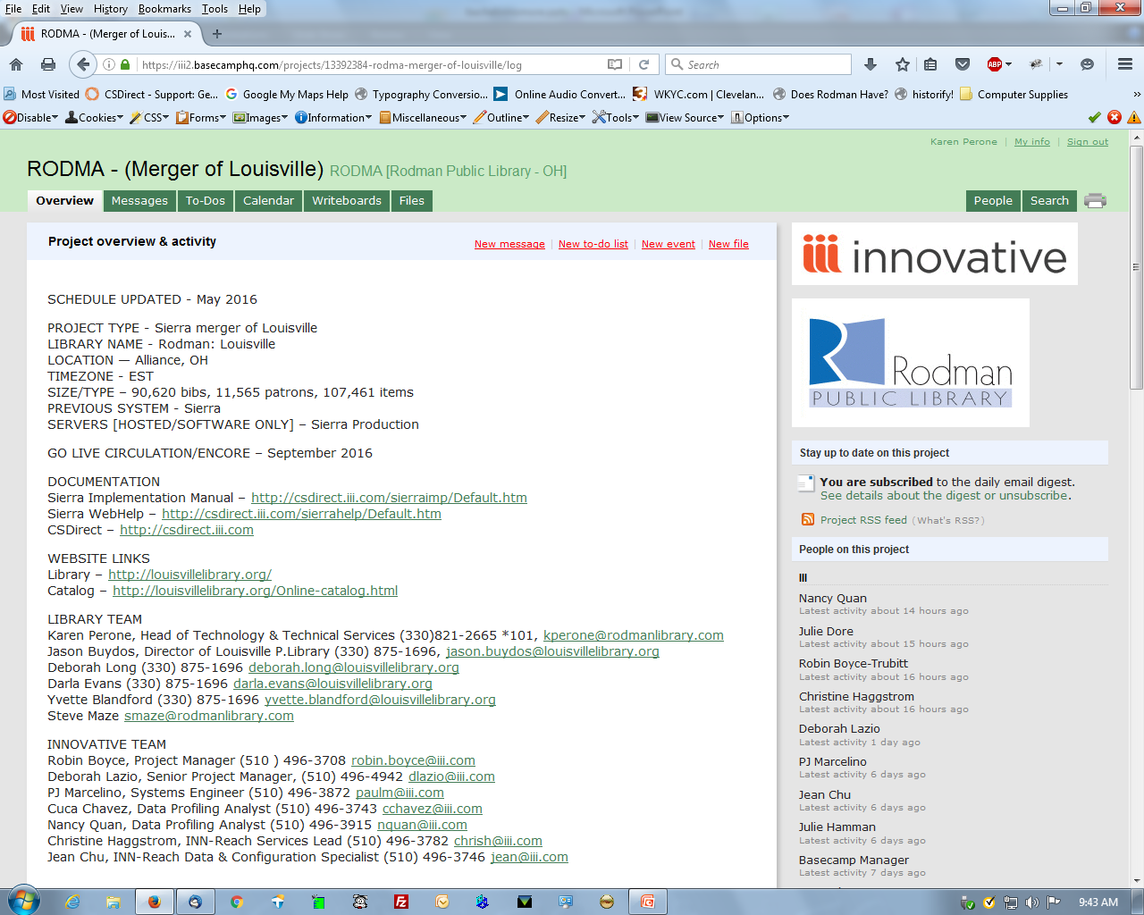
Notes:
Description of Basecamp – how it organized the project and maintained communications

Slide 21
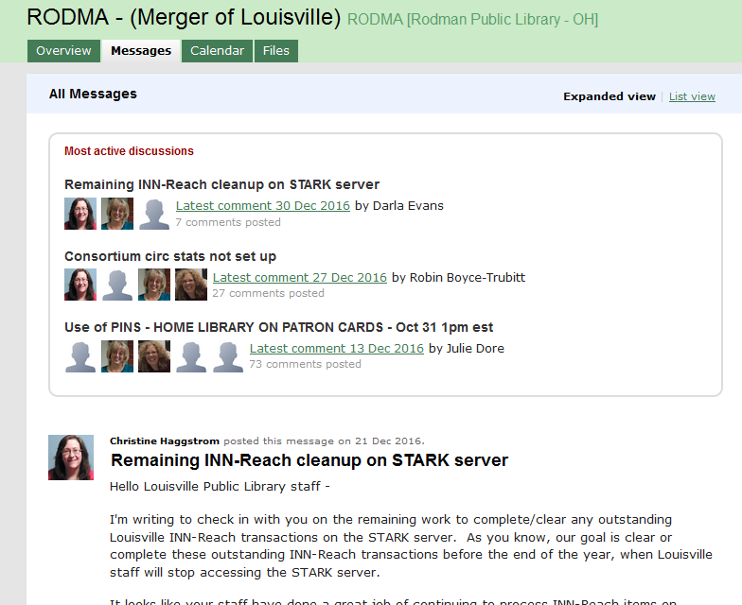
Notes:
The team

Slide 22
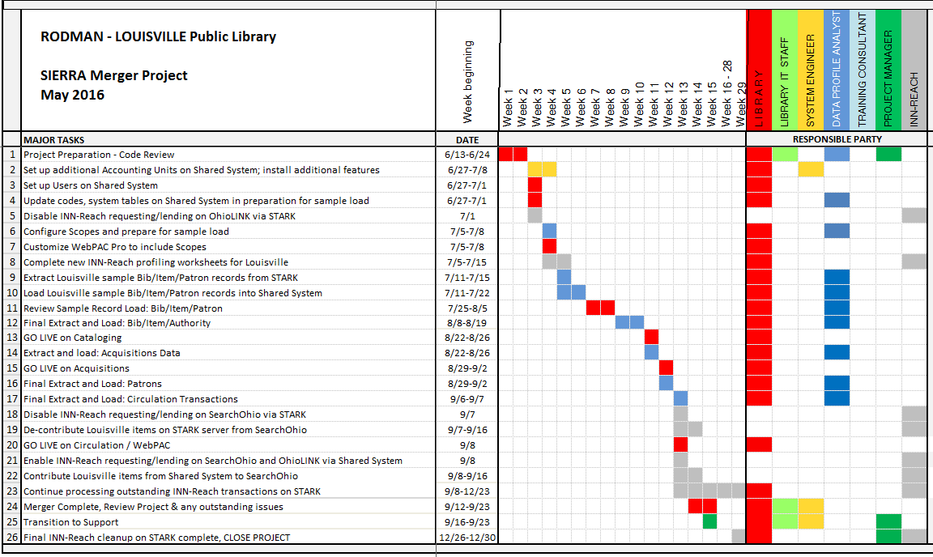
Notes:
The schedule – weekly telephone calls

Slide 23
The Work Begins
Getting to Know the Family

Slide 24
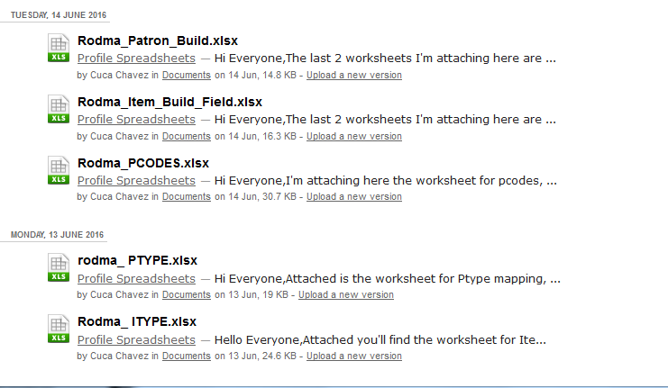
And There Were LOTS of Forms
Notes:
Every piece of Louisville’s data had to be mapped into Rodman’s schema.

Slide 25
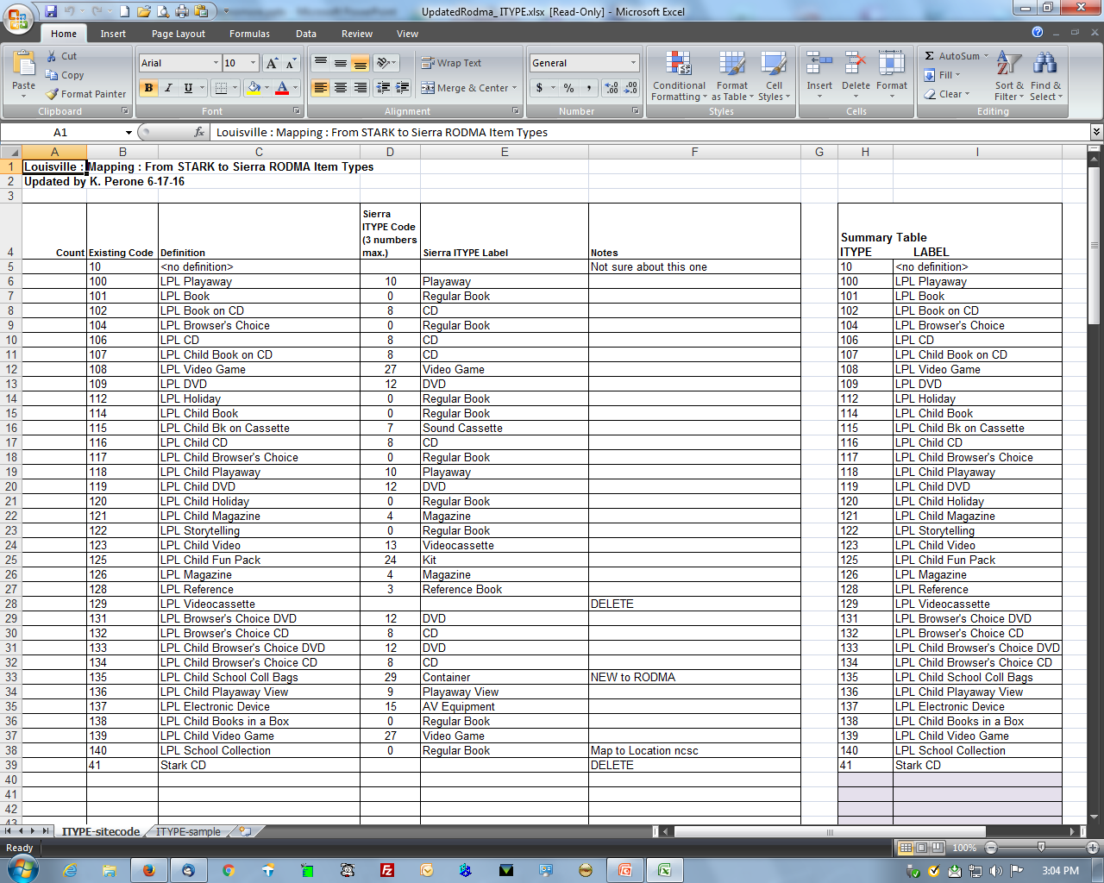
Mapping of Data
Notes:
Test data loads were important – sample chart for mapping itypes
Similar for other codes
LPL 38 itypes → RPL 18 itypes

Slide 26
Order of Worship
Loading data – Bibs/Items
  Sample records (weeks 5 & 6)
  Review sample records (weeks 7 & 8)
  Final extract and load (weeks 9 & 10)
Go LIVE
  Cataloging (week 11)
  Acquisitions (week 12)

Slide 27
Order of Worship
Loading data – Patron & Transactions
  Sample records (weeks 5 & 6)
  Review sample records (weeks 7 & 8)
  Final extract and load – Patrons (week 12)
  Final extract and load – Transactions (week 13)
Go LIVE
  Circulation/WebPAC (week 13)
Notes:
LPL Circ was offline for about 3 days. SOH about 2 days.
No items checked in during cutover
Came back online, checked everything in then processed offline checkout files
RPL – no downtime, business as usual

Slide 28
Loan Rules
Before:
3 Sets Needed
  RPL to RPL
  SOH to RPL
  OL to RPL
After
8 Sets Needed
  RPL to RPL
  LPL to LPL
  SOH to RPL
  SOH to LPL
  OL to RPL
  OL to LPL
  RPL to LPL
  LPL to RPL
Notes:
Loan rule determiner table more than doubled in size
Important to test, test, test
Can’t stress the importance of starting this as soon as possible. Took much longer than anticipated

Slide 29
Oh yes, I Forgot to Tell You…
WebPAC setup
  Co-branding
  Pickup locations
  Help screens
Teleforms messages
  Pickup location message
  Generic overdue message
Notes:
Dealing with codes and loan rules took up a lot of time. Then we realized we needed to update the branding for webPAC and teleforms.

Slide 30
Housekeeping
I Always Cry at Weddings

Slide 31
Clean Up Data - Before
Start as soon as possible
Keep up with the Headings Reports
  Prevent duplicates on database load
Check for data errors BEFORE the merge
  Bad locations, itypes
  Old codes
Notes:
Try to clean up as many of your data errors before the merge takes place

Slide 32
Clean Up Data - Before
Delete old “dead” records
Revisit fixed field codes
Batch check-in
Purge old fines
Messages and notes
Notes:
Delete records for long gone items
Batch check-in so items can be deleted
Delete expired patrons

Slide 33
Clean Up Data - After
Prepare to be overwhelmed
Reviewing data from loads
Work together as a team
Learning new procedures
Notes:
So much data will be thrown at you in a short period of time it becomes overwhelming

Slide 34
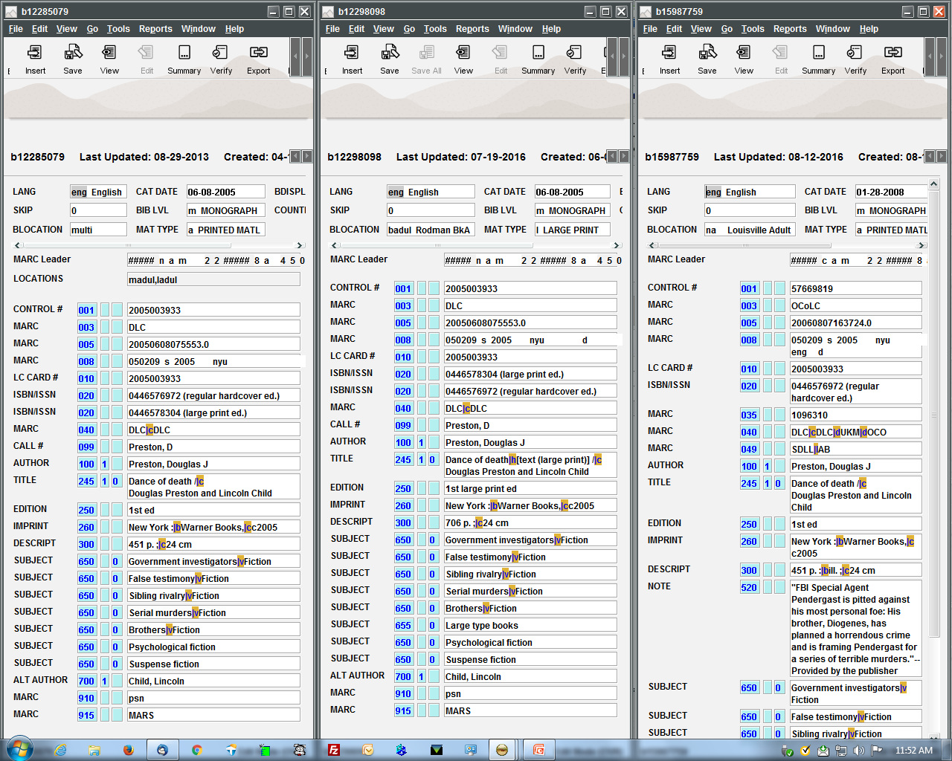
Notes:
Example of bad practices leaving all ISBNs in record

Slide 35
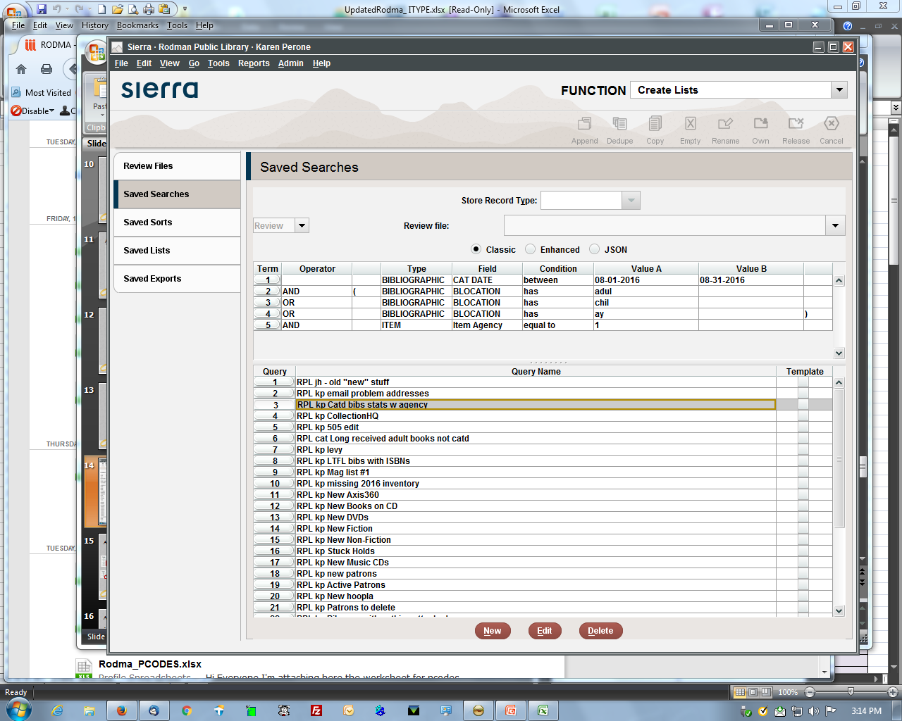
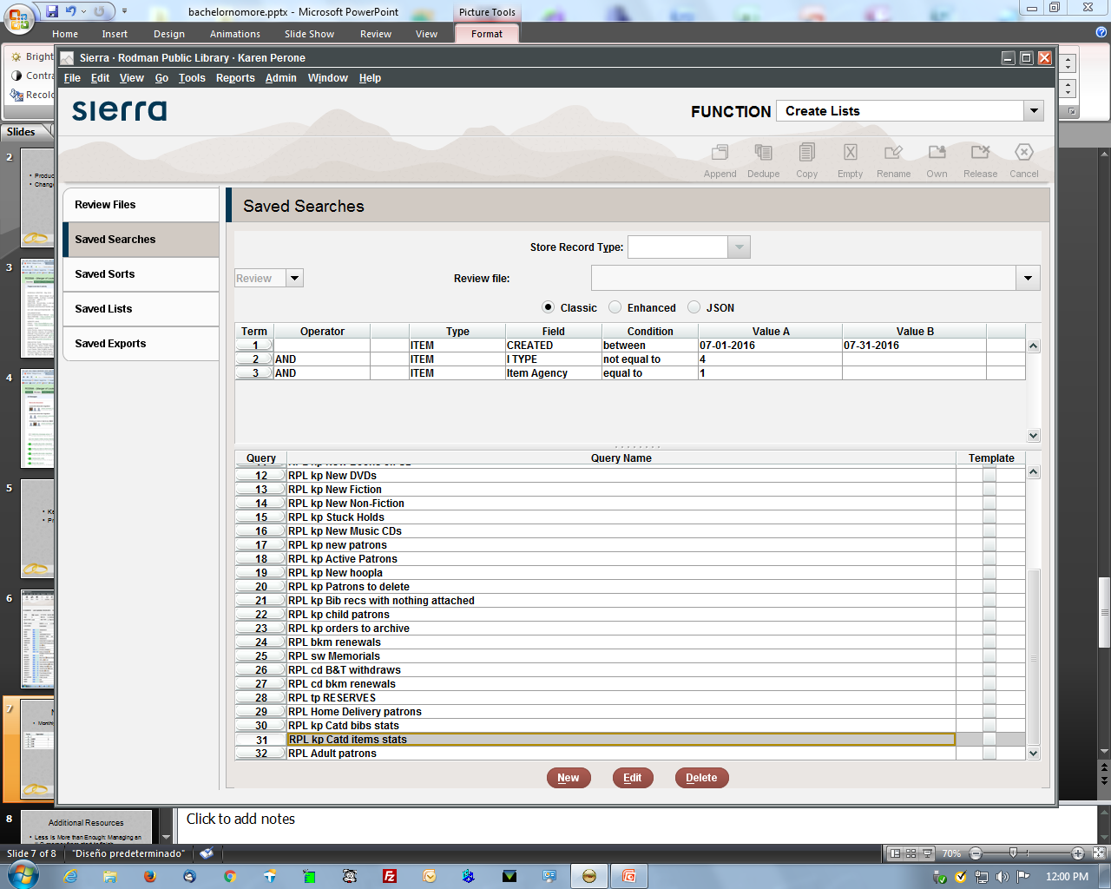
Adapting to the New Environment
Monthly Cataloging Stats
Notes:
These processes may change as we get used to consortium management extensions

Slide 36
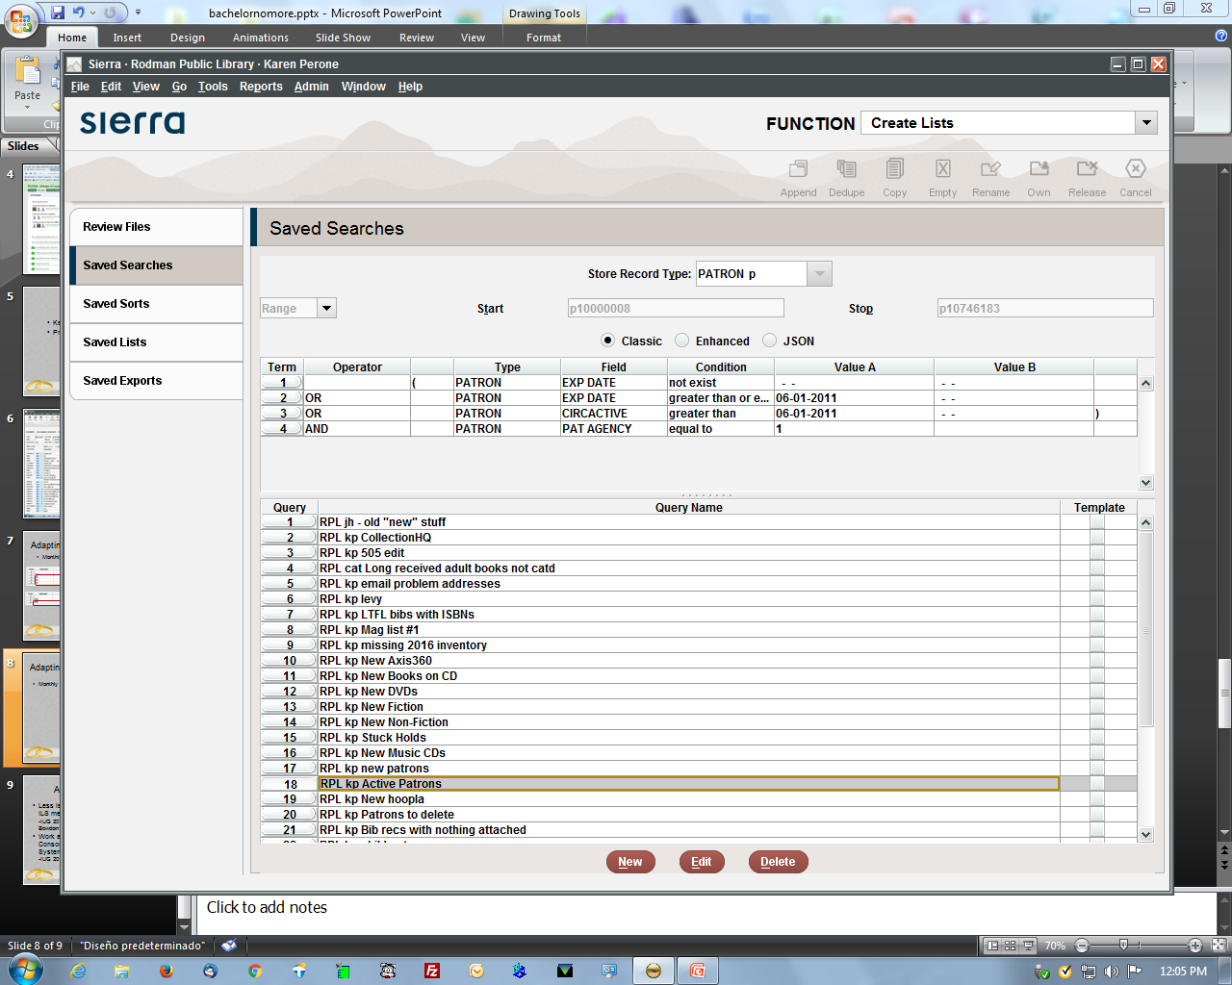
Adapting to the New Environment
Monthly Active Patron Count

Slide 37
LPL New Responsibilities
Maintaining local users
Collection agency procedures
Notes:
LPL responsible for setting up staff user accounts. Know workflows

Slide 38
Cohabitating
Naming schemes
  Login names
  Saved searches
  Create lists
PINs
PayPal
Notes:
Karen

Slide 39
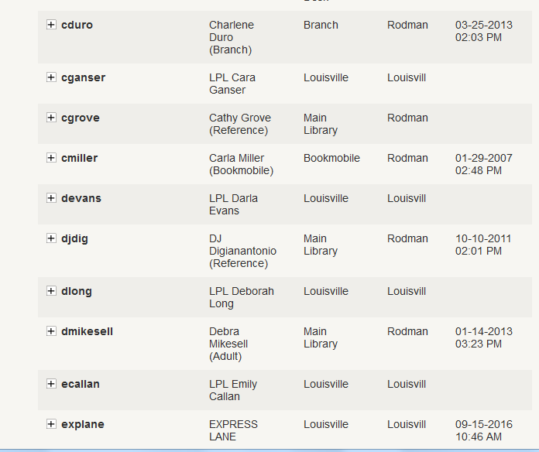
Naming Schemes

Slide 40
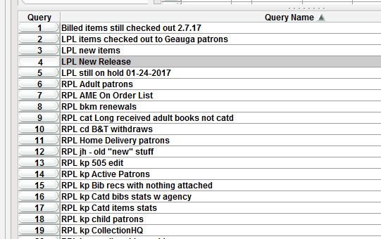
Naming Schemes

Slide 41
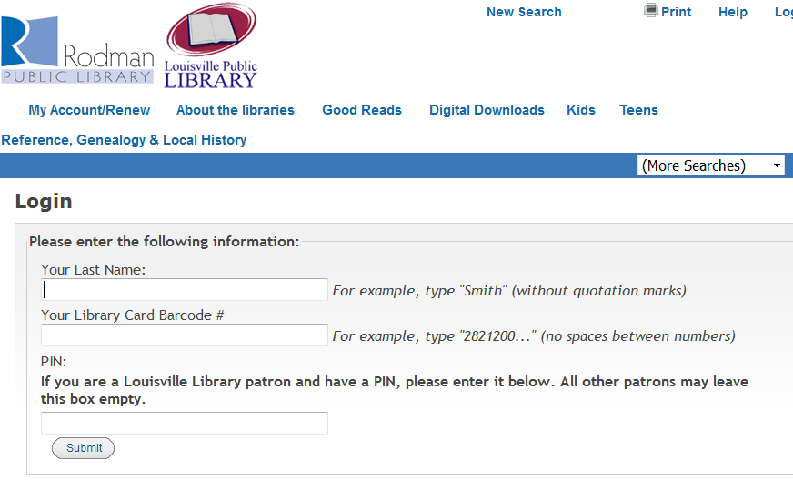
PINs
Used by Louisville for self-check only
Notes:
Julie Dore

Slide 42
PayPal
Set up separate PayPal manager accounts
Important: list a default * account
#lib:libuser:libvendor:partner:partnerpwd:hostaddr:timeout
*:Default_account:null:PayPal:null:payflowlink.paypal.com:30
1:Lib1_account:null:PayPal:null:payflowlink.paypal.com:30
2:Lib2_account:null:PayPal:null:payflowlink.paypal.com:30

Slide 43
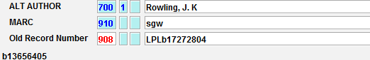
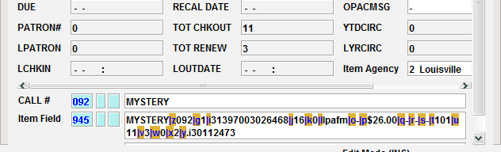
New Places for Old Data

Slide 44
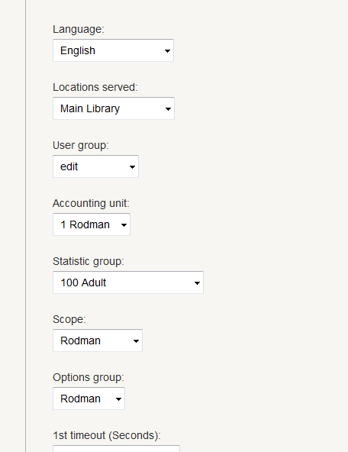
Separate but Equal

Slide 45
Where Do We Go From Here?
The 1st Anniversary

Slide 46
It’s Better with a Friend
Good partnership
Ongoing maintenance
Sharing expenses
Sharing staff experiences
Notes:
Maintenance costs are lower
Monthly meetings to discuss database maintenance/circ issues

Slide 47
Additional Resources
Less is More than Enough: Managing an ILS merger from start to finish
-IUG 2015 program on Colby, Bates and Bowdoin Colleges merging systems
Work and Play Well Together: Using Consortia Best Practices to Set Up Your System for Success
-IUG 2016 Innovative program by Jason Boland

