Slide 1
Staff Meeting Fall 2014
Introductions and signing contracts
My expectations for you
Be on time and here for your shifts.
Help patrons – You will need to know the Library: hours, policies, circulation system, navigate the library website, how to find library materials, Google Calendar, Library of Congress System basics, printers/copiers, and where to find this information if you forget.
Do Library Work Before Your Own Work
Desk time
Library Changes 2014
Millennium is now Sierra
New webpage
Cinema Studies Hard drives on Reserve
Furniture Use Survey

Slide 2
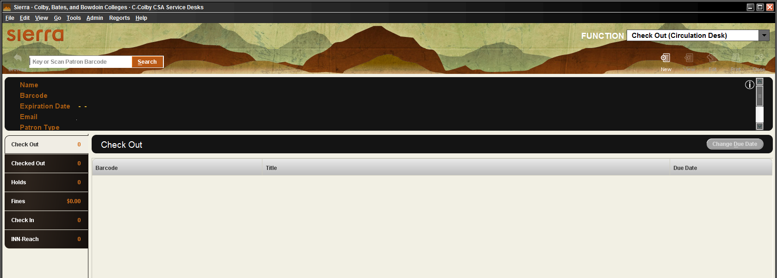
Welcome to Sierra
Sierra is our new library software.
It looks a bit different from Millennium…

Slide 3
When you first login as a Student Staff user you will see the check out page. Make sure a line for the curser is blinking in the search box, then scan the library card as you would have in Millennium.

Slide 4
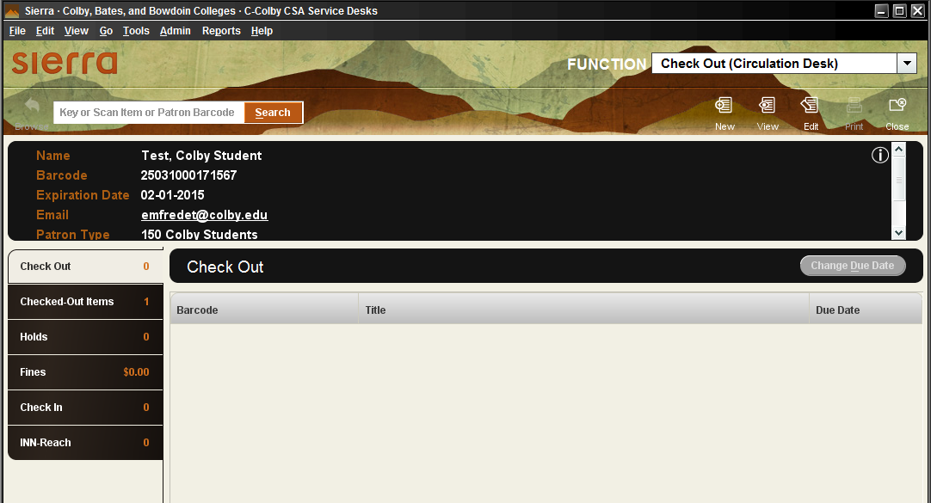
Scan the cards barcode and the person’s name (last, first), expiration date, and patron type will appear. Now scan the barcodes of the items you are checking out.

Slide 5
Items you scan to check out, should appear below “Check Out” with the barcode, title, and due date. Make sure the due date is correct and tell the person the due date.
Not sure if the due date is correct?
Look at the patron type and see the “Loan Periods, Renewals, and Fines” page on the library website, refer to the manual or the libguides page.

Slide 6
If the person wants to know about other items they have checked out, make sure they know they can view their account online and how to do so, and then click “Checked Out Items”. Information of the person’s Holds and Fines are also viewable if clicked on.

Slide 7
Question???????
Someone calls or comes to the desk and wants to know if you will look up an account without a card or card#, or wants to know if someone has an account here. Can you look them up or give them such information?

Slide 8
NO
Even if you know Robin Duperry has a Colby library account, you can not tell anyone she does.

Slide 9
Checking Items IN Look for “FUNCTION” use the drop down menu, select “Check-in (No Patron)”. Click on the “Search” box and start scanning barcodes.

Slide 10
Items being checked in will appear with the barcode, call number, title, patron name, and any fines due. This is a great time to make sure which library the item belongs to…
After the Call Number is a code for the item’s library location
All Colby locations start with “C”, Bate is “A”, Bowdoin is “B”.
“cb” = Colby Bixler, “cm” = Colby Miller, “co” = Colby Olin

Slide 11
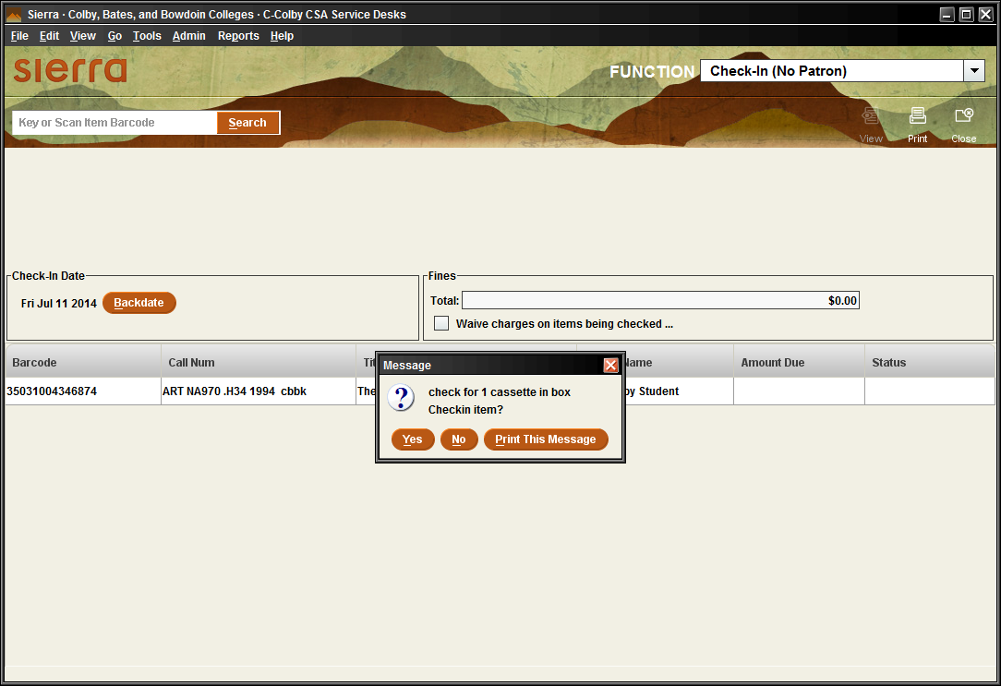
Look for & follow any pop-ups

Slide 12
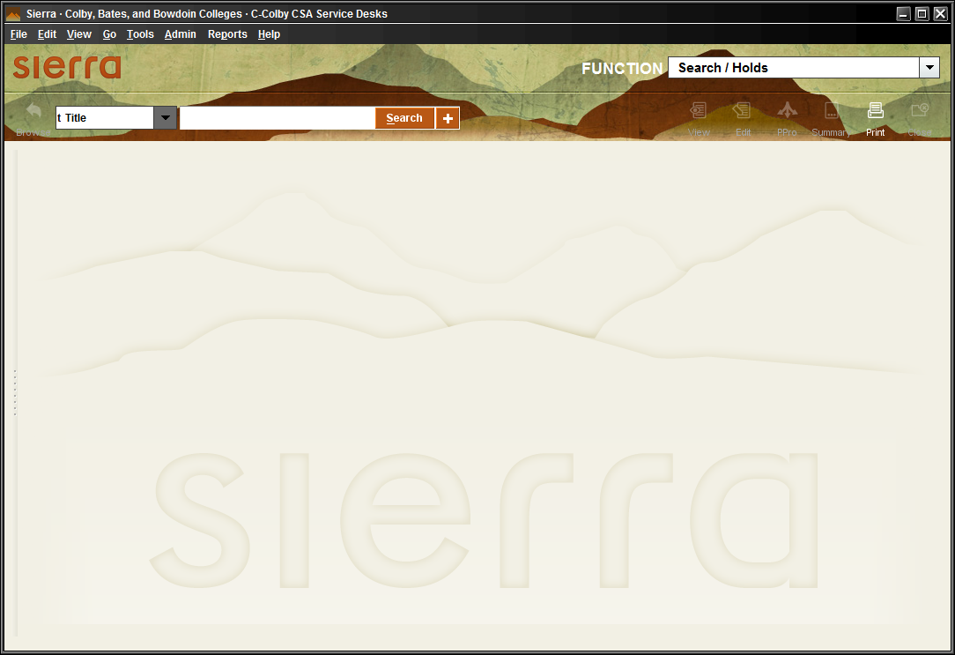
What if you are searching for an item or want to know if it has been checked in or has a Hold?
Find the “Functions” drop down and select for “Search/Holds”.

Slide 13
Selecting, “Function” - Search/Holds allows you to then look up items by title, author, barcode, call no., etc.

Slide 14
Here are some other Functions in Sierra…Count Use…, INN-Reach…, and Renew...
If you find a pile of books on a table, what should you do after you make sure the books are checked in?

Slide 15
Count Use!
Count Use allows the library to know about books that are not necessarily being checked out but are being used in the library.
This is important because every library will need to eventually weed through its collection of unused books. The library would not want to remove from the collection a book that was used a lot in the library, but just not checked out.

Slide 16
Which of these would you select for a person with a card from another library?

Slide 17
INN-Reach - Visiting Patron Check-out
INN-Reach

Slide 19
A person from another library calls and wants to know if they can use their card here?
You have TWO ways to find out…
Go to visiting patron check-out in Sierra like you are going to check them out. Look through the dreaded list and hope you see their library.
2. Look in the manual for a list “Library cards which can be used for
Visitor Checkouts”. This list is alphabetical by library. ☺
Library not on either list?
They are welcome to use library martial within the library,
& not check anything out.
They can also try an Interlibrary Loan at their home library, apply for a
Colby Courtesy Card ($20 a year and one book can be checked out at a time) or as a Maine Resident they can go to the Maine State Library and use that card here (free).

Slide 20
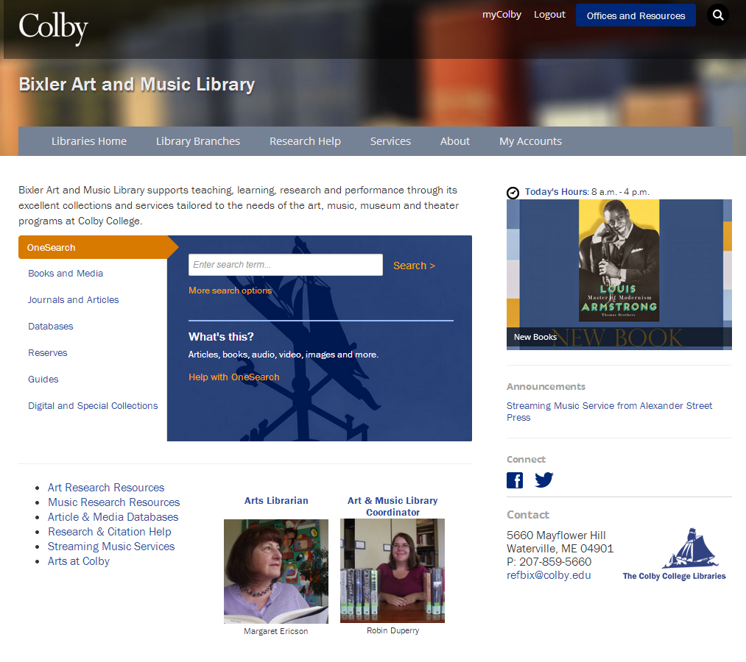
You may have notice our website has changed? The look has but is still works about the same.

Slide 21
1. How does someone search for a book they can take out “Right Now?” 2. Where can a person find out about their library fines, checkouts, due dates? 3. Where does a person go to recommend the library add a book to the collection?

Slide 22
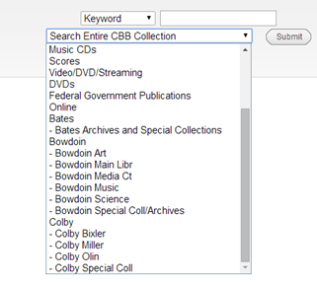
1. How does someone search for a book they can take out “Right Now!”
Select “Books and Media
2. Make sure CBBCat is selected
3. Click “More search options and you will come to the CBBCat screen where you can select for Colby Bixler items.

Slide 23
2. Where can a person find out about their library fines, checkouts, due dates?
Click “My Accounts”

Slide 24
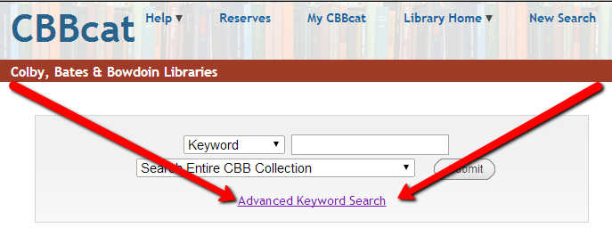
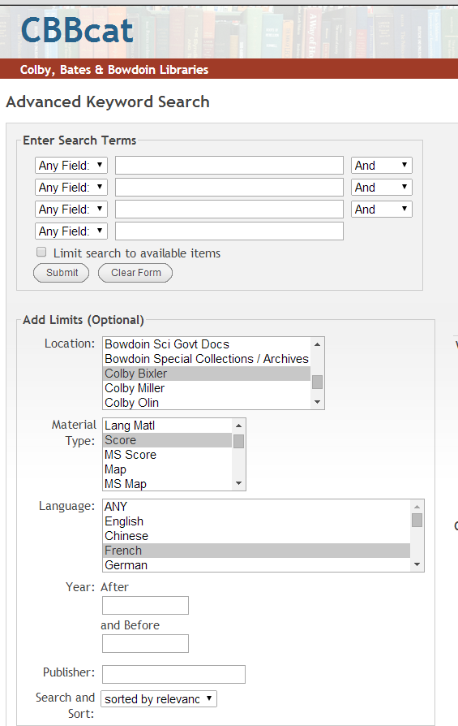
Using the “Advance Keyword Search” option in the CBBCat tab will bring you to a screen where you can refine you search even further.
In CBBCat “Advance Keyword Search”, you can search all of Colby’s collection, or limit it to things like just Bixler’s sound recordings or scores.

Slide 25
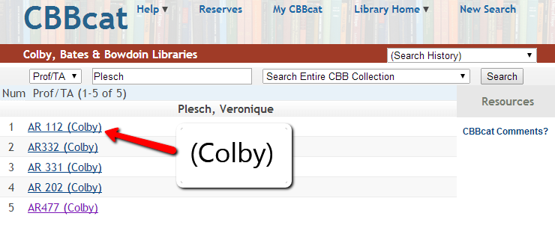
Reserves?

Slide 26
Furniture Use Survey
This year we need to count once an hour how many people are using different types of furniture in the library. I need this done a few days each month.
More details to follow
Fall | Jan Plan | Spring
September (10,11,12) 15-21 | January, 3,4,5 | February, 2-8
October, 20-26 | January, 11,12,13 | April 6-12
December 7-13 | January, 24,25, 26 | May 4-10

Slide 27
Timesheets! Please fill out your timesheet today, they are due tomorrow. You are paid to be here today. If you were here for the full hour add one hour.
Training with Margaret Ericson
Please sign up if you can not make October 2nd 4-5pm

