Slide 1
Mapping Our Patrons
Jeremy Goldstein
Data Curation Librarian
Minuteman Library Network

Slide 2
About Me
Librarian since 2006
With Minuteman since 2013
All but 1 year of that has been on Millennium / Sierra
Originally a cataloging/acquisitions person
now handle analytics….developer projects….training
…and still acquisitions
Not a trained coder

Slide 3
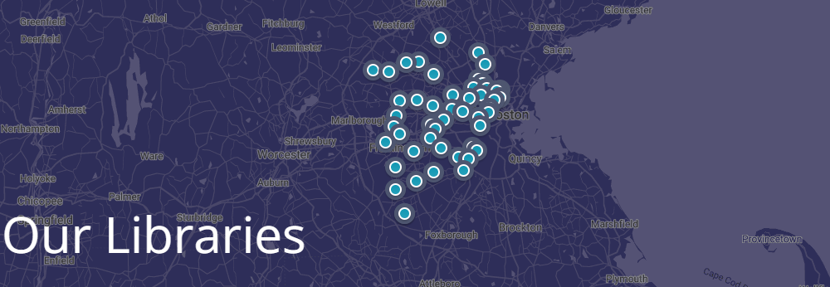
About Minuteman
41 Member consortia
MetroWest area outside Boston
Both Public and Academic members
Sierra hosted customer
Notes:
1 of 8 resource sharing networks in Massachusetts
Our service area covers about 1.1 Million residents and also a lot of students from the various colleges in the area.
Encompasses large Boston suburbs such as Cambridge and Newton and smaller bedroom communities like Sherborn and Dover

Slide 4
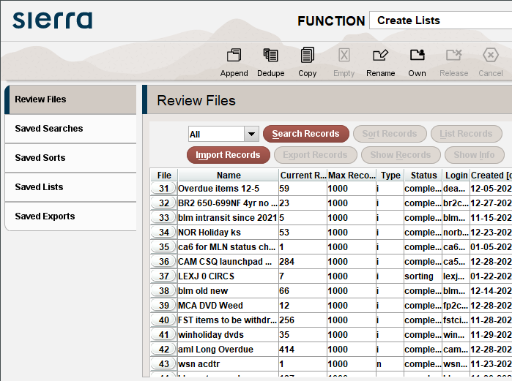
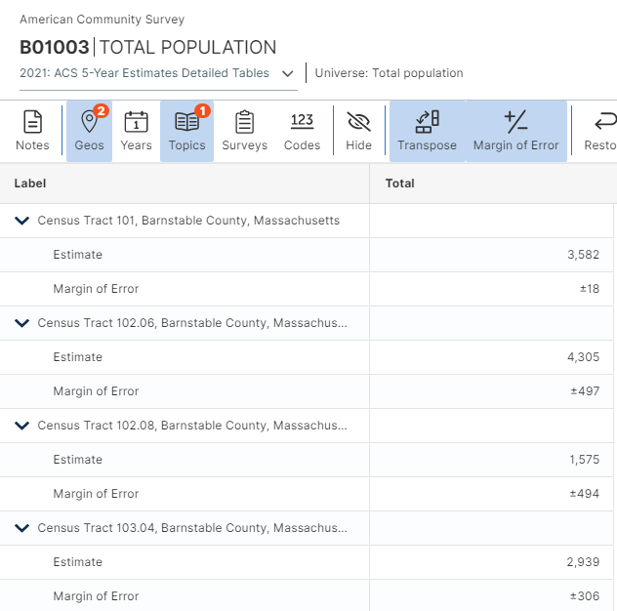
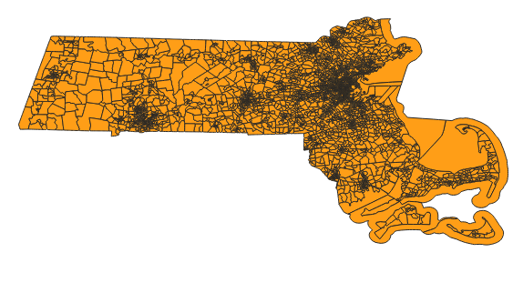
Our Goal
Track the portion of our service area with library cards
Incorporate additional Sierra & Census data if viable
Automate everything
Sierra
Census
Tiger/Line
Patron addresses and circulation activity
Demographic data
Geographic details
Need a single matching data point

Slide 5
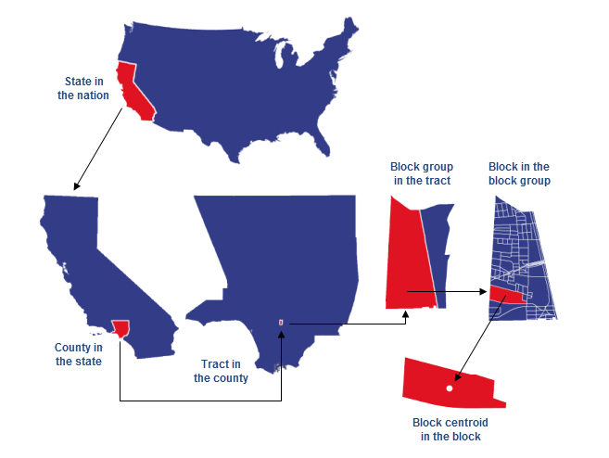
Census Geography
https://learn.arcgis.com/en/related-concepts/united-states-census-geography.htm

Slide 6
Census Geography
Geography | Digits | GeoID
State | 2 | 25
County | +3 | 25017
Tract | +6 | 25017383901
Block Group | +1 | 250173839014
Block | +3 | 250173839014003
Notes:
For our needs we will be focusing on the tract and block group levels to provide meaningful data from the census at a sufficient level of granularity.

Slide 7
Problem #1
Patron Records need geoids
Create a field & schema for records
Find the id for each patron
Load those ids into each record
Keep those ids current
Notes:
The loading into Sierra portion of this is so that we may run on demand queries later and generally function at our scale. For a single library or something that’s more of a one time project you could just export everything to a spreadsheet or external database and work from that…just be cautious to take measures to ensure the privacy of your patron data.

Slide 8
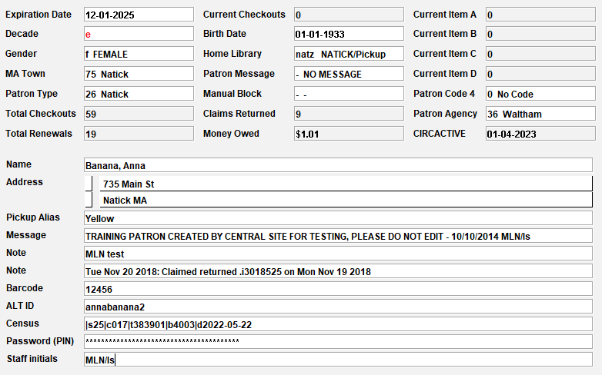
Schema
Geography | Subfield
State | s
County | c
Tract | t
Block Group | n/a (included with block
Block | b
Updated Date | d
Notes:
This schema is largely being driven by the format of the data provided by the census. For example they provide block numbers but do not break out block groups separately when using their geocoder (discussed on the next slides). So for working the with block group, we just truncate that subfield as needed. The updated date is so we can later query older entries and recode them in case of address changes.

Slide 9
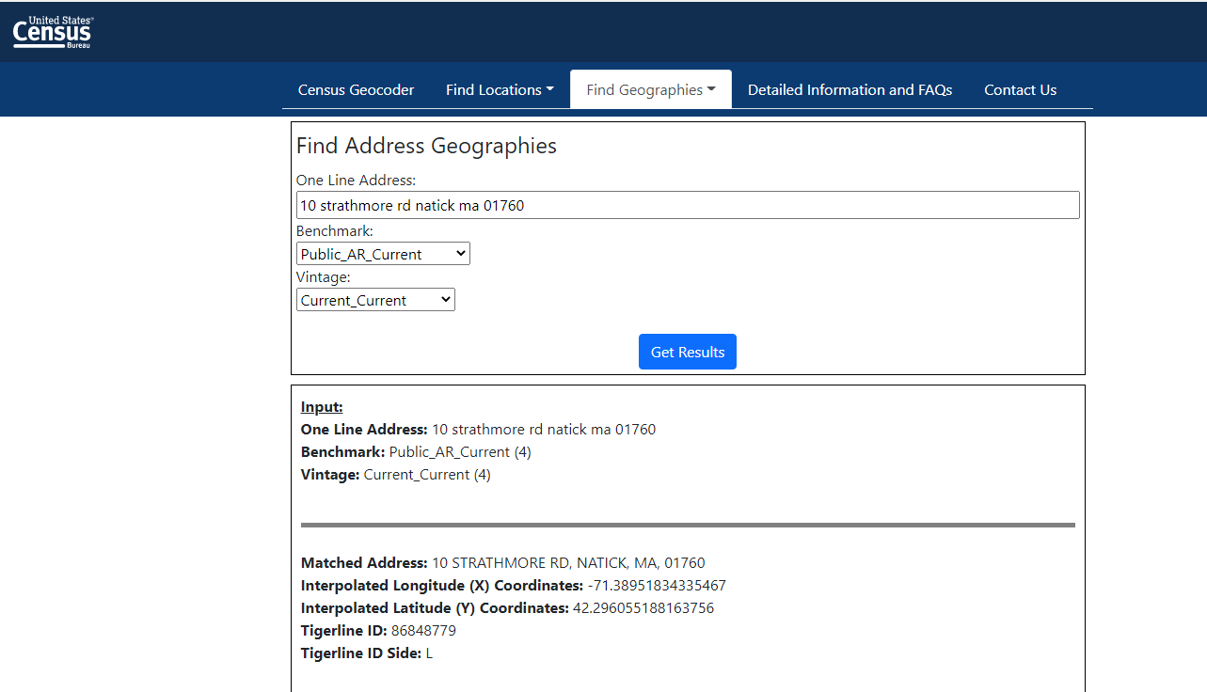
Census Geocoder
Be aware of the Benchmark (address range collection period) and Vintage (Census/ACS year) selected
https://geocoding.geo.census.gov/
Notes:
You can search for entries one at a time by entering addresses into their form in order to test out the data.
Beyond Census geographies this will also provide Congressional and state legislative districts

Slide 10
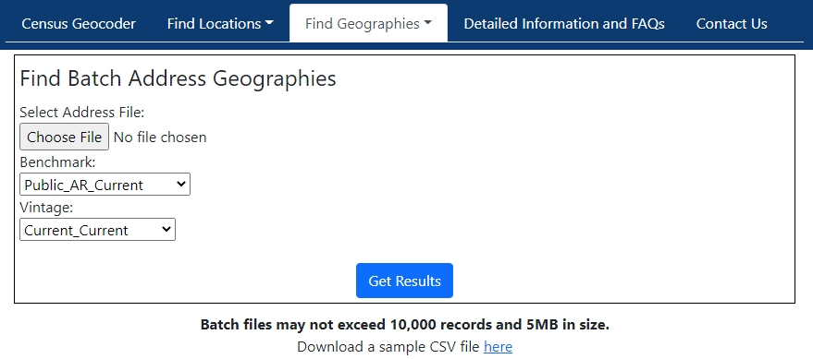
Census Geocoder
Initial Load
685,178 current patrons / 10,000 = 69 Files
Updates during the year
340,421 patrons active in the past year / 10,000 = 34 Files
Notes:
Beyond the initial load (or update as we had to do after the 2020 census….more on that later) we need to routinely check for address changes and new patrons.
In our loads we exclude records for students from our academic members (all students get a card so measuring the cardholder percentage isn’t useful, and also their address are often not useful).
We also exclude residents of towns outside our immediate service area since the cardholder numbers are low enough that the data wouldn’t be sufficiently anonymized in resulting reports.

Slide 11
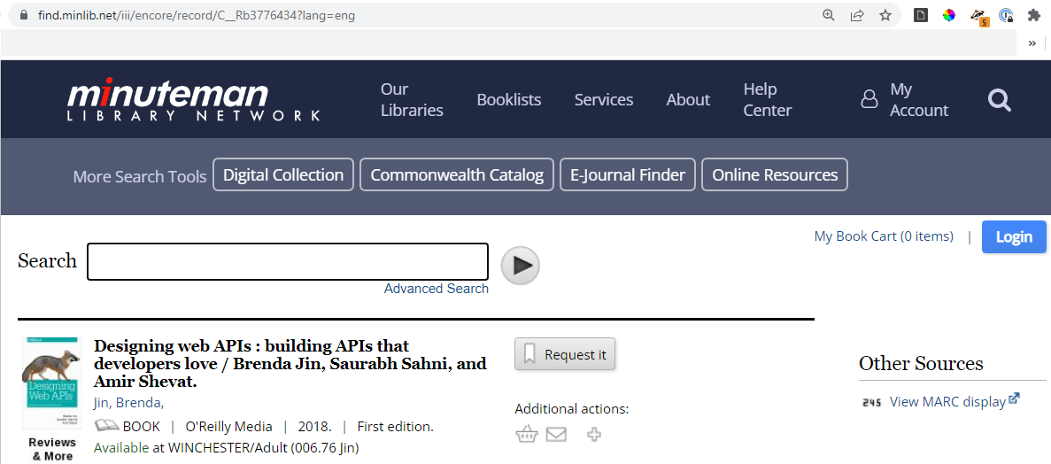
RESTful API
Application Programming Interface Protocol for two programs to communicate with one another Restful Confirms to a set of system architecture principals In particular no client information is stored between requests and each request is separate and unconnected HTTP based
Base URL: find.minlib.net/iii/encore/
Endpoint: record/C_R
Record to search: b3776434
Additional parameters:
Language: English
Notes:
As an approximation of how RESTful API calls are made via HTTP we can compare to how HTTP calls are made within our catalog
There’s a base URL that is used within all calls
A particular endpoint appended to that for the particular call being made (here a search by record number)
A value to search that endpoint on
And then optional parameters to further control the data returned
A RESTful API call is a bit more complicated then that as there’s also an authentication step to go through and there may be more options for the data being sent/received but it still follows this basic structure

Slide 12
TODO
1. Retrieve Patron addresses
2. Send via Batch Geocoding API
ILS
?
Geocoding API
4. Update Patron Records
3. Parse API response
Notes:
At this stage we know the steps we need to take and the two endpoints we’re using. However we need an intermediary layer as the census bureau isn’t designed to work with an ILS system and vice-versa

Slide 13
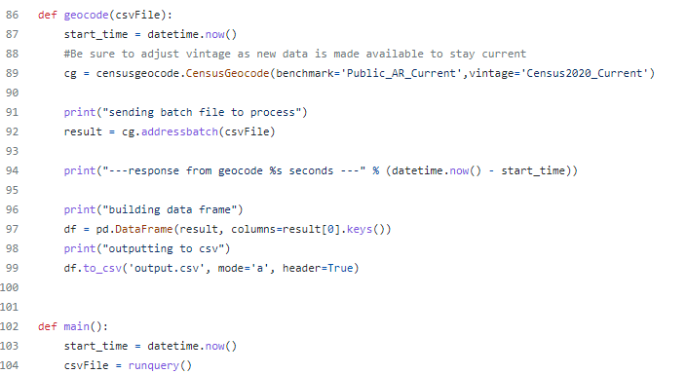
Python
https://github.com/Minuteman-Library-Network/Patron-Geocoder
Send data to API
Function to call geocoder API
Save to CSV
Main function to run through each step
Make csv of addresses & send to geocode
Notes:
For that intermediary layer we are using a Python script, of which this is a part, you can see the full script by following the link.
This excerpt is focused on sending a file of addresses gathered from a Sierra SQL query and appending the census geocode id to those results using the Geocoder API

Slide 14
Problem #2
How to add a unique field to 10,000 patron records
Notes:
A traditional batch update in Sierra is to apply a single change to a group of records, such as finding all items with the new bookshelf location and updating them all to the regular shelf.
But here we need to apply a unique value to each record so we can’t use that particular tool. There might be something to be done with a custom load profile and overlaying records but there’s an easier way that will also help with our automation efforts.

Slide 15
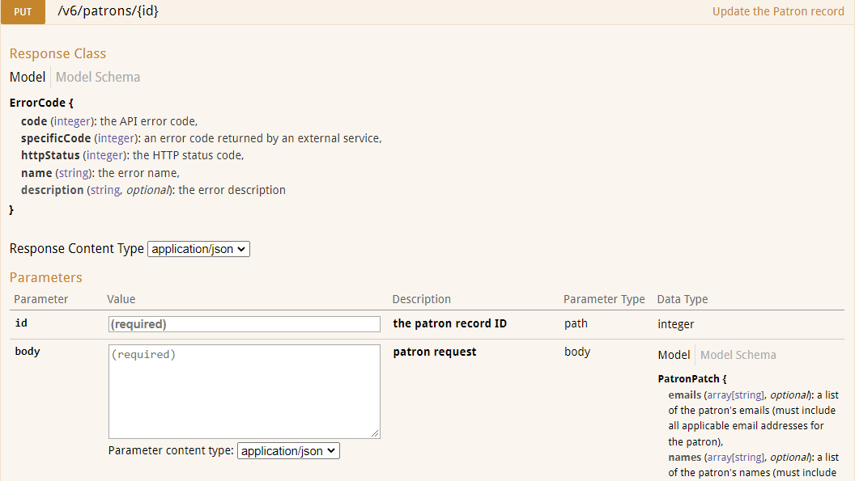
Patron API
Notes:
With the patron PUT endpoint we can append our census field to each record, the API just needs a record number and the data we wish to add, formatted correctly in JSON.

Slide 16
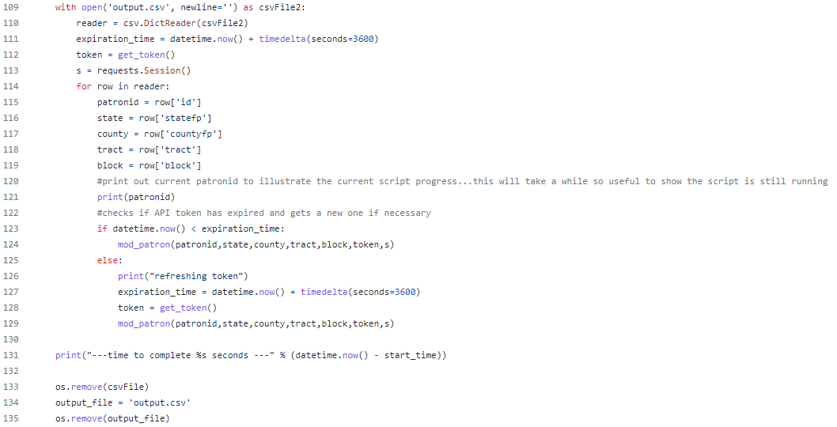
Modify Patron Function
Run Modify Patron for each row of csv file
Delete Files
Notes:
With that API we can then create a function in our Python script (mod_patron) that writes a census field to a patron record.
Then it’s just a matter of looping through the rows from the file we made previously and calling that function for each row.
When we’re done we delete that file so we’re not keeping patron data around for loner than necessary.

Slide 17
Problem #3
The final script takes over 5 hours to run
Notes:
Pulling data from Sierra initially takes moments. Waiting on the geocoder api to return an updated file takes maybe 30 minutes. Making 10,000 API calls to Sierra to update the patrons takes the rest of that time.
So we can’t run this daily, but once a week is manageable with something dedicated to that task. We have a workstation that is only used at this point for running scripts. We use that for monthly reports, data extracts for services like shoutbomb, automated emails, and tasks like this that we fit in to that schedule where we can.

Slide 18
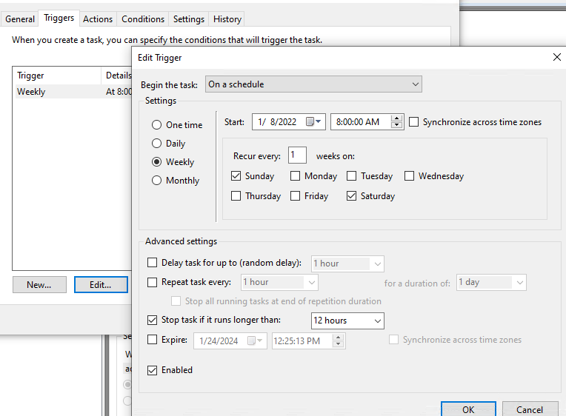
Scheduling
Batch file to run Python script
Job in Windows Task Scheduler to run the batch file
Notes:
We just set this and all our scripts to run via Windows task scheduler.
We have a small batch file to activate the appropriate python virtual environment (geocoder is configured to provide the Python libraries used for set of scripts) and then run the file
Then task scheduler triggers that batch file to be executed on a regular schedule.

Slide 19
Problem #4
How to turn
Sierra
Census
Tiger/Line
Patron addresses and circulation activity
Demographic data
Geographic details
Into

Slide 20
ILS Data
https://github.com/Minuteman-Library-Network/SQL-Queries/blob/master/Custom%20reports%20site/patrons%20by%20geography.sql
Notes:
Here you see the results of a query we use to gather a number of stats grouped by geoid into a table. You can see the full query at the link.
Now we can see values like the count of cardholders, the count of active cardholders, and the total circulation for each geographic area…assuming we can link these geoids to a map in order to make those geographic areas convey some meaning

Slide 21
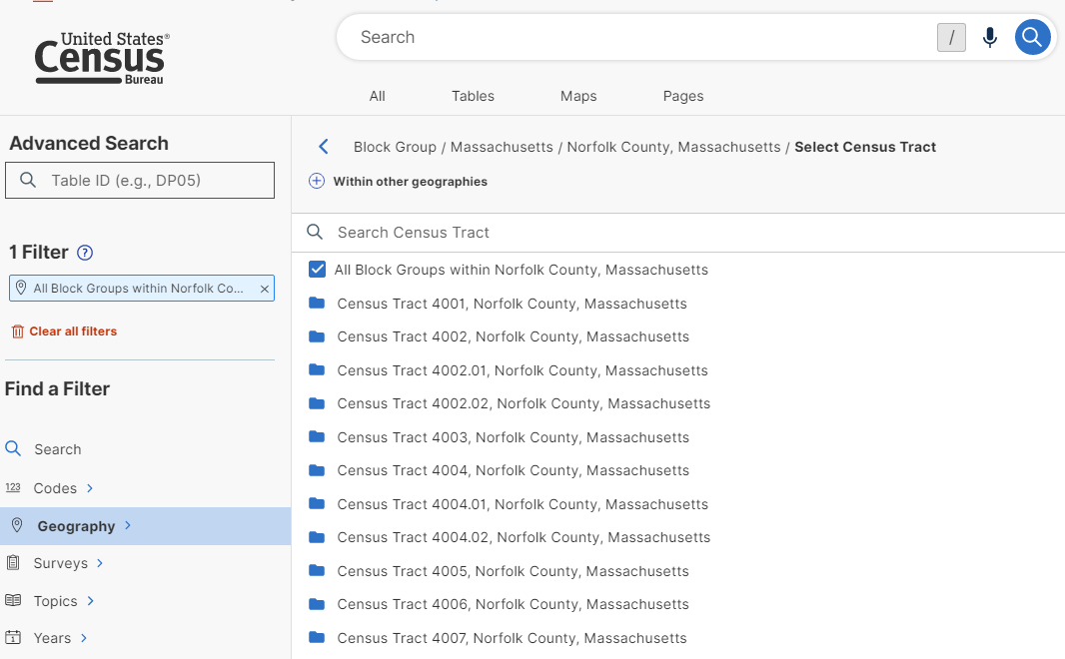
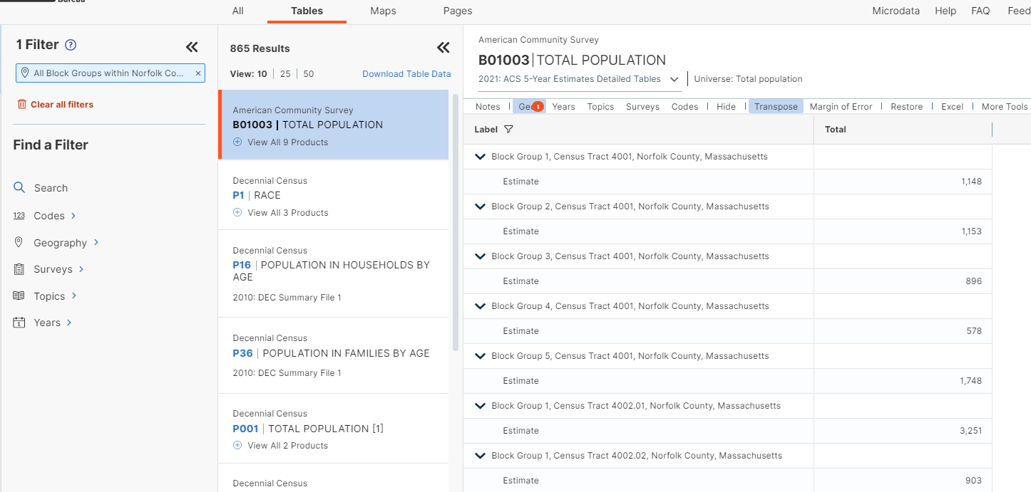
Census Data
https://data.census.gov/
Notes:
We can pull demographic data for those matching geographies from the Census Bureau’s data site. If we can combine these resources we can then do things like compare the cardholder totals to the population estimates for each geography.
With the census site you will have to jump through some hoops to filter your data to where you’d like it to be, and maybe clean it up some after (more on that next slide), but that’s an annual task at most when using the data from one of their surveys like the ACS 5-year estimates.

Slide 22
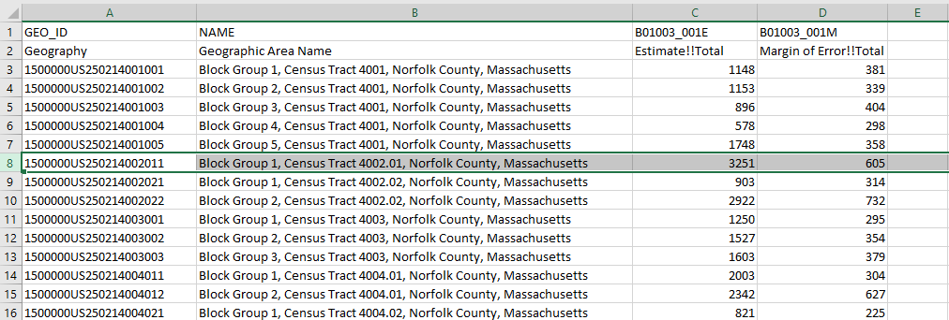
Matching Up Data
Census Block Group 250214002011 has 1922 library patrons out of an estimated population of 3251
Note:
Remove
1500000US
Prefix
Notes:
Now we can link up the geoids from both data sources….after a bit of data cleanup.
The raw data from the census includes some unfortunate column headings, and the geoids all include a prefix designating the geographic level included in the report. You will want to clean that up a bit to make the data easier to work with.
Depending on the exact visualizations you may wish to provide you may also need to pivot the results of some data sets. Tables with subdivisions of population totals break out each grouping into a separate column, which you may need to combine.

Slide 23
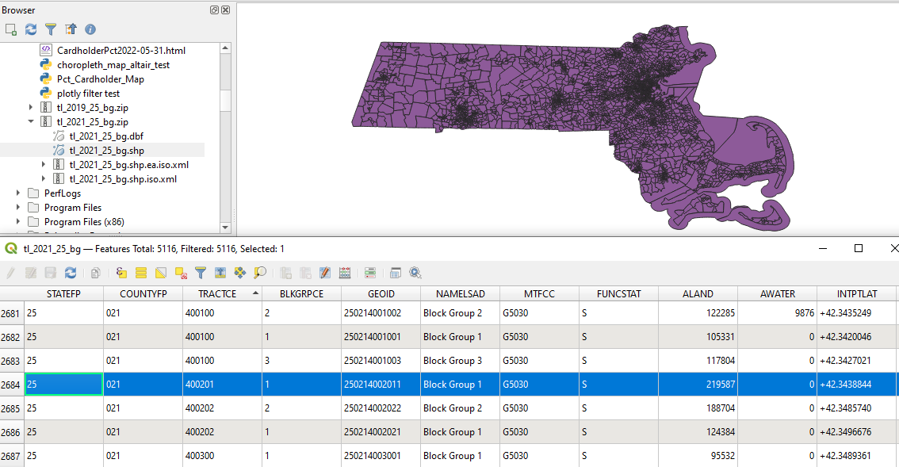
Shapefile
TIGER/Line files are produced for the census and are freely available
Zip archive containing multiple files
Coordinate data to define each geographic region for a map
Metadata about each of those regions
One of those points is again a geoid we can use for joining to our other tables
Get TIGER/Line shapefiles https://www.census.gov/cgi-bin/geo/shapefiles
Notes:
Topologically Integrated Geographic Encoding and Referencing

Slide 24
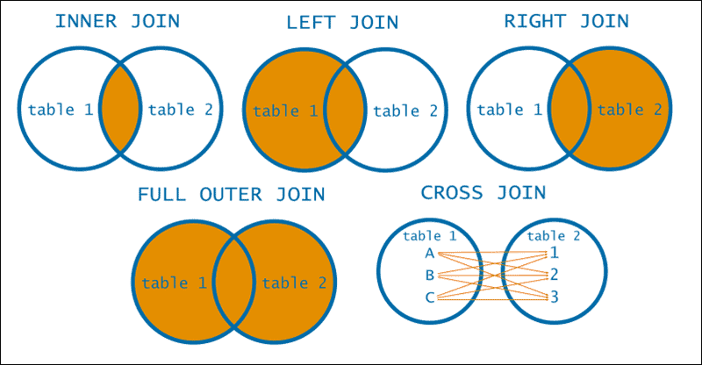
Joining Tables
Table 1
Name | City
Adam | Austin
Beth | Boston
Chris | Cincinnati
Table 2
Name | State
Adam | TX
Beth | MA
David | CA
Inner Join
Left Join
Right Join
Name | City | State
Adam | Austin | TX
Beth | Boston | MA
Name | City | State
Adam | Austin | TX
Beth | Boston | MA
Chris | Cincinnati | NULL
Name | City | State
Adam | Austin | TX
Beth | Boston | MA
David | NULL | CA
Notes:
Join provide the different parameters for combining tables and are all about how you wish to handle cases where there is data in one table that does not match the other.
The traditional way to envision this is by using venn diagrams, shading in the data set you wish to use for your particular use case.

Slide 25
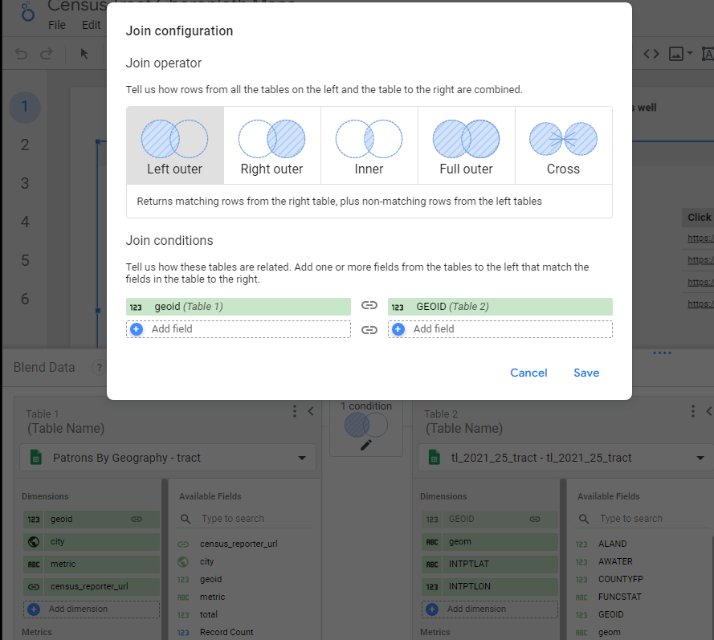
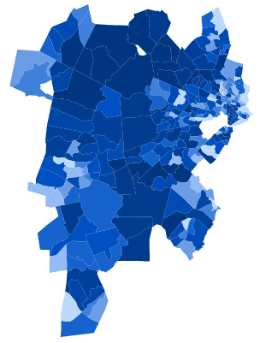
Limiting to Our Service Area
Notes:
Using a left join between our data from sierra and the TIGERline file gets us everything from our Sierra data and then only the portions of the map matching one of those geographic areas, limiting us to our service areas.
An Inner join would also work in this case, but then the resulting data would omit any of our sierra data that couldn’t be matched for any reason, and that data could be helpful for correcting errors later.

Slide 26
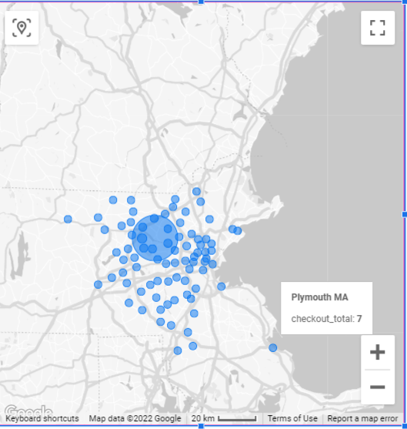
Aggregate Data and Privacy
Limiting to our immediate service area to avoid outlying data
A geography containing 100’s of patrons helps to anonymize that data
A region with a single family using your library risks re-identifying those patrons
Notes:
This early draft of a checkouts by residency report did not filter out towns outside our service area.
For an example of how this may be problematic, here you we can see 7 checkouts that occurred to patrons living in Plymouth. That’s a small enough number that it likely accounts for a single household. From that it’s not an unreasonable leap that this user may be a staff member who commutes. Assuming that’s correct it may not be difficult to find a list of employees of the library in question and determine which one lives in Plymouth, allowing someone to then track their borrowing habits.

Slide 27
Visualization Products
Notes:
Many options for producing visualizations exist, though not all are able to utilize a shapefile of your choosing. Each comes with pros and cons in terms of cost, complexity, etc…

Slide 28
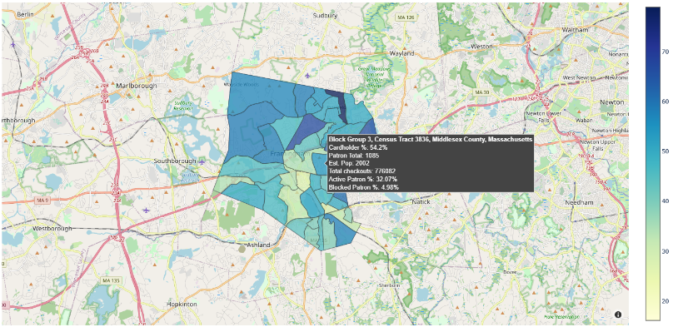
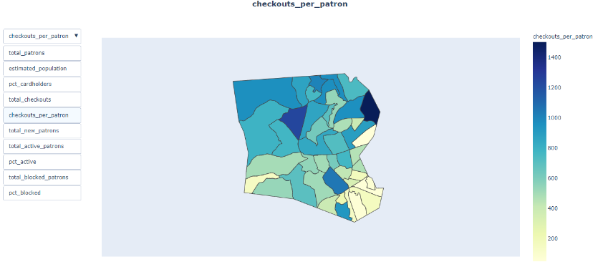
Using Python &
https://github.com/Minuteman-Library-Network/Patron-Maps
We produce monthly updates via automated script for each municipality in Minuteman
Outputs HTML files featuring various interactive choropleth maps
Thanks to code contributions from:
Kate Wolfe & Ray Voelker
Notes:
Plotly is an open source data library for visualizing data that can be utilized within a number of common languages such as Python, R and Javascript.
The script found at this link will run the Sierra query we looked at a few slides back, join the results to both our Tigerline file and a saved excel spreadsheet from the census bureau, and then output these maps as html files. In Minuteman we also have the script upload the files via ftp to our intranet site.
The two maps utilize slight different forms of the Plotly library for different features. The All-in-one map in the lower left is using Plotly Express to produce it’s figures and provide a selecting menu in which the user may toggle between different metrics. The cardholder percentage map in the upper right is using the mapbox feature of Plotly’s underlying graph objects feature to overlay its image on a map pulled from open street maps, but does so at the expense of providing the metric selector.
Both approaches we’re using were developed with a lot of code suggestions and just general support from Kate Wolfe & Ray Voelker.

Slide 29
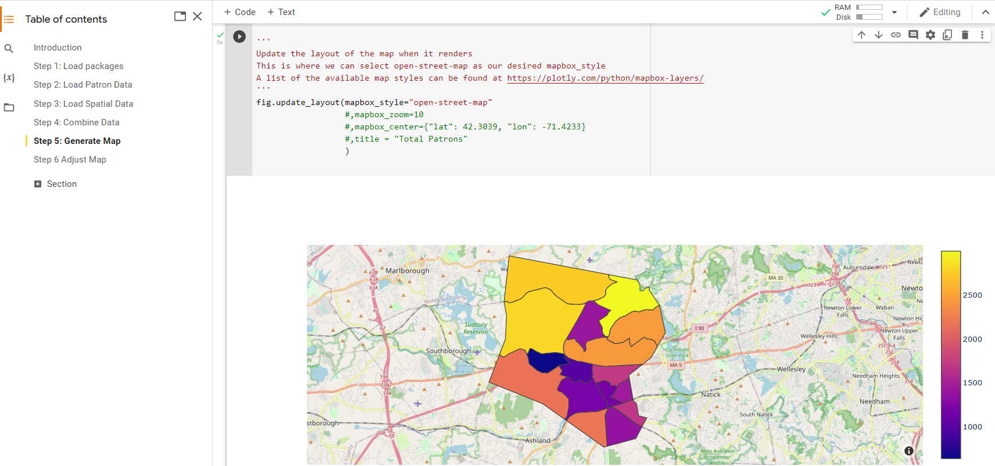
Try It Yourself
https://colab.research.google.com/drive/1ZSanf8nO10abSIAKWU7RPYKozCK10AQw
Notes:
You can experiment with a demo version of this script using this notebook built with in Google Colab using a sample set of data.
You can execute portions of the code block by block running through the full tutorial. The page will not save any changes to the code you may make so you can freely mess with the script if you wish and just reload the page to revert those changes to try experiment. You can also make a copy of the script for yourself if you wish to have full editing privleges for a version of this.

Slide 30
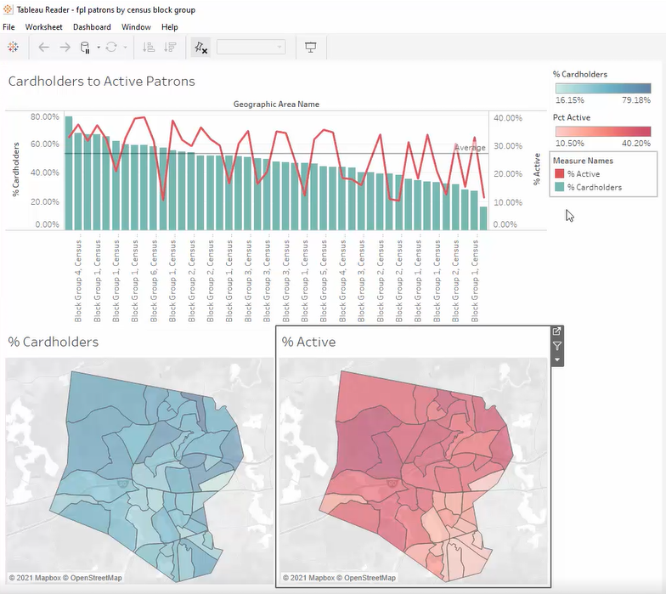
Original Data dashboard used in Minuteman (replaced when maps were updated for 2020 census)
Tableau desktop is pricey
Web based public version is available if you don’t mind sharing your data
Easiest option for us to build visualizations but most difficult to maintain and to distribute
Notes:
Tableau is a very nice and relatively user friendly tool for creating visualization dashboards. We used it to produce our original dashboards but not in a very sustainable manor. We did not want to make our dashboard publicly available so avoided the web based public version of the site.
So instead we produced dashboards using Tableau desktop using a single user license. We could produce dashboards and distribute them through our staff intranet site, which staff could then view with Tableau reader. However keeping dashboard current proved to be unmanageable and the need to download another program to use the files proved to be a barrier to adoption for many.

Slide 31
Problem #5: The 2020 Census
Updated Geographies released Jan/Feb ’21
Census Data was not released until March 17, 2022
Data Quality was below standards of prior census
https://www.census.gov/programs-surveys/decennial-census/decade/2020/planning-management/process/data-quality.html
Many metrics have quite high margins of error
Notes:
Had to update our geoids to match the new geographies and redo the dashboards to utilize new maps.
Delays and data collection issues due to the pandemic’s impact on the Census Bureau’s resources and the impact to the response rate brought about by the controversy over introducing a question around citizenship to the Census.
Paused our reports for much of ‘21 to reevaluate
During this time we shifted from using Tableau to Looker Studio

Slide 32
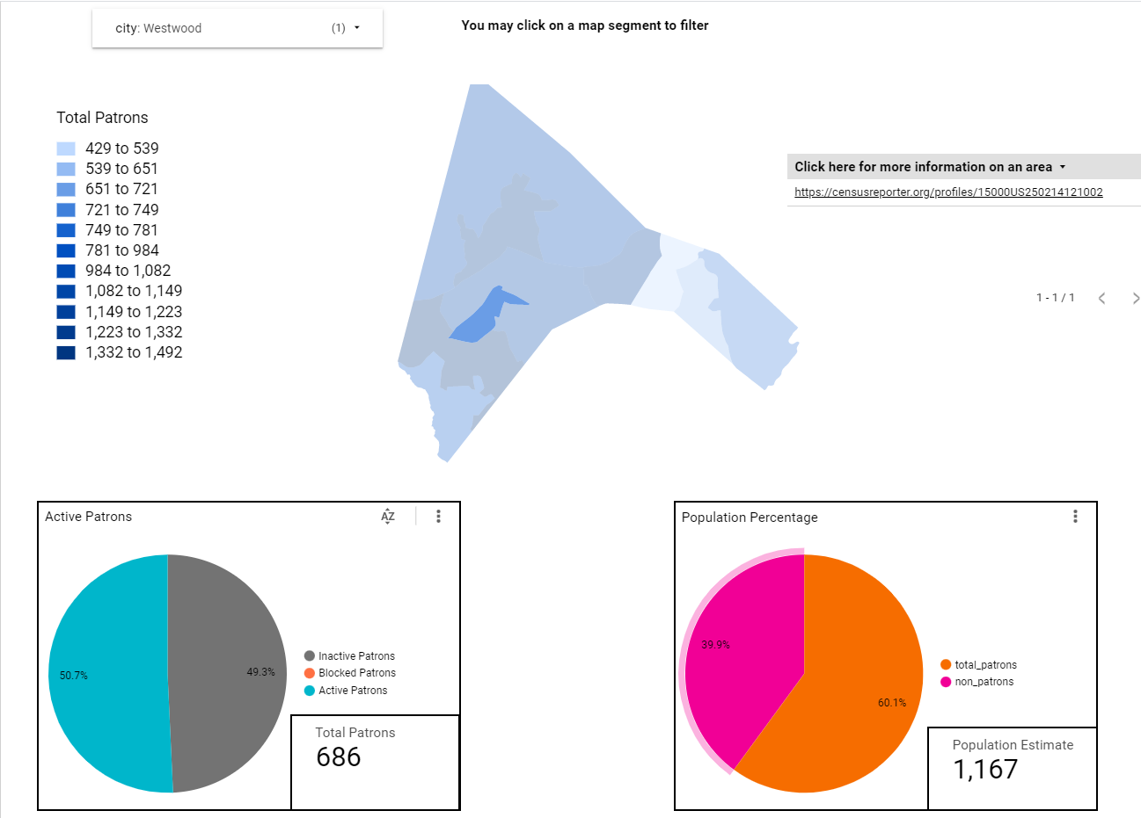
Free Visualization platform from Google
Lacks a native feature for ingesting shapefiles, but a community member created one
Designed to pull data from Google Sheets, analytics and BigQuery
Similar sharing features to Google docs/drive, making it easy to control access
Dashboard pulls from a few Google sheets that we keep current via Python script
Notes:
Called Data Studio until recently
The community visualization requires an additional step to convert the shapefile into a format that Looker Studio can use. See the link in the slide for instructions.
Dashboard utilizes a Google sheet with our shapefile data, joined to another sheet containing our ILS data, and then joined to additional sheets containing various census demographics as needed for any particular chart.
Here’s the lead page of our dashboard, illustrating the number of patrons in each geography with pie charts to compare those numbers to the estimated population and to break out the percentage of those patrons that have been active in the past year. Chart can be filtered to any town/city within Minuteman and clicking on an area the map will filter the other charts on the page.
Pages can be downloaded as pdfs or as the underlying spreadsheet data, links can be generated to individual pages of the dashboard, including selected filters if you wish.

Slide 33
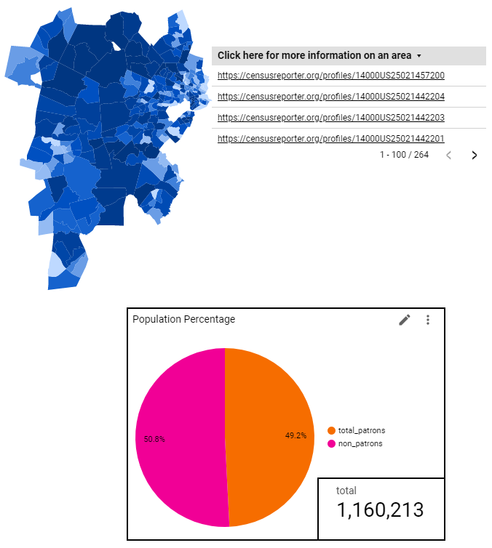
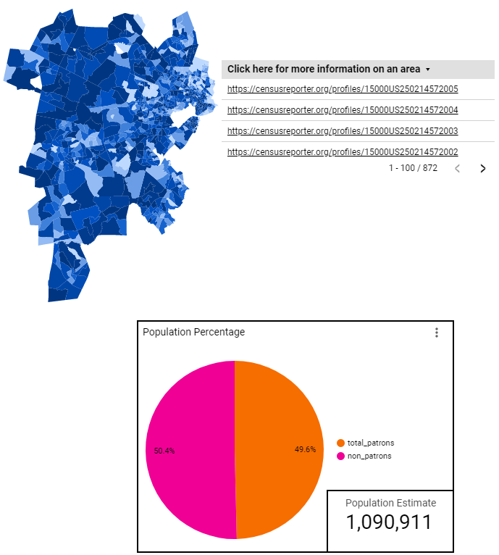
Two Versions
Population By Census Tract
Population By Block Group
Notes:
We have produced two parallel versions of this dashboard, one using census tracts and one using block groups.
Note that difference in population total between the two charts. There are addresses for which the bureau has been able to determine a tract but not a block group, so this can be seen as a choice between accuracy vs. precision. The missing data is not evenly distributed among communities, in general the cities with higher population densities see a greater discrepancy between the two geographic levels.
We do have one town within Minuteman with a population small enough to be fully encompassed by a single census tract. In that instance only the block group version of the dashboard can be helpful for isolating out data by neighborhoods.

Slide 34
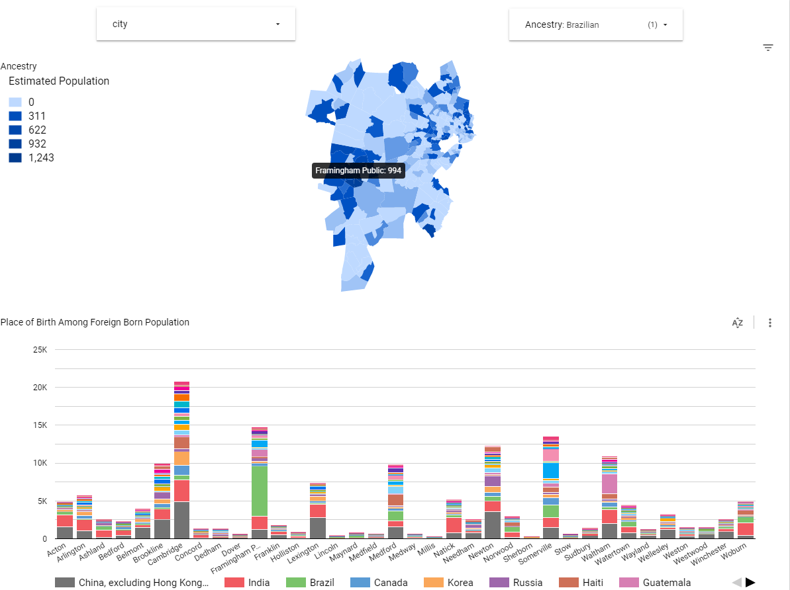
Tract Only Data
Detailed ancestry and place of birth data not available at the block group level
This data is also not updated with the annual ACS surveys
Notes:
This is as close as we can come to decent data around detailed languages spoken by area. The full data around that is made available at the statewide level. But as you can see here with the huge spike in the Brazilian population within a single community, there can be a wide degree of variation between neighborhoods.

Slide 35
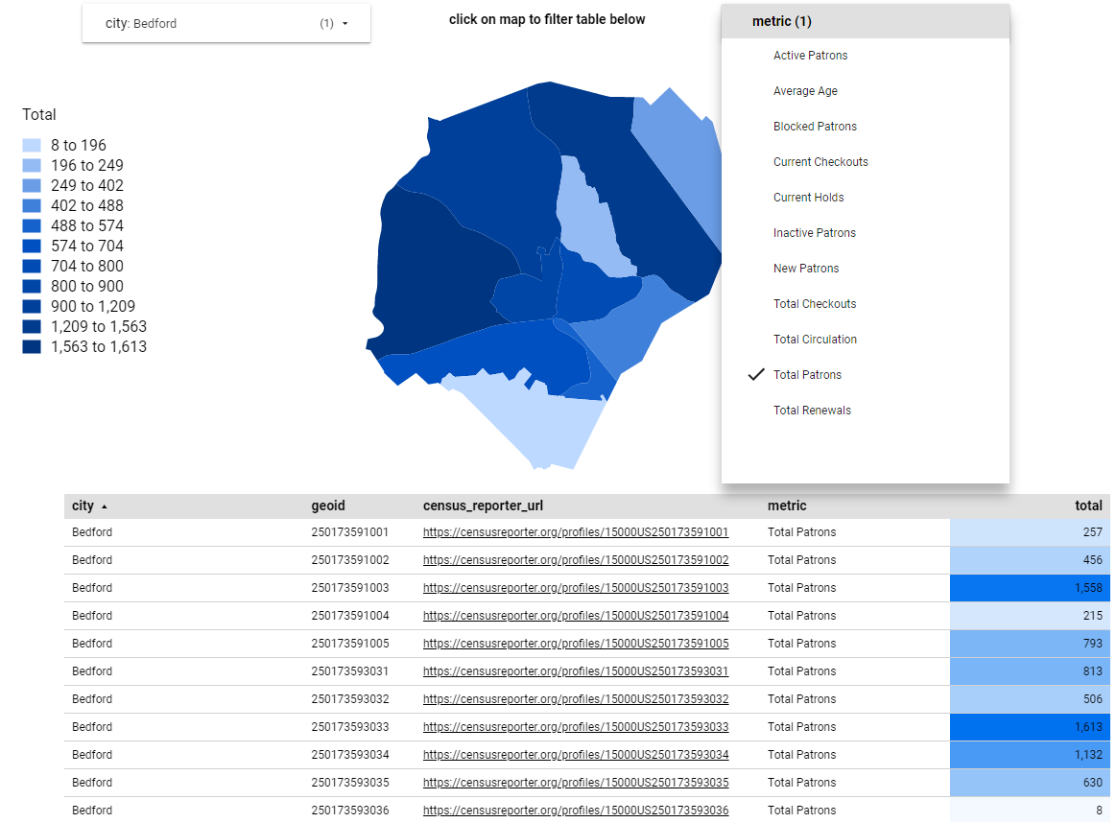
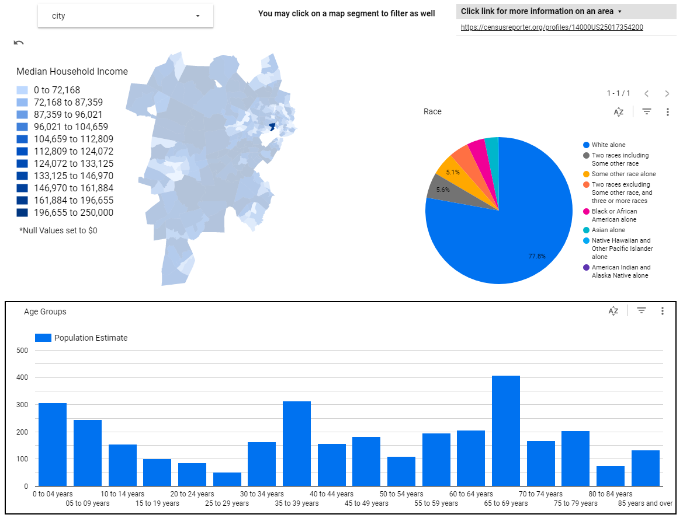
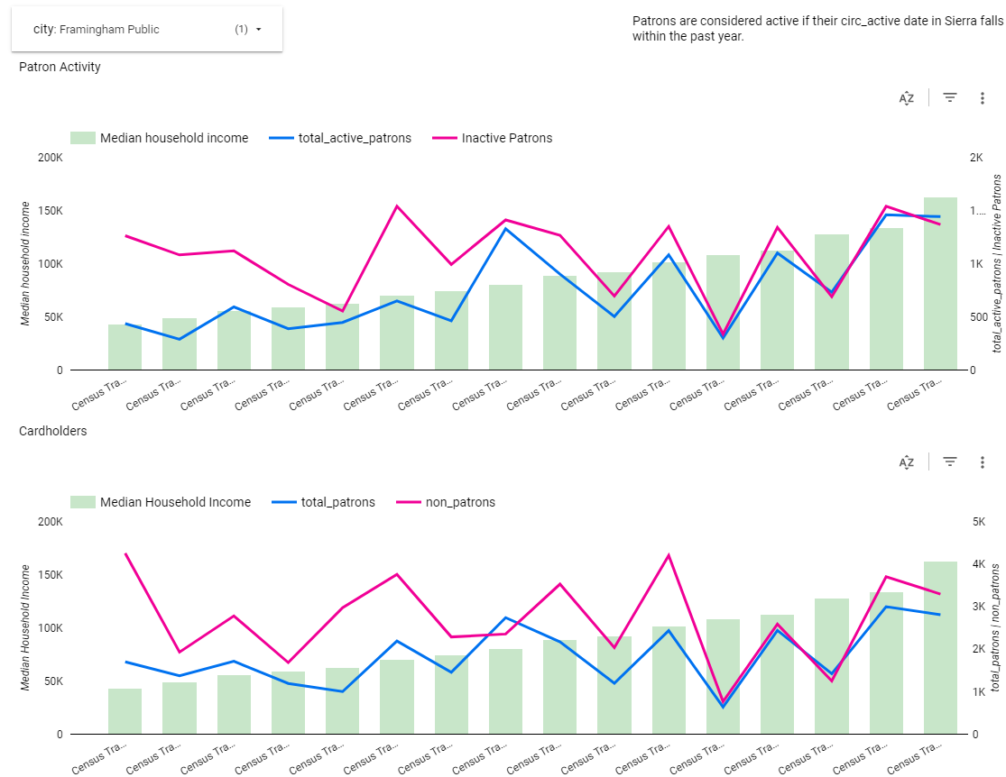
Gallery
Notes:
Using more of the demographic data from the census we can compare the median household income, racial makeup, and age breakdown of any of these geographic segments in line with our patron data. Comparing median income to the cardholder percentage can be particularly revealing to identify if library services are reaching generally underserved communities.
In the prior Tableau dashboard we had a version of this chart that was based around fines data, but during the pandemic enough of our libraries went fines free that we could no longer pull meaningful data from such a report.
Then we also a form of the all in one map seen in our Python based approach.

Slide 36
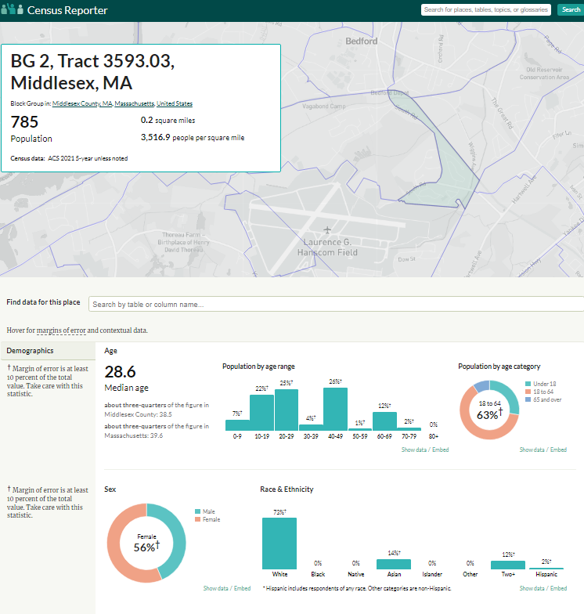
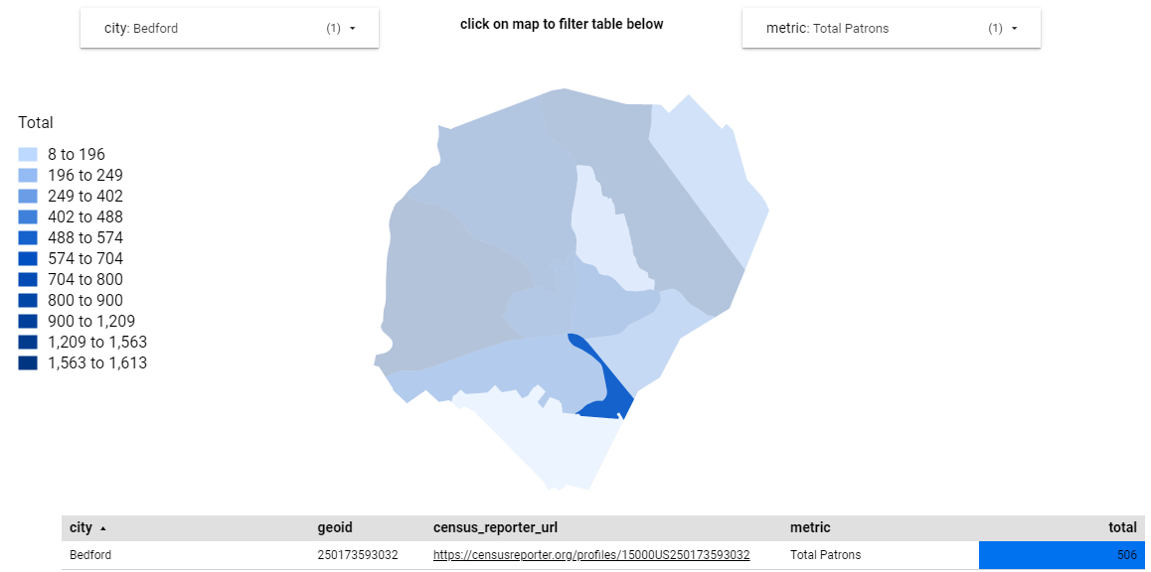
Census Reporter Links
Notes:
One last trick we’ve incorporated into this tool, thanks again to Ray Voelker for the idea, is to build in links to the Census Reporter website. By clicking on any region in the map it’ll filter the corresponding table to the matching row to provide one of these links. The census reporter is an excellent tool for both orienting the user with a map (sadly the visualization in Looker Studio cannot yet be overlaid on a street map) and for exploring additional demographic metrics from the census database for that area.

Slide 37
Questions?
jgoldstein@minlib.net
https://github.com/Minuteman-Library-Network/Patron-Maps

