Slide 2
Barcode to Record Number Conversion Utility
Or how one project becomes something completely different
Jason Fleming
University of North Carolina Wilmington

Slide 3
Sierra import functionality
Sierra can import record numbers of different types in Create Lists
Yay!
But what about Barcodes?
Notes:
I thought this was great news. But I also remembered several projects of my own where the group of identitifying numbers that I had were barcodes and what would I do if that was the case again.

Slide 4
ILS Committee
Would anyone find it useful if we created a utility to convert a .txt file of barcodes to their corresponding record numbers? (Item or BIB)
Notes:
So, this is the question that I posed to our library committee that meets biweekly to talk about all things Sierra.
I think there was a general consensus that this would be a good thing to work on. At least one person had a project in mind and thought it would be useful

Slide 5
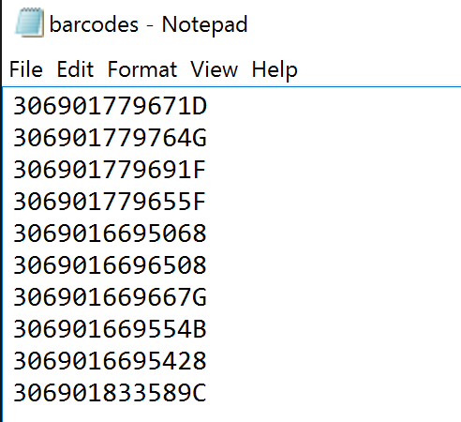
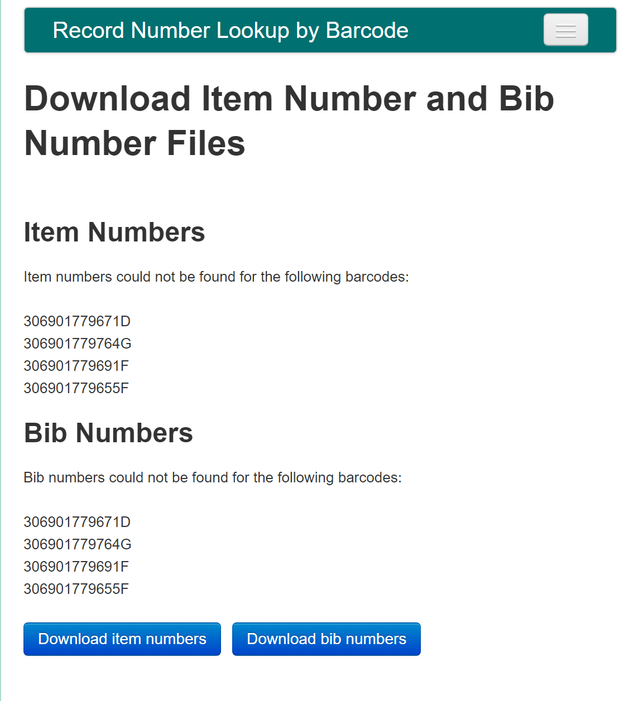
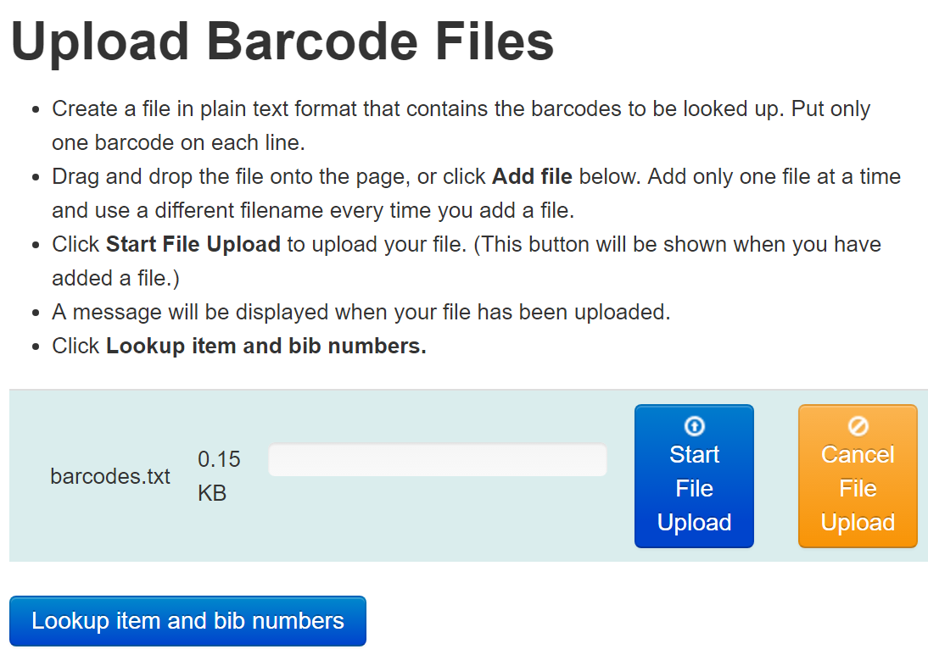
The web application
Upload a .txt file
Get back a .txt file
Notes:
So after some back and forth between myself and the web applications developer we arrived at this utility. I provided the SQL queries that would generate the results and described how the functionality should work. It uses a local database of record numbers that we pull down once a week, and if it can’t find a barcode it will look at the LIVE data for those cases where a book was recently cataloged.

Slide 6
Project Complete
But wait.. Why is no one using it?
Michael Sauers
https://flic.kr/p/9bYwCD
https://creativecommons.org/licenses/by-nc/2.0/
Notes:
So, I’m not Michael Sauers, but this is how I feel sometimes when I don’t see a utility being used by staff.

Slide 7
Tracking down the projects
I swear Gov Docs said they were going to use it
ENTER: Library IT Govs Docs meetup // workflow analysis session
Notes:
So after sometime we remembered that Government Documents was going to use the utility so we met with them to see what their workflow was and what projects they are working on that could use this functionality. Maybe the issue was the need for training or a demonstration?

Slide 8
Gov Docs Workflow Analysis
Depository libraries have to compile a list of items they want to deselect
Items have to be offered to the state library
This is done by creating a list within their system of materials
Notes:
So, this is what we found. For a variety of reasons Government Documents is going through a major shift and deselection right now. They were taking items from the shelf and looking up information in the catalog and then adding that information to an excel spreadsheet. A lot of the items were barcoded, but some were not. We saw this as an opportunity to rework our own application and make it work for the project that they had

Slide 9
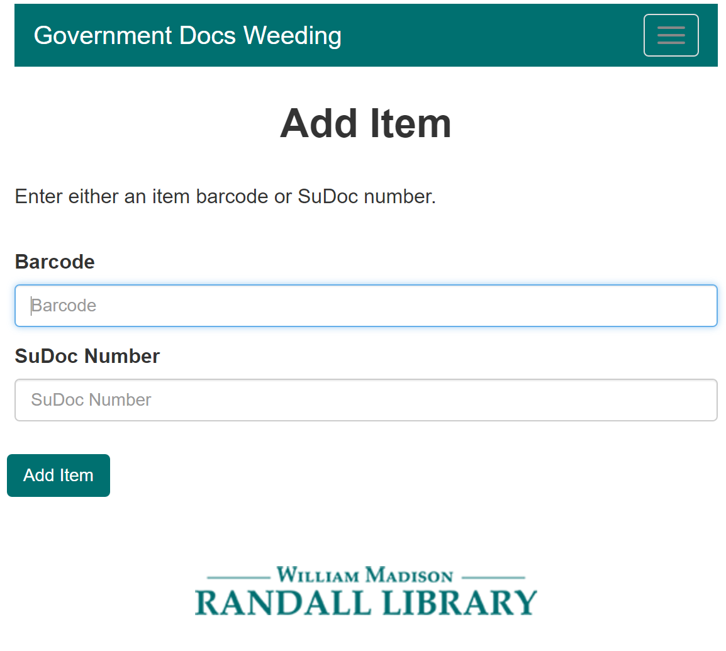
New Projects
Gov Docs Weeding Project
Scan in barcodes or enter SUDOC # to look up bib information
Notes:
So together the web and applications developer worked on this project. I found where the information was and framed the initial workflow should look like and then he took it and continued to change things in response to their needs. But it starts actually with you creating a list to work on and then adding items. AS you can see here you add items by entering a barcode or SUDOC number

Slide 10
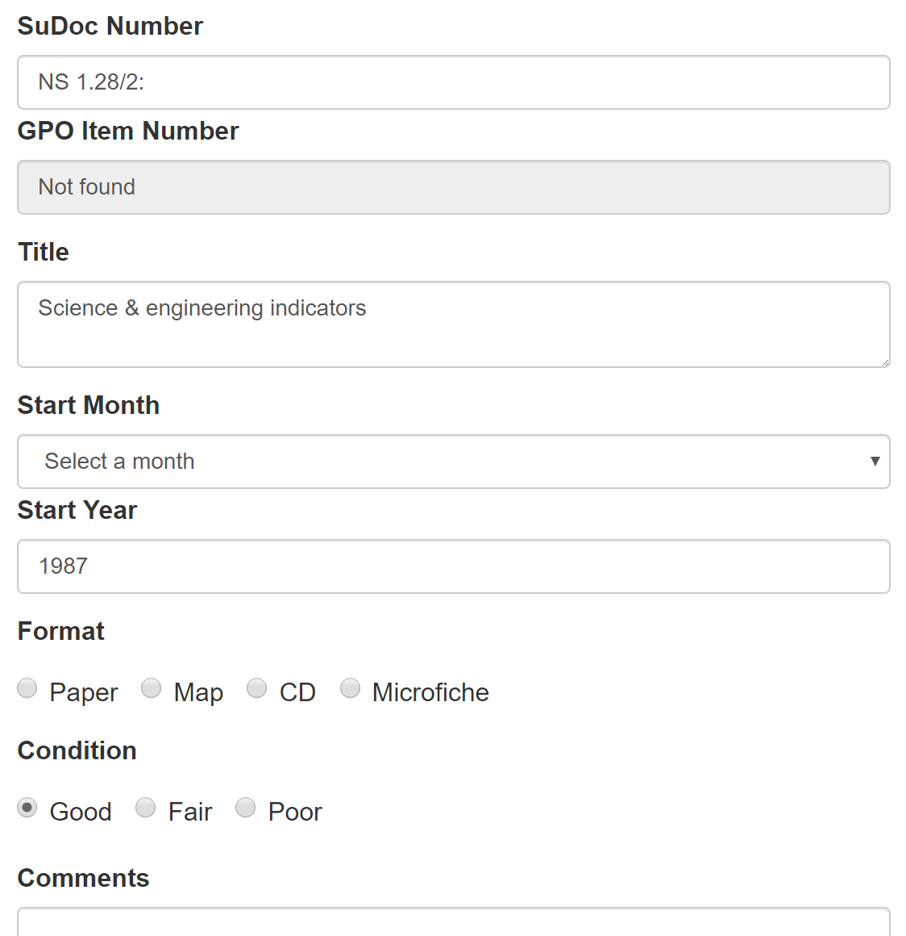
Barcodes
This is where the previous application came in handy
Barcode -> BIB Record -> SUDOC, TITLE, Publication Date

Slide 11
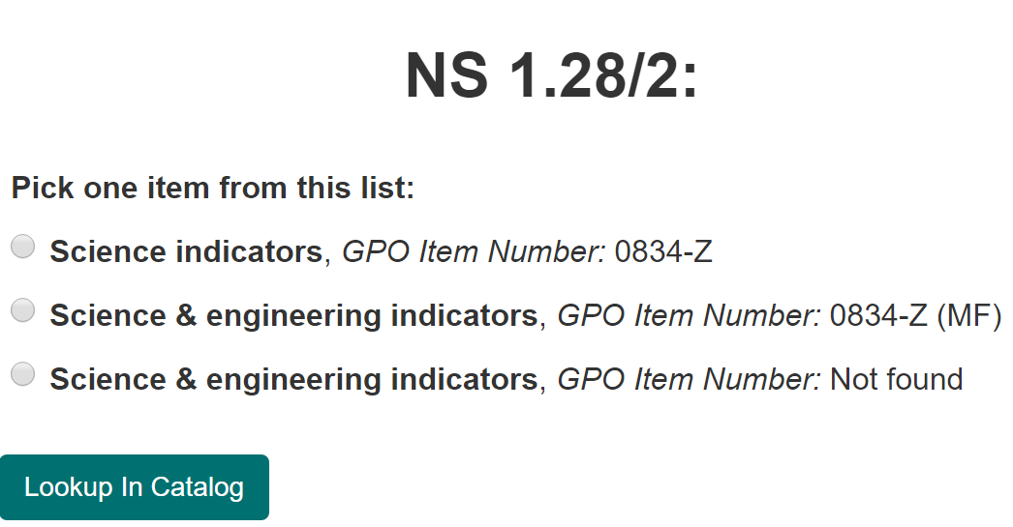
SUDOC
Notes:
With SUDOC numbers it is a little different because the same SUDOC number can pull up different records, so we had to give them a choice of items to choose from

Slide 12
Output
At any time the user can output the records in an excel file that is properly formatted for uploading into the State system
Notes:
It used to be that once they downloaded the file it was erased from the application but Government Documents wanted to keep that information in our system in that format in case they needed to refer back to it. There were a lot of little things like that that we had to go back and forth and change how things were done.

Slide 13
Thank you!

