Slide 2
2nd Year Updates from Linked Data Early Adopters
Presented by:
Erica Findley, Multnomah County Library
Susan Allan, Worthington Libraries
Andrew Wright, Dallas Public Library
Colleen Brazil, Sno-Isle Libraries
Jeff Penka, Zepheira

Slide 3
Library.Link at Multnomah County Library Year 2
Erica Findley, Cataloging|Metadata Librarian
ericaf@multcolib.org

Slide 4
Our Journey

Slide 5
What we can measure
Referrals from link.multcolib.org

Slide 6
What we can measure
All referral sources

Slide 7
Looking ahead
Change in re-direct
New analytics tools

Slide 8
Questions?
Erica Findley
ericaf@multcolib.org
Cataloging | Metadata Librarian
Multnomah County Library

Slide 9
Library.Link at Worthington Libraries Year 2
Susan Allen

Slide 10
Worthington Libraries
“When my community
searches the web for
something we have, we
better show up as an option.”
Chuck Gibson
Director, Worthington Libraries

Slide 11
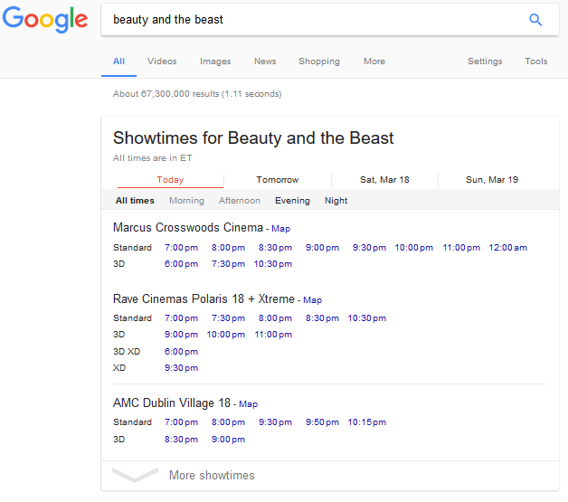
Expectation
Geolocation:
We hoped that people in our community would find our content based on their geographic location;
à la movie show times.

Slide 12
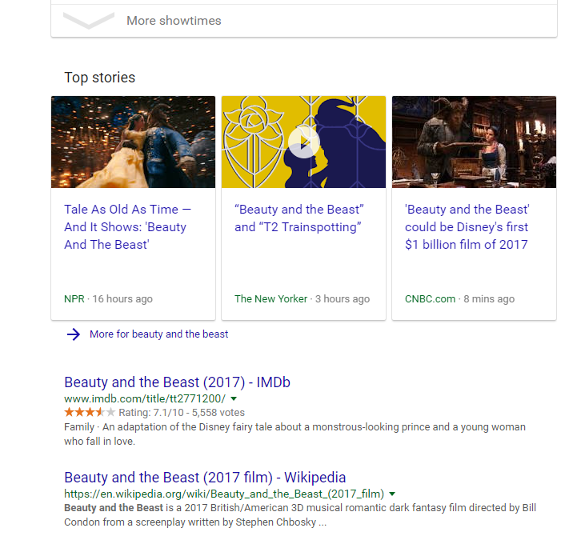
Expectation
Geolocation:
…And our content would show up somewhere over here in results if Google detected their location was in Worthington.

Slide 13
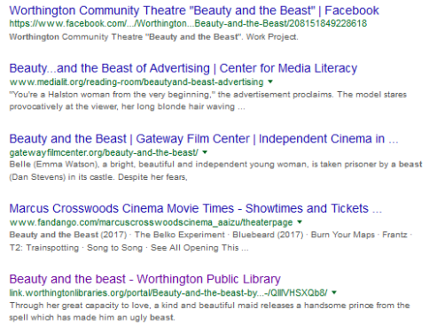
What is happening
When “Worthington” is included in search terms our content shows up in results.

Slide 14
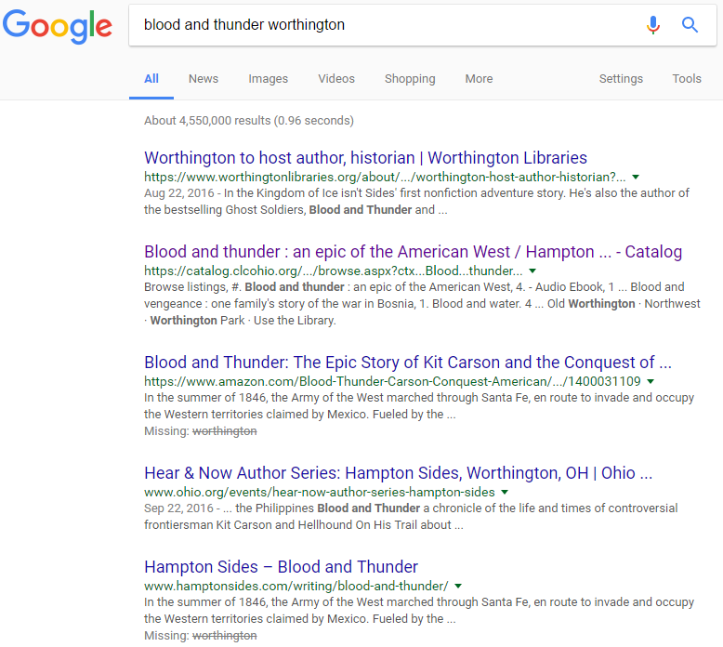
Expectation
Links to our PAC records in search results
What is happening
On occasion we see direct links to our catalog
More often we see links to our link.library portal
Prior to publishing data we never saw links to our catalog in search results

Slide 15
Measurement and assessment
link.worthingtonlibraries.org
portal visits November 2015 – February 2017

Slide 16
Measurement and assessment
Using Google Analytics, these are metrics that I look at monthly.
Clicks to item > reserve in PAC
Clicks to library card application
Sessions
Entrances
Sessions by region
Sessions by city
Sessions by traffic type
Sessions by source / medium
Sessions and entrances by page title
Sessions vs new users
Sessions by network domain

Slide 17
Who is finding our “stuff”

Slide 18
What’s next?
Continue bi-monthly upload of data through 2017
Upcoming workshop with Zepheira
Assessment

Slide 19
Library.Link at Dallas Public Library Year 2
Andrew Wright

Slide 21
Embedded Data
List’s, carousels.
Web pages & Social media inclusion
Help expand awareness of linked data.

Slide 22
Library.Link at Sno-Isle Libraries Year 2
Colleen Brazil

Slide 23
Theory
If our MARC records are converted to xml and published regularly on link.sno-isle.org that our page ranking in search engine results would increase and be found by our customers.

Slide 24
Link.sno-isle.org

Slide 25
Reality:
Things happen

Slide 26
Major
Lost two of our team analytics specialists
Moved to a new catalog
Minor
Lost momentum of regular publishing
Conversions problems

Slide 27
Link.sno-isle.org

Slide 28
Reboot team
Reboot analytics
Increase publishing cycle
Participate in regular meetings
Resetting Expectations

Slide 29
What the future holds for us?
Revived team
End of year evaluation
Decisions

Slide 30
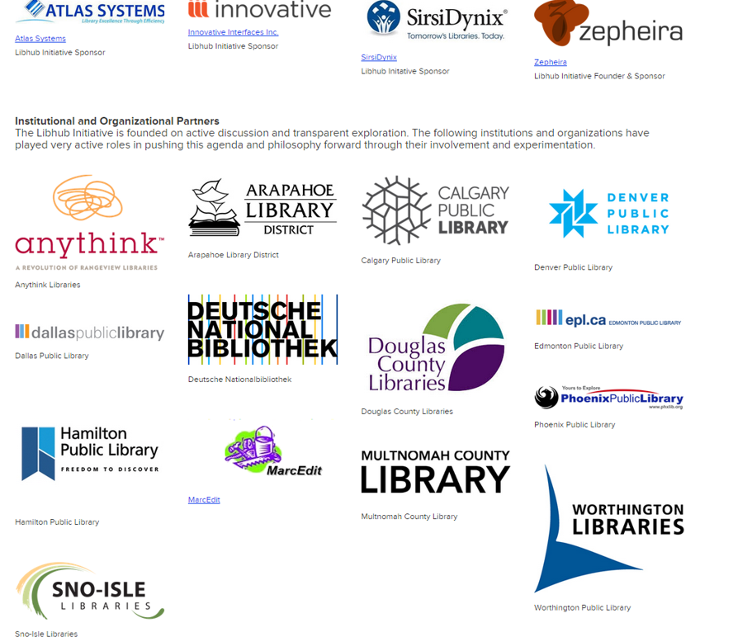
LibHub Early Adopter Survey

Slide 31
What went well in the last year?
Launch of network-level identifiers for works and instances, along with network link analysis (albeit experimental).
We gained greater insight into the Link initiative and its impact on member libraries by sharing and comparing data through the Alumni Assessment team. We also gained access to Google Search Console data and now have a better understanding of Google Analytics.
The work with the assessment team to compare data and look at trends. It's helpful to be able to collaborate with other libraries.

Slide 32
What was your biggest success in the 2nd year?
More results showing in web searches.
Discussions within our regional consortium to consider translating our shared union catalog to BIBFRAME; discussions with our main book vendor regarding why Linked Data (in some form) seems likely to be in our shared future.
Setting up Google Analytics and Google Search Console and establishing a consist set of data points to measure and assess going forward.
More libraries participating, vendors awareness of linked data, advocacy efforts.

Slide 33
What hasn’t worked as expected?
We still see some unexpected results in the published data as far as the Resources. Some of the terms don't seem to match, but they work on them as we report them.
I was expecting/hoping that the expanding nature of the Library.Link network would translate into more prominent placement in search-engine results, but it seems that the actual indexing of our BF resources remains unpredictable.
The data refresh process has not worked as expected. Contrary to what we’ve been told, we are not seeing data refreshes on a consistent, bi-weekly, basis. Our data harvesting tool also didn’t work as expected initially and it wasn’t configured to exclude works/items that we did not want published. Also our Link site is underperforming in regards to visibility in search engine results.
We thought we would see a steady increase in hits to our catalog and indexing on google.

Slide 34
What is your own definition of success in year two of this project?
Success is very hard to measure since we can't tie web searches to actual new cards or holds or checkouts. But we have had over 800 referrals to our catalog from web searches.
Building momentum around Linked Data awareness and understanding.
That we became more knowledgeable. We had hoped to see an increase in traffic to our online catalogue from our Link site, however, this did not happen in a measurably significant way.
The growing library.link network, having a better understanding of our analytics.

Slide 35
What do you highlight when you present this project to your Administration?
We highlight the fact that we are experimenting with Bibframe, which is most likely to be the successor to MARC.
While not new in 2016, I highlight the before/after proposition: previously our catalog data simply could NOT be found using a web search engine, whereas it can now be indexed, discovered, and navigated. We publish 3.7M linked-data resources that web bots can crawl, and we're doing so within a network of trusted library partners.
The ability to get our data on the web, and ongoing enhancements to BIBFRAME are important steps to increasing our presence in our community and beyond.

Slide 36
What do you highlight when you present this project to your Administration? (Continued)
We highlight the number of data refreshes that occur in a month, the number of Link URLs that are submitted to search engines for indexing, the number of Link URLs that get indexed, the number of Link impressions or URLs that surface in user search engine results, the average position of those results, activity on our Link site (sessions), where geographically those sessions are coming from, referrals to our online catalogue from the Link site, the number of new users from the Link site to our online catalogue, and the bounce rates.

Slide 37
What are your plans in regard to linked data for 2017?
We are working with our IT developer to somehow connect clicks and referrals to actual library card registrations. Our Get A Card page uses Google Analytics as well, so we're hoping to make some connections between the two.
I'd like to devote some time to making local MARC bib enhancements that would not only improve accuracy and navigation within our PAC, but also include data in $0 to link this information to corresponding identifiers on Wikidata. (This could be done, for example, with name headings, popular series headings, or perennial classics with uniform titles.
We recently became a Zepheira field tester for new Link tools and services, we hope to work with our discovery layer provider on implementing schema.org microdata throughout our catalogue, and we will continue to monitor Link site activity, share data through involvement in the assessment team and assess the impact the Link initiative is having on exposing our library collections on the greater web.
See what we can do to enhance MARC records to improve visibility. Perhaps use the data that we now have on the web in some way.

Slide 38
Jeff Penka
Updates from Zepheira

Slide 39
Questions?

Slide 40
Contact Information
Andrew Wright
Andrew.wright1@dallascityhall.com
Susan Allan
sallen@worthingtonlibraries.org
Erica Findley
ericaf@multcolib.org
Colleen Brazil
cbrazil@sno-isle.org
Jeff Penka
jeffpenka@zepheira.com

