Slide 1
Reimagining Workflow with BTCat
Christopher Mayhew and Grace Palmisano
Notes:
Speaker: Grace
Good morning and thank you for joining us at today’s presentation. Today we’re going to discuss how we at the Nassau Library System in New York chose to and went about updating our cataloging workflow using BTcat as well as AutoIT and FTP. Over the last year, we’ve managed to streamline our cataloging process using macros, developed ways to automatically input custom material types, and even begin to automate the copy cataloging process. Today we will be discussing how we went about making these changes and what we’ve learned in the process.

Slide 2
About Us
Robert Drake
Assistant Director, Technology Operations
Nassau Library System
New York
Christopher Mayhew
Principal Library Assistant & Copy Cataloger
Nassau Library System
New York
Notes:
Chris:
Grace:
I act as a go between for library staff and the catalogers and help facilitate cataloging updates and changes.
I administer the shared OverDrive digital book collection
I coordinate database subscriptions for all 54 libraries
I am currently working toward creating qualitative and quantitative collection development standards to be, hopefully, adopted throughout the 54 member libraries NLS serves.

Slide 3
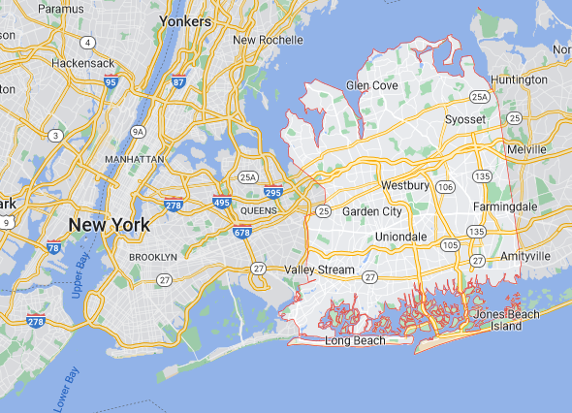
About the Nassau Library System (NLS)
Cooperative library system in Nassau County, New York:
54 member libraries (school, association, village, and special district libraries)
Each is independent, autonomous, supported by local taxes, and governed by its own Board
Total population to serve: 1,350,903
Notes:
Speaker: Grace
Now that we’ve introduced ourselves, allow me a moment to introduce our organization.
Chris and I are from the Nassau Library System (NLS) which is a one of 23 public library systems within the State of New York and one of 16 cooperative systems therein. Our service area, Nassau County, is located on Long Island which is just east of Queens, one of the 5 boroughs of New York City. Nassau County is a decidedly suburban area with a population of over 1.3 million people.
All 54 public libraries in Nassau County are members of the Nassau Library System consortium. While these libraries–which including school, association, village, and special district libraries–are supported by the System, these member libraries are independent and autonomous (awe-tawn-i-mus), each with its own Board of Trustees and supported by local taxes.
The Nassau Library System itself is governed by a 9-member Board of Trustees (these are representatives of the 9-geographic areas of the county) which are nominated and elected by the member library trustees. Nassau Library System is managed by its own Director who is appointed by the NLS Board. NLS is supported financially by NYS and its member libraries.

Slide 4
About the Nassau Library System (NLS)
Purpose of NLS:
Foster quality public library service
Enhance the public library resources and services available
Effect economies in operations
Provide training and continuing education opportunities
Stimulate development of public library service in unserved areas
Notes:
Speaker: Grace
So what is the purpose of the Nassau Library System?
The purpose of the Nassau Library System is to
Foster quality public library service in Nassau County
Enhance the public library resources and services available
Effect economies in operations
Provide training and continuing education opportunities, and
Stimulate development of public library service in unserved areas.
Nassau Library System is staffed by a team of nearly 30 librarians, catalogers, IT specialists, and business support personnel. These individuals organize group subscriptions (databases, digital books), facilitate learning opportunities for library staff, centralize specific technological needs (Internet access), and provide general guidance.

Slide 5
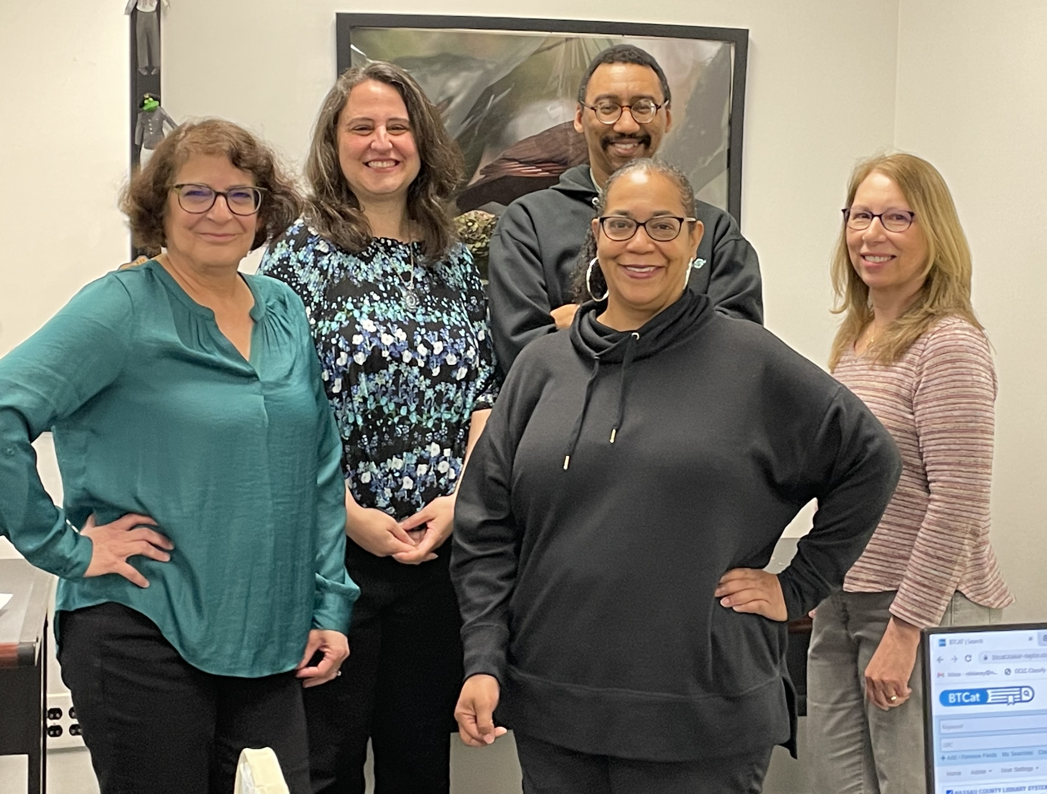
About the NLS Cataloging Department
Maintain all the bibliographic records of a catalog shared by 51 of the 54 member libraries
5,027,258 physical items in the catalog
Abt. 3,300 records (physical items) added monthly
Staffed by 6 FT individuals
2 Original Catalogers/Librarians
1 Library Assistant/Copy Cataloger
2 Copy Catalogers
1 Manager (non-cataloger)
Notes:
Speaker: Grace
In addition to the aforementioned responsibilities, NLS is also responsible for the maintenance of the online catalog which is shared by 51 of the member libraries. While the member libraries purchase items on their own and attach the items to existing bibliographic records, it is the catalogers at NLS who see that all title records are uploaded into Sierra and are edited for quality and discoverability. There are currently about 5M physical items in the catalog (excluding digital ebooks/audiobooks) and over 3K new records are added each month.
Currently, the NLS Cataloging department is staffed by 6 individuals, 5 of whom are responsible for handling each and every record added to the catalog. We have two original catalogers/librarians, 1 library assistant/copy cataloger, and 2 copy catalogers. I am the final department member. Although I do not physically do any cataloging myself I act as a go between for library staff and the catalogers and help facilitate cataloging updates and changes.
Before we go any further, I would like to mention that over the last five years or so, NLS has lost one part time copy cataloger to another department and a cataloging manager who cataloged a percentage of items each month. These positions have not been filled nor are there currently plans to do so.

Slide 6
Agenda
Where We Started
Original Workflow
Factors for Change
Ingredients for Change
Create List & FTP
BTCat
AutoIT
Results, Analysis, and the Future
Results
What We Learned
What We Hope to Do Next
Notes:
Speaker: Grace
So now that introductions have been made, it's time to move on to the presentation proper. Today we will be looking at where we started in our cataloging journey, changes we needed to make to update our workflow, and what results came from those changes.

Slide 7
Where We Started
Notes:
Speaker: Grace
So, without further ado…where we started.

Slide 8
Original Workflow
Items are purchased by the libraries and bibliographic records are added to the shared catalog
Q Clicks: minimal records provided by purchasing vendor
Cat Reqs: bare bones records created by member library staff
Use Create List to develop a list of records needing attention
Use SkyRiver or BookWhere to discover a useable record
Make changes to the SkyRiver/BookWhere record
Upload to Sierra to overlay original record
Update authority records
Quality check by Manager
Notes:
Speaker: Grace
Until recently, the following steps constituted the standard procedures for adding and updating records in our shared catalog.
First, the individual libraries purchase titles for their collections. If the title came with a MARC bibliographic record (titles obtained through a major vendor), then the record would be automatically added to the Sierra catalog (we call these records Q Clicks). If a title does not come with a MARC record (purchased from Amazon or donated by a patron), then the owning library would make a bare bones bibliographic record in Sierra (called a CatReq). The goal of this step was to get a bibliographic record, any bibliographic record, into the catalog as quickly as possible to allow for discoverability, reservability, and circulation.
But these newly added records are not complete and/or up to NLS’ standards: Q Clicks come in in varying degrees of completeness and CatReqs are bare boned and entered by non-catalogers. As a result, each and every one of them needs to be updated by NLS catalogers and to isolate them, they use Sierra’s Create List.
Now, these first two steps are still done today even with the workflow changse which we will discuss. The remaining steps, however, have since changed, but were as follows.
Next, armed with these lists of records, the catalogers proceed to enter each individual title into SkyRiver and BookWhere in an attempt to find a more complete record to overlay the existing one with.
Once an appropriate record is identified, the cataloger makes the necessary adjustments, by hand and line by line, to make the record meet NLS’ standards. These updates include adding, removing, editing, and physically rearranging MARC lines.
When the record is perfect, the cataloger overlays the new record over the existing one in Sierra. Depending on the system used, this upload could take upwards of 24 hours to complete. Once overlaid, the cataloger would go into the record again in Sierra this time and check authority fields.
Finally, at a later date, the manager would through a percentage of records and report back to the original cataloger if mistakes/updates need to be made.
This system worked, it worked for many years, but it was becoming increasingly evident that the system needed to be updated and five factors played a major role in this realization.

Slide 9
Factors for Workflow Change
Backlog of records
Image from Pixabay
Notes:
Speaker: Grace
The first factor was the ever increasing backlog of records needing attention. As of December 2021, we had a rolling backlog of about 36K records in the system–36K records that had yet to be updated by our catalogers–with no end or reprieve in sight. Now it’s important to note that this backlog included items added as recently as the night before (remember, we take in about 3K records a month) so the situation wasn’t as dire as it could be, but there was still a significant number of older items needing attention and output, in any case, was not equaling or exceeding input. In other words, we found ourselves swimming against the tide…focusing as best we could on the more recent titles, but forever falling further behind.

Slide 10
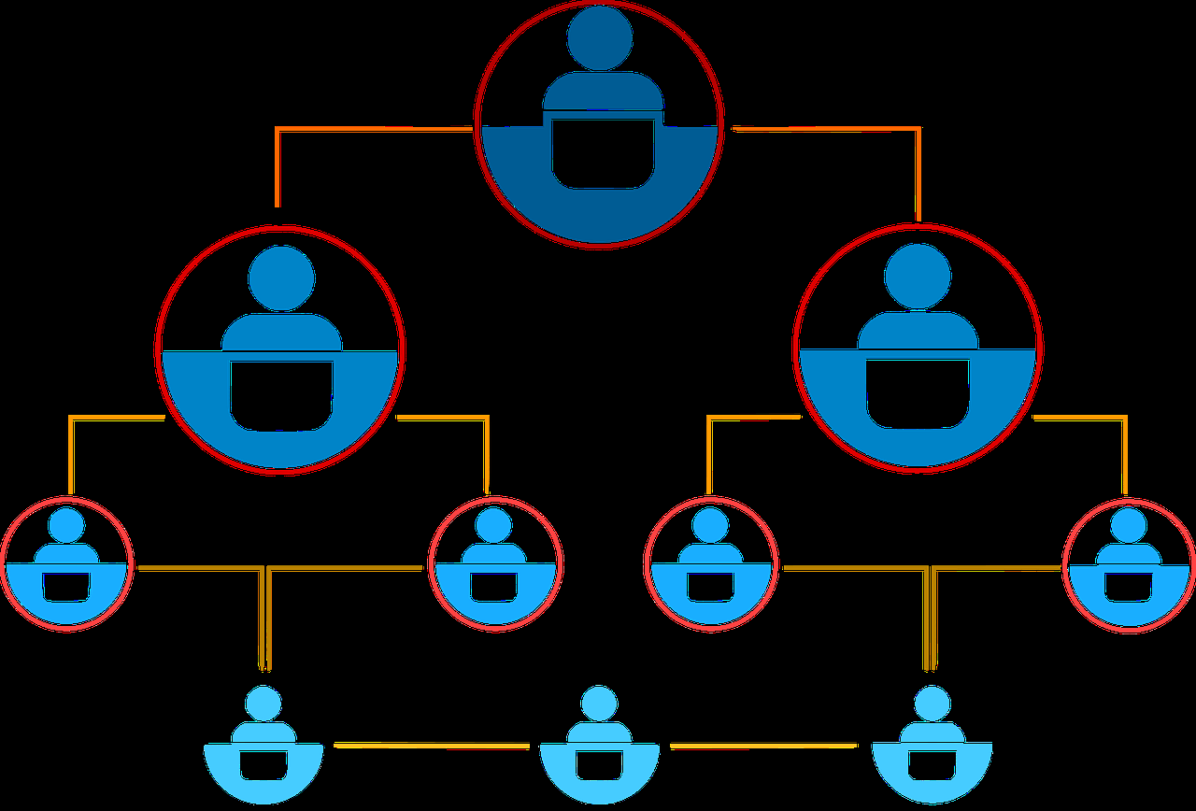
Factors for Workflow Change
Backlog of records
Staffing changes
Image from Pixabay
Notes:
Speaker: Grace
The second factor was staffing changes at NLS. As I mentioned in our introductions, within the last few years, the department found itself down 1 1/2 employees including a veteran manager. The loss of these professionals resulted in a hit on the department’s productivity, but also opened up the opportunity for administration to start looking at changes which had been put off for years. Basically, an opportunity presented itself to start looking at the department with fresh eyes. The first thing that went…the double checks. It took way too much valuable time and energy. It was decided early on that if there was a particularly egregious issue in a record, one of the member libraries would likely spot it and report it at which point a cataloger would then go in and fix the issue.

Slide 11
Factors for Workflow Change
Backlog of records
Staffing changes
Creation of a procedural document
Image from Pixabay
Notes:
Speaker: Grace
As a result of staffing changes, it became evident that it was vital to document procedures and rules to ensure that all existing catalogers were on the same page doing the same thing while also solidifying the future. In the end, the cataloging staff put together a 100+ page procedural document which we continue to update monthly. In addition to the benefits the department gained through such a written document, we also came to quickly discover that this inventory of rules and standards would prove useful in the next factor…

Slide 12
Factors for Workflow Change
Backlog of records
Staffing changes
Creation of a procedural document
New products made available
Notes:
Speaker: Grace
…which was the discovery of BTCat.
For those unfamiliar with this product, BTCat is an online cataloging utility developed by Baker and Taylor which, among other features,
Allows for individual title and multi-title cataloging functionalities
Uses a macro to make multiple immediate changes to records
And allows for immediate overlaying of existing records
Once we discovered BTCat, things started moving quickly. In December 2021 NLS administration met with BTcat representatives. A month later, BTCat started customizing their system to match our procedure manual. In February 2022, Chris was becoming familiar with the product and establishing a preferred workflow, and by June 2022, although kinks were still being worked out, BTCat became the preferred way of cataloging by staff.

Slide 13
Factors for Workflow Change
Backlog of records
Staffing changes
Creation of a procedural document
New products made available
Ongoing push towards automation
Image from Pixabay
Notes:
Speaker: Grace
The final factor in our workflow reboot was NLS’s ongoing desire to automate as many departments and tasks as possible. Prior to looking at the cataloging department, many monthly and daily reports and lists were already generating automatically. Trying to incorporate automation into cataloging was a logical next step especially since we had a cataloger on staff who had an eye for scripts and coding.

Slide 14
Ingredients for Change
Notes:
Speaker: Chris

Slide 15
What We Needed
Create List
FTP Server
BTCat
AutoIT
Notes:
Speaker: Chris
Create List
How many of you have used “Create List” before? Well, you will be happy to know there is no right or wrong answer here. The thing you need to understand is that we use “Create List” to help set up our BTcat records.
FTP server
This is where the link is established between the BTcat and Sierra servers.
BTcat
This is the Baker & Taylor application where we are getting the majority of our Sierra records from.
AutoIT
This application is helping us address our cataloging backlog and improve our basic cataloging functions. Now we are going into detail about each of these.

Slide 16
Create List & FTP Server
FTP (File Transfer Protocol): Allows for the transfer of files from one computer network to another (NLS to BTCat and BTCat to NLS)
Export to BTCat, via the FTP connection, a Create List of eligible records
Author
Title
Record Number (b number)
ISBN
024 field (numerical field)
028 field (numerical field)
Notes:
Speaker: Chris
Create List of eligible records
At the beginning of each month, I use this feature to get a list of records for the previous month I take 6 fields: Author, Title, Record number, ISBN along with 2 numerical fields the (024 & 028) I then export that list into a folder on my desktop. Then make a copy of the exported file and add it to the FTP Server.
The F.T.P. Connection
This stands for “File Transfer Protocol”. This is where we house all the Create List files that are shared between Sierra and BTcat. So, imagine you have 2 workspaces, one that belongs to Sierra and the other to BTcat. All I do is paste the exported copy from my folder to the Sierra side of the file. Then make an additional copy and place it in the BTcat side.
Export to BTcat
Now that BTcat has a copy of these records. Either later that day, or the following day, BTcat then loads those records into their server. As a result, we have a connection between the numerical elements in the Create List file and the record number itself. And besides other things that are enhancing the record, there are 4 fields added:
690 (for cataloger’s initials)
907 (record number)
946 (for cataloger’s initials and can be used as a retrieval method if needed)
949 (the mat type code)

Slide 17
BTCat
Macro: Specific instructions indicating which MARC fields should be added, removed, changed, and kept from an existing record.
Single all encompassing macro
Living document
Image from Pixabay
Notes:
Speaker: Grace
With Create List and FTP set up, we turned our eye toward the BTCat settings.
First, we had to set up a macro. BTcat’s macro system is a list of specific instructions indicating which MARC fields should be added, removed, changed, or kept which can be easily pushed through simultaneously. So, rather than manually making multiple changes to the MARC record, NLS’ catalogers could, with the click of a single button, add, remove, rearrange, and edit specific MARC lines leaving only specialized updates to be manually completed later.
In the end, we ended up with one single all encompassing macro–One Macro to Rule Them All. We now know that some other BTcat uses have set up multiple macros which they use for different collections, but we found this not to be necessary (not to mention, it appears that BTcat prefers a single macro to a plethora of them…easier to ensure edits are made). Our macro is very much a living document, even more than a year after instituting it. Nearly every week, I submit a list of changes we’d like made. In the beginning, the changes were procedural and far reaching (the removal of certain subject headings and the order of the 5xx fields in DVD records). Now, changes are more specific and nitpicky (adding the words “On board pages” in the 500 line of board books).

Slide 18
BTCat
z39.50: Protocol used to allow for the searching of and retrieval from a database via TCP/IP (often used in library cataloging systems).
BTCat comes with BTCat Community Records
Definition: a depository of records maintained by Baker and Taylor
More choices necessary
Completeness of records
Consistency
Personal preference
Notes:
Speaker: Grace
Once the macro was set up, we needed to set up our z39.50s. BTcat comes with BTCommunity records built in (a depository of records maintained by B&T) but we found that we wanted additional options for various reasons including:
Completeness of records (some records from outside collections started off more complete than others)
Consistency (when possible, records for series were obtained from the same sources)
Personal preference (some of the catalogers had a certain loyalty to certain sources)
We did run into two issues with z39.50s::
Narrowing down the dozens of Z39.50s we were using in BookWhere and SkyRiver to the 10 BTCat allowed
Obtaining technical details from sources to enable specific z39.50s (target, address, port, and database)

Slide 19
BTCat
Image from Canva
Notes:
Speaker: Grace
Finally, before we could start cataloging with BTcat, we had to decide what we wanted to get out of the product. In the end, it came down to a question of quality vs quantity. We could plow through large numbers of records using bulk searches, however, the resulting records would lack the quality the department prided itself on. Conversely, we could continue handling records one at a time which, while considerably faster to do using BTcat, still made the goal of depleting the backlog a bit of a pipe dream.
In the end, we decided to lean toward the side of quantity for our oldest records and quality for our newest. Older records, records which were, frankly, nearer to being weeded than searched for in any great degree, were pushed through batching–a close enough system that helped us make headway in our backlog. The newer items, on the other hand, would continue to be handled one at a time.

Slide 20
BTCat
Sierra Title Search
Begin by searching for duplicates in Sierra.
Basic title search
Numerical search
Advanced search (non-numerical)
Notes:
Speaker: Chris
So, now we are now ready to begin processing records. First, we must search Sierra to see if there are any duplicates. Now it can be relatively easy if there is a simple title and numbers to work with (Basic title search) As some of you may know it can get interesting if the title has a misplaced “Skip” fixed field character or the title has some weird diacritics. Under those circumstances it may be necessary to use the record number or the numbers within the record itself (numerical search)
But there are those times that we come across the dreaded record with no numbers in it at all. These records may need to have a keyword search done on them to identify the record properly. And in some cases, may need to be researched and/or edited before proceeding to BTcat to find it [Advanced search (non-numerical) Example: ]

Slide 21
BTCat
One Record at a Time
Search for an item in Sierra first
Cataloger picks the best available record
Run the macro
Make additional tweaks to the record
Mark for extraction
Batching
Search for a group of items
BTCat algorithm pick the best available record
Run the macro
Mark for extraction
Notes:
Speaker: Chris
One record at a time
Here we begin looking for a quality record. BTcat gives a variety of ways to search for records including Keyword, Title, ISBN and UPC code. And BTcat assists with the search process by means of a new feature within BTcat: the ability to filter the results by encoding level, format, and publication date!
When we find a good record, we apply our local department macro. Well, when this macro is applied it looks at the numbers in the record and sees that there is a corresponding record number and adds the 4 fields, we talked about earlier including the record number to the selected record!
Most of the time we will opt to save the record for extraction at that point, but occasionally there might be a need to make some minor changes. After that the record is added to that file. When we are ready, we can extract the entire file for that day or for several days in one shot.
Batching
Here we are looking for quantity, trying to find any decent records to overlay the existing Catreq or Q-click. We search for the item, as part of a batch set or occasionally on an individual case if there are not any numbers in the record.
This process is used to help us deal with a considerable backlog of records, in our system. We had over 3000 backlog records to get through. We have currently processed over 1000 of them between April and now! And we have a current processing success rate of over 50%!
Once a record is found we apply the local macro and add a unique 946 field to indicate that this record is part of a Batch cataloging process. At the end of the day, I will usually Export all the records at that time into Sierra.

Slide 22
BTCat
Data Exchange: Function of Sierra used to import records into its system
Used in connection with the extraction process in BTCat to physically upload updated (and completed) records into Sierra
Once enabled, updates overlay immediately
Generally run once a day by each cataloger
Notes:
Speaker: Chris
When the records are processed each member of the department must physically bring the records into Sierra to overly the existing records. It begins with an email sent to the person performing the extraction. Then we go into Sierra and choose the “Data Exchange” tab. We then perform a process where the records from BTcat are physically overlaid into Sierra. So, the basic idea is we are calling on the BTcat server to release the records into Sierra.
So, as a reminder, the FTP server is used to push the Catreq or Q-click information from Sierra into BTcat. Whereas the “Data Exchange” process is where we pull the completed record from BTcat back into overlaying the Sierra record.
Once these records come into Sierra, we make sure it overlaid the connect record, also checking for additional duplicates, along with reviewing the quality of the subject headings and completing the authority work on all records in the file.

Slide 23
AutoIT
A downloadable computer software program that allows the user to write a script (using loops, mouse movements, program interaction) that will automate a repetitive task and increase productivity and speed.
It can…
Open and close programs
Start and stop programs from running
Copy mouse and keyboard moves
React to answered questions
Transfer data from one application to another
Help the user come to fully understand the workflow being done
Notes:
Speaker: Chris
What is AutoIT?
It is an application that after being downloaded to your computer, gives you the ability to write your own scripts that will help you automate your repetitive tasks faster. Let’s see an example of what it can do.
How powerful is AutoIT?
Some things that can be done by AutoIT effectively with proper script development would be to:
Act as an administrator to facilitate macros that are run when asked.
Open and close a program along with start or stop running a program.
Copy and imitate mouse and keyboard movements inside of a program.
Respond to questions you ask of yourself in the program to perform direct actions.
Can take data from one application and use it in another.
It helps you understand your workflow better through reviewing and “training” AutoIT to perform tasks successfully.

Slide 24
https://www.dropbox.com/s/k0it9nma76903cu/RingCentral_Video_meeting_2023-03-27_12-12-34.mp4?dl=0
Notes:
Speaker: Chris
Macro Palette Button video

Slide 25
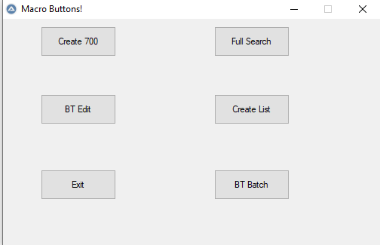
AutoIT
Notes:
Speaker: Chris
Programs I have built using AutoIT.
I have a major AutoIT Macro Palette Button it literally houses many AutoIT macro buttons, that can be run in one window! This feature is cool in that it allows you to run a macro inside another macro! It literally acts as an administrative assistant macro and gives administrative privilege to the macro you choose and waits for the macro to finish.
I also designed a “Browse” macro for Sierra. Now to understand how I user this let me explain that I have the task of collecting the statistics for the department at the end of the month. One of those statistics numbers is the library requests for Catreqs and Q-clicks during the month. So throughout the month I get and store the numbers in a separate Excel document for review at the end of the month. So, if I come in to work on a given day and I am missing a Catreq or Q-click total, I can get it using this macro in under 60 seconds.
First the program will perform the beginning screen clicks to get the appropriate search tool selected on screen. Then the program will ask “if I want a “single” or “ranged” Catreq or Q-click date?” If I say “yes” the “single” process will begin, If I say “no” the “ranged” process will begin.
I will then be prompted to input the date(s) that apply. It will then set my screen up accordingly.
Then it will ask if “I want Q-clicks or Catreqs?” If I say “yes” Q-clicks” or “no” it’s Catreqs. Then the program will perform the search depending on which choice I selected and give the results.
All I need to do is copy the results to my Excel file.
Next is a 700-field creator macro. This will generate the appropriate field for a person with first and last name, to any of 3 places: Sierra, BTcat or Skyriver!
Next I have a macro that is a BTcat batch program: it will take a predetermined group of numbers in a column in Microsoft Excel and add them to a batch search screen in BTcat.
Then there is a Full Search Macro: it begins by copying your title from Excel then searching it in Sierra, after you are satisfied with the results, AutoIT will ask “if you are ready to copy the ISBN?” If you say “yes”, it copies it along with the record number and pastes the ISBN into BTcat. Then when you find the record you want, the program will ask “if you are ready to edit the record?” If you say “yes”, it places you in “edit mode” and applies the Cataloging Services” local macro to the record. If the local macro was performed successfully there will be a 690, 949, 946 and a 907. If satisfied with the current state of the record, you can answer yes when the program asks you “if you want to export the record?” It performs the Export keystrokes. Now sometimes after a BTcat export is performed, the screen will automatically clear itself and other times it won’t. Depending on the state of your screen at the time, AutoIT will ask you if you want to “clear the screen?” If you say “yes” it will do so and continue to the next phase. Otherwise, it will go directly back to Excel and color the record number in “green” to let me know the state of the cataloging process I am in. Then adds the “Status” update information to the record for my monthly statistics. It then brings up the “Macro Palette Button” again and exits the program.

Slide 26
Results, Analysis, and the Future
Notes:
Speaker: Grace
So we’ve upended our workflow…was it worth it? By and large, we’d say yes.

Slide 27
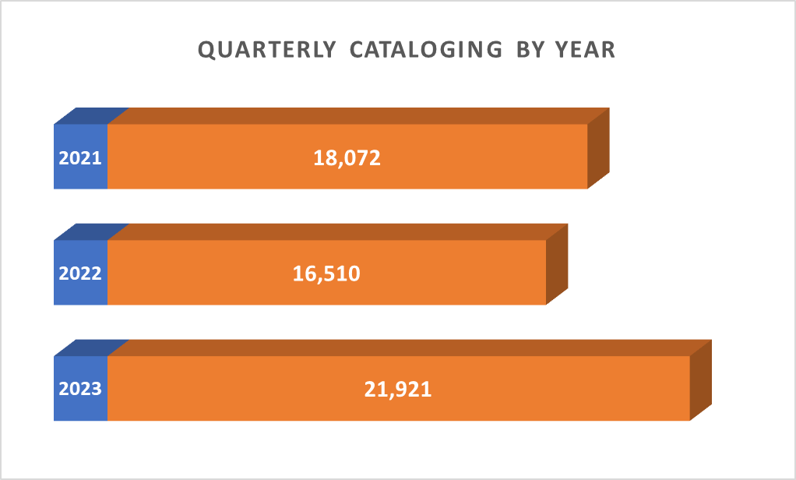
Results
Backlog decreased
36K in Nov. 2021
27K in May 2023
Productivity increased
Records completed in…
Jan-April 2021:18,072
Jan-April 2022:16,510
Jan-April 2023:21,921
Chart
Notes:
Speaker: Grace
Our backlog has decreased from around 36K records in November 2021 to ____ in May 2023. And while the remaining backload might still seem like a large number, nearly all of these remaining records are less than a year and a half old…a window we can comfortably classify as “new” (though that designation might change as we continue to experiment with batching).
In addition, the department is working its way through more records than ever despite being down 1.5 catalogers and the inevitable learning curve slowdown that came with switching to a new product like BTcat. The chart shows the number of records cataloged over a __ year period, and you can actually see changes which have occurred throughout those years…the loss of the part time cataloger in ________, the loss of the manager (who cataloged) in November 2021, and the learning curve brought about by the switch to BTcat. But you can also see, in the most recent months, that the number of records handled has increased significantly…to a point that exceeds productivity back when those 1.5 employees were still with the department.

Slide 28
What We Learned
BTCat
Have a procedures list
Track macro changes
Have a backup plan
Supportive vendor/staff is key
Don’t be afraid to attempt the seemingly impossible
Notes:
Speaker: Grace
We’ve also learned some things over the last year and a half of working on this workflow change.
On the BTCat side,
Start with a list of procedures: It’s good to have a clear understanding of exactly what is expected from the staff as well as the resulting records. This list also comes in handy for referencing when questions arise and can act as a training guide for new employees.
Keep track of macro changes: Right now we’ve got a multipage document listing all the changes we’ve requested. In addition to keeping track of these changes, this document also proves helpful in determining which fixes stuck and which ones did not.
Have a backup plan: I think we’re all aware that in 2022 Baker and Taylor ended up the victim of a cyber attack and were down for a bit of time. When they were down, we obviously were unable to use the BTCat system, however, because we never gave up our SkyRiver and BookWhere subscriptions, we were able to fall back on our old methodologies and not have productivity come to a complete standstill. In addition, we’ve also discovered that, on occasion, records we need simply don’t appear in BTcat. Being able to check against SkyRiver and BookWhere has prevented us from always having to resort to original cataloging for these items.
A supportive vendor/staff is key: The vendor wanted this endeavor to succeed and worked tirelessly to help us achieve it, meeting with us regularly, implementing suggestions and requests we made, and taking the time to really understand what we needed. On NLS’ side, the catalogers have gone above and beyond to use the product and suggest changes. They’ve gone through a tough learning curve and I couldn’t be prouder of how they handled the entire experience.
Don’t be afraid to attempt the seemingly impossible: We’ve requested some really complicated macro additions that I seriously thought we’d be told wasn’t possible or wouldn’t be achievable in the first attempt. Turns out I was wrong…some major changes took less than a week to become real. One example of this is our handling of video GMD for multipack items. Using wording in the 5xx line as a guide, we’ve set up GMD wording as well as GMD order rules.

Slide 29
NLS’ GMD Request
Setup:
Videorecording GMDs are: [videorecording (something)]
The ranking order for GMDs is Blu-ray 4K, Blu-ray 3D, Blu-ray, and DVD (so if an item is a combo with a Blu-ray and Blu-ray 4K then Blu-ray should be listed first)
Macro: Using the 5xxs as a guide
If Ultra HD is listed anywhere in the 5xxs, then the GMD should be Blu-ray 4K
If Ultra HD is not listed in the 5xxs but Blu-ray 3D is, then the GMD should be Blu-ray 3D
If Ultra HD or Blu-Ray 3D is not listed in the 5xxs but Blu-ray is, then the GMD should be Blu-ray
If Ultra HD, Blu-Ray 3D, or Blu-ray is not listed in the 5xxs then the GMD should be DVD
Combos:
Combo of Blu-ray 4K and DVD = [videorecording (Blu-ray 4K)]
Combo of Blu-ray 4K and Blu-ray = [videorecording (Blu-ray 4K & Blu-ray)]
Combo of Blu-ray and DVD = [videorecording (Blu-ray)]
Notes:
Speaker: Grace
And this is the instructions that I sent along to BTCat regarding out video GMD request. I don’t mean for you to read this now (or ever if you’re not interested) but it does give you an idea of what exactly we were asking for and all the moving parts associated with it. As I said, BTcat managed to put this all together in a matter of 8 days and it worked perfectly right out of the box.

Slide 30
What We Learned
BTCat
Have a procedures list
Track macro changes
Have a backup plan
Supportive vendor/staff is key
Don’t be afraid to attempt the seemingly impossible
AutoIT
Best to start small and simple
AutoIT is a memory drain
Notes:
Speaker: Grace
So back to what we learned…
On the AutoIT side
It’s best to start small and simple. It’s easy for a script to end up with a fault if you try to do too much too quickly. And if the script is also complicated, it's that much more difficult to pick out that fault. Do not become overwhelmed…start small
Realize that AutoIT is a memory drain…create small scripts and link them together

Slide 31
What We Hope to Do Next
BTCat:
Make further advances in Batch cataloging
Increase quantity without impacting quality
Attempt to phase out record by record cataloging
Investigate Authority Records in BTCat
Auto IT:
Create a “Universal Macro” script
Other:
Allow catalogers time to work on other projects
Notes:
Speaker: Grace & Chris
GRACE
So what does the future hold?
On the BTCat side, we’re working to make further advances in our batch cataloging system. We want to continue to increase quantity without compromising quality and hopefully, begin to phase out record by record cataloging altogether. We’re also beginning to investigate the possibility to use BTCat to help with updating authority work which even still must be handled on a record by record basis.
CHRIS
I hope to write a script that will act as a “Universal Macro” that will move a Catreq” or Q-click to a neutral environment like notepad and gather all the necessary information without me having to “ask” AutoIT to what to look for. Then go into BTcat and find the relevant record on its own and search thru all the possible records, finding the best one and applying our local macro accordingly. Then making sure all 4 fields I discussed earlier are in place without a human being involved in the process. We would just look the record over before we strip our 690 from the records, after the export process.
GRACE
And finally, we’d like, with the eventual depletion of the backlog and a comfortable grip on new records coming in, to look to engage our catalogers in additional projects and responsibilities both in the cataloging department and beyond.

Slide 32
Questions?

Slide 33
Contact Us
Robert Drake 516.292.8920 x241 rdrake@nassaulibrary.org
Christopher Mayhew 516.292.8920 x226 cmayhew@nassaulibrary.org
Notes:
Speaker: Grace & Chris

Slide 34
THANK YOU
Questions?

Slide 35
Tips for an Accessible Presentation
While preparing:
Make text and visuals big enough to be read from the back of the room. Try to keep your font size at 18 or above.
Use an easy-to-read font. Fonts are easiest to read when the thickness is consistent.
Check your color-contrast. Use a light text background and dark text when presenting in a bright room, or a dark background and a light text when presenting in a darkened room.
Run an accessibility check. Microsoft PowerPoint has a free accessibility checker to help you identify and adjust any issues.
Source: "Giving Accessible Presentations" by Lillian Hogendoorn, used under CC BY-SA 4.0 / Edited

Slide 36
Tips for an Accessible Presentation
While presenting:
Be visible when speaking. Seeing your face can help participants hear and understand better.
Use a microphone. Even in a small space, some people may need audio electronically. If you ask, “Can everyone hear me?”, some people may be uncomfortable identifying they cannot. If possible, encourage participants to use a microphone to ask questions. If this is not available, repeat questions through your microphone.
Describe visual information. For example, if you have an important chart or image on your slide, describe the key points. Or, if you ask participants to move in some way (i.e. “raise your hand if you have been to IUG before”), describe the response (i.e. “Okay, that seems like about half of you!”).
Source: "Giving Accessible Presentations" by Lillian Hogendoorn, used under CC BY-SA 4.0 / Edited

Slide 37
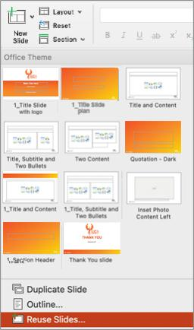
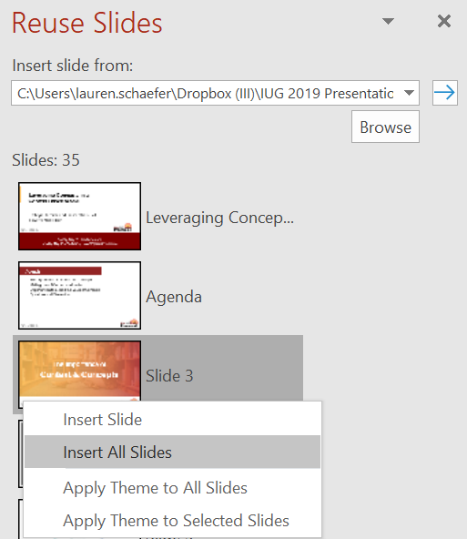
How to import slides into the template
Select “New Slide” > “Reuse Slides…”
Choose “Browse File” to select from your computer
Click on each slide to add them individually, or right-click to select “Insert All Slides”
Use “Reset” to help reset the layout on individual slides

