Slide 1
The Long Winding Road to Centralized Cataloging
Bridget Krejci
Kathy Setter
With help from Deb Faulhaber
IFLS Library System, Wisconsin
Notes:
Kathy

Slide 2
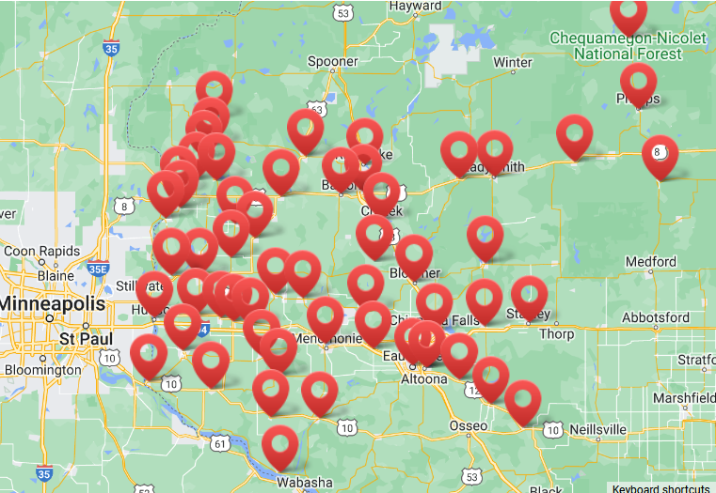
About IFLS
MORE Consortium
52 Public Libraries
1 Technical College Library
In 10 counties in West-Central Wisconsin
Bib records 570,000
Item records 1,395,085
Patron records 161,720
Notes:
Kathy
These are all independent libraries with their own governing boards. The decision-makers of the MORE consortium are the library directors, not system staff. We can recommend and encourage but don’t always get our way. We have to make a case and persuade, which is why it took 3 years to get where we wanted to be with centralized cataloging.

Slide 3
Cataloging History
Each library responsible for their own cataloging
System staff checked bib records
As the consortium grew, this task became unsustainable
3,000 – 4,000 new bib records each month
Consistent issues with record quality
Training Efforts
Extensive documentation
Templates for different formats
Group training sessions
Twice a year, covering MARC fields and local practices
Notes:
Kathy

Slide 4
Providing Help
System survey in 2012 – what do you most need help with?
Cataloging!
Shared Services was born in 2013
Full service, cataloging and processing
Fees on a cost-recovery basis
Orders sent directly to System Office, items sent to libraries shelf-ready
Started with 3 libraries, currently 4 (plus one branch) subscribe to this service
One cataloger and 2 processors
Freed staff to spend their time on more patron-facing activities
What about all the other libraries?
Notes:
Kathy
Often a retirement was the catalyst for changing up what staff do

Slide 5
Database Quality Concerns
Duplicate bib records
Poor quality
Missing fields
Incorrect information
Inconsistency
Patron service/Accessibility
MORE standards not followed
Also, time spent helping libraries with cataloging questions/concerns.
Notes:
Bridget
The Bibliographic Records and Standards Committee formed the rules to follow – created training documents
Examples –adding qualifiers at the end of 020 fields, |e 100 and 700 fields, series statements, copyright information in the 264 _4

Slide 6
More Help
Cataloging And Bibliographic Services (CABS) was born in 2018
Offering bibliographic record cataloging only
A Fee-based service
Libraries continued to do processing and adding item records
Service started with 10 libraries
Database quality concerns remained
1.5 FTE catalogers
Notify when things are in the system and ready for item records
Started looking at how we could do all bib record cataloging
Notes:
Bridget
Stories – Luck – take all this away from me! Roberts – the closet of shame. Hundreds of books the person doing the cataloging didn’t know how to handle, so they sat in the dark.

Slide 7
CABS Process
CABS staff accesses order information directly from some vendors
Orders from other vendors forwarded to CABS staff
Database checked for matching bib record
If not found, one is added
Donations / single orders added by filling out the CABS request form
Fields in the form vary by the format chosen on the first page
Goal is to have the bib record ready when the order arrives at the library
MORE project managers help with special items
Kits, Library of Things, Equipment
Notes:
Kathy
Getting order information was the trickiest part of setting up the service, always things to figure out
Some staff need hand-holding, others take right to it
Items are called in if needed; compare editions, find out if these really are the same
Still dealing with older records with scant information in them

Slide 8
Choices
Libraries offered 4 choices for their cataloging needs in 2020
Shared Services
CABS
Certified Cataloger
Employ professional, dedicated cataloging staff (3 libraries)
Certified Cataloger
Only no fee option
Person cataloging required to attend training
Initial day long retreat
Refresher sessions each year
Work checked by System Staff
Notes:
Kathy
Libraries with dedicated cataloging staff are Cataloging Partners and continue to do all their bib cataloging.

Slide 9
Certified Cataloger
Expectations
Follow the rules
Used special catcode in records to identify them
Watch for messages on the morecat email list
Updates on any rule changes
Ask when you have a question; ask for record review
Request a visit if desired
Expect follow-up from a MORE Project Manager
Staff responsibilities
Divided the catalogers between the 2 Project Managers
Reviewed and edited records created
Sent messages with things that needed correction
Followed up to make sure corrections were made
Notes:
Bridget
Specific catcode required and that wasn’t being followed- some “d” RDA some “s” short bib. Good indicator of who couldn’t be consistent with records.

Slide 10
Results
Frustration!
Follow up took even more time
Often getting all corrections done took 3-4 interactions
Still seeing poor quality records
Over 25% of each Project Managers’ time spent on this
Spent the year persuading libraries to join CABS
Increased participation to 20
Started planning on how to make CABS part of the budget
Wanted all bib cataloging done by system staff
Notes:
Bridget

Slide 11
The Push for Centralized Cataloging
Survey of quality of new bib records
237 bibliographic records completed by certified catalogers shows:
14% with no errors
36% with access-related errors, meaning patron access is affected by errors and omissions
50% with other errors and omissions
Main Goals
Findability
Consistent adherence to cataloging standards
Best use of system staff time
Significant efficiencies gained
Notes:
Kathy
Access-related errors include: wrong format code, children’s LC headings [which will not show in a subject search], no summary statement, wrong indicators, missing audience code, no subject headings, no genre headings, incorrect subject headings, missing subject/genre headings, no series statement or incorrect entering of the series statement [490_0 instead of 490_1 with matching 800/830]
Other errors include: no 264_4 copyright date, missing |e in 100 and 700 fields, wrong/missing punctuation, subject headings not used by MORE [fast, bisach, mesh], fields not deleted [003, 005, 092, 856 that are not useful,], missing/wrong |q qualifiers in 020, missing elements in the 33x and 34x fields, mismatch in country code in fixed field, 008, and 264_1, GMD left in
Significant efficiencies can be gained by IFLS staff taking more direct charge of database quality control: supplying accurate and complete bibliographic records with an eye toward the database as a whole.

Slide 12
Making the Case
Proposal at the 2020 Budget hearing for inclusion in the 2021 Budget
Focused on Goals for high database quality
Reviewed reasons Certified Catalogers was not working
Explained what would and would not change with cataloging workflows
Libraries would continue to order, receive and process materials
Libraries would continue to add item records and maintain them
Libraries would no longer add or edit bibliographic records
Reiterated ongoing problems with database quality
Duplicate records
Incomplete data
Inaccurate data
Emphasized benefits of Centralized Cataloging for Bib records
Budget included 1 full-time and 2 part-time catalogers
Notes:
Kathy
While MORE’s Cataloging Certification option aims to help library staff consistently adhere to standards, the task has proven unmanageable. The ongoing need for IFLS staff to train, check, re-train, correct, and monitor the bibliographic work of certified catalogers at MORE-member libraries is beyond the current capacity of IFLS staff, and does not make the best use of either IFLS staff or MORE-member library staff time.
Member libraries benefit from skilled cataloging services including full description for all kinds of materials, and quality control for all records to maintain accuracy, authority, and currency. The goal is to make the rich collections developed by member libraries accessible and discoverable to MORE library patrons.

Slide 13
Results
After much discussion, budget passed with Centralized Cataloging included
Most libraries embraced the change
A few insisted they wanted to continue to do their own cataloging
Several were granted permission to edit bib records to mitigate this
After Implementation
Bib record adding/editing reduced to 12 catalogers instead of 60+ library staff
Less duplicate records, database cleanup more manageable
All surrounding records are checked for each title for consistency
Process has been streamlined, less handling of physical items
Fast turn around time
Better quality of original bib records
More record consistency overall
Staff increased to 2 full-time,1 part-time catalogers
Customer service oriented – accommodate the library’s workflows
Notes:
Kathy
Shared Services libraries extra costs went down as they no longer had to pay for cataloging (as it’s included in the budget) only the processing. Fee includes labor, supplies are charged separately.
Communication has increased between system staff and library staff, asking questions about items, matching bib records, fixing errors.

Slide 14
Staff Reactions
I am happy to participate in the CABS program if it can reduce anyone in MORE's workload AND keep the bib police happy. I am all for it.
Emailing CABS my orders has been very easy
I absolutely love CABS. I am able to spend more time on Director work instead of searching and then creating a new record. I dreaded that job!
I also understand that the
expanded CABS model is probably best for the good of the whole system since clearly the records in our system were so poor & access to those records is vital.
The entire team has been wonderful and timely
Notes:
Kathy
It was a process to get where we are; we’re happy with where we are and how it’s going.

Slide 15
THANK YOU
Bridget Krejci krejci@ifls.lbi.wi.us
Kathy Setter setter@ifls.lib.wi.us
Deb Faulhaber faulhaber@ifls.lib.wi.us

