Slide 1
Automating Monthly Clean Up:
No longer a babysitter
Stacey Wolf
University of North Texas
Notes:
Hi I’m Stacey Wolf from the university of north Texas and I’m here to talk about automating monthly clean up: no longer a babysitter.

Slide 2
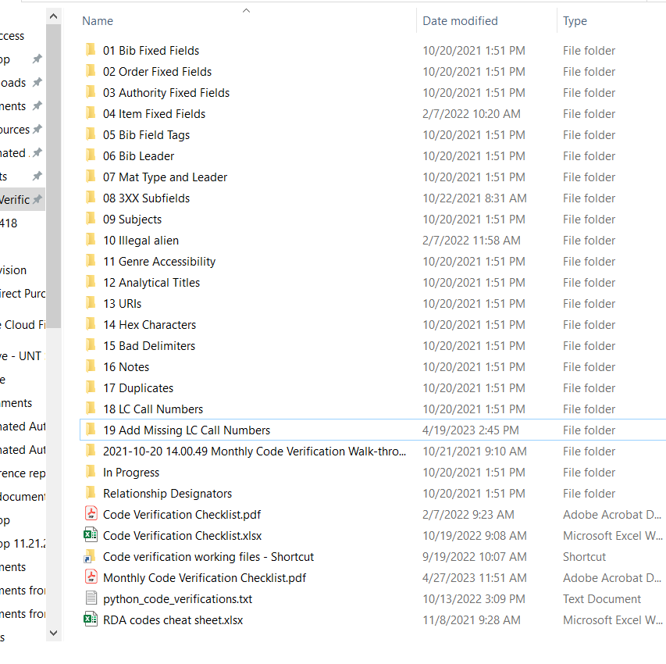
Monthly Clean-up with SQL
~200 SQL queries
Developed by Adam Baron, our former Cataloging Coordinator at UNT
Run every other month over several days
Notes:
Every month, my former boss, Adam Baron, ran just under 200 SQL queries that he developed for cleaning up our catalog. The entire process would take several days to complete. When he left UNT, I took over the process, but moved it to every other month due to the amount of time it required.

Slide 3
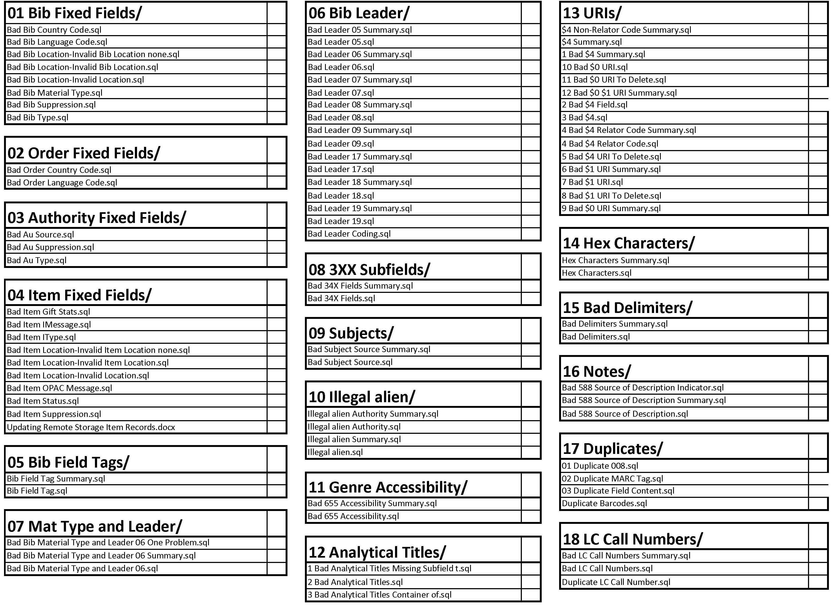
Notes:
Here’s a list of half of the queries. You can see what types of things he was looking for: fixed fields, field tags, leader coding, 3XX fields, subjects, analytical titles, URIs that need to be deleted before we send records to our authority control vendor. Hex characters, Bad delimiters, duplicates, and call number problems.

Slide 4
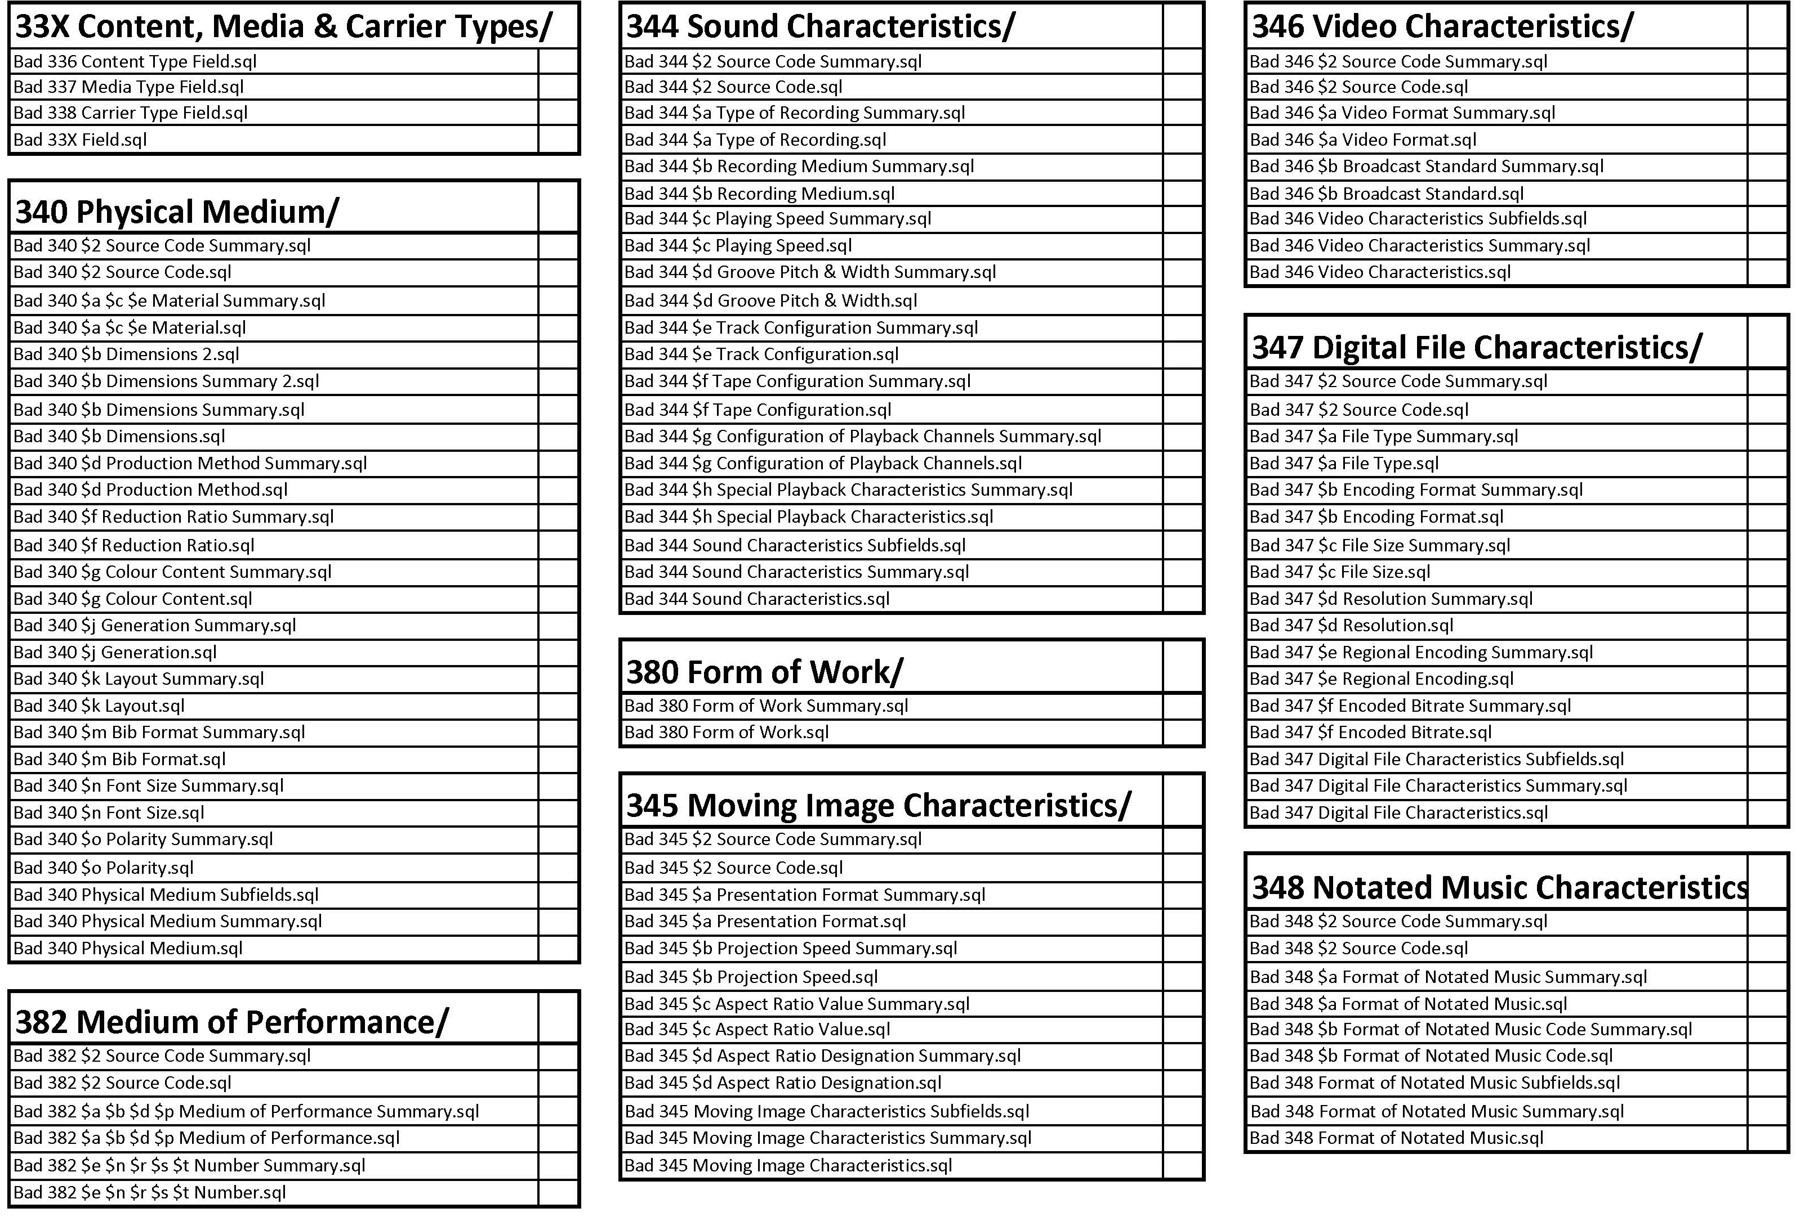
Notes:
Then, here are the 3xx fields:
We look for inaccurately coded Content, media and carrier types.
34X fields
38X fields
Look for invalid content in each subfield of each of these fields. The queries use the rda terms appropriate for each field/subfield
Lots of terms end up in the wrong field or subfield or are misspelled

Slide 5
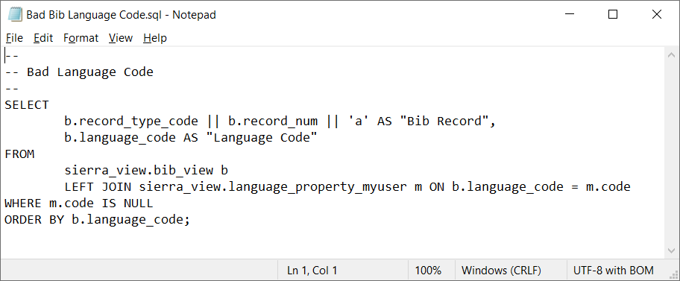
Example Queries
Notes:
Here are a few example queries:
Returns the bib record number and the language code used in the bib record. Most often it returns blanks that need to be updated to null

Slide 6
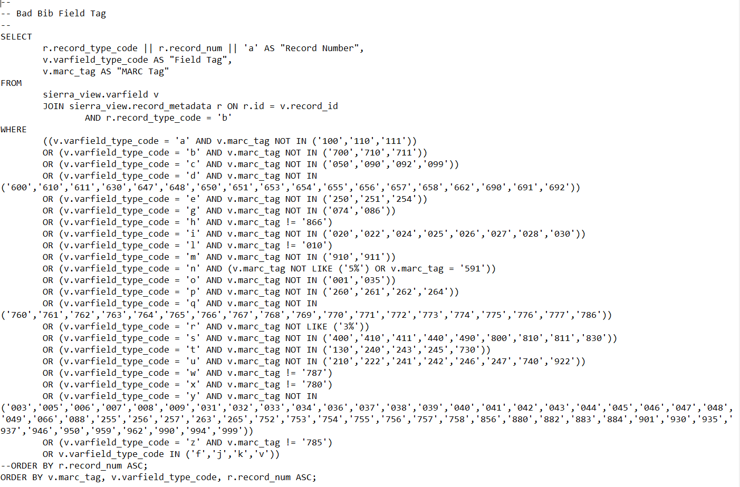
Example Queries
Notes:
This one looks more complex but is still pretty simple. This finds Sierra type codes that don’t match our defined fields for each type code. I can go in and correct the type code to the appropriate letter.

Slide 7
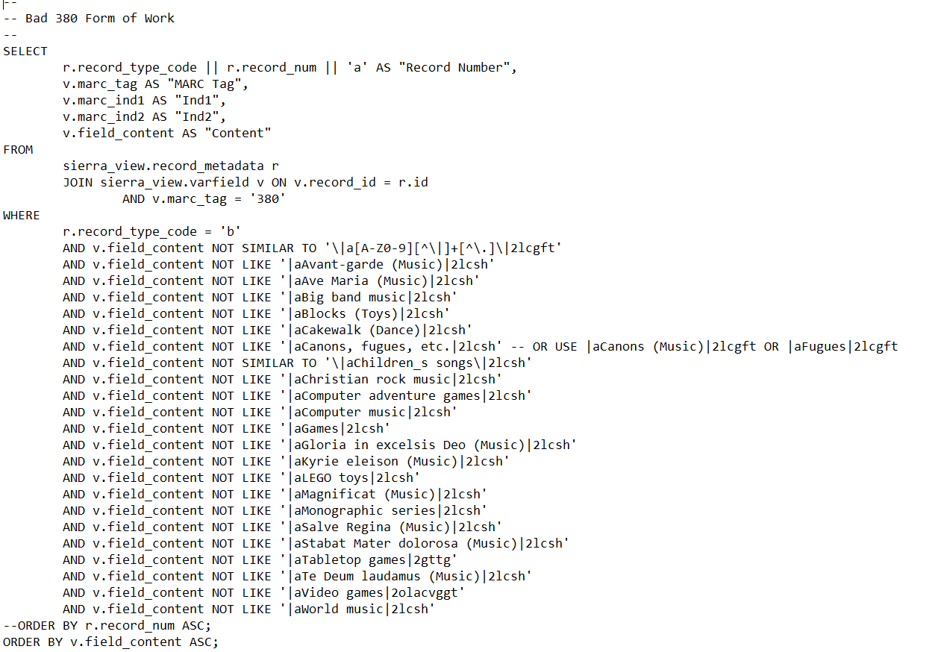
Example Queries
Notes:
This one is a more complicated query to create because you have to figure out what you have in the fields and what’s valid. This finds things that don’t match these terms so you can correct it, delete the field, or add the term to this list.

Slide 8
Running the queries
Notes:
Now some screenshots that walk us through running a query using SQL

Slide 9
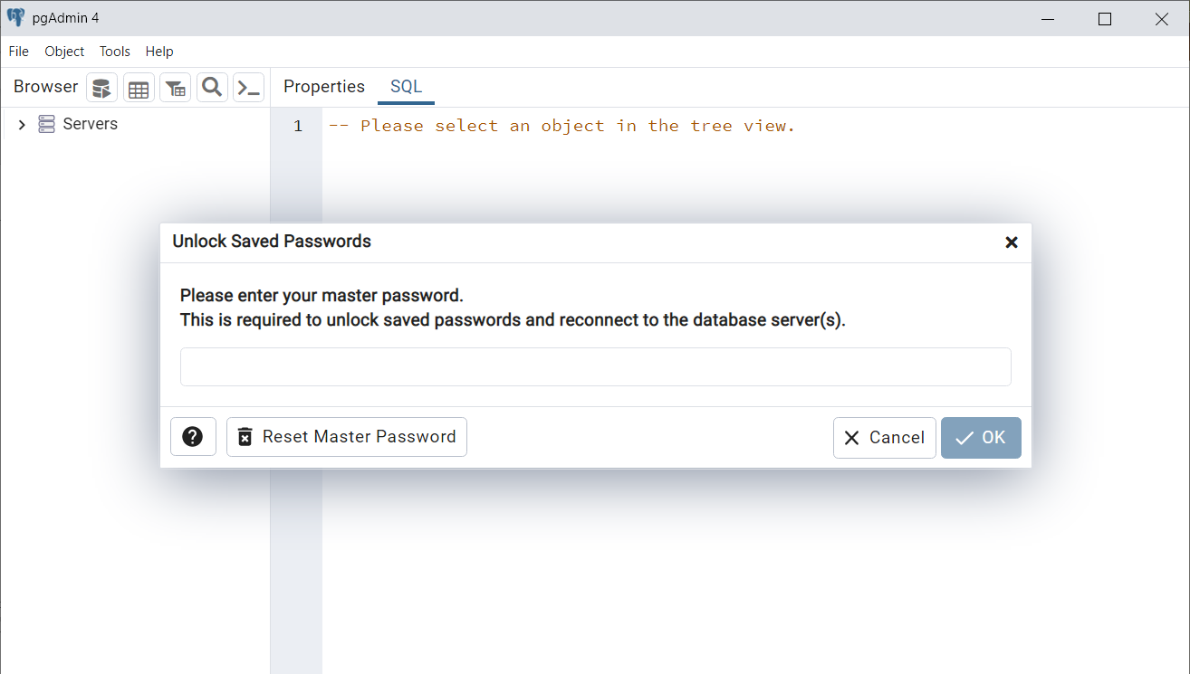
Notes:
Log into pgAdmin 4

Slide 10
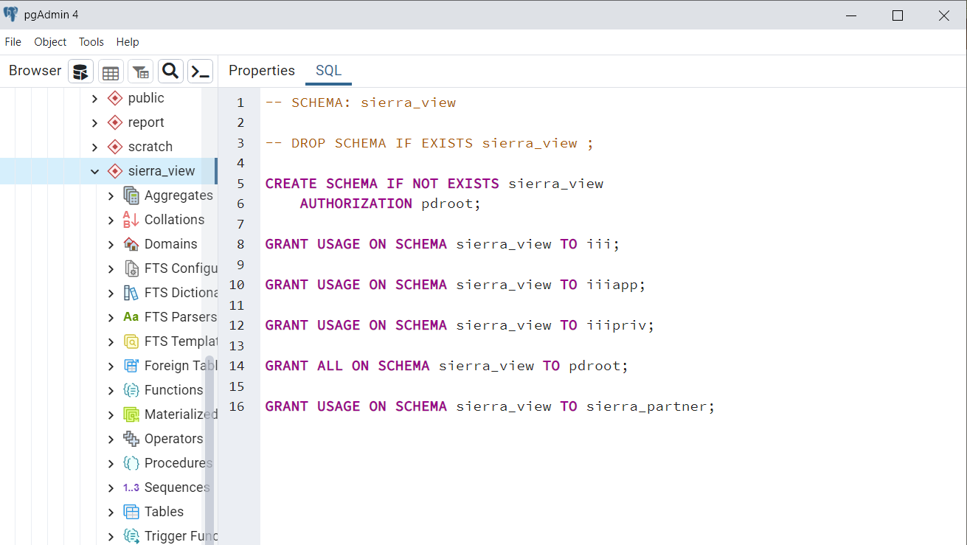
Notes:
Click on Sierra_view to make the query tool available.

Slide 11
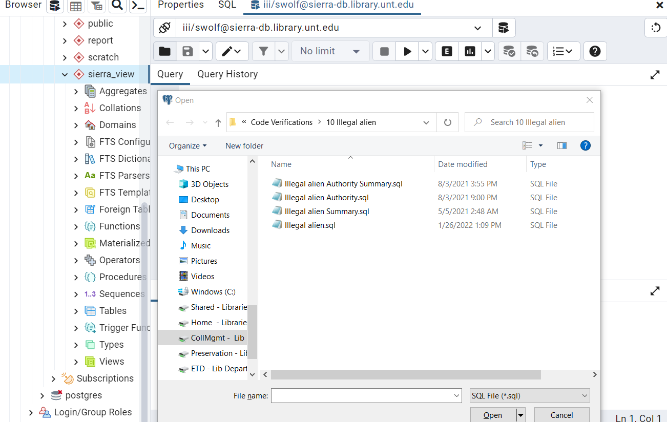
Notes:
Find the query in the appropriate location. I’m going to demonstrate our illegal aliens query to find records that need to be updated with our local subject heading of undocumented immigrant

Slide 12
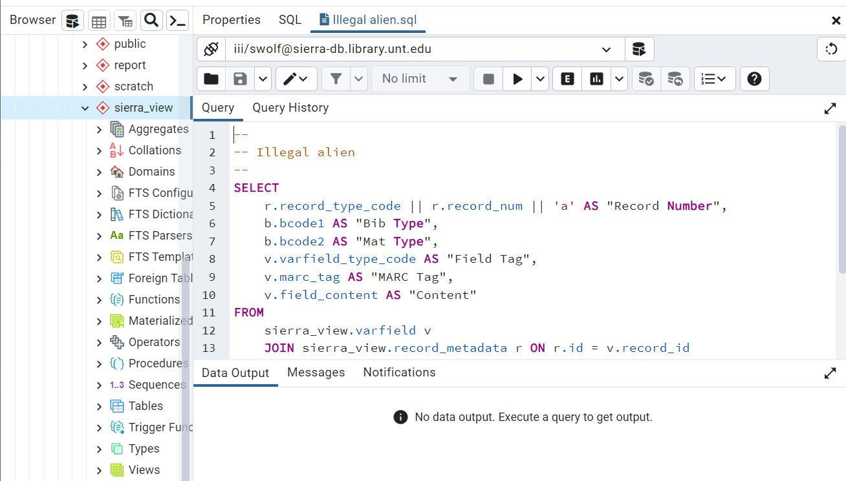
Notes:
Here I have the query loaded and ready to press execute

Slide 13
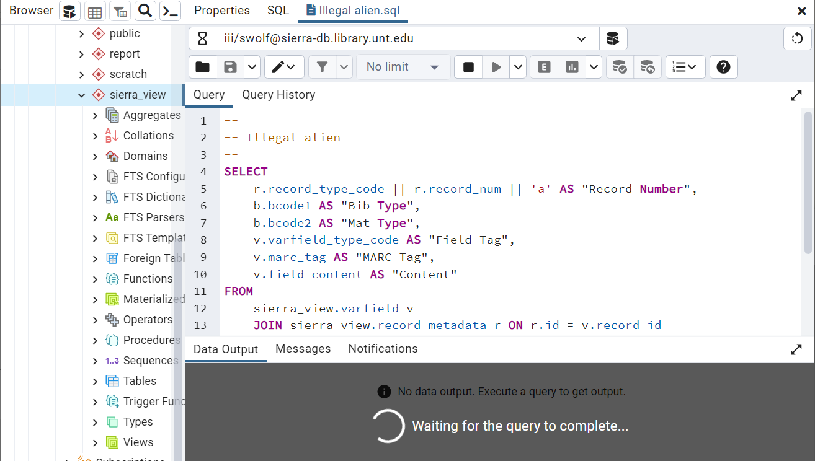
Notes:
Click execute and now the query runs. I’m never sure how long this will take because it depends on the query and the data in Sierra.

Slide 14
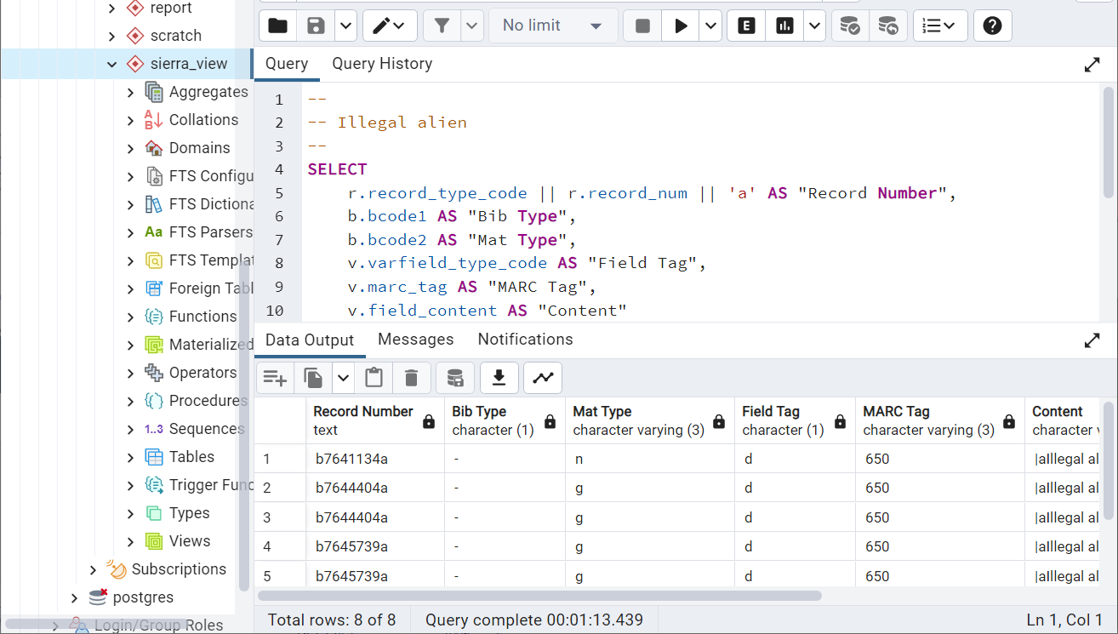

Notes:
This one completed in just over 1 minute, so pretty quickly.
The results have the bib record number in the first column so it’s easy to import the file into Create lists without needing to further manipulate the data. Then there is other information that might be important to the clean up process.

Slide 15
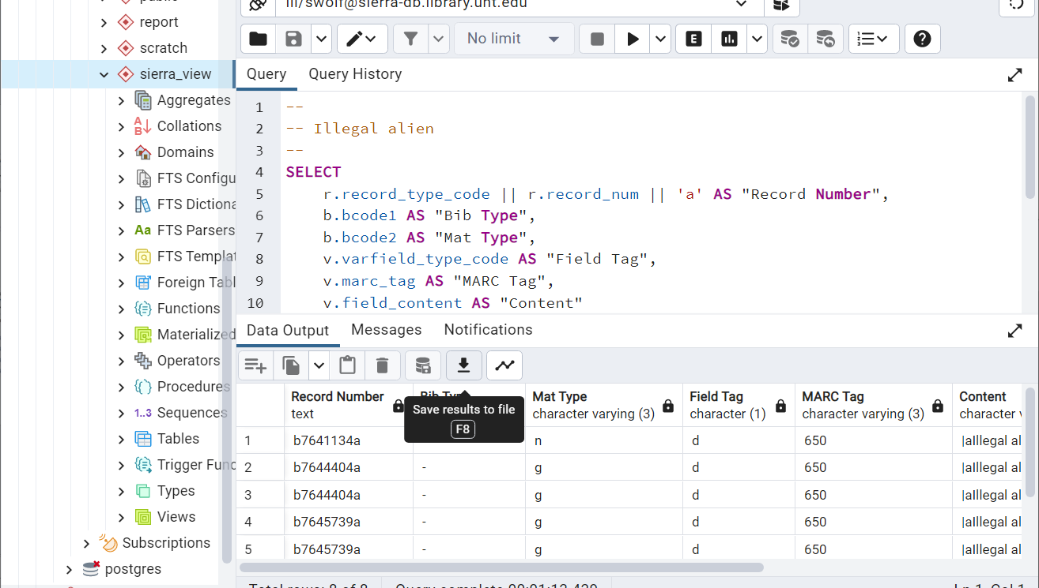
Notes:
Save the results to a file

Slide 16
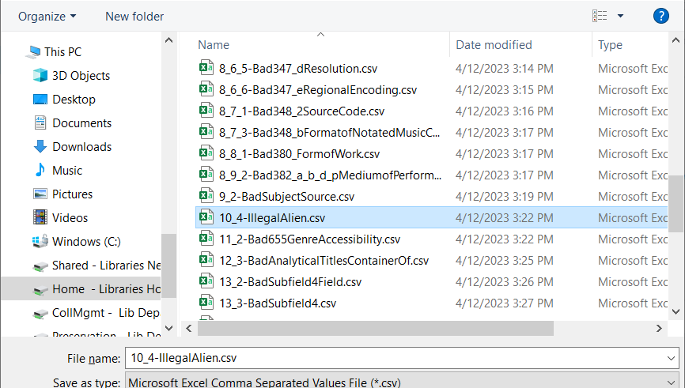
Notes:
Name it something that matches the query (or whatever you want)

Slide 17
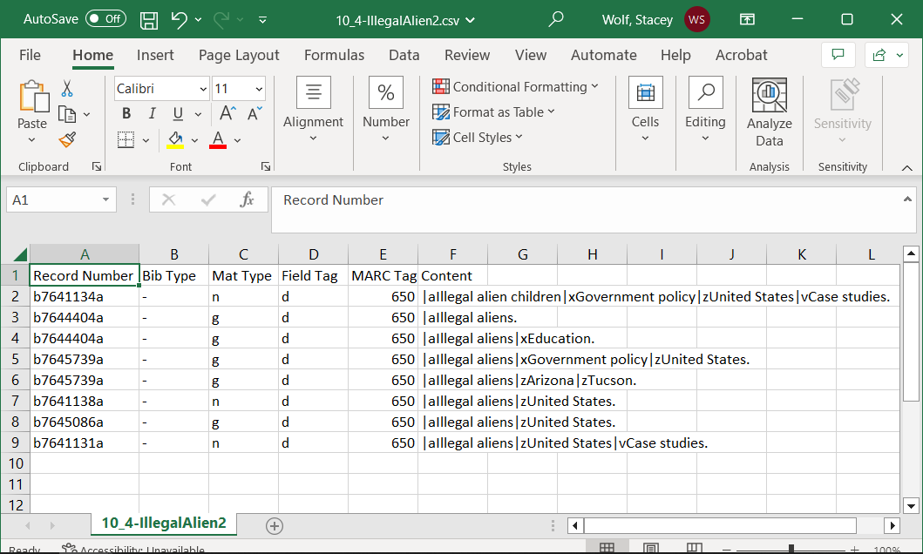
Notes:
This is what the data looks like in the .csv file if you open it in Excel. The queries results are all formatted so you don’t have to open any of them to make changes before importing into sierra

Slide 18
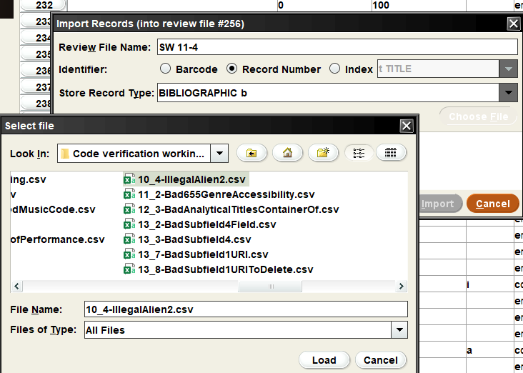
Notes:
In create lists in Sierra, find your saved results file

Slide 19
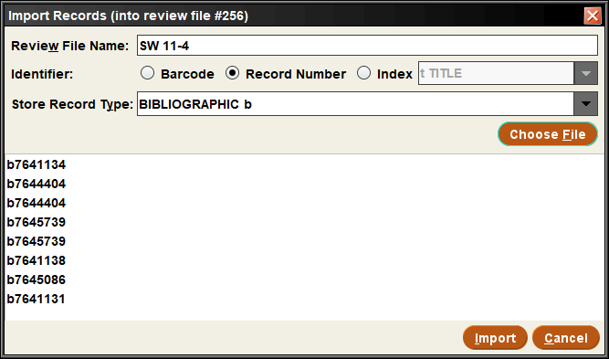
Notes:
Here are my bib records from the file. Click import and you can then start going through the bib records to clean them up. Or move on to running the next query.

Slide 20
Annoyances
Unpredictable timing
  Immediate results
  ~1 minute
  <10 minutes
  Timed out
All queries no matter the results take at least a minute to set up and run
1 minute X ~200 queries = ~200 mins = ~3 hours
Notes:
I found my self getting annoyed with how much time this whole process felt like it wasted. Queries have unpredictable timing. Some provide immediate results, which is great because this usually means only a couple of items to fix or nothing at all. Most take about a minute or more, which isn’t really enough time to multi-task and do something else. I’d try to use that minute to import the previous file into Create lists or run the next query in another window. I could have up to 5 windows open, so it could get unwieldy and not save as much time in the end. Some queries take closer to ten minutes, which is enough time to go do something else, but then I’d forget to come back to it and the results would sit for a bit longer than ten minutes. Not really a problem, but doesn’t move the process along like it could be. Timed out queries are just annoying because you wasted time and have to rerun it or adjust it and rerun it.
Queries that return no results still waste a few minutes to find that out. Setting up a query in general takes less than a minute usually. Running that type of query usually takes less than a minute, but maybe a little longer. So you have 1-2 minutes per query that may result in no files, just checking off that box and moving on. Repeat this by dozens of queries and it starts to feel like a waste of time just to find out you can skip that query.
Not dealbreakers but little annoyances when it’s part of a process that takes days and you have other things you want to get done.

Slide 21
Enter Python scripts
Notes:
Adam mentioned before he left for another institution that he wanted to turn the queries into python scripts but hadn’t spent the time to figure it out. I love to automate anything I can, so I talked my supervisor into allowing me to take some Innovative trainings to learn how to do this.

Slide 22

Innovative training series
Sierra Python Scripting Workshop (part 1 of 5 course series)
Sierra SQL Refresher Workshop (part 2 of 5 course series)
Sierra Scripting for SQL Workshop (part 3 of 5 course series)
Introduction to Sierra RESTful APIs (part 4 of 5 course series)
Sierra Scripting for APIs Workshop (part 5 of 5 course series)
Notes:
This is the series of classes from innovative I signed up for. It was either class 1 or 3 that taught the python scripting if you want to learn more about how to do it and not just copy and paste. We learned how to create a python script, which allowed me to create the pattern and fill in queries later.

Slide 23
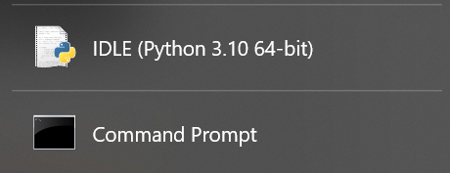
Programs needed
Notes:
You need IDLE, a python program to create the python scripts. And the command prompt to run the scripts. You can technically run them from IDLE, but I found that process cumbersome for the number of scripts I wanted to run at a time.

Slide 24
Password tip – store in a separate file
postgresql_password = "ENTERPASSWORDHERE”
Save as: postgresql_password.py
Use postgresql_password in your queries to refer to your password

Slide 25
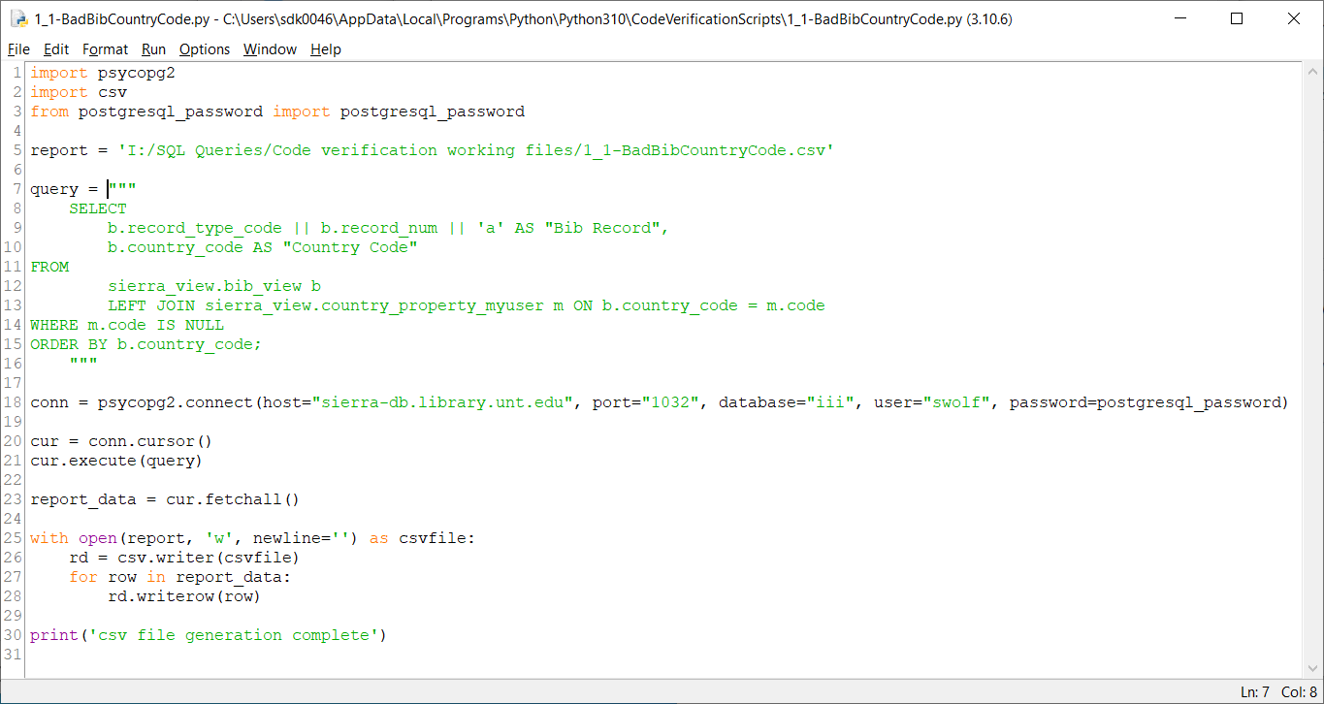
Example scripts
Notes:
Here is the first query I showed earlier of bad bib country codes within the python script.
First you import the python programs you need; here I do psycopg2 and csv
Tell the script where to find your password
Report = lets you determine where to create the file and the name of it. This will vary for anyone who wants to reuse the script
The query is next, just copy and paste so that the SQL query falls in between three double quotes before and after.
Conn= tells the script how to access your Sierra backend, this will need to be adapted to your institution.
The last bits tell how to write the csv file. You can add column headers or leave them off; it won’t affect your results or ability to import into sierra.
And the print(‘csv file generation complete’) is just so you know that script has finished and the file is now in your folder.

Slide 26
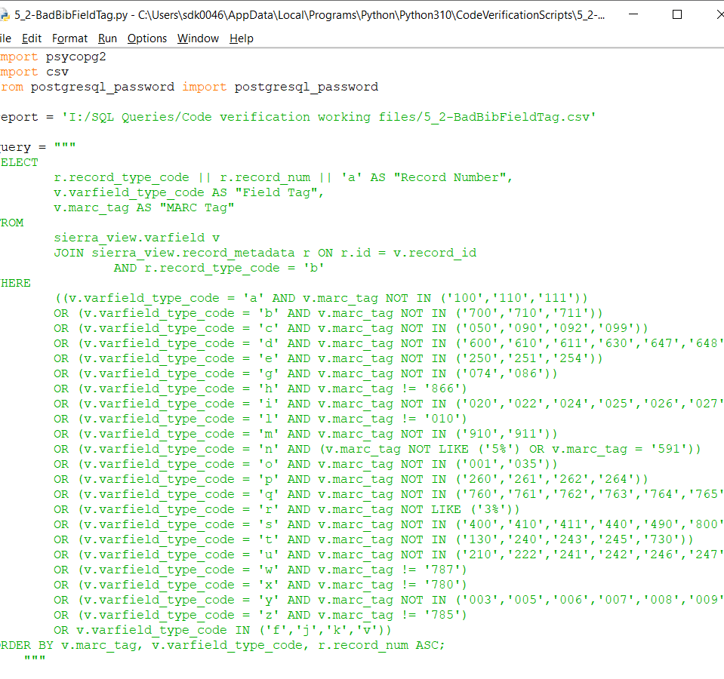
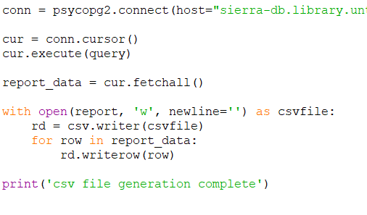
Example scripts
Notes:
Here is the bad bib field tags script

Slide 27
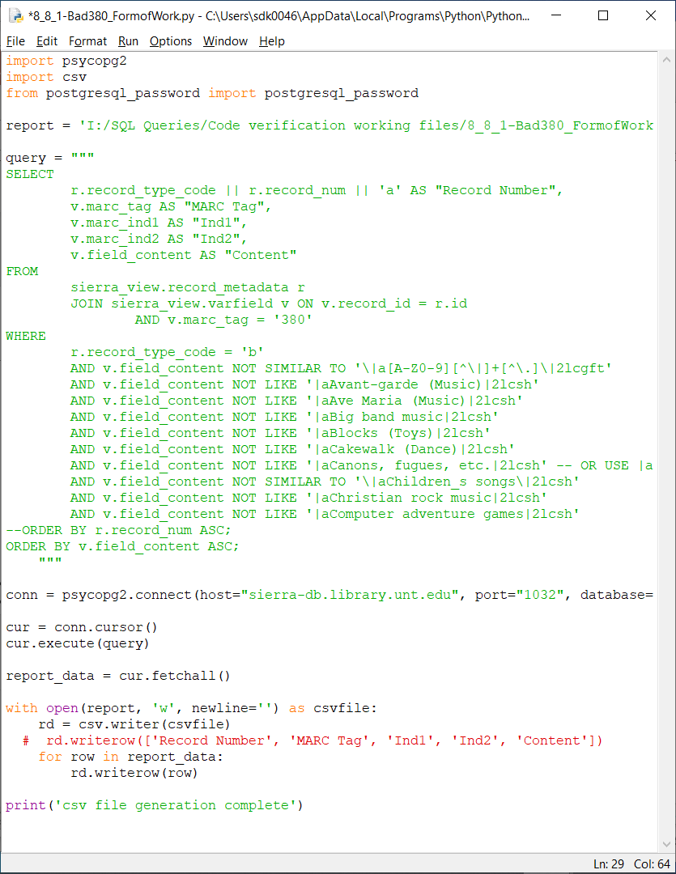
Example scripts
Notes:
And here is the bad 380 form of work. I’ve taken a few of the entries out just to make it all fit on the screen

Slide 28
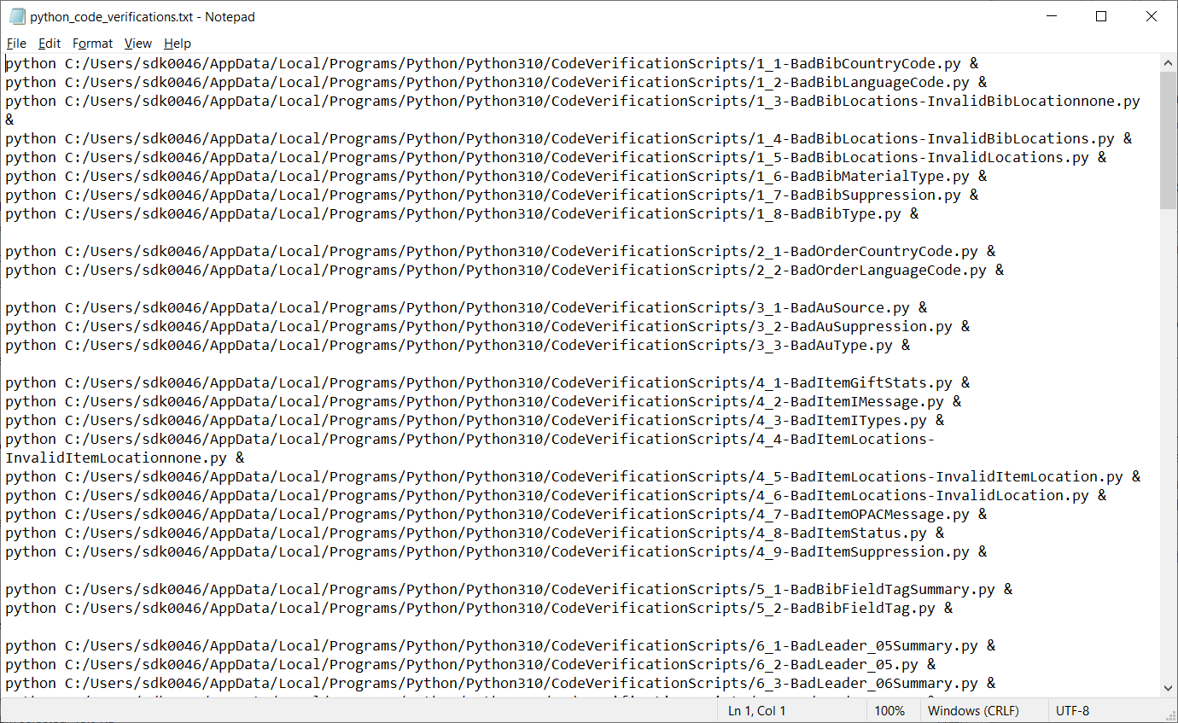
Notes:
If you are careful about how your name your scripts (mainly with no spacing), you can create a text document that will allow you to run all of the scripts with one copy/paste command.
This starts with Python, telling the command line to pull up python, then the file name of the script (your location will vary). The ampersand makes the command line go to the next entry when it’s finished so you don’t have to keep copying and pasting

Slide 29
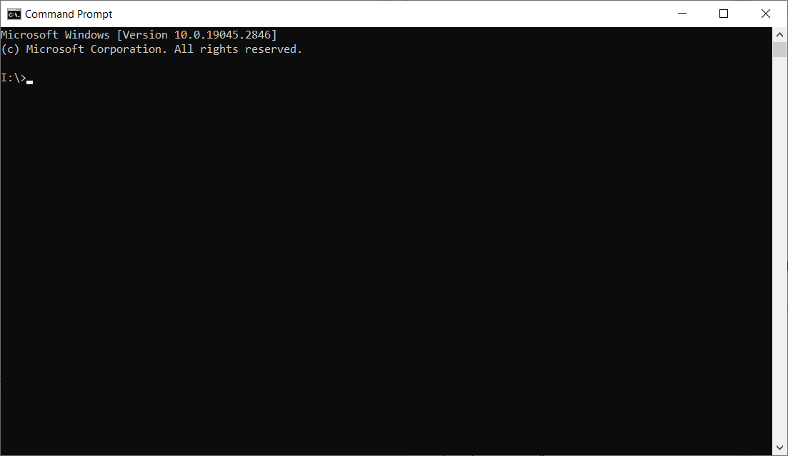
Notes:
I open the command prompt window.

Slide 30
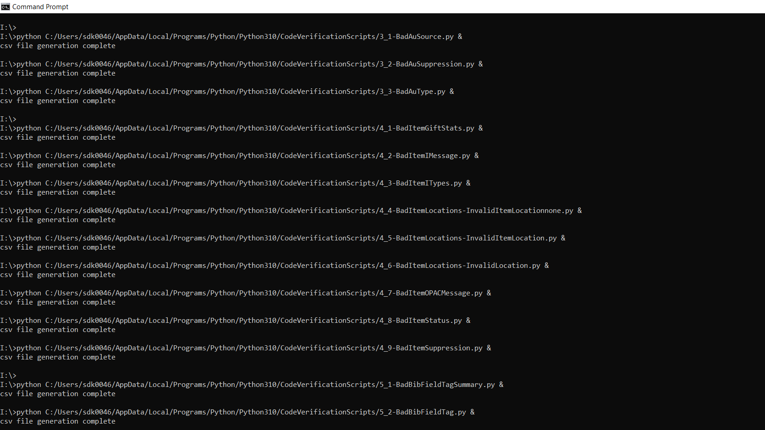
Notes:
I copy and paste my text and it starts creating files.

Slide 31
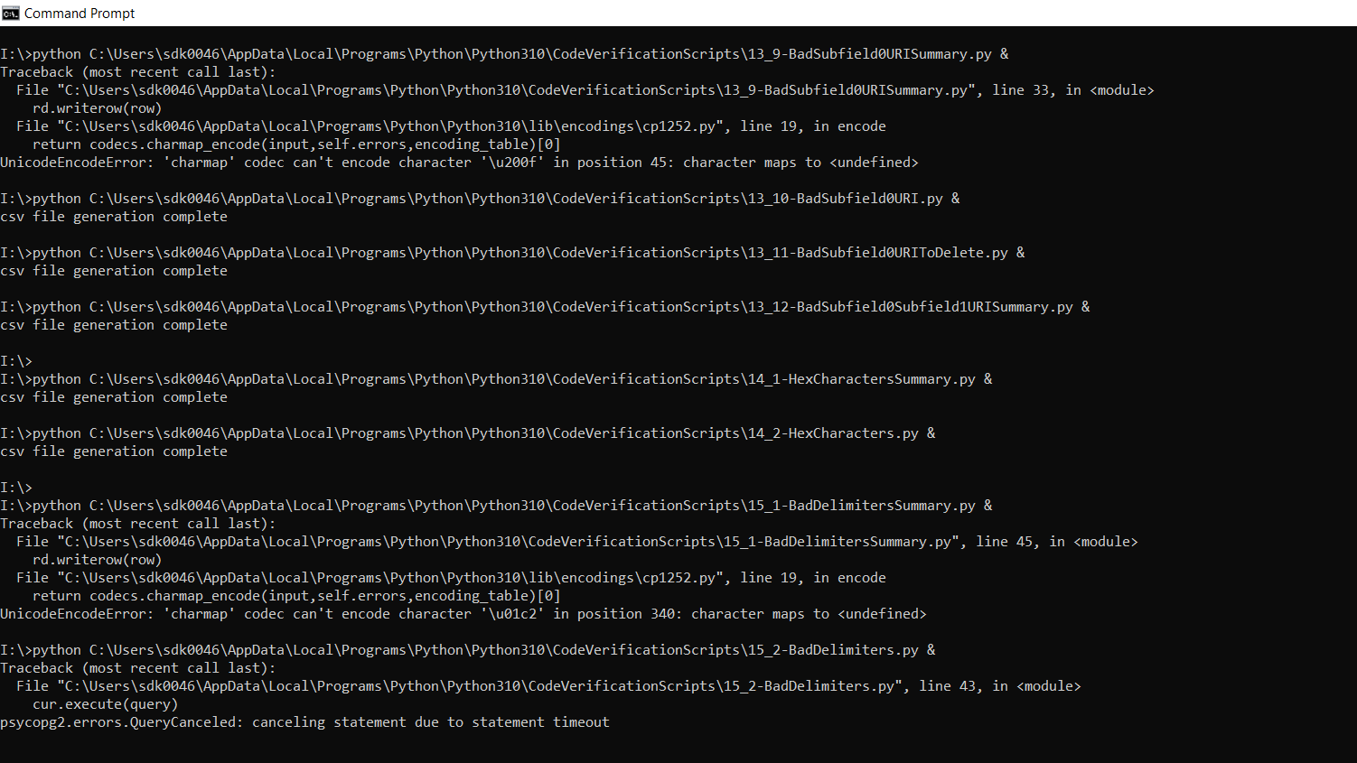
Notes:
Sometimes a special character will trip it up and it’ll either skip that file or print what it had before it got tripped up. Since I usually end up rerunning queries as I complete the corrections, this isn’t a big deal. Pgadmin will show everything later.

Slide 32
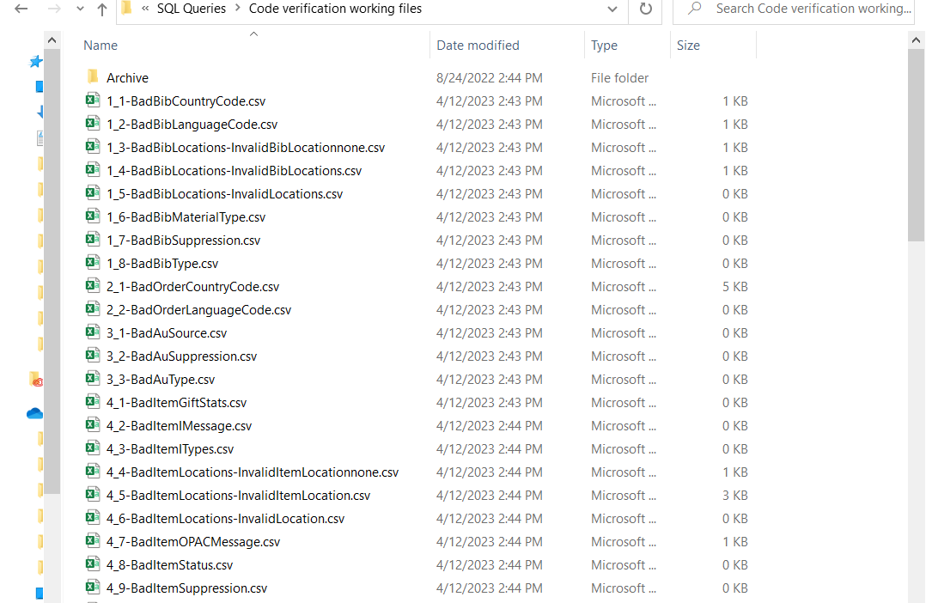
Notes:
And here are all of my files that were created. Because of how the program is set to create the CSV file, it overlays the file or creates a new one if it can’t find one. So you need to make sure the files are all closed or you’ll get an error.

Slide 33
Statistics
Started around 2:43pm; Finished at 4:03
1 hour 20 minutes total
  Run this at the end of my day or before lunch break
126 files created
56 files empty; 16 files of Summaries only have 1KB= practically empty; just headings
54 files to import into Sierra (42% of all files)
Notes:
Last time I did the clean up, I took notes about the process for this presentation. I started mid-afternoon and it finished before I was leaving for the day. It took an hour and 20 minutes to run about 126 scripts. This is different from the 200 I mentioned in the beginning because I didn’t make scripts for a lot of the summary queries that just show a count of the problems.
I got 126 files from the process. 56 had 0kb; 16 summary files had 1kb which is usually just the headings I tell the script to print to the csv file. So it’s practically empty and can be deleted without ever looking at it. And empty file for the main search version of the summary also helps indicate that there are no results.
54 files were left to import into Sierra, which is 42% of all the files. I was able to knock out nearly 60% of the clean up queries without ever having to do anything but copy and paste and hit enter.
My next goal is to try to set up some APIs that could change records automatically. Nothing complex, more like if a fixed field is blank, enter --- or whatever our default is.

Slide 34
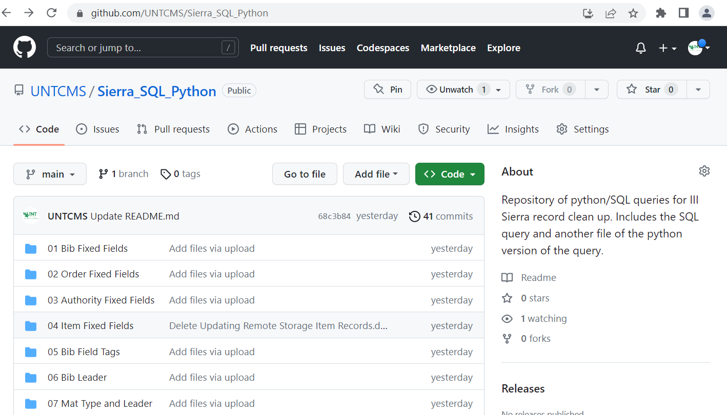
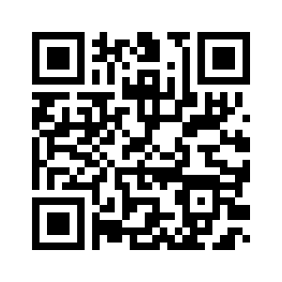
https://github.com/UNTCMS/Sierra_SQL_Python
Notes:
I’ve wanted to share the sql queries with the library community for the longest time and this presentation has finally forced me to do it. I’ve added all of the SQL queries to our UNTCMS github. I’ve also added all of the python scripts to the corresponding folders

Slide 35
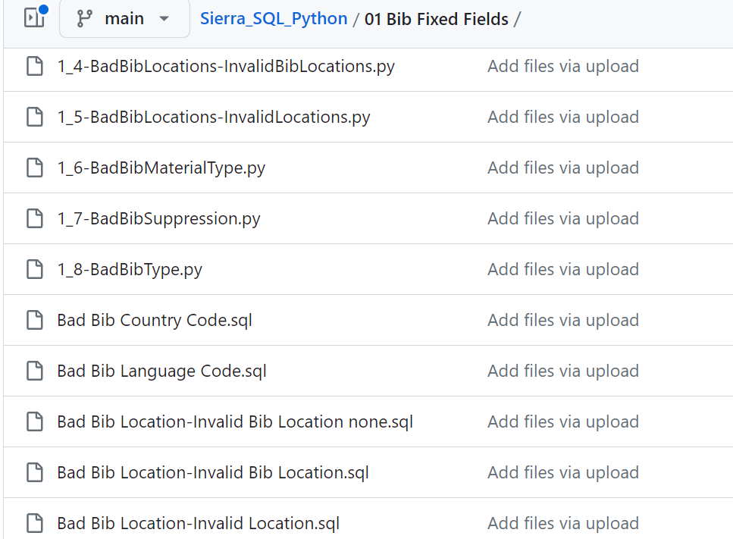
https://github.com/UNTCMS/Sierra_SQL_Python
Notes:
Here you can see both the .py file type and the .sql file. So please, go download and play around with them. And reach out if you need help adjusting the script to your institution.

Slide 36
THANK YOU
Questions?
stacey.wolf@unt.edu

