Slide 1
Spotlight Your Collection
Showcase Your Holdings Using Vega & III Mobile
Alison Pruntel
Fauquier Public Library
Notes:
Hello and welcome to IUG 2022 and my presentation on highlighting your collection in Vega Showcases and III Mobile.
My name is Alison Pruntel and I am the manager of technology and materials for Fauquier Public Library, a 3-branch system serving over 70K, located about 45 minutes northwest of Washington, DC. You may know me from being on the IUG steering committee (I’m passing the baton after this conference!) or the many rambling questions I post to the Sierra listserv
FPL was an early adopter of Vega (went live to the public in April 2021), and along with our new catalog interface, we are also transitioning from the MyLibrary! app to the III Mobile app. In fact, we should be live in the app stores later this month. We feel that both of these products, Vega and the III Mobile app, provide a more compelling introduction to our collection.

Slide 2
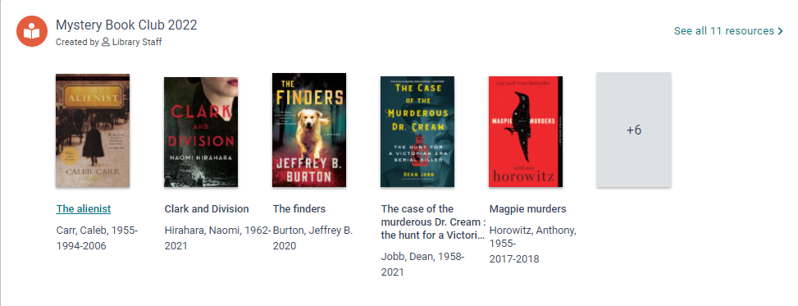
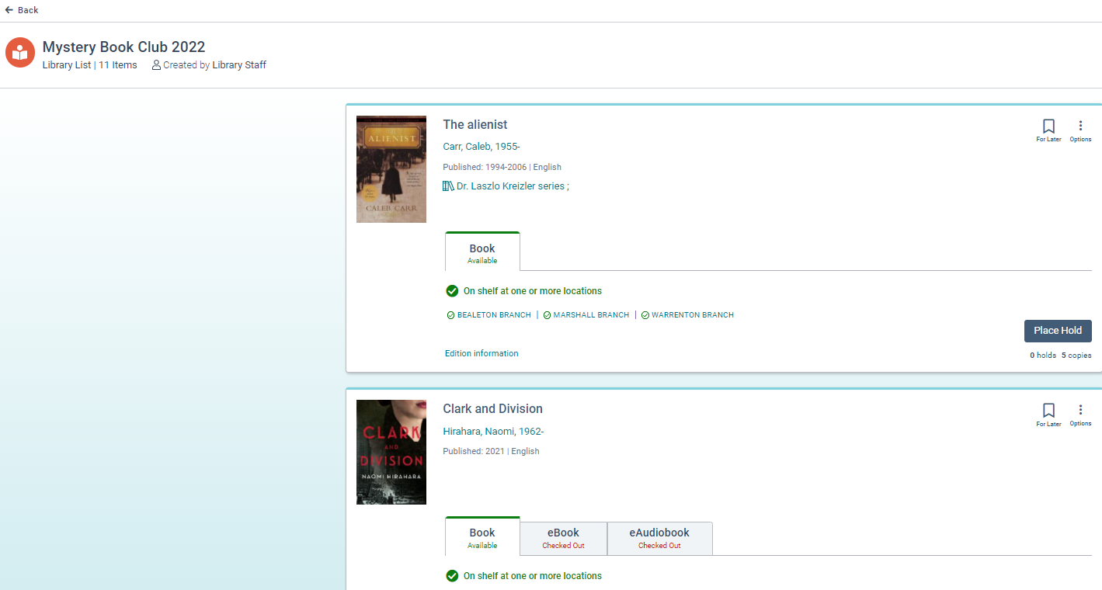
Showcases – What Are They?
Items in your Vega catalog that staff bundle together in a saved list and publish as a visual collection in Vega search results.
The showcase/collection displays when you look at an item that is included in the published collection, just like Related Resources, Contributors and Topics.
Example – Caleb Carr’s The Alienist was a title that the Mystery Book Club read in 2022. When you view that title in Vega, you will see, along with other titles by Caleb Carr, a showcase of all the titles (12) that the Mystery Book Club read that year.
Notes:
I’m sure you’ve heard quite a bit about Vega at this point of the conference, if not prior. I am guessing you are somewhat familiar with the concept of “showcases.”
As a refresher, basically showcases are… (talk through slide)
This instance illustrates how a showcase helps us build awareness of your book clubs and related titles that your patrons may completely bypass on your library website or on a published book list you have at the library. In the case of our library, most of our website traffic, where the details about the Mystery Book Club reside, don’t even use the website. They go directly to the search (for a title) or to log in to their account. This provides more personalized RA/recommendations, as well as exposing the user to this book club.

Slide 3
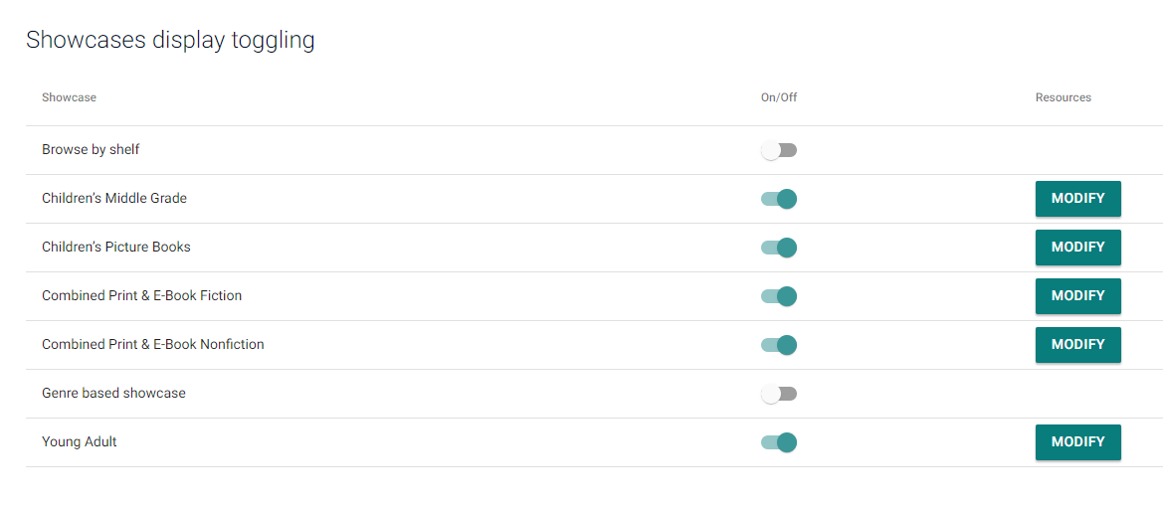
Showcases – What Are They? (cont.)
Vega provides you with a set of default showcases, which you can opt to turn on/off. These include:
Browse by shelf—Browse by shelf considers the call number from the instance.
Genre-based showcase—Browse by genre considers the genreForm field.
NYT—Children's Middle Grade Bestsellers
NYT—Children's Picture Books Bestsellers
NYT—Combined Print & E-Book Fiction Bestsellers
NYT—Combined Print & E-Book Nonfiction Bestsellers
NYT—Young Adult Bestsellers
In the above example, you can see that the library has only turned on the NYT showcases.
Notes:
If showcases seem overwhelming at this point, you’re in luck, as Vega provides you with a number of default showcases you can toggle on or off.
As you can see here (looking at the admin side of Vega), we’ve turned on the NYT lists and kept browse by shelf/genre off for now.
Patron and staff feedback on seeing the New York Times lists has been incredibly positive.
At this time, the default showcases are not “shareable” nor can they be embeddable, which I will talk about next.

Slide 4
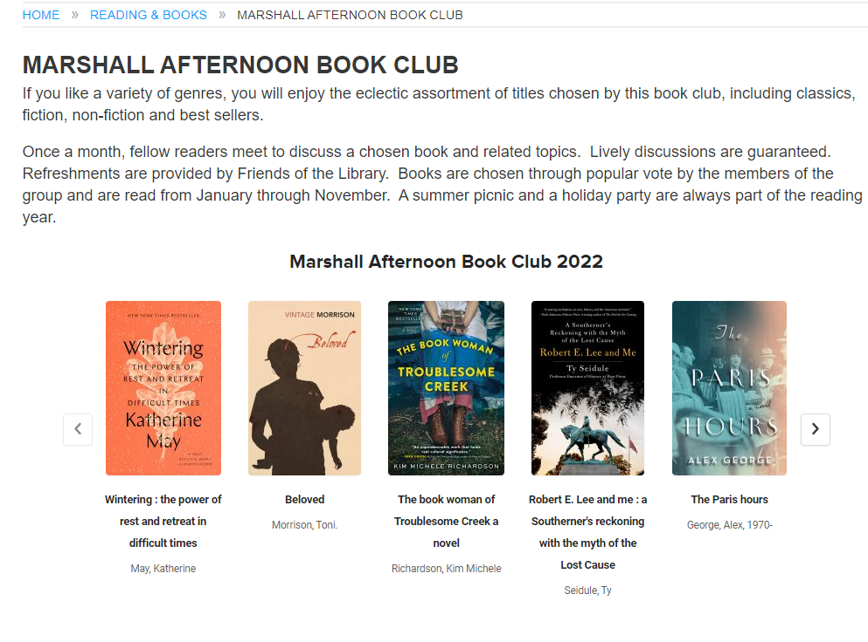
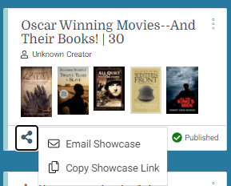
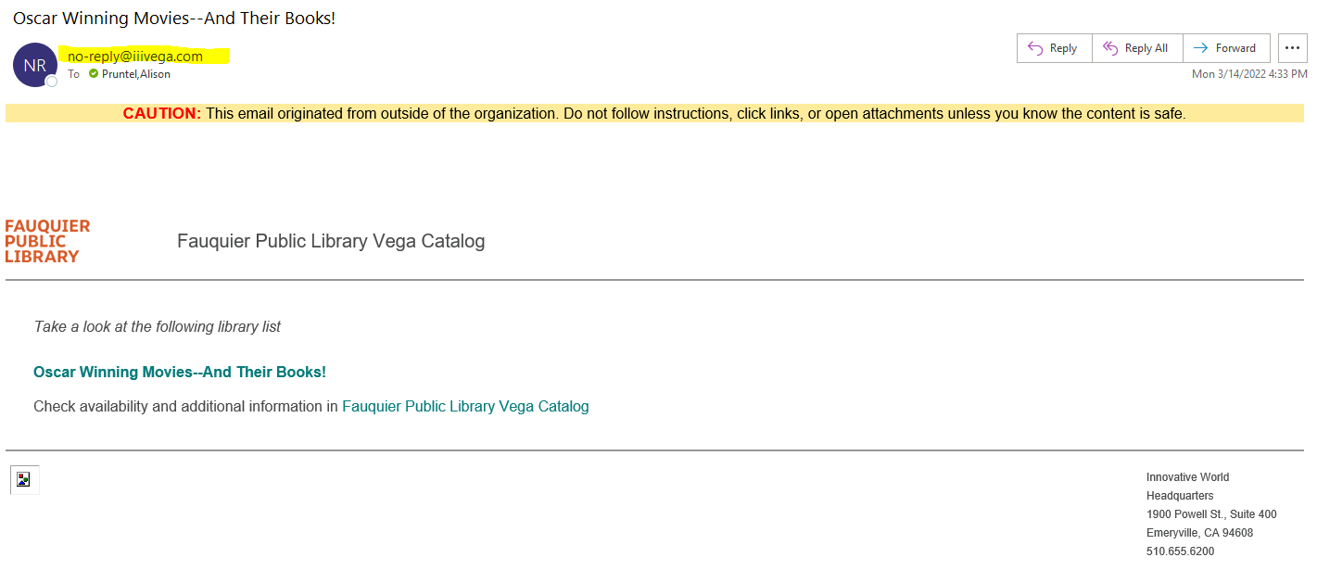
Showcases – What Can You Do With Them?
Just like you can with booklists, you can share by copying/pasting a link to your showcase or send via e-mail
If you e-mail the link, the mail will come from no-reply@iiivega.com.
You can also embed showcases on websites, social media, etc.
Notes:
Go through slide, pointing out that the email or sharing of via link is handy, especially when a patron asks you for a list of books/needs RA assistance.
If you send by email and the recipient does not receive it, the address no-reply@iiivega.com may be blocked by their spam filter/firewall.
The Marshall Afternoon Book Club image is an example of a webpage with an embedded showcase.

Slide 5
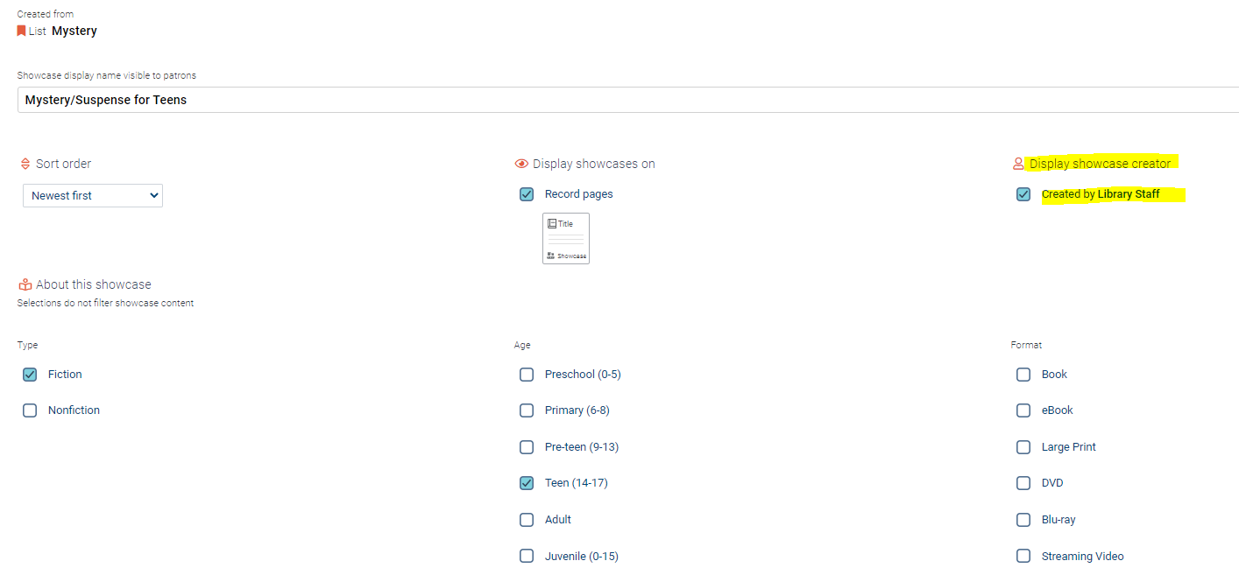
Showcases – Easy to Create and Publish
Library staff with showcase privileges (assigned by library card barcode #) log into the public-facing Vega and create a booklist of items (these will be under the Bookmarks tab).
Keep as a list, which can be shared (via a link or send by email), or create a showcase, which you can Save or Save & Publish.
When you create your showcase, you will give it a name/title, can select age level, format, etc. (or leave that unchecked).
The Showcase creator display name will be the nickname in the account. Tip: Have all use something generic, like “Library Staff”
Notes:
Details on administering showcases is available in the Vega administrative guide, which you can find in the III Supportal.
In order to create a showcase, a staff member will need to log in to Vega with a card number that has showcase privileges. What I did was assign cards/barcodes that are used by staff for certain things. They don’t belong to an individual person on staff (who may leave), but are for a department (Main Street Branch Children’s Staff, for example).
Just like a patron, the staff member signs in (but in this case, with library barcode with showcase privileges), makes a booklist and then has the option of creating a showcase out of that list of items.
The staff member has options they can set as to how to display items (by order added, alphabetically, etc.). I don’t know if you can see this closely in the image, but there is the option to display the creator name. The creator name is derived from the “nickname” you can set up in your Vega account (whether you’re a patron or a staff member).

Slide 6
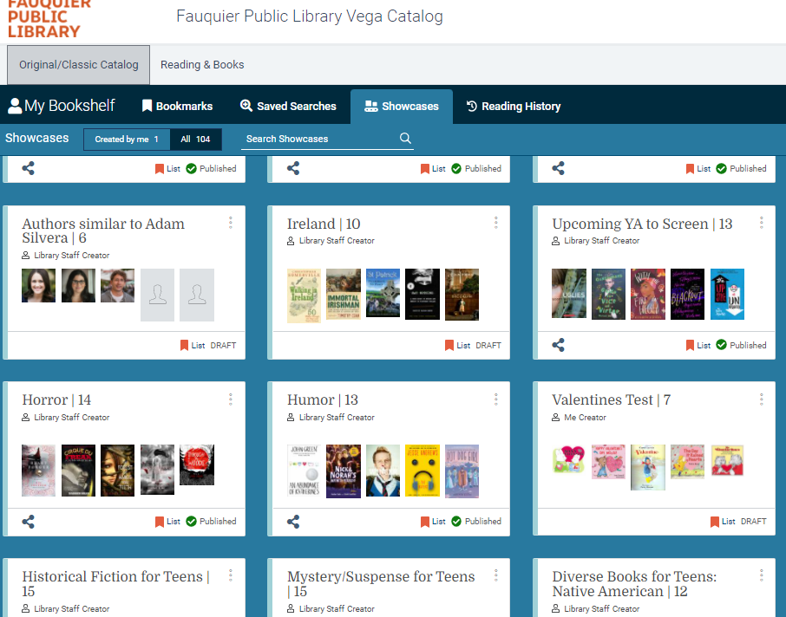
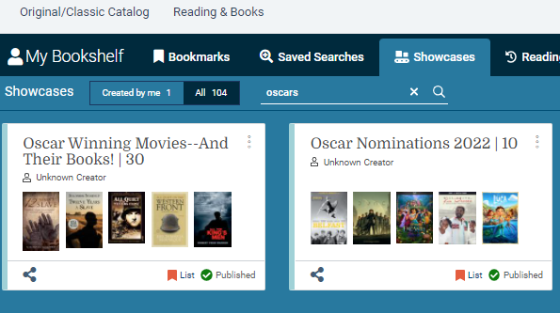
Showcases – Easy to Create and Publish (cont.)
When you log in to the public-facing Vega with showcase privileges, you’ll see not only your showcases, but those created by others with the rights to do so.
As you can see from this example, while this user has only created one showcase, there are 104 in total (draft and published).
Luckily, you can search by keyword to narrow down your choices.
Notes:
The downside of showcases being so easy to create and publish is that you can end up with many, many showcases, which may or may not be desirable. You’ll also find lots of “test” showcases that staff may have created and then never published. While you can search for showcases that you’re aware of, it’s admittedly overwhelming to browse. In the next few slides, I will go over some ways you can limit the number of showcases you have at any one time.

Slide 7
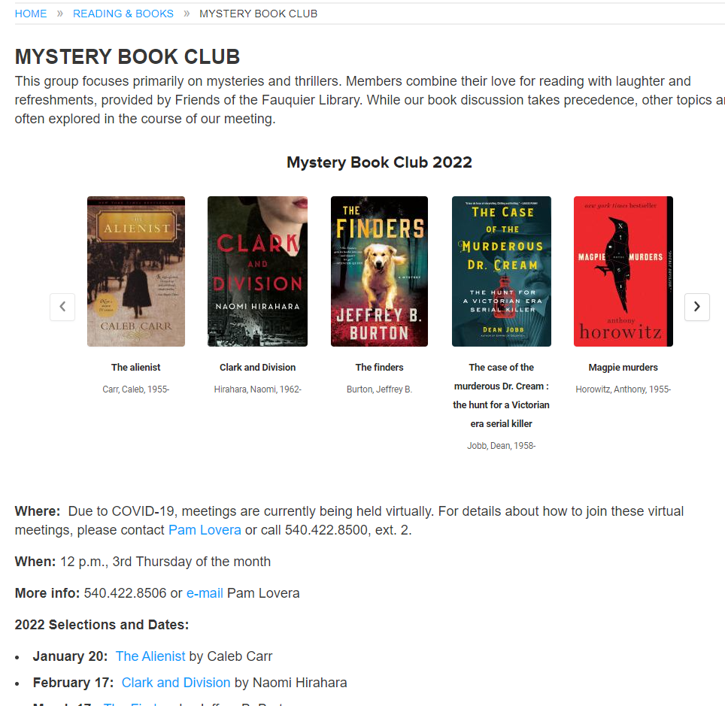
Editorial Decisions – What to Showcase
What do you want to showcase?
Lists of items you want to embed/feature on your website (ex. book club)
Titles/items that you’d normally publish in print (ex. book lists that you’d hand out to a patron)
Titles/items related to a marketing initiative (ex. bird watching kits – related books, materials that may or may not display as a related resource in Vega)
Titles that are related to a program that is going to be heavily promoted
Notes:
Showcases (and the lists they are based on) can grow like topsy, so you want to put some limits in place, preferably before you roll the option out to staff.
What really warrants a showcase? I’ve listed some questions you’ll want to ask yourselves. We opted to limit our lists/showcases to book club selections; book lists (published in print or on our website), which include frequently requested themes like princesses or Battle of the Books; grade-level lists (best books for 2nd graders) that we publish/update each year in advance of our summer reading program.
For example, these grade-level lists - in pre-Vega times, we would have staff create/print tri-fold brochures to hand out ($$$). We also required staff to send our website manager the titles and URLs (after explaining to staff how to create the correct URL to go to a “roll up”) so she could create/publish as a page or post on our website. That’s a lot of publishing (and more website content to manage).
Now we will simply add links (or embed) showcases on our website that go directly to Vega, vs. another page on our website with links. We will also use QR codes posted through the library branches, etc., to take you to those showcases directly in Vega.
We’re definitely saving money (ditching the printed stuff) and staff time (no double publishing).

Slide 8
Editorial Decisions - Who
What staff members do you want creating showcases?
Limit to staff that are responsible for creating content for your website or creating printed book lists and displays.
Assign an editorial lead (ex., person who is in charge of marketing) who is responsible for what is/isn’t published (the “Decider”).
When assigning staff roles, limit the publish/unpublish, create published showcases to the editorial lead.
Have a system in place where the editorial lead is alerted when a showcase has been drafted and needs review.
Make sure to set up generic staff cards/barcodes (“children’s reference staff”) and assign those cards the roles.
Notes:
As you saw with the example showing 104 showcases in various stages (tests, drafts and published), you may not want to have all of your staff members creating/publishing Showcases.
Select staff members that are good at merchandising or marketing what’s relevant – the people who put together the book displays or who the marketing folks go to for lists of “best books” on a particular topic.
As mentioned earlier, sure to look at the “Assign staff roles” section for administering showcases in the online manual. You really will want to make sure you assign roles to a generic card/barcode vs. a staff member’s person card number, esp. if s/he leaves the organization.
You will also want to have some staff with creation rights but not publishing rights. Appoint a “decider” or editorial lead to handle that.
Also, as noted earlier in the presentation, the “nickname” in the account should be something that makes sense, like “Library Staff” vs. what you may have in the name field in the patron record.

Slide 9
Editorial Decisions – Example Process
During marketing meeting, a list of spring holiday books is requested.
Children’s reference librarian creates list, makes draft showcase of titles and alerts editorial lead.
Editorial lead reviews list, alerts librarian to any changes needed and then publishes the showcase.
Editorial lead embeds showcase on library website, in newsletters, on social media channels, etc.
Showcase is removed (unpublished or deleted) by editorial lead on agreed-upon date.
Notes:
This slide is just an example of how you could implement the introduction of Showcases in your system. It will of course depend on how large your system is, if you’re a member of a consortium, etc. This is what works for our 3 branch system.
For your convenience, I’ve included a handout (in Word, so you can edit to fit your setup), I think it’s just called Handout 2, that lists out our procedures for creating, approving, publishing and maintaining Vega showcases.
Regarding the process here for the spring holiday book list, #5 mentions removal of the Showcase, which leads me to the next slide on the “weeding” or maintaining of published Showcases.

Slide 10
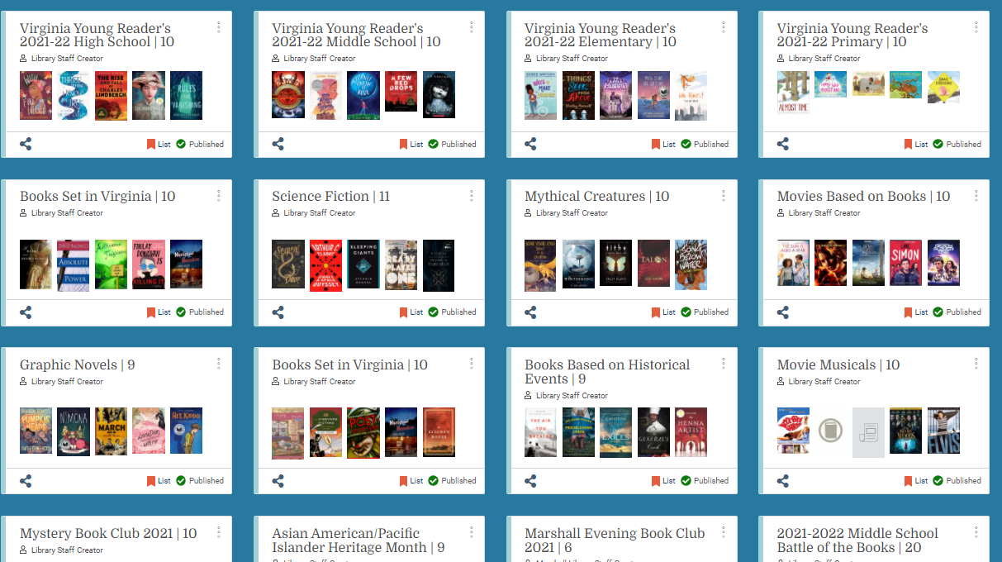
Showcases – Management
Set guidelines for how long you will retain certain types of lists/showcases (ex. Book Club showcases will be kept for 2 years).
Decide whether you will unpublish or delete the showcase, or will you simply update it?
Factors to consider – do you have the list embedded or listed as a link somewhere (website, etc.)? You may want to update vs. replace.
Make sure to make revisiting a showcase or list part of your process – it’s easy to publish and then forget about it.
Make “showcase review” part of your annual cleanup.
Showcases may have dates associated with them or will need to be updated for currency.
Notes:
As I mentioned earlier, the downside of showcases being so easy to create and publish is that you can end up with a lot of showcases that may not be relevant (or good) or may become dated. For example, our “Battle of the Books” for the 2020-2021 school year is not something we want to keep – we either want to update the titles (and change the dates in the title) or create a new one for the 2021-2022 school year and delete the old one.

Slide 11
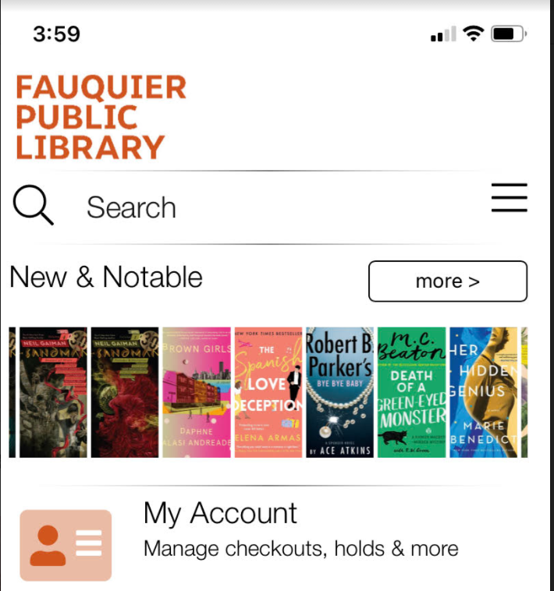
III Mobile
The III Mobile app allows the library to display “carousel” feeds to users.
Feeds consist of bibliographic item IDs, separated by commas (1351772,
1352718, etc.). Do NOT include the record tag (i.e., “b” for bibliographic) and you also must remove the check digit.
You can have up to ten (10) feeds, but only the first feed in your list of feeds will display on the home page of your mobile app. The rest of the feeds you create are available when the user taps on the “more” button.
Notes:
So enough about showcases. There’s another tool you can use to highlight your collection to your patrons – III mobile.
We will be rolling out the III mobile app to our patrons later this month. Up until now, they’ve been using the MyLibrary! app. There are features in the III mobile app (like adding/managing other accounts – great for busy parents - besides your own and self-check) that pushed us to try III mobile instead. Aside from those new functionalities I just mentioned, our beta testers really like the New & Notable carousel that sits at the top of the homescreen.
Go over slide, how it works.
Reminder: there is some documentation available on the Supportal. One thing to note is that because this is a 3rd party product (Solus UK), the documentation on the Supportal does not appear to cover everything, and not super detailed. We have a super helpful implementation team (shout out to Joe Phelps and Dane Larsen), who have been great about getting documentation from Solus.
We base our carousels on the beloved “featured lists” we have in our Classic WebPAC. Beloved by staff and some power users, I might add. These are review files that the WebPAC can display (FEATURED_LIST is the web option). In our case, it’s anything new added in the past month, with lists broken down by category or format (new DVDs, new picture books, etc.). Since we pretty much point to Vega for everything, staff/patrons miss seeing those lists, having them one click away (at this point, Vega doesn’t allow for more than 2 links in the navigation; in addition, we I think it would be weird to be taking patrons away from Vega, and then viewing something, placing a hold, etc. in the Classic WebPAC.

Slide 12
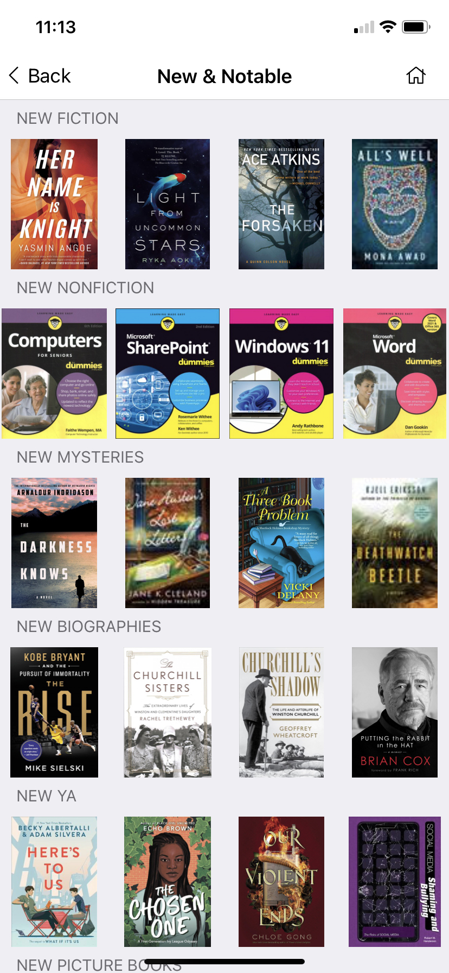
III Mobile
To set up your feeds, log in to the III Mobile admin application, select Mobile Apps, choose your library, select the Home Screen and then Edit Tab – Home Screen.
Enable Carousel Feeds and then populate the Feeds (bib ID separated by commas) in the order in which you want them to display. Give each feed a title (ex. New Fiction). In this example, FPL bases the New & Notable feeds on the “New to the Collection” lists that are displayed in Classic WebPAC.
Make sure your Homescreen Title (ex. New & Notable) is short and sweet so it doesn’t bump up against the “more” button.
Since it’s easy to export a list of bibliographic record IDs from Sierra Create Lists, this is what FPL does to populate these lists. See handout #1 that accompanies this presentation for complete details.
Notes:
This slide illustrates the basics of what you’ll need to do to get your carousel(s) working.
When first presented with the somewhat cryptic directions on how to populate the carousel feeds , I imagined a lot of copying/pasting from Vega (wish I could just link to already created showcases created in Vega!). Then I realized that I could simply export the bib record ID from “featured lists” I run each month. I believe you can also export ISBNs, and use those vs. bib IDs, but our records have multiple ISBNs and I prefer the Bib ID.
After I run those featured lists on the first of the month, I export the bib numbers, do a little cleanup in Excel, and then copy/paste a complete list into a feed and save. Refresh the app and there they are. If you do this and see no book covers displaying, then you will know you forgot to remove the check digit (last digit of the bib record number). This is not spelled out in the documentation. I ended up creating my own documentation (see Handout 1) that lays this all out, if you’d like to use it. I uploaded it as a Word doc so you can make it your own.

Slide 13
Wrapping Up
Vega showcases and book lists, along with III Mobile’s carousels allow libraries a way to provide visually compelling content to their patrons.
To ensure you don’t waste time creating random content (which you’ll then have to clean up), enlist staff feedback on the “what” and “who” prior to enabling these features.
Document the “rules” for these features and assign an editorial lead to enforce them (see handout #2).
Don’t forget to regularly review and refresh content as needed.
Notes:
So, there you have it. The key points…
I don’t think my presentation took the full 45 minutes, so you’ll get some of your life back.

Slide 14
THANK YOU
Questions?
Alison.Pruntel@fauquiercounty.gov
Notes:
If you have questions or want to suggest other ways you’ve used these features (or anything else) to spotlight your offerings, join me for the Q&A on Thursday, April 7, from 9:45-10:30 AM EST. Have a great day!

