Slide 1

Automating the Routine
Creating workflows and scripts that take routine processes out your hands
Nicole Allen

Slide 2
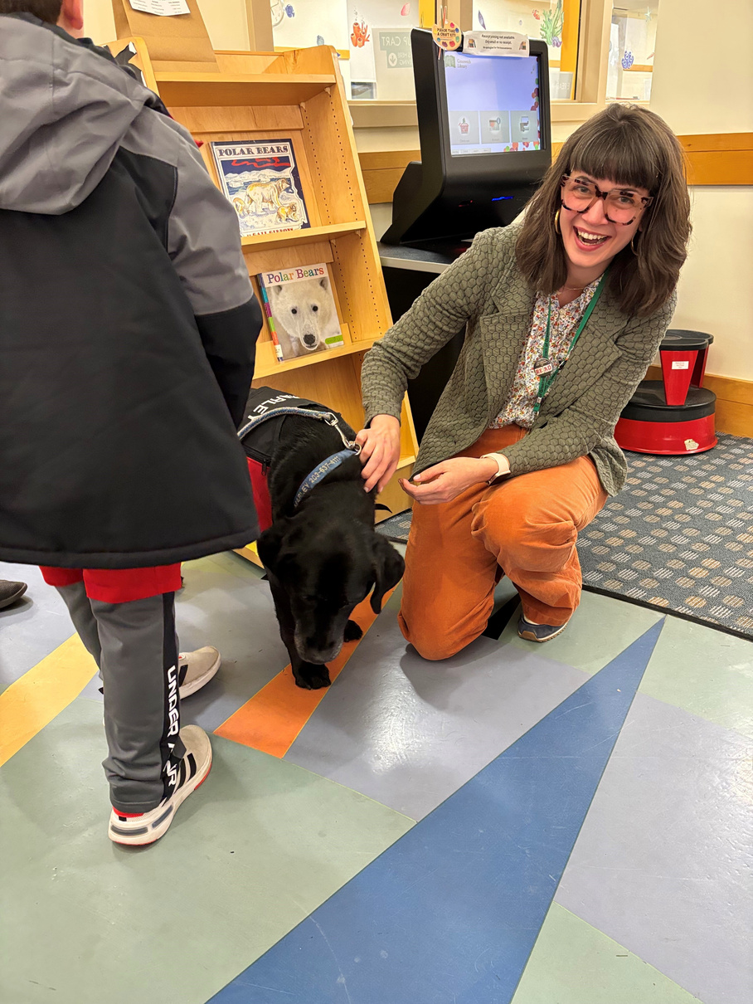
Nicole Allen
nallen@greenwichlibrary.org
About me
  With Greenwich Library since 2003
  Worked as a Circ-Aide, Clerk, Shelving Supervisor
  Current role is Acquisitions Librarian in Resources Management
  I report collection related statistics, manage our authority control records, create/update templates, load profile work & oversee all catalog cleanup
  Learned how to automate SQL from a presentation @ IUG. Check out Gem Stone’s presentation from the 2017 IUG Conference in Washington D.C.
  Work public desks 4 hours a week

Slide 3











About my library
63,574
POPULATION
3
BRANCHES
124
EMPLOYEES
102k sq ft
Size of Main Branch
6
Teams
$10.5 M
OPERATING
BUDGET
490,536
LIBRARY
VISITS
962,331
ITEMS
CIRCULATED
$1.19 m
Materials Budget
No. of items bought for all locations
33,466
  Sierra (hosted)
  Bibliocommons discovery layer
  Overdrive, Kanopy, Hoopla, Naxos, Pressreader
  Most Unusual collection: Lending Art & Bloomberg Terminal
374,030
ITEMS
OWNED
86,515
eBooks & eAudiobooks
54
Databases

Slide 4
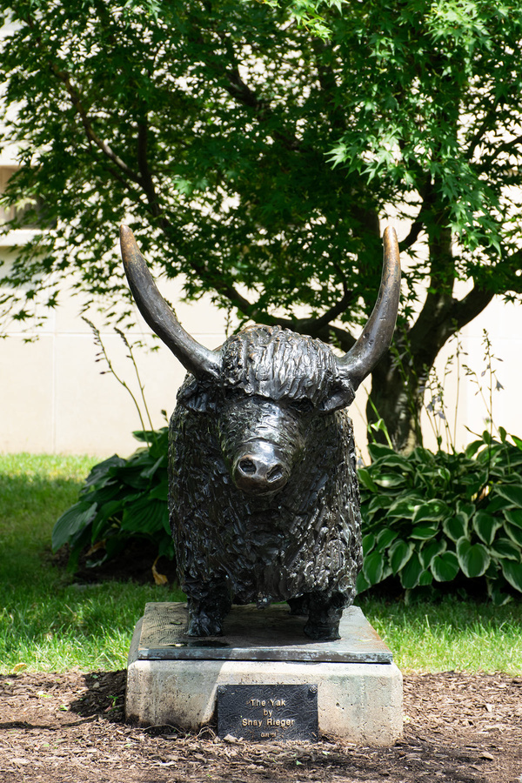

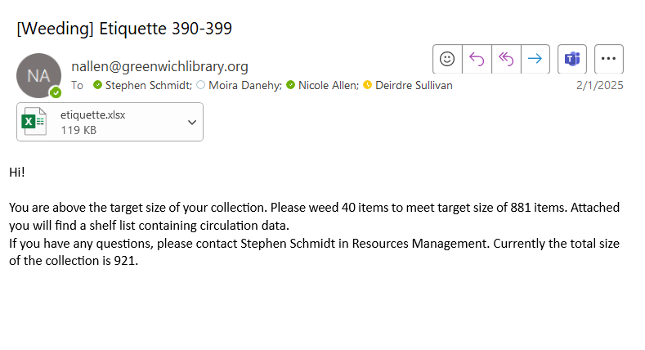
The Basics
GITHUB:
NICOLEALLENGRW
  Everything I am going to show you is done with free software.
  PgAdmin for SQL, Anaconda (Spyder), notepad ++ and task scheduler are needed
  Procedures and best practices is the goal.
  350+ unique scripts

Slide 5




What do you want to Automate
For me I needed to get basic things off my plate and to staff members who could do the work.
SQL
This is the query you will create that will help you find the data your are looking for.
Python Script
This is the script that will create an email with an attached spreadsheet containing the data from SQL
Automation
.bat files
This is the file you will run that will trigger your python script
Task Scheduler
This is the frequency and time you want your email to be generated

Slide 6
What to Automate & Why
  If you pull the same data regularly using create lists or web management reports… consider automation
  Start simple: item records
  Expand to cataloging errors, orders,acquisitions, holdings, circ stats
  Track weeding progress and make it part of everybody’s routine
  Staff turnover does not mean losing the ability to run these lists
  Free up your time
  Create standardized procedures for how old and outdated data is delt with
  Reduce errors when copy and pasting data
  Empower staff who do not have the skills to access the data they need

Slide 7
Item Records
Missing Items
Lost & Paid
Billed More Than 2 Yrs
  Every Thursday a list is sent to circulation of all items marked missing in the last 2 weeks. Staff do a THOUROUGH search. Found items are checked-in
  On the 1st of every month a list is emailed to collection managers & selectors of all items that have been marked missing for more than 6 months. Replacements are ordered and a staff member deletes all items on the list
  On the 1st of the month a list is sent to collection managers & selectors of all items that have been billed for more than 2 years
  Replacements are ordered
  A staff member then checks the items in using Admin Corner and replacement charges are automatically placed on the patron’s card
  A staff member then deletes the item records
  On the 1st of the month a list is sent to all collection managers & selectors of all items marked Lost & Paid
  Replacements are ordered
  Item records are deleted

Slide 8
More Item Records
In Transit
In Process
Museum Passes Expiring Soon
  Once a week circulation staff at each branch are notified of items in-transit for more than 7 days.
  Each branch receives a list of items owned by them, sent from their location or sent to their location
  Location codes and the In-transit messages with terminal location are used in SQL query.
  Designated staff member is notified of all items in-transit for more than 30 days. Marked missing.
  On the 1st of every month all locations get a list of items that have been in Process for more than 45 days
  Items not found are marked missing by staff who performed the search
  On the 1st of the month a list is sent to our Museum Pass buyer of all item records
  Replacements are ordered

Slide 9
Even More Item Records
Wrong Location
Wrong i-type
New Books
  A SQL query was created for all locations and what call numbers are allowed to be found in that location. Essentially a bunch of OR statements
  A staff member who LOVES finding mistakes receives the email with the list every Wednesday
  She searches for the items and corrects the issue
  Our Main Library has a specific location code for new books. They stay in the section for 6-9 months depending on popularity
  They are manually updated and moved by circulation when they are deemed no longer new
  List is created once a month of all books with the new book location code and a created date of greater than 12 months
  Very similar to the location search
  locations and or call numbers are called with incorrect i-types
  Staff receives once a week and looks for titles

Slide 10
Bib Records
Wrong Audience
Wrong Material Type
Call numbers with ,
  This mistake is a big problem for patrons searching for books. They often filter by Children’s, Adult or YA
  Bib records are pulled by call number and audience fields in the 008 are compared.
  Ex. control.p22 != 'd' and call.index_entry like 'ya%'
  Cataloger receives the email on 1st of every month with a list of bibs that need updating.
  This mistake is also a big problem for patrons looking to filter by format
  List is very similar to Wrong Audience except it is looking at materials types instead of Audience codes
  This is a common mistake at our library and can mess with call number stats, dumping data and a whole host of other issues
  Super simple search. Search the call number field for ,
  Cataloger receives the email on 1st of every month with a list of bibs that need updating

Slide 11
Acquisitions
Order records
Fund Reports
Express de-acquistion
  Every Tuesday all selectors receive a spreadsheet of all open order records sorted by date created.
  Spreadsheet contains release dates, vendors, internal notes as well as funds.
  This has been very helpful in keeping track of vendors with fullfillment issues so we can quickly pivot to another vendor when something doesn’t arrive in time.
  We have a Express books collection at all locations. They circ for a less time and do not fulfill holds. They come preprocessed and are leased.
  Every Wednesday a clerk in our department gets a list of suggested titles to pull and to send back.
  The search is Express books (i-type) older than 4 months, not checked-out and there is more than 1 available circulating copy on the shelf
  Goes out twice a month. Broken down by city line budget. We have 132 funds broken down into 16 lines.
  Because of the complexity of the town budget, Sierra fund breakdown is very hard for most selectors to visualize. Regular emails helps everyone stay on track.

Slide 12
Holds
Old Holds
Canceled Holds
Oustanding Holds
  Twice a week circulation gets a list of all bib level holds older than 4 days with available items attached to the record
  Staff will investigate what is going on with the record
  Staff then alerts the acquisitions or ILL team if the available item is not located
  Twice a week members of the circulation dept get emails containing holds that need to be canceled
  The SQL search is for all hold notes with the word cancel
  This hold note is created by acquisitions staff as they cancel order records for titles that we will not be receiving
  Circulation staff then contacts the patron
  Every Monday morning an email goes to all selectors/buyers & key Info staff members. Each branch get’s their version too
  Multiple lists by Materials type (books, DVDs, Music, etc.)
  Contains a list of all bibs with more than 2 holds, items owned and items on order. A formula was built to create a column showing a ratio of holds to items (owned+on order) .

Slide 13
Stats
Circulation stats
Holdings Reports
Patrons
  Comes on the 1st. Contains all circulation by call number and location.
  Call number circulation broken down by branch
  i-type circulation broken down by branch
  p-Code3 circulation broken down by branch
  Comes on the 1st of the month
  Contains counts (items owned) by call no,. & broken down by branch
  Contains counts (items owned) by material type & broken down by
  Contains items owned, total items checked-out, % off-shelf broken down by call no.
  Total holdings at each location. No. of items added to each branch and no. of items deleted from each branch.
  Comes at the end of the fiscal year.
  Shows the number of items added to each p-type location and the total number of patron accounts for each p-type
.

Slide 14
Collection Management
Collection Sizes
Shelf Lists
More Lists
  Library collections are broken down into 138 collections. Every collection has a collection manager and selector
  Every collection has a target size
  Target sizes are determined by a committee during a series of meetings held every 5-7 yrs
  Every collection manager receives a shelf list of their collection on the 1st of every month
  The email that contains the shelf list also tells the collection manager how many items they currently have in their collection and how many they are over or under
  Collection managers are responsible for weeding based on this information
  Many collection managers have a list sent to them of all new titles added to their collections every week.
  We are working on tracking the diversity of our collections within these shelf lists.
.

Slide 15
THANK YOU
Questions?
#IUG2025

Slide 16
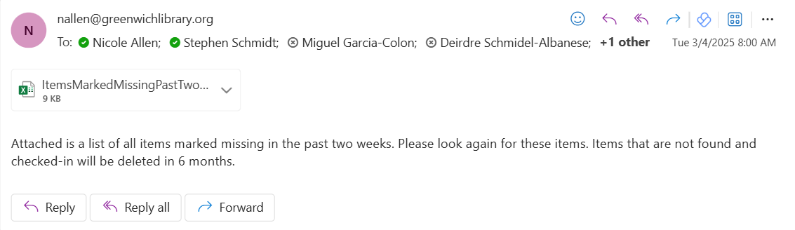
Call # | Title | Barcode | Location | Last Updated
821 chauc...g | The Canterbury tales | 31117010329576 | gbadu | 03/03/25
fiction albom...m | The first phone call from heaven | 31117018696604 | gbadu | 02/28/25
fiction alder...n | The Power | 31117020635616 | gbadu | 02/28/25
fiction allen...i | The house of the spirits | 31117020660127 | gbadu | 02/28/25
fiction amsde...d | Important things that don't matter | 31117012083114 | gbadu | 03/03/25
fiction backm...f | Anxious people | 31117021932442 | gbadu | 03/03/25
fiction badan...s | The storyteller's secret | 31117021283937 | gbadu | 03/03/25

Slide 17
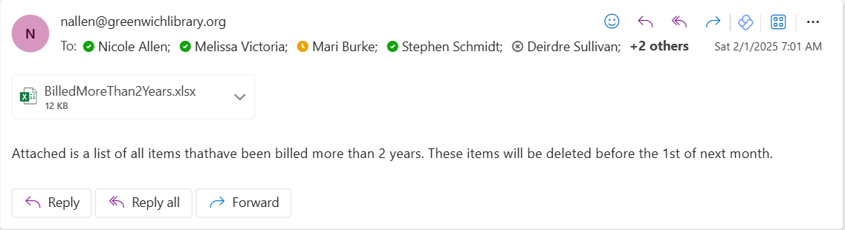
Call # | Title | Barcode | Location | Total C/out | Cat Date | Status | Due Date | No. Of Holds | item No.
001.9 sagan | The demon-haunted world : science as a candle in the dark | 31117015242980 | gmad1 | 33 | 04/04/2008 | n | 01/24/23 | 0 | i1499387a
109 ferry | A brief history of thought : a philosophical guide to living | 31117017745634 | gmad1 | 19 | 01/05/2012 | n | 01/30/23 | 0 | i1775463a
155.24 clear | Atomic habits : tiny changes, remarkable results : an easy & proven way to build good habits & break bad ones | 31117021270793 | gmad1 | 45 | 10/15/2018 | n | 02/10/23 | 0 | i2189485a
158.1 deida | The way of the superior man : a spiritual guide to mastering the challenges of women, work, and sexual desire | 31117022499177 | gmad1 | 1 | 09/06/2022 | n | 02/03/23 | 0 | i2348693a
160 | Clear thinking. | 31117003537383 | gmad1 | 35 | 01/01/1988 | n | 01/21/23 | 0 | i363727a
172.4 oneil | Justice across boundaries : whose obligations? | 31117020583204 | gmad1 | 1 | 10/13/2017 | n | 01/30/23 | 0 | i2127589a
292.13 grave | Greek myths | 31117009868881 | gmad1 | 38 | 04/05/1999 | n | 01/21/23 | 0 | i898550a
322.4 x x | The autobiography of Malcolm X | 31117021353896 | gmad1 | 10 | 03/18/2019 | n | 02/03/23 | 0 | i2202050a
378.1616 gelb | Conquering the college admissions essay in 10 steps : crafting a winning personal statement | 31117020562240 | gmad1 | 13 | 09/14/2017 | n | 01/26/23 | 0 | i2123566a

Slide 18
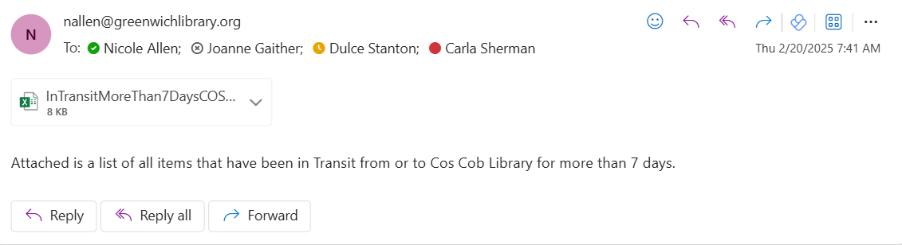
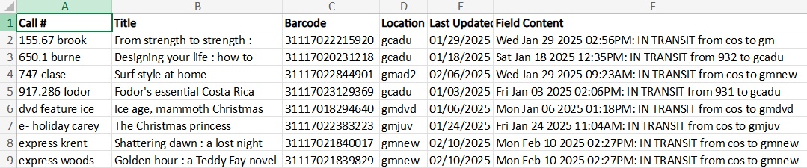

Slide 19
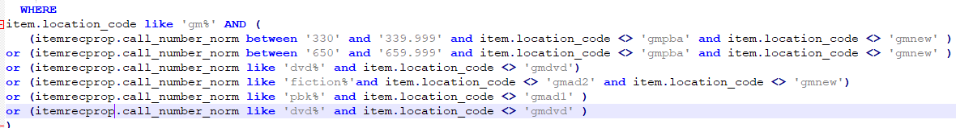
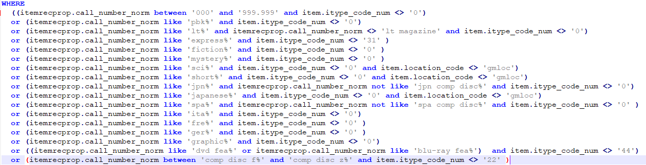

Slide 20
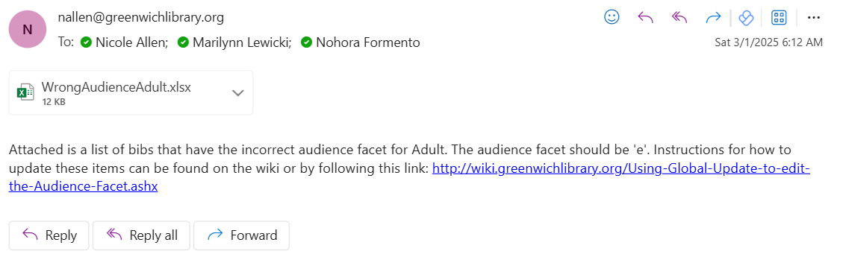
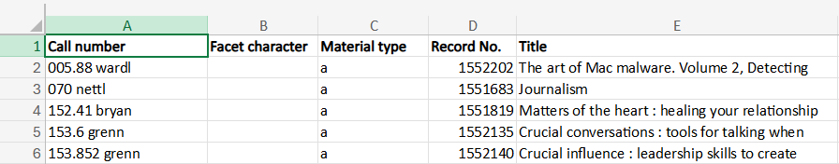

Slide 21
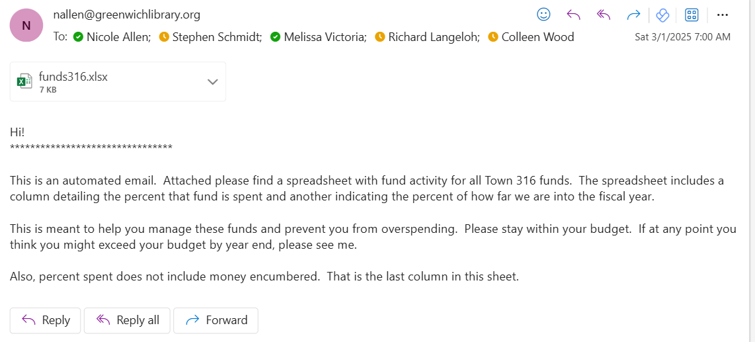
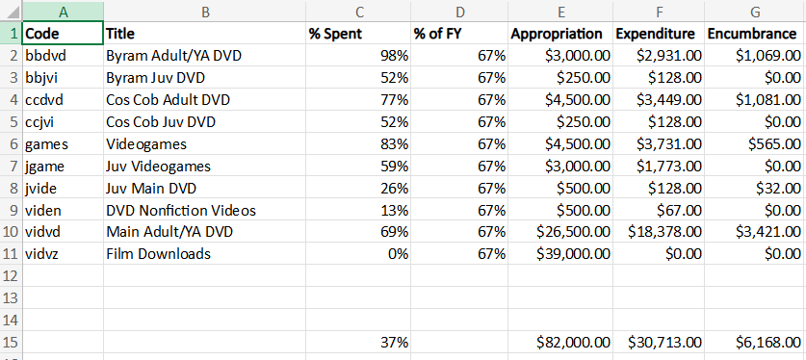

Slide 22
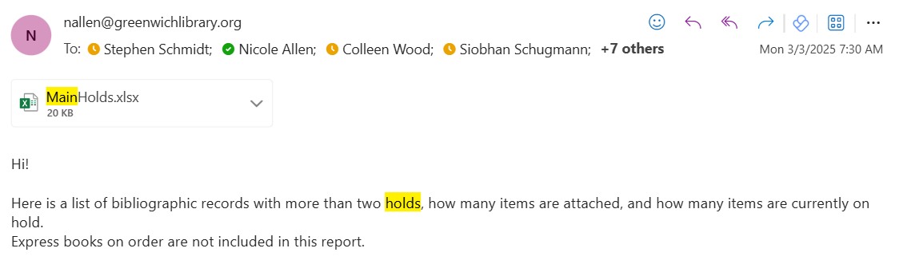
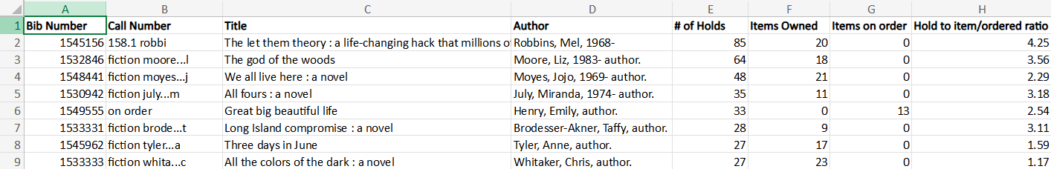

Slide 23
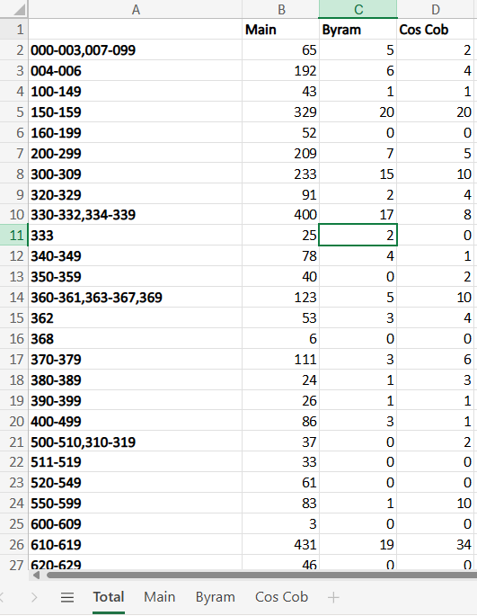
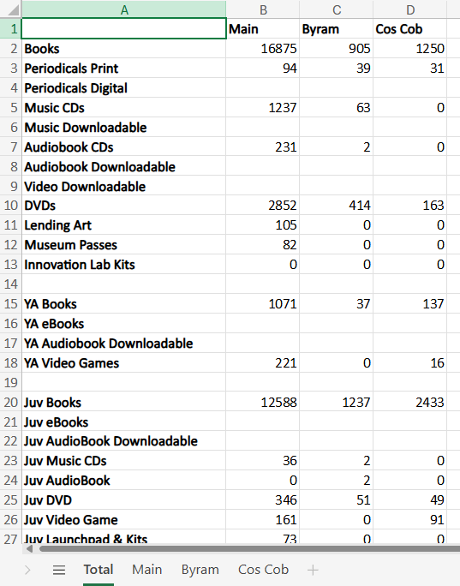

Slide 24
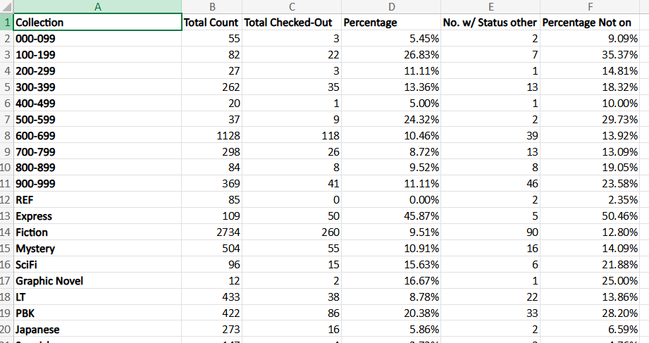
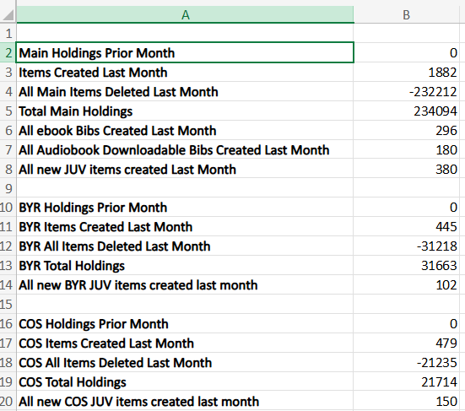

Slide 25
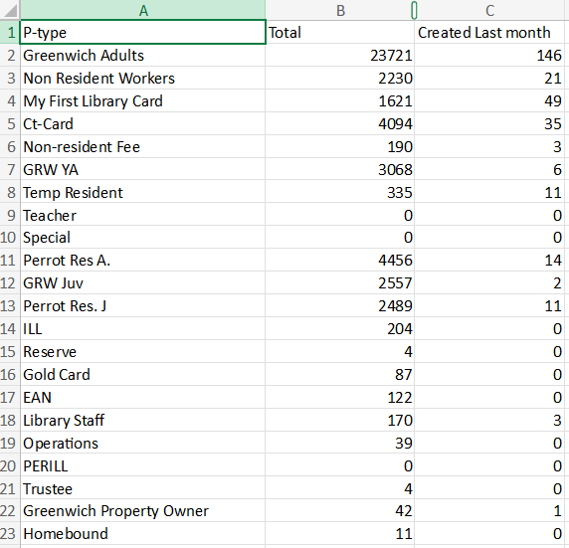

Slide 26
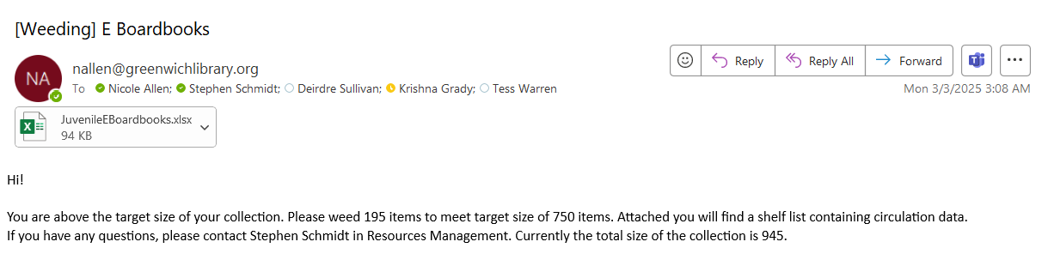
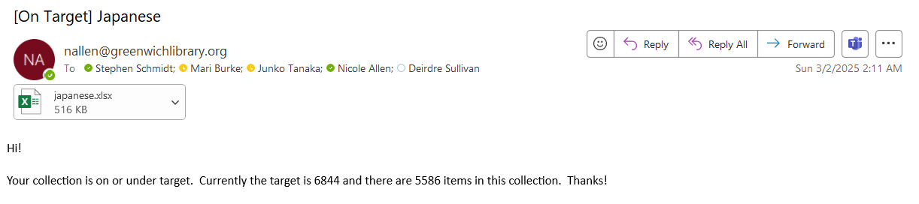

Slide 27
