Slide 1
There is no such thing as a permanent URL
Ways to identify and repair broken links in your catalog
Michael Cummings, Watson Library, the Met

Slide 2
Abstract & Background Information
URLs, the unique identifiers that direct users to specific online resources, can change or become obsolete over time, rendering the links in library catalogs unusable. This can lead to frustration for users who encounter broken links, hindering their ability to access essential information. Therefore, it is crucial for libraries to proactively monitor their catalogs for broken links and take steps to repair them.
Books
Selected external link sources Metropolitan Museum of Art Thomas J. Watson Library, Sierra OPAC “Watsonline”
https://library.metmuseum.org

Slide 3
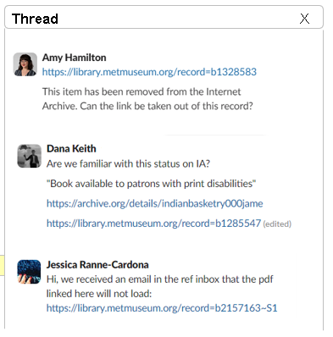
Problem use case
Top outbound link sessions per Google Analytics
https://www.metmuseum.org
https://www.jstor.org
https://serialssolutions.com
https://firstsearch.oclc.org
https://libmma.contentdm.oclc.org
https://www.worldcat.org
https://proquest.com
https://www.artnet.com
https://www.oxfordartonline.com
https://www.bloomsburyfashioncentral.com
https://search.ebscohost.com
https://archive.org

Slide 4
Session Agenda
Part 1
Part 2
Part 3
GUI
CLI
Python Script
SEO Spider Tool (Paid License)
Sierra Catalog
URL Checker
Sierra Catalog
SEO Spider Tool (Free)
Sierra Catalog

Slide 5
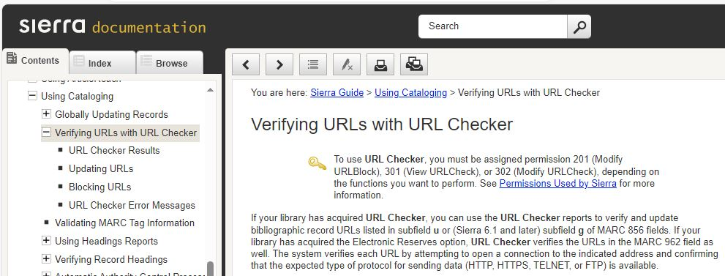
Part 1: Sierra URL Checker / Permissions
URL Checker requires user permissions.
201 (Modify URLBlock)
301 (View URLCheck)
302 (Modify URL Check)
Configurable to check URLs on MARC:
856 subfield u
856 subfield g (Sierra 6.1 or later)
962 (for electronic reserves)
The list of URLs automatically updates the first day of each month at 2:30 am.
Sierra documentation

Slide 6
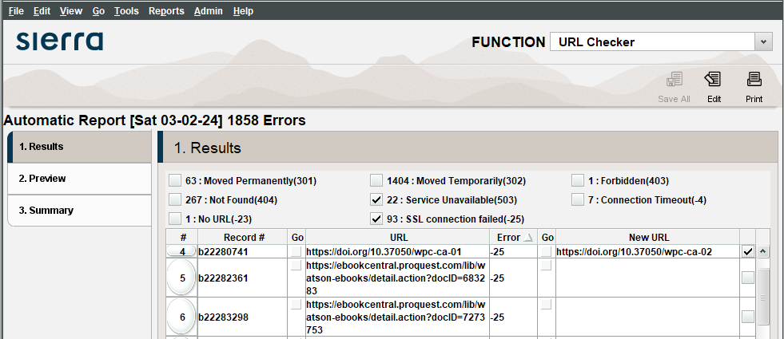
Part 1: Sierra URL Checker / Results
URL Block
Interactive Report
Go buttons

Slide 7
Part 1: Sierra URL Checker / Results
* Summary from previous slide
Choose URL Checker function
Results screen shows:
Total number of errors found
Number of each error type
List of problem URLs
HTML error codes
3xx Moved
4xx Forbidden / Not Found
5xx Service Unavailable
None, SSL failed, and Timeout
You can perform these functions:
Sort the report by clicking any column heading
Go to a URL (click Go button on left)
Update to New URLs
enter a new URL
check the box on the right
Click Preview; click Process
Test new URL (click Go button on right)
Edit selected bib record (click Edit, top right)
Print the list
Select URL block from the Admin menu
Select Interactive Report from the Tools menu

Slide 8
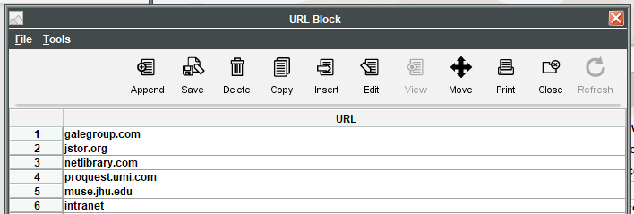
Part 1: Sierra URL Checker / Blocking (excluding) URLs
The block list can have up to 500 entries. To add a URL, select URL Block from the Admin menu.
You should exclude trusted URLs from being tested by the URL Checker
by adding the URL or a portion of the URL to the URL Block list.
This is highly recommended

Slide 9
Part 1: Sierra URL Checker / Interactive Report
URL Block
Interactive Report
Interactive Report
You can run URL Checker at any time, whether you are using automatic URL Checking or not. Using the interactive URL Checker, you can run a report over a review file, a range of records, or from an index search.

Slide 10
Part 1: Sierra URL Checker / Interactive Report
Create Lists
Save the URLs from a specific resource in Review File
URL Checker
Run the Interactive Report on Review File
URL Checker
Select Edit for each bib record
Sierra Catalog
Delete or modify URL; perform other bib / item edits
Recommended Process
Highly recommended
Notes:
Step through the error records by choosing the Edit command…
Delete the bad link from the bib record
Edit other tags on the bib record (e.g., 5xx, 7xx, 9xx)?
Delete an item record? (if your library creates an item with location www).

Slide 11
Part 1: Sierra URL Checker / urlverify.html
URL Block
Interactive Report
URL Checker creates the urlverify.html file in your WebPAC live/screens subdirectory after it completes its record processing. You can use the HTML file to manually test links and view the HTML error messages recorded for each link failure. To view the large urlverify.html file, transfer the file to your local workstation using the Web Master function and open it with a Web browser.
Not very useful

Slide 12
Part 2: Link checking with SEO Spider Tool
https://www.screamingfrog.co.uk/seo-spider/
Requirements
Download the either the free or paid license version of the SEO Spider Tool.
Generate a file from Sierra containing a list of URLs you wish to verify. Each line
In the file should contain the bib id and a URL
Part 2 of this presentation illustrates a
workflow using the free version.
SEO Spider Features
Finds Broken Links, Errors & Redirects *
Analyzes Page Titles & Meta Data
Generates XML Sitemaps
Creates Site Visualizations
* The free version has a limit of 500 URLs per batch process

Slide 13
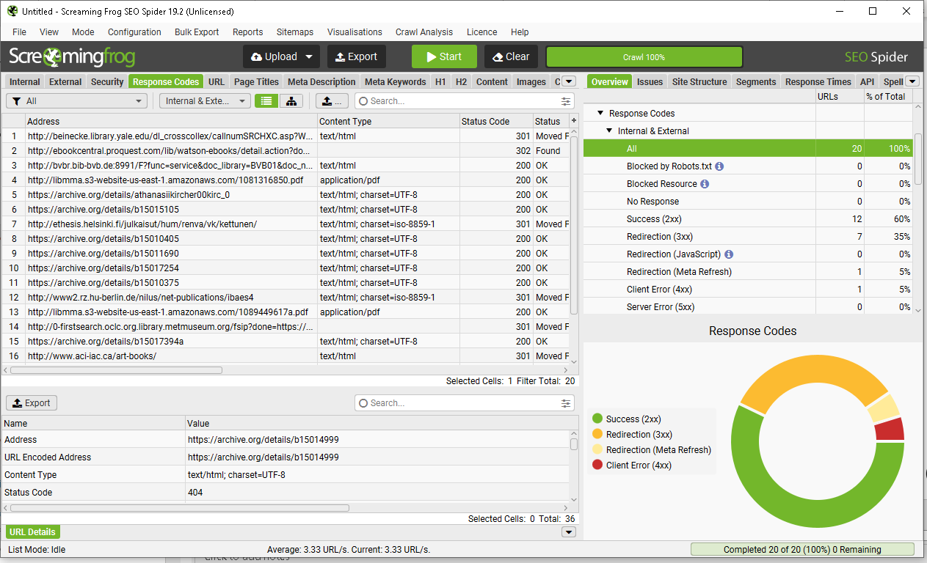

Slide 14
Part 2: Link checking with SEO Spider Tool
Create Lists / SQL
Save URLs from a specific resource in an Excel File.
Open Excel; Copy about 500 URLs
SEO Spider Tool
Select Upload / Paste / OK
Select Crawl Data / Response Codes in the Overview tab
SEO Spider Tool
Select Client Error (4xx) or other error type.
Copy error addresses to Excel list.
Save list of bad URLs file.
Sierra Catalog
Import the file of bibs and bad URLs to Create Lists.
Revise the records in the list.
Workflow
More details on next slide and ‘demo’ screen shots are provided

Slide 15
Part 2: Link checking with SEO Spider Tool
Workflow illustrated on the following pages. Numbers in this outline correspond to numbers on demo pages.
Generate a list with bib id and URL -- using Create Lists, SQL, or API. Can be a csv, txt, or Excel (recommended).
Open the list of bib ids and URLs
Repeat this process:
1 Copy just URLs from the list to the clipboard. You can copy up to 500 URLs at a time.
2 SEO Spider Mode must be set to List. Select Upload / Paste (or file upload if loading the entire file).
URLs are automatically process. Any with errors will be automatically identified.
3 Select the Crawl Data / Response Codes / Internal and External in the Overview tab.
4 Click the response group Client Error (4xx) or Server Error (5xx) if the number of URLs is not zero.
5 For each error shown in the Response Code address pane:
Copy the URL from the Response Code address pane.
Find the URL copied from SEO Spider in the source list of URLs.
Move the line with bib id and URL to a new tab or file.
6 When done processing URLs:
Save the file of bad URLs found.
Import the file into Sierra Create Lists.
Edit the bibs in the list.

Slide 16
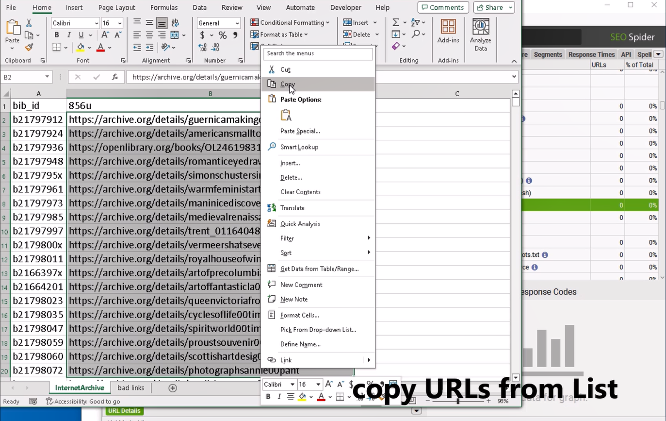
Part 2: Link checking with SEO Spider Tool
DEMO
1

Slide 17
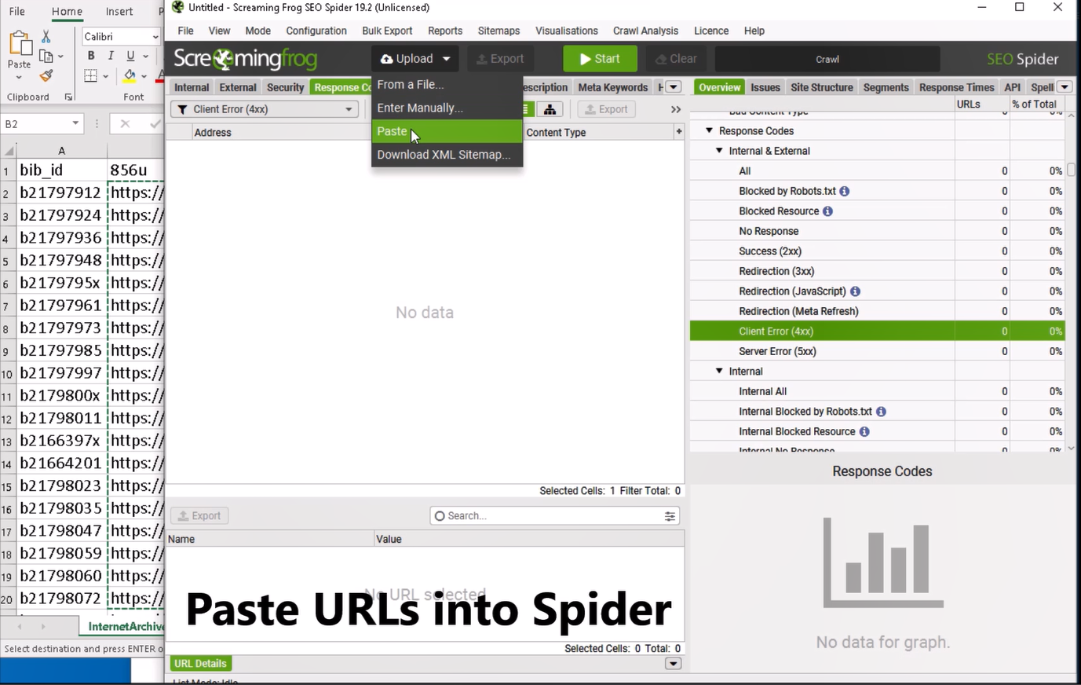
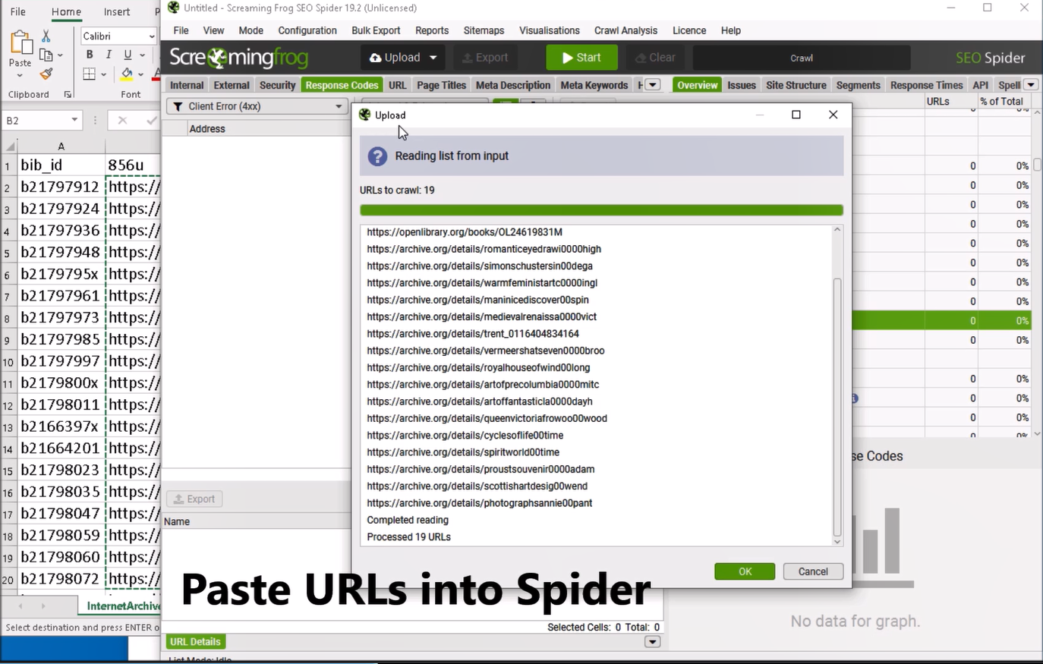
Part 2: Link checking with SEO Spider Tool
DEMO
2

Slide 18
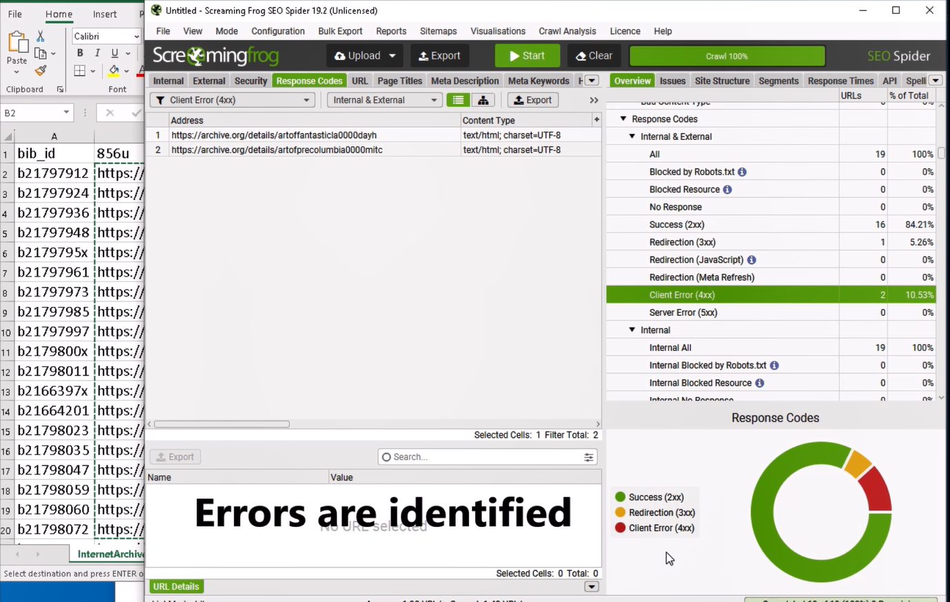
Part 2: Link checking with SEO Spider Tool
DEMO
3
4

Slide 19
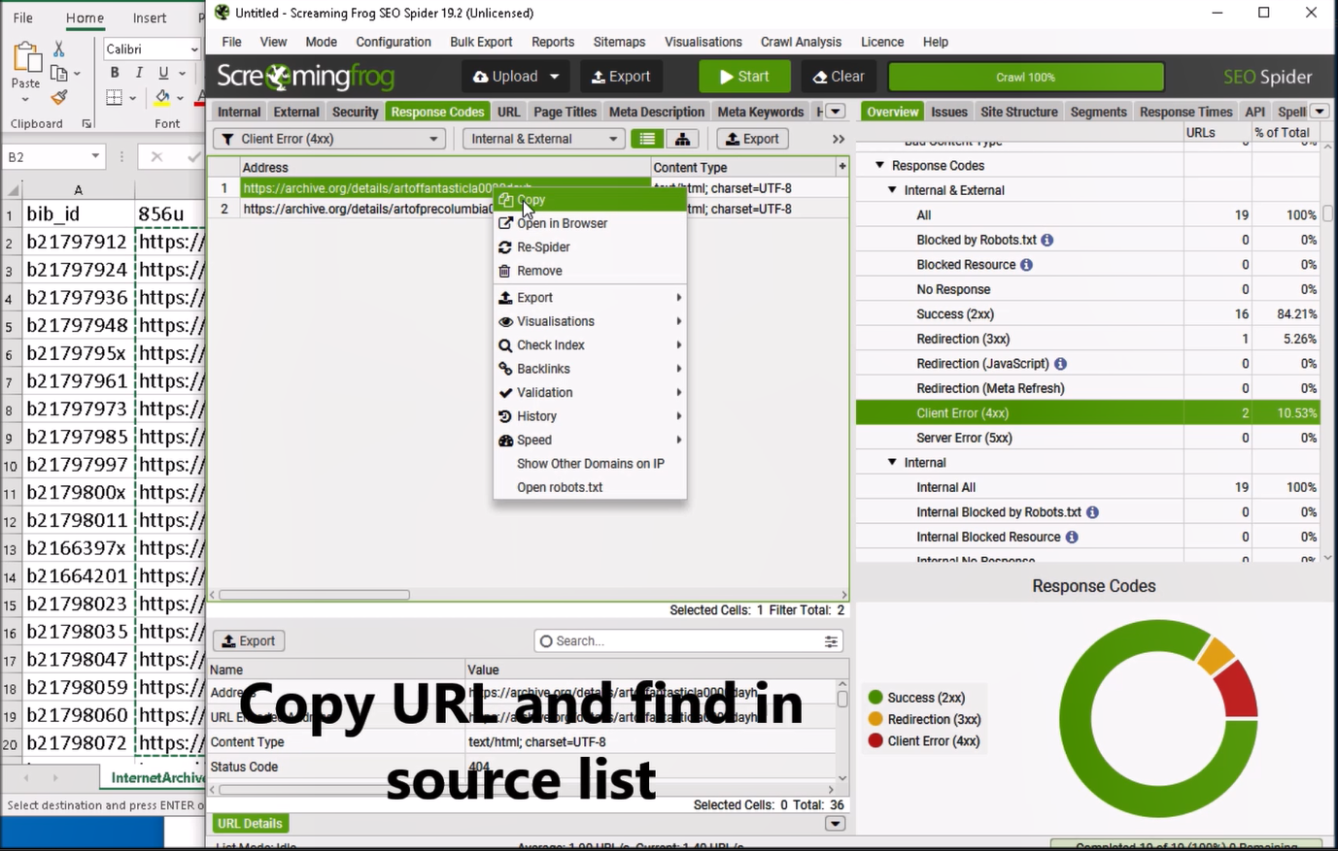
Part 2: Link checking with SEO Spider Tool
DEMO
5

Slide 20
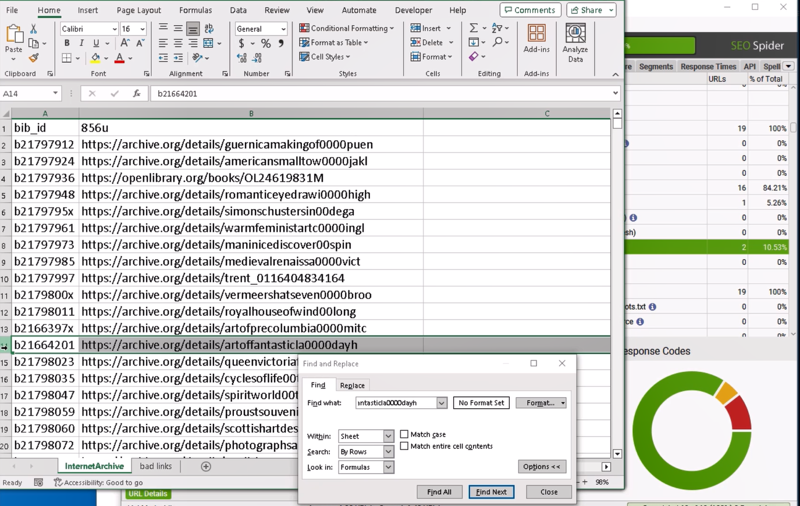
Part 2: Link checking with SEO Spider Tool
DEMO
5

Slide 21
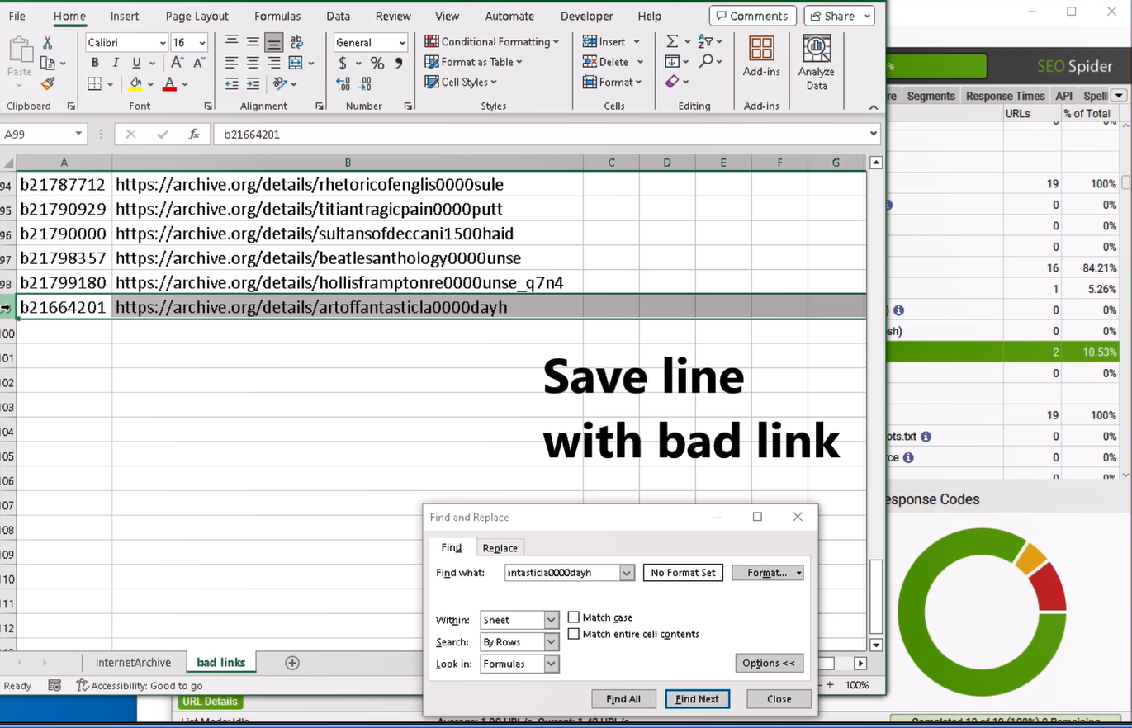
Part 2: Link checking with SEO Spider Tool
DEMO
5

Slide 22
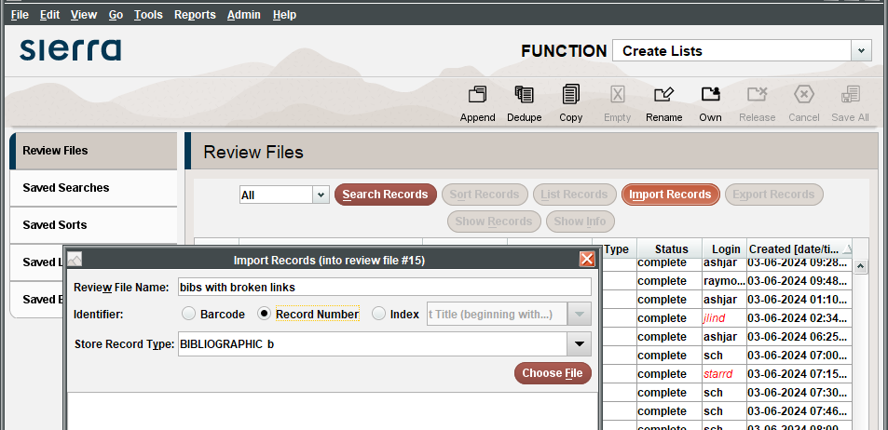
Save the file containing lines with bib id and URL; import file into Create Lists for editing.
6

Slide 23
Part 3: Link Validation using Python Scripts
This part outlines how to use Python script than runs the SEO Spider tool from a command-line interface. This doesn’t have a limit to the number of URLs, and it automatically saves a log of bibs, error code, and URL.
This approach requires a paid License Version of SEO Spider ($299 annually)
A 64-bit OS is required
For crawls under 200,000 URLs, 8GB of RAM should be sufficient.
Licensed version includes these features and more:
Customizable crawl settings
Command Line Interface option
Free Technical Support
Handles batches of thousands of URLs *
* Depends on processing power of pc, memory, and crawl configuration.
https://www.screamingfrog.co.uk/seo-spider/faq/#what-hardware-is-recommended

Slide 24
Part 3: Link Validation using Python Script
One-Time Set up
Workflow using the script
Download script files from github
Configure SEO Spider Tool
Response Codes only
Optionally, edit seospidercli.py
Generate a csv data file from Sierra
Each line must have bib id, URL
Copy the data file to the script directory as sierra_urls.csv
Open a terminal window
Change directory to the script directory
Run the command > python seospidercli.py
The script generates logfile.csv
Open Sierra Create Lists and import logfile.csv
Edit the records in the list
# --------------------------------------
# Global configuration. Edit as needed.
# --------------------------------------
MAX_LINES_PER_FILE = 499
HTML_ERRORS_LIST = ['0', '401', ‘
403’, '404', '500', '501', '503']
Snippet from script
Notes:
Although sierra_urls.csv may contain thousands of lines, the MAX_LINES_PER_FILE setting may be used to break up the original file into smaller batches. Any bad links found in the process will all be compiled into a single log file.

Slide 25
Part 3: Link Validation using Python Script
Workflow summary
Create Lists / SQL
Generate URL list with Create Lists, SQL, or APIs.
Save URLs from a specific resource in CSV file sierra_urls.csv
SEO Spider CLI
Execute the Python script from the Windows command prompt / terminal window. This handles any number of URLs.
Sierra Catalog
Import the log file containing bibs and bad URLs to Create Lists.
Revise the records in the list.
More details on next slide

Slide 26
Part 3: Link Validation using Python Script
DEMO
Workflow: Execute the Python script from the Windows command prompt
C:\Users\hendershaw\Desktop\urlcheck> python seospidercli.py
SEO SPIDER VIA CLI :
BEGIN PROCESSING FILE: part_0_links.csv
END PROCESSING FILE : part_0_links.csv
BEGIN PROCESSING FILE: part_1_links.csv
END PROCESSING FILE : part_0_links.csv
MATCHING BETWEEN : res_part_0_links.csv and part_0_csv
MATCHING BETWEEN : res_part_1_links.csv and part_1_csv
SAVING results.
Data file and log are saved in the directory named data\logid_5398
Logfile.csv may be uploaded into Sierra Create Lists.
Progress messages
Import logfile.csv to Create Lists and edit the bib records
1651932,https://archive.org/details/holyplacearchite0000akin, 404
1159570,https://archive.org/details/thomascolelandsc0000cole, 404
1291095,https://archive.org/details/americanpictures0000conr, 404
Sample logfile

Slide 27
Part 3: Link Validation using Python Script
Watson Library Repository on github
The code for this project will be available for download from
https://github.com/Thomas-J-Watson-Library

Slide 28
Summary

Slide 29
We considered three options to monitor and maintain URLs
Part 1
Part 2
Part 3
URL Checker
Sierra Catalog Recommendations for blocking and Interactive Report.
SEO Spider Tool (Free)
Sierra Catalog
Free for batches up to 500.
SEO Spider Tool offers URL validation and more!
Python
SEO Spider Tool (Paid License)
Sierra Catalog Streamlined workflow
Requires paid license good for one year

Slide 30
THANK YOU
Questions?

