Slide 1

Trading Spaces: Who Moved My Desk?
Presenter: Dorothy Hargett, MA, MLIS
Librarian – Head of Access Services
Regent University Library

Slide 2





So Many Emotions

Slide 3
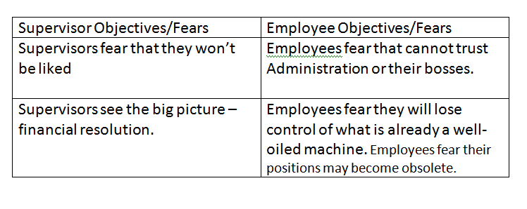
So What’s the Problem!!!

Slide 4
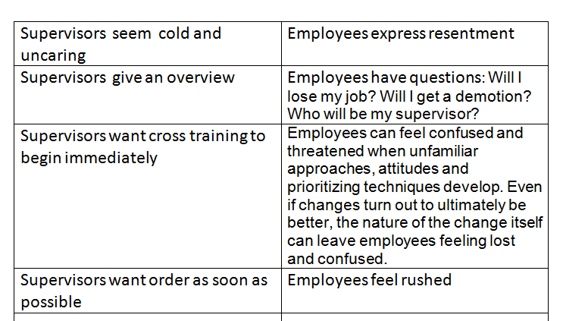

Slide 5

Keys to a Successful Merger
Communicate
Listen
Respect
Action

Slide 6
Discussion Points
Develop a workflow timeline
Three major challenges to expect and practical ways to work through each of them.

Slide 7
Develop a plan to bridge the gap between Library Administration and the merging departments.
How customer service and statistics changed with the merge
How Millennium is used in the merge

Slide 8

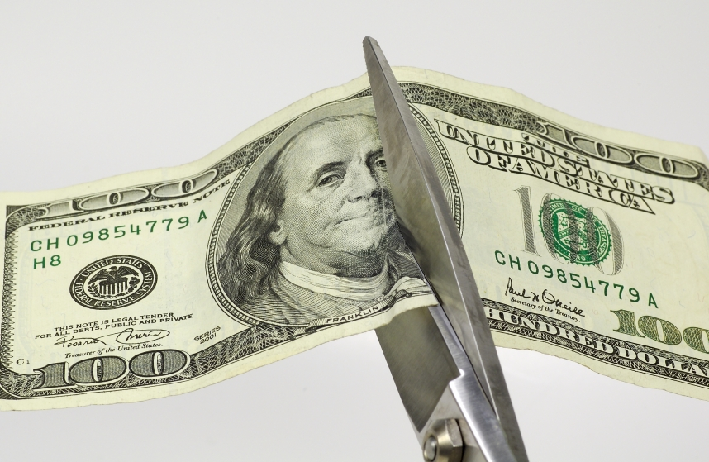

Slide 9


Slide 10

Can we survive the change?

Slide 11

PEOPLE RUN TO AVOID CHANGE AS LONG AS POSSIBLE.
This is what I heard from the employees:
This will never work.
I feel like I’m being disrespected.
Do I still have a job.
Other supervisors were afraid that this would happen to them.

Slide 12
Reasons Employees Don’t Like Change
Taken by surprise
Not included in the process
Feelings not taken into consideration
Expected to change overnight
Not heard

Slide 13

Meeting with All Parties

Slide 14

LISTEN

Slide 15
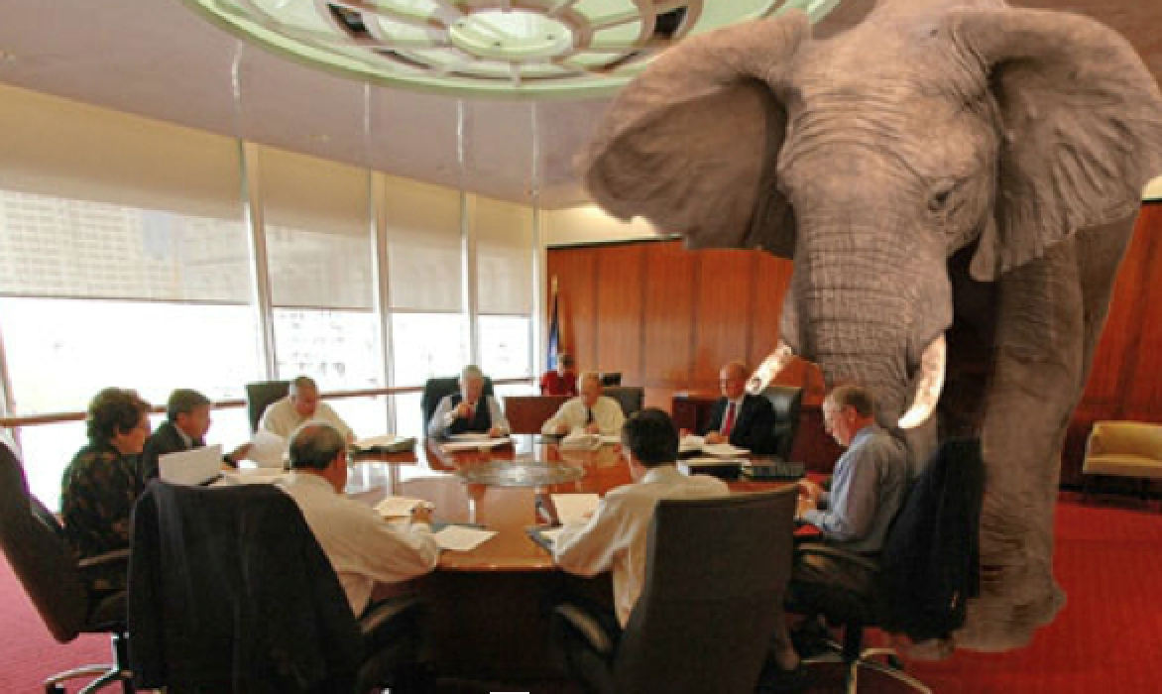
Do not be afraid to discuss the chain of command—stop hiding and ignoring the main topic.

Slide 16

Develop a Workflow Timeline
RESPECT

Slide 17
Meeting – Layout a Plan
The ILL long time employee gave incoming Head of Access Services an overview of how ILL is set up and operating.
What is the vision of the combining circulation and ILL . How can we do this in your space?
Logistics—ILL moved to a central location conducive to the workflow

Slide 18
Layout A Plan….(example)
The Circulation Student Schedule is as follows:
M-F
8am-9am: Pull Books and Bound Journals
10am-11am: Photocopying (beginning Monday
9/9)
11am-12pm: Packing all Outgoing Mail

Slide 19

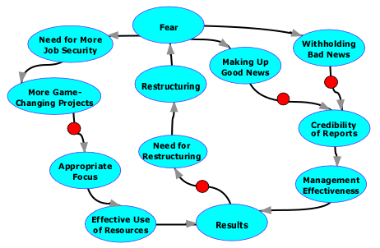
Restructuring
Changing Workstations
Training Circulation Assistants
Training Staff

Slide 20
Training/Concerns
Training Tools—One on one training with the former ILL supervisor and Atlas video training
ILL Specialist is learning Circulation tasks and rotating weekend duties with Circulation supervisors.
Concerns – During the process we were still questioning and saying: this looks good on paper but can this really work.

Slide 21
Priority Tasks
High:
Borrowing, Lending and Document Delivery online processing including any online updates.
Medium
Scanning Articles
Low:
Pulling books and bound journals from collection

Slide 22
Three Major Challenges
No Manual of Detailed Procedures
Training
Scheduling

Slide 23

Bridge the gap between Library Administration and the merging departments.
Just make it happen – No Excuses
Weekly Updates

Slide 24
Access Services Weekly Update- Week 4
Dorothy has been processing books received for ILL local and DE students through Illiad.
Also every Friday at 10am Abe will be making Courtesy Calls for ILL books waiting to be picked up. These are books that have not been picked up for 1 week or longer, after the initial e-mail contact when the book was received.

Slide 25
How customer service Improved
Night and Weekend ILL Services
Circulation staff and assistants are more knowledgeable.

Slide 26
Statistics Changed with the Merge
Received 1267 more borrowing once merge was completed. (Based on first 3 quarters comparison)

Slide 27
MILLENNIUM
Use of Patron records
ILLIAD on circulation computers and pulled up with Millennium
Blocks can be added in Millennium—not just ILLIAD
Check-in mail at circulation in Millennium

Slide 28

SUPRISES
THIS MAY TAKE LONGER THAN YOU THINK!!

Slide 29
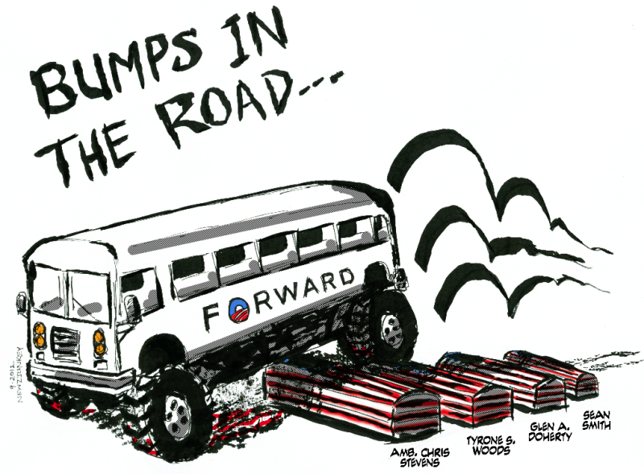
Bumps in the Road

Slide 30

What’s Happening Now
From This
Circulation
Interlibrary Loan

Slide 31


Access Services
To This
Circulation
Interlibrary Loan

Slide 32


Slide 33

Dorothy Hargett, M.A., MLIS
Librarian – Head of Access Services
dorohar@regent.edu

