Slide 1
Batch, Please!
Batch Editing and Loading MARC Records Using MarcEdit and Sierra’s Data Exchange
Keri-Lynn Paulson
King University

Slide 2
Background
Electronic Resources Librarian
Reference and Instruction background—not cataloging
King University
1800 FTE, undergrad and grad programs
Consortium (Holston Associated Libraries—HAL)
2 public libraries & 2 private academic libraries, across 2 states
shared ILS (Sierra)
the 2 academics are also in Appalachian College Association (ACA)

Slide 3
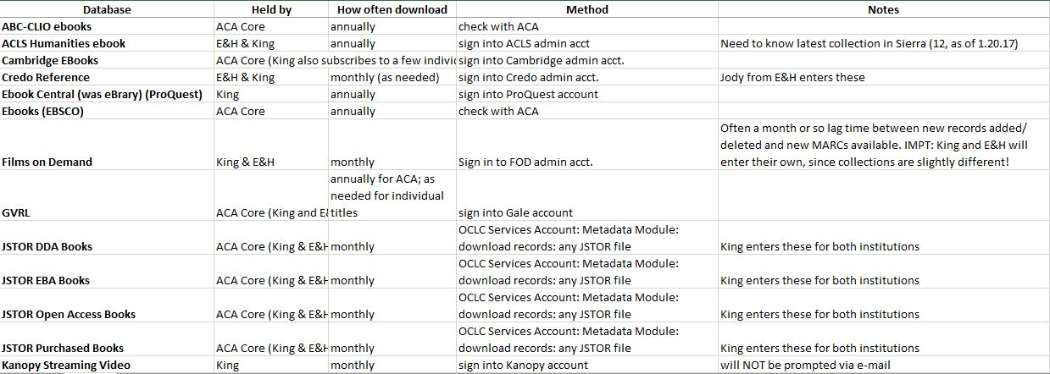
Ebook/ Streaming Film packages
14 vendors, 19 collections

Slide 4
Tip #1: Loading for More than One Institution
Agree on:
1. Who loads what shared collections & when
2. Match point fields (we use 001)
3. Local notes fields (590)
4. Series notes (830)
5. URL labels (856z subfield)

Slide 5
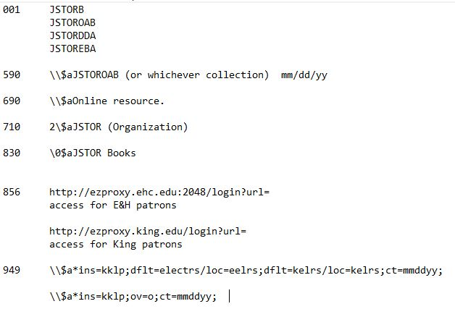
Tip #2: Keeping Things Tidy

Slide 7
Tip #3: Load Order
For Collections:
New Records
Update Records (Merges First!)
Deleted Records
Multiple Collections: ex. JSTOR
Evidence Based Acquisitions
Demand Driven Acquisitions
Purchased
Open Access Books

Slide 8
THANK YOU
Questions?
Keri-Lynn Paulson
Electronic Resources Librarian
King University
kpaulson@king.edu

