Slide 1
Redo a Create Lists search with JSON

Slide 2
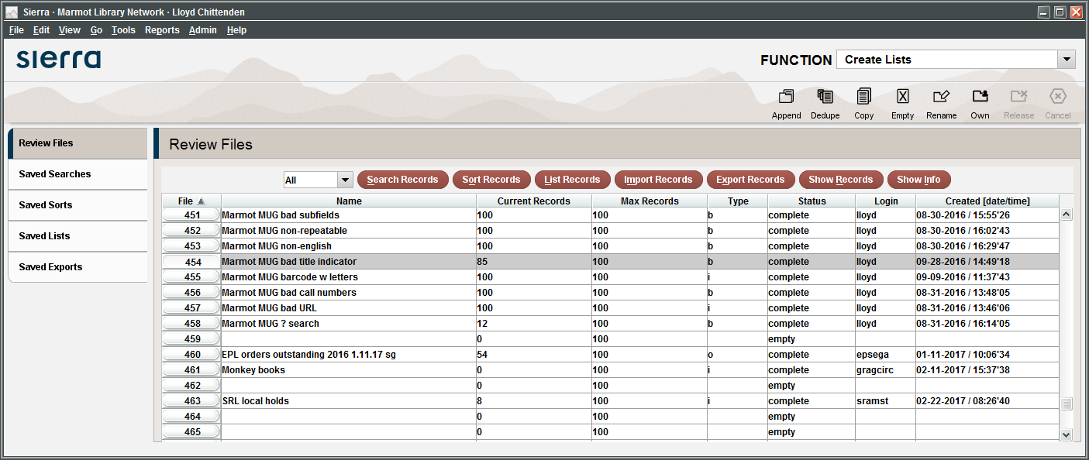
Here’s a weird complex search you want to redo

Slide 3
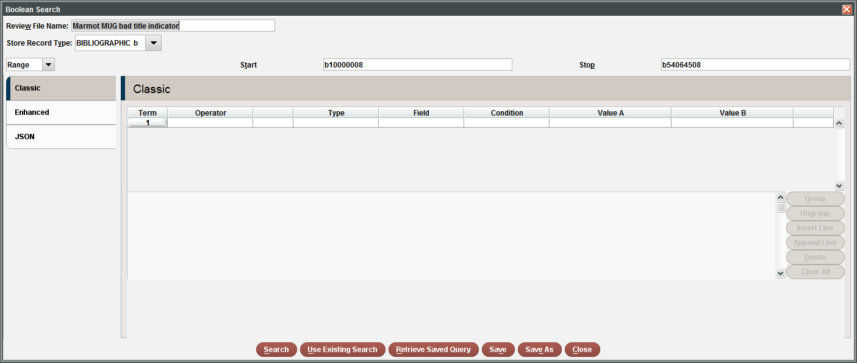
Click Search Records, and your search is not there

Slide 4
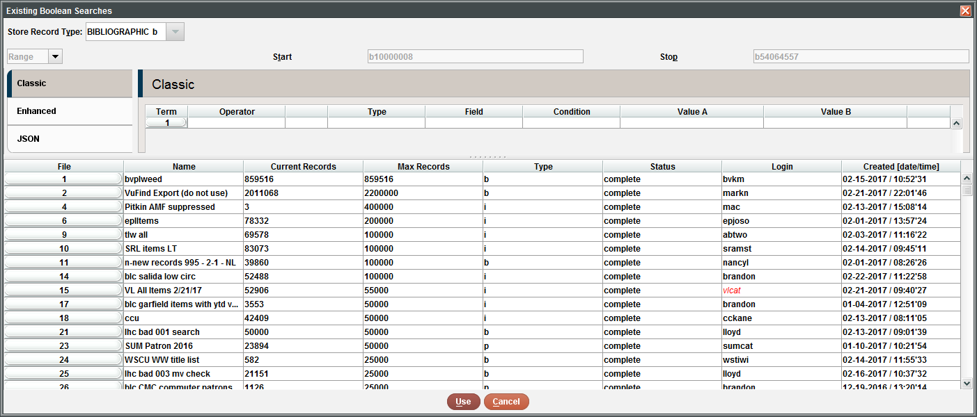
You can do Use Existing Search, but what was my list number?

Slide 5
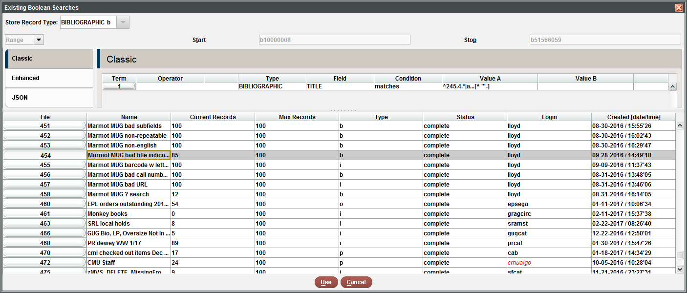
Oh yeah, it was list 454 scrolling, scrolling, hunting, hunting

Slide 6
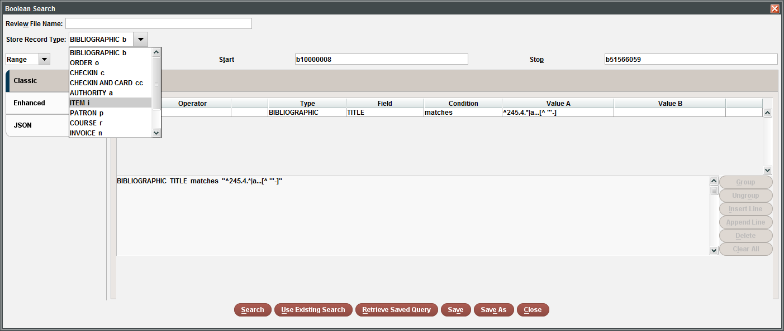
I’ve got the search back, but I want a different record type

Slide 7
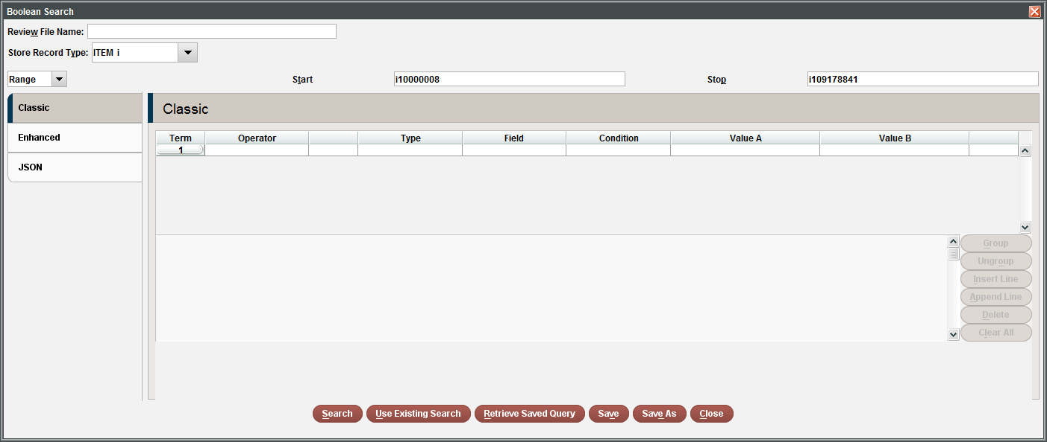
Now it’s gone again

Slide 8
How can JSON help?

Slide 9
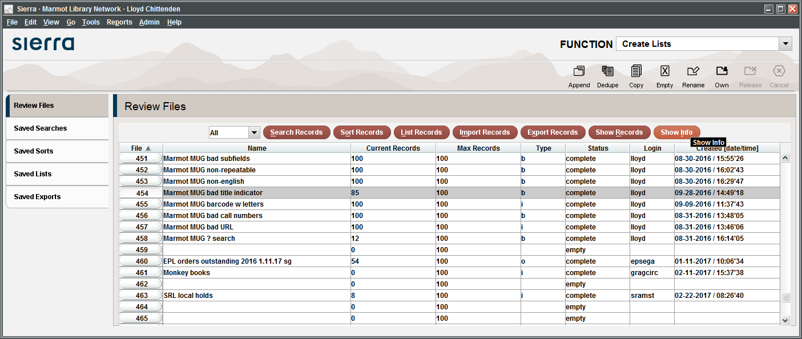
Click Show Info

Slide 10
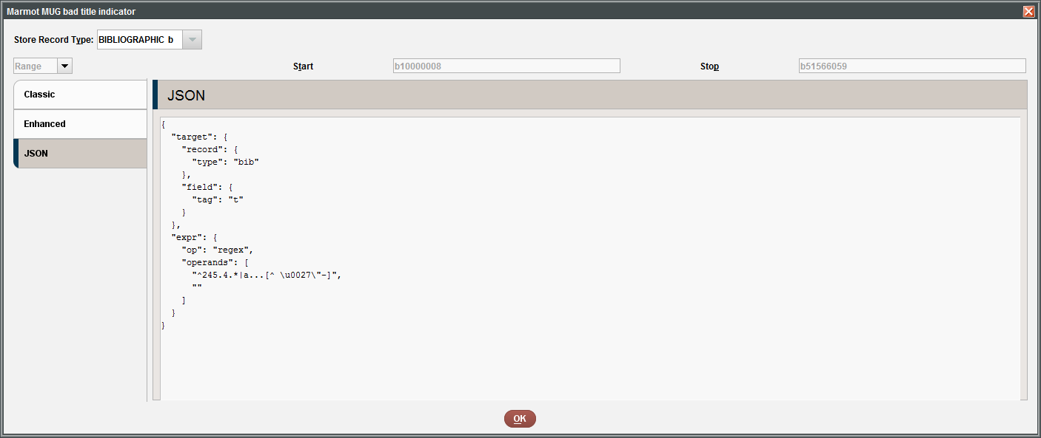
Open the JSON tab

Slide 11
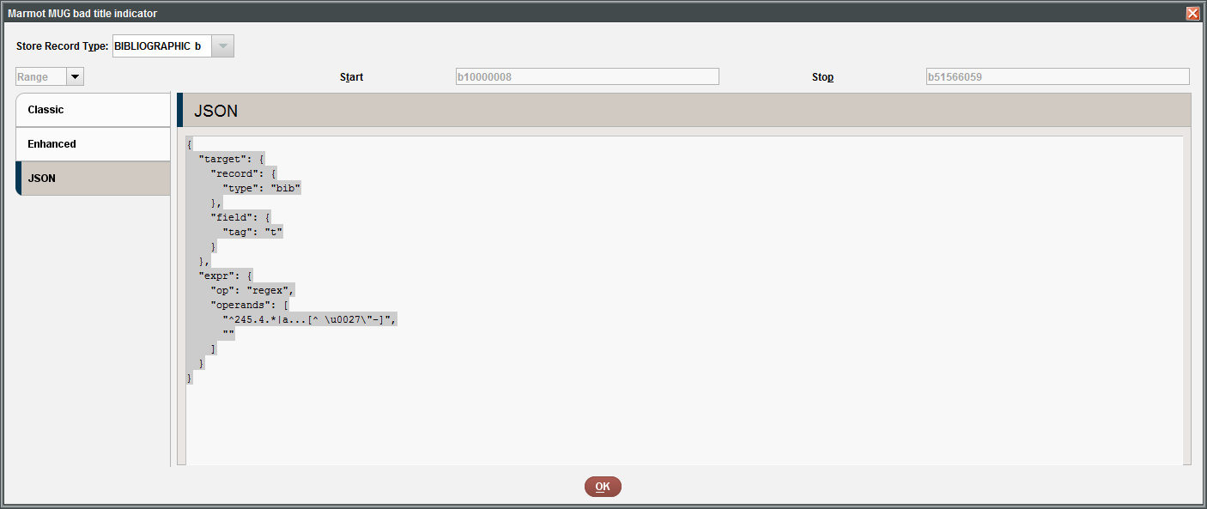
Click Ctrl-a to select all

Slide 12
Click Ctrl-c to copy the JSON text

Slide 13
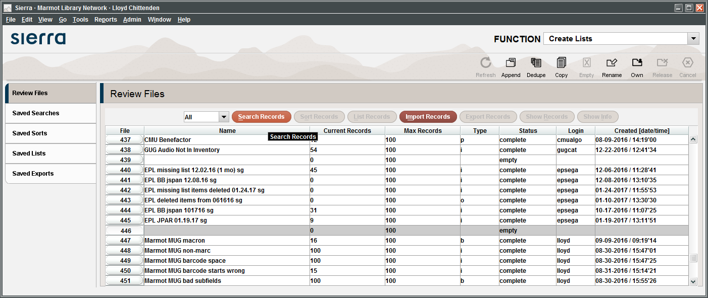
Select the same file or a different file, click Search Records

Slide 14
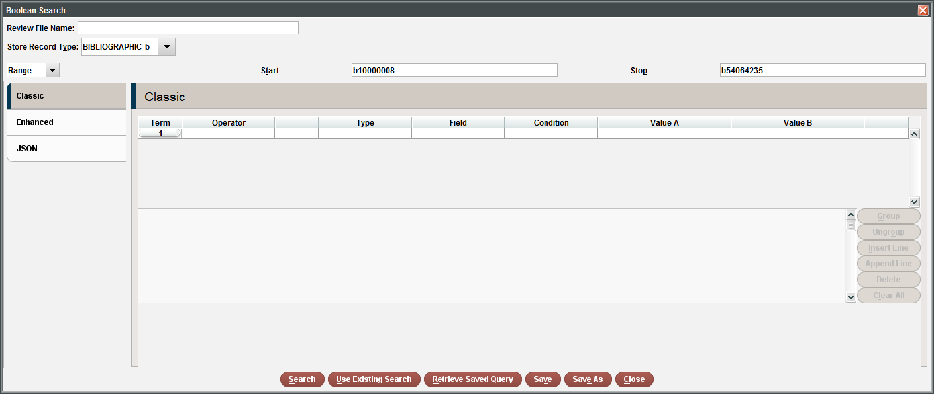
Open the Boolean Search window

Slide 15
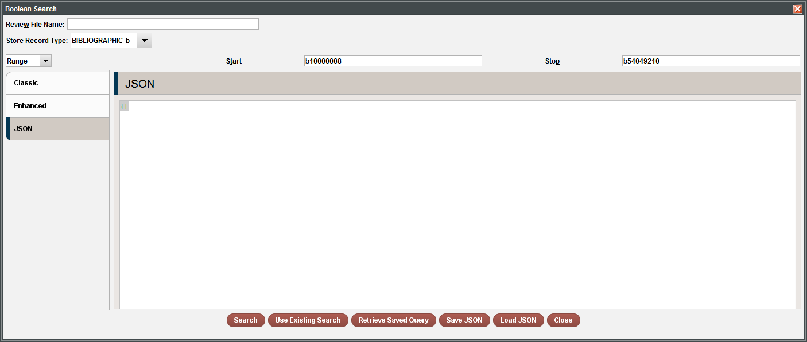
Click the JSON tab and delete the curly braces {}

Slide 16
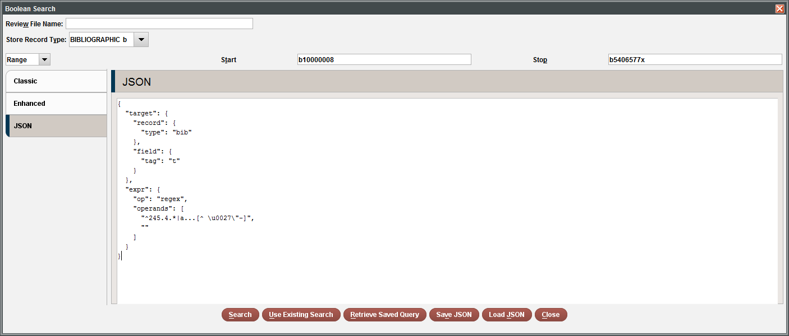
Ctrl-v to paste in the JSON

Slide 17
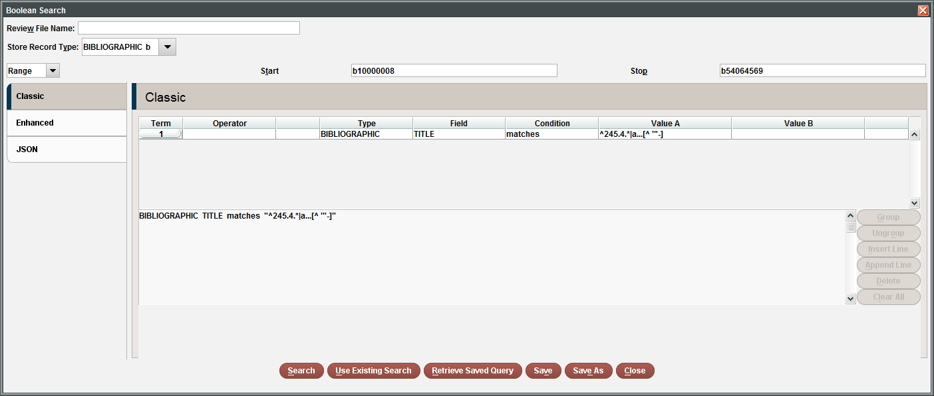
Click the Classic tab, and your search is back

Slide 18
How is this better than Use Existing Search?
You don’t need to remember the list number
You don’t need to scroll to find your existing search
You can run a search with a different stored record type
You can get the JSON while the search is still running!

Slide 19
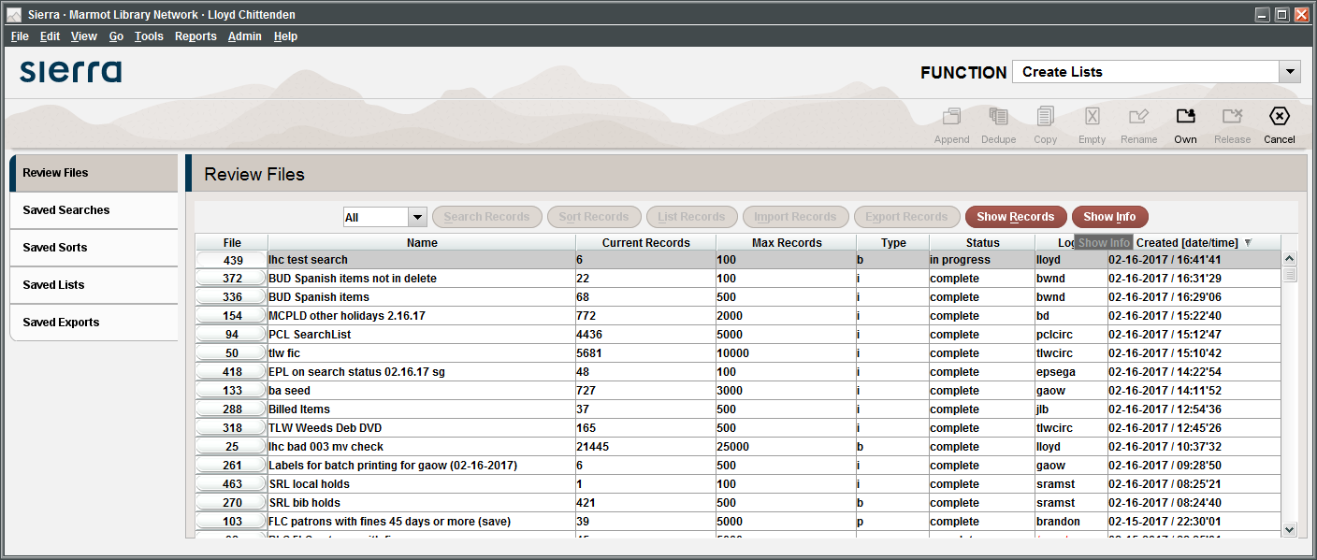
You can get the JSON from Show Info button, while the search is in progress!

Slide 20
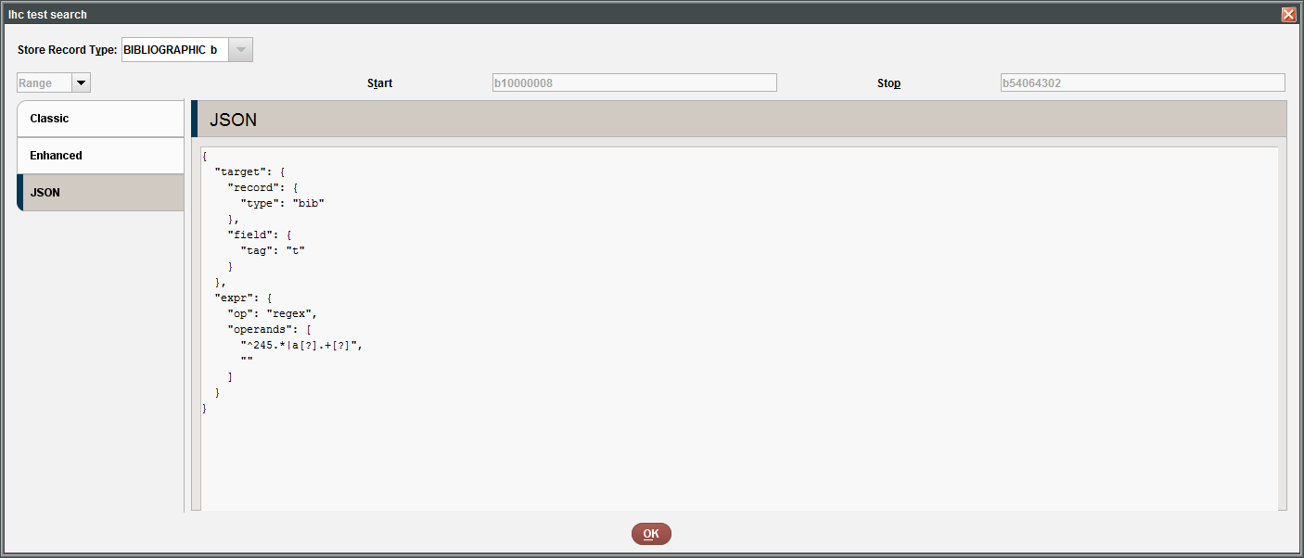
Copy the JSON

Slide 21
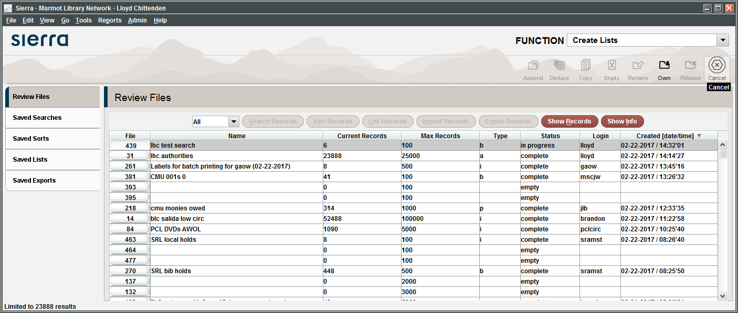
Cancel the search

Slide 22
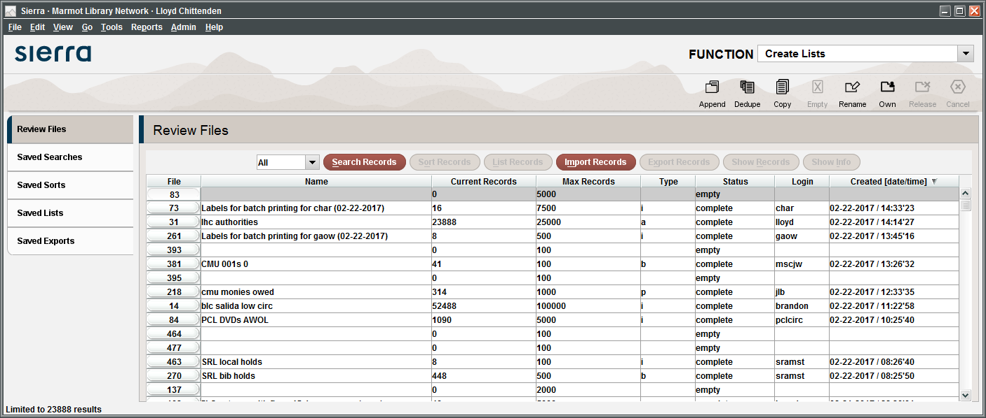
Open Search Records again

Slide 23
Paste in the JSON to recreate the search

Slide 24
And your canceled search is back

