Slide 2
Circulation?
G04
Q05
Student Workers
Ways of teaching and learning the system?
Eileen Fredette Richards
Systems Coordinator
Colby College Libraries
Waterville, Maine

Slide 3
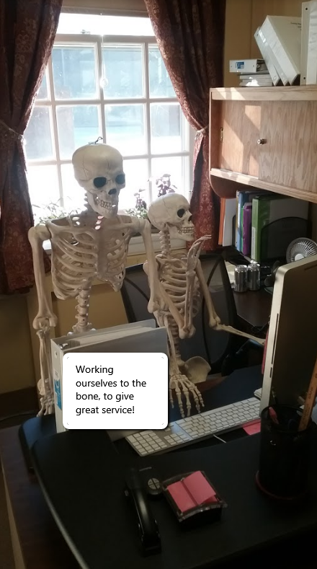
Eileen Fredette Richards
Reserve Assistant
Circulation Supervisor
Systems Coordinator
Colby College Libraries
29 years with the College
With iii for about 29 years – Stand Alone
Circulation Functional Expert
3 years as a Consortium
CBB – Colby, Bates & Bowdoin

Slide 4
Overview
Student Employment Agreement
Staff Meeting introducing Sierra
Student Staff Meeting with pop-up examples
Training video
Training Basics
Call number worksheet
LC Easy – Wizard!!!
Weekly Quizzes with Prizes
Custom Settings – see less know more
Create the login and Customize the Display
Options & Settings
Sierra Skin – Which one works best?

Slide 5
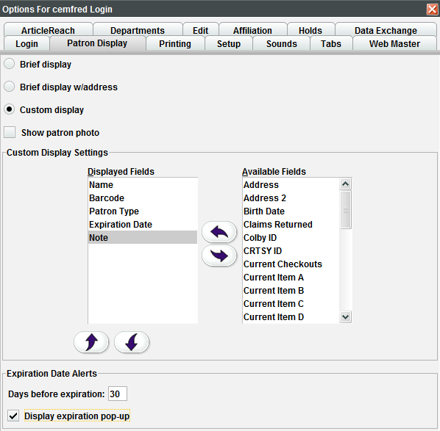
Customize Patron Display
Sierra
-Admin
--Options
---Patron Display
This set by login and you may need to work with your Systems Person for permissions
Less is always better!
Confidentiality

Slide 6
Patron Display
TABS

Slide 7
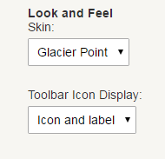
Settings
Display

Slide 8
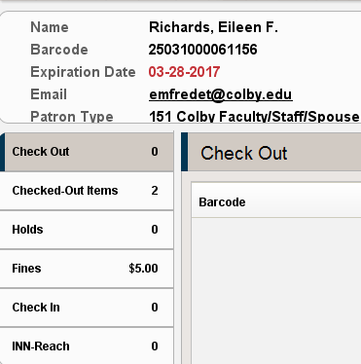
Half Dome Skin
Glacier Point Skin

Slide 9
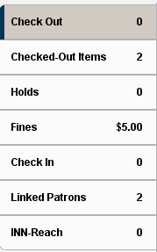
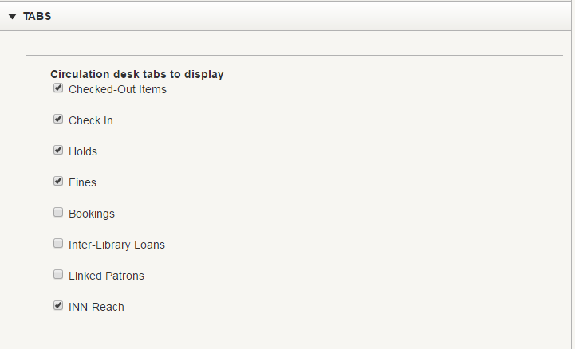
Tabs
Sierra
-Admin
--Options
---Tabs
Only select the fields that you use

Slide 10
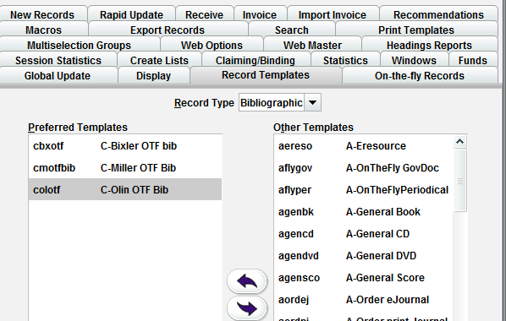
Using Settings (permission 176)
Sierra
-Admin
--Settings
---Record Templates
Record Templates Bib, Item, Patron, Reserve

Slide 11
On-the-Fly
Create an OTF Record
Less is more!!!

Slide 12
Eileen Fredette Richards
Systems Coordinator
Colby College Libraries
Waterville, Maine
Email: Eileen.Richards@Colby.edu
Telephone: 207-859-5118

